Slide 1
SPINAL DYSRAPHISM
By Dr. TEJAS MANKESHWAR

Slide 2
In the spine, the most common congenital lesions presenting to medical attention are the diverse forms of spinal dysraphism and the diverse forms of caudal spinal anomalies.
Spinal dysraphisms result from derangement in the normal embryogenetic cascade occurring during a limited period of time during early embryonic development, between gestational weeks 2 and 6.

Slide 3
The relevant embryogenetic steps are represented by –
Gastrulation (weeks 2–3),
Primary neurulation (weeks 3–4),
Secondary neurulation (weeks 5–6).

Slide 4
Gastrulation
Gastrulation is the process by which the bilaminar disk is converted into a trilaminar disk, with formation of an intervening third layer, the mesoderm.

Slide 5
Initially 2 layered embryo – Epiblast facing amniotic cavity and hypo blast facing the yolk sac.
Epiblast forms 3 layers.
Hypoblast forms extra embryonic tissues.

Slide 6
Various terms used –
Prochordal plate – Establishes cephalic end and left right axis.
Primitive streak - stripe of thickened epiblast that appears caudally in the midline of the dorsal surface of the embryo and extends along the middle of the disk.
Primitive groove – superficial midline groove in primitive streak.
Primitive node/Hansens node – Thickening of primitive streak in cranial aspect.
Primitive pit – Depression in primitive node.

Slide 8
Epiblastic cells start migrating toward the primitive streak and pass inward at the primitive pit.
The first wave of ingressing cells displaces the hypoblast laterally and becomes the endoderm.
Subsequent waves of epiblastic cells migrate laterally along the interface to form the interposed mesoderm.
Mesodermal cells migrating along the midline form a rod of tissue called the notochord.

Slide 9
Notochord extends in length and reaches upto the level of mid brain where it ends in a hooklike extremity in the region of the future dorsum sellæ of the sphenoid bone.
The notochord lies at first between the neural tube and the endoderm of the yolk sac, but soon becomes separated from them by the mesoderm, which grows medially and surrounds it.
From the mesoderm surrounding the neural tube and notochord, the skull and vertebral column, and the membranes of the brain and spinal cord are developed.

Slide 10
As notochordal cells are laid down, the primitive streak shortens and diminishes in size, and the node progressively regresses towards the caudal extremity.
Primitive streak remnants may persist and give rise to sacrococcygeal teratomas which typically contain various types of tissue due to the pluripotential nature of primitive streak cells.

Slide 11
PRIMARY NEURULATION
The notochord induces the overlying ectoderm to differentiate into a specialized neuroectoderm and occurs at the beginning of gestational week 3.
Originally neuroectoderm is flat – Neural plate.
On day 18, the neural plate anchors to the notochord at level of the ventral hinge point and starts bending to form a neural groove that has neural folds on each side.
The neural folds progressively increase in size and flex to approach each other, until they eventually fuse in the midline to form the neural tube.

Slide 16
Neural plate closure first occurs at the level of 4th somite and proceeds in cranial and caudal direction in zipper like fashion.
Rostral craniopore fuses early as compared to caudal neuropore.
During neurulation, ectodermal cells progressively disconnect from the lateral walls of the neural folds and differentiate into the neural crests.

Slide 17
Immediately after neural tube closure, surface ectoderm and neural ectoderm separate from each other in a process called disjunction.
Superficial layers produce a continuous skin coverage to the underlying neural tube.
Mesenchyme spread dorsally in the interface between skin and neural tube. These mesenchymal cells will form the meninges, neural arches of the vertebrae, and paraspinal muscles.

Slide 18
SECONDARY NEURULATION
The caudal region of the spine and spinal cord is formed by the process of secondary neurulation, which starts by the end of primary neurulation and proceeds until approximately gestational day 48.
Additional part of the neural tube is formed caudad to the caudal neuropore.
Starts between the third to fifth sacral vertebrae [7].
Therefore, the remaining five somites (corresponding to the caudal part of the sacrum and the coccyx), as well as the corresponding sacrococcygeal spinal cord metameres, are formed by the process of secondary neurulation.
Eventually, the secondary neural tube will result in the tip of the conus medullaris and the filum terminale.

Slide 19
The secondary neural tube develops from the so called tail bud (also known as caudal cell mass), which corresponds to a mass of cells located at the caudal end of the embryo which, in turn, derives from the caudal portion of the primitive streak.
Filum terminale forms by process of Retrogressive differentiation, in which a combination of regression, degeneration, and further differentiation would occur.
A slight expansion of the central canal within the conus medullaris, called terminal ventricle, represents the sole eventual remnant of the lumen of the secondary neural tube. On MRI it is not identified.

Slide 20
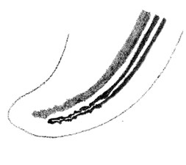
The tail bud forms as a result of coalescenceof the neuroectoderm with the lower notochord.
A secondary neural tube connects cranially with the neural tube formed by primary neurulation.

Slide 21
Eventually, the tip of the conus medullaris and the fi lum terminale result from this process. The terminal ventricle is the sole remnant of the secondary neural canal

Slide 22
RELATIVE ASCENT OF SPINAL CORD
Due to differential growth rates of spine and spinal cord relative ascent is seen.
Initially nerve roots are horizontal, but at term they become caudad and form cauda equina.
The spinal cord terminates at or above the inferior aspect of the L2 vertebral body.
The conus medullaris has reached its mature adult level at term in most infants and in 100% of cases at approximately 3 months after full-term gestation.
If the position of the cord remains low after age 4 months or if the conus medullaris lies at or below the L3 level at term, a cause of cord tethering be actively sought.

Slide 26
IMAGING MODALITIES
Plain Radiograph – Preliminary examination, focal spina bifida, widened spinal canal, scoliosis, segmentation anomalies, bony spur in diastematomyelia.
USG – ANC to look for flaring of posterior elements and post natal to look for contents of sac.
CT Scan may be used for bony spur.
MRI – Imaging modality of choice.

Slide 27
OPEN SPINAL DYSRAPHISM
OSD implies exposure of neural tissue or its covering meninges to external environment without any cutaneous covering.
Exposed non-neurulated neural tissue is called placode. It may be categorized into terminal and segmental depending on its location along the spinal cord.
This category includes myelomeningocele, myelocele, hemimeningocele and hemimyelomeningocele.

Slide 28
MYELOCELE AND MYELOMENINGOCELE
Myelomeningocele and myelocele are the most common form of OSD.
Serum AFP and USG can identify many cases.
Folate supplementation.
Chiari II is commonly associated.
In a meningomyelocele the ventral subarachnoid space is distended displacing the neural placode posteriorly while myelocele lies flush with the skin surface without CSF space expansion

Slide 29
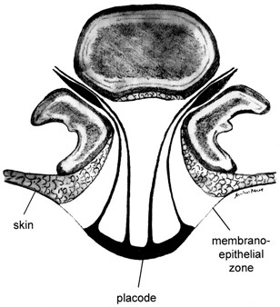
Membrano-epithelial zone is a transitional area between the placode and the cutaneous ectoderm.
Mesodermal elements are lateral to placode because of failed disjunction.

Slide 30
Superficial ectoderm does not disjoin from the neuroectoderm, thereby producing a midline defect.
The neural tube remains open and the neural folds remain in continuity with the cutaneous ectoderm at the skin surface.
The affected newborn is identified by the presence of a placode of reddish neural tissue in the middle of the back that is exposed to air because of the absence of overlying skin.
Most common location of OSDs is lumbo-sacral region (44%) followed by thoracolumbar region (32%).
On imaging dehiscence of overlying structures and other associated findings are looked for.

Slide 31
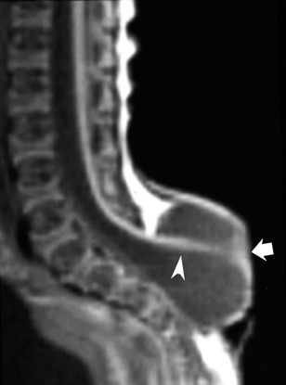
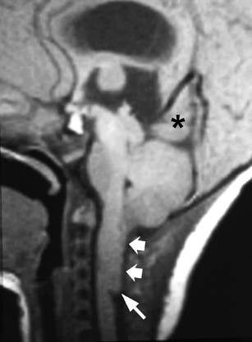

Slide 32
Hemimyelocele/Hemi-myelomeningocele
Rarest form of OSD.
Results when split cord malformation is associated with defective primary neurulation of one of the hemicord which forms part of myelomeningocele.

Slide 34
CLOSED SPINAL DYSRAPHISM
CSDs are covered by skin (i.e., there is no exposed neural tissue), although cutaneous stigmata, such as hairy nevus, capillary hemangioma, dimples, dyschromic patches, dystrophy, and subcutaneous masses, indicate their presence in as many as 50% of cases.

Slide 35
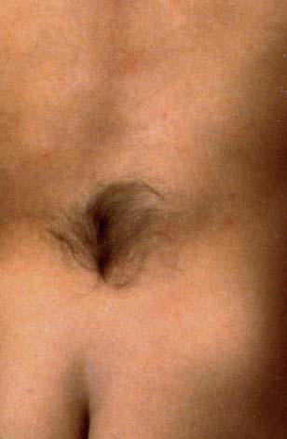
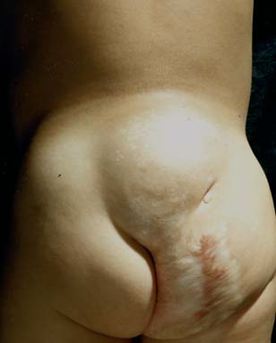

Slide 36
CLOSED SPINAL DYSRAPHISM WITH SUBCUTANEOUS MASS
At lumbosacral region - lipomyelocele, lipomeningomyelocele, meningocele, myelocystocele.
Lipomyelocele and lipomyelomeningocele are common entities.
At cervical level - cervical meningomyelocele, meningocele and myelocystocele.

Slide 37
Lipoma with Dural Defect (Lipomyelocele and Lipomyelomeningocele)
Lipomyelomeningocele consists of a large subcutaneous skin covered mass in lumbosacral region that contains fat, neural tissue, CSF and meninges.
Premature separation of surface ectoderm from neural ectoderm prior to formation of proper neural tube which allows ingress of intervening mesoderm into neural tube which in turn prevents further neurulation.
These mesodermal components specifically differentiate towards adipose tissue and form fatty component of these disorders.
Clinically, a midline subcutaneous mass right above the intergluteal crease and extending asymmetrically into one buttock is the rule .

Slide 39
In lipomyelomeningocele the lipoma-placode interface is outside the confines of spinal canal, whereas in lipomyelocele interface is either inside or at the edge of spinal canal .
In lipomyelocele, size of the subarachnoid space ventral to the cord is normal; however, the size of the canal may be increased depending on size of the lipoma.
On the other hand in the lipomyelomeningocele there is ballooning of subarachnoid space ventral to the cord.

Slide 40
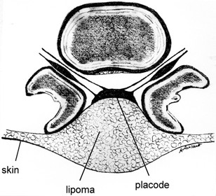

Slide 41
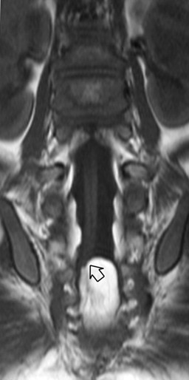
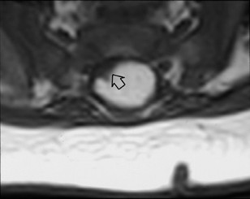

Slide 42
The placode is terminal (apical or parietal) and may be asymmetric if the premature disjunction involves only one edge of the neural plate.
The placode-lipoma interface may extend over several vertebral levels.
It may be smooth and regular, or large and irregular, with stripes of fat permeating the exterior of the spinal cord and even penetrating into the central canal.
Hydromyelia usually is present in these cases.
The size of the spinal canal may be increased, depending on the amount of fat, but the size of the subarachnoid space ventral to the cord is normal.

Slide 43
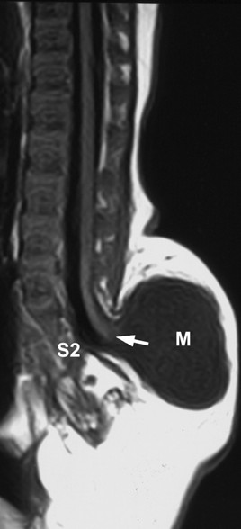
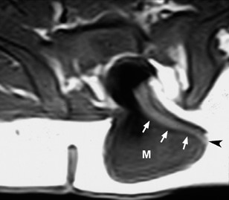

Slide 44
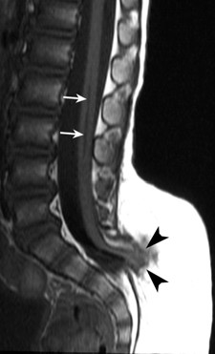
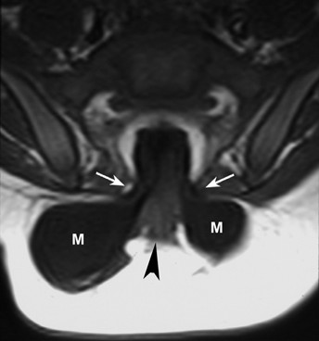

Slide 45
MENINGOCELE
Meningocele is characterized by herniation of meninges through bony defect covered externally by the skin.
The mass should not contain any of spinal cord segments or nerve root as content.
They result from ballooning of the meninges through a posterior spina bifida due to the relentless effect of CSF pulsations in the subarachnoid spaces.

Slide 46
Anterior sacral meningocele is characterized by herniation of meninges through anterior sacral defect, forming cyst like structure filled with CSF continuous with subarachnoid space of spinal cord.
When this condition is associated with anorectal anomaly it is called Currarino’s triad.

Slide 47
MYELOCYSTOCELE
Terminal myelocystoceles represent a rare form of CSD.
Severe disruptive form of terminal ventricle, a defect in secondary neurulation.
Elements include an expansion of the central canal of the caudal spinal cord produced by a CSF-containing terminal cyst (“syringocele”), which itself is surrounded by an expanded dural sheath “meningocele”).
Myelocystocele may be terminal or segmental (cervical).

Slide 48
The inner terminal cyst communicates with the central canal of the spinal cord, whereas the outer dural sac communicates with the subarachnoid space.
The outer and inner fluid spaces usually do not communicate.

Slide 49
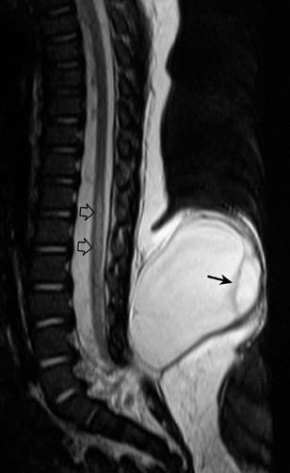
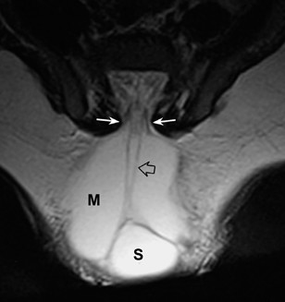

Slide 50
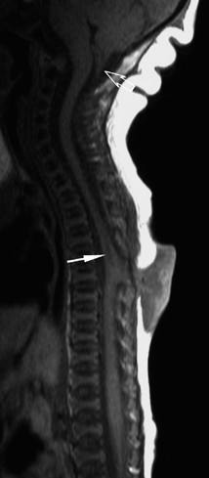
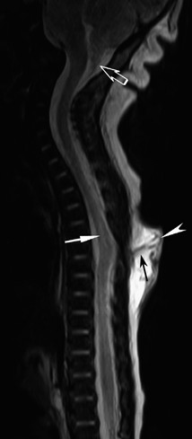
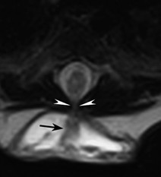

Slide 51
CSD WITHOUT SUBCUTANEOUS MASS
Posterior Bony Spina Bifida – defective fusion of posterior bony element.
Isolated posterior spina bifida is seen in upto 5 percent of the general population.
Defect is commonly seen at L5-S1 level.
It is physiological to see unfused posterior elements in lumbosacral region upto 6 years of age.

Slide 52
LIPOMA (INTRADURAL AND INTRAMEDULLARY)
Lipoma results from early disjunction between neuroectoderm and ectoderm.
Most commonly seen at lumbosacral level and is usually subpial in location.
Lipomas are contained within intact dural sac and are located in midline dorsally.
If located at the bottom of the thecal sac may present with TCS, whereas cervicothoracic lipomas generally produce insidious signs of spinal cord compression.

Slide 53
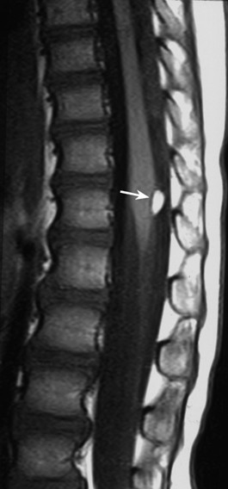
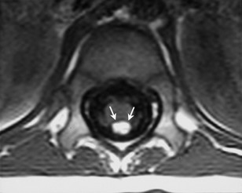

Slide 54
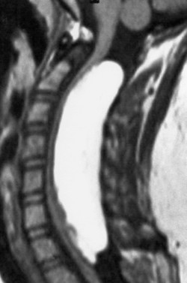

Slide 55
Filum Terminale Lipoma
Results from defective secondary neurulation which leads to persistence of mesodermal elements within filum terminale.
It is a common incidental finding.
Diagnosis of filum terminale lipoma should be made when the fatty filum measures more than 2 mm.
May or may not be associated with cord tethering.

Slide 56
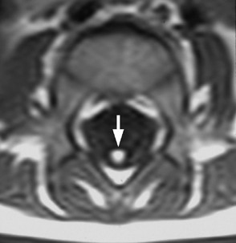

Slide 57
TIGHT FILUM TERMINALE SYNDROME
The tight filum terminale is characterized by a short, hypertrophic filum terminale that produces tethering and impaired ascent of the conus medullaris.
Related to abnormal retrogressive differentiation of the secondary neural tube, producing a thicker than normal filum.
The filum terminale is not >2 mm in diameter in normal individuals.
May be associated with spina bifida and scoliosis.

Slide 58
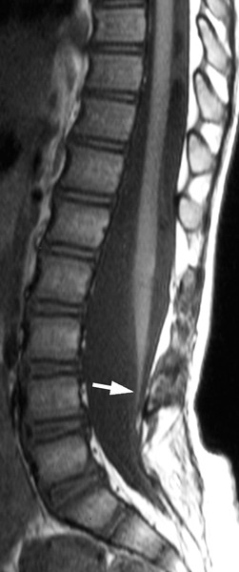
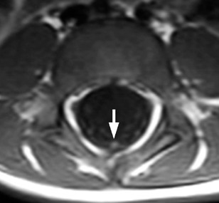

Slide 59
PERSISTENT TERMINAL VENTRICLE
Persistent terminal ventricle results from defect in the process of secondary neurulation, resulting in the formation of small ependymal lined cavity with in conus medullaris.
Asymptomatic.
Needs to be differentiated from intramedullary tumour which can be done by its central location, CSF isointense signal intensity, and by noting lack of contrast enhancement.

Slide 60
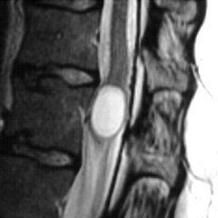
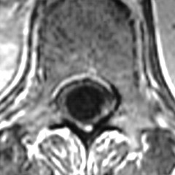

Slide 61
DORSAL DERMAL SINUS
The dermal sinus is an epithelium-lined fistula that extends inward from the skin surface and can connect with the CNS and its meningeal coating.
More frequently in the lumbosacral region.
On clinical examination, a midline dimple or pinpoint ostium is found often in association with hairy nevus, capillary hemangioma, or hyperpigmented patches.
Result from focal incomplete disjunction of the neuroectoderm from the cutaneous ectoderm.

Slide 62
May open in the subarachnoid space and cause leakage of CSF.
Meningitis and abscesses are recognized complications of these fistulas.
the dermal sinus courses obliquely and downward.
easily recognized on midline sagittal scans as a thin hypointense stripe within the subcutaneous fat.
Intrathecal portion is difficult to detect.
Mostly associated with a dermoid.

Slide 63
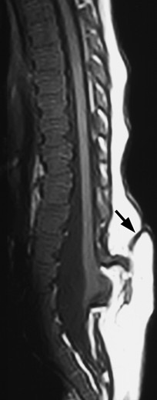
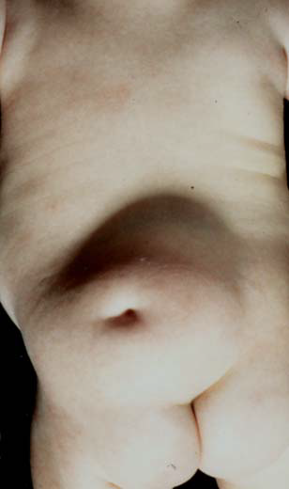

Slide 64
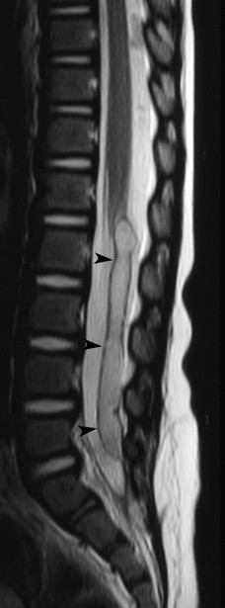
Dorsal dermal sinus will be seen as hypointense tract in both T1 and T2 weighted images extending from skin surface to spinal canal.

Slide 65
NEUROENTERIC CYST
Neurenteric cyst results from incomplete regression of neuroenteric canal.
They are enteric lined cysts that present within the spinal canal and exhibit a definite connection with the spinal cord and/or vertebra.
May communicate with an extra-spinal component of cyst in the mediastinum or mesentery through a dysraphic vertebra or they may attach by a fibrous stalk to the vertebra or gut.

Slide 66
Most common location is thoracic spine followed by cervical spine.
Vertebral anomalies are common.
Diagnosis should be thought, whenever a posterior mediastinal mass is seen along with congenital vertebral anomalies.
Neurenteric cysts are isointense to CSF on T1W images and hyperintense on T2W images. No post contrast enehancment noted.
Neurosensory deficit may be present.

Slide 67
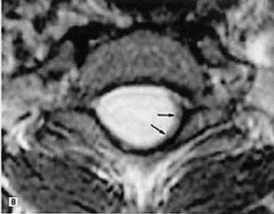
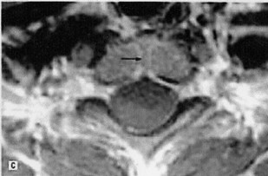

Slide 68
SPLIT CORD MALFORMATION
In SCM, the spinal cord is partially or completely spilt into two hemicords by either an osteocartilaginous septum or by a fibrous septum.
Failure of midline notochordal integration produces two separate, variably elongated notochordal columns, each inducing a separate hemi-neural plate.

Slide 69
Type I SCM consists of two hemicords contained within individual dural tubes, separated by a bony or osteocartilaginous septum that extends from the vertebral body to the neural arches. This rigid median septum is entirely extradural.
In type II SCM, a common dural tube houses both hemicords, and there is no osteocartilaginous spur present, although a midline, nonrigid, fibrous septum sometimes detected at surgery.
Medial septum may be complete or incomplete and may course obliquely dividing the cord asymmetrically.

Slide 70
Most commonly occurs in the thoraco-lumbar region (between D9 and S1 vertebral levels).
Fibrous septum may be very thin and is best demonstrated using thin axial/coronal T2W images. It appears hypointense on T1W and T2W images.
In most cases of diastematomyelia type I, the cleft is located at the thoracic or lumbar level and lies at the caudal end of the splitting.
Hydromyelia is a common associated finding and may involve the normal cord both above and below the splitting, as well as one or both of the hemicords.
Bilateral hydromyelia generates an “owl’s eye” sign on the axial plane.

Slide 71
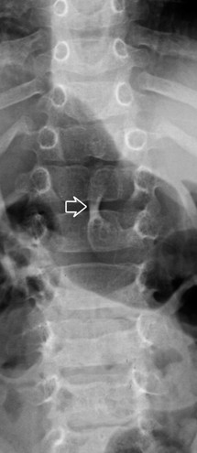
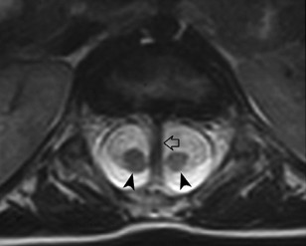
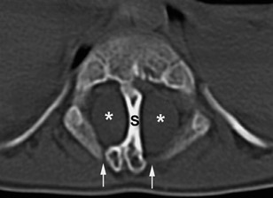

Slide 72
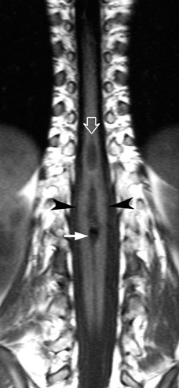

Slide 73
