Slide 1
Long case presentation
DR ANURAG BIJPURIYA
JUNIOR RESIDENT III
DEPT OF RADIODIAGNOSIS
BJGMC & SGH PUNE

Slide 2
40 Years old male came in out patient department with complaint of
-Difficulty in speech since one month.
-Difficulty in walking since one month.
H/o similar complaints in the past on and off.
There is no history of any major illness in the past.
Patient advised MRI brain contrast study for further evaluation.

Slide 3
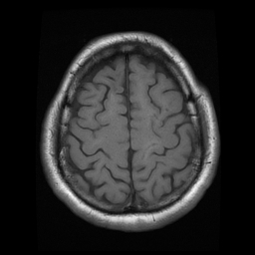
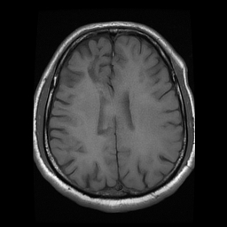
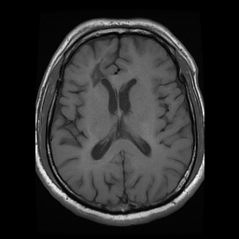
AXIAL T1W

Slide 4
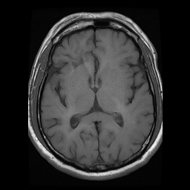
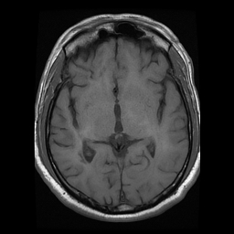
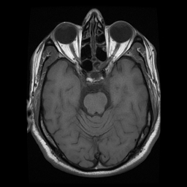
AXIAL T1W

Slide 5
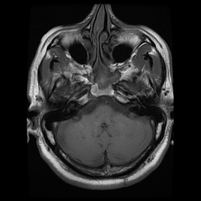
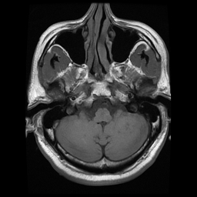
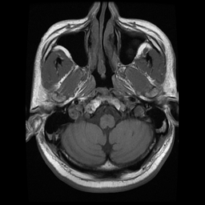
AXIAL T1W

Slide 6
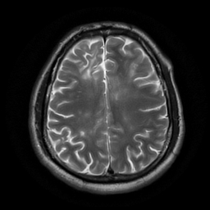
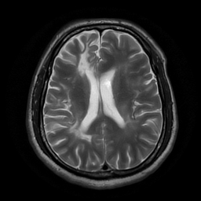
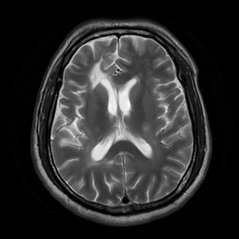
AXIAL T2W

Slide 7
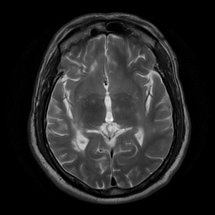
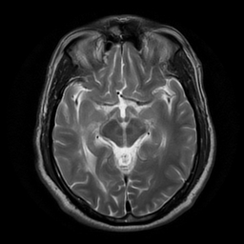
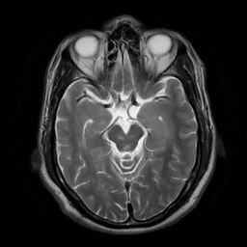
AXIAL T2W

Slide 8
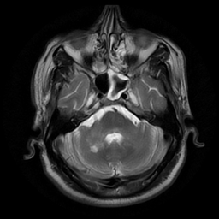
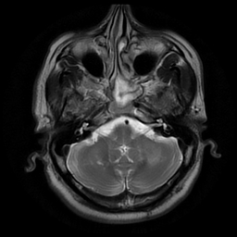
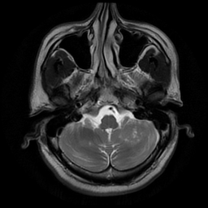
AXIAL T2W

Slide 9
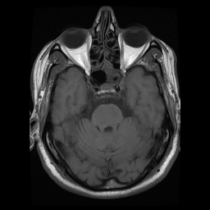
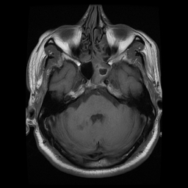
AXIAL T1W

Slide 10
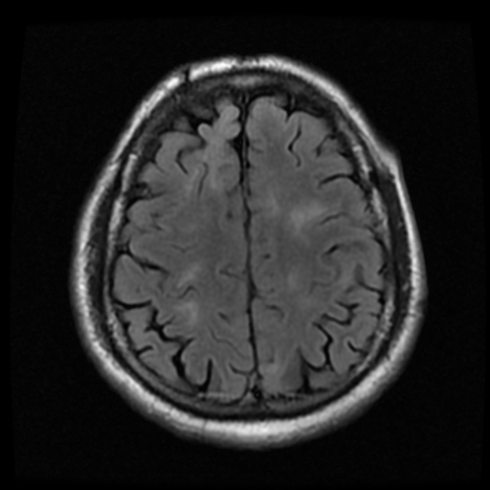
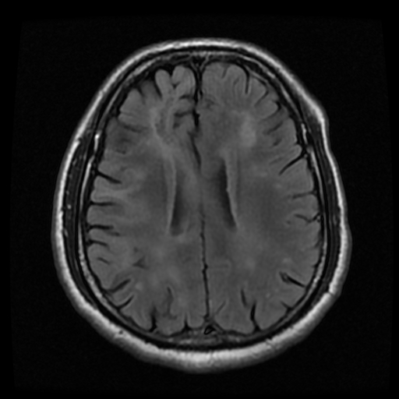
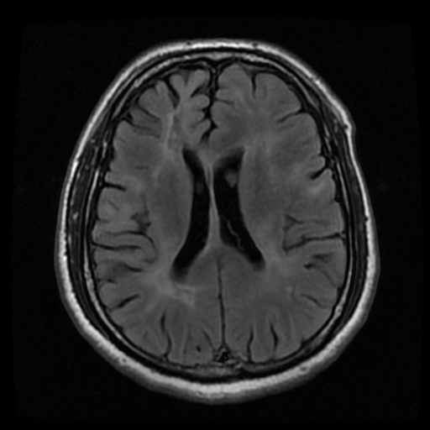
AXIAL T2 FLAIR

Slide 11
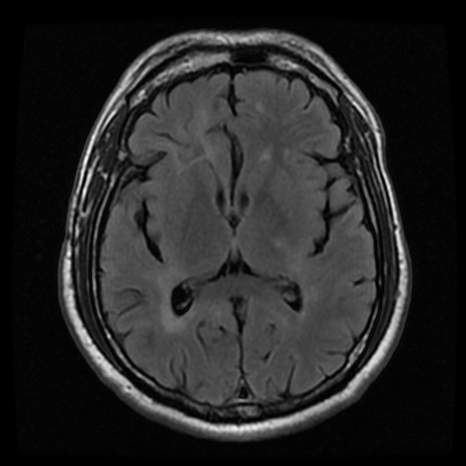
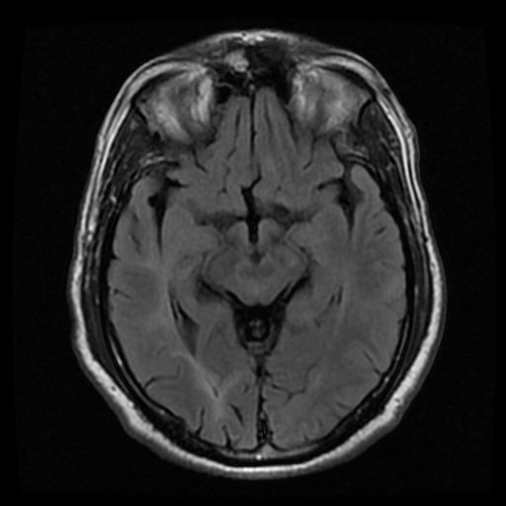
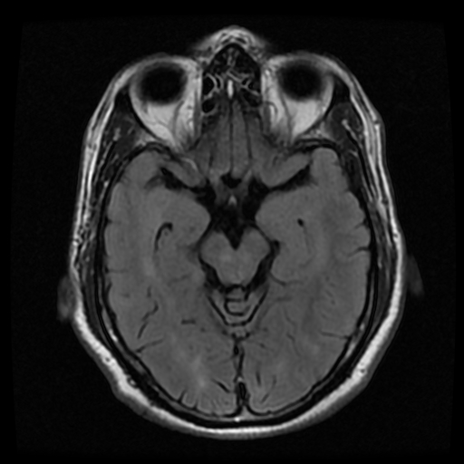
AXIAL T2 FLAIR

Slide 12
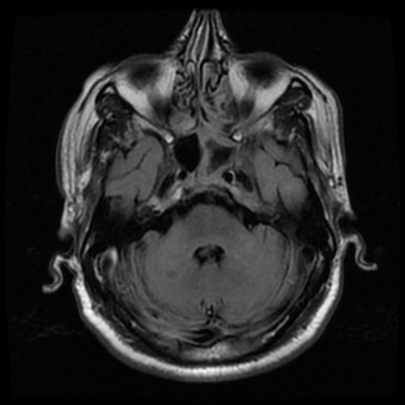
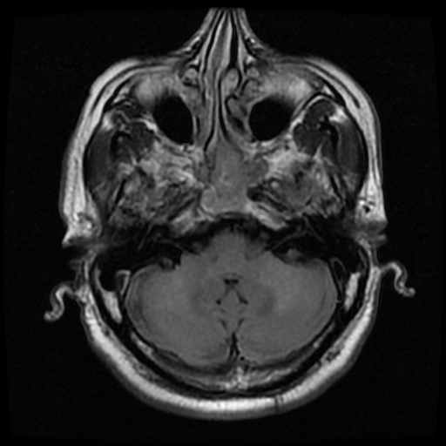
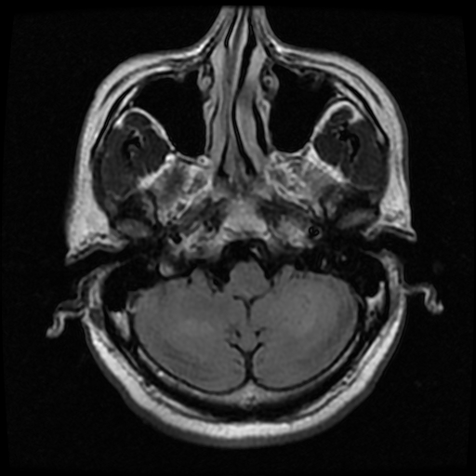
AXIAL T2 FLAIR

Slide 13
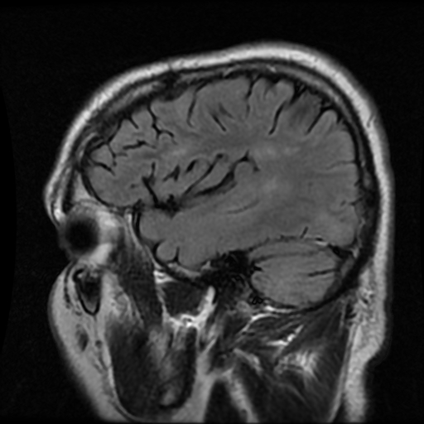
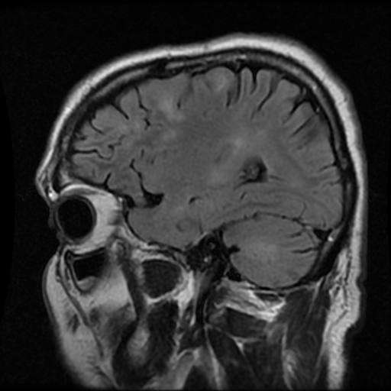
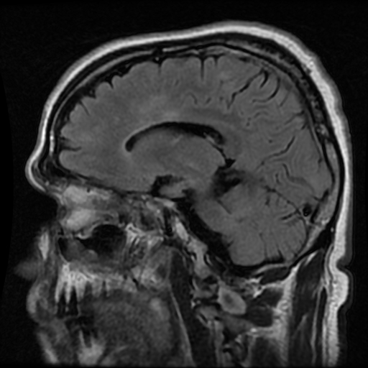
SAG T2 FLAIR

Slide 14
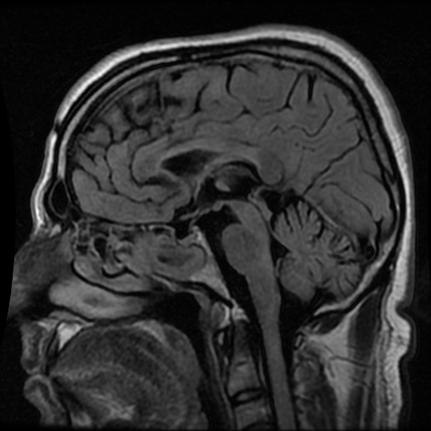
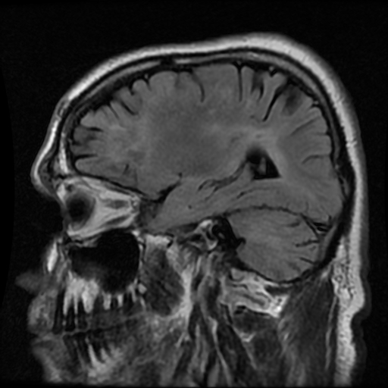
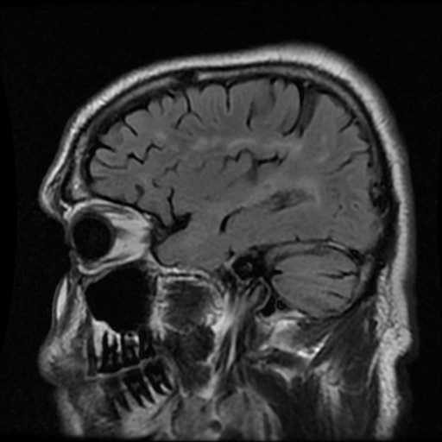
SAG T2 FLAIR

Slide 15
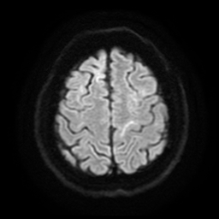
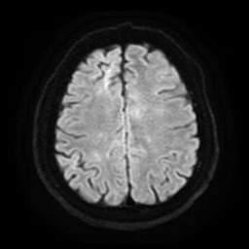
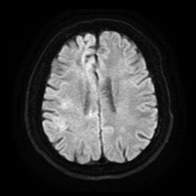
AXIAL DWI

Slide 16
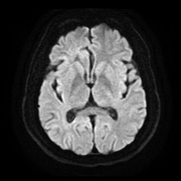
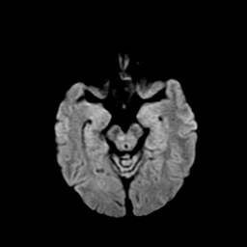
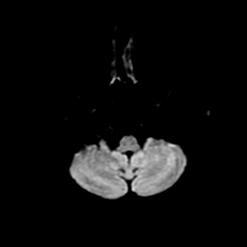
AXIAL DWI

Slide 17
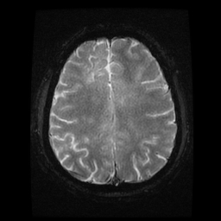
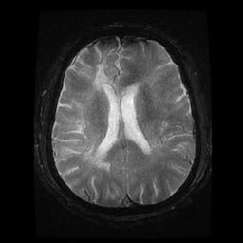
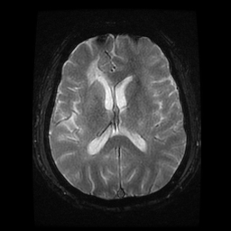
AXIAL GRE

Slide 18
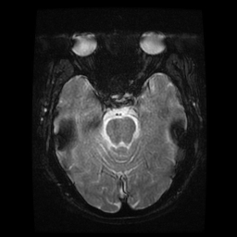
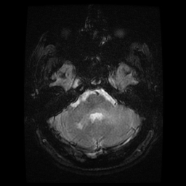
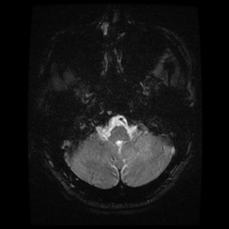
AXIAL GRE

Slide 19
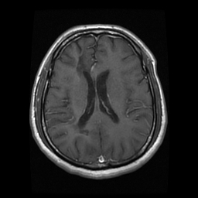
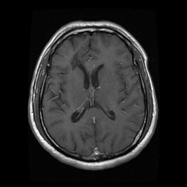
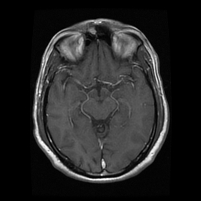
AXIAL CON

Slide 20
AXIAL CON

Slide 21
SAG T2W TOP

Slide 22
SAG T2W MID

Slide 23
SAG T2W BOT

Slide 24
Findings are
Multiple discrete foci of T2W and FLAIR hyperintensities are noted in bilateral cerebral and cerebellar hemispheres, corpus callosum at the calloseptal interface, posterior limbs of bilateral internal capsules, bilateral thalami, midbrain and pons.
These areas appear isointense on T1W images.
Few of them appear hypointense on TIW images s/o chronicity.
No obvious restriction diffusion/blooming on DWI/GRE images noted.
No obvious enhancement on post contrast images.

Slide 25
Differential diagnosis-
Multiple sclerosis.
ADEM.
Autoimmune mediated vasculitis.
Lyme’s disease.
Susac syndrome (SICRET syndrome).
Notes:
MS has a typical distribution of WMLs. This can be very helpful in differentiating them from vascular lesions .Typical for MS is involvement of corpus callosum, U-fibres, temporal lobes, brainstem, cerebellum and spinal cord. This pattern of involvement is uncommon in other diseases.
In small vessel disease there may be involvement of the brainstem, but it is usually symmetrical and central, while in MS it is peripheral.

Slide 26
DISORDERS THAT CAN MIMIC MULTIPLE SCLEROSIS
Acute disseminated encephalomyelitis (ADEM).
Antiphospholipid antibody syndrome.
Behcet’s disease.
CADASIL.
Congenital leukodystrophies (e.g., adrenoleukodystrophy, metachromatic
leukodystrophy).
HIV infection.
Ischemic optic neuropathy (arteritic and nonarteritic).
Lyme disease.
MELAS.
Neoplasms (e.g., lymphoma, glioma, meningioma)
Sarcoid.
Sjogren’s syndrome.
Stroke and ischemic cerebrovascular disease.
Syphilis.
Systemic lupus erythematosus and related collagen vascular disorders.
Tropical spastic paraparesis (HTLV-1/2 infection).
Vascular malformations (especially spinal dural AV fistulas).
Vasculitis (primary CNS or other).
Vitamin B12 deficiency.

Slide 27
Multiple sclerosis
Multiple sclerosis (MS) is the most common inflammatory demyelinating disease of the central nervous system in young and middle-age adults, but also affects older people.
Its counterpart in the peripheral nervous system is inflammatory demyelinative polyradiculoneuropathy (Guillain-Barré syndrome-GBS) and its chronic variants.
MS and GBS are autoimmune inflammatory diseases.

Slide 28
PATHOLOGY
Myelin is a fatty white substance that surrounds the axon of some nerve cells, forming an electrically insulatinglayer. It is essential for the proper functioning of the nervous system. It is an outgrowth of a type of glial cell.
DENDRITE
AXON TERMINAL
NODE OF RANVIER
SOMA
AXON
OLIGODENDROCYTE/SCHWANN CELL
NUCLEUS
MYELIN SHEATH

Slide 29
PATHOLOGY
MS is thought to be an autoimmune disorder which is probably triggered by a viral infection. Genetic susceptibility and environmental factors play important roles in its pathogenesis. A strong association with HLA-DR2 class II has been identified
There is chronic inflammation and selective destruction of CNS myelin. Peripheral nervous system is spared .
Pathologically, the multifocal scarred lesions of multiple sclerosis (MS) are termed plaques.
Plaques can occur anywhere in the central nervous system. They are typically ovoid in shape and perivenular in distribution.

Slide 30
Epidemiology
Age: 20-40 yrs; peak onset = 30 yrs; 3-5% cases < I5 yrs, 8-10% cases > 50 yrs.
Adults: M:F = 1:2. More common in females.
Children/adolescents: M:F = 1:5-10.
All groups but Caucasian most common.
Most often occurs in temperate zones.
45% patients with "probable" MS and positive MR progress to clinically definite MS.

Slide 31
MS variants/subtypes-
Tumefactive MS. It is seen in patients with established multiple sclerosis who develop large aggressive demyelinating lesions.
Marburg type: Younger patients, febrile prodrome, clinically fulminant, death in months.
Schilder type ("diffuse sclerosis"): Extensive, confluent, asymmetric demyelination, bilateral supra-/infra-tentorial parenchyma.
Balo type ("concentric sclerosis"): Large lesions with alternating zones of demyelinated/myelinated WM.
Devic type ("neuromyelitis optica"): Simultaneous optic/spinal demyelination.

Slide 32
TUMEFACTIVE MULTIPLE SCLEROSIS
Tumefactive MS is a variant of Multiple Sclerosis. It on MRI presents as a large intra-parenchymal lesion with usually less mass effect than would be expected for its size.
After the administration of gadolinium, there may be some peripheral enhancement, often with an incomplete ring/open ring enhancement.
These lesions can be distinguished from gliomas or intraparenchymal abscesses, which typically have a closed-ring enhancement.

Slide 33
TUMEFACTIVE MULTIPLE SCLEROSIS
Notes:
There is an intraparenchymal mass in the right temporal and occipital lobe with a hypointense rim on T2W, which only partially enhances (open-ring sign) on the postcontrast images. There is surrounding edema, but relatively little mass effect. This was a biopsy-proven demyelinating lesion.
The open-ring enhancement pattern with low signal T2 ring and low CBF are all indicative of demyelination.

Slide 34
Balo’s Concentric Sclerosis
Balo's Concentric Sclerosis is an uncommon demyelinating disease.
It was first described by J Balo in 1928.
It is characterized by alternative bands of demyelination and myelin preservation, often in whorl-like configurations giving it a characteristic 'bulls eye' or 'onion bulb' appearance.
it is usually monophasic, but most closely resembles acute Marburg type multiple sclerosis, with rapid progression and sometimes fulminant course.

Slide 35
Notes:
Here T2 and postcontrast T1W images showing a large lesion in the left hemisphere with alternating T2-hyperintense and isointense bands. On the T1W images after gadolinium there is alternating linear enhancement. There is a smaller, similar lesion on the right.

Slide 36
Marburg's variant of multiple sclerosis
Marburg's variant of multiple sclerosis, also known as acute, fulminant, or malignant multiple sclerosis, is characterised by extensive and fulminant acute demyelination, often resulting in death within one year after the onset of clinical signs.
Marburg variant is typically seen in younger patients .
Clinical presentation-Symptoms may be preceded by fevers and are typically monophasic.
Pathology-Areas of demyelination demonstrate marked macrophage infiltration, marked associated inflammation, and extensive tissue destruction, necrosis and axonal damage and necrosis.
Unlike other multiple sclerosis variants, the peripheral nervous system may also be involved ².
Notes:
Cellular structure with a single morphologic pattern ---monophasic. having a single phase;

Slide 37
Marburg's variant of multiple sclerosis
On MRI extensive confluent areas tumefactive demyelination are seen with mass effect and defined rings and incomplete ring enhancement . Only rarely are numerous smaller lesions seen disseminated throughout the brain.
Treatment and prognosis- Marburg type MS typically is rapidly progressive, fulminant and often results in death from involvement of the brain stem or due to marked mass effect and herniation. Only rarely do affected areas remyelinate.
It was first described in 1906 by Otto Marburg .
Differential diagnosis
Balo concentric sclerosis (BCS).
acute disseminated encephalomyelitis (ADEM).

Slide 39
Schilder's disease
Schilder's disease, (also known as diffuse myelinoclastic sclerosis, or diffuse cerebral sclerosis) is considered a variant of multiple sclerosis (MS), and represents an extremely rare progressive demyelinating process that begins in childhood.
Posner diagnostic criteria. All six criteria must be met.
1-2 large plaques: should be in each brain hemisphere predominantly in centrum semiovale. Lesions are greater than 2 cm in 2/3 dimensions.
No additional lesions identified.
No peripheral nervous system abnormality.
Normal adrenal function.
Normal serum long chain fatty acids.
Pathologic/histologic changes consistent with sub-acute/ chronic myelino-clastic diffuse sclerosis.

Slide 40
Schilder's disease
Note that the diagnosis cannot be made on imaging findings alone.
Treatment-Patients have a poor prognosis. Current recommendations are high dose corticosteroids and supportive care .
Differential diagnosis
Appearances, clinical presentation and histological findings are similar to tumefactive demyelinating lesions, and it has been proposed that in fact Schilder type multiple sclerosis actually merely represents the paediatric version of tumefactive demyelinating lesions .
Appearances are also similar to Marburg variant of multiple sclerosis, although the brain stem is usually spared, and response to steroids is more common.

Slide 41
Schilder’s disease. A 10-year-old male presented with headache, vomiting, ataxia and foot drop. The MRI reveals multiple large hemispheric (predominantly T2-hyperintense) lesions (a) with ring enhancement (b).

Slide 42
Neuromyelitis Optica
A very important variant to keep in mind, especially in patients with a bilateral optic neuritis, is Neuromyelitis Optica (NMO) or Devic's Disease.
This is a demyelinating disease in which the optic nerves and spinal cord are usually involved.
Often there are few T2-lesions in the brain. Think of NMO when there are extensive spinal cord lesions (more than 3 vertebral segments) with low T1-signal intensity and swelling of the cord.
On axial images the lesions often involve most of the cord. This is unlike MS, in which the lesions are usually smaller and peripherally located.
The clue to the diagnosis was the AQP4-AB titer 1:1024.

Slide 43
Neuromyelitis Optica
NMO is now recognized as an autoimmune encephalitis caused by antibodies directed against neuronal-glial surface antigens, specifically antibodies to the water channel protein Aquaporin-4 (AQP4), which is present in astrocytic processes along the BBB.
Because of its broad clinical spectrum, this entity is now called Neuromyelitis Optica Spectrum Disorder (NMOSD).
Unlike MS, NMOSD is frequently associated with other autoimmune diseases (thyroiditis, type 1 diabetes, celiac disease, SLE, Sjogren syndrome)

Slide 44
Notes:
Here we see a sagittal T2-weighted image of the spinal cord in a patient with NMO showing a longitudinally extensive cord lesion with marked swelling.

Slide 45
Radiographic features

Slide 46
Typical for MS in this case is:
Involvement of the temporal lobe (red arrow).
Juxta-cortical lesions (green arrow) - touching the cortex.
Involvement of the corpus callosum (blue arrow).
Peri-ventricular lesions - touching the ventricles.
The lesions in the deep white matter (yellow arrow) can be seen in many diseases.

Slide 47
Juxtacortical lesions are specific for MS. -These are adjacent to the cortex and must touch the cortex. Subcortical word is not used to describe this location, because that is a less specific term, indicating a larger area of white matter almost reaching the ventricles.
Temporal lobe involvement is also specific for MS. In hypertensive encephalopathy, the WMLs are located in the frontal and parietal lobes, uncommonly in the occipital lobes and not in the temporal lobes. Only in CADASIL there is early involvement of the temporal lobes.

Slide 48
Notes:
In small vessel disease these juxtacortical U-fibers are not involved and on T2 and FLAIR there will be a dark band between the WML and the (also bright) cortex (yellow arrow).

Slide 49
Juxta-ortical lesions located in the U-fibers are specific for MS. They are difficult to differentiate from the hyperintense cortex. The involvement of the U-fibers is best seen on the magnification view.
There are multiple peri-ventricular lesions of which some have the typical Dawson finger aspect (blue arrow), but there is also a juxta-cortical lesion.

Slide 50
Multiple lesions adjacent to the ventricles (red arrow).
Ovoid lesions perpendicular to the ventricles (yellow arrow). These ovoid lesions are also called Dawson fingers. They represent areas of demyelination along the small cerebral veins that run perpendicular to the ventricles.
Multiple lesions in brainstem and cerebellum.

Slide 51
Dawson fingers, typical for MS and are the result of inflammation around penetrating venules. These veins are perpendicular to the ventricular surface.
Multiple lesions adjacent to the ventricles are also noted.

Slide 52
There are multiple lesions in the spinal cord. This is another typical feature of MS.
Typical spinal cord lesions in MS are relatively small and peripherally located.
They are most often found in the cervical cord and are usually less than 2 vertebral segments in length.
A spinal cord lesion together with a lesion in the cerebellum or brainstem is very suggestive of MS.
Spinal cord lesions are uncommon in most other CNS diseases, with the exception of ADEM, sarcoid, Lyme disease and SLE.

Slide 53
On PDW-images the spinal cord has a uniformly low signal intensity (like CSF), which gives the MS lesions a good contrast against the surrounding CSF and normal cord tissue.
Notes:
This image is a proton density weighted image (PDWI). They are crucial for studying the spinal cord. Use a 512 matrix and cardiac gating for optimal results.

Slide 54
For dissemination in space (DIS) lesions in two out of four typical areas of the CNS are required:
Juxtacortical
Periventricular
Infratentorial
Spinal cord

Slide 55
For dissemination in time (DIT) there are two possibilities:
A new T2 and/or gadolinium-enhancing lesion(s) on follow-up MRI, with reference to a baseline scan, irrespective of the timing of the baseline MRI OR
Simultaneous presence of asymptomatic gadolinium-enhancing and non-enhancing lesions at any time.

Slide 56
Multiple enhancing lesions. Many of these lesions 'touch the cortex' and must be located in the U-fibers.
These enhancing lesions all are new lesions, since Gadolinium enhancement is only visible for about 1 month. So this finding is proof of dissemination in time.
Notes:
Typical findings for MS as seen in this case are: T1WI: multiple enhancing lesions

Slide 57
New lesions on T2W images also indicate dissemination in time. The patient on the left had a follow-up examination 3 months after the first clinical event.
LEFT: Single lesion on T2WI. RIGHT: Two new lesions at 3 month follow-up.

Slide 58
MR spectroscopy
NAA peaks may be reduced within plaques, which is the most common and remarkable finding.
Choline and lactate are found to be increased in the acute pathologic phase.
Double inversion recovery DIR: A new sequence that suppresses both CSF and white matter signal and offers better delineation of the plaques.

Slide 59
Diagnosis
The diagnosis of multiple sclerosis requires the constellation of clinical findings and various investigations, including.
Typical history.
MR imaging.
Oligo-clonal bands in CSF.
Immunoglobulin G in serum.
Abnormal visual evoked potential.
Lack of viable alternative diagnosis.

Slide 60
The diagnosis of MS requires elimination of more likely diagnoses and demonstration of dissemination of lesions in space and time.
According to the McDonald criteria for MS, the diagnosis requires objective evidence of lesions disseminated in time and space.
As a consequence there is an important role for MRI in the diagnosis of MS, since MRI can show multiple lesions (dissemination in space), some of which can be clinically occult, and MRI can show new lesions on follow up scans (dissemination in time).

Slide 61
Dissemination in Space (DIS) is:
≥ 1 T2 lesion in at least two out of four areas of the CNS: periventricular, juxtacortical, infratentorial, or spinal cord.
Gadolinium enhancement of lesions is not required for DIS.
Dissemination in Time is:
A new T2 and/or gadolinium-enhancing lesion(s) on follow-up MRI, with reference to a baseline scan, irrespective of the timing of the baseline MRI OR
Simultaneous presence of asymptomatic gadolinium-enhancing and non-enhancing lesions at any time.

Slide 64
The diagnosis is either-
MS : all criteria fulfilled.
Possible MS : not all criteria fulfilled.
Not MS : no criteria fulfilled.

Slide 65
Major clinical subtypes
Relapsing-remitting (RR) (85% initial presentation)
Secondary-progressive (SP) also called as relapsing progressive. By 10 years 50%, and by 25 years 90% of RR patients enter SP progressive phase.
Primary-progressive (PP) also called as chronic progressive. 5-10% of MS population progressive from start
Progressive-relapsing (PR) rare, defined as progressive disease with clear acute relapses, with/without full recovery. Periods between relapses characterized by continuing disease progression.

Slide 66
Treatment and prognosis
The aim of treatment is twofold: to curtail progression (disease-modifying agents) and symptomatic relief.
Steroids, interferon, monoclonal antibodies and autologous hematopoietic stem cell transplantation are all used.
Prognosis is variable and depends on the pattern of disease a patient has (e.g. primary progressive carries a worse prognosis than relapsing-remitting).

Slide 67
Complications
In addition to the potential for disease progression resulting in progressive neurological impairment, a number of specific complications need to be considered.
Progressive multifocal leukoencephalopathy (PML)
Particularly in patients treated with natalizumab with positive JC virus serology.
PML-IRIS
A complication of cessation of natalizumab or treatment for natalizumab-related PML with plasma exchange or immunoabsoption.
Primary CNS lymphoma
Rarely lymphoma appears to arise from previously identified demyelinating lesions.

Slide 68
Natalizumab-associated PML
Progressive Multifocal Leukoencephalopathy (PML) is a demyelinating disease caused by JC virus in immunosuppressed patients.
Natalizumab is a monoclonal antibody against α4-integrin approved for the treatment of multiple sclerosis due to a positive effect on clinical and magnetic resonance imaging (MRI) outcome measures. A relatively rare but serious side effect of this drug is a higher risk of developing PML.
The diagnosis of PML according to diagnostic criteria is based on the clinical presentation, the identification of JCV DNA in the CNS (e.g., in the cerebrospinal fluid) and imaging findings preferably on MRI.

Slide 69
Key imaging signs are:
Focal or multifocal lesions in the supratentorial subcortical white matter involving the U-fibers and the cortical grey matter, less frequently posterior fossa and deep grey matter.
T2-hyperintense (occasionally with small focal lesions in the vicinity of the main lesion).
T1-isointese or hypointense depending on the degree of demyelination.
In approximately 30% of the patients PML lesions can show contrast enhancement.
High signal intensity on DWI particularly in the border of the lesions reflecting active infection and swelling of the white matter cells.

Slide 71
It can be difficult to differentiate progressive MS from natalizumab-associated PML.
How to image natalizumab-associated PML:
FLAIR has the highest sensitivity in the detection of PML lesions
T2-weighted sequences can show certain aspects of PML lesions (eg, microcysts)
T1W with and without contrast is helpful to assess the degree of demyelination and signs of inflammation.
DWI is useful for the detection of active infection.

Slide 72
 | MS | PML
Shape | Ovoid | Diffuse
Borders | Well- circumscribed | Ill-defined
Size | 3-5mm | >5mm
Location | Peri-ventricular Dawson fingers | Sub-cortical
Mass effect | Yes, large lesions | No
Resolution | Yes | Progressive increase in size

Slide 73
TAKE HOME MESSAGE
Multiple sclerosis (MS) is a relatively common acquired chronic relapsing demyelinating disease involving the central nervous system, and is the second most common cause of neurological impairment in young adults, after trauma.
Characteristically, and by definition, multiple sclerosis is disseminated not only in space (i.e multiple lesions in different regions of the brain) but also in time (i.e. lesions occur at different times).
A number of clinical variants are recognised, each with specific imaging findings and clinical presentation.
MRI has revolutionised the diagnosis and surveillance of patients with MS. Not only can an MRI confirm the diagnosis, but follow-up scans can assess response to treatment, complications and help determine the disease pattern.

Slide 74
Thank you

