Slide 1
MR SPECTROSCOPY

Slide 2
INTRODUCTION
Noninvasive technique to determine the molecular metabolites in any given living tissue.
A method of molecular imaging.
In many pathologic processes, metabolic changes precede anatomic changes. Concentration of these metabolites alter in a defined reproducible way in diseased tissue - Abnormal spectra
So, MRS offers a method for early detection of diseases and can influence therapy.

Slide 3
Nuclei with odd no of protons and neutrons (atomic mass number) have a magnetic moment and interact with external magnetic field and are observed in MR spectroscopic studies.
Ex : 1H, 31P, 13C,19F, 23Na.
MRS can detect metabolites in conc. more than 0.1 mM.

Slide 4
PREREQUISITE
Basic principles are the same as MRI with following differences:
WATER SUPRESSION
MR images are reconstructed from entire proton signals from tissue dominated by water and fat protons. Protons from other metabolites do not contribute to imaging because of their negligible conc.
In MRS - aim itself is to detect these small metabolites.
Most metabolites of clinical interest resonate between resonant frequencies of water and fat. Hence to detect them large signal from water protons needs to be suppressed.

Slide 5
Concentration of water can be 10000 times the concentration of other metabolites. Most frequently used technique - Chemical Shift Selective excitation (CHESS) - reduces water signal by a factor of 1000. (Adequate water suppression if base line is normal.)

Slide 6
Factors affecting resonance frequency:
Lamda (Gyromagnetic ratio),
Field strength,
Chemical environment,
Magnetic homogeneity.

Slide 7
Gyromagnetic ratio: Fixed for an atom of an element.
The gyromagnetic ratio (also sometimes known as the magnetogyric ratio in other disciplines) of a particle or system is the ratio of its magnetic moment to its angular momentum.
The gyromagnetic ratio (MHz/T) for a few commonly measured or imaged isotopes are ¹:
H-1 42.58
F-19 40.05
Na-23 11.26
P-31 17.24

Slide 8
2. Field strength:
So, in homogenous field,
Precessional frequency of protons in a given metabolite proportional to chemical shift to the position of metabolic peak.
From Larmor equation, ω = γB
precessional frequency of any proton is directly proportional to external magnetic field strength.
Chemical Shift in Hz will be different at different magnetic field strengths. Hence, Chemical shift is expressed in terms of ppm ( parts per million ), which remains same for a particular metabolite at all field strengths.
Also since Chemical shift is proportional to external magnetic field, smaller CS will not be detected at low field strengths.
Field strength of 1.5T or above is required for improved spectral separation and increased SNR.

Slide 9
3. CHEMICAL SHIFT phenomenon:
Variation in the resonance frequency of a nuclear spin due to the chemical environment around the nucleus - Chemical shift.
Chemical shift results from the magnetic shielding by the electrons around the nucleus.
Chemical shift forms basis of 2 imaging patterns:
In phase and out phase imaging: when fat and water are in phase and out of phase so that their signal add or cancel each other respectively.
MR spectroscopy: Chemical Shift determines the position of metabolic peak in MRS.
For ex: proton in water, fat , NAA will all precess at different frequencies.

Slide 10
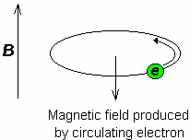
Chemical shift results from the magnetic shielding by the electrons around the nucleus.
All nuclei in a given molecule are surrounded by an “electron cloud.”
Higher the electron density around a nucleus- more effectively is the nucleus shielded.
When placed inside the static external magnetic field B₀, a circulation in the electron cloud surrounding the nucleus is induced such that the induced magnetic field, B_{ind}, is opposite to B₀.
Notes:
Five years later, Proctor and Yu (3) proposed that the resonance frequency of a nucleus depends on its chemical environment, which produces a small, but perceptible, change in the Larmor resonance frequency of that nucleus. This nuclear behavior is termed “chemical shift,” and is caused by the magnetic fields generated by circulating electrons

Slide 11
The opposing magnetic field, B_{ind}, reduces the field experienced by the nucleus- resulting in a “shielding” of the nucleus from the full strength of the external magnetic field.
Effective magnetic field, B_{eff}, felt by the nucleus is therefore smaller than the applied magnetic field - resulting in a lower resonance frequency of the nucleus:
Higher the electron density around a nucleus- more effectively is the nucleus shielded.
The strength of the induced magnetic moment depends on the applied magnetic field and the shielding constant, σ:

Slide 12
REMEMBER
In MRS- standard is the resonance of a compound
Tetramethylsilane (TMS) - arbitrarily defined as 0 ppm
For in vivo MRS - the water resonance is typically used as an internal standard, at 4.7 ppm with regard to TMS

Slide 13
4. Magnetic field homogeneity:
MRS requires more homogenous magnetic field than MRI.
Since, CS is proportional to external magnetic field, smaller chemical shifts will be misinterpreted and incorrect conc. will be recorded in inhomogenous field.
Homogeneity required MRI - 1 to 10 ppm
MRS - 0.1 ppm
Magnetic field is made homogenous by – SHIMMING

Slide 14
LOCALISATION TECHNIQUES IN MRS
Two major approaches to localize MRS signal :
Single voxel spectroscopy (SVS) - pulse sequences used are
STEAM
PRESS
ISIS
Multivoxel spectroscopy - based on Chemical shift imaging (CSI)

Slide 15
1.STEAM ( STIMULATED ECHO ACQUISITION MODE)
Simple and short TE (20-30 ms )
ADV: More effective water suppression
Disadvantage - signal loss (approx. 50%)
- susceptible to motion artifact
- not suited for detection of nuclei
with short T2 values like P31.

Slide 16
2. PRESS ( Point Resolved )
90 - 180- 180 RF pulses
Used for longer TE ( 135, 270 ms) spectroscopy.
Signals are strong (twice the SNR of STEAM)
Less susceptible to motion artifact
Disadvantage - can’t be performed at short TE values
(<40 ms ).

Slide 17
3. ISIS ( Inversion Sequences)
Three inversion pulses are applied f/b a fourth non-selective pulse for observation of signal.
Specilally useful for observation of nuclei with short T2 values - 31P.

Slide 18
MULTIVOXEL SPECTROSCOPY
Based on CSI. (also called MRSI)
Signal intensity, peak resonance area can be converted in image format and overlaid onto anatomical MR image.
Phase encoding is done in one , two or three dimensions to encode information from multiple voxels simultaneously.
Then data are translated to extract chemical shift information from multiple positions using Fourier Transformations.

Slide 19
SVS
- Excellent localization,
Field homogeneity
Excellent Water suppression.
Short time.
-Generate data from well defined small volume in short time – 3 to
6 min.
MVS
- Advantage of acquiring multiple spectra in
single acquisition.
Shown superimposed on MR image.
- Long time- upto 12 min
- Sensitive to motion artefacts

Slide 20
Vs
MRI | MRS
Digitizes signal & generate images | Digitizes signal & generates spectrum
Data analyzed in time domain | Data analyzed in frequency domain
Frequencies used to encode space. | Frequencies used to encode chemistry
H2O & Fat predominates | Metabolites predominate
All field strengths | Field strength > 1.5 T
Homogeneity Imp (1-10ppm) | Field Homogeneity crucial(0.1ppm)
No additional shimming | Additional shimming
All available signal contribute | Selective signal contribute
.
.
.
.
.
)

Slide 21
NAA
Cr
mI
Cho
Glu/
Gln
Lipids, Lactate

Slide 22
STEPS TO OBTAIN MRS
1. Patient positioning and acquisition of MR images for
localization-
2. Selection of MRS parameters : TE
TE- 20-30 ms, 135-145 ms , 270 ms
Short TE- ALL METABOLITES (Glu, Gln, mI) are visible
Long TE (>135ms) - major brain metabolites
- Choline ,Creatine ,NAA, Lactate
Thus, Less noise at longer TE.
3. SHIMMING: For narrower metabolic peaks, better spectral resolution and good SNR.

Slide 23
Water suppression
So that small metabolite peaks are visible.
By CHESS technique.
5. MRS data collection, processing and display
Done by software.
Zero point in spectrum is set at freq. of TMS (tetra methyl silane).

Slide 24
Notes:
In clinical spectroscopy,
the size of the voxel generally varies between
2 and 8 cm3, but with current equipment,
it may be as small as 1 cm3. Smaller voxels
contain smaller amounts of tissues and produce
lesser signal-to-noise ratios.

Slide 25
INTERPRETATION
Look at the baseline
Look at peak separation
Identify the Normal & Abnormal Metabolites
Assess Metabolite Ratios using Cr as internal reference
Should always be based on
-ratios of metabolites rather than absolute conc. of individual metabolites
-comparison with normal side.

Slide 27
NAA Regional Variations
Marker of neuronal / axonal viability and density
Adult – concentration more in gray matter than white matter. Infant concentration is equal in both.
. Evenly distributed throughout the cerebral cortex
. Less in hippocampus.
. Lesser in cerebellum.
NAA Pathological Variations
NAA count decreases in brain disorder , resulting in neuronal and axonal loss
Ex., neurodegenerative disease ,stroke ,tumor , epilepsy, multiple sclerosis (decreased number of neurons).
NAA concentration increases in Canavan’s disease (due to deficiency of enzyme N-acetylaspartate cyclase).

Slide 29
Creatine + Phosphocreatine =Total Creatine
Marker of intact brain Energy Metabolism.
Acts as store of ATP.
Used as internal reference as most stable metabolite, Cr = 1
Higher in grey matter than white matter (as cell nucleus lies in neuronal body that lie in grey matter)
Higher in thalamus and cerebellum than white matter (as they are nuclei / grey matter / neuronal body )
Increased : In trauma, Hypometabolic states.
Reduced: Hypoxia, stroke, necrosis, malignant tumor (where it is used up already), in hypermatebolic states- hyperthyroidism

Slide 31
Phosphorylcholine + glycerophosphorylcholine
Total Choline
Choline is slightly more in white matter than gray but more in thalamus and cerebellum.
Concerned with cell membrane turnover.
Choline released during disease from the pool.
Increased in condition of: myelin breakdown, hypercellular state– tumor (increased cell turnover).
Reduced in hepatic encephalopathy, stroke (decreased number of cells
and so cell membranes).

Slide 32
4. MYOINOSITOL (mI) First peak : 3.56 ppm Second peak : 4.1 ppm
Acts as an osmolyte (cell volume regulator )
Almost exclusively located in astrocytes -- a marker of gliosis.
Most dominant peak in newborns and decreases with age.
Increases in- Alzheimer’s disease, frontal lobe dementias
(as neuron number deceases and glial cell marker increases),
diabetes, hyperosmolar states.
Decreases in - hepatic encephalopathy (edema), stroke, tumor ( as in these cases glial cell also decrease in number). hyponatraemia, osmotic pontine myelinolysis

Slide 35
Lactate increases in -:
hypoxia,
tumor,
Mitochondrial encephalopathy,
Canavan’s disease,
Alexanders disease

Slide 37
Doublet at 30 ms
Persists even after 270 ms
Inverts at 144 ms

Slide 38
-
-
.
.
-
.
.

Slide 39
Lipids : - It is non specific indicator of anaerobic glycolysis.
Normally Bound - not seen
Seen when liberated in pathological processes -cell death and cell membrane destruction:
- high grade tumors with necrosis,
- multiple sclerosis,
- tuberculomas,
- stroke.
. Definitely pathological - indicates necrosis and / or disruption of myelin sheath
. Difficult to differentiate from macromolecules
. Nonsignificant lipid - contamination of Voxel Of Interest from lipids in scalp.

Slide 41
GLUTAMATE
Glutamate is excitatory neurotransmitor.
Glutamate is a neurotoxin when concentration exceeds that required for neurotransmission
Glutamate is elevated : in hypoxia, ischemia, recovering brain.
GLUTAMINE
Glutamine is astrocyte marker.
Protective function of astrocyte
Main ammonia intake route.
ALANINE
Alanine doublet seen at 1.48 ppm
Elevated in meningioma.
Valine and leucine are marker of abscess

Slide 42
Metabolite ppm
Macromolecules 0.5-1.8
Cystosolic amino acids 0.9
Lipid 0.9
Propylene glycol (doublet) 1.14
Ethanol (triplet) 1.16
Lipid 1.3 . 1.4
Lactate (doublet) 1.33
Alanine (doublet) 1.48
Acetate 1.92
Marker peaks 2.0-2.6
Ketones 2.2
Succinate 2.4
Aspartate 2.6
ã- aminobutyric acid (GABA) 2.9
Glycine 3.56
Threonine 3.6
Mannitol 3.8
Lactate 4.1

Slide 43
LIMITATIONS
Neurotransmitters are beyond detection (Low concentration) - Ach, NE, Dopamine, serotonin
(Exceptions - Glycine, Glutamate, Glutamine, GABA)
Hormonal messengers are not detected
Inositol polyphosphates, c- AMP( Lack of Methyl group)
Macromolecules not detected - RNA, DNA (Bound state, Limited Mobility)
Time required,
Motion artefacts may make it impossible in some pt
Expertise technician

Slide 44
CLINICAL APPLICATIONS
Brain
Prostate
Breast
Gaucher’s D: quantification of fat in marrow.
31P MRS: used in herpes encephalitis.
Liver
Cardiac.

Slide 45
BRAIN TUMORS
In general show 5 biochemical defects
NAA is decreased – destruction/absence of neurons & axons
Cr is moderately decreased - Low energy state of tumors
Choline is increased - Proliferation of cell membrane
Lactate is increased - Increased anaerobic glycolysis
Lipid is increased - Necrotic regions or Rx response
Reduced NAA/Cr ratio,
elevated Cho/Cr ratio

Slide 47
I. DIAGNOSIS AND GRADING
Grading of glial tumors
Cho/ Cr ratio > 2.0 in glioma, bet 1.3 -2.0 in hamartoma ,and less than 1.3 in normal brain
High choline, low NAA, presence of lactate and lipid- correlates with higher grade of malignancy- reflects tumor, hypoxia and necrosis
Eg: in GBM.

Slide 48
ASTROCYTOMA
Myo-ionositol - Marked elevation - Low grade gliomas
Normal or absent mI - High grade gliomas
NAA levels are low in all astrocytoma, but are lowest in grade-IV tumors.
Choline is always elevated in solid astrocytomata, but is more so in those of higher grades.
The presence of lactate generally reflects necrosis and, therefore, a higher degree of malignancy

Slide 49
GLIOBLASTOMA showing a bifid lactate peak at 1.3 ppm (TE = 270 ms)

Slide 50
2. Low grade glioma Vs Gliomatosis cerebri (GC)
Morphologically similar - infiltration of large area of brain parenchyma, lack of contrast enhancement, often indistinguishable on brain biopsy.
Pts with GC - poor response chemo and Radiotherapy,
overall unfavourable prognosis compared to
LGG
GC - inc.levels of Cr compared to LGG
LGG - low to normal Cr.
No significant differences in levels of Cho, NAA and myoinositol

Slide 51
3. Meningioma Vs GBM
Sometimes may be difficult to differentiate with conventional MR images.
On MRS,
Meningioma - low NAA (neuron destruction)
- Alanine peak .
GBM - low NAA , high Lac , lipid peak.
- mI increased

Slide 52
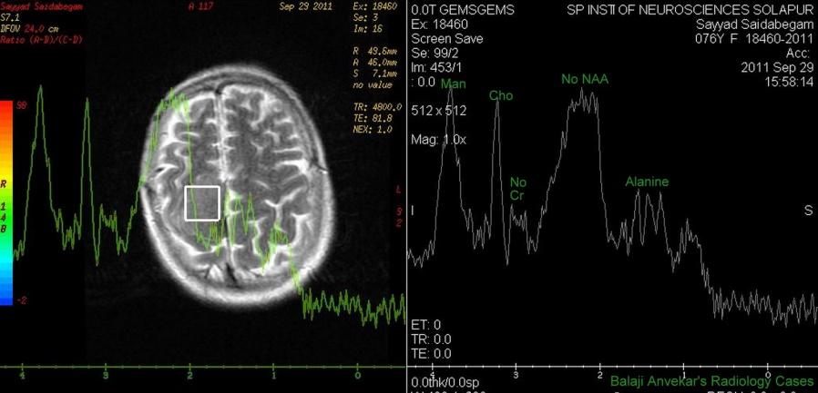
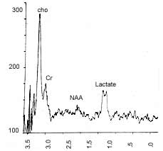
MENINGIOMA VS GBM

Slide 53
4. METASTASIS
Most useful in solitary lesion.
High choline, Decreased - Cr and absent NAA
Astrocytomas also have similar spectra.
Differentiated by- sharp margin of mets with no spectroscopic abnormality in the immediate adjacent tissue.
Incontrast gliomas - spectroscopic abnormalities extending
beyond the enhancing margin of tumor.
Glycine level markedly elevated in GBM , ependymoma and medulloblastoma whereas it is low in mets.

Slide 54
5. Lymphoma
low NAA and high Cho.
Similar to astrocytomas.
MRS helpful in assessing response to treatment - successfully treated lymphoma shows progressive decreases in choline and lipids.

Slide 55
II. TUMOR EXTENT - EDEMA VS INFILTRATION
Both appear hyperintense on T2 and FLAIR.
MRS - area of cellular infiltration shows increased Cho and low NAA.
- Vasogenic edema does not show any such changes.
MRS helps to delineate tumor margins - for complete tumor resection or planning RT and avoiding it (tumor under Rx.)
III. Therapeutic planning for gliomas and predicting response to therapy.

Slide 56
IV. Radiation necrosis Vs Tumor recurrence
On MRI both appear as heterogeneous mass lesions with enhancement and edema.
On MRS,
Tumor recurrence - relative incresed choline levels
Radiation necrosis- shows low or absent Cho.

Slide 57
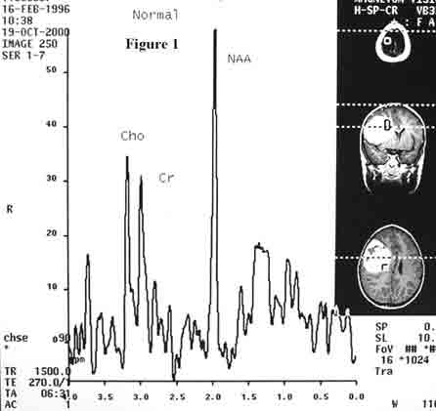
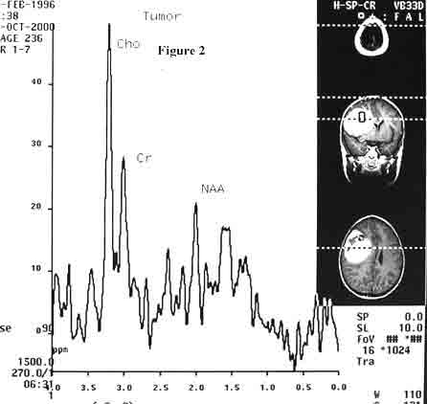
RADIATION NECROSIS TUMOUR RECURRENCE

Slide 58
V. DIFFERENTIATION OF INTRACRANIAL RING ENHANCING LESIONS
1. Necrotic brain tumors Vs abscess
MRS in
Pyogenic abscess - shows lactate
- amino acid peaks like valine and leucine
Necrotic areas of tumors - show only lactate peak
Further, anaerobic brain abscesses- acetate and succinate, which are not seen in aerobic ones.

Slide 59
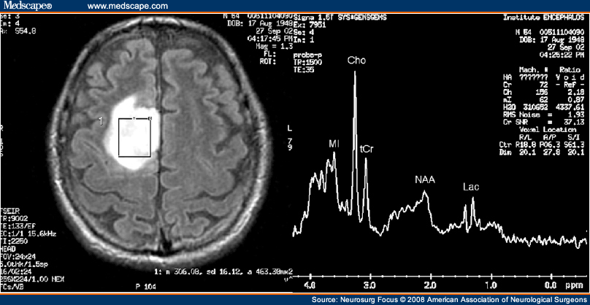
PYOGENIC ABSCESS VS BRAIN TUMOUR

Slide 60
2. Pyogenic Vs Tubercular abscess
Pyogenic - lipid, lactate and amino acids- valine, leucine
Tubercular abcesses - only lipids and lactate
TB abscesses vs necrotic tumors
Both show only lipids and lactate, but necrotic high grade tumors also show significantly elevated Cho / NAA ratios.

Slide 61
3. NCC Vs Intracranial tuberculoma
NCC- shows an extremely low levels of metabolites.
TB- primarily lipid peak at 0.9 and 1.3 ppm (d/t large lipid
fraction present in mycobacteria).
Recent studies –
Tuberculomas show inc. Choline and low Cr with
Cho/Cr ratio >1 in tuberculomas as compared to NCC.

Slide 62
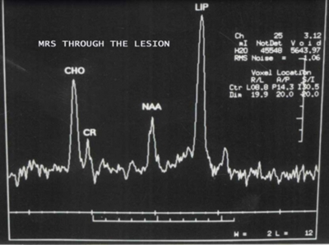
NCC TUBERCULOMA

Slide 63
C. MRS IN EPILEPSY :
Conventional MRI - normal in some cases of mesial temporal lobe epilepsy.
MRS - metabolic changes that precede imaging findings, like
low NAA, NAA/ (Cho+ Cr) in ipsilateral hippocampus.
- NAA/Cr - reduced in ipsilateral frontal lobe in frontal
lobe epilepsy.
31P MRS- pH and Pi, in involved frontal lobe/ hippocampus.
Changes persist interictally - helps to lateralize epileptic focus.
Pre-op planning of epilepsy surgery.

Slide 64
VI. NEURODEGENERATIVE DISEASES
1. Alzheimers disease
Diagnosis is achieved – at autopsy
AD vs NPH
MRS – AD - Dec. NAA , NAA/Cr in fronto-parietal, temporal lobes
and hippocampus
- Increased myo-Ionositol is hallmark of AD
- mI /Cr increased (help to diff. from other dementia)
NPH - NAA/Cr is unchanged.
31 P MRS - Inc. PME, dec. PCr in initial stages of AD.
- As dementia worsens, level of PME dec and PCr
inc.

Slide 65
NORMAL BRAIN VS ALZHEIMERS

Slide 66
VII. MRS in Demyelinating diseases
1. Multiple sclerosis
Hyperacute plaques - normal spectrum
Acute active plaques
- Enhance with Gd-DTPA
- Raised lactate and mobile lipids and so called
“marker peaks” in 2.1-2.6 ppm (not seen in
children)
Chronic plaques - mI (myoinositol).
NAA or NAA/Cr is a good surrogate marker for monitoring of response to treatment in MS.
Myo-Ionositol level detected when disease process is severe.

Slide 67
AGE VARIATIONS
CHILD
2 Days Choline & mI are high, NAA is low
Lactate present in preterm and small for date infant, present till 40 weeks
. 2 Months All are roughly equal
. 2 Years Adult pattern, increased NAA and low choline

Slide 69
F. HEAD TRAUMA:
To evaluate tissue viability following trauma.
Helps to decide and whether RX is effective.
MRS in injured region
- highly lactate - due to ischemia
- NAA, Cr, Cho - due to edema (dilution effect).
Diffuse axonal injury
- grossly normal CT
- significant NAA/Cr and NAA/Cho in splenium of patients
- correlating well with severity of head injury.

Slide 70
G. MRS in STROKE
Acute stroke-
- NAA and lactate level - in area of infarct.
- Correlates clinically with functional outcome and
disability.
In ischemic penumbra - lactate without dec in NAA.
Chronic infracts - raised lactate levels.(??? Lactate may be
present in low level)

Slide 71
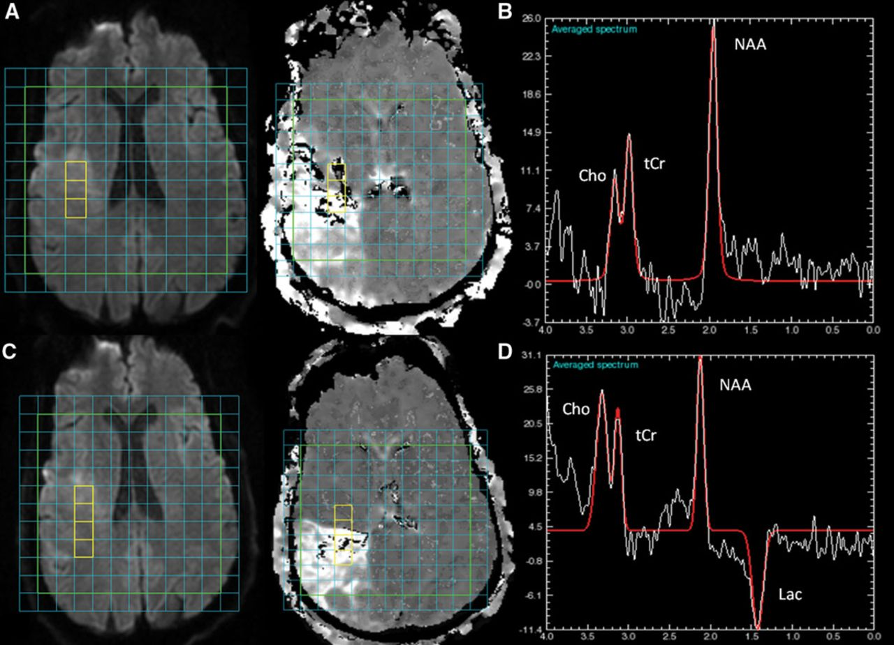

Slide 72
Leukodystrophies:
MRS can detect secondary changes that result from these disorder - help in diagnosis.
Ex : High NAA — Canavans disease
High phenylephrine (7.3 ppm ) — PKU
Abnormal lipids— Niemann pick disease
High glycine ( at )— Non ketotic hyperglycemia.
High lactate— Mitochondrial disorders

Slide 73
Notes:
Spectroscopy is extremely helpful in differentiating Canavan disease from Alexander disease; clinical features (megalencephaly and diffuse demyelination) overlap. Canavan disease, however, has raised NAA levels because of deficient levels of the enzyme N-acetyl aspartase (Figure 2).¹³⁻¹⁵

Slide 74
HYPOXIC ISCHEMIC INJURY
MRI - may be normal in first
few days, DWI shows
changes in 2-4 days
MRS - Appearance of
lactate
- Loss of NAA ,Cr
- Increase of Glx, Cho
. Persistent lactate at 1 yr is poor prognostic sign

Slide 75
MRS OF PROSTATE
Combined with MRI
- To differentiate benign conditions from Ca
prostate
- Intraglandular cancer localization and staging
- Tumor volume estimation
- Assessment of cancer aggressiveness.
Pref use endorectal coil. Use 1H MRS,
Peaks for choline, creatine and polyamines overlap in regions of healthy prostate tissue. So we consider them together but actually increase in choline is pathological.
Citrate is present in normal cells and decreases in cancer and so ratio choline+creatine : citrate is most specific.
Chances of % malignancy if ratio is > than normal > than twice or thrice

Slide 76
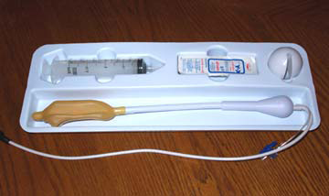
MRS OF PROSTATE

Slide 77
MRS BREAST
1H MRS is commonly used - more sensitive than 31P.
Multichannel phased array coil.
SVS is more sensitive and commonly used.
Adipose tissue - abundant in breast, absent in brain. Can cause contamination of spectra.
Voxel placement – most important
Placed to cover as much of lesion as possible while excluding surrounding adipose and fibroglandular tissue.
Use of long TE – 135 to 350 ms
To reduce amplitude of lipid and water signals through natural T2 relaxation effects that still allows assessment of pathological lipid signals.
t Cho – at 3.2ppm-- most important metabolite.
To diff benign from malign,
To monitor Rx,

Slide 78
APPLICATIONS
Benign Vs malignant
-Raised tCho in malignant lesions.
-Some benign pathologies
Fibroadenoma detectable levels of
Tubular adenomas tCho at 1.5 T
Lactating subjects

Slide 79
THANK YOU
- Dr. Azharuddin Syed
JR II

