Slide 1
BARIUM SWALLOW
DR. NILESH PANDIT
ASST PROF
DR PURNACHANDRA LAMGHARE
PROFESSOR

Slide 2
Fluoroscopic imaging of the esophagus.
Evaluation of swallowing.
Also imaging of the oropharynx and of stomach to some extent.
Using Barium sulphate preparations.

Slide 3
SWALLOWING
Deglutition.
Passage of bolus from oral cavity to stomach via pharynx and esophagus.
Protection of airway.
Inhibition of air entry into the stomach.
Three phases – oral, pharyngeal, esophageal.
Esophageal phase – primary, secondary, tertiary waves.
Notes:
Oral preparatory phase – chewing and mixing with saliva. Bolus formation. Oral phase proper. Laryngeal elevation. Esophageal stage – 10 -15 sec.

Slide 4
TECHNIQUE

Slide 5
INDICATIONS

Slide 6
CONTRAINDICATIONS

Slide 7
MODIFICATIONS

Slide 8
ESOPHAGUS
25-40 cm long with a diameter of 1-2 cm.
Four layers.
Three parts –
Cervical.
Thoracic.
Abdominal.
Two sphincters –
Upper – cricopharyngeus.
Lower – vestibule.
Three normal constrictions –
Cervical – cricoid cartilage.
Thoracic – aortic arch.
Abdominal – diaphragmatic hiatus.

Slide 9
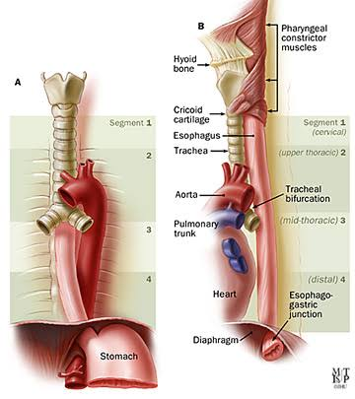

Slide 11
SPHINCTERS
Upper esophageal –
Cricopharyngeal muscle.
C5-C6 level
Relaxes with bolus
Lower esophageal –
Distal 2-4 cm high pressure zone – vestibule.
Prevents GER.
Can be mistaken for hiatal hernia.

Slide 12
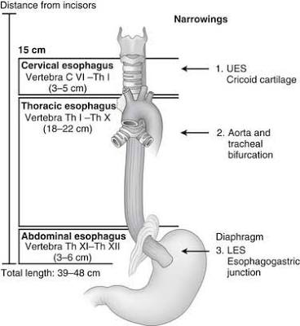

Slide 13
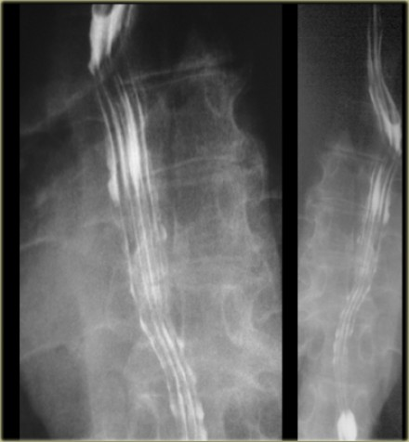

Slide 14
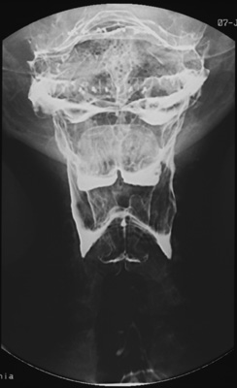

Slide 15
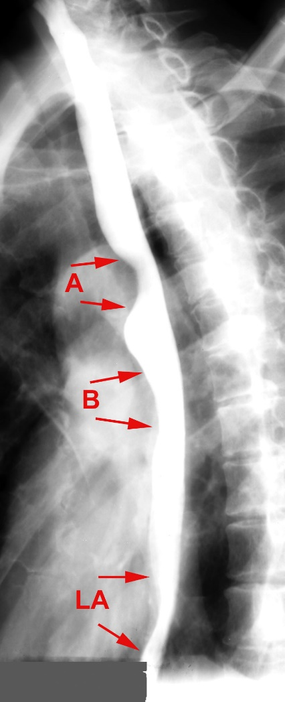

Slide 18
PERISTALSIS
Primary –
Propels bolus.
Secondary –
Propels remaining food.
Tertiary –
Non propulsive.
Abnormal.
Diffuse esophageal spasm –
Intermittent contraction of mid & distal part.
Cork screw appearance.

Slide 19
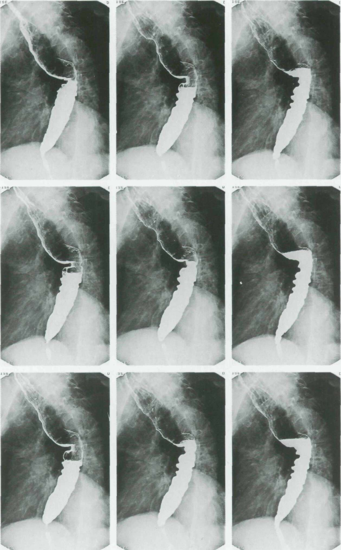

Slide 20
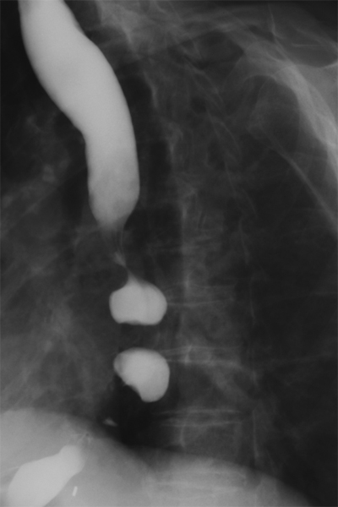

Slide 21
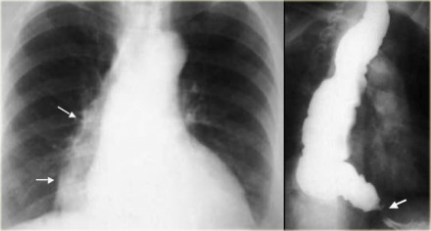

Slide 22
ACHALASIA
Impaired relaxation of LES.
Gradually progressive dysphagia for both solid & liquids.
Chest pain, regurgitation.
Abnormal opacity with air fluid levels in mediastinum.
Bird beak sign, smooth tapering.
Pooling/stasis of barium in esophagus.

Slide 23
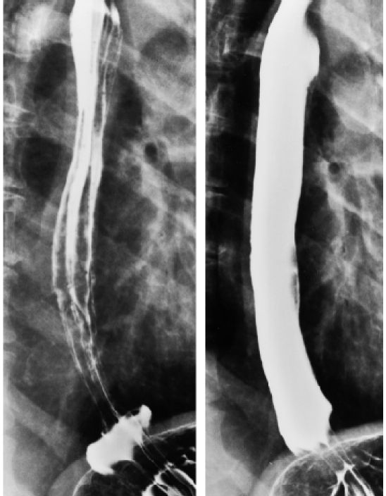

Slide 24
REFLUX ESOPHAGITIS
Most common inflammatory disease.
Reflux of gastric content due to dysfunction of LES.
h/o of episodic heartburn & regurgitation, worsening on lying down.
Double contrast esophagography.
Abnormal motility, mucosal nodularity, ulceration, thickened folds, scarring/ stricture.

Slide 25
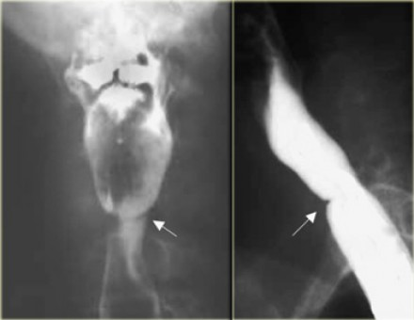

Slide 26
WEB –
Hypopharynx & proximal esophagus.
Majority from anterior wall.
Symptomatic if lumen obstruction by 50%.
Plummer-Vinson syndrome.

Slide 27
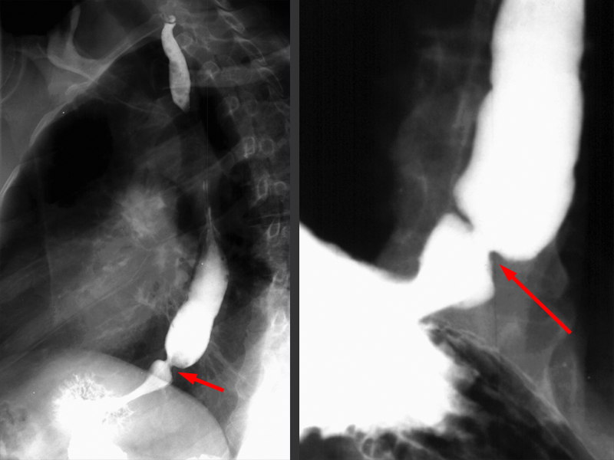

Slide 28
SCHATZKI RINGS –
Lower esophageal ring.
Stenotic ring that causes dysphagia.
C.C. – episodes of severe chest pain, uncomfortable sensation in lower chest.
Ba swallow – thin, 2- 4 mm in height, luminal opening of less than 13 mm diameter.

Slide 29
DIVERTICULUM
Pulsion – Mucosa & submucosa herniating through muscular layer.
Traction – All three layers.

Slide 30
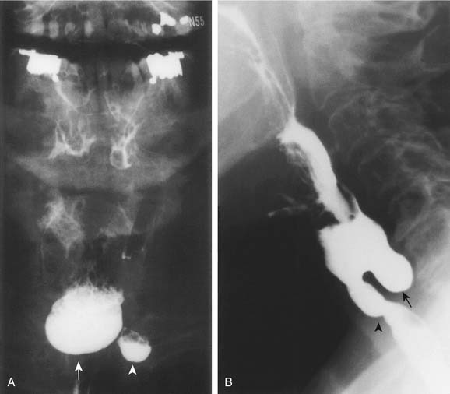

Slide 31
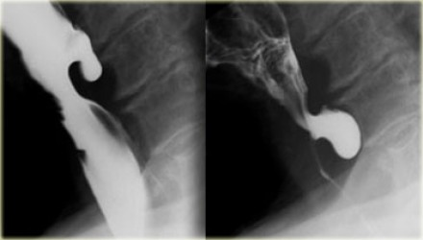

Slide 32
ZENKER’S DIVERTICULUM
Posterior hypopharyngeal diverticulum.
Pulsion type.
Through area of weakness between horizontal and oblique components of cricopharyngeus – Killian’s dehiscence.
Dysphagia, regurgitation of undigested food, hoarseness, halitosis, neck mass.
Air – fluid level in neck.
Posterior, midline bulge above cricopharyngeus.

Slide 33
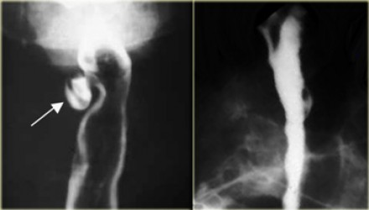

Slide 34
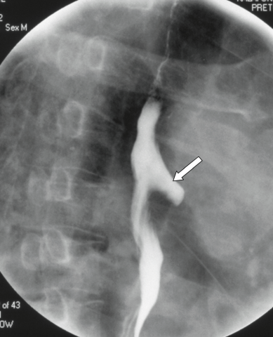

Slide 35
KILLIAN-JAMIESON DIVERTICULUM –
Pulsion type.
Below the cricophyaryngeus.
Lateral.
EPIPHRENIC DIVERTICULUM –
Pulsion type.
AORTOPULMONARY WINDOW DIVERTICULUM –
Traction diverticulum.
Granulomatous disease.

Slide 36
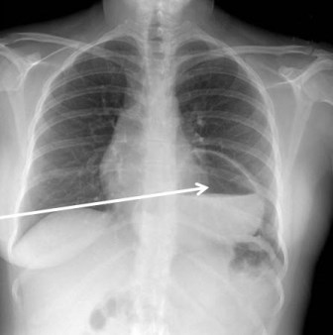

Slide 37
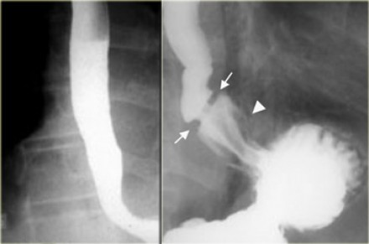

Slide 38
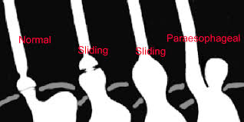
HIATUS HERNIA
Sliding –
GE junction >2cm above hiatus.
>95 %
Paraesophageal –
Fundus herniates through hiatus.
GE junction normal.
Mixed –

Slide 39
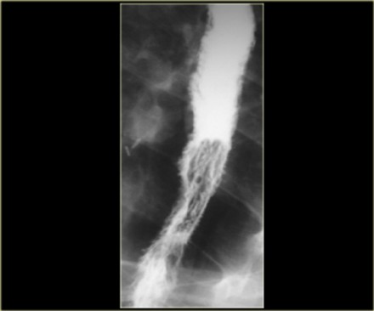
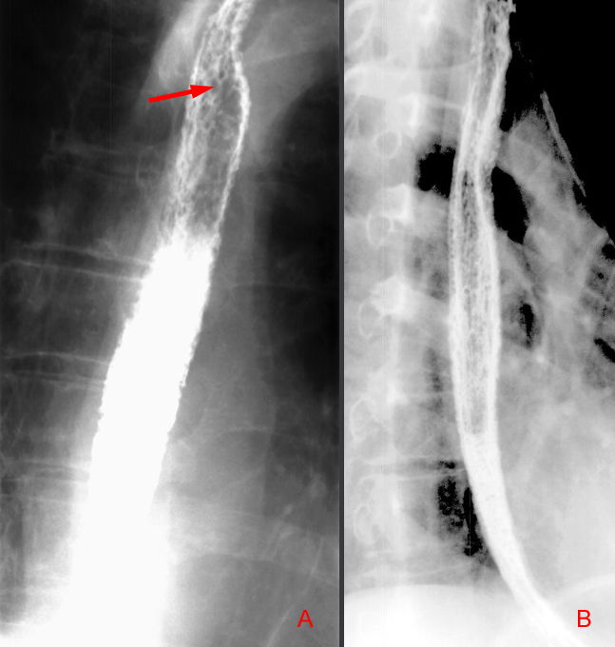

Slide 40
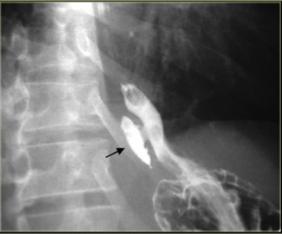

Slide 41
ESOPHAGITIS
CANDIDA
Double contrast study
Longitudinally oriented Small plaques.
Fine granular appearance secondary to mucosal edema & inflammation.
HERPES –
Severe substernal chest pain during swallowing.
Discrete, superficial ulcers in midesophagus without plaques.
CMV
Giant ulcers.

Slide 42
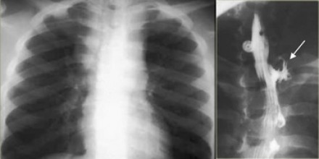

Slide 43
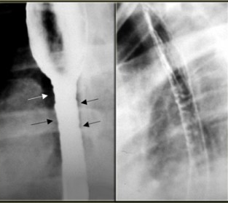

Slide 44
TB
Direct extension from adjacent lesions.
Sinus tracts.
Ulcers.
EOSINOPHILIC
h/o allergies.
Dysphagia.
Diffuse narrowing, strictures, corrugated margins.

Slide 45
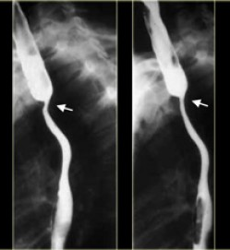

Slide 46
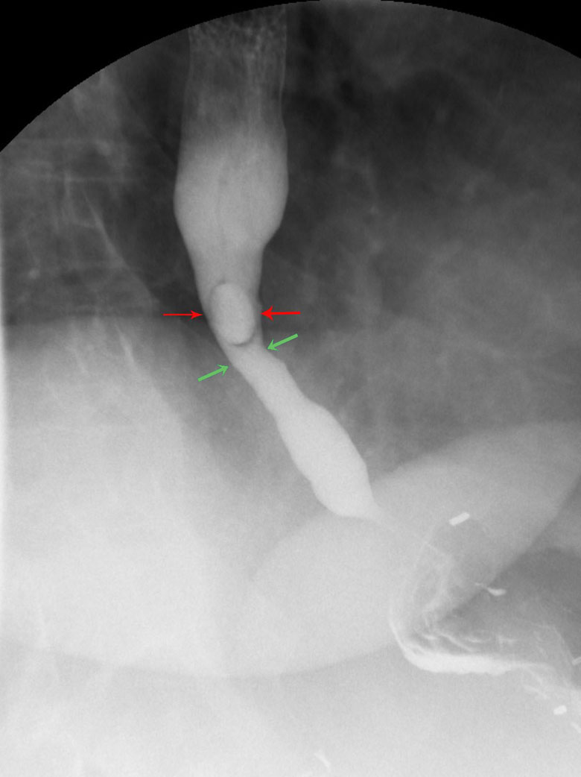

Slide 47
STRICTURES
Reflux esophagitis.
Barrett’s esophagus.
Corrosive poisoning.
Esophagitis.
Radiotherapy.
Benign pemphigoid.
GVHD.

Slide 48
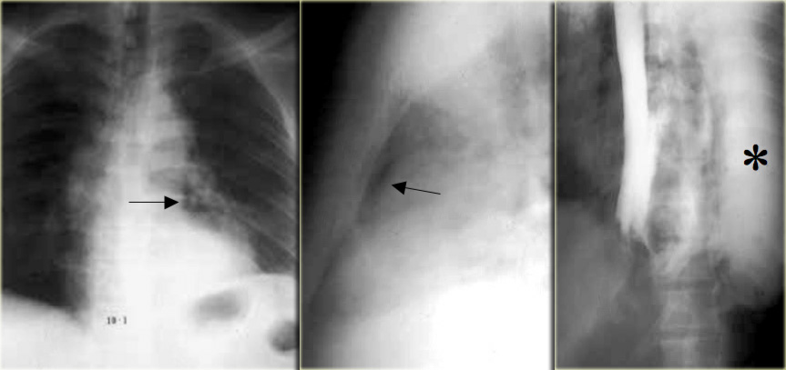

Slide 49
BOERHAAVE SYNDROME
Rupture of wall – distal left posterolateral 1-4 cm, transmural/ full thickness tear.
Water soluble contrast.
Excessive vomiting in eating disorder, alcoholic binge, excessive coughing, trauma.
Pneumomediastinum.
Left pleural effusion.
Left pneumonthorax.
Extravasation of contrast material.

Slide 50
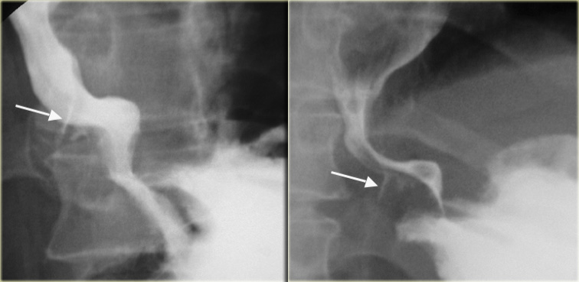

Slide 51
MALLORY-WEISS TEAR
Sudden increase in intra esophageal pressure.
Prolonged forceful vomiting.
Linear mucosal laceration.
Partial thickness tear of mucous membrane.
Hematemesis.
Diagnosis always by endoscopy.
Linear 1-4 cm longitudinal collection in distal esophagus.

Slide 52
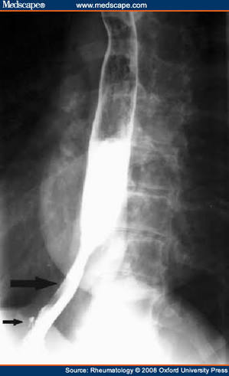

Slide 53
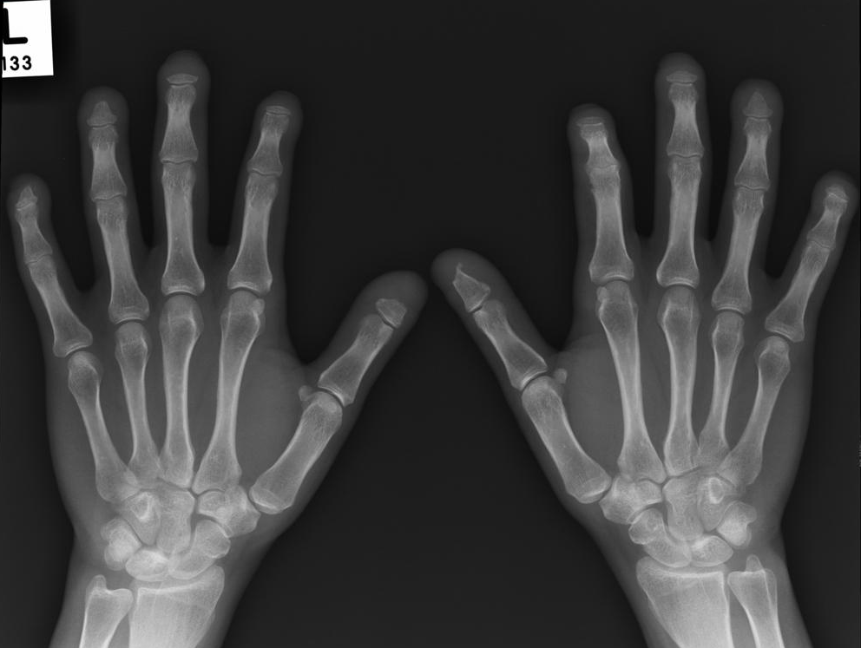

Slide 54
SCLERODERMA
Collagen vascular disease.
Diffuse fibrosis.
75-85 % with esophageal involvement.
Aperistalsis due to disruption of smooth muscles including LES.
Dilatation with dysmotility of distal esophagus.
Apparent shortening due to fibrosis.
GER due to dysfunction of sphincter.

Slide 55
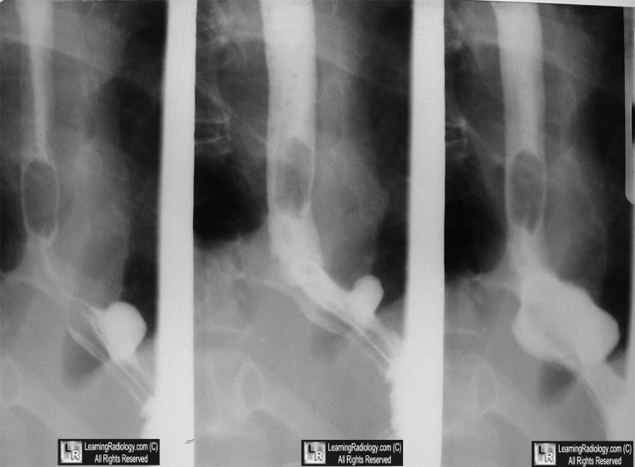

Slide 56
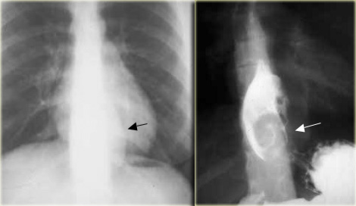

Slide 57
LEIOMYOMA
Most common benign esophageal neoplasm (50%).
Slowly progressive, often large but nonobstructive, calcified.
Distal third – 60 %
Asymptomatic, intermittent dysphagia, substernal pain.
Soft tissue mass in posterior mediastinum, punctate areas of calcification.
Smooth submucosal masses, round or ovoid filling defects, obtuse angle with esophageal wall.
At GE junction, can involve cardia & fundus, causes severe dysphagia.

Slide 58
A calcified esophageal mass
Is almost always
leiomyoma

Slide 59
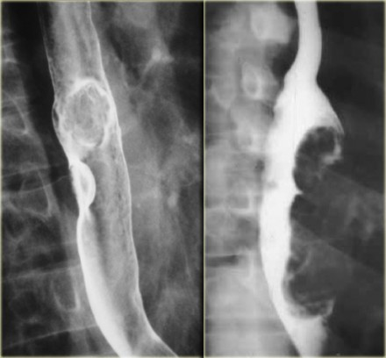

Slide 60
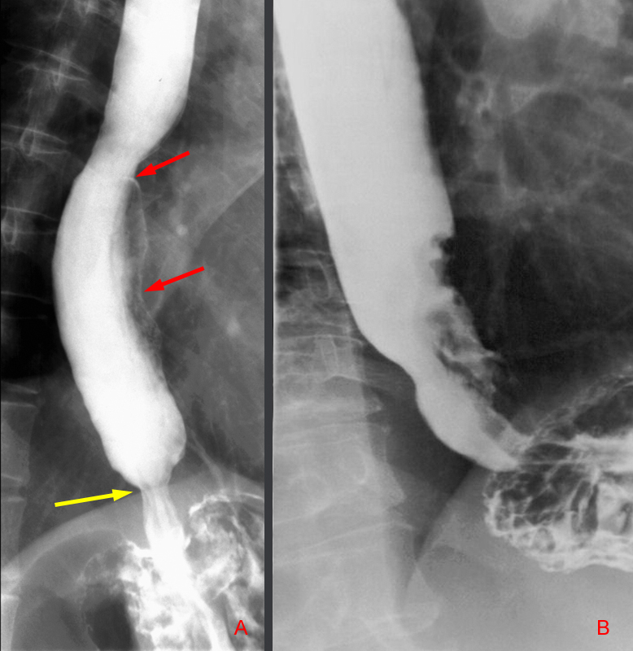

Slide 61
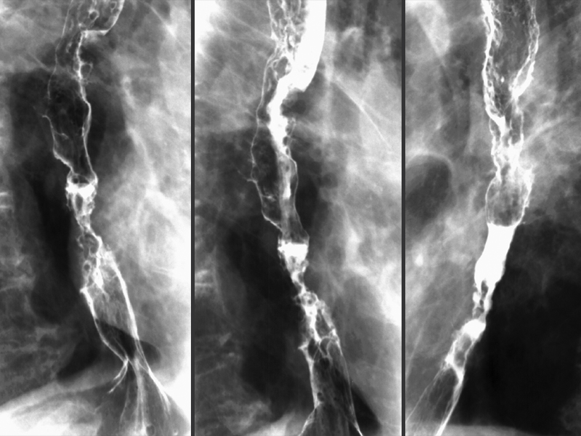

Slide 62
CARCINOMA
Tobacco, alcohol – major risk factors.
Majority are squamous type.
Adeno CA – lower part, longer segments.
Symptomatic after 50-75% lumen obstructed.
Dysphagia, more to solids.
Widening of mediastinum, retrocardiac mass, widened azygoesophageal recess, tracheal deviation.
Infiltrating, irregular, polypoidal, ulcerative or varicoid mass.
Narrowing of lumen, shouldering.
Rat tail appearance.

Slide 65
VARICES

Slide 66
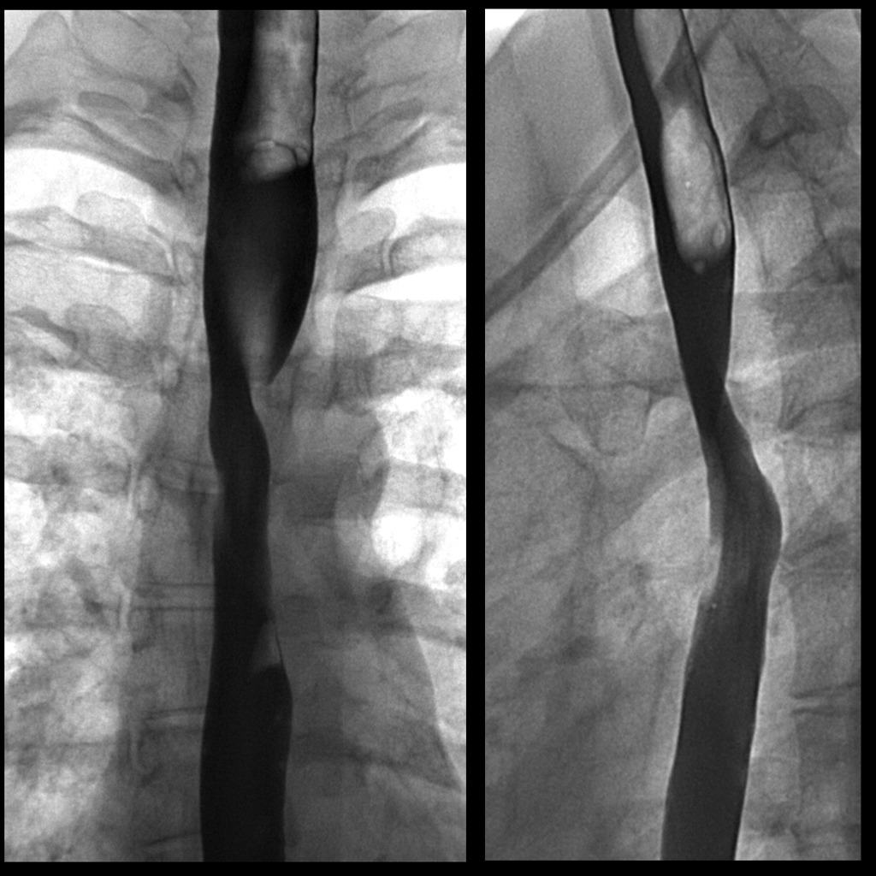

Slide 67
ABERRANT RIGHT SUBCLAVIAN ARTERY

Slide 68
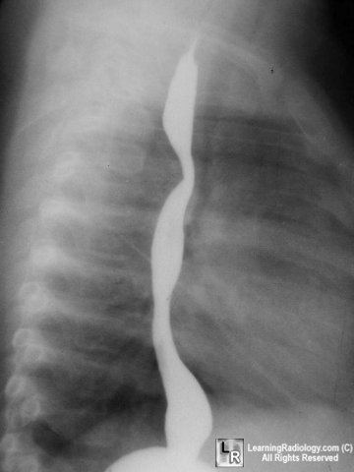

Slide 69
DOUBLE AORTIC ARCH
Persistence of R and L IV branchial arches
Passes on both sides of trachea
Joins posteriorly behind esophagus
Right arch is larger and higher
Left arch is smaller and lower
Barium swallow shows bilateral impressions on frontal view and Posterior impression on lateral view

Slide 70
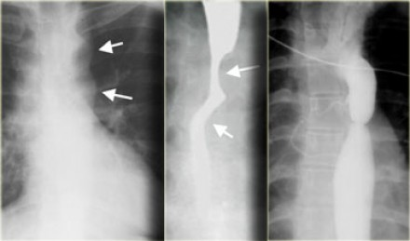

Slide 71
COARCTATION OF AORTA

Slide 72
THANK YOU..!!!

