Slide 1
INHERITED METABOLIC DISEASES
Dr. Azharuddin Syed
JR III

Slide 2
White matter disease can be broadly grouped into:
Dysmyelinating : Abnormal structure and function of myelin , usually secondary to a hereditary disorder.
Demyelinating :Damage or destruction of previously normally myelinated structures.
Hypomyelinating : Reduction in the amount of myelination .

Slide 5
Approach to pediatric white matter lesions
(predominantly)Sub cortical white matter lesion.
early involvement of U fibers.
(predominantly)Deep white matter lesion.
early sparing of u fibers.

Slide 6
Sub cortical deep white matter lesion
Normocephally
Zellweger syndrome
Gallactosemia
Kearn sayer disease
Macrocephally
Canavan disease
Alexander disease
Vanishing white matter disease.
Megalencephalic leucoencephalopathy
with cyst.

Slide 7
Deep white matter lesion
Thalamic involvement
Krabbes disease
Gangliosis GM1& GM2
Tay –sach disease
Non thalamic involvement
Corticospinal tract
Adrenoleucodystrophy
Mapple syrup urine disease
No corticospinal tract
Metachromatic leucodystrophy
Mucopolysacchariodoses
Pelizaeus Merzbacher disease

Slide 8
Leucodystrophy mimic's
Subacute sclerosing
panencephlitis
Acute disseminated
encephallitis
Periventricular
leucomalacia
Lymes
disease

Slide 9
Canavan disease
spongiform degeneration of white matter
deficiency of N- acetylaspartoacylase.
it has a predilection for subcortical U fibers.
Clinical feature:
Megalocephaly.
Mental deficits .
Blindness.

Slide 10
MRI
Megalencephaly.
There is typically a diffuse bilateral involvement of sub cortical U fibres, perivenricular & deep white matter , thalami & globus pallidus.
T1 - low signal.
T2 - high signal.
MR spectroscopy - markedly elevated NAA .
There is no enhancement of affected region.

Slide 11
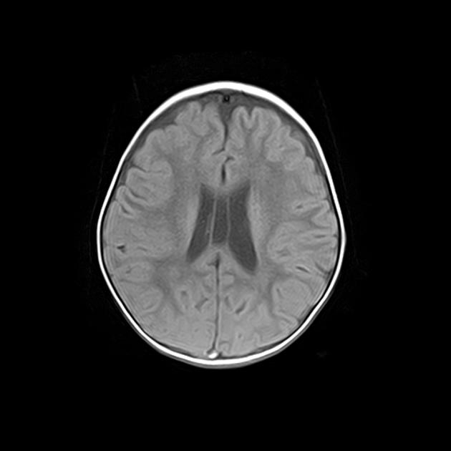
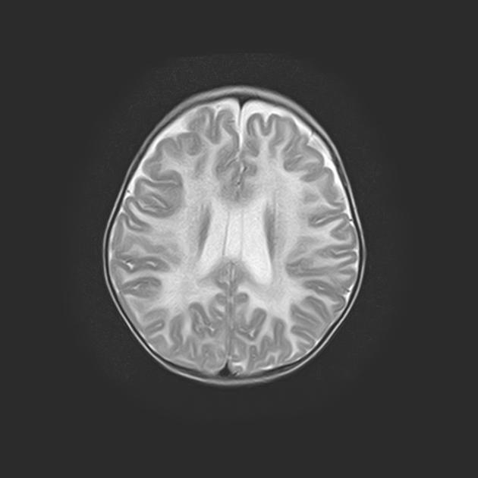
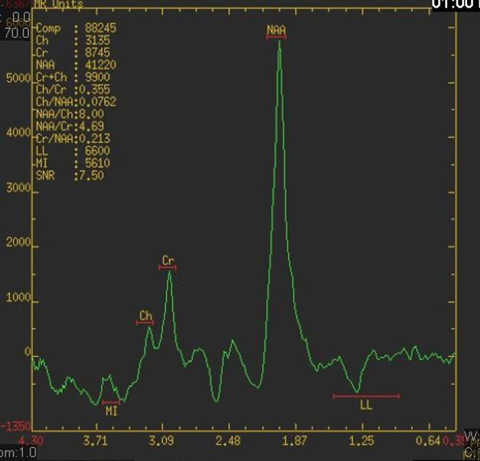
T2
T1
T2

Slide 12
Alexander disease
fibrinoid leukodystrophy.
Defect in gene for glial fibrillary acidic protein (GFAP)
Clinical presentation
Macrocephaly
progressive quadreparesis
intellectual failure.

Slide 13
begins in frontal region and extends posteriorly.
End stage disease is characterised by contrast enhancing cystic leukomalacia.

Slide 14
MRI
T2 - hyper intense.
bifrontal white matter which tends to be symmetrical
caudate head > globus pallidus > thalamus > brain stem
periventricular rim.
C + (Gd) - enhancement.

Slide 16
Vanishing white matter disease
childhood ataxia with central hypomyelination (CACH)
preceded by a minor head trauma or infection.

Slide 17
Diagnostic criteria :
1. initially psychomotor development is normal.
2.onset of neurologic deterioration is episodic with chronic progressive course, and occurs in childhood.
3.neurologic signs typically include:
cerebellar ataxia
spasticity
optic atrophy
epilepsy
motor functions, disproportionately affected.
4.Imaging (MRI) bilateral and symmetric cerebral hemispheric white matter signal intensity, similar to CSF.

Slide 18
MRI
White matter is diffusely involved, ( peri ventricular white matter to the subcortical arcuate fibres. )
Over the time white matter vanishes & replaced by near-CSF intensity fluid ( it attenuates on FLAIR).
Cerebellar atrophy and typically involves the vermis.
MRS: only lactate and glucose peaks remain.

Slide 19
T2
FLAIR
T2
FLAIR

Slide 20
Megalencephalic leuckoencepalopathy
Van der Knapp disease .
diffuse leukoencephalopathy associated with cystic degeneration of the white matter of the brain.

Slide 21
MRI Brain
megalencephaly with bilateral cystic lesions of CSF intensity particularly affecting the anterior temporal lobes.
wide diffuse signal abnormality.

Slide 22
T1

Slide 23
Zellweger syndrome
Cerebro- hepato -renal syndrome.
Deficiency of multiple peroxisomal enzyme.
Renal (Antenatal ultrasound)
hyperechoic kidneys.
Hepatic(Ultrasound)
hepatomegaly.

Slide 24
MRI
abnormal gyration patterns
Pachygyria :specially medial gyri .
Polymicrogyria : laterally.
MRS: increase lipid & lactate & decrease NAA.

Slide 25
T2

Slide 26
Kearn sayer disease
Mitochondrial disorder.
Diagnosis require:
opthalmoplegia
retinitis pigmentosa
on set of neurological disfunction <20 yr.
Cardiac conduction defect

Slide 27
MRI BRAIN.
Involve subcortical white matter & putamen,thalamus & globus pallidus.
Cerebral, cerebellar and brainstem atrophy.
T2:hyperintense.
MRS: increase lactate & low NAA.

Slide 29
Krabbe’s disease
( globoid cell leukodystrophy)
Deficiency of galactocerebroside ß- galactosidase.
Clinical presentation
Hypertonia.
Irritability.
delayed milestones.
loss of developed milestones.
Fever.
Myoclonus.
Opisthotonus.
Nystagmus.

Slide 30
MRI brain
T2 - high signal ( periventricular white matter, Thalamus & basal ganglia, centrum semiovale and deep gray matter).
subcortical U fiber spared.
T1 C+ (Gd) - no contrast enhancement.
MR spectroscopy
abnormal choline elevation in centrum semiovale.

Slide 32
Adrenoleukodystrophy
deficiency of Acyl Co A synthatase.
Resulting into accumulation of very long chain fatty acids.
The cerebral white matter is typically split into three different zones:
central (inner) zone - irreversible gliosis and scarring
intermediate zone - active inflammation and breakdown of the blood-brain barrier.
peripheral (outer) zone - leading edge of active demyelination

Slide 33
MRI Brain
involve the posterior periventricular white matter (posterior cerebral, around splenium and peritrigonal white matter & internal capsule).
There is relative sparing of sub-cortical u fiber involvement.
T1:central zone - hypo intense.
intermediate zone - ?
peripheral zone - ?
.
T1 C+ (Gd) - serpiginous, garland-shaped enhancement.
T2 :
central zone - markedly hyper intense
intermediate zone - ?
peripheral zone - ?
MR spectroscopy
decrease in the NAA peak and an elevation in the lactate peak.

Slide 34
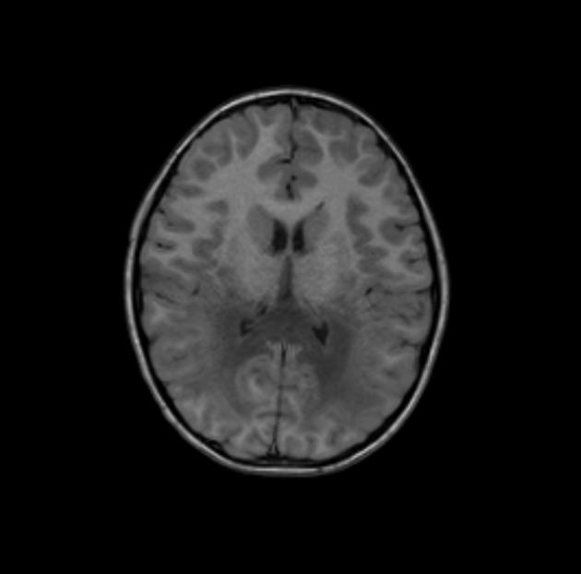
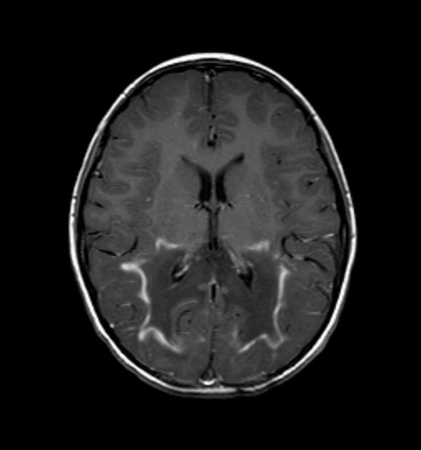
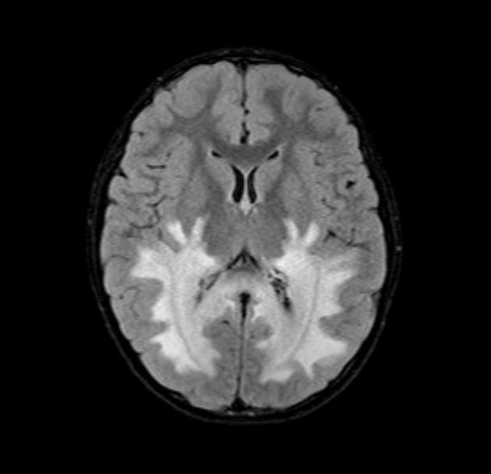
T1
T2
T1C
FLAIR

Slide 35
Maple syrup urine disease
Inborn error of amino acid metabolism.
Elevated plasma concentrations of branched-chain amino acids.
Clinical presentation
Manifests itself in the first few days of life (12-24 hours) with the complex of symptoms which include.
poor feeding
vomiting
ketoacidosis
hypoglycemia
lethargy
seizures
a characteristic odour of maple syrup

Slide 36
MRI – brain
diffuse swelling of the brain due to extensive edema of the white matter.
DWI - the posterior limbs of the internal capsules and optic radiations and the central corticospinal tracts within the cerebral hemispheres exhibit diffusion restriction.
The structures in the posterior fossa exhibit prominent changes in signal intensity, swelling, and diffusion restriction.
MRS: lactate peak & branched chain amino acid peak.

Slide 37
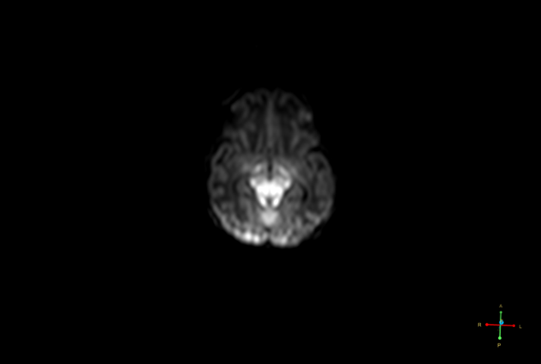

Slide 38
Metachromatic leukodystrophy
most common hereditary leukodystrophy.
deficiency of an enzyme Arylsulphatase.
Clinical features.
gait abnormality, muscle rigidity, loss of vision, impaired swallowing, convulsions, dementia.

Slide 39
MRI Brain
involve bilateral symmetrical periventricular white matter.
sparing of subcortical U fibers.
T1 - low signal
T1 C+ (Gd)
​ no enhancement.
T2 - high signal and shows a “tigroid pattern“
MR spectroscopy - (of affected white matter)
reduced N -acetylaspartate.
increased myo -inositol
increased choline

Slide 40
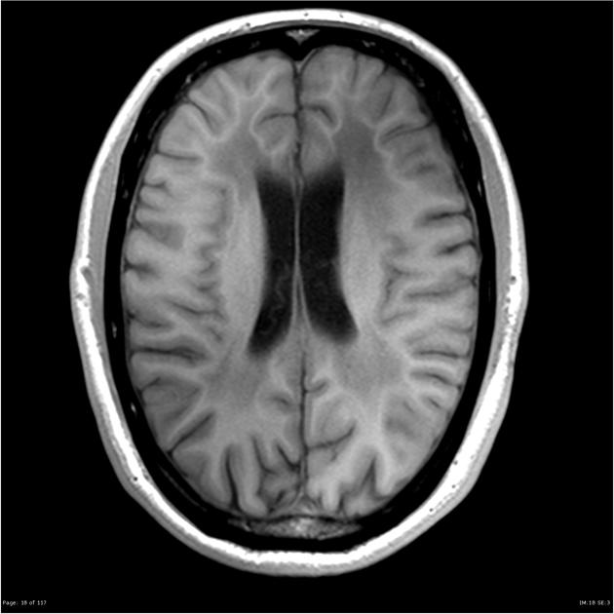
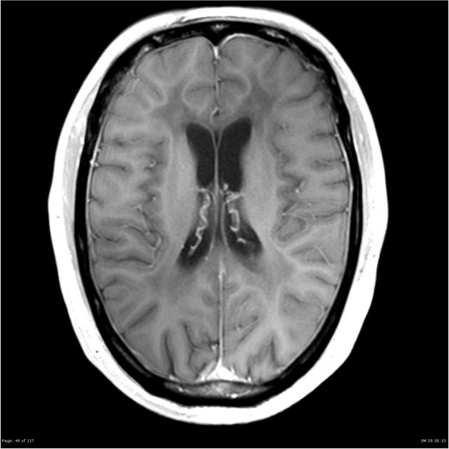
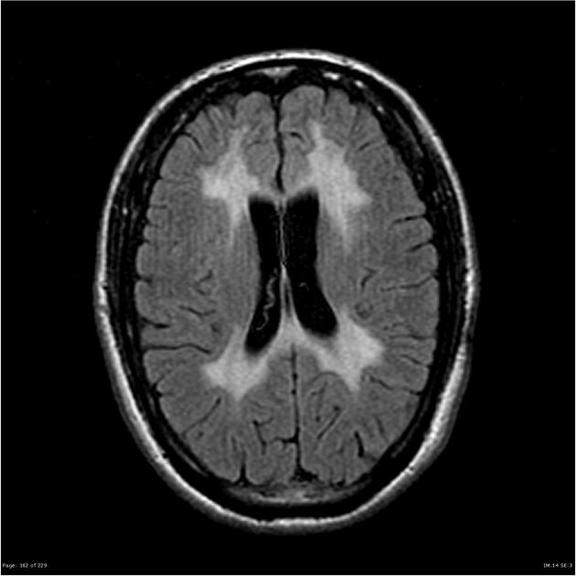
T1
T1C
T2
FLAIR

Slide 41
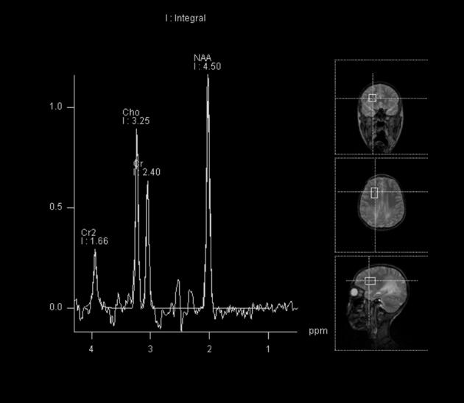
MRS of affected white matter with TE=30
MRS of normal anterior white matter with TE=144

Slide 42
Pelizaeus Merzbacher disease
Characterized by an arrest in myelin development.
It occurs from a derangement in the proteolipidprotein.
Clinical presentation:
pendular eye movements
Hypotonia.
pyramidal disease.

Slide 43
MRI
T2: hyper intensity (internal capsule, proximal corona radiata and the optic radiation).
patchy involvement: tigroid appearance.
MR may also show cortical sulcal prominence.
MR spectroscopy : reduction in the NAA peak .

Slide 45
Subacute sclerosing panencephalitis
Caused by a persistent infection of immune resistant measles virus.
Clinical presentation
gradual, progressive neuropsychological deterioration, consisting of personality change, seizures, myoclonus, ataxia, photosensitivity, ocular abnormalities, spasticity, and coma.
CSF analysis : elevated levels of gammaglobulin & anti measles anti bodies.

Slide 46
MRI
acute :patchy asymmetric involvement of white matter
typically in the temporal and parietal lobes.
Gradually more extensive white matter involvement ( corpus callosum and basal ganglia).
Eventually a generalised encephalomalacia develops.
T1 C+ (GAD) : enhancement .
MR spectroscopy
May demonstrate :
decreased NAA : from neuronal loss
increases in choline : from demyelination.
increase myo-inositol : from active gliosis.

Slide 48
Acute disseminated encephalomyelitis
Demyelination of white matter following a recent (1-2 weeks prior) viral infection or vaccination .
Grey matter, especially that of the basal ganglia.
cross reactivity to viral antigens.

Slide 49
Radiographic features
Appearances vary from small ‘ punctate ' lesions to tumefactive regions, which however have less mass effect than one would expect for their size.
Bilateral but asymmetrical Involvement of cerebral cortex, sub cortical grey matter.
T2 - high signal, with surrounding edema typically situated in subcortical locations.
T1 C+ (Gd) - punctate, ring or arc enhancement (open ring sign) is often demonstrated along the leading edge of inflammation.
DWI - there can be peripheral restricted diffusion; the center of the lesion, although high on T2 and low on T1 does not have increased restriction on DWI .

Slide 50
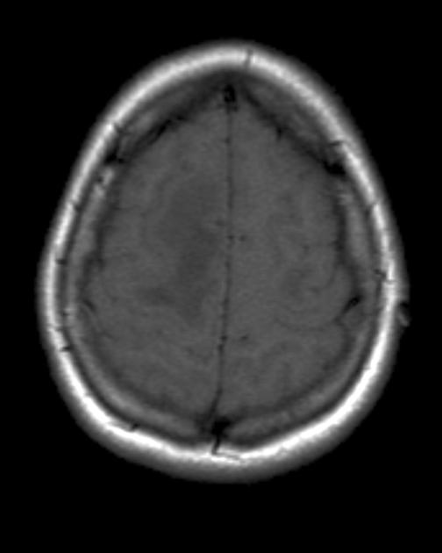
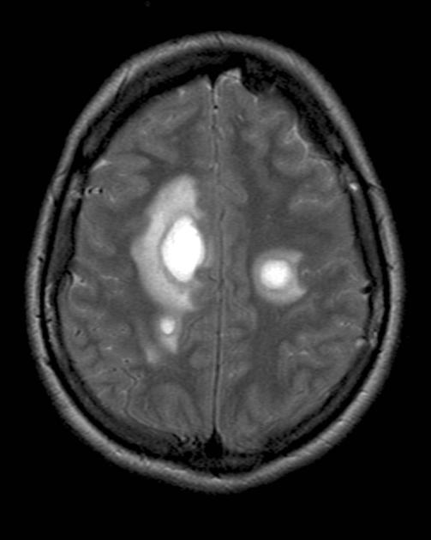
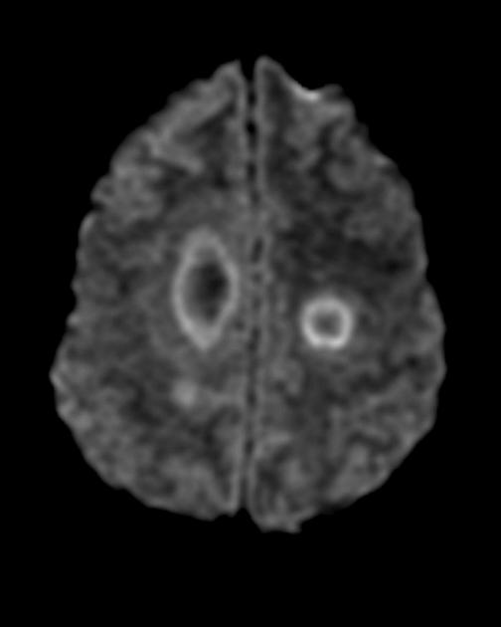
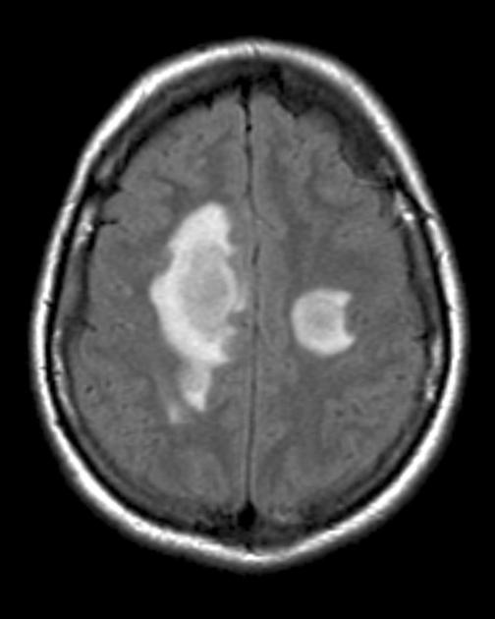
T1
T1C
T2
FLAIR
dwi

Slide 51
Periventricular leukomalacia
Hypoxic-Ischemic Encephalopathy (HIE) of the preterm.
premature infants born at less than 33 weeks gestation (38% PVL) and less than 1500 g birth weight .
The white matter necrosis occurs in a characteristic distribution (dorsal and lateral to the the lateral ventricles) and with involvement of the the centrum semiovale, the optic (trigone and occipital horns) and acoustic (temporal horn) radiations.

Slide 52
MRI
Initial MR images depict areas of T1 hypointensity within larger areas of T2 hyper intensity.
Progressive necrosis of the periventricular tissue with resulting
ventriculomegaly with irregular margins of the bodies and trigones of the lateral ventricles, loss of periventricular white matter with increased T2 signal, and thinning of the corpus callosum.

Slide 53
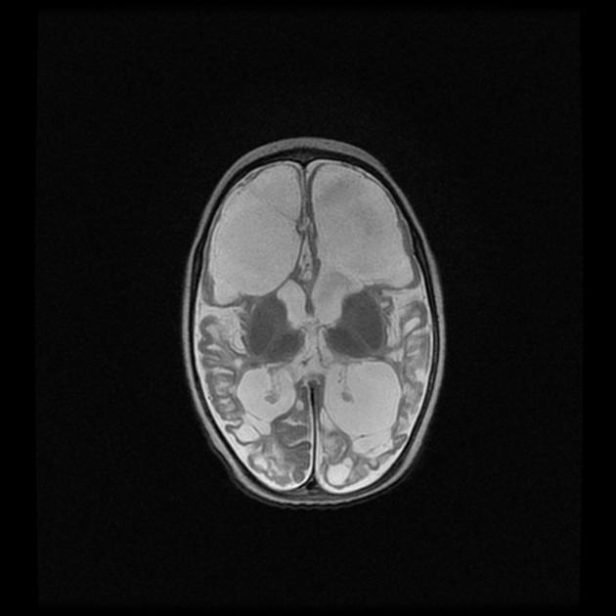
T1
T2

Slide 54
Summary
Sub cortical deep white matter lesion
Normocephally
Zellweger syndrome
(pachy & polymicrogyria)
Cerebral atrophy.
Kearn sayer disease
(putamen, thalamus & globus pallidus)
Macrocephally
Canavan disease ( increase NAA)
Alexander disease (B/L frontal lobe, enhancement)
Vanishing white matter disease.
Megalencephalic leucoencephalopathy
with cyst.(anterior temporal lobe)

Slide 55
DEEP WHITE MATTER LESION
Thalamic involvement
1.Krabbes disease
thalamus, basal ganglia
Increase choline in Centrum semiovale
Non thalamic involvement
Corticospinal tract
Adrenoleucodystrophy
Posterior fossa, tripple layer, enhancement.
Mapple syrup urine disease
Restricted diffusion in internal capsule, posterior fossa
No corticospinal tract
Metachromatic leucodystrophy
Tigroid pattern
2.Pelizaeus Merzbacher disease
Tigroid pattern ,cerebral atrophy
LEUCODYSTROPHY MIMICKS
Subacute sclerosing
Panencephlitis
Temporal & parietal region
Acute disseminated
encephallitis
Open ring enhancement

Slide 56
THANK YOU..

