Slide 1
INFLAMMATORY BOWEL DISEASES
Dr MAYUR MAHADULE
UNDER GUIDANCE OF DR NILESH SIR
ASSISITANT PROFESSOR
BJMC ,PUNE

Slide 2
Infammatory bowel disease.
A group of disorder characterised by intestinal inflammation, extra intestinal manifestations and relapsing course.

Slide 3
Epidemiology
The peak age of onset of UC and CD is between 15 and 30 years.
A second peak occurs between the ages of 60 and 80.
The male to female ratio for UC is 1:1 and for CD is 1.1–1.8:1.
UC and CD have two- to fourfold increased frequency in Jewish populations

Slide 4
Epidemiology
Urban areas have a higher prevalence of IBD than rural areas
High socioeconomic classes have a higher prevalence than lower socioeconomic classes.

Slide 5
Infammatory bowel disease.
Ulcerative colitis
Crohn’s disease
Ischaemic bowel disease

Slide 6
Modalities
1) Barium study
# Double contrast enema
# Barium meal follow through
# Enteroclysis
Presence and extent of disease, Better visualisation of mucosa.
Limitation in assessing extramural and extraintestinal extension.

Slide 7
2) USG-
Simple, non invasive, non ionising & easily available.
Detects complications like fistula and abscess.
Doppler shows increased vascularity in areas of active inflammation.

Slide 8
3) CT-
MDCT- MURAL EXTRA MURAL AND EXTRAINTESTINAL EXTENT.
VIRTUAL COLONOSCOPY-COLONIC DISTENTION IS REQUIRED, RISK OF PERFORATION.
CT PERFUSION – ACTIVE INFLAMMATION
RISK OF RADIATION IN FREQUENT FOLLOW UP PT.

Slide 9
4) MRI-
Good soft tissue resolution
Multiplanar capabilities
Non ionising radiation
Safe in pregnancy and renal failure.
Advantage- can diff between active inflammation and fibrosis.

Slide 10
5) PET CT
Non invasive
Localises active inflammation
Morphological and functional imaging in single examination.

Slide 11
Upper GI examination Techniques
Small bowel follow through / BMFT.
Small bowel enema / enteroclysis.
Per oral pneumocolon
Barium enema.

Slide 12
Barium meal follow through
Indications.
Contraindications.
Patient preparation.
Methods.
Technique.

Slide 13
Indications
Low suspicion of small bowel disease.
Suspected complete or near complete small bowel obstruction.
Suspected of suffering from Crohn’s disease.

Slide 14
Contraindications
Colonic obstruction
Suspected Perforation.
Paralytic Ileus.

Slide 15
TECHNIQUE
600-900ml ,50-60% Barium given to patient to drink this as rapidly as possible.
Patient put in right dependant position in order to increase the transit.
Film is taken after 15 -20 min with patient in prone position
Subsequent films are taken at 15-20 min interval till IC junction is visualized.

Slide 16
Patient is put in supine with right side up since ileum enters caecum posteromedial.
Four spot views of IC junction should be taken with variable amount of compression.
Atleast two spot films taken at different times must have the abnormality to demonstrate persistence of the lesion.

Slide 17
Enteroclysis/Small bowel enema
150-200 ml of barium (60ml/min) introduced using Bilbao-Dotter tube (tube tip 4-5 cm distal to duodenojejunal flexure).
When barium reaches distal ileum.
600-1000 ml of air (100 ml/min).
When air reaches distal ileum.
Antispasmodic agent is given.
Procedure of choice to demonstrate adhesions.

Slide 18
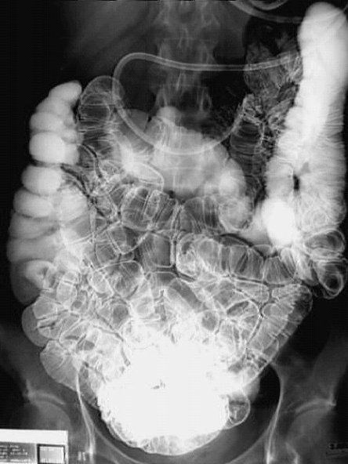
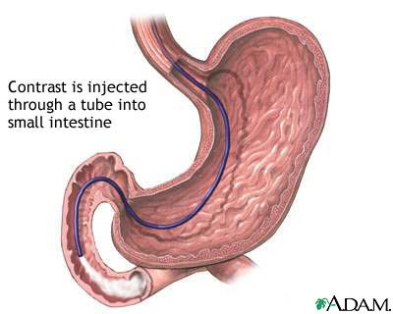
Enteroclysis
A tube is placed down through the stomach into the small intestine, often under endoscopic control.
Notes:
http://www.nlm.nih.gov/medlineplus/ency/article/003818.htm

Slide 19
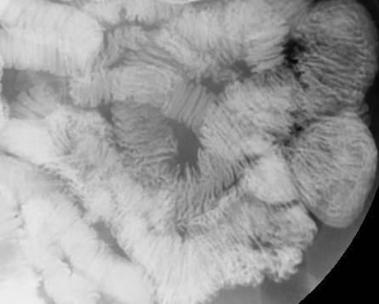
Enteroclysis
a
Jejunal mesentery
V
Jejunum
Eneteroclysis study showing the jejnum
The jejunum, has a feathery appearance due to the numerous folds, valvulae conniventes (plicae semi circulares)

Slide 20
Per oral pneumocolon
Done at the end of BMFT to evaluate terminal ileum.
Technique :When barium reaches right and proximal transverse colon ,air is insufflated into the rectum and refluxed in the distal ileum

Slide 21
Barium enema
A barium enema is given in order to perform an x-ray examination of the large intestine
During the procedure, a well lubricated enema tube is inserted gently into the rectum.
The barium is then allowed to flow into the colon.
A small balloon at the tip of the enema tube may be inflated to help keep the barium inside.
Notes:
http://www.nlm.nih.gov/medlineplus/ency/article/003817.htm

Slide 22
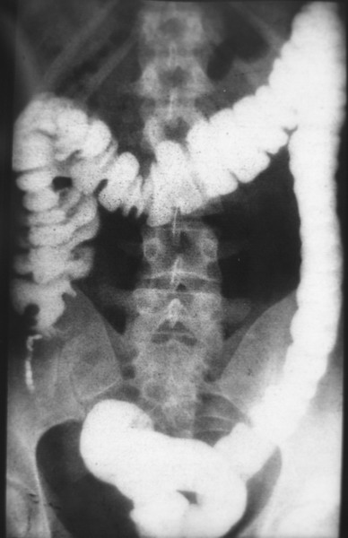
Barium enema
Single contrast barium enema

Slide 23
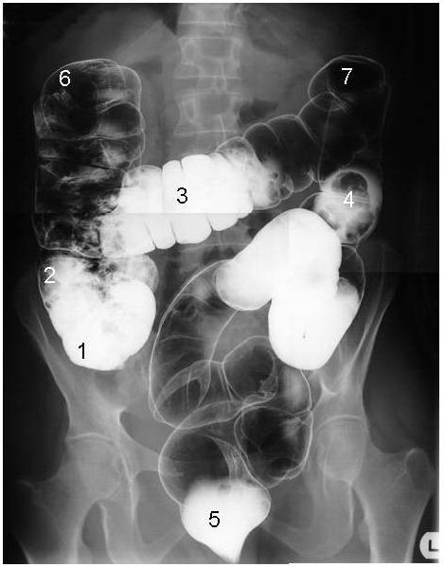
Barium enema
The flow of the barium is monitored on an x-ray fluoroscope screen.
Air may be puffed into the colon to distend it and provide better images –
a double contrast study
The enema tube is removed after the pictures are taken.
Double contrast barium enema
Notes:
http://www.nlm.nih.gov/medlineplus/ency/article/003817.htm
http://www.liv.ac.uk/HumanAnatomy/phd/mbchb/travel/ba3.html
http://www.liv.ac.uk/HumanAnatomy/phd/mbchb/travel/ba4.html
Note the caecum (1), ascending colon (2), transverse colon (3), descending colon (4) and the rectum (5). On the right, the ascending colon turns towards the midline. This is called the right colic flexure (6) (also known as the hepatic flexure - so called as it is adjacent to the liver). On the left, the transverse colon turns downwards, creating the left colic flexure (7) (or splenic flexure - so called as it is adjacent to the spleen).
The rectum appears well filled with barium (10). Superior to the rectum and hidden by its outline can be seen the sigmoid colon (11). The lower part of the descending colon can also be identified (12).

Slide 24
Single Contrast
Generally uses just thin Barium
Distends lumen with high density material
Easier for patient/less mucosal detail
Double Contrast/Air Contrast
Thick barium coats lumen
Effervescent tablets ingested to distend lumen with air
Produces images with greater mucosal detail
Greater sensitivity for small lesions, polyps, ulcers

Slide 25
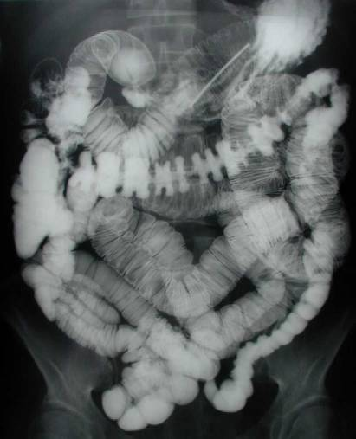
 | Small Bowel | Colon
Location | Central | ‘Picture Frame’
Mucosal Folds | Continuous (Plicae Circulares) | Interrupted (Haustra)
Diameter | < 3cm | < 6 cm (Cecum < 9 cm)
Fecal Content | Rarely | Usually
COLON
Small bowel

Slide 26
Crohn's Disease
CD usually presents as acute or chronic bowel inflammation, the inflammatory process evolves toward one of two patterns of disease:
Fibrostenotic obstructing pattern
Penetrating fistulous pattern
Each with different treatments and prognoses. The site of disease influences the clinical manifestations.

Slide 27
Location
Anywhere along gut from mouth to anus
Most common:
Terminal ileum (95%)
Colon (22-55%)
Rectum (14-50%)
Morphology
Skip lesions (segmental or discontinuous)
Transmural, granulomas (non caseating type)
Cobblestone mucosa, fissures & fistulas

Slide 28
Radiographic Findings on barium study
Early changes
Lymphoid hyperplasia: 1-3 mm mucosal elevations
Aphthoid ulcerations: "Target" or "bull's eye” appearance (punctate shallow central barium collections surrounded by a halo of edema)
Cobblestone pattern: Combination of longitudinal & transverse ulcers
Deep ulcerations (fissuring ulcers)
Mural thickening: Transmural inflammation,
fibrosis (Crohn more than ulcerative colitis)
Skip lesions: Segmental/normal intervening areas

Slide 29
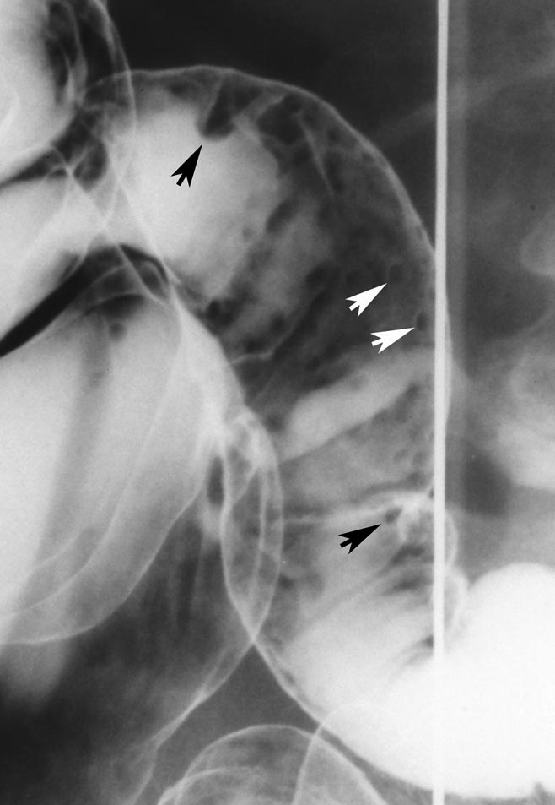
Double-contrast barium enema examination
shows enlarged
lymphoid follicles as small round nodules (arrows)
separated by normal mucosa in terminal ileum

Slide 30
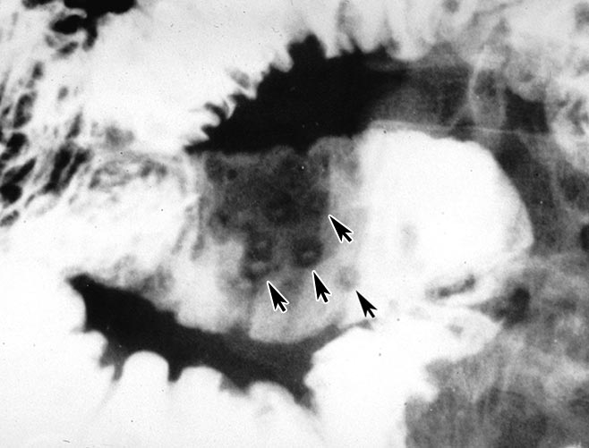
Frontal spot image from SBFT in patient with Crohn disease shows multiple aphthoid ulcers as punctate collections of barium surrounded by radiolucent mounds of edema

Slide 33
Late changes
Sacculations: Seen on ant mesenteric border(↑ luminal pressure)
Intramural abscess
"String sign": Luminal narrowing + ileal stricture
Sinus tracts, fissures, fistulas: Hallmark of disease

Slide 34
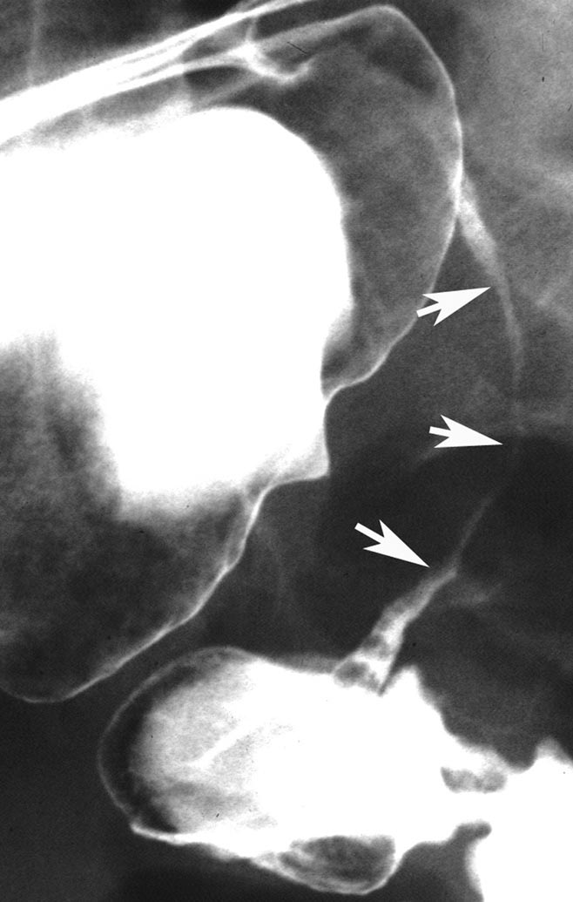
Double-contrast barium enema examination-
Crohn disease shows classic string sign with marked narrowing of terminal ileum (arrows) due to severe edema and spasm.

Slide 35
Contour abnormalities
String sign of crohns

Slide 36
Ultrasound
Ultrasound has a limited role, but due to it being cheap and available and not involving ionizing radiation, it has been evaluated as an initial screening tool.
Bowel wall thickness should be less the 3 mm
Thickness of less than 3 mm helps exclude the disease in a low risk patient.
Thickness of greater than 4 mm helps establish the diagnosis in a high risk patient

Slide 37
USG
Bowel wall thickening
Bowel wall appears hypoechoic in both UC & CD.
Doppler shows increase vascularity (d/t inflammation)
Doppler also shows increased flow in SMA (early stages)
LN
H2O2 enhanced US fistulography for sinuses or fistula can be done.
Complications
Fistula
Obstruction
Perforation
Notes:
30% h202 and 70 povoide iodine

Slide 38
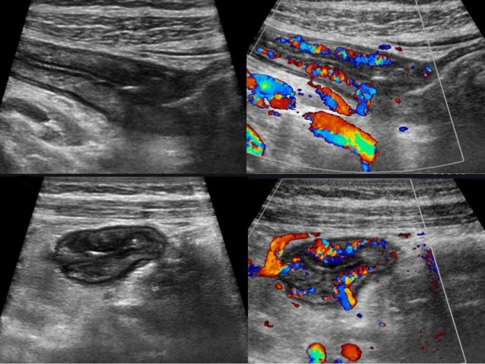

Slide 39
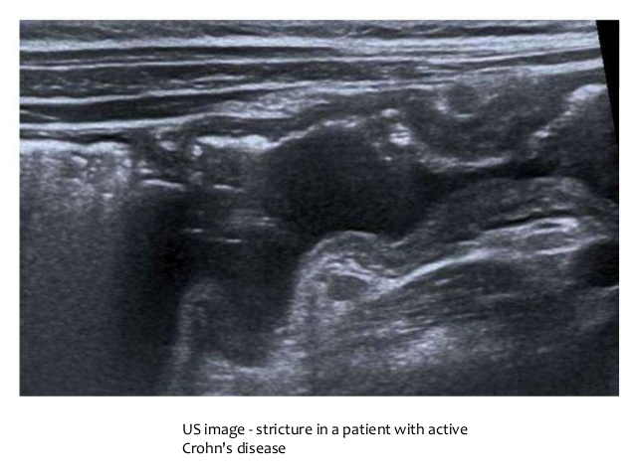

Slide 40
CT enterography
Large volumes of ingested neutral enteric contrast material permit visualization of the entire small bowel and lumen.
Unlike routine CT, which is used to detect the extra enteric complications of CD such as fistula and abscess, CT enterography clearly depicts the small bowel inflammation associated with CD
CT enterography is the first-line test for the evaluation of suspected CD and its complications.

Slide 41
CT Findings
• Discontinuous & asymmetric bowel wall thickening (more than 1 cm)
Acute or non cicatrizing phase:
Minimal narrowing
Mural stratification: Intact
Inner ring: Soft tissue density (mucosa)
Middle ring: Low density (sub mucosal edema/fat)
Outer ring: Soft tissue density (muscularis propria-serosa)
Proliferation of mesenteric fat ± lymphadenopathy
"Target" or "double halo" sign on CECT
Intense enhancement: Inner mucosa + outer muscularis propria
↓ Attenuation: Oedematous thickened sub mucosa

Slide 42
Mural Stratification Trilaminar: Mucosa, Submucosa, Serosa

Slide 43
Chronic or cicatrizing phase:
Luminal narrowing
No "target" sign
Mural stratification lost (indistinct mucosa,submucosa, muscularis propria)
Homogeneous attenuation of thickened bowel wall on CECT (indicating irreversible transmural fibrosis)
Abscesses, fistulas, sinus tracts.
Mesenteric changes: Abscess, fibro fatty areas
Perianal disease, enlarged mesenteric lymph nodes
"Comb" sign: Mesenteric hypervascularity(dilatation, tortuosity & wide spacing)

Slide 44
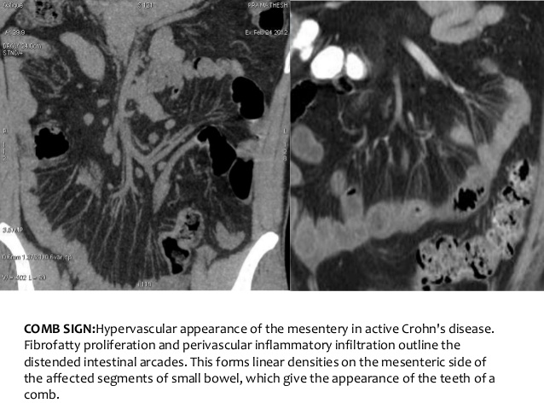

Slide 45
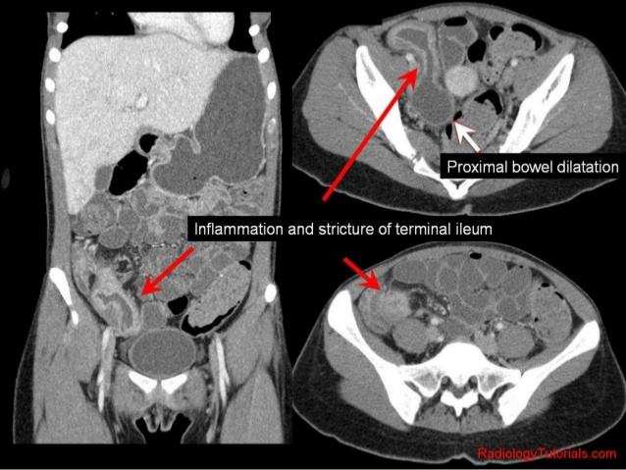

Slide 46
MR Findings
Dark lumen technique- PR water enema and IV contrast.
Bright lumen technique- mixture of GD and water PR.
Abnormal high bowel wall signal intensity on T2WI caused by edema and inflammation & contrast enhancement on T1WI indicates active disease
Low signal on T2WI & no enhancement on T1WI indicates decrease disease activity.

Slide 47
Show extent, mural thickening & severity of disease
Perianal Crohn disease
MR sensitive in detecting
fistulas
Sinuses
Abscesses
MRI can diff b/w active inflammation & fibrosis(low signal on both T1 & T2 WI )

Slide 48
Crohn’s Disease MRE Findings
Enhancement
Wall thickening
Comb sign

Slide 49
Complications
Because CD is a transmural process, serosal adhesions develop that provide direct pathways for fistula formation and reduce the incidence of free perforation.
Perforation occurs in 1–2% of patients, usually in the ileum
Toxic mega colon.
Intraabdominal and pelvic abscesses occur in 10–30% of patients with Crohn's disease.
Intestinal obstruction
Massive hemorrhage
Malabsorption

Slide 50
Ulcerative Colitis
Signs and Symptoms
Diarrhea
Rectal bleeding
Tenesmus
Passage of mucus
Crampy abdominal pain.

Slide 51
Radiographic Findings
Acute changes
Fine mucosal granular pattern(edema/hyperemia)
Mucosal stippling: Punctuate barium collections(crypt abscesses erode into lumen forming ulcers & barium collection)
"Collar button" ulcers (flask-like): Due to undermining of ulcers.
Haustra: Edematous & thickened
Colorectal narrowing + incomplete filling (spasm+ irritability)
Pseudopolyps (remnants of mucosa & submucosa)

Slide 52
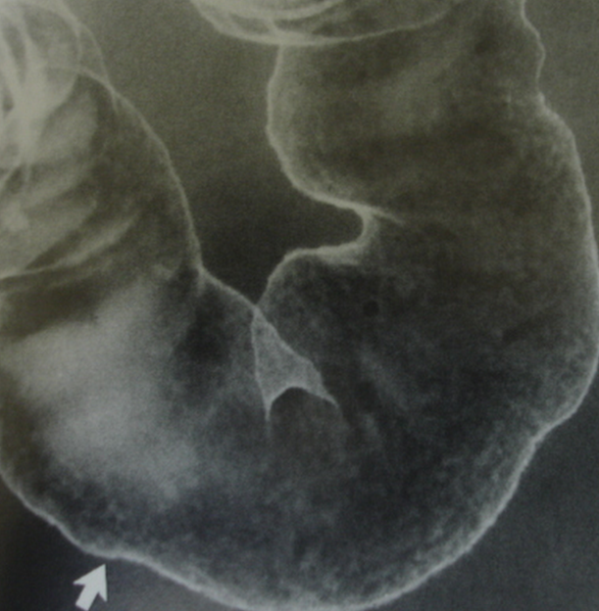
Double contrast barium enema illustrating granular mucosa in a patient with active ulcerative

Slide 54
Chronic changes
Shortening of colon with depression of flexures (reversible)
"Lead-pipe" colon: Rigidity + luminal narrowing
Haustrations: Blunted or complete loss
Backwash ileitis: Distal 5-25 cm of ileum is inflamed (seen in 10-40% cases)
Luminal narrowing & widened presacral space (more than 1.5 cm)
Benign strictures: Local sequelae of UC (seen in10% of patients)

Slide 55
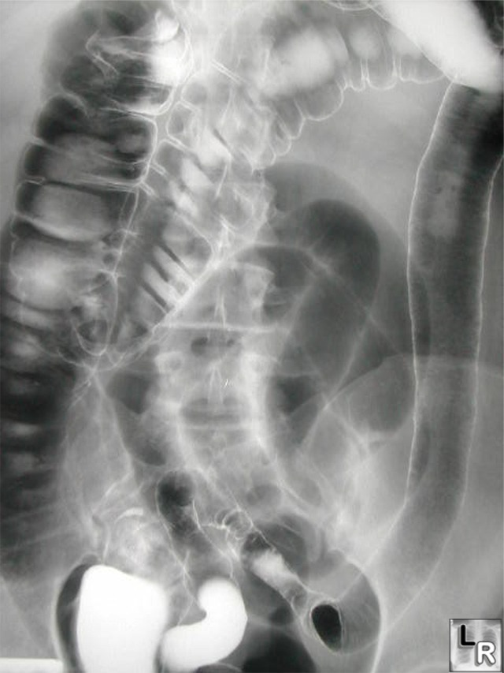

Slide 57
CT Findings
NECT
Colorectal narrowing
Widening of presacral space: > 1.5 cm
Due to perirectal fibrofatty proliferation
Diffuse + symmetric wall thickening of colon Less than 10 mm (average 7-8 mm)
Mural thickening & luminal narrowing seen in subacute & chronic ulcerative colitis

Slide 58
CECT
"Target" or "halo" sign
Enhancing inner ring of bowel wall (mucosa)
Nonenhancing middle ring of bowel wall (submucosa): Due to edema in acute or halo of fat in chronic phase
Enhancing outer ring of bowel wall (muscularis propria)
Enhancement of "Mucosal islands" or inflammatory "pseudopolyps“
Inflammatory peri colonic stranding

Slide 59
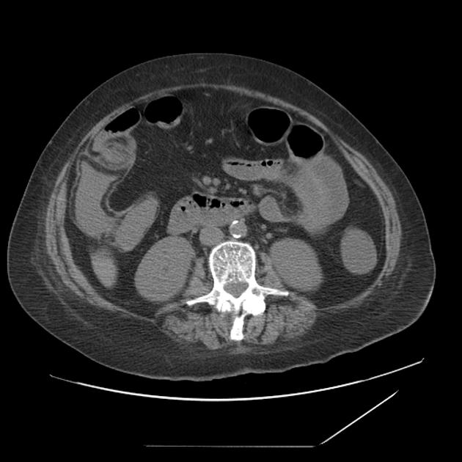
The fat halo sign represents infiltration of the submucosa with fat, between the muscularis and the mucosa.

Slide 60
Complications
Only 15% of patients with UC present initially with catastrophic illness.
Massive hemorrhage occurs with severe attacks of disease in 1% of patients, and treatment for the disease usually stops the bleeding.
If a patient requires 6–8 units of blood within 24–48 hours, colectomy is indicated.

Slide 61
Toxic megacolon
Toxic megacolon is defined as a transverse or right colon with a diameter of >6 cm, with loss of haustration in patients with severe attacks of UC.
It occurs in about 5% of attacks and can be triggered by electrolyte abnormalities and narcotics.
About 50% of acute dilations will resolve with medical therapy alone, but urgent colectomy is required for those that do not improve.

Slide 62
PERFORATION
Perforation is the most dangerous of the local complications, and the physical signs of peritonitis may not be obvious, especially if the patient is receiving glucocorticoids.
Although perforation is rare, the mortality rate for perforation complicating a toxic megacolon is about 15%.
In addition, patients can develop a toxic colitis and such severe ulcerations that the bowel may perforate without first dilating.

Slide 63
Strictures UC
occur in 5–10% of patients and are always a concern in UC because of the possibility of underlying neoplasia.
Although benign strictures can form from the inflammation and fibrosis of UC, strictures that are impassable with the colonoscope should be presumed malignant until proven otherwise.
A stricture that prevents passage of the colonoscopy is an indication for surgery.

Slide 64
Perianal complication UC
UC patients occasionally develop anal fissures, perianal abscesses, or hemorrhoids, but the occurrence of extensive perianal lesions should suggest CD.

Slide 65
UC CD
Location- Colon (rectum)
Involvement- Diffuse
Mucosal pattern- granular
Polyps-Present
Malignancy-more
Abscess,
Fistula,
Perforation- less
Mouth to anus (ileum)
Segmental
Smooth
Absent
Less
more

Slide 66
UC CD
Wall thickness- moderate.
Wall echogenicity-
hypoechoic.
Anatomic layers- preserved.
Mesentric involvemnet-
less.
Marked
Hypoechoic
Lost
More

Slide 67
Intestinal TB Crohn’s disease
Short concentric smooth sticture with prestenotic dilatation.
Longitudinal ulcers
Comp- Enteroliths
Asymm eccentric stricture with sacculations at antimesentric border without dilatation.
Apthous ulcers.
Fistula abscess perforation.

Slide 68
Intestinal TB Crohn’s disease
LN marked
Comb sign absent
Ascites
Mild LN
Present
Abscess

Slide 69
THANK YOU

