Slide 1
POSITRON EMISSION TOMOGRAPHY
By Dr Pooja Deshpande

Slide 2
PET
Introduction
Physics
Technical aspects
Applications
PET MR
Comparisons between different modalities

Slide 5
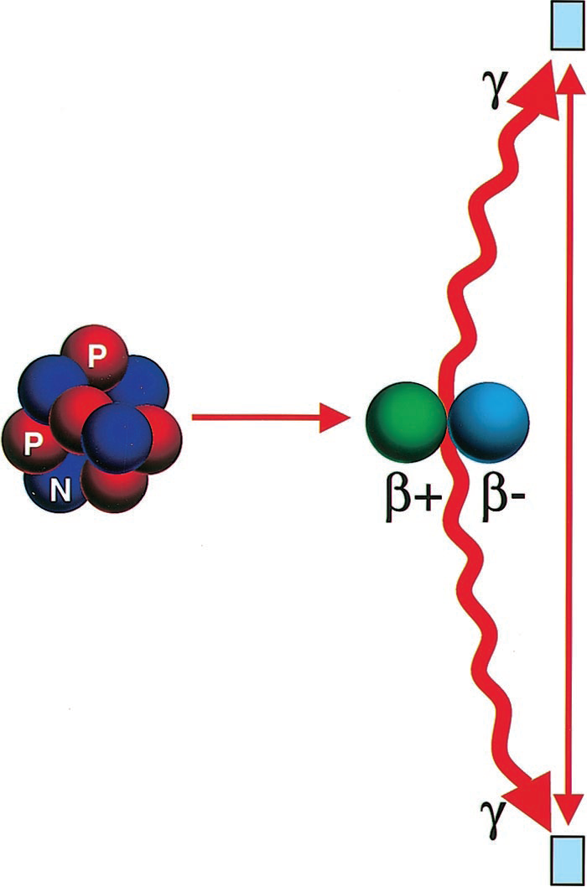
introduction
PET – functional /molecular imaging
CT & MR – mainly anatomical imaging.. Some functional
PET is based on the detection of photons released when radionuclides, such as F-18, carbon-11, and oxygen-15, emit positrons that undergo annihilation with electrons.
Positron is a particle of matter with same mass as that of electron but opposite charge.
FDG (glucose analogue) is the most commonly used metabolite in PET which emits positrons.

Slide 6
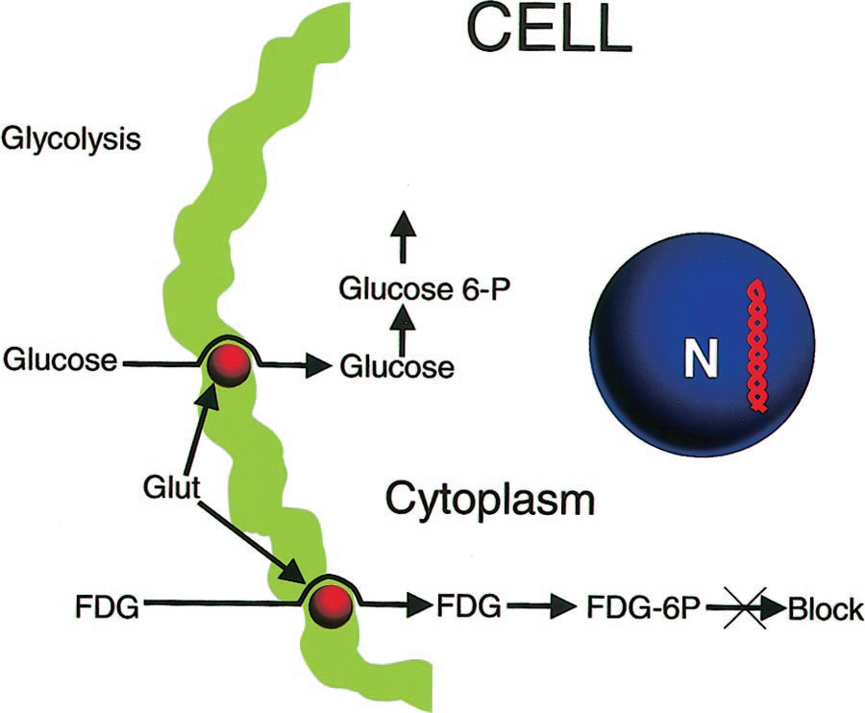
How FDG is useful for PET?
Malignant cells have increased glucose utilization due to upregulation of hexokinase activity.
FDG(2-[fluorine-18]fluoro-2-deoxy-d-glucose) is a radiopharmaceutical analog of glucose that is taken up by metabolically active tumor cells using facilitated transport similar to that used by glucose.

Slide 7
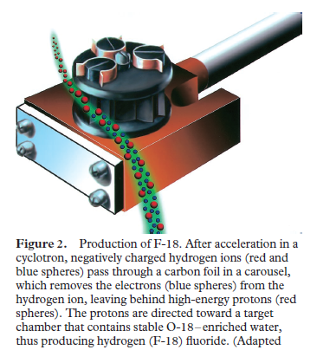
Production of F-18
In FDG PET, F-18 is the unstable nucleus which is clubbed with metabolically active Glucose.
F-18 is produced in a Cyclotron by bombarding O-18–enriched water with high-energy protons.
The protons undergo a nuclear reaction with the O-18–enriched water to form hydrogen (F-18) fluoride:
H2(O-18) + H-1 + energy H2 (F-18)
F-18 is an unstable radioisotope and has a half-life of 109 minutes. It decays by emitting a neutrino and a positron :
F-18 O-18 +positron+ neutrino

Slide 8
Patient preparation
NBM for 4–6 hours prior to enhance FDG uptake
blood glucose level is measured- should be less than 150mg/dL
avoid any kind of strenuous activity
dose of FDG is 10 mCi injected intravenously.
Patient activity and speech are limited for 20 minutes immediately following injection
Imaging is initiated approximately 60 minutes following the injection of FDG.
PET is performed following the CT study without moving the patient.
The CT study takes approximately 60–70 seconds to complete and the PET study takes approximately 30–45 minutes, depending on the coverage required.
Assessment of radiotracer uptake by normal and pathologic tissues is done by visual inspection, the standardized uptake value (SUV), and glucose metabolic rate.

Slide 9
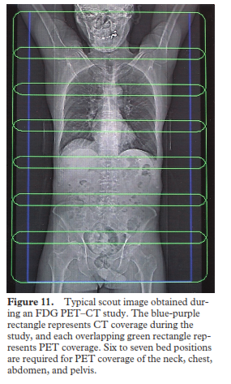
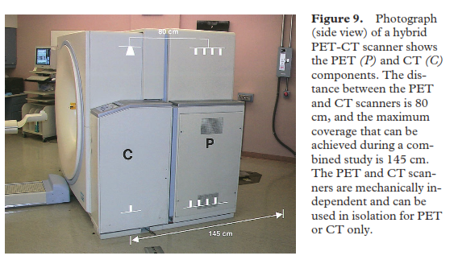

Slide 10
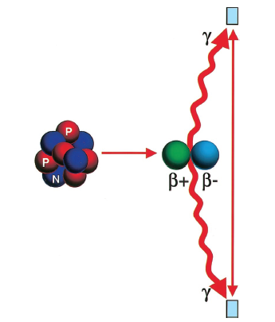
Annihilation Reaction
Injected FDG gets trapped in cells & emits positrons
Positron emitted from FDG distributed in pt. body
Interacts with adjacent electrons
Emission two photons(511KeV) at 180⁰ to each other
Detected by crystals- scintillators

Slide 11
PET and CT are housed in single gantry, The CT is usually in the front and the PET in the back.
Photons produced by annihilation
Scintillator ( block detectors)
Light produced
Photomultiplier tubes( coupled to scintillators)
Electrical signal produced
Acquisition computer- image display

Slide 12
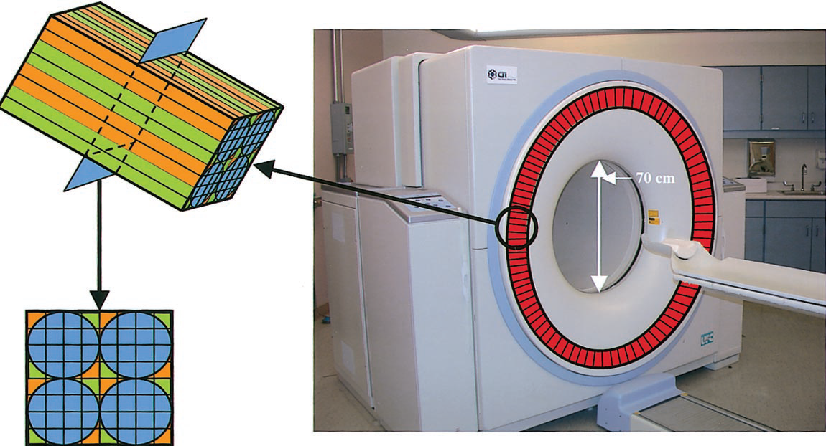
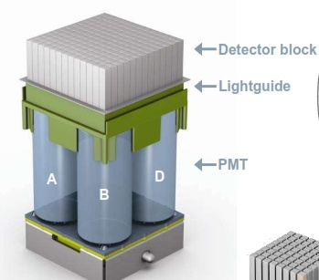

Slide 13
Scintillators in PET

Slide 15
suv
It is a quantitative assessment of the radiotracer uptake from a static PET image.
SUV = tracer activity in tissue
injected radiotracer dose/patient wt
SUV is dependent on the body weight. Therefore, correction with the lean body mass (SUV_{LBM}) is required to avoid erroneous comparisons.
Typically, a lesion with an SUV greater than 2.5–3.0 is considered suspicious for malignancy.
Inflammatory lesions may also demonstrate high SUV.

Slide 16
Pet tracers
FDG- most commonly used
FLT- better than FDG for tumors
F-18 fluoride- bone metastases- better
C-11 choline, F-18 fluorocholine- prostate
Ga-68 DOTATOC- neuroendocrine tumour
Ga-68 DOTANOC- pheochromocytoma, paraganglioma
C-11 methionine, C-11 acetate- brain tumors
F-MISO- hypoxia imaging- radiosensitivity of tumor cells before RT planning
Radiolabelled IgG, cytokines, leukocytes- infection, inflammation
O-15 water, N-13 ammonia- myocardial blood flow & coronary flow reserve
C-11 Pitsburg compound, F-18 FDG, F-18 DOPA- dementia

Slide 17
Uses of pet/ct
DIAGNOSIS:
INITIAL STAGING
TREATMENT RESPONSE EVALUATION-
most drugs are cytostatic not cidal- so CT & MR are of limited value
PET can detect reduced glucose uptake by tumor cells early after therapy
Can be done 1-2 weeks after chemotherapy
RESTAGING/RECURRENCE/PROGNOSIS
False positive: infection, inflammation, post treatment
False negative: small,necrotic, mucinous, low grade , cystic tumours
PERCIST criteria – response evaluation in solid tumors by PET/CT

Slide 19
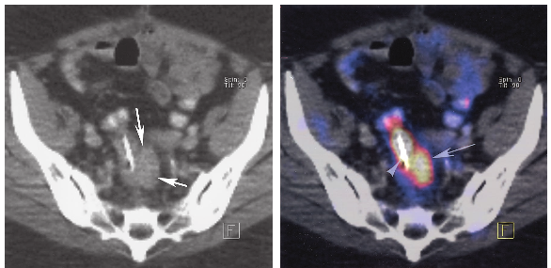

Slide 20
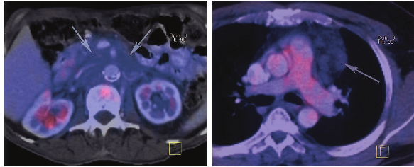

Slide 21
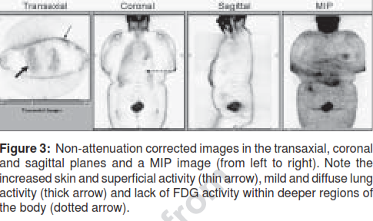
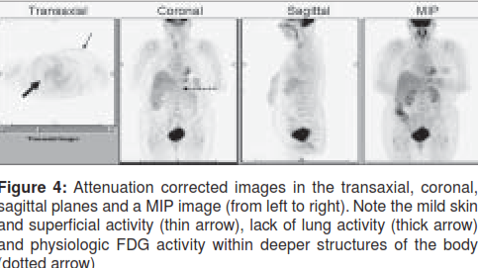
Attenuation correction
For accurate results, the images must be corrected for scatter- this degrades image quality.
Raw data sinogram
Emission scan (non- attenuation corrected)- underrepresentation of deeper areas
Attenuation map (transmission images) generated from CT imaging
Attenuation coefficients for various body parts calculated & applied

Slide 22
Pet mri

Slide 23
Pet mri
Excellent soft tissue contrast of MRI alongwith availability of functional MR imaging add to the molecular information provided by PET.
PET/MR can be done by Software based registration of independently acquired PET & MR images or by using sequencial or concurrent imaging instrumentation.

Slide 29
MR COMPATIBLE PET DETECTORS
Why?
Cross-talk effects between PET and MRI can cause disruption of PET signal cascade as well as degrade MRI signal
Strategies
Position PMT detectors remotely from magnetic field connected by optical fibers
Utilize MR compatible PET detectors
Avalanche Photodiode (APD)
Silicone Photomultipliers (SiPM)

Slide 32
PET/MR methodological pitfalls and technological challenges
MR based attenuation correction:
Unlike PET/CT or PET/transmission scanners, PET/MR scanners cannot directly measure attenuation information.
›Transforming MR image intensities into accurate attenuation coefficients is problematic.
Artifacts of MR
Interactions of PET & MR

Slide 33
ATTENUTATION CORRECTION
MR based Ac
Segmentation method
Atlas based method

Slide 34
Applications of pet/mr
ONCOLOGICAL- liver, prostate, head & neck, breast, gynecological
NON ONCOLOGICAL
Neuropsychiatric- dementia, epilepsy, movement disorders, cortical dysplasia
Cardiac- FDG uptake is marker of myocardial viability
Bone and soft tissue
Infections and inflammations

Slide 38
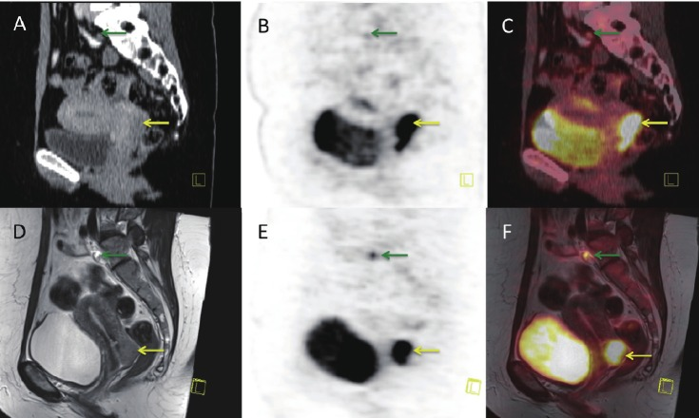

Slide 40
Advantages OF PET-CT over PET
Decreased scan time.
Better anatomical localization of activity to normal vs abnormal structures.
CT visualization of PET-negative lesions (especially bone lesions).
Confirmation of unusual or abnormal sites
Improved localization for biopsy or radiotherapy.

Slide 42
SPECT Vs PET
Advantages of SPECT:
Many radiotracers available.
Tc-99m can be produced by a generator that lasts a week or longer.
A SPECT camera is less costly than a PET scanner.
Limitations of SPECT:
Absolute quantification of uptake (for instance in Bq/mL) is very hard to achieve.
Sensitivity for photons is low, because a collimator is needed. Typically only 1 in 10.000 emitted photons is counted.
The spatial resolution is not as high as in PET.
For high-energy photons (i.e. I-131), more lead is needed in the collimator, reducing sensitivity and/or spatial resolution.

Slide 43
SPECT Vs PET
Strengths of PET:
FDG is a very good tracer.
Sensitivity is good, No physical collimator is needed.
Good spatial resolution (small crystals can be used, and count statistics is good)
In PET/CT, uptake can be given in absolute values (for instance Bq/mL)
Generator-produced tracers are becoming available (Ga-68).
Limitations of PET:
For FDG and many other applications, a cyclotron must be available near the scanning site (near enough for transportation of tracer to be feasible).
The scanner is more expensive than a SPECT scanner .
No dual isotope. All PET isotopes emit the same energy (511 keV), meaning that different isotopes cannot be distinguished.
PET cannot be used for the Tc-99m tracers, so many well-tested tracers cannot be used for PET.

Slide 44
THANK YOU

