Slide 1
SKELETAL TRAUMA -II
AXIAL SKELETON

Slide 2
SKULL VAULT FRACTURE

Slide 3
LINEAR FRACTURE
Lateral Skull, Parietal Bone

Slide 4
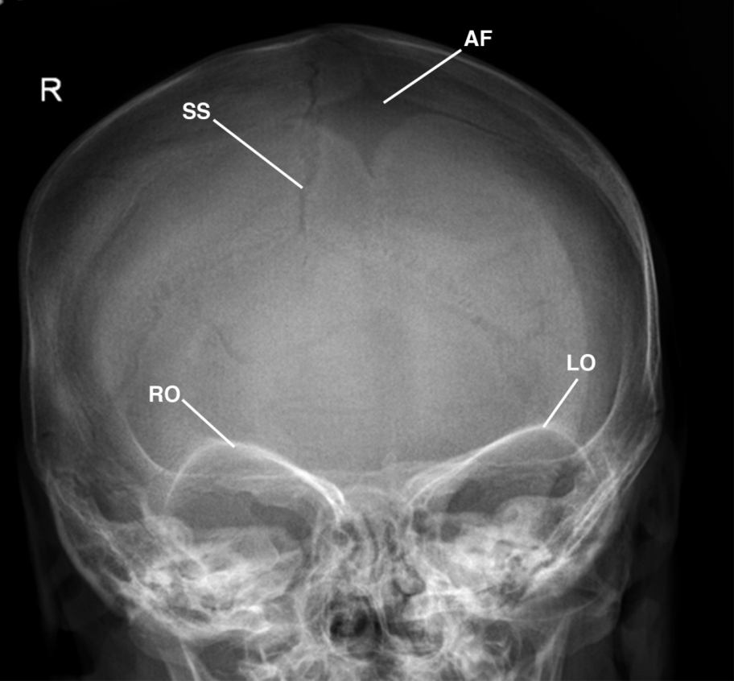
FRACTURE LINE
SUTURE
VASCULAR MARKINGS

Slide 5
The linear fractures must be differentiated from vascular grooves or sutures.
Fracture lines are more radiolucent (involve both the inner and outer table)
Vascular grooves are less sharp in appearance (involve varying depth on either the inner or outer table)
Fractures will cross sutures, whereas vascular grooves will not.
Radiolucent lines with serrated edges - sutural lines rather than fractures.
The skull bones most commonly fractured - temporal and parietal

Slide 6
DEPRESSED FRACTURE
Multiple fracture fragments, which are displaced inward

Slide 7
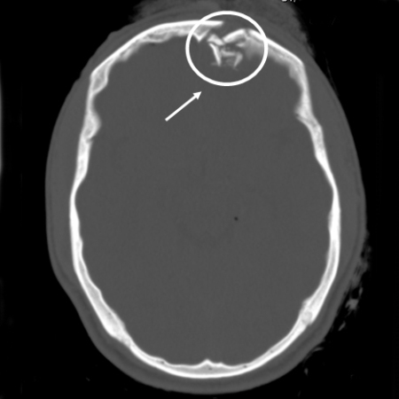
DEPRESSED FRACTURE

Slide 8
SKULL FRACTURE
SKULL VAULT FRACTURE
LINEAR
DEPRESSED

Slide 9
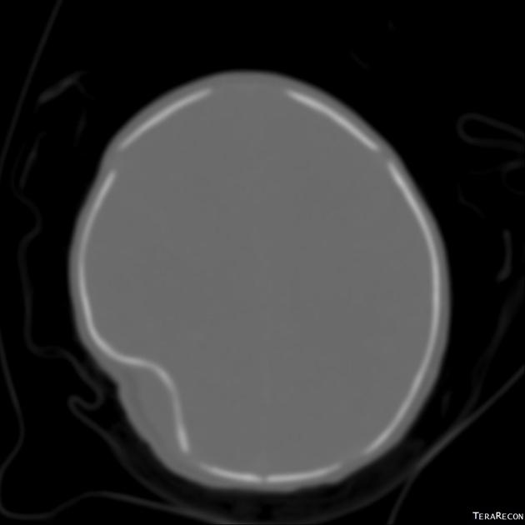
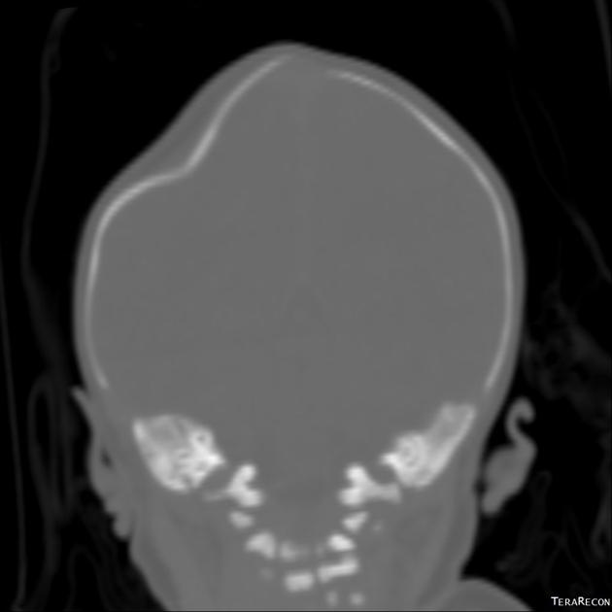
PING PONG FRACTURE

Slide 10
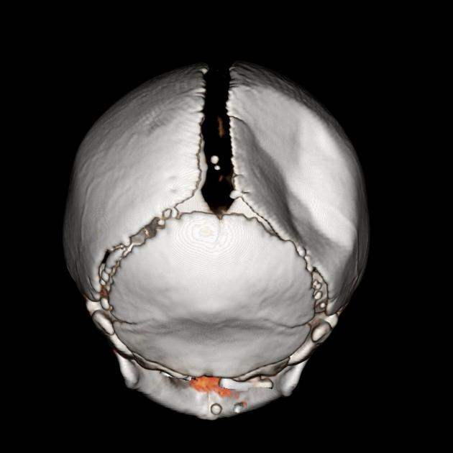
PING PONG FRACTURE
The ping pong fracture
variation of the depressed
fracture
seen most often in
the young child, whose skull is
very soft and pliable.
The skull sustains a deep and broad depression without an overt fracture
Like the indentation produced by one’s fingers being pushed into a Ping Pong ball.

Slide 11
DIASTATIC FRACTURE
A. AP Towne’s View. B. Lateral Skull.

Slide 12
DIASTATIC FRACTURE
Diastatic fracture represents a traumatic sutural separation, which is usually unilateral and seen most commonly in children.
The lambdoidal and sagittal sutures are the most common areas of diastasis.
Unilateral separation of a suture > 2 mm is considered a sufficient roentgen sign to make the diagnosis of a diastatic fracture.

Slide 13
BASAL SKULL FRACTURE
The skull base is one of the most difficult areas in which to demonstrate a fracture.
The most reliable index of the presence of a basal skull fracture is an air-fluid (hemorrhage) level or complete opacification of the sphenoid sinus.
This sign is seen in up to 75% of patients with basal skull fractures.

Slide 14
FACIAL FRACTURES

Slide 15
NASAL BONE FRACTURE

Slide 16
Nasal fractures are sustained by high-velocity forces directly impacting in the region of the nasion.
Nasal bone fractures are best seen on lateral projections, which need to be underexposed to enhance depiction of the fractures.

Slide 17
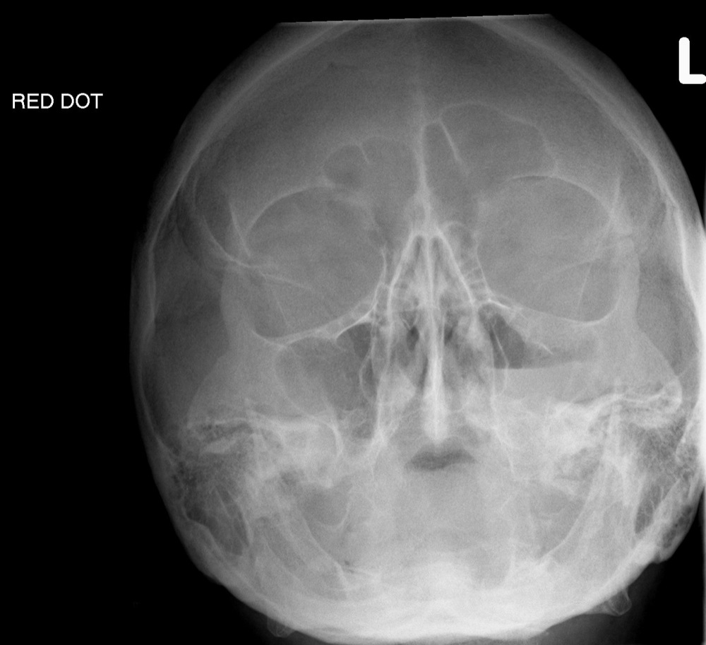
WATER’S VIEW

Slide 18
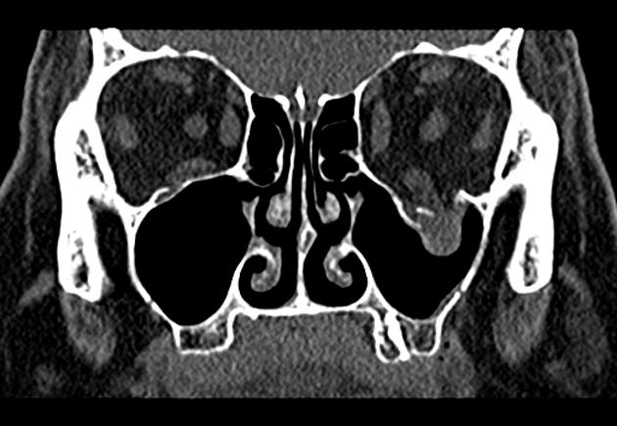
CT CORONAL WINDOW

Slide 19
ORBITAL BLOW OUT FRACTURE

Slide 20
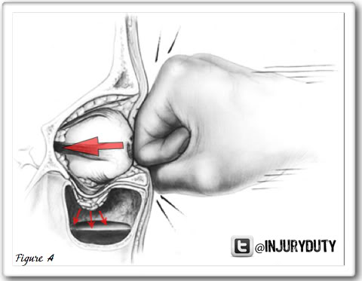
BLOW OUT FRACTURE
It is defined as a fracture that disrupts the infraorbital plate of the maxillary bone.
Orbital blowout fractures usually occur as a result of a blow by a fist or a ball directly over the globe of the eye or just caudal to it.
The patient often complains of diplopia.

Slide 21
TRIPOD FRACTURE
WATER’S VIEW

Slide 22
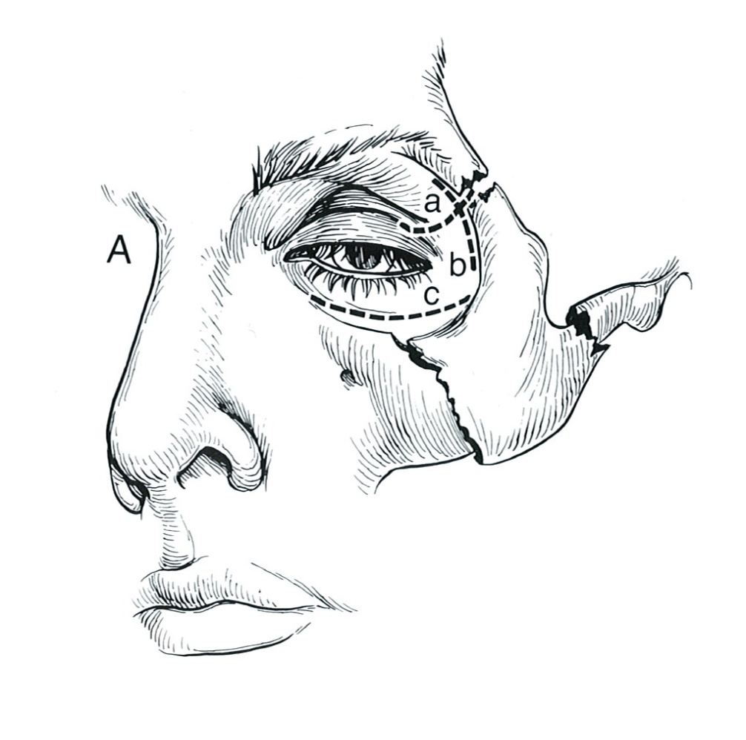
TRIPOD FRACTURE
orbital process
The tripod fracture is the most common fracture of the facial bones.
The mechanism of injury represents a blow over the malar eminence and primarily involves the zygoma.
Because of the three components of this fracture, it was named tripod fracture.
zygomatic arch
maxillary process

Slide 23
LE FORT FRACTURE

Slide 24
LE FORT FRACTURE
Le Fort fractures are fractures of the midface, which collectively involve separation of all or a portion of the midface from the skull base.
The Le Fort classification system attempts to distinguish according to the plane of injury.
Fracture of the pterygoid plates is mandatory to diagnose Le Fort fractures (CT).

Slide 25
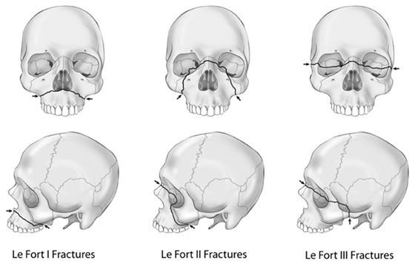
FLOATING PALATE
FLOATING MAXILLA
FLOATING FACE

Slide 26
Le Fort 1. Represents a fracture through the midportion of the maxilla and the pterygoid plates.
Le Fort 2. Occurs as a result of a blow to the nasofrontal area. fracture arch passes through posterior alveolar ridge, lateral walls of maxillary sinuses, inferior orbital rim and nasal bones
Le Fort 3. Craniofacial dysjunction
Fracture line passes through nasofrontal suture, maxillo-frontal suture, orbital wall, and zygomatic arch / zygomaticofrontal suture

Slide 27
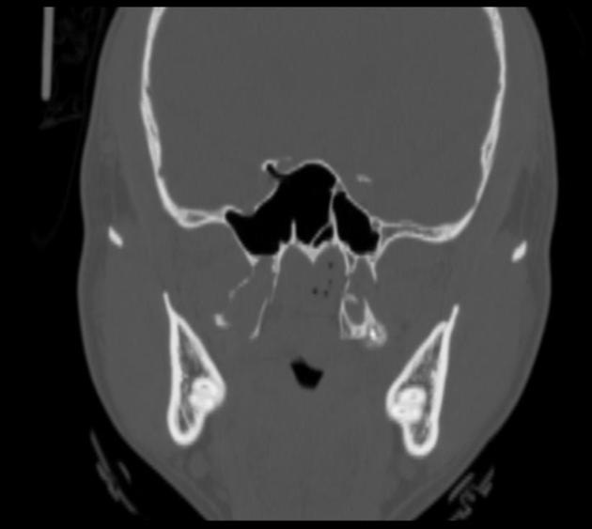
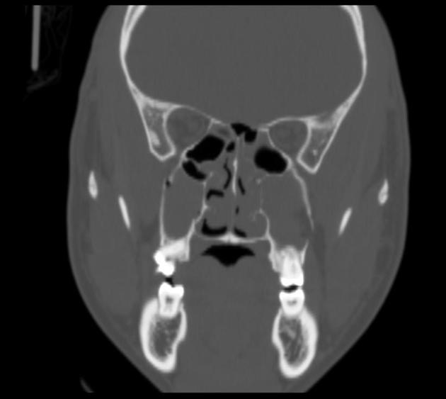
LE FORT TYPE I

Slide 28
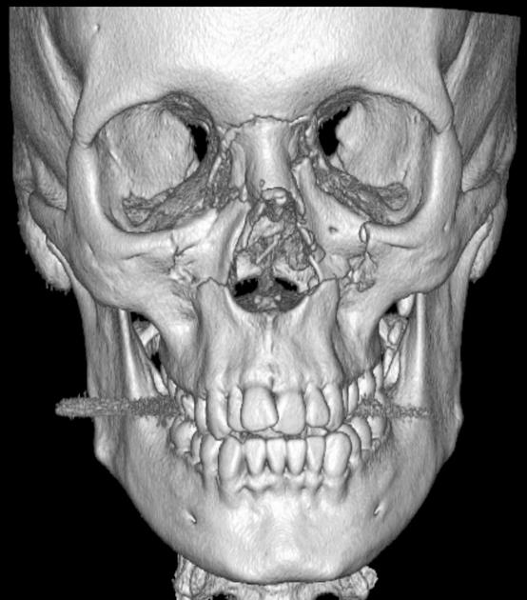
LE FORT TYPE II

Slide 29
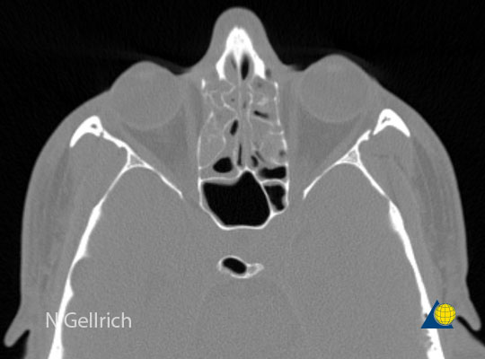
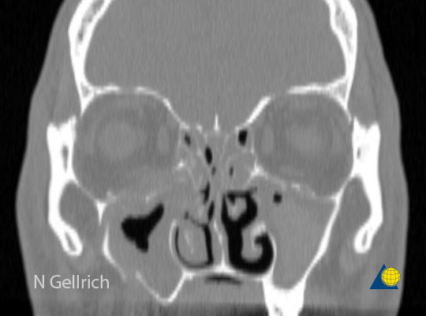
LE FORT TYPE III

Slide 30
FRACTURES AND DISLOCATIONS OF THE SPINE

Slide 31
Fractures of spinal column found most commonly at C1-C2, C5-C7 and T12- L1.
Spinal fractures and spinal cord injuries result mostly from automobile accidents and sports activities.
Spinal cord injuries occur in 10-14% of spinal fractures and dislocations.
Flexion is the most common line of force in spinal injuries, with extension, rotation, shearing, compression, and distraction occurring less frequently.

Slide 33
CERVICAL SPINE

Slide 34
Fractures of the atlas

Slide 35
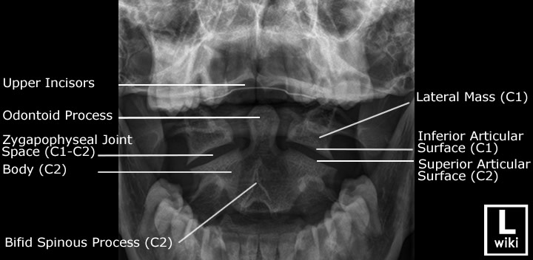

Slide 38
JEFFERSON’S FRACTURE
Burst fracture of C1 with fractures through anterior and posterior arches.
Automobile injury OR Diving head first into shallow water. Axial compression injury.
Not normally associated with neurological deficit
Retropulsed fragment
Associations:
Other C-spine injuries (50%)
C2 fracture (33%)
Head injury (children 25-50%)
Vertebral artery injury
Extra-cranial nerve injury

Slide 39
Unilateral Jefferson’s fracture

Slide 40
Pseudo-spread of atlas
Normal variation identical to jafferson’s fracture
Found at around age 4

Slide 41
Posterior arch fracture of atlas :
most common 50%
occur during severe hyperextension

Slide 42
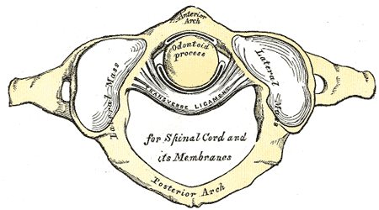
Rupture of the transverse ligament

Slide 43
Rupture of the transverse ligament
Flexion lat Cx spine
C1-C2 articulation
Steele’s Rule of Thirds

Slide 44
Rupture of the transverse ligament
A key radiologic feature of a ruptured transverse ligament is an abnormally wide atlantodental interspace (ADI) (> 3 mm in adults and 5 mm in children), most pronounced in flexion.
The posterior cervical line will also be disrupted.
Cord compression may not be clinically apparent until considerable anterior displacement of the atlas (up to 10 mm) has occurred, owing to the protective effect of the surrounding tissues of the cord, which make up approximately one third of the diameter of the atlas ring.

Slide 45
Fracture of the Axis

Slide 46
fracture lines through the pedicles of the axis.
The fracture occurs as a bilateral disruption through the pedicles of the axis.

Slide 47
HANGMAN’S FRACTURE.

Slide 48
HANGMAN’S FRACTURE.
Mechanism of Injury
During judicial hangings, a hyperextension
and rotatory force to the neck directs the
impact to the pedicle regions of the C2
segment, resulting in fracture.
Radiologic Manifestations
fracture lines through the pedicles of the axis.
The fracture occurs as a bilateral disruption through the pedicles of the axis.

Slide 49
C. Diagram. In addition to the fracture through the pedicle region, disruption at the discovertebral junction may result in vertebral displacement.

Slide 50
Anteroinferior corner of C2, which has been avulsed, creating a free triangular fragment.

Slide 51
Teardrop fracture

Slide 52
Teardrop fracture
The teardrop fracture is an avulsion of a triangular-shaped fragment from the anteroinferior corner of the axis body.
Although teardrop fractures can occur at any cervical body, the lesion is most common at the axis.
At this level an acute hyperextension is the usual mechanism of injury, which explains its common occurrence in combination with a hangman’s fracture.

Slide 53
Teardrop fracture
Flexion
Extension

Slide 54
ODONTOID FRACTURE
Peg or dens fracture
Flexion or extension with or without compression
Classification: Anderson and D’Alonzo
Most commonly used
Level of fracture line

Slide 55
ODONTOID FRACTURE
Rare/stable
Common/unstable/
poor healing
Usually stable/better prognosis than II
Notes:
Type I rare/stable
Type II common/unstable/poor healing
Type III: can be unstable/ better px than type II

Slide 56
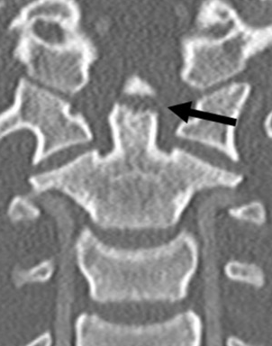
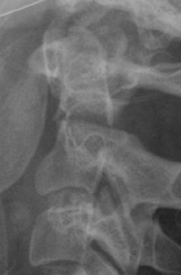

Slide 57
GUILLOTINE EFFECT OF ANTERIOR ATLAS DISPLACEMENT.
Transverse Ligament. Transverse ligament rupture creates a potential for cord compression between the approximated posterior arch and odontoid process.
Odontoid Process. Odontoid process fractures result in less compression of the spinal cord because the odontoid process and atlas move as a unit.

Slide 58
ODONTOID FRACTURE
DDx:
Os odontoideum
Persistent ossiculum terminale
Mach Band effect

Slide 59
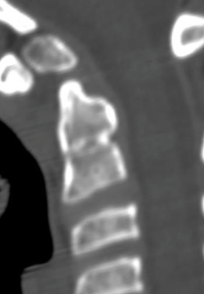
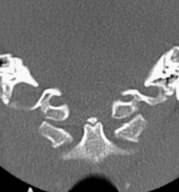
OS ODONTOIDEUM
PERSISTENT OSSICULUM TERMINALE (Bergmann’s ossicle)

Slide 61
MACH BAND EFFECT
As a result of overlap of various structures - the anterior and posterior atlas arches, tongue, and the teeth - can simulate a fracture line at the junction of the base of the odontoid process and the body of the axis.

Slide 63
CLAY SHOVELER’S FRACTURE

Slide 64
CLAY SHOVELER’S FRACTURE
Clay shoveler’s fracture (coal-miner’s or root-puller’s fracture) is an avulsive injury of the spinous process.
Common occurrence in clay miners in Australia during the 1930s.
It results from abrupt flexion of the head, such as is found in automobile accidents, diving, or wrestling injuries or from repeated stress caused by the pull of the trapezius and rhomboid muscles on the spinous process.
The spinous avulsion most commonly occurs at C7, with C6 and T1 also frequently involved.
This is a stable fracture without neurological deficit.

Slide 65
DOUBLE SPINOUS PROCESS SIGN CLAY SHOVELER’S FRACTURE

Slide 66
Dislocations of the Cervical Spine
Atlanto-Occipital Dislocation.
Anterior Dislocation.
Vertical Translation.

Slide 67
Dislocations of the Cervical Spine
Anterior atlanto-axial dislocation :
Rupture of transverse ligament

Slide 68
Dislocations of the Cervical Spine
Rotary atlantoaxial fixation (subluxation):
Type I. Rotatory fixation without anterior displacement and within the normal range of motion. This is the most common type.
Type II. Rotatory fixation with 3-5 mm anterior displacement of the atlas.
Type III. Rotatory fixation with > 5 mm anterior displacement of the atlas.
Type IV. Rotatory fixation with posterior displacement of the atlas. The odontoid needs to be deficient to allow this type.

Slide 69
Rotary atlantoaxial fixation (subluxation):

Slide 70
UNILATERAL INTERFACETAL DISLOCATION

Slide 71
UNILATERAL INTERFACETAL DISLOCATION

Slide 72
Unilateral interfacet dislocation
Unilateral interfacet dislocation is due to a hyperflexion injury with rotation.
The superior facet on one side slides over the inferior facet and becomes locked.
This results in an anterior subluxation of the upper vertebral body of about 25% of the AP diameter of the body.
Simple unilateral facet dislocation is a stable injury.

Slide 73
Bilateral Interfacetal Dislocation

Slide 74
Bilateral Interfacetal Dislocation

Slide 75
Bilateral Interfacetal Dislocation
Bilateral interfacetal dislocation (BID) is the result of extreme hyperflexion.
There is anterior dislocation of the articular masses with disruption of the posterior ligament complex, posterior longitudinal ligament, the disc and usually also the anterior longitudinal ligament.
When the dislocation is complete, the dislocated vertebra is anteriorly displaced one-half of the AP diameter of the vertebral body.
Because of its extensive soft tissue damage and dislocated facet joints, BID is unstable and is associated with a high incidence of cord damage

Slide 76
THORACO LUMBAR SPINE INJURY

Slide 77
THORACO LUMBAR SPINE INJURY
CLASSIFICATION

Slide 78
1.The anterior column consists of the anterior vertebral body, anterior annulus fibrosus, and anterior longitudinal ligament.
2.The middle column includes the posterior longitudinal ligament, posterior annulus fibrosus, and posterior wall of the vertebral body.
3.The posterior column consists posterior ligamentous complex.

Slide 79
Spine injury - TLICS Classification Thoraco-Lumbar Injury Classification and Severity score

Slide 80
Morphology

Slide 81
The PLC serves as a posterior "tension band" of the spinal column and plays an important role in the stability of the spine.
The PLC is composed of the supraspinous ligaments, interspinous ligaments, articular facet capsules, and ligamenta flava .
The supraspinous ligament is a strong, cordlike ligament which connects the tips of the spinous processes from C7 to the sacrum.
The interspinous ligaments are weak, thin, membranous structures connecting the adjacent spinous processes.
The contractile force of the ligamenta flava presses the vertebrae together and keeps them aligned.
The facet joints act against rotational forces

Slide 84
SIMPLE COMPRESSION FRACTURE

Slide 86
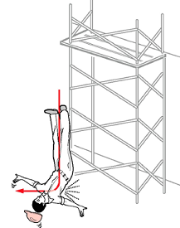
FLEXION COMPRESSION INJURY

Slide 87
Simple compression fracture

Slide 88
It is distinguished from Scheuermann disease and physiologic anterior vertebral wedging; the latter two usually involve both superior and inferior endplate

Slide 91
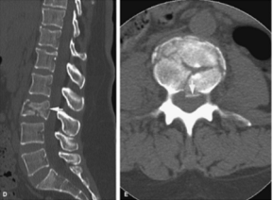
BURST FRACTURE

Slide 92
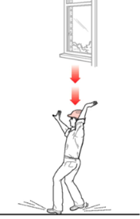
AXIAL / VERTICAL COMPRESSION FOR BURST FRACTURE

Slide 93
Mechanism –
Axial compression of the vertebral body from above by the nucleus pulposus, which explodes into the superior vertebral endplate to result in centripetal displacement of the body and its fracture fragments
The retropulsion of the posterior aspect of the vertebral body into the spinal canal is pathognomonic of a burst fracture
As the PLL is often intact, spinal traction can reduce this displaced fragment by tightening the PLL
Applying the three-column principle, there is a minimum two-column disruption (the anterior and middle) in a burst fracture

Slide 94
BURST FRACTURE CHARACTERISTICS

Slide 95
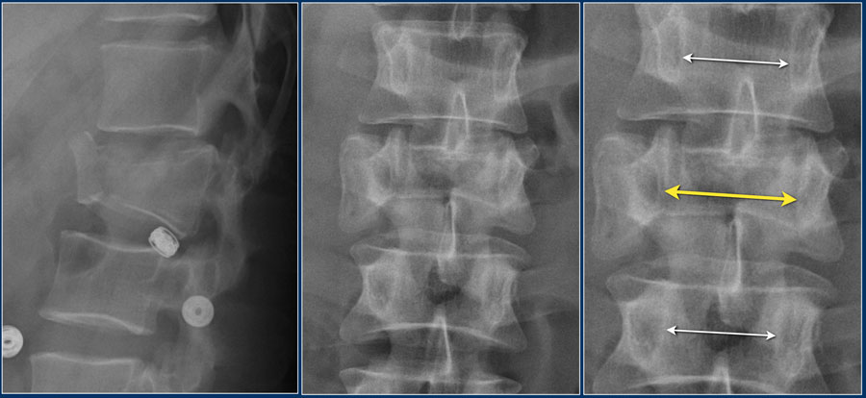
WIDENING OF THE INTERPEDICULAR DISTANCE
Widening of the interpedicular distance, often a result of the sagittal fracture, is seen in 80% of burst fractures.
The lateral view shows the typical features of a burst fracture.
On the AP-view notice the subtle widening of the interpedicular distance compared to the levels above and below.

Slide 96
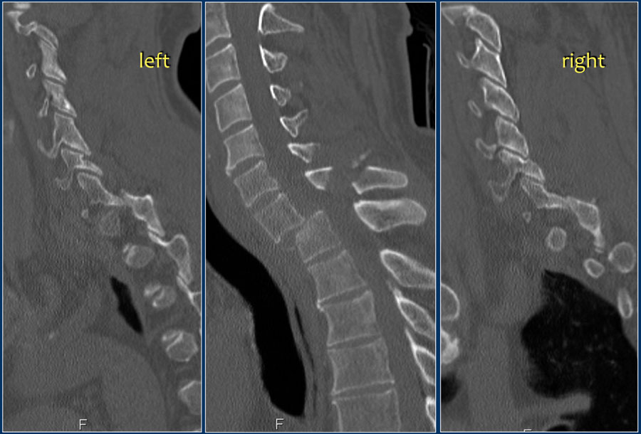
TRANSLATION - ROTATION
In this case there is bilateral facet dislocation and also a horizontal fracture of the spinous process.
There is severe narrowing of the spinal canal.

Slide 97
TRANSLATION - ROTATION
This type of fracture includes all fractures that are the result of displacement in the horizontal plane: side-to-side motion, either left-to-right or anterior-to-posterior or side-to-side rotary motion of one vertebral body with respect to another.
Often unilateral or bilateral facet dislocation is seen in rotational fractures.
It is a severe type of injury, which always involves the PLC.

Slide 98
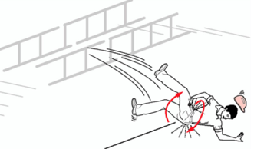
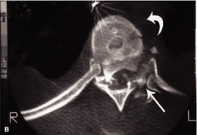
Flexion/Rotation Injury

Slide 100
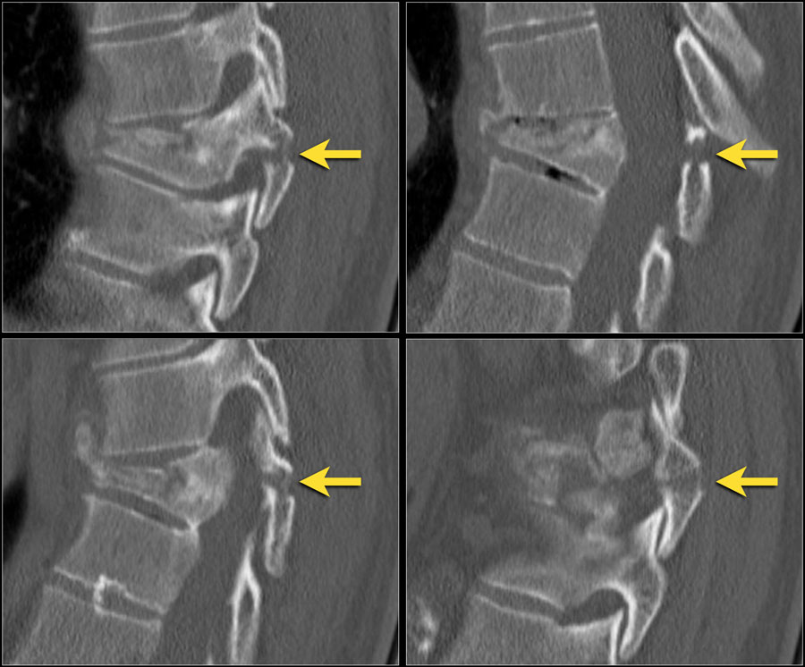
DISTRACTION
In this case there is severe compression of the vertebral body.
However the most important findings are the horizontal fractures of the posterior elements.

Slide 101
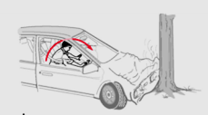
Distraction
A distraction injury is separation or pulling apart of two adjacent vertebrae.
Mechanism - result of hyperflexion of the upper thoracic spine while the lower spine remains relatively fixed
Classically caused by a deceleration-type motor vehicle accident

Slide 103
Transverse fracture through the pedicles, pars interarticularis, lamina, and spinous process of the L3 vertebra.
Superior angulation of the superior portion of the fractured vertebra, creating a wide radiolucent gap between the two fracture segments

Slide 104
CHANCE FRACTURE

Slide 105
CHANCE FRACTURE
Horizontal splitting of the spinous process and pedicle continuing though into the posterior vertebral body to involve the superior endplate.
Most common location for the transverse Chance fracture is in the upper lumbar spine (L1-L3).
Also called as lap seat belt fracture.

Slide 107
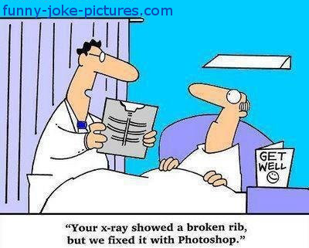
THANK YOU

