Slide 1
VARIATIONS IN PARANASAL SINUSES
DR ANURAG BIJPURIYA
JUNIOR RESIDENT II
GUIDE DR SAGAR MAHESHWARI
ASSISTANT PROFESSOR
DEPT OF RADIODIAGNOSIS
BJMC & SGH PUNE

Slide 2
Introduction
Paranasal sinuses are a group of air-filled spaces developed as an expansion of the nasal cavities, eroding the adjacent bone structures.
Such regions present a high risk for injuries and consequential intraoperative complications, with the ethmoid and frontal sinuses being most frequently affected.
Anatomical variations, in association with their inherent conditions, are added to such risks so the knowledge on these structures is critical for endoscopic surgeons as well as for radiologists involved in the preoperative evaluation, in order to avoid therapeutic failure and iatrogenic complications.

Slide 3
Anatomy of paranasal sinuses
Clinically paranasal sinuses have been divided into two groups
1) Anterior group- This group includes maxillary, frontal and anterior ethmoid. They all open in the middle meatus.
2) Posterior group- This group includes posterior ethmoid sinus which open in the superior meatus and sphenoid sinus which open in sphenoethmoid recess.
Paranasal sinuses develop as outpouching from the mucous membrane of lateral wall of nose.

Slide 4
Growth and development of paranasal sinuses
Sinus | Status at birth | Growth | First radiologic evidence
Maxillary | Present at birth | Rapid growth from birth to 3 years. Adult size 15 years | 4-5 months after birth
Ethmoid | Present at birth | Reach adult size by 12 years | 1 year
Frontal | Not present | Invades frontal bone at the age of 4 years and size increases till teens. | 6 years
Sphenoid | Not present | Reaches sella turcica by the age of 7 years, dorsum sellae by late teens and basisphenoid by adult age. Adult size – 15 years. | 4 years

Slide 6
Osteomeatal unit
The osteomeatal unit (OMU) includes the (1) maxillary sinus ostium, (2) ethmoid infundibulum, (3) anterior ethmoid air cells, and (4) frontal recess.
They are referred to as the anterior sinuses.
The OMU is the key factor in the pathogenesis of chronic sinusitis.
The ethmoid sinus is the key sinus in the drainage of the anterior sinuses.
It is vulnerable to trauma during surgery due to its close relationship with the orbit and the anterior skull base.

Slide 7
Osteomeatal unit

Slide 8
Coronal CT scan shows the osteomeatal unit which comprises of maxillary ostium, ethmoid infundibulum.

Slide 9
Nasal turbinates
The lateral nasal wall contains three bulbous projections, namely the superior, middle, and inferior turbinates (conchae), which divide the nasal cavity into superior, middle, and inferior meati.
The superior meatus drains the posterior ethmoid air cells and the sphenoid sinus via the sphenoethmoidal recess.
The middle meatus drains the frontal sinus via the nasofrontal recess, the maxillary sinus via the maxillary ostium, and the anterior ethmoid air cells via the ethmoid cell ostia.
The nasolacrimal duct drains into the inferior meatus.

Slide 11
Functions of paranasal sinuses
Air conditioning of the inspired air by providing large surface area.
To provide resonance to voice.
To provide thermal insulators to protect the delicate structures in the orbit and the cranium.
To lighten the skull bones.

Slide 12
Projections for paranasal sinuses
Water’s view. ( Occipitomental view or nose chin position)
Caldwell view. ( Occipitofrontal view or nose forehead position)
Submentovertical view. (Basal)
Lateral view.
Right and left oblique views.

Slide 14
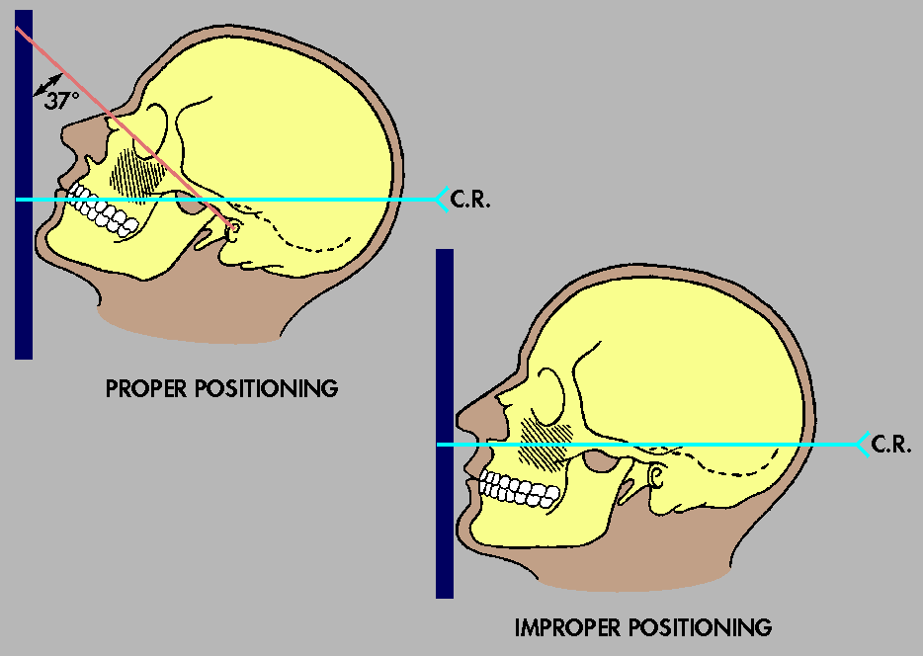

Slide 18
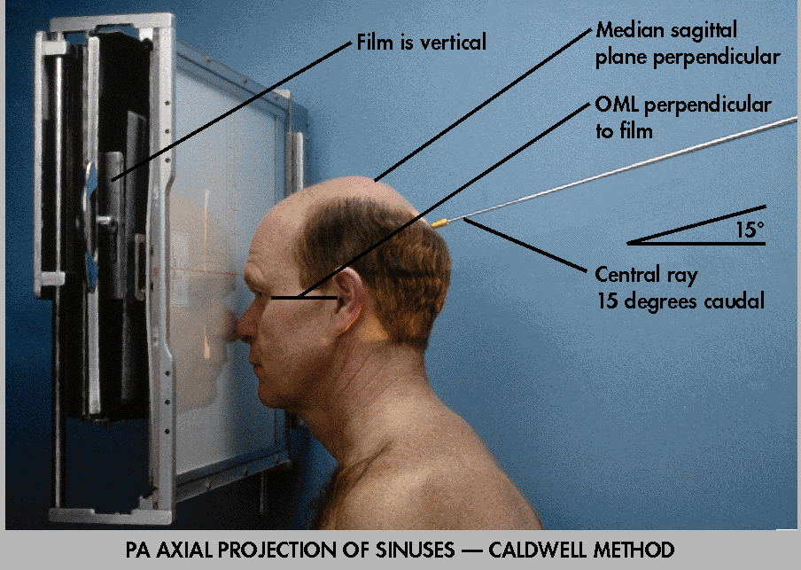

Slide 19
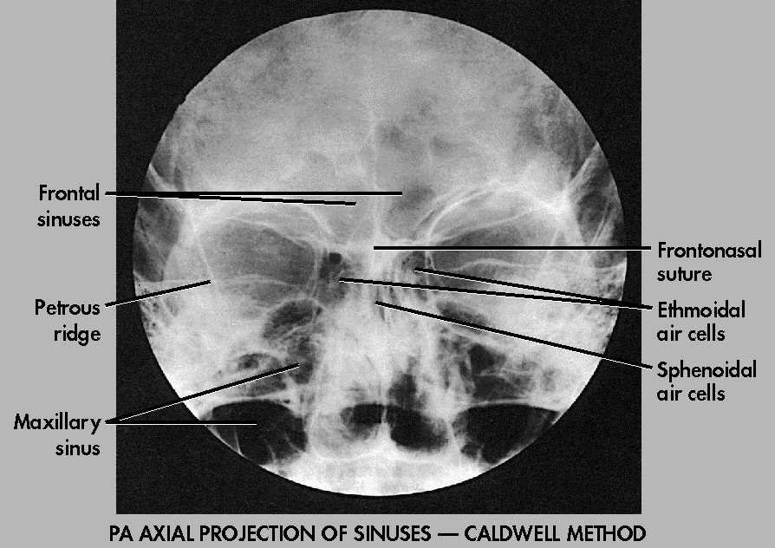

Slide 23
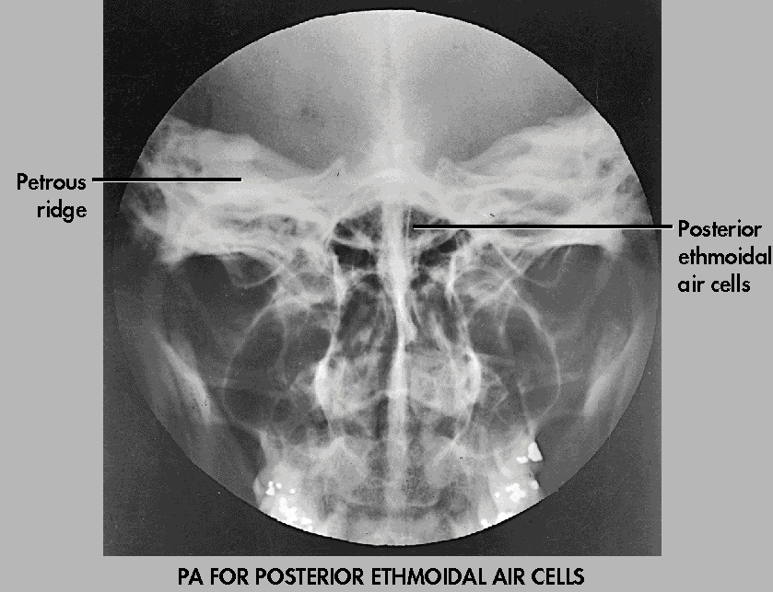

Slide 25
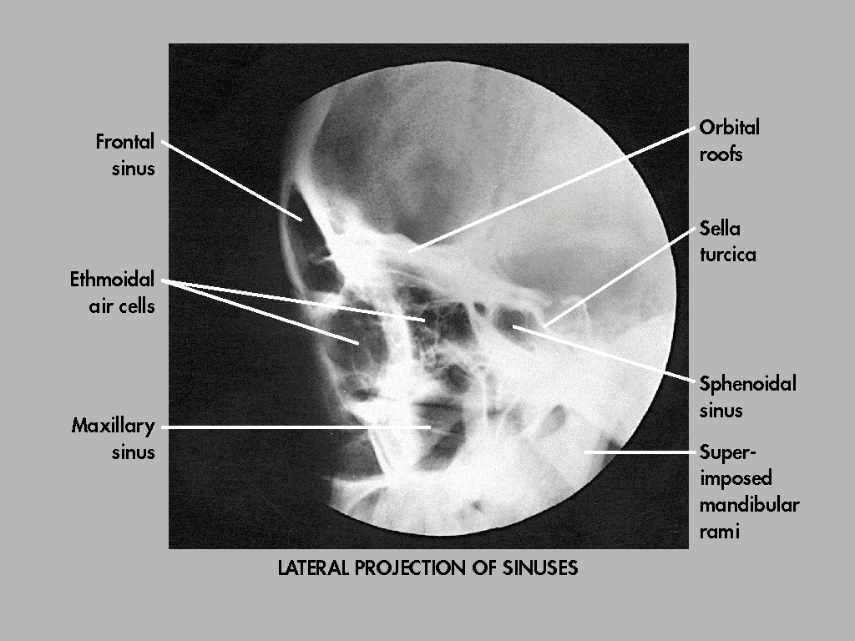
LATERAL VIEW

Slide 27
NASAL SEPTUM
Alterations of the nasal septum (delimited by the vomer, perpendicular plate for the ethmoid bone and septal cartilage) result in morphological variations such as septal deviation, chondrovomeral junction deformity and nasal bone spur.
Septal deviation is a shift of the midline associated with deformities or asymmetry of the adjacent turbinates or of the nasal wall structure, with variable presentations in the population.

Slide 28
Nasal septal spur
Nasal septal spur is a generally asymptomatic bone deformity that may cause restriction of the nasal air flow, and that may be associated with septal deviation.
Depending on the degree of obstruction and symptoms severity, surgical correction may be required.

Slide 30
Posterior Nasal Septal Air Cell
Air cells may be seen in the posterosuperior portion of the nasal septum and may communicate with the sphenoid sinus.
Any inflammatory disease that occurs within the paranasal sinus may affect these cells. It can resemble a cephalocele. CT scan and magnetic resonance imaging (MRI) are useful to differentiate this entity.
Coronal CT showing posterior nasal sepal air cell.

Slide 31
Posterior Nasal Septal Air Cell

Slide 32
Middle Turbinate Variations
(a) Paradoxical curvature: Normally the convexity of the middle turbinate is directed medially toward the nasal septum. When the convexity is directed laterally, it is termed a paradoxical middle turbinate.
Depending on the degree of curvature of the paradoxical turbinate, compression of the infundibulum and sinusal obstruction may be observed.
Most authors agree that the paradoxical middle turbinate can be a contributing factor to sinusitis.

Slide 33
Coronal CT showing paradoxical left middle turbinate (arrow)

Slide 34
(b) Concha bullosa: This is an aerated turbinate, most often the middle turbinate. When pneumatization involves the bulbous portion of the middle turbinate, it is termed concha bullosa.
If only the attachment portion of the middle turbinate is pneumatized, it is termed lamellar concha. A concha bullosa may obstruct the ethmoid infundibulum.
Clinical importance-Varied degrees of pneumatization of the concha may be observed, possibly causing middle meatus or infundibulum obstruction, besides being related to deviation of the nasal septum to the contralateral side.

Slide 35
Pneumatized bulbous portion of middle turbinate—concha bullosa—bilaterally

Slide 36
Left lamellar concha

Slide 39
UNCINATE PROCESS VARIATIONS
The uncinate process is a superior extension of the lateral nasal wall that is anatomically relevant for draining the frontal recess. Variations such as hypertrophy, deviation and pneumatization may affect the drainage, generating abnormalities in the osteomeatal complex and predisposing to obstruction.
Traditionally, the uncinate process is identified from its lower segment through the architecture of the osteomeatal unit. Variations in the superior insertion of the uncinate process are classified according to the criteria developed by Landsberg & Friedman.

Slide 43
Coronal CT showing bilaterally pneumatized uncinate process (arrow). Also note bilateral concha bullosa (stars)

Slide 44
PARANASAL SINUSES PNEUMATIZATION EXTENT
The sphenoid sinuses arise from presphenoid bone centers, with variable pneumatization extent.
In most of cases, pneumatization presents recesses related to the greater sphenoid wing, although lateral extensions may also be observed in the smaller sphenoid wing, inferolateral and septal recesses.

Slide 45
Frontal sinus extension
Frontal sinus extension is a rare condition characterized by increased sinusal aeration beyond the normal margin of the frontal bone that originates from anterior extension of the anterior ethmoid air cells.
Extensions related to the lamina of the frontal bone, crista galli, besides inferior, symmetric extension of the frontal sinus towards the anterior ethmoid air cells may also be found predominantly in male individuals in the age range between 20 and 40 years.

Slide 46
Maxillary sinus extension
As regards the maxillary sinus, four recesses have been described, as follows:
1)The palatine recess that extends inferomedially to the hard palate towards the midline.
2)The alveolar recess, closely related to the molar and premolar teeth roots,
3)The infraorbital recess, projecting anteriorly along the roof of the maxillary sinus; and
4)The zygomatic recess that extends over the malar bone at variable distances.

Slide 49
Ethmoid Roof
The ethmoid roof is of critical importance for two reasons.
First, it is most vulnerable to iatrogenic cerebrospinal fluid leaks.
Second, the anterior ethmoid artery is vulnerable to injury, which can cause devastating bleeding into the orbit.
During FESS, intracranial injury can occur on the side where the position of the roof is relatively low.

Slide 50
VARIATIONS OF THE CRIBRIFORM PLATE
The cribriform plate may present at variable levels and, in such cases it is classified according to the criteria developed by Keros, that is based on the height of the olfactory fossa in relation to the roof of the ethmoid sinus as compared with the length of the lateral lamella of cribriform plate.
The higher the Keros grade, the greater the chance of injury of the cribriform plate and olfactory fossa, with consequential risk for iatrogenic cerebrospinal fluid fistula and olfactory impairment.

Slide 52
Coronal CT scan shows that the ethmoid roofs are almost in the same plane as the cribriform plate (double arrow) – Keros type I

Slide 53
Coronal CT reveals the olfactory fossae are deeper and the lateral lamellae are longer (double arrow) – Keros type II

Slide 54
Coronal CT shows that the olfactory fossae are very deep (double arrow) – Keros type III

Slide 55
ETHMOID CELLS VARIATIONS
Haller cells
Infraorbital ethmoid cells or Haller cells, are ethmoid air cells located anteriorly to the ethmoid bulla, along the orbital floor, adjacent to the natural ostium of the maxillary sinus, which may cause mucociliary drainage obstruction, predisposing to the development of sinusitis.

Slide 57
Coronal CT shows right Haller cell (star). These cells may contribute to narrowing of the infundibulum

Slide 58
Agger nasi cells
Agger nasi cells which are the most anterior ethmoid cells, are located anteriorly to the upper margin of the nasolacrimal duct and anteriorly to the plane of the maxillary sinus infundibulum.
Studies demonstrate that their major dimensions are correlated with frontal sinus diseases and lacrimation.

Slide 60
Onodi cells
Onodi cells are ethmoid cells that have migrated to the anterior region of the sphenoid sinus, with anterosuperior location, and intimately related to the optic nerve, causing optic neuropathy in case of certain conditions that affect such cells.
It is also a potential cause of incomplete sphenoidectomy.

Slide 61
CT PNS, coronal view, shows a septate Onodi cell (O) extending superiorly and laterally to the sphenoid sinus (S). Also seen is the extension of the Onodi cell laterally to that of the optic canal (star)

Slide 63
Bulla frontalis
Bulla frontalis are characterized by anterior ethmoid cells which invade the frontal bone, bulging its floor, but with no connection with this sinus.
They are more easily demonstrated at sagittal computed tomography, where they appear as ethmoid air cells located above the ethmoid bulla and as an extension towards the frontal sinus.
Depending on their size and pneumatization extent, such cells may affect the frontal sinus drainage, representing a real diagnostic challenge in addition to the difficulty of the surgical management of inflammatory diseases involving such a sinus.

Slide 65
Frontal Recess
The frontal recess refers to the narrowest anterior air channels that communicate with the frontal sinus. They are common sites of inflammation.
The walls of the recess are formed by the agger nasi cell anteriorly, the lamina papyracea laterally, and the middle turbinate medially.
This recess opens into the middle meatus in 62% of subjects and into the ethmoid infundibulum in 38%.
This recess is identified superior to the agger nasi cell.

Slide 66
The frontal recess classified into four types as follows:
a) type 1: detected in 37% of frontal recesses; defined as a single ethmoid cell located anteriorly to the frontal recess and above the agger nasi cell;
b) type 2: detected in 19% of cases; two or more ethmoid cells located anteriorly to the frontal recess, above the agger nasi cell.
c) type 3: represents 6-8% of cases; a single, voluminous cell detected above the agger nasi cell, with extension to the frontal sinus;
d) type 4: rarely found, it represents 2- 4% of cases, corresponding to an ethmoid cell within the frontal sinus, with no connection with the agger nasi cell.

Slide 68
Bulla Ethmoidalis
This is the largest and most prominent anterior ethmoid air cell. It is related laterally to the lamina papyracea. It may fuse with the skull base superiorly and with the lamella basalis posteriorly. On coronal CT scan it is seen superior to the ethmoid infundibulum.
The degree of pneumatization varies, and failure to pneumatize is termed torus ethmoidalis. A ‘giant bulla’ may fill the entire middle meatus and force its way between the uncinate process and the middle turbinate.

Slide 69
Coronal CT shows ethmoid bulla (arrow) superior to the ethmoid infundibulum (star)

Slide 70
MAXILLARY SINUSES SEPTA
Maxillary sinus septa are thin walls of cortical bone present within the maxillary sinus, with variable number, thickness and length.
Such septa may divide the sinus into two or more cavities arising from the inferior and lateral walls of the sinus.
Septa originating from teeth may be classified according to their development at the different phases of the dental eruption.

Slide 72
ACCESSORY MAXILLARY OSTIA
Accessory maxillary ostia are generally solitary, but occasionally may be multiple.
Such variation may be congenital or secondary to sinusal diseases. Possible mechanisms involved in the development of such variation include: main ostium obstruction, maxillary sinusitis or anatomical/pathological factors in the middle meatus, resulting in rupture of membranous areas⁽¹⁷⁾.

Slide 74
Aerated Crista Galli
The crista galli is normally bony. When aerated, it may communicate with the frontal recess, causing obstruction of the ostium and thus lead to chronic sinusitis and mucocele formation. It is crucial to identify and differentiate this from an ethmoid air cell before surgery to avoid inadvertent entry into the anterior cranial fossa.

Slide 75
Aerated crista galli

Slide 76
Sphenoid Sinus
The intersphenoid septum is deflected to one side, attaching to the bony wall covering the carotid artery, and thus arterial injury may result when the septum is avulsed during surgery.
The artery may bulge into the sinus in 65-72% of patients. There may be dehiscence/absence of the thin bone separating the artery and the sinus in 4-8% of cases.
The pterygoid canal or the groove of the maxillary nerve may project into the sphenoid sinus, which may result in trigeminal neuralgia secondary to sinusitis.

Slide 77
Coronal CT shows the sphenoid septum deviated to the right (arrow); it is seen to insert over the bone covering the right internal carotid artery (C)

Slide 78
Agenesis of the sphenoid sinus may be seen Coronal CT shows agenesis of the sphenoid sinus

Slide 79
Coronal CT image reveals pneumatization of the anterior clinoid process (bent up arrow) and bilateral pterygoid processes (star), with protrusion and partial dehiscence of bilateral vidian nerves (arrow)

Slide 80
Coronal CT showing pneumatized bilateral greater wing of sphenoid (star), with protrusion of maxillary nerve bilaterally (arrow). The left maxillary nerve is dehiscent. Note also the protuberant vidian nerves bilaterally (downward curved arrow)

Slide 81
Variations of the Optic Nerve
The optic nerve, carotid arteries, and vidian nerve develop prior to the paranasal sinuses, and are responsible for the congenital variations in the walls of the sphenoid sinus.
Delano, et al., categorized the various relationships between the optic nerve and posterior paranasal sinuses into four groups as follows:

Slide 82
Type I: The most common type, it occurs in 76% of patients. Here, the nerve courses immediately adjacent to the sphenoid sinus, without indentation of the wall or contact with the posterior ethmoid air cell.

Slide 83
Coronal CT showing type I optic nerve (arrows) the nerve is seen to course immediately adjacent to the sphenoid sinus, without contact with the posterior ethmoid air cell

Slide 84
Anterior clinoid process pneumatization is associated with type II and type III optic nerve and predisposes this nerve to injury during FESS.
Type II: The nerve courses adjacent to the sphenoid sinus, causing an indentation of the sinus wall, but without contact with the posterior ethmoid air cell.
Type III: The nerve courses through the sphenoid sinus with at least 50% of the nerve being surrounded by air

Slide 85
Coronal CT showing type II optic nerve (curved arrows) causing an indentation of the sinus wall, but without contact with the posterior ethmoid air cell

Slide 86
Coronal CT shows type III optic nerve (arrows) where more than 50% of the nerve is surrounded by air

Slide 87
Type IV: The nerve course lies immediately adjacent to the sphenoid and posterior ethmoid sinus
Delano, et al., found that 85% of optic nerves associated with a pneumatized anterior clinoid process were of type II or type III configuration, and of these, 77% showed dehiscence indicating the vulnerability of the optic nerve during FESS.

Slide 88
Coronal CT showing type IV optic nerve on the right (arrow) -The nerve course lies immediately adjacent to the sphenoid and posterior ethmoid sinus. O: Onodi cell; S: Sphenoid sinus

Slide 89
Coronal CT showing type IV optic nerve bilaterally (arrows). O: Onodi cell; S: Sphenoid sinus

Slide 90
Coronal CT shows pneumatisation of anterior clinoid process (stars) with type III optic nerve (stars) with bony canal dehiscence bilaterally

Slide 91
sphenoid sinus septa
The sphenoid sinus septa may be attached to the bony canal of the optic nerve, predisposing the nerve to injury during surgery)

Slide 92
Coronal CT showing sphenoid septa (arrow) attached to the bony walls of type III optic nerve bilaterally (stars

Slide 93
Conclusion
To summarize, a thorough understanding of the paranasal sinus anatomy and its variations is important and essential for FESS surgeons.
The radiologist plays a vital role in providing the information required by the surgeons.

Slide 94
Thank you

Slide 95
Ethmoid Infundibulum
The ethmoid infundibulum is bounded anteriorly by the uncinate process, posteriorly by the anterior walls of the bulla ethmoidalis, and laterally by the lamina papyracea. It opens into the middle meatus medially through the hiatus semilunaris.
On coronal CT scan, the bulla ethmoidalis is seen superior to the ethmoid infundibulum. The maxillary sinus ostium is seen to open into the floor of the infundibulum

