Slide 1
PHAKOMATOSES- 2
Z

Slide 2
Sturge Weber syndrome encephalotrigeminal angiomatosis
Congenital non hereditary disorder.
Failure of normal development of fetal cortical veins.
PORT WINE STAIN
PORT WINE = Portugal wine

Slide 3
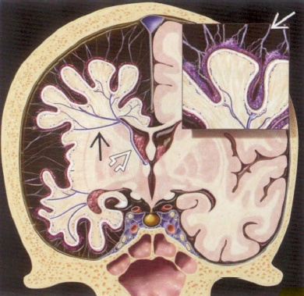
PATHOLOGY
The leptomeningeal haemangioma results in a vascular steal affecting the subjacent cortex and white matter producing localised ischaemia. In about 80% of the cases, there is an unihemispheric involvement.

Slide 4
CT Detects subcortical calcification at an earlier age than plain film and can also demonstrate associated parenchymal volume loss
tram-track sign of cortical and subcortical calcification , calvarial and regional sinus enlargement may be evident
ipsilateral choroid plexus may be enlarged
in severe cases, a Dyke-Davidoff-Masson appearance may be seen
MRI
T1: signal of affected region largely normal, with anatomic volume loss evident at older age
T1 C+ (Gd)
prominent leptomeningeal enhancement in affected area
much later in life the angioma may 'burn out' losing enhancement
enlarged ipsilateral choroid plexus
T2
low signal in white matter subjacent to angioma representing
postulated accelerated myelination in neonate
calcification later in life
abnormal deep venous drainage seen as flow voids
GE/SWI/EPI: sensitive to calcification, seen as regions of signal drop out
MR spectroscopy: decreased NAA .

Slide 5
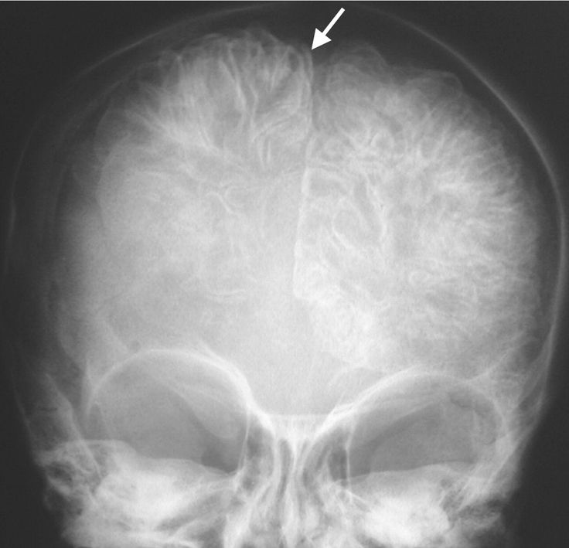
FRONTAL SKULL XRAY - GYRAL CALCIFICATIONS

Slide 6
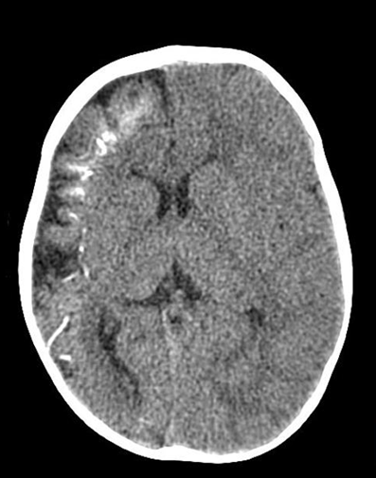
Tram track sign of gyral calcification

Slide 7
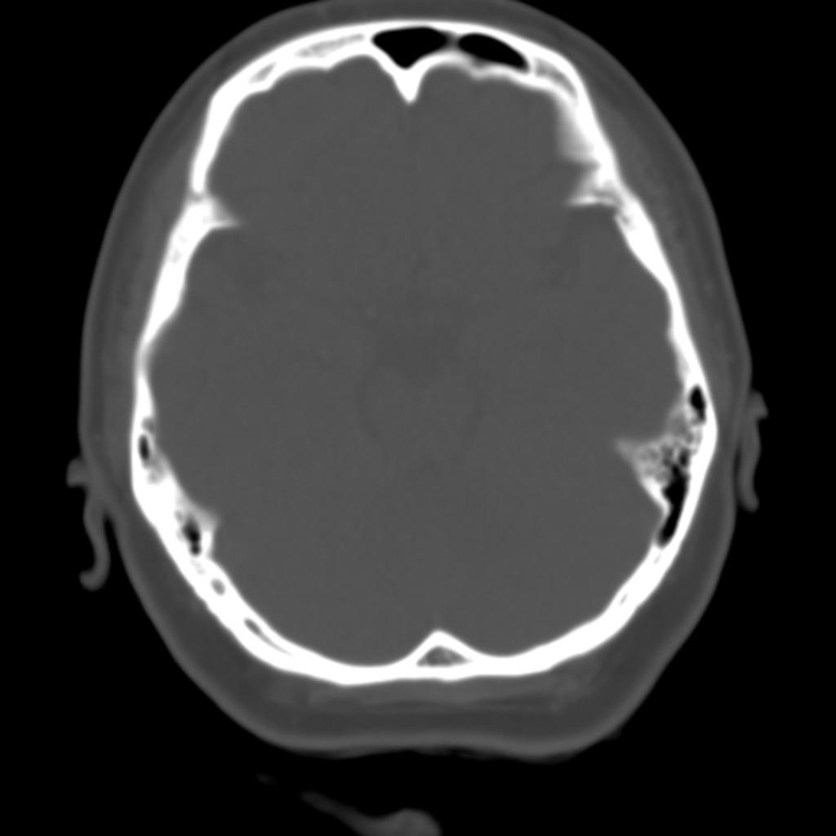
Left sided dilated frontal sinus

Slide 8
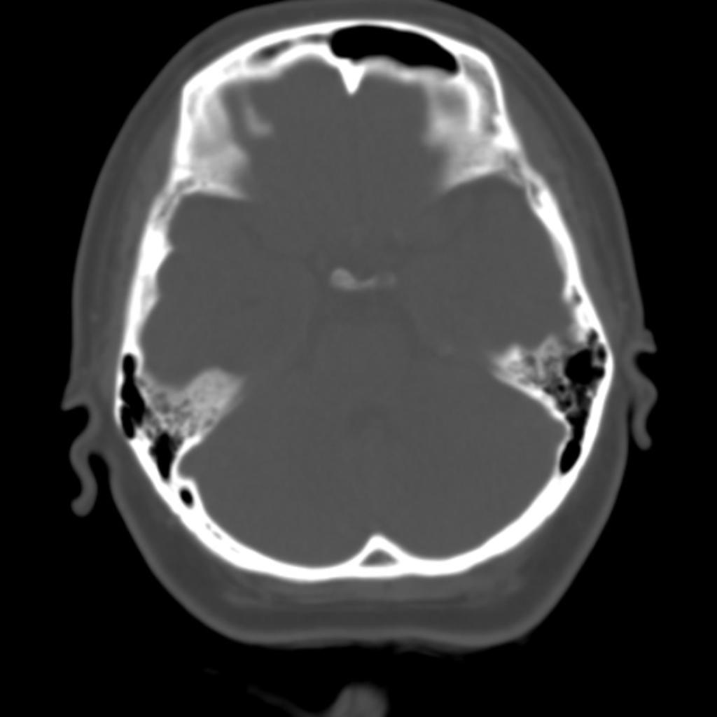
Left sided dilated frontal sinus

Slide 9
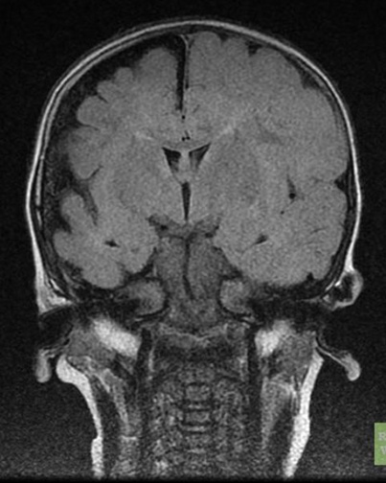
T1: signal of affected region largely normal, with anatomic volume loss.
COR T1

Slide 10
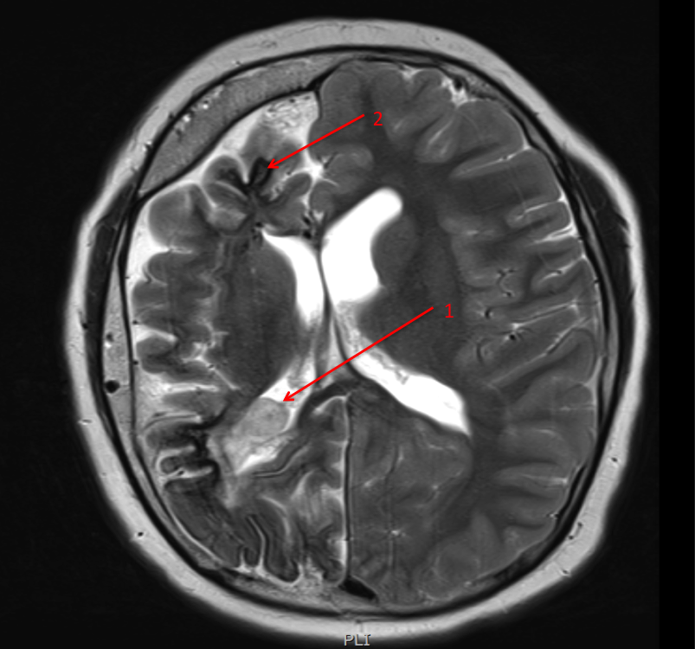
T2 weighted image, showing atrophy of the right hemisphere, enlargement of the choroid plexus (arrow 1), a thickened overlying skull and subcortical calcification (hypointense / dark signal in the subcortical region - arrow 2).

Slide 11
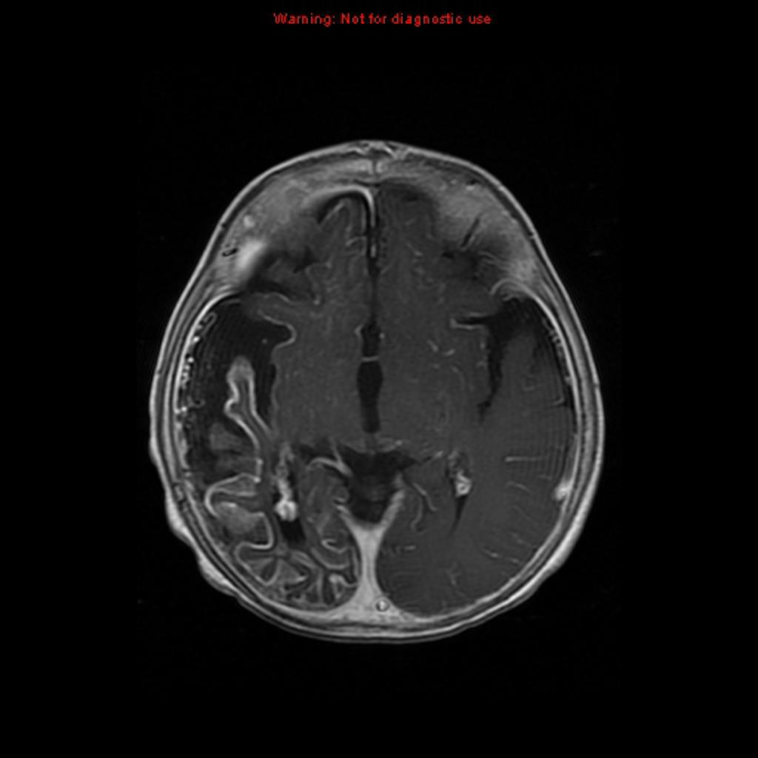
T1 C+ (Gd)
prominent leptomeningeal enhancement in affected area with
enlarged
right
sided
choroid

Slide 12
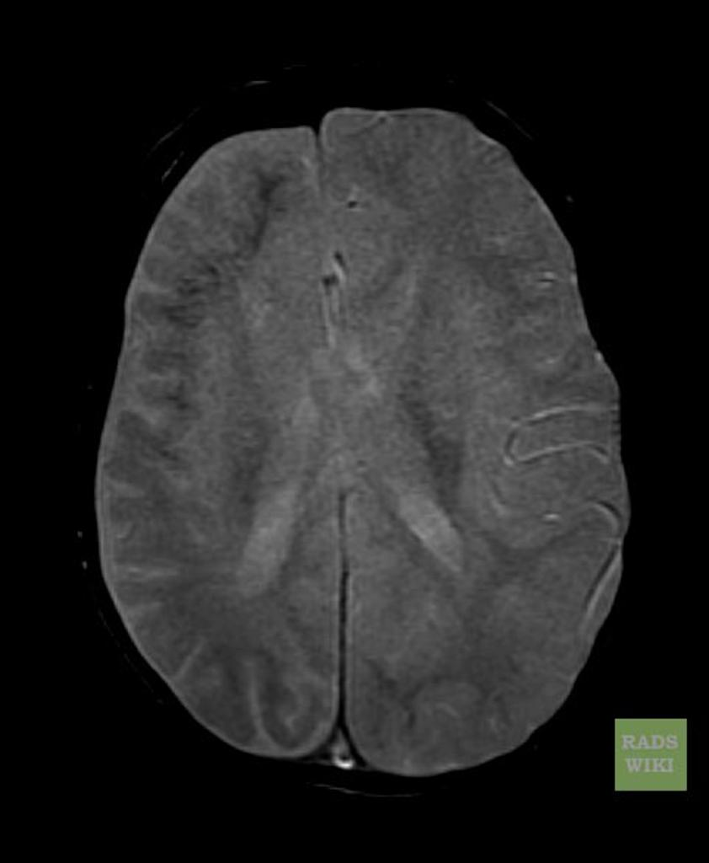
GE/SWI/EPI: sensitive to calcification seen as regions of signal drop out

Slide 13
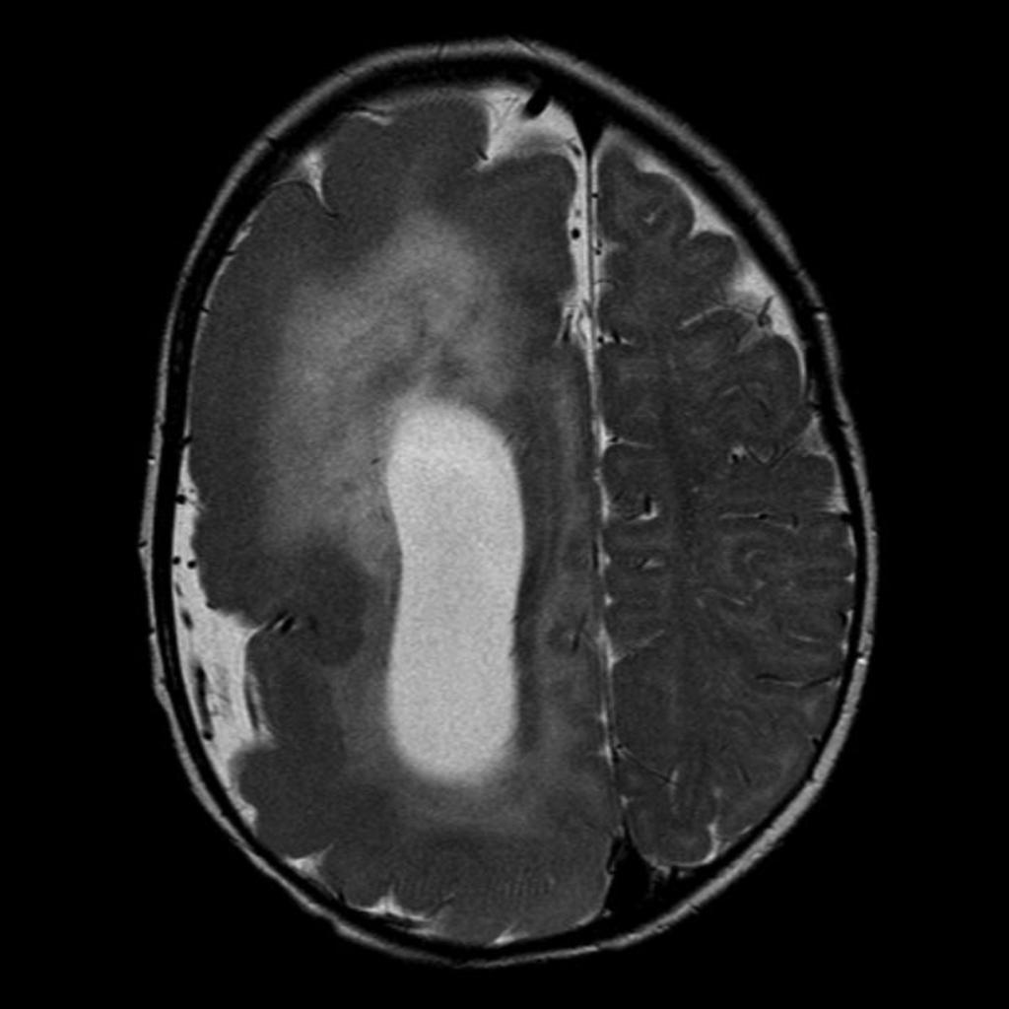
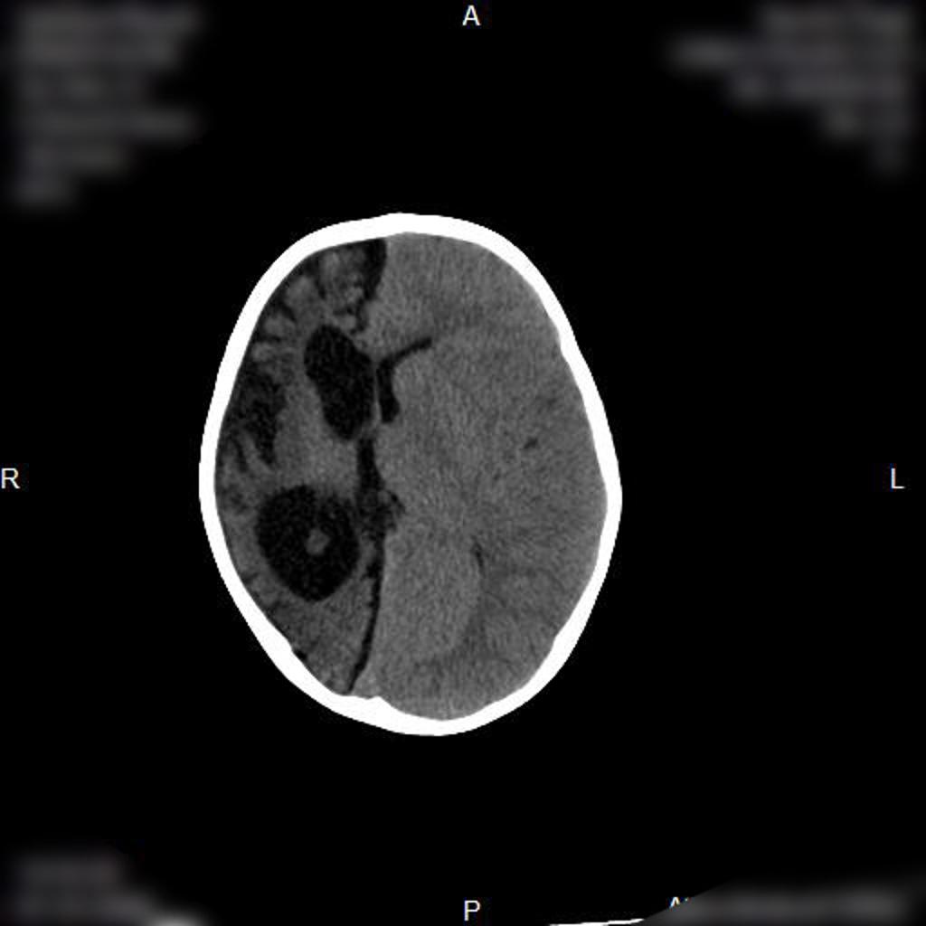
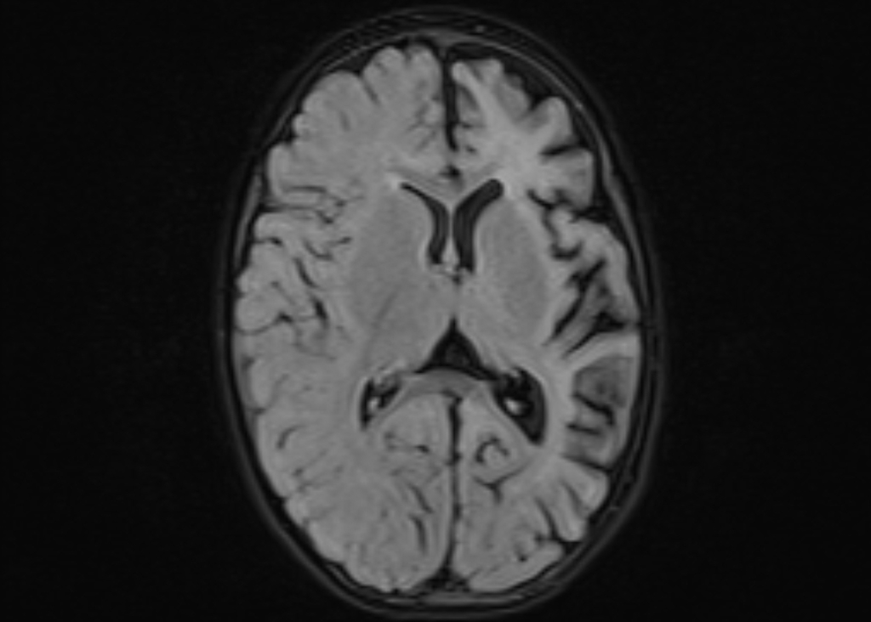
Hemimegalencephaly
Dyke davidoff masson syndrome
Rasmussen encephalitis: tends not to have calvarial changes

Slide 14
Dyke-Davidoff-Masson syndrome (DDMS) was initially described as changes in the skull seen on skull x-ray in patients with cerebral hemiatrophy but is now applied more broadly to cross-sectional imaging also. It is characterised by:
thickening of the skull vault (compensatory)
enlargement of the frontal sinus (also ethmoidal and mastoid air-cells)
elevation of the petrous ridge
ipsilateral falcine displacement
capillary malformations (are a novel finding for children with Dyke-Davidoff-Masson syndrome
DYKE DAVIDOFF MASSON APPEARANCE

Slide 15
HEMIMEGALENCEPHALY
MRI of the brain demonstrates the right cerebral hemisphere to be markedly enlarged. The grey matter is disorganized and thickened, consistent with migration arrest. The right lateral ventricle demonstrates an abnormal morphology and is also markedly enlarged. There is diffuse T2 hyperintensity throughout the white matter of the right hemisphere. The right cranial vault is also expanded.
Additionally the right cerebellar hemisphere is also enlarged with abnormal cortical formation.
The left hemisphere is essentially normal in appearance.

Slide 16
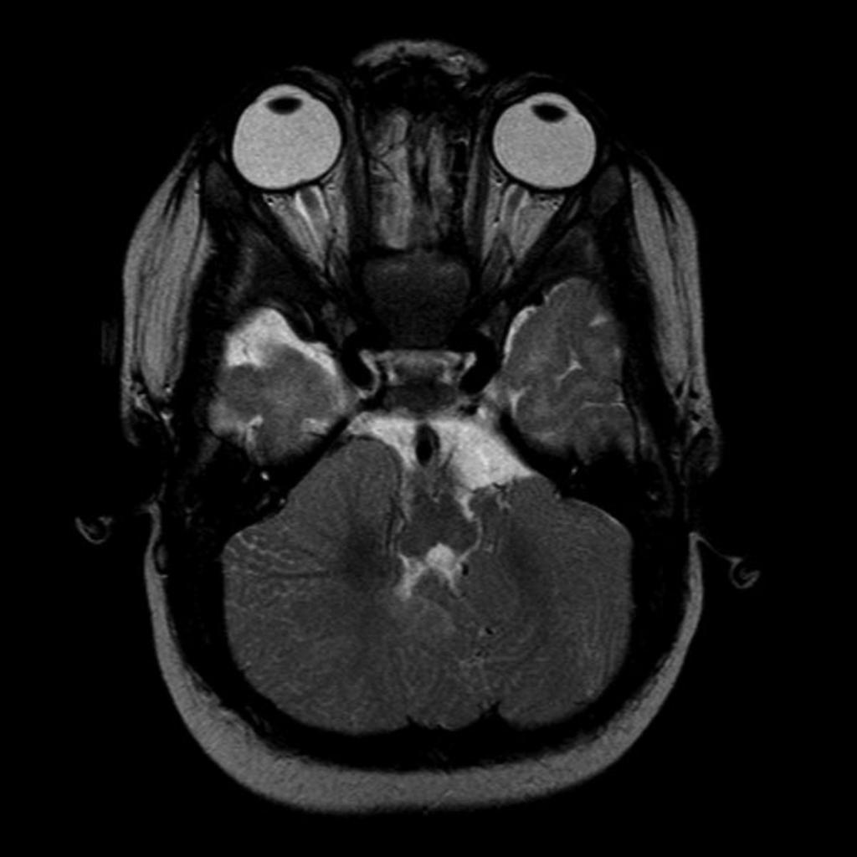

Slide 17
RASMUSSEN’S ENCEPHALITIS
ASSMUSSENS
A chronic viral infection of the brain affecting only one hemisphere with unilateral cerebral hemiatrophy resulting in drug-resistant epilepsy, and progressive neurological and cognitive deterioration.
Mild diffuse uniform atrophic changes of the left cerebral hemisphere manifested as deepening of cortical sulci and mildly decreased volume of cortex and white matter. This is associated with mild exvacuo dilatation of the left lateral ventricle. Mild diffuse T2 and FLAIR hyperintensity is noted affecting the white matter of the left cerebral hemisphere. Mild attenuation of the left middle cerebral artery is also noted.
Preserved volume and MRI features of both cerebellar hemispheres.

Slide 18
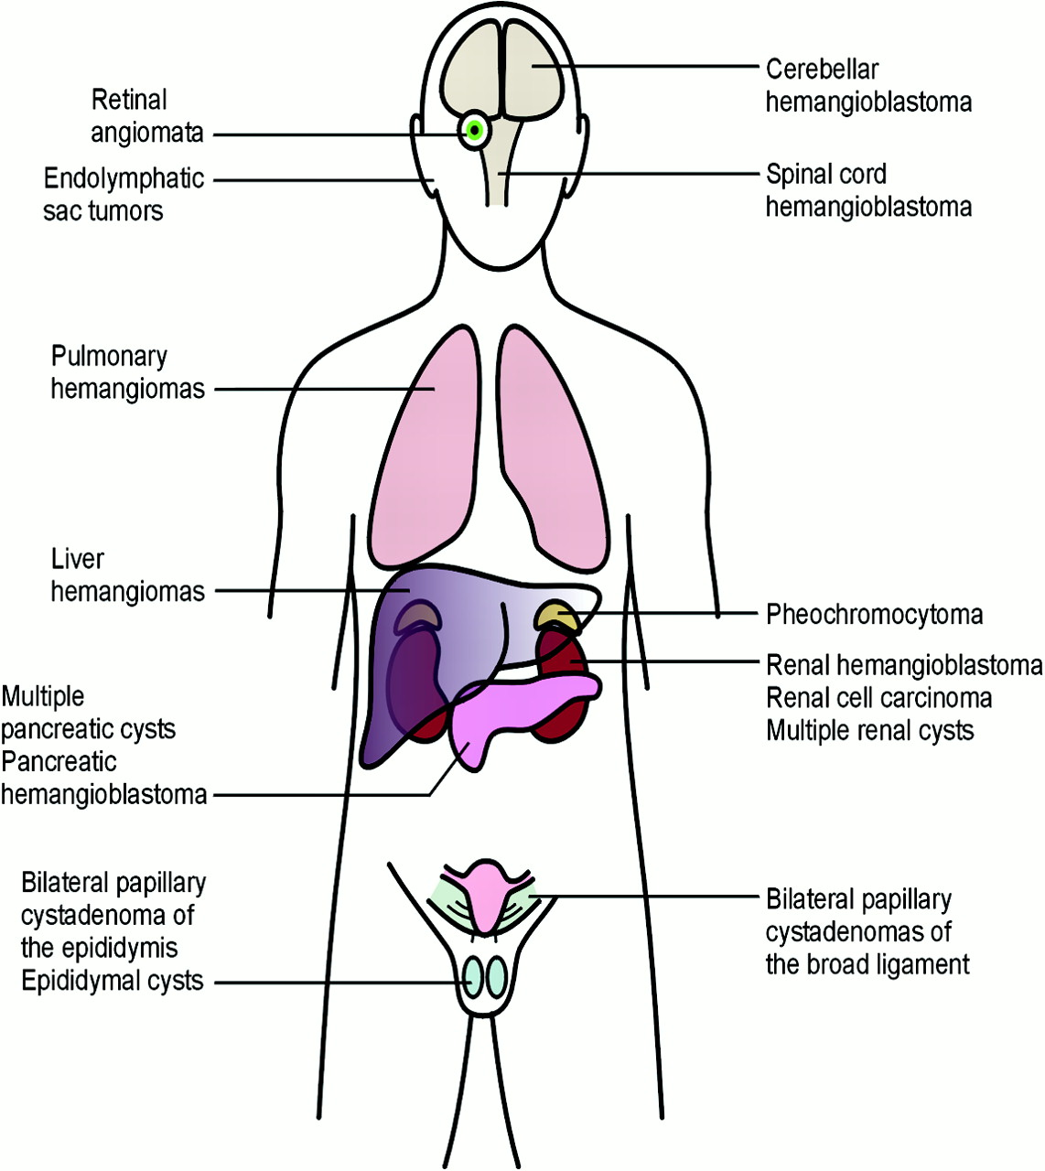
Von Hippel Lindau disease
Due to mutations in the VHL tumour suppressor gene on chromosome 3.

Slide 19
Von Hipple Lindau disease
CNS
Hemangioblastoma
Choroid plexus papilloma
Endolymphatic sac tumor
Cerebellar
Spinal
Retinal
most common presenting feature
bilateral ELSTs considered pathognomonic for vHL

Slide 20
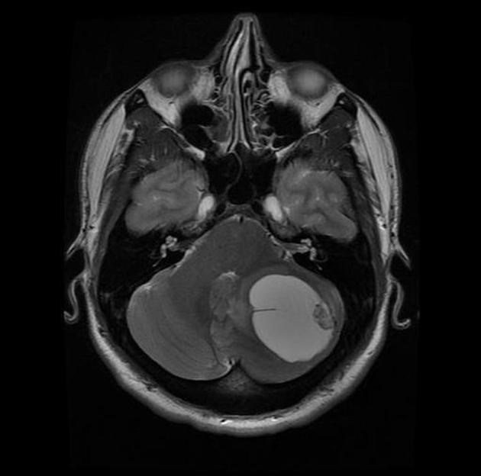

Slide 21
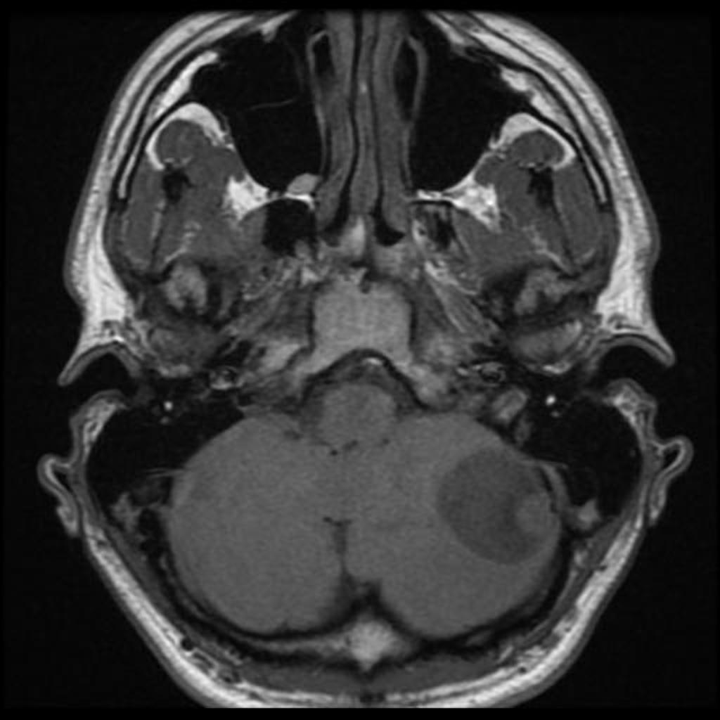

Slide 22
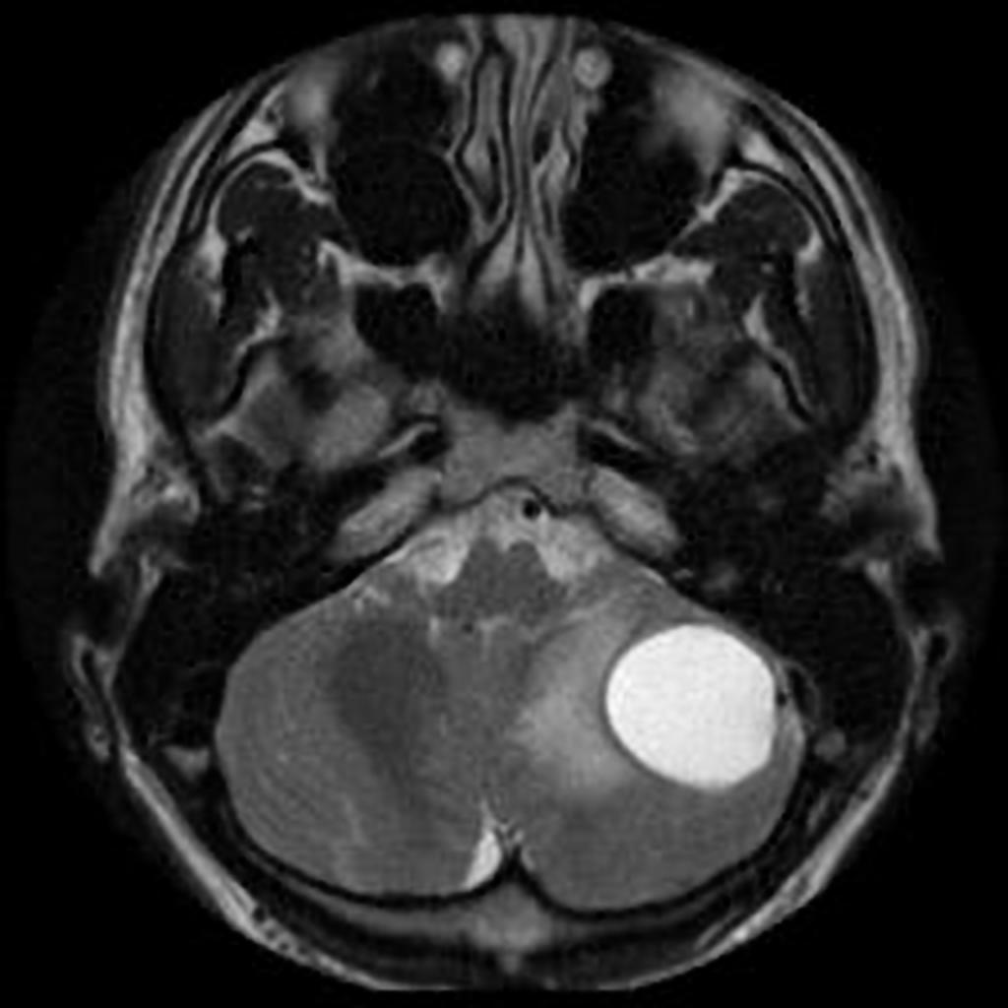

Slide 23
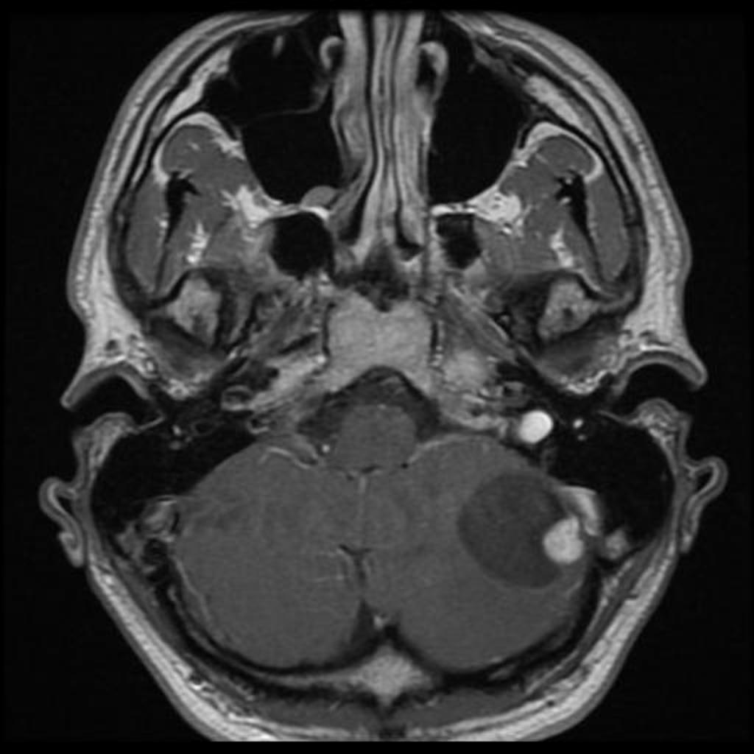

Slide 25
Pilocytic astrocytoma | Hemangioblastoma
Age: children | Age: young adults
Tumor nodule: lack vascular flow voids | Tumor nodule: show vascular flow voids
Tumor nodule often doesn’t abut pial or ependymal surface. | Tumor nodule abuts the pial or ependymal surface

Slide 26
CHOROID PLEXUS PAPILLOMA
Choroid plexus papillomas are an uncommon, benign (WHO grade I) neuroepithelial intraventricular tumour which can occur in both the paediatric (more common) and adult population.
On imaging, these tumours are usually identified in the fourth ventricle in adults and in the lateral ventricles in the paediatric population. They commonly present as a solid vascular tumour with vivid frond-like enhancement pattern. In a quarter of cases, speckled calcifications are present.

Slide 27
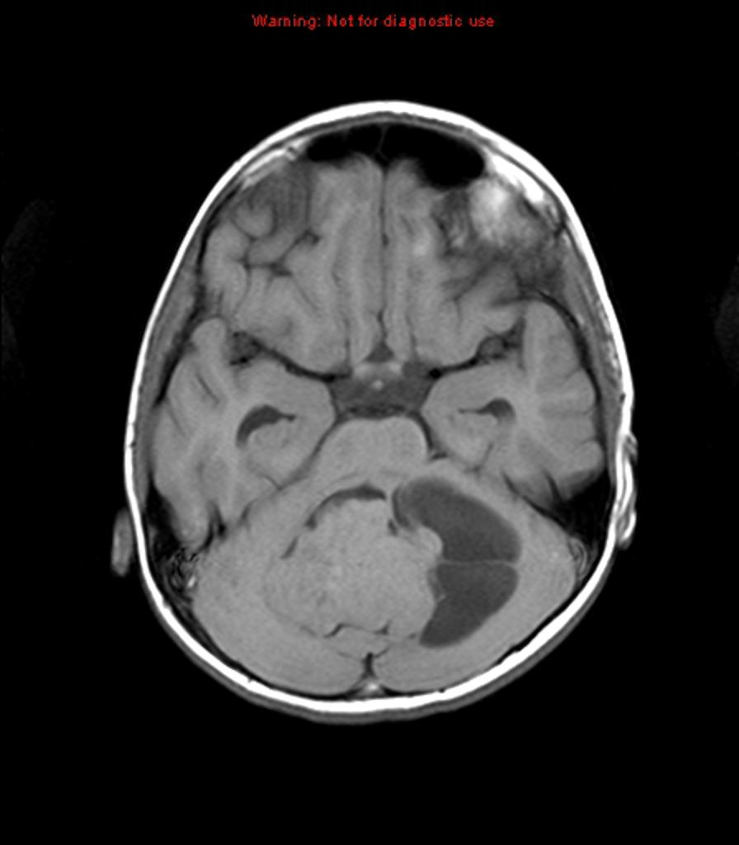
T1: typically isointense compared to adjacent brain; may be somewhat hypointense

Slide 28
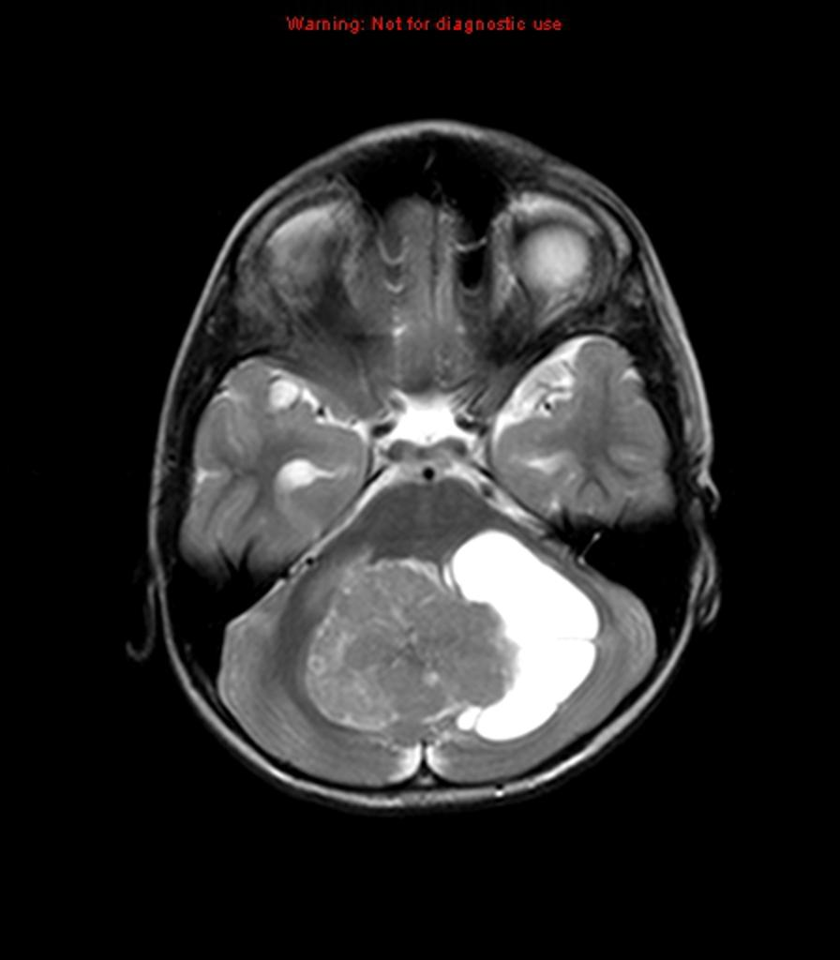
T2iso to hyperintense
small flow-voids may be seen within the tumour

Slide 29
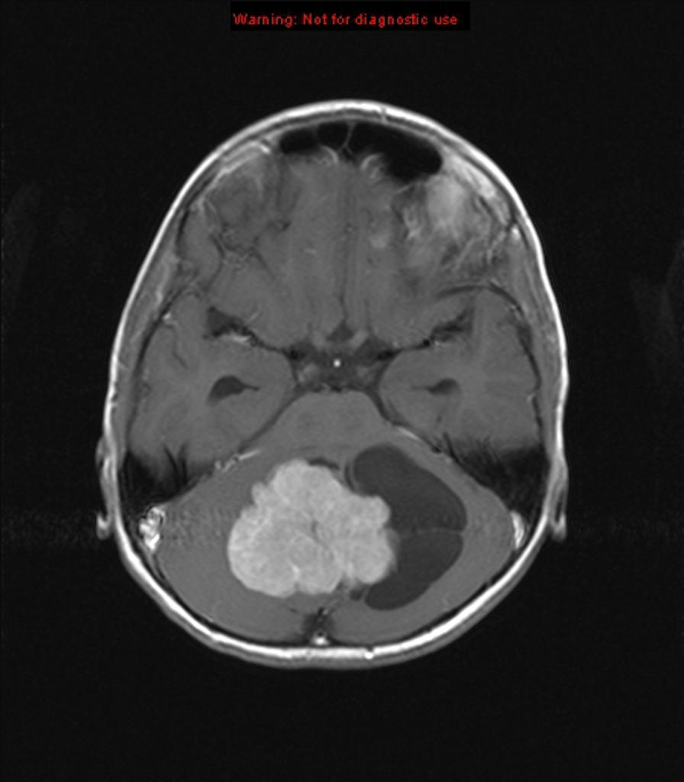
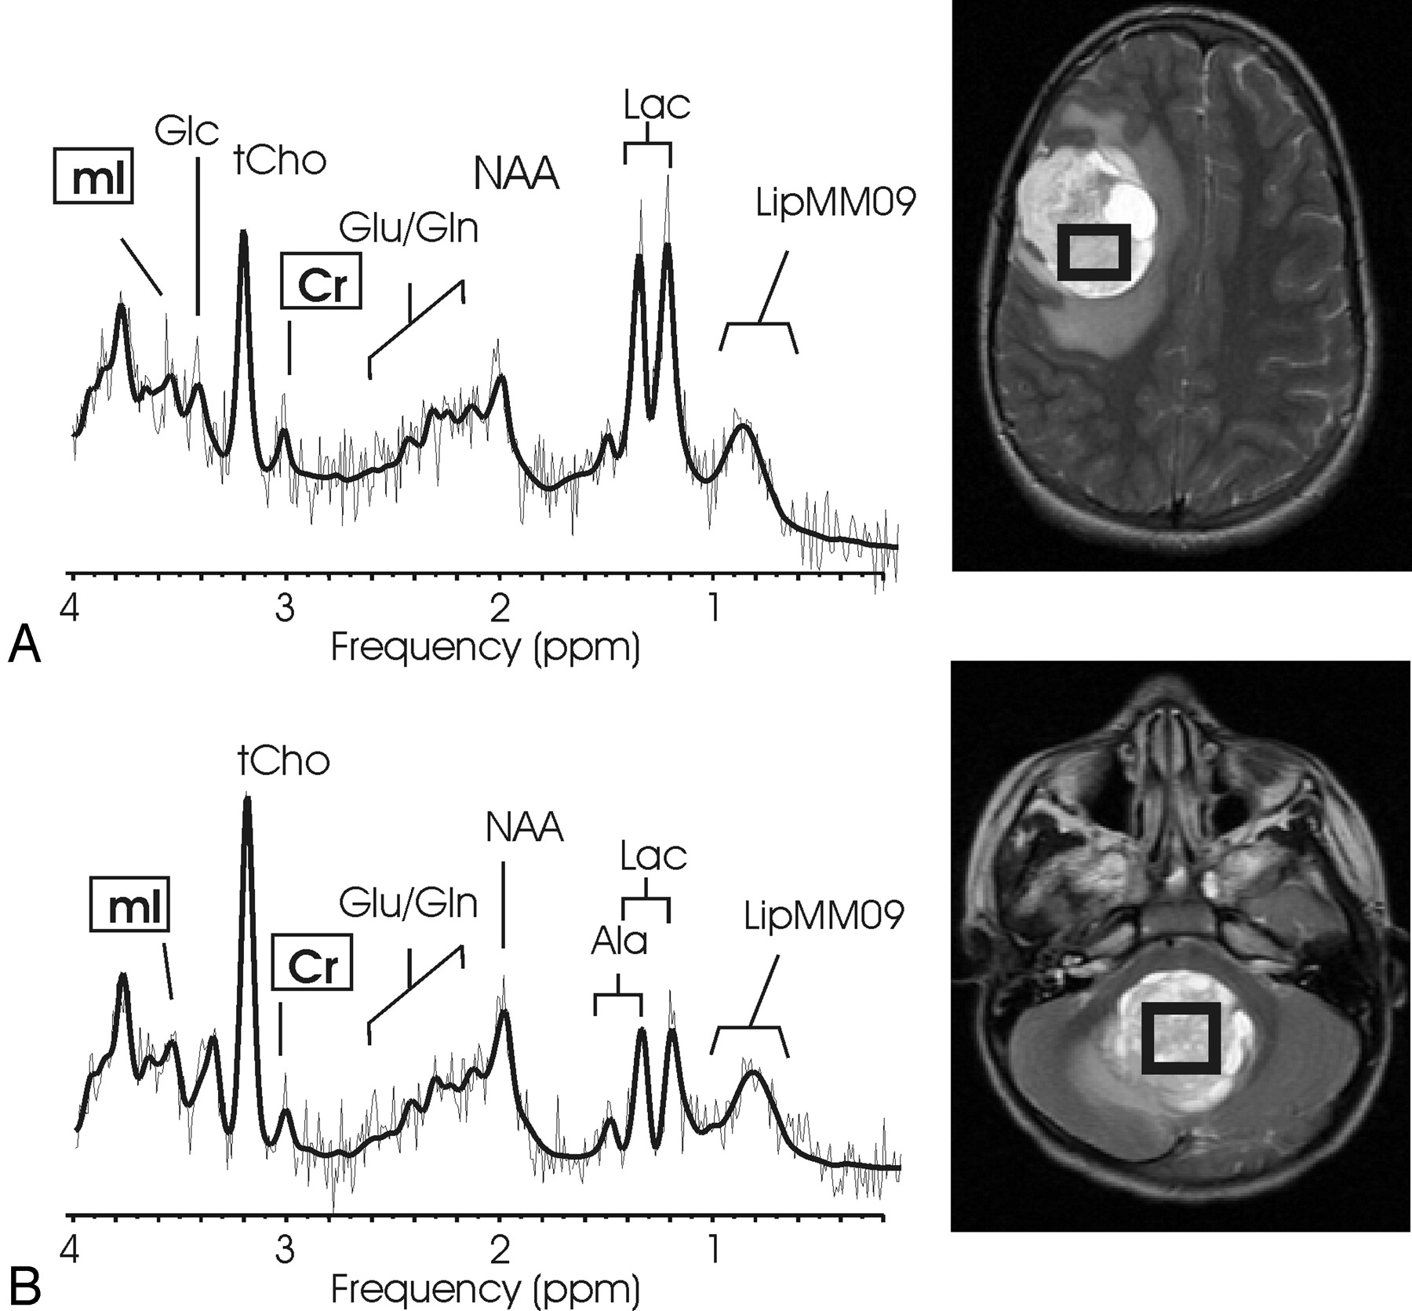
T1 C+ (Gd): marked enhancement, tends to be homogeneous
MR spectroscopy
decreased NAA
increased Cho

Slide 30
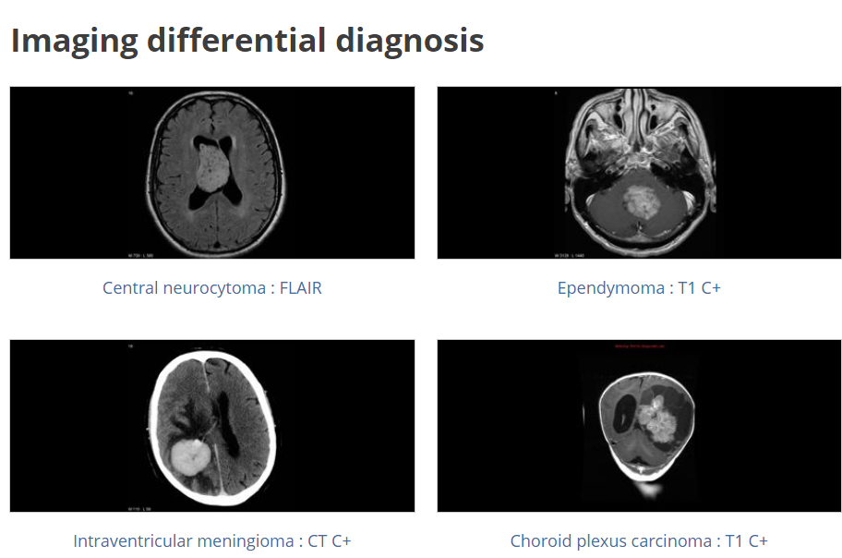

Slide 31
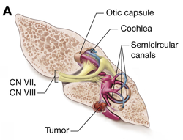
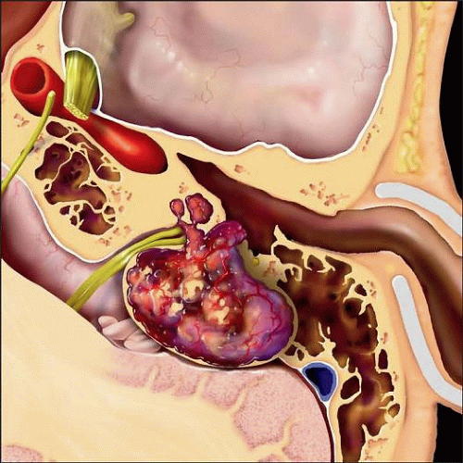
ENDOLYMPHATIC SAC TUMOR
IMAGING
T1 hyperintense, T2 hyperintense, multilobulated mass at the location of the vestibular aqueduct.

Slide 32
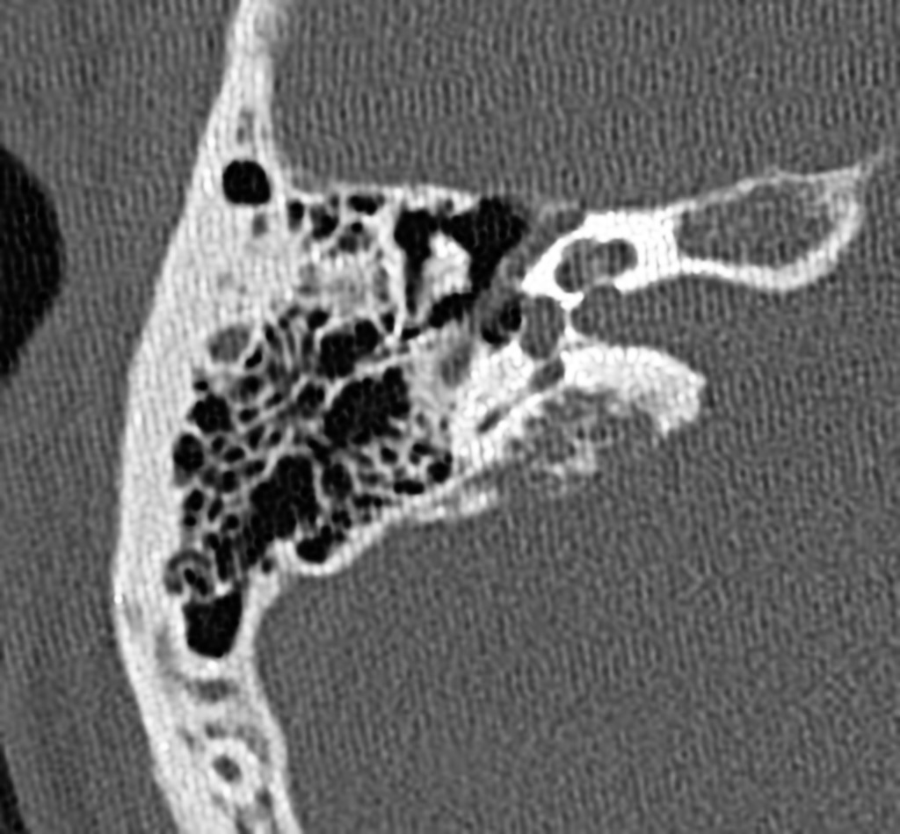
It gives a picture of bone erosion and the "moth-eaten" petrous bone. Endolymphatic sac tumours commonly enhance intensely on CT.

Slide 33
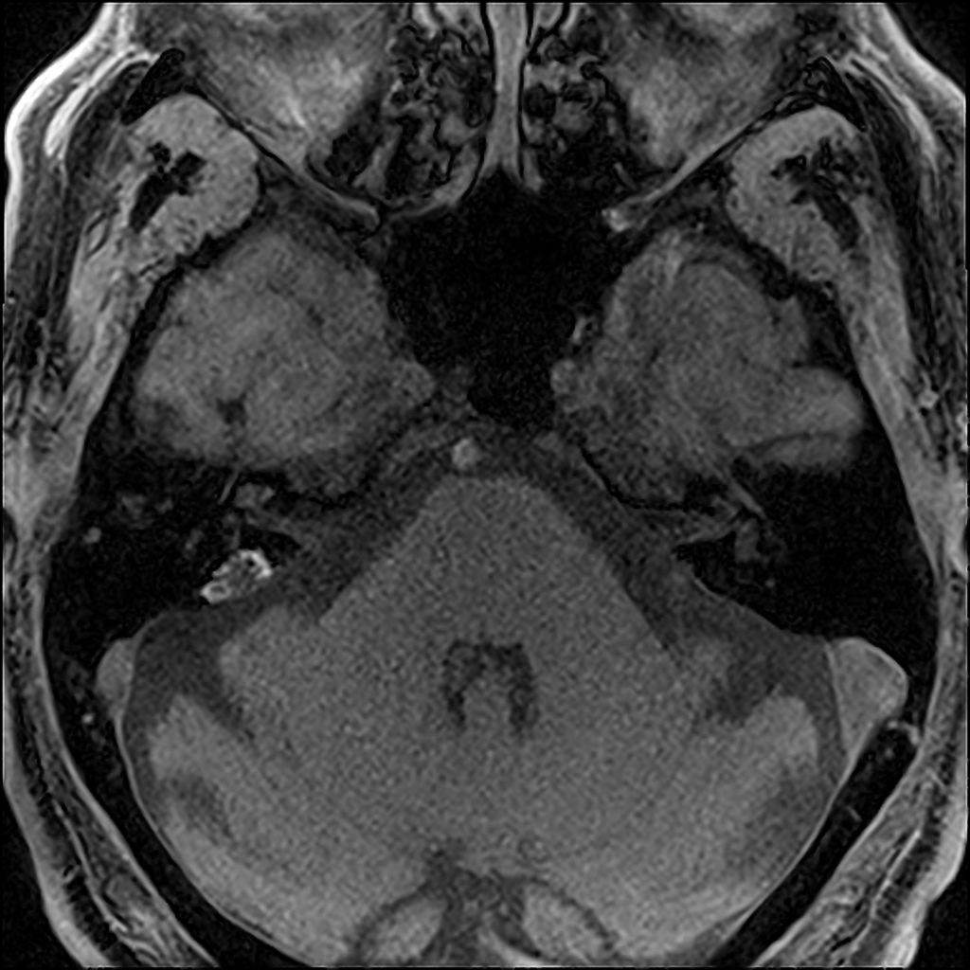

Slide 34
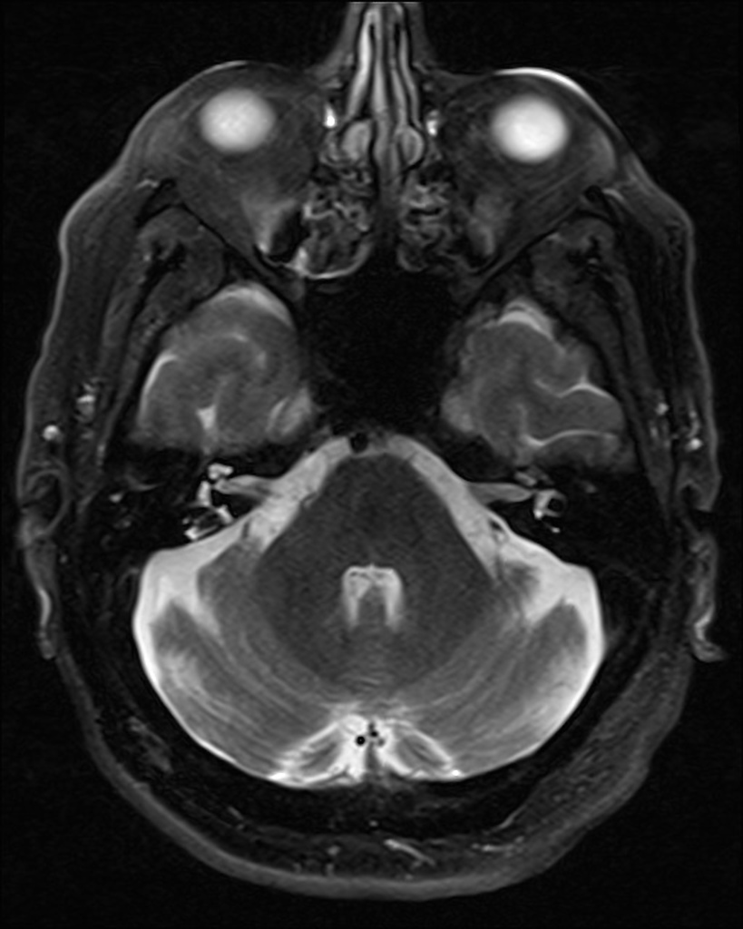

Slide 35
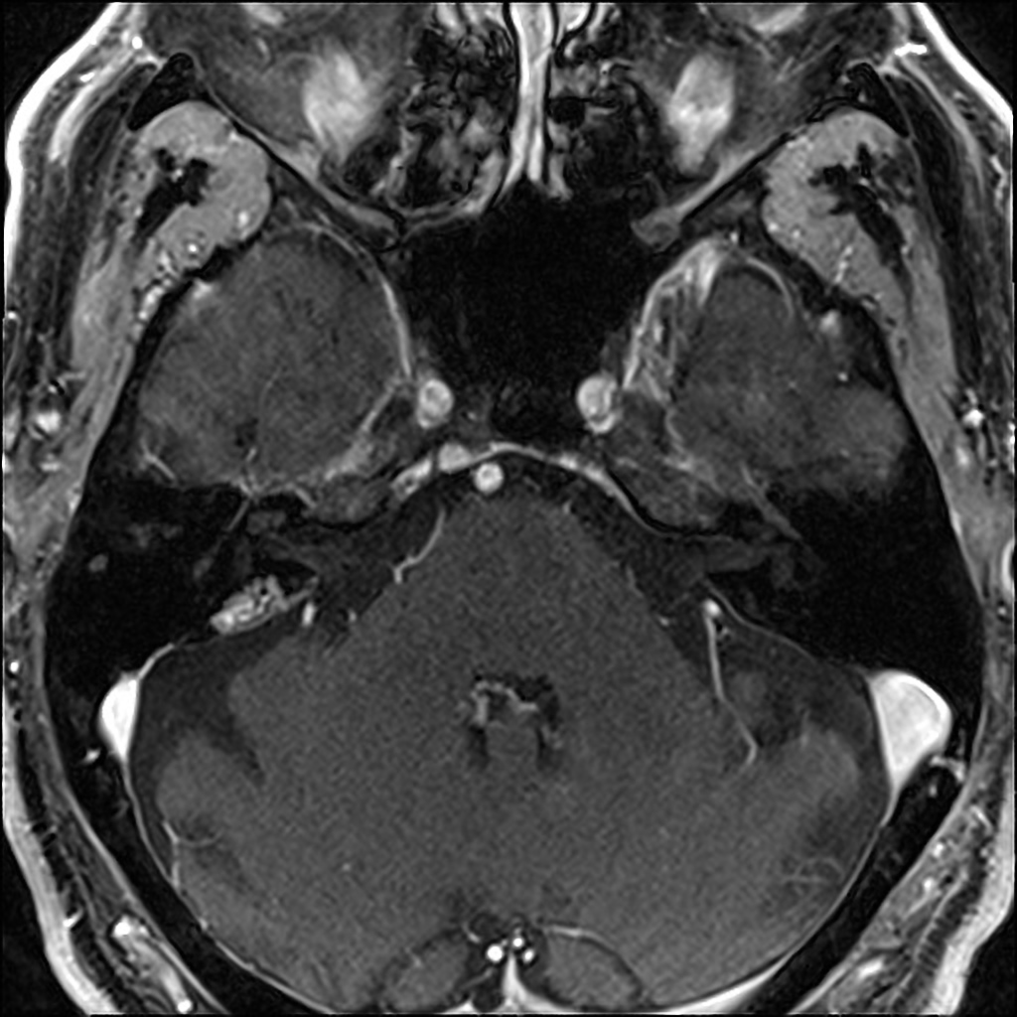

Slide 37
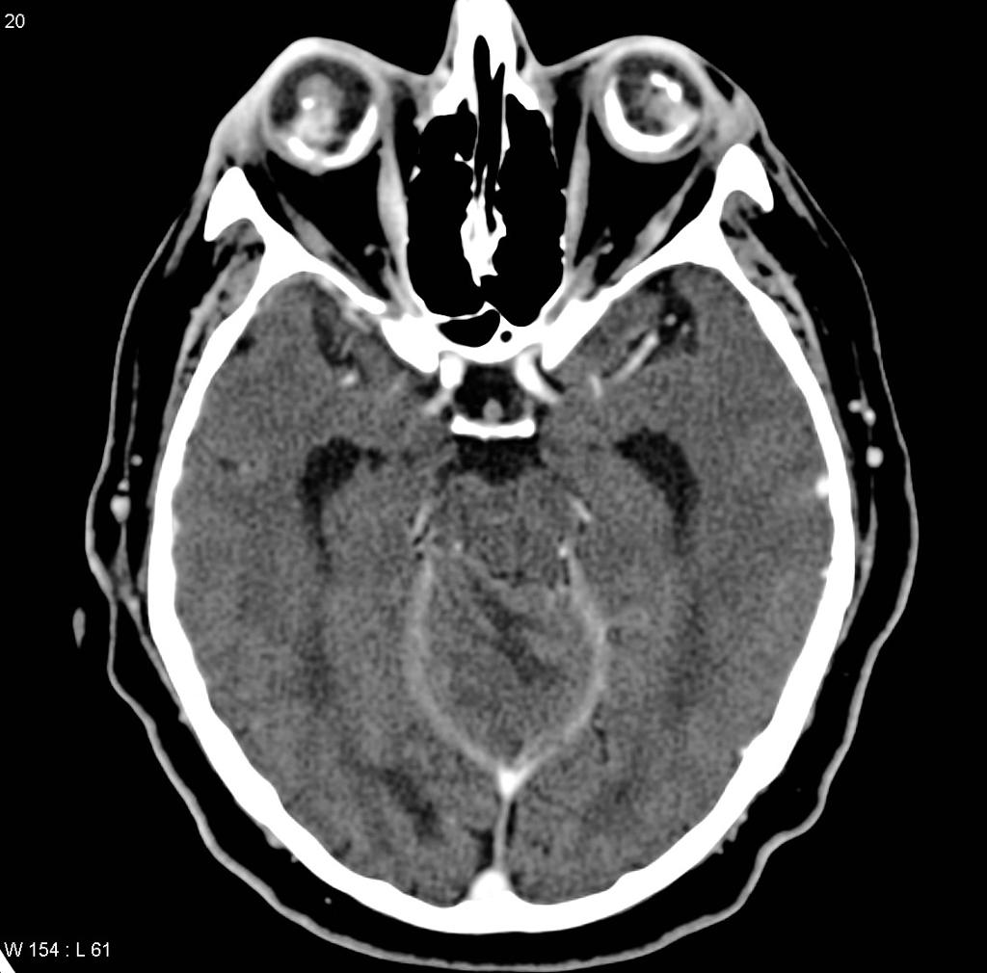

Slide 38
INCONTINENTIA PIGMENTI
Incontinentia pigmenti, also known as Bloch-Sulzberger syndrome, is a rare condition that can affect many body systems, specially the skin. As an X-linked dominant genetic disorder, it occurs much more often in females than in males.
CNS
microcephaly
cerebral atrophy
hypoplasia of corpus callosum
periventricular white matter damage
strokes
hydrocephalus
porencephalic cysts
neuronal heterotopias

Slide 39
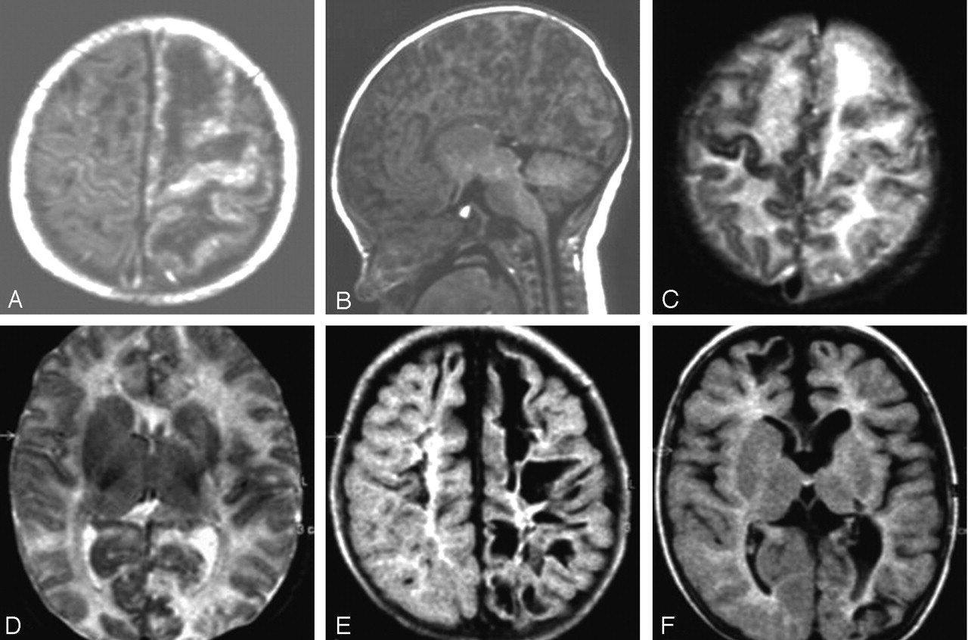
MR imaging on the 3rd day of life (A–D) and at the age of 5 months (E and F).
A and B, T1-weighted images. The sagittal view (B) illustrates the extensive cortical damage including cerebellar cortex.
C and D, Axial T2-weighted images, demonstrating high signal intensity in the subcortical white matter mainly of the left hemisphere and also signal intensity changes of almost the entire left cortex. On T1-weighted images, these white matter areas appear hypointense (A). E and F, At follow-up, fluid-attenuated inversion recovery images show residual cystic lesions, more on the left than on the right, involving mainly subcortical white matter and also cortical areas. There is no normal signal intensity of myelination. Basal ganglia appear atrophic on the left (F).

Slide 40
Hypomelanosis of ITO
Skin lesions are hypopigmented zones or spots with irregular borders, sometimes whorls, or linear white streak lines following Blaschko’s lines.
The exact cause of hypomelanosis of Ito is unknown with many cases being associated with genetic mosaicism and sporadic gene mutations.
CNS
Dilated VR spaces
hypoplasia or cerebellar atrophy
focal or generalized cerebral atrophy
neuronal heterotopias
hemimegalencephaly
HI has been associated rarely with vascular anomalies as Moyamoyasyndrome.

Slide 41
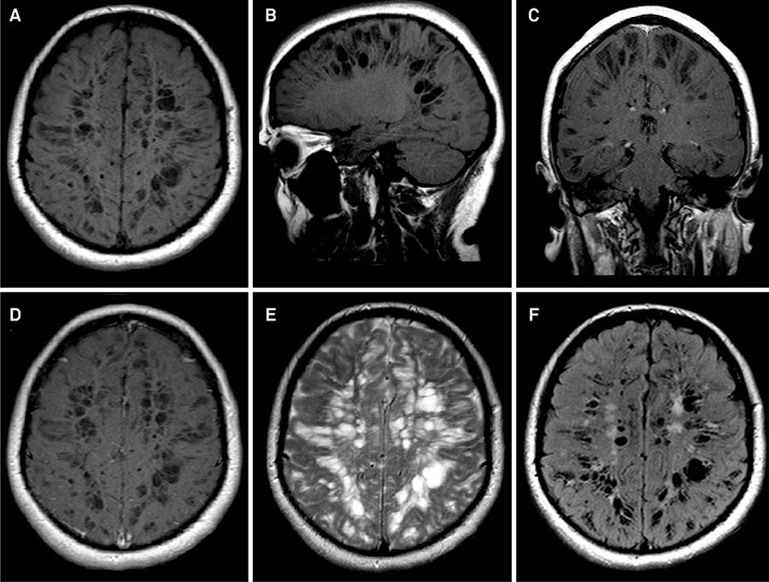
Brain MRI disclosing marked enlarged Virchow-Robin spaces in axial (A) and sagittal (B) unenhanced T1-weighted images and in coronal (C) and axial (D) enhanced T1-weighted images. Axial T2-weighted (E) and FLAIR (F) images shows enlarged Virchow-Robin spaces with mild surrounding gliosis depicted as T2 and FLAIR hyperintense foci.

Slide 42
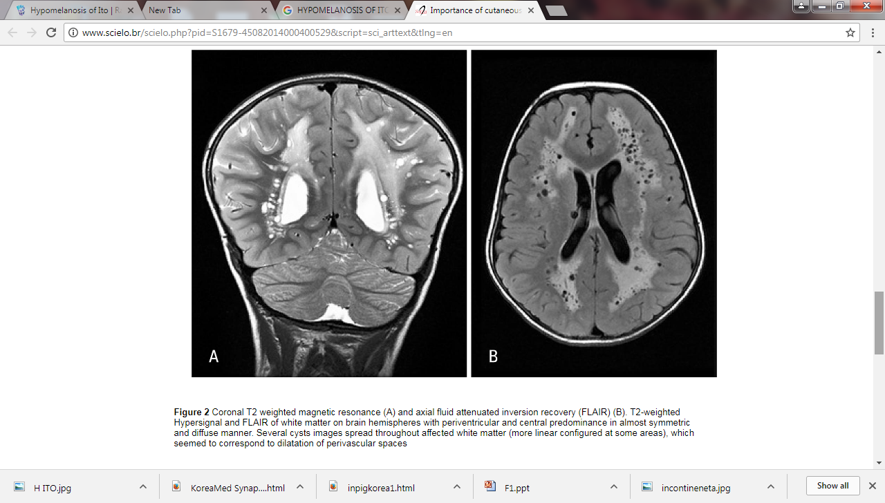

Slide 43
GROLIN GOLTZ SYNDROME – BASAL CELL NAEVUS SYNDROME
It is related to a mutation in PTCH tumor suppressor gene on chromosome 9
CNS
Agenesis of the corpus callosum
medulloblastoma: especially in males
macrocephaly
calcified falx cerebri
calcified tentorium.
Cranio facial.
odontogenic keratocysts, often multiple
frontal bossing
hypertelorism
Macrocephaly.

Slide 44
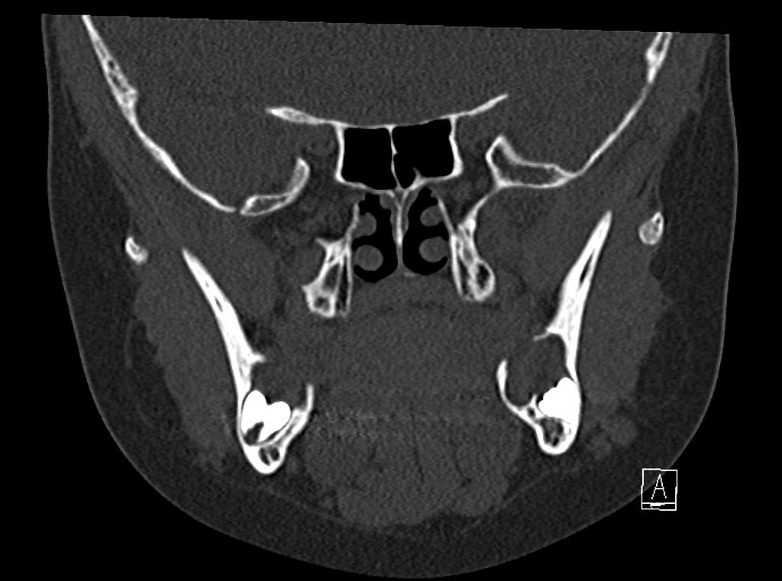
Multiple radiolucent periodontogenic lesions with smooth border and cortical thinning.

Slide 45
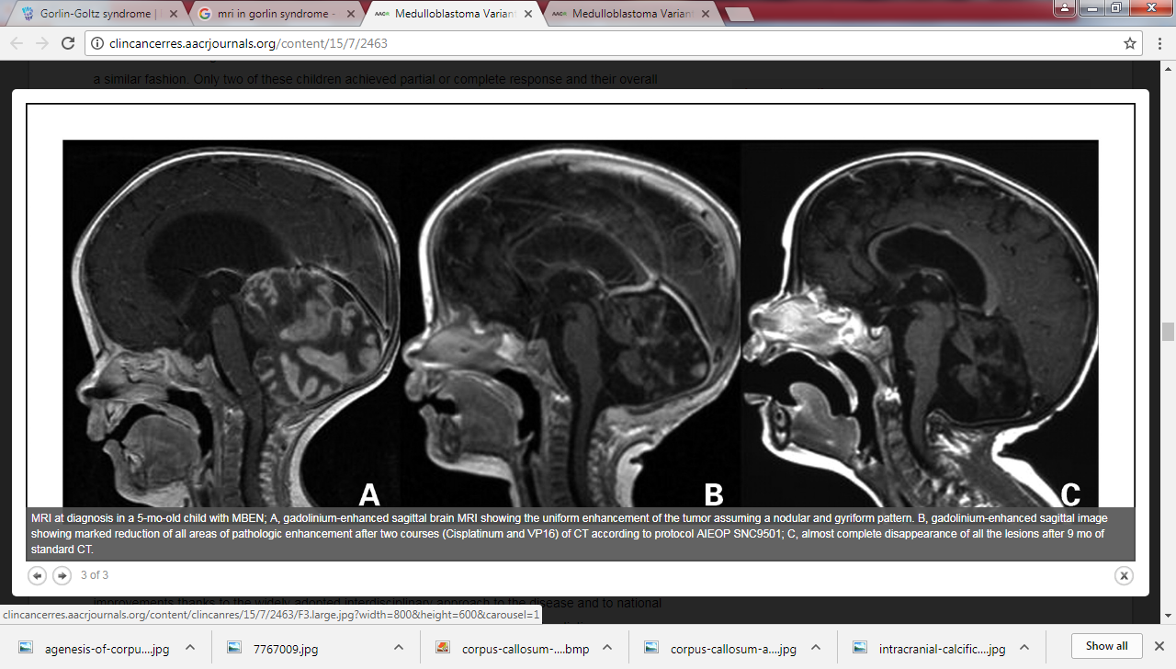

Slide 46
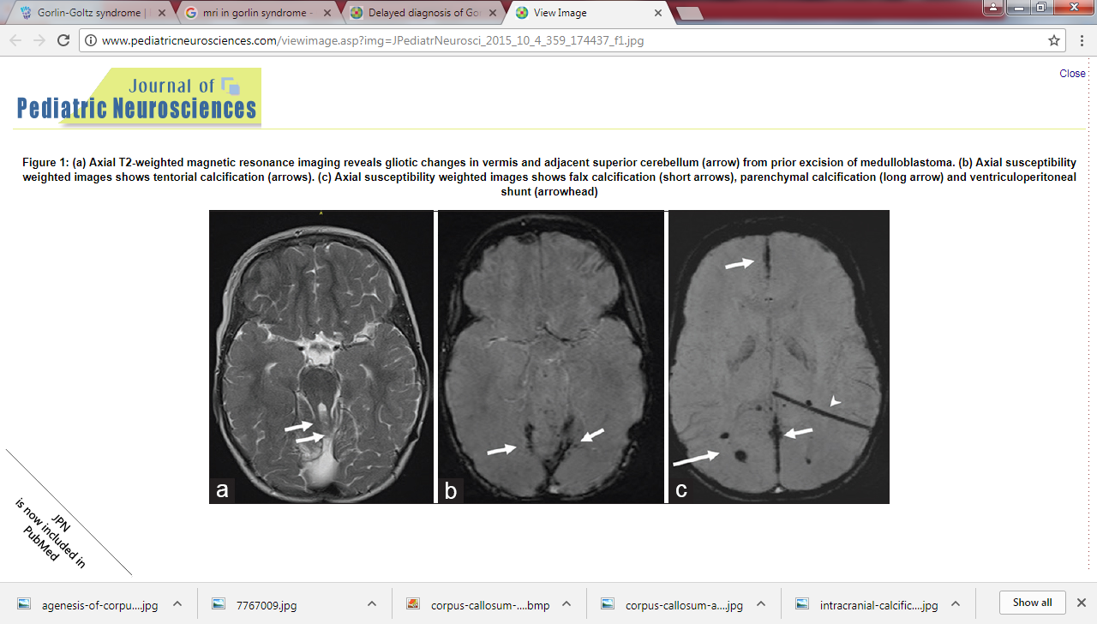

Slide 47
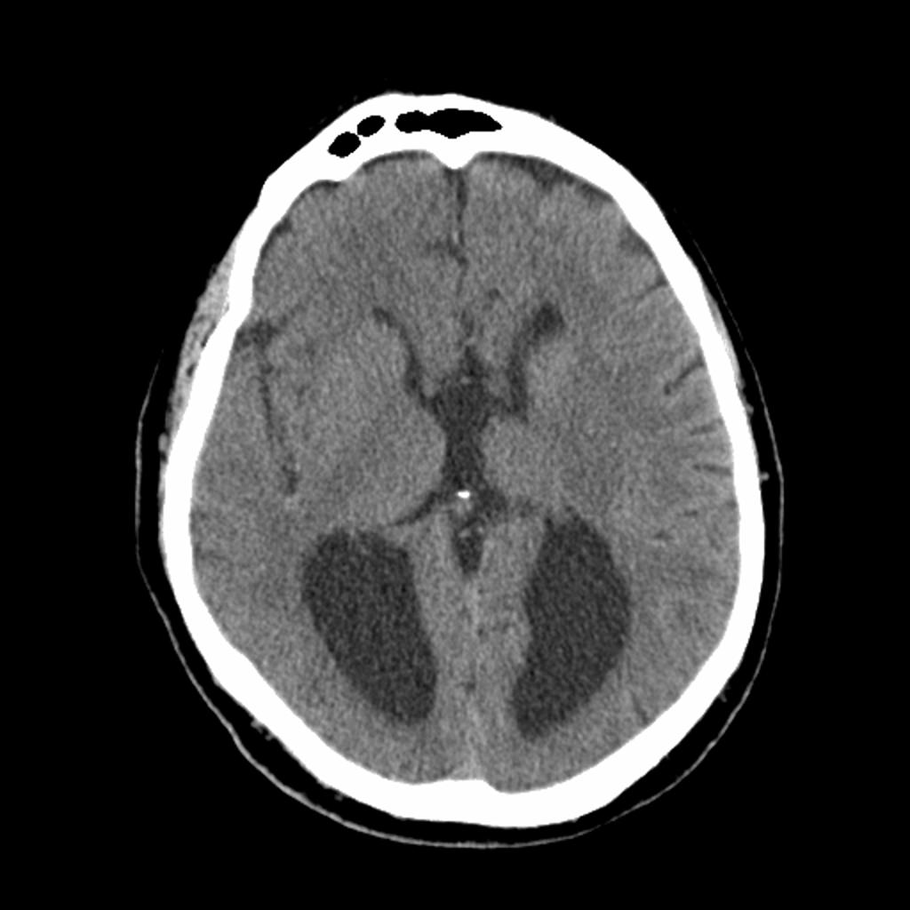
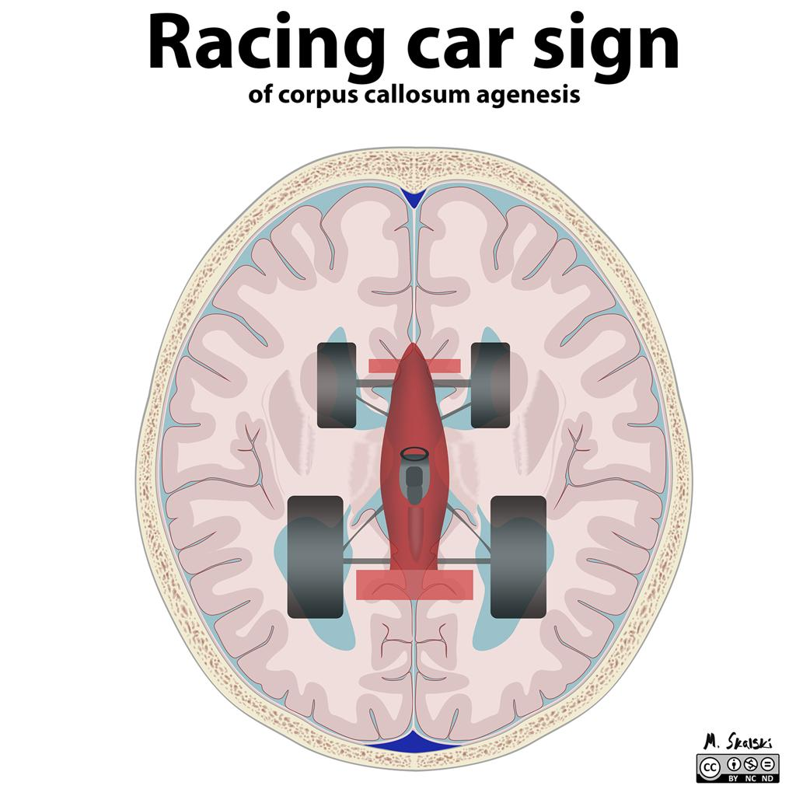
AGENESIS OF CORPUS CALLOSUM
Axial CT image showing dilated occipital horn of bilateral lateral ventricles

Slide 48
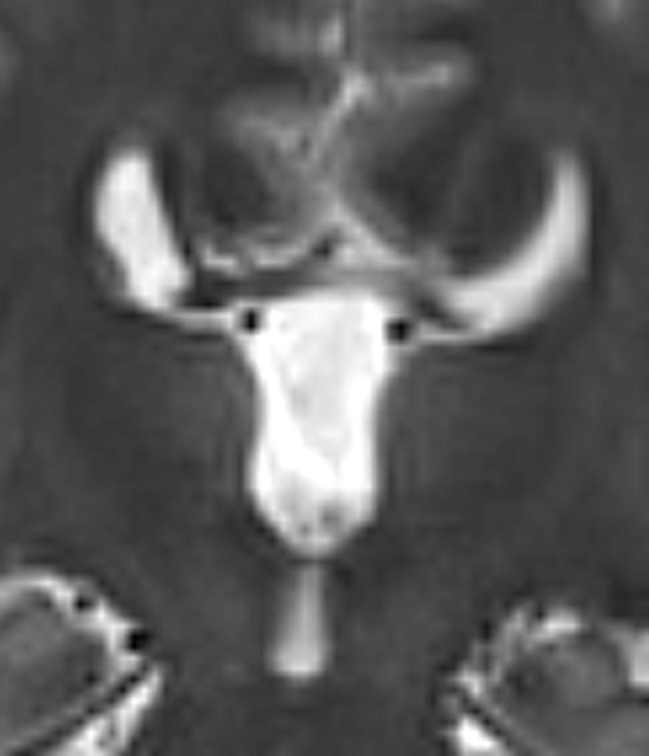
AGENESIS OF CORPUS CALLOSUM
CORONAL T2W MR I IMAGE SHOWING HIGH RIDING BILATERAL FRONTAL HORNS OF LATERAL VENTRICLES

Slide 49
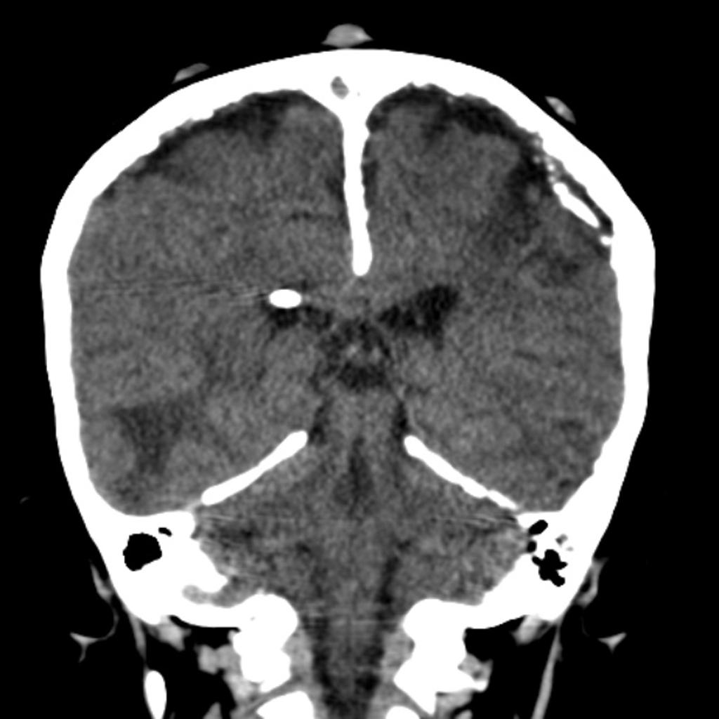
Coronal CT image showing calcification of the midline falx and tentorium

Slide 50
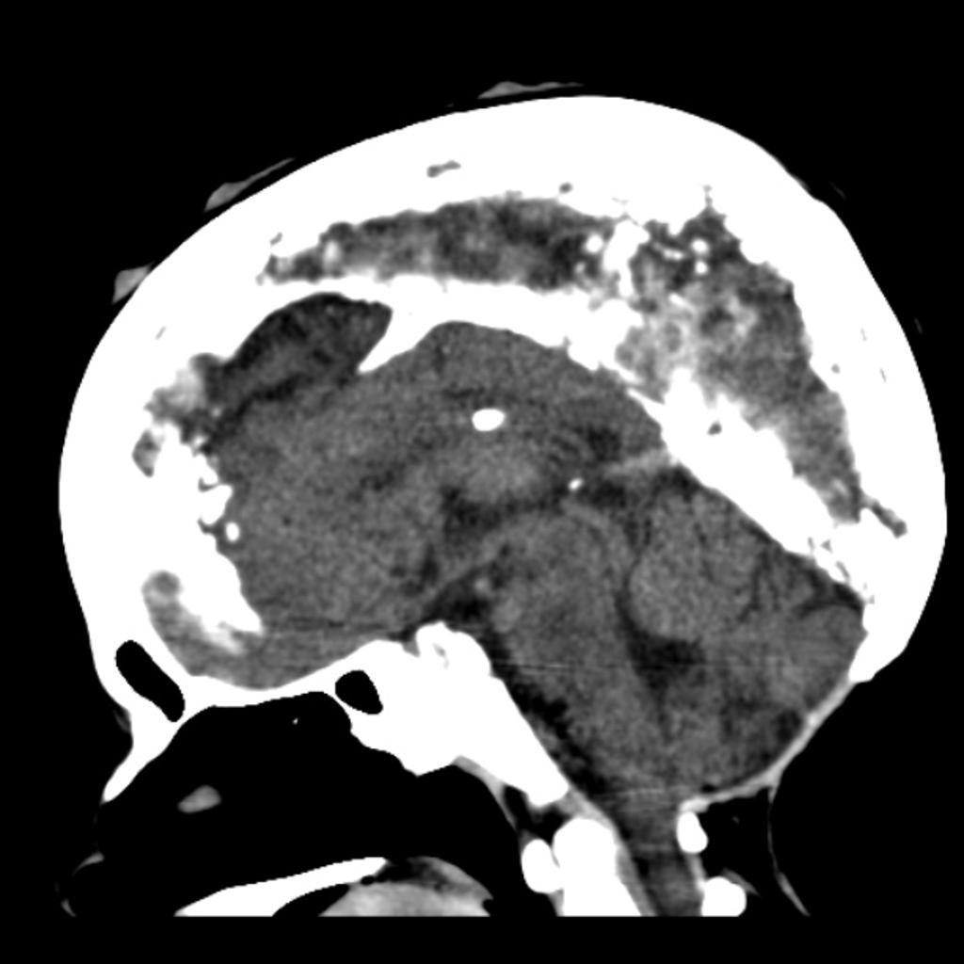
Saggital CT image showing calcification of the midline falx .

Slide 51
DIFFERENTIALS

Slide 52
GOMEZ - LOPEZ –HERNADEZ SYNDROME
The exact causes of Gomez-Lopez-Hernandez Syndrome are currently unknown. Mutations of the ACP2 gene have been implicated but not confirmed
GOMEZ LOPEZ HERNADEZ
Gomez-Lopez-Hernandez syndrome, also known as cerebellotrigeminal-dermal dysplasia, is a rare phakomatosis characterised by rhombencephalosynapsis, parietal-occipital scalp alopecia, brachycephaly, facial malformations and trigeminal anesthesia.

Slide 53
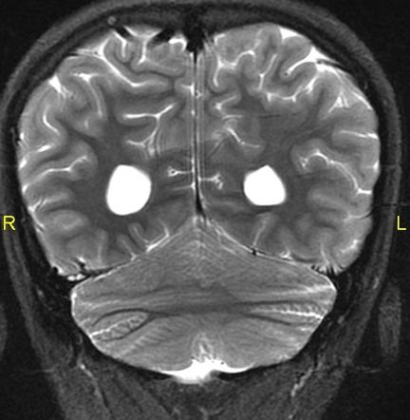
GOMEZ LOPEZ
HERNADEZ

Slide 54
WYBURN MASON SYNDROME
Wyburn-Mason syndrome (also known as Bonnet-Dechaume-Blanc syndrome) is a rare, nonhereditary neurocutaneous disorder that typically presents with unilateral vascular malformations that primarily involve the brain, orbits and facial structures. It is currently classified as a craniofacial arteriovenous metameric syndrome (CAMS)
Features include
facial vascular naevus
visual pathway and orbital arteriovenous malformations (AVMs)
intracranial arteriovenous malformations (AVMs)

Slide 55
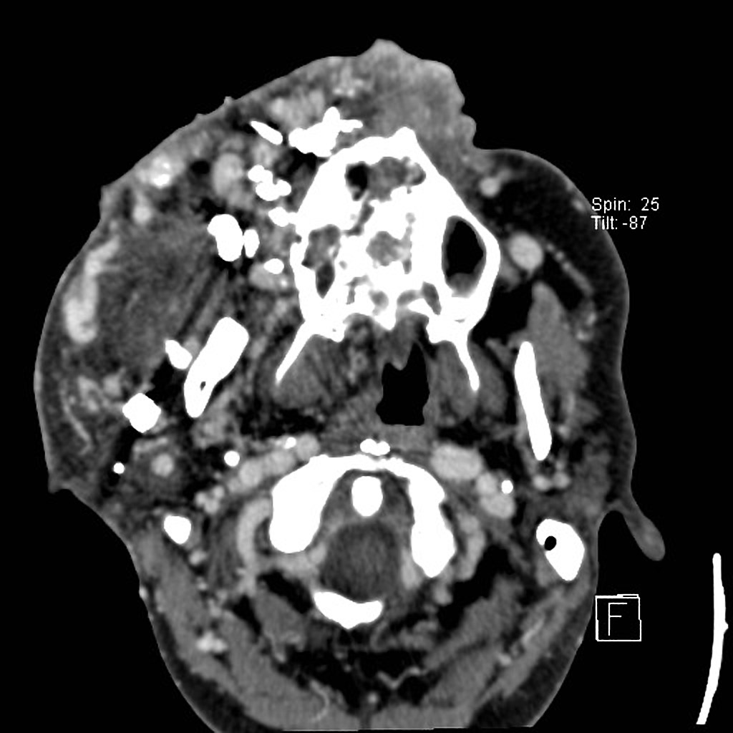
This case illustrates a known case of Wyburn-Mason syndrome, which is part of a wide spectrum of possible phenotypes included in the CAMS - Craniofacial arteriovenous metameric syndrome.
The syndrome was discovered in this patient at the age of 5 years (then not visible externally). Slow growth over years with recurrent bleeding in increasing frequency. Embolization was done several times during lifetime.

Slide 56
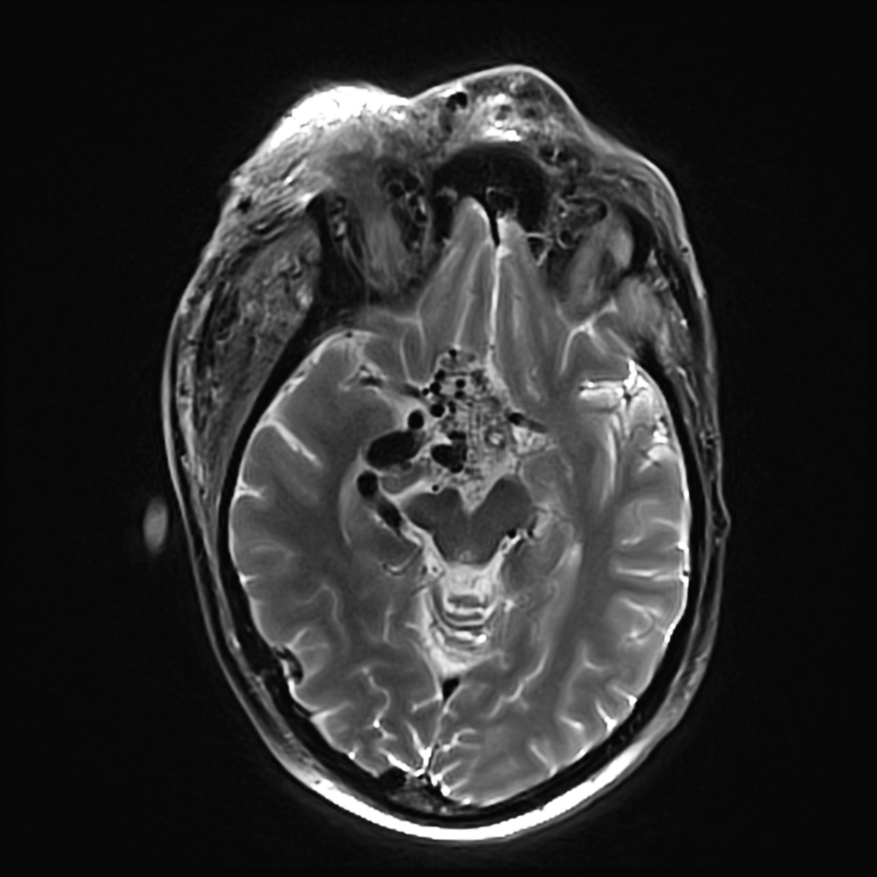
Wyburn-Mason syndrome- image desription from rp Right sided multifocal giant AVM maxillo-facial with involvement of the orbito-nasal space as well as partial involvement of the left side. Involvement of the maxilla, zygomatic bone and the sphenoid. Additional hypothalamic AVM. Soft tissue swelling in the right half of the face, in the parotid, masticator and parapharyngeal space. Dilated vessels on the nose. Exophthalmos on both sides.

Slide 57
ATAXIA TELANGECTASIA
Ataxia telangiectasia is a rare multisystem disorder which carries an autosomal recessive inheritance.
It is characterised by multiple telangectasias, cerebellar ataxia, pulmonary infections and immunodeficiency.
On brain imaging, it usually demonstrates vermian atrophy, compensatory enlargement of the fourth ventricle, cerebral infarcts and cerebral haemorrhage secondary to ruptured telangiectatic vessels.

Slide 58
MRI typically demonstrates cerebellar volume loss and compensatory enlargement of the 4thventricle.
Additionally, scattered small white matter T2 hypointensities are often identified in patients with ataxia telangiectasia, most likely representing tiny hemosiderin deposits related to thrombosis and vascular leaks from telangiectatic vessels
. This imaging appearance can also be seen in amyloid angiopathy, disseminated intravascular coagulopathy and multiple cavernomas ⁶. “Gliovascular nodules” within the white matter have previously been described and consist of dilated capillary loops with perivascular haemorrhages and hemosiderosis, surrounded by reactive fibrosis and demyelinated white matter⁷.
Diffuse T2/FLAIR hyperintense signal within the cerebral white matter consistent with demyelination and gliosis has previously been described in ataxia telangiectasia and may reflect ischaemia and white matter degeneration due to vascular abnormalities ¹¹, severe oligodendrocyte and myelin loss ⁸, coagulation necrosis ⁹ and leukodystrophy ¹⁰. A recent study using MR spectroscopy of adult patients with ataxia telangiectasia suggests that the white matter T2/FLAIR hyperintense signal abnormality is secondary to reduced cellularity rather than active demyelination or ischaemia ¹¹.
MR spectroscopy: increased choline signal in the cerebellum.

Slide 59
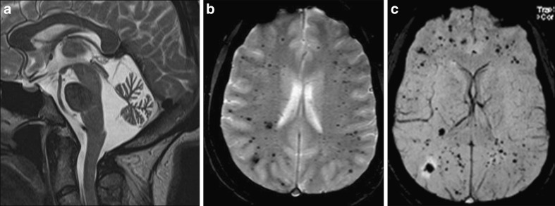
A Sagittal T2-weighted image demonstrates severe atrophy of the cerebellar vermis. b GE T2*-weighted image reveals multiple hypointense foci located in both hemispheres. c SWI minIP: additional hypointense black spots can be identified, corresponding to haemosiderin deposits presumably due to gliovascular nodules with perivascular haemorrhage

Slide 62
THANK YOU

