Slide 1
SPOTTERS

Slide 2
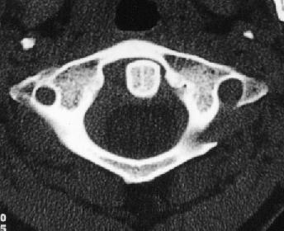
Notes:
Rotary atlantoaxial dislocation

Slide 3
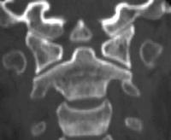
Notes:
OS ODONTOIDEUM

Slide 4
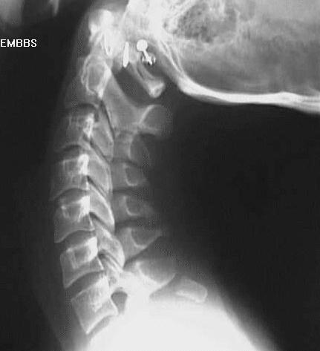
Notes:
Clay-shoveler’s” fracture

Slide 5
Notes:
Acom aneurysm

Slide 6
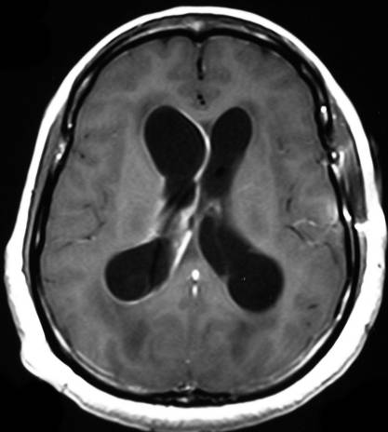
Notes:
VENTRICULITIS

Slide 7
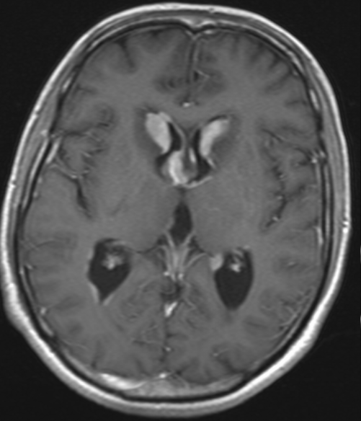
Notes:
PRIMARY CNS LYMPHOMA

Slide 8
Notes:
OSTEOID ISTEOMA OF ACETABULAR CUP.

Slide 9
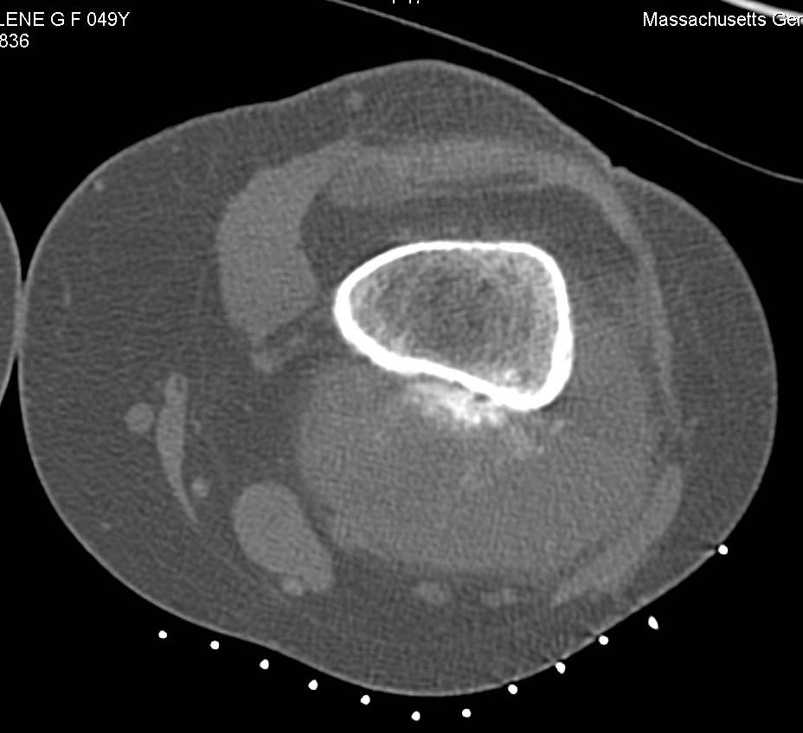
Notes:
DENSITY ≤ CORTEX
CLOUD-LIKE AND LINEAR MINERALIZATION
LARGE AMOUNT OF NON-MINERALIZED TISSUE
HIGH GRADE SURFACE OSTEOSARCOMA

Slide 10
Notes:
BUTTON OSTEOMA
Benign bone forming tumors that arise from the outer table of calvarium

Slide 11
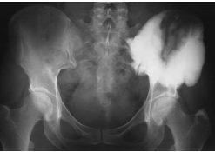
Notes:
MELORHEOSTOSIS; LEFT ILIAC WING.

Slide 12
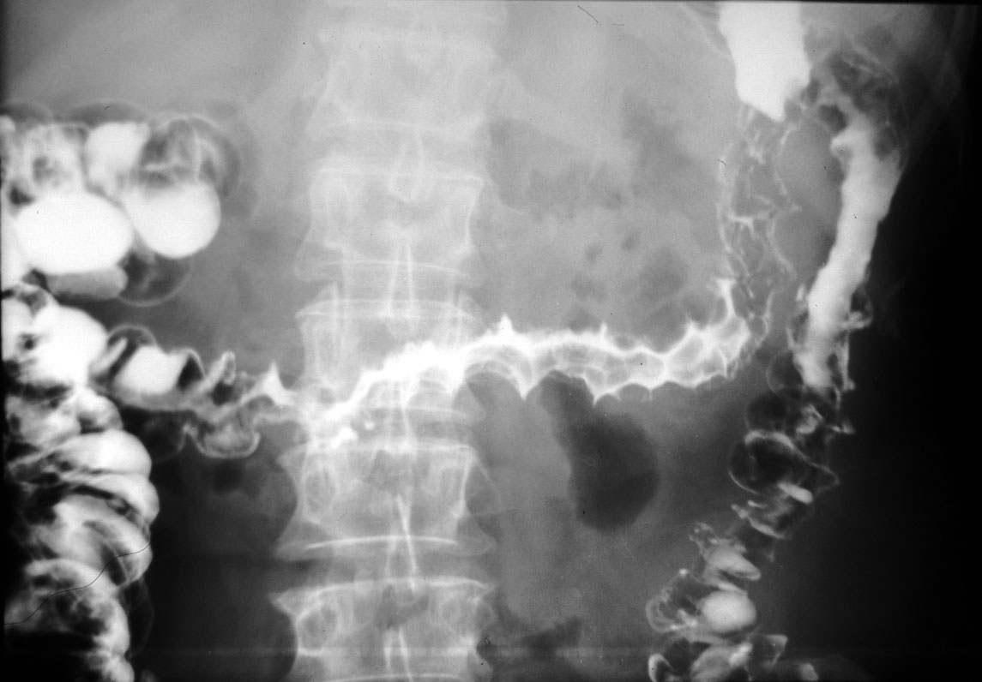
Notes:
ISCHEMIC COLITIS

Slide 13
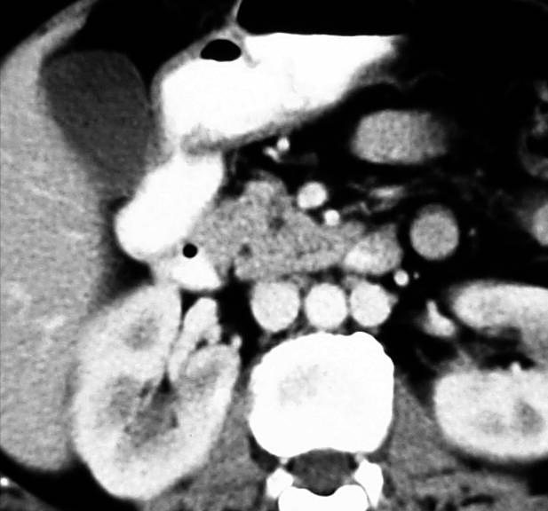
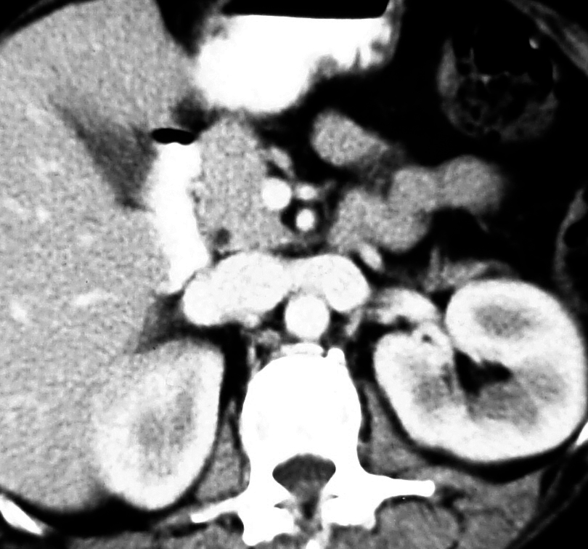
a
b
Notes:
DOUBLE IVC

Slide 14
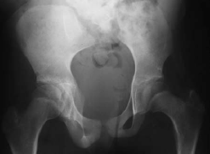
Notes:
Sacral agenesis

Slide 15
Notes:
RT Changes: Chronic FIBROSIS

Slide 16
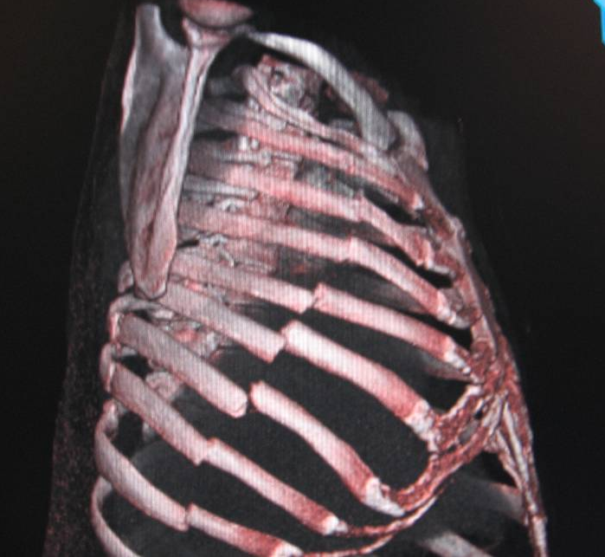
Notes:
FLAIL CHEST

Slide 17
Notes:
HEP ART ANEURYSM

Slide 18
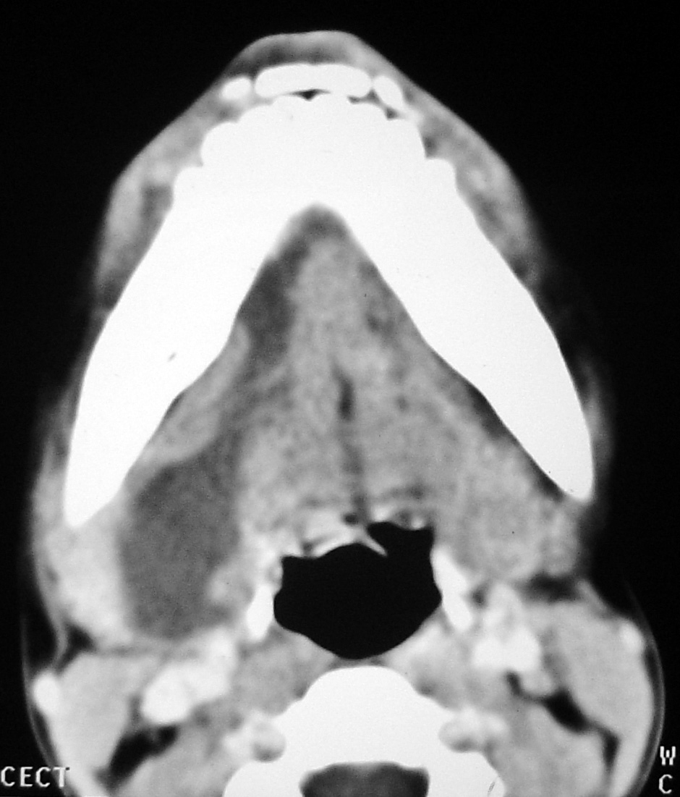
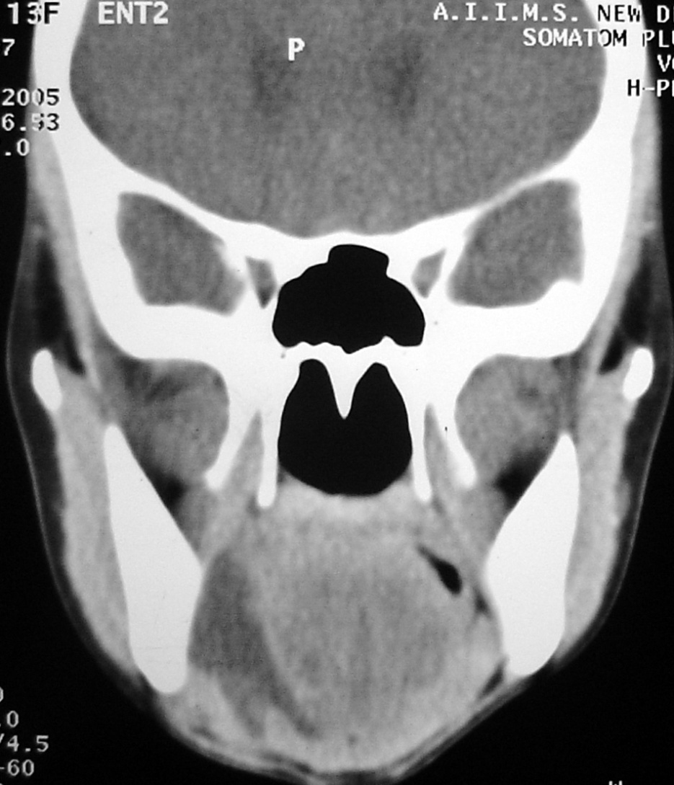
Notes:
PLUNGING RANULA

Slide 19
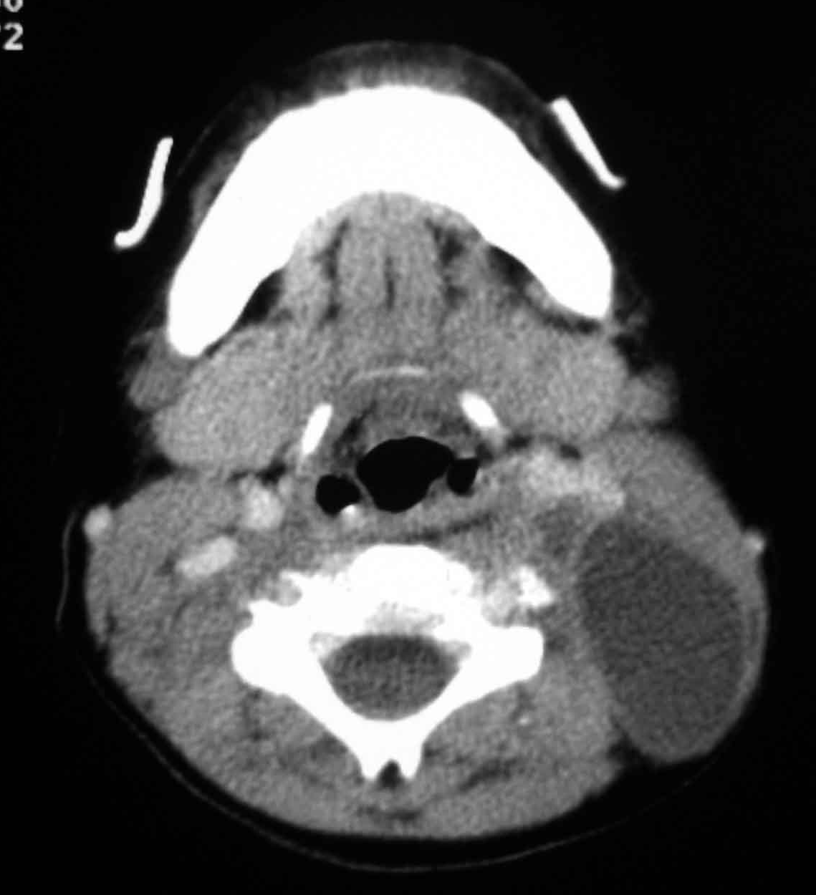
Notes:
CYSTIC HYGROMA

Slide 20
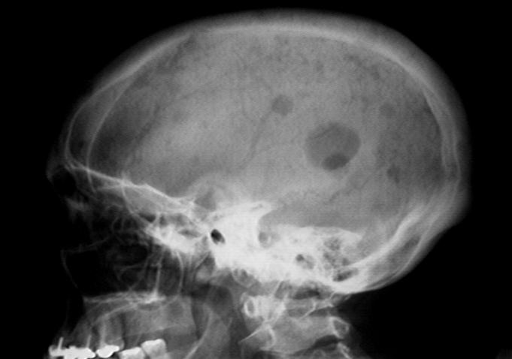
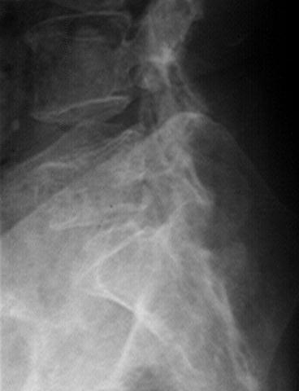
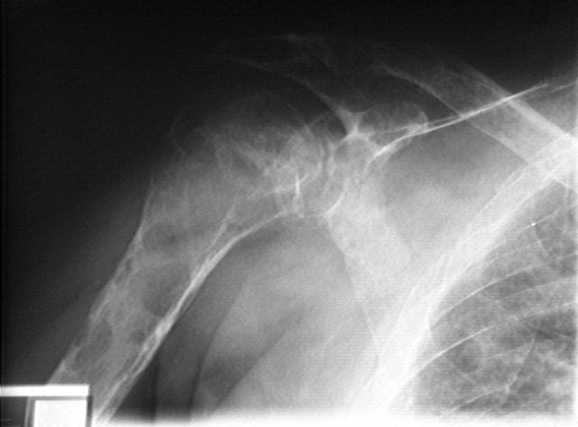
Notes:
patient with MM and spinal involvement shows compression fracture of a myelomatous L5 vertebra.
MM often shows characteristic "punched out" lytic lesions in the skull.
However, as these lesions in the humerus show, it is frequently impossible to distinguish between MM and lytic metastases.

Slide 21
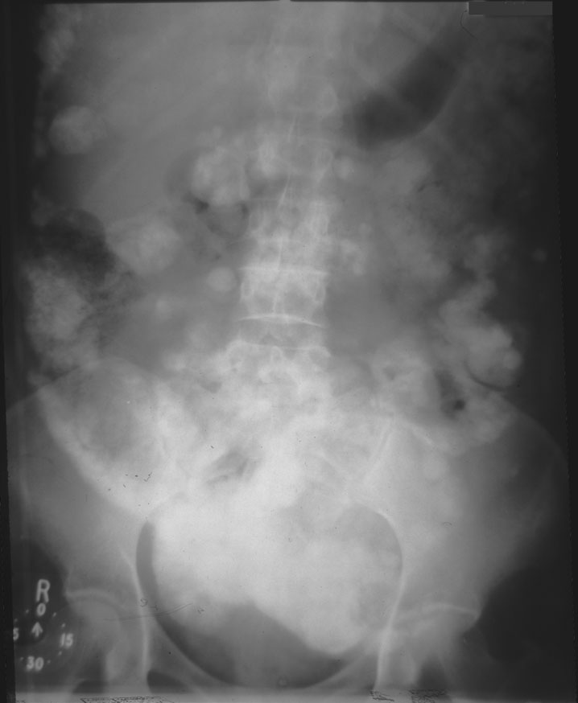
Notes:
Calcifying peritoneal mets.cystadenoma ovary Ca
There is extensive amorphous calcification throughout the abdomen. It extends from pelvis, but includes a line of densities lateral and below the liver. The liver appears outlined by the calcifications. A similar 'negative' impression in the calcifications can be seen in the form and location of the caecum, transverse colon, occasional small-bowel loops and a vaguely round defect immediately above the left femoral canal that might be sigmoid colon. In the para-spinal region, there are occasional densities that resemble the position of lymph-nodes as well as transverse colon.

Slide 22
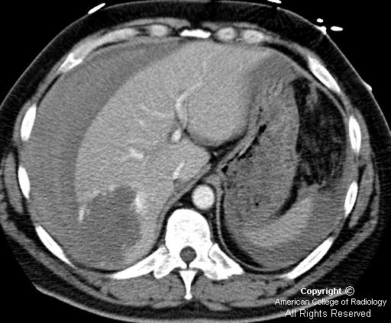
Notes:
Cavernous hemangiomas of the liver on non-contrast CT are typically low attenuation lesions which on post-contrast scans demonstrate peripheral, nodular enhancement that follows the blood pool of the aorta and fills in centrally on later series.
Hepatic hemangiomas which are larger than 4 cm are termed "giant hemangiomas" and are more likely to rupture

Slide 23
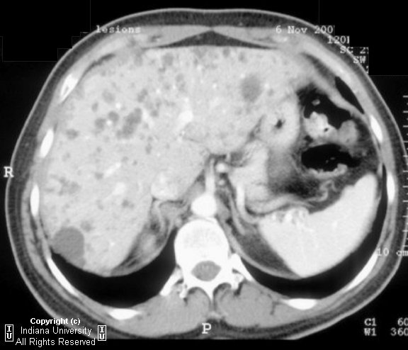
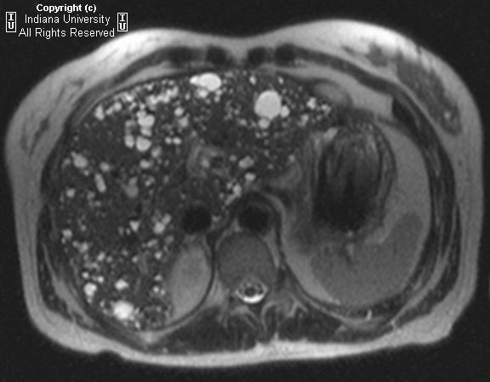
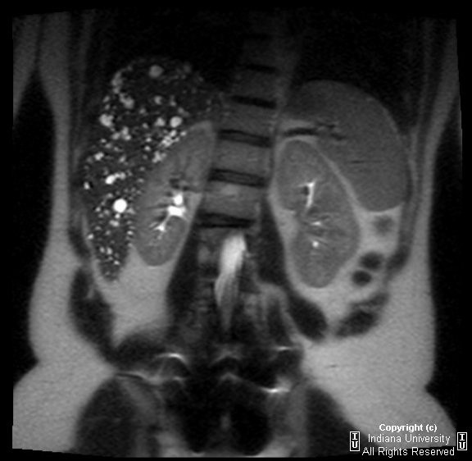
Notes:
CT demonstrates innumerable, non-enhancing, lesions throughout the liver, with attenuation and signal like that of cysts. Of note there are no cysts in the kidneys or pancreas.
MRI shows innumerable cystic lesions throughout the liver. These range in size from a few millimeters to 2.5 cm in diameter. There appear to be several areas of minimal to mild dilatation of bile ducts throughout the liver. Several of the cyst appear to communicate with adjacent dilated ducts. There is no instrinsic intra or extrahepatic duct dilatation.
Multiple biliary hamartomas
Caroli's disease
Hepatic cysts in association with autosomal-dominant polycystic kidney disease
Metastatic disease to the liver
Hepatic microabscesses

Slide 24
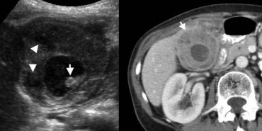
Notes:
Xanthogranulomatous cholecystitis is an unusual variant of chronic cholecystitis, characterized by a lipid-laden inflammatory process comparable to xanthogranulomatous pyelonephritis.
Imaging studies show marked gallbladder wall thickening, often containing intramural nodules that are hypoechoic at sonography and hypoattenuating at CT, representing abscesses or foci of xanthogranulomatous inflammation. These features overlap with those of gallbladder carcinoma, making preoperative distinction between these entities often impossible [6].

Slide 25
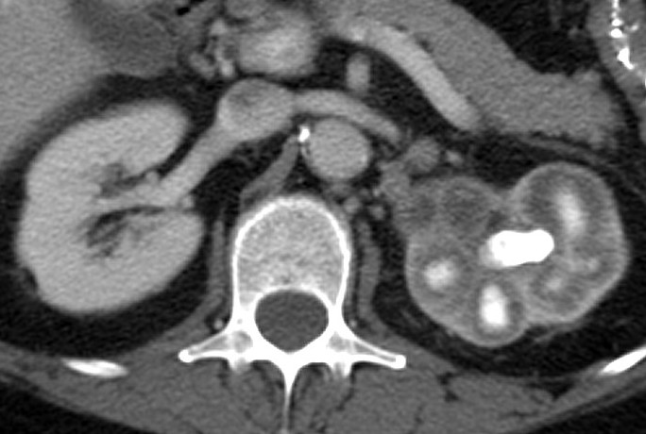
Notes:
Xanthogranulomatous PyelonephritiS

Slide 26
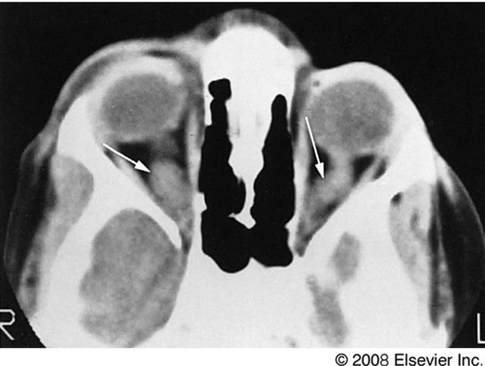
Notes:
Axial CT Scan. Neurofibromatosis with bilateral optic nerve gliomas.

Slide 27
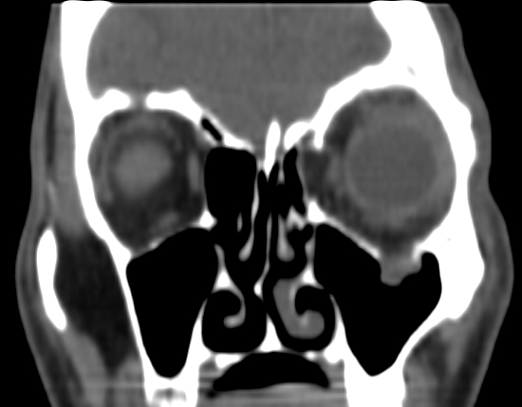
Notes:
Orbital blowout fractures may be isolated or a part of a combination injury

Slide 28
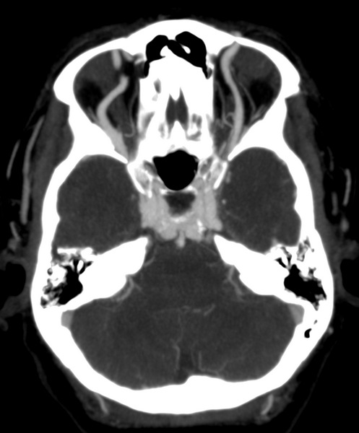
Notes:
The above axial maximum-intensity projection slab from a CT cerebral angiogram shows dilatation of both superior ophthalmic veins and engorgement of the cavernous sinuses. The appearance is consistent with caroticocavernous fistula.

Slide 29
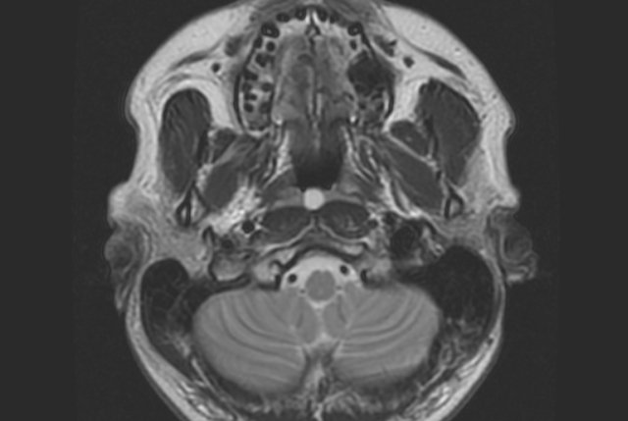
Notes:
Midline nasopharyngeal cyst of homogeneous high T2 signal was incidentally found on MRI brain. It is well circumscribed, embedded within nasopharyngeal mucosa between prevertebral muscles.
Thornwaldt cysts are benign developmental nasopharyngeal cysts covered by mucosa anteriorly and bounded by longus muscles posteriorly

Slide 30
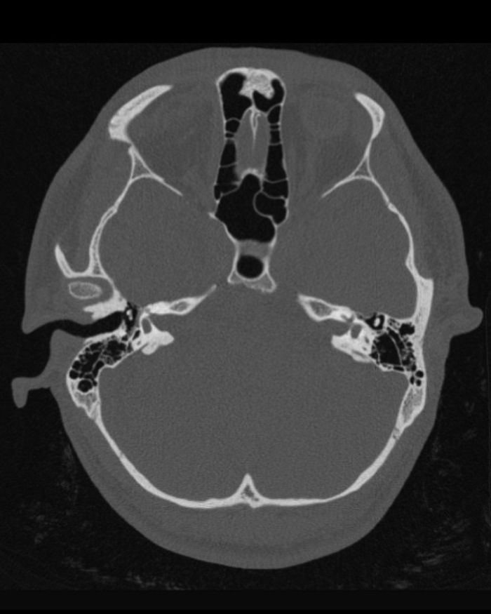
Notes:
congenital aural dysplasia, or microtia, this condition is characterised by bony atresia of the external auditory canal (EAC) and a dysplastic auricle. Findings in the middle ear are variable and the inner ear and internal auditory canal are typically normal.

Slide 31
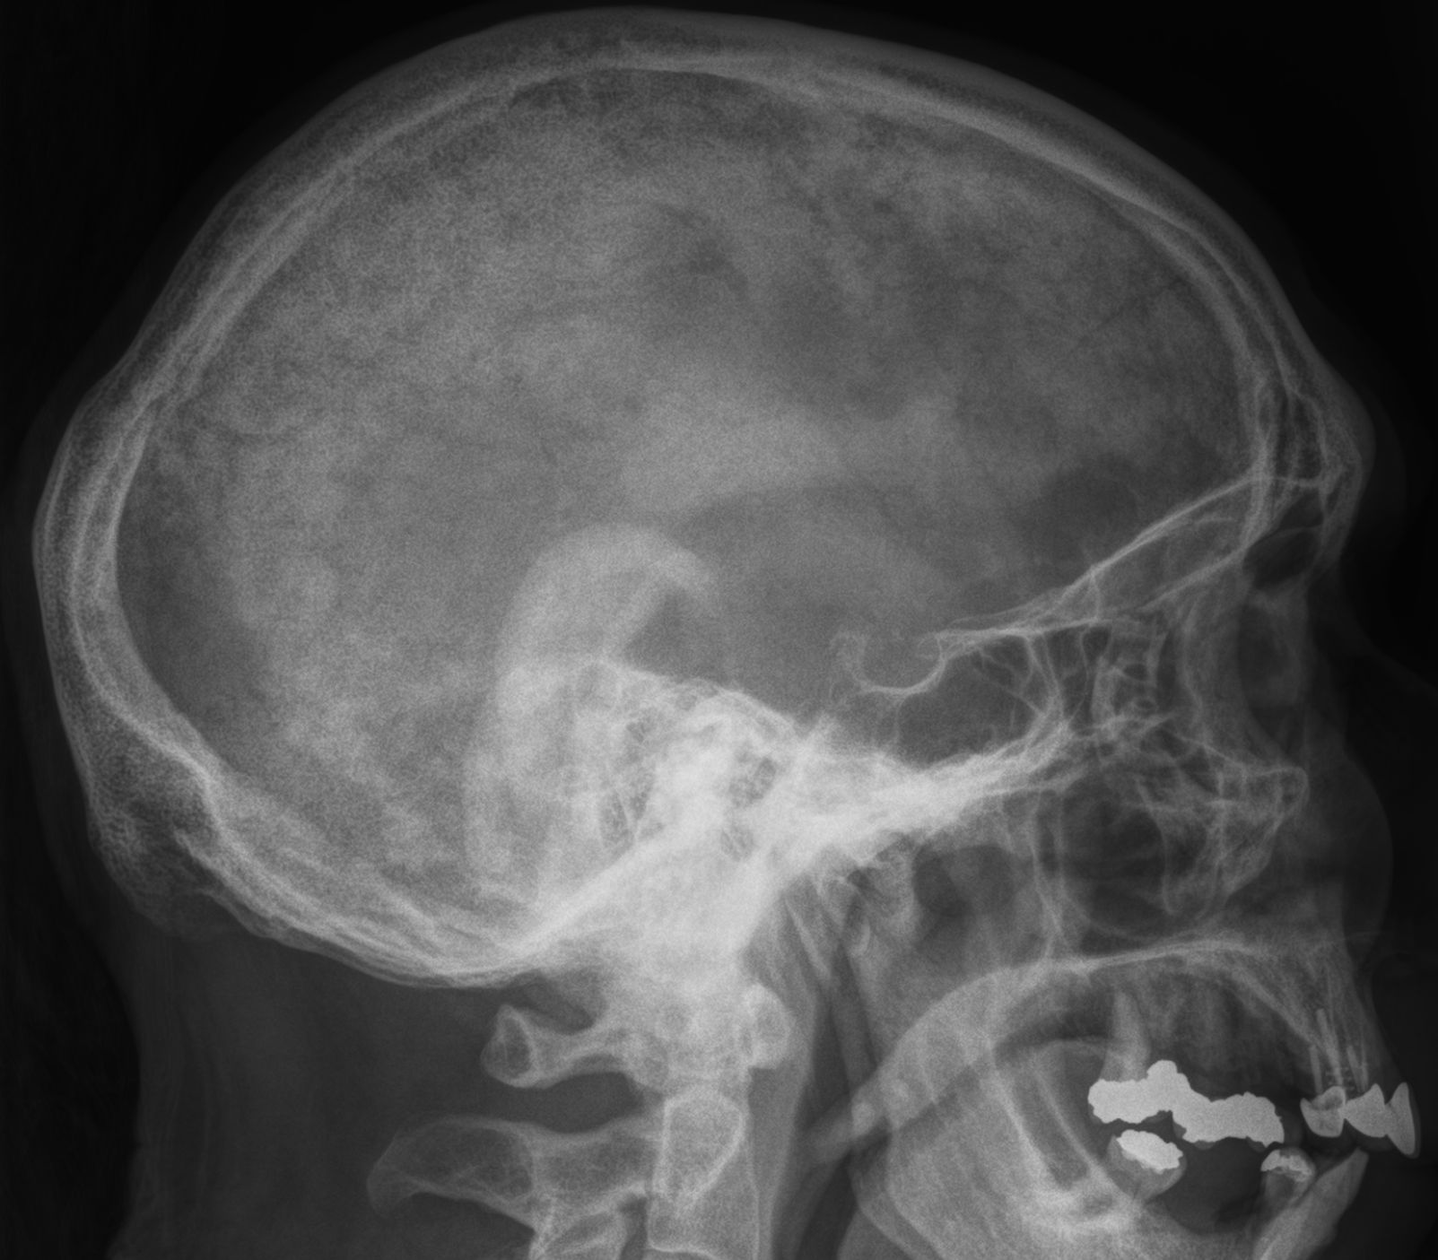
Notes:
This lateral skull xray demonstrates many of the changes of Paget’s disease, with areas of lysis, areas of sclerosis (’cotton-wool spots’), and calvarial thickening.

Slide 32
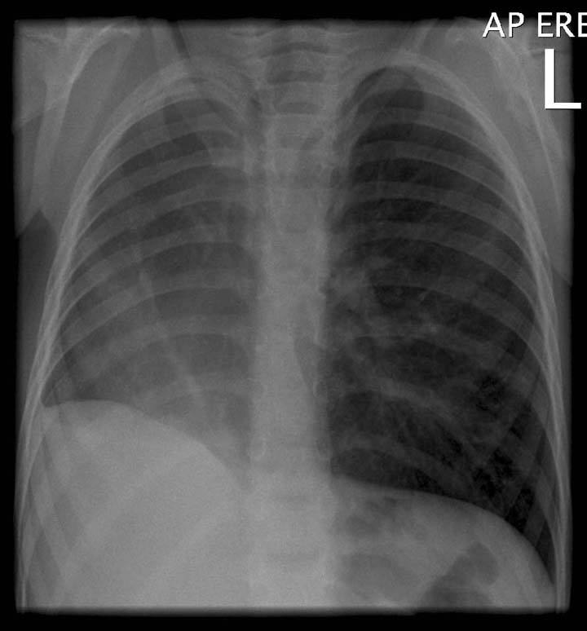
Notes:
Scimitar syndrome is characterised by a hypoplastic lung that is drained by an anomalous vein into the systemic venous system. It is essentially a combination of pulmonary hypoplasia and partial anomalous pulmonary venous return. It almost exclusively occurs on the right side. The haemodynamics are that of an acyanotic left to right shunt. The anomalous vein most commonly drains into the IVC, right atrium or portal vein. The lung is frequently perfused by the aorta, but the bronchial tree is still connected and thus the lung is not sequestered. CXR findings are that of a small lung with ipsilateral mediastinal shift, and in one third of cases the anomalous draining vein may be seen as a tubular structure paralleling the right heart border in the shape of a Turkish sword (“scimitar”). Scimitar syndrome is associated with congenital heart disease, ipsilateral diaphragmatic anomalies and vertebral anomalies.

Slide 33
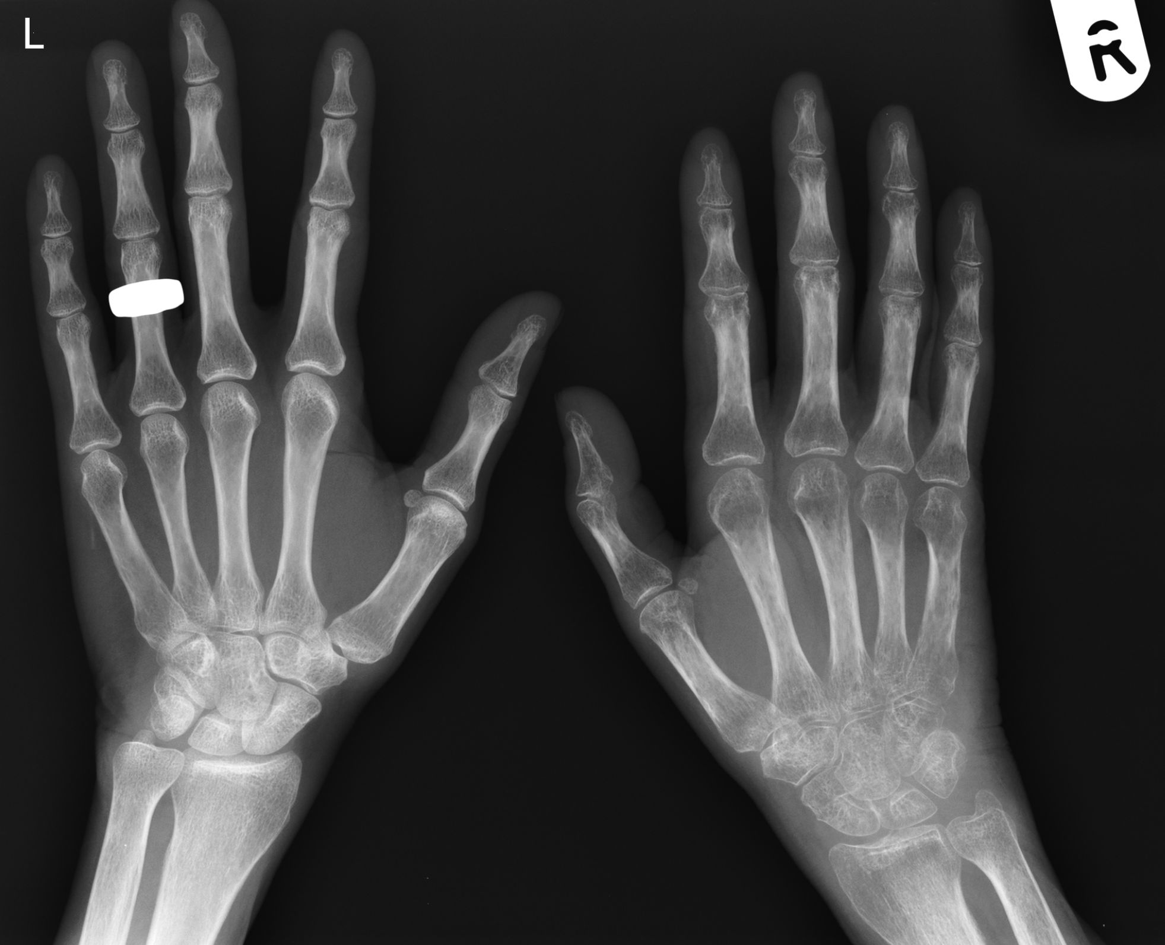
Notes:
The appearances in the right hand are classical for reflex sympathetic dystrophy, or Sudeck’s atrophy, and include:
1. Pronounced demineralization of the bones, particularly in the periarticular region. 2. No joint involvement. 3. Associated soft tissue atrophy.
This condition has been recently renamed the “complex regional pain syndrome”.

Slide 34
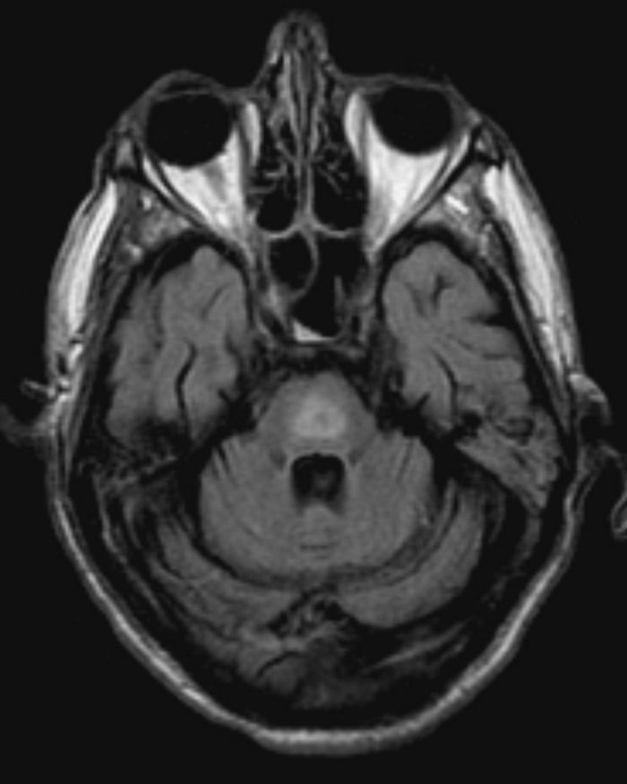
Notes:
The FLAIR MR image above shows changes typical of central pontine myelinolysis.
Also known as osmotic demyelination, central pontine myelinololysis is an acute demylination of the white matter tracts traversing the pons, seen in the setting of sudden osmotic changes, typically the rapid correction of hyponatraemia. Occasionally extrapontine white matter is also affected, in the basal ganglia, mid brain and subcortical white matter.

Slide 35
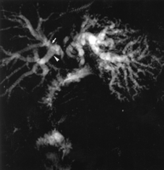
Notes:
Bismuth type II cholangiocarcinoma
invasion of CHD, RHD & LHD.

Slide 36
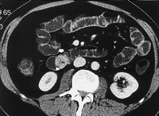
Notes:
SB INTRALUMINAL HEMATOMA

Slide 37
Notes:
SPLENIC ARTERY ANEURYSM

Slide 38
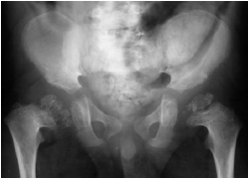
Notes:
B/L COXA VARA & EPIPHYSEAL STIPPLED IRRREGULARITY. CONGENITAL HYPOTHYROIDISM

Slide 39
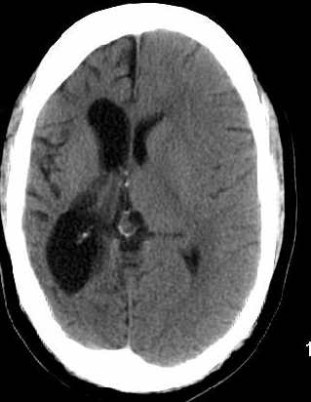
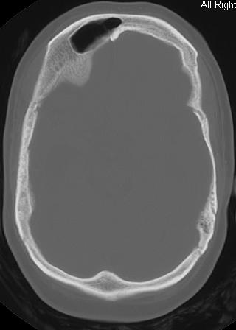
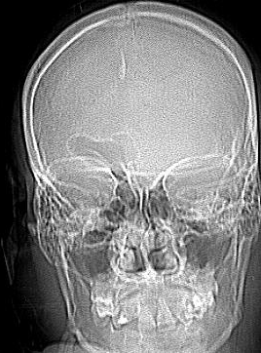
Notes:
Differential diagnosis of cerebral hemiatrophy
Dyke-Davidoff-Masson Syndrome.
Rasmussen Encephalitis.
Sturge Weber Syndrome.
Hemimegalencephaly.

Slide 40
Notes:
total right ICA occlusion- collateral flow across the contralateral ICA to the ACA and across the ACA

Slide 41
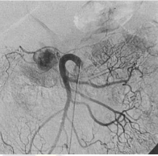
NAME THE ARTERY
POOLING IS SEEN IN PANCREAS : NAME THE TUMOR OF PANCREAS
Notes:
inSULINOMA IN PANCREATIC HEAD

