Slide 1
SPOTS

Slide 2
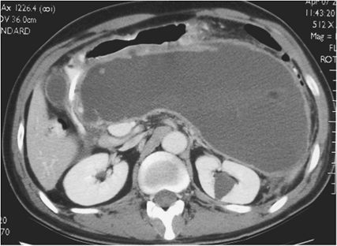
Notes:
Figure 15-89 Organized pancreatic necrosis in a 48-year-old man 8 weeks after onset severe acute pancreatitis with failure to thrive. A 5-mm portal venous phase computed tomography image demonstrates very large predominantly low attenuation collection replacing the pancreas. Note the low attenuation retroperitoneal fat and faintly visible residual pancreas within the collection. There is marked narrowing of the gastric outlet, but oral contrast does pass into the bowel. Because of the patient's symptoms, limited surgical necrosectomy through the posterior gastric wall was performed; approximately 1000 cc dark liquid and several grams of necrotic debris were removed.

Slide 3
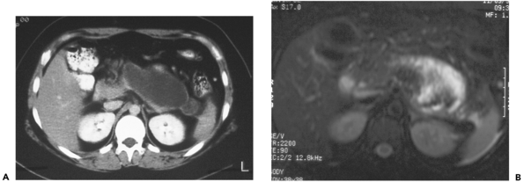
T2-weighted fat suppressed
Notes:
Figure 15-87 Organized pancreatic necrosis in a 21-year-old woman with gallstone pancreatitis, referred for â€œpseudocyst drainage.â€ A: Contrast-enhanced computed tomography of the abdomen approximately 8 weeks after onset of pancreatitis demonstrates a homogeneous well encapsulated fluid collection anterior to the splenic vein. B: Prior to drainage, T2-weighted fat suppressed magnetic resonance image of the same region demonstrates marked heterogeneity within the collection, with high signal fluid as well as large areas of low signal soft tissue consistent with persistent solid debris.

Slide 4
Notes:
Figure 15-84 Infected pancreatic necrosis in a 60-year-old man with 1 week hospitalization for severe acute pancreatitis. Portal venous phase 5-mm computed tomography image demonstrates a 12 Ã— 7 cm heterogeneous, gas containing collection replacing the pancreas anterior to the splenic vein (arrow), consistent with infected pancreatic necrosis.

Slide 5
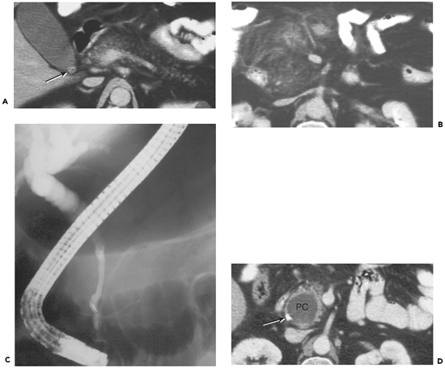
Notes:
Figure 15-81 Pseudocyst complicating acute pancreatitis, leading to obstruction of the common bile duct. A: Late portal venous phase computed tomography (CT) image through the pancreas demonstrates normal fatty infiltration of tail and body region. Note blurred appearance of the interdigitating fat of the head and neck due to acute inflammation, and gallstone (arrow) in the gallbladder neck. B: 3 cm inferiorly, inflammatory stranding is seen extending from the inferior pancreatic head region into the mesenteric root, Grade C pancreatitis. C: Eight weeks later, patient had persistent elevated bilirubin. Endoscopic retrograde cholangiopancreatography spot radiograph with injection into the distal common bile duct demonstrates smooth narrowing of the lower half of the bile duct through the superior pancreatic head and suprapancreatic regions. The transition from smoothly narrowed to dilated proximal duct occurs at the level of the scope. Faintly seen pancreatic duct appears normal. D: Portal venous phase CT image after endoscopic biliary stent (arrow) placement demonstrates smooth round 3.5-cm pseudocyst (PC) within the pancreatic head, which was responsible for the mass effect on the distal duct.

Slide 6
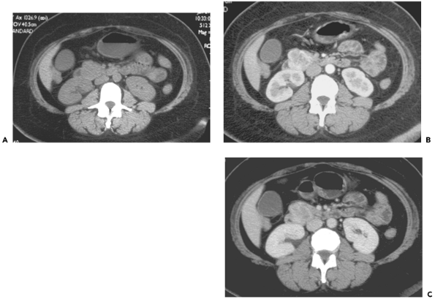
Notes:
Figure 15-68 Ampullary mass. A: Pre-intravenous contrast 5-mm computed tomography (CT) image through the inferior pancreatic head demonstrates moderate lobularity and relative expansion of the head compared to the remainder of the gland. B: Pancreatic parenchymal phase 2.5-mm CT image through the same level demonstrates a hyperenhancing heterogeneous 2.3-cm mass. C: Portal venous phase 5-mm CT image through the same level demonstrates diminished but persistently heterogeneous enhancement through the same region. At surgery, a gastrointestinal stromal tumor (GIST) of the medial duodenal wall was found.

Slide 7
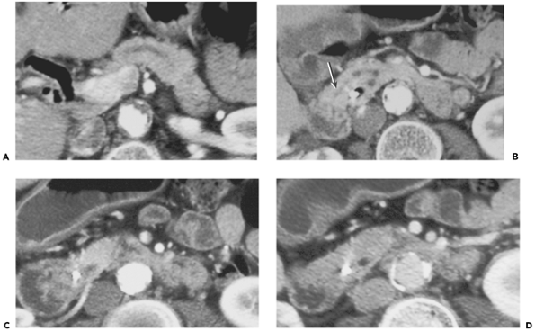
Notes:
Figure 15-66 Ampullary mass. A: Pancreatic parenchymal phase 5-mm computed tomography (CT) image through the porta demonstrates air within the biliary tree in this patient with recent biliary stent placement. Note dilatation of the main pancreatic duct in the neck and body. B: Next caudal 5-mm pancreatic parenchymal phase CT image demonstrates emptying of the duct of Santorini to the medial duodenal wall (arrow) with biliary endoprosthesis seen within the nondilated distal common bile duct. C: 1.5 cm inferiorly, there is a heterogeneously enhancing hypoattenuating mass surrounding the distal common bile duct stent, and extending into the duodenal lumen. D: Portal venous phase CT image, same level as C demonstrates poor demarcation between the mass and remaining normal pancreas. Specimen from Whipple resection showed chronic inflammation and no neoplasm.

Slide 8
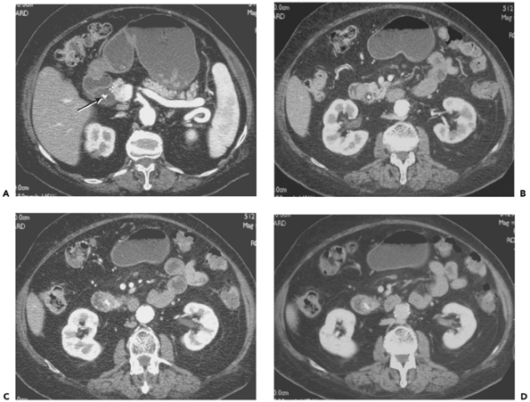
Notes:
Figure 15-64 Ampullary mass in a 70-year-old woman with 2-week history of painless jaundice. A: Pancreatic parenchymal phase computed tomography (CT) image through the superior pancreas demonstrates marked common bile ductal dilatation, with biliary endoprosthesis in place (arrow). B: 2 cm inferiorly, a focal 2-cm hypoattenuating mass is seen between the dilated bile duct and medial duodenal wall. C: Next caudal CT image shows heterogeneous hypoattenuating mass surrounding the distal common bile duct at the ampulla. D: Same level portal venous phase image demonstrates decreased demarcation of the mass compared to the normal sleeve of pancreatic tissue seen medially on the pancreatic parenchymal phase images. At Whipple resection, a 3.0-cm villous adenoma with high grade dysplasia was found at the ampulla.

Slide 9
Notes:
Figure 15-63 Colon carcinoma with contiguous spread into the pancreatic head in a 77-year-old man with abdominal pain. Portal venous phase 5-mm computed tomography image demonstrates heterogeneous, lobular soft tissue mass replacing the pancreatic head and neck, in direct contact with a similar appearing mass of the proximal transverse colon (arrow). Calcification is seen within the substance of the mass, proven to be mucinous colon carcinoma with contiguous spread through the transverse mesocolon to involve the pancreatic head.

Slide 10
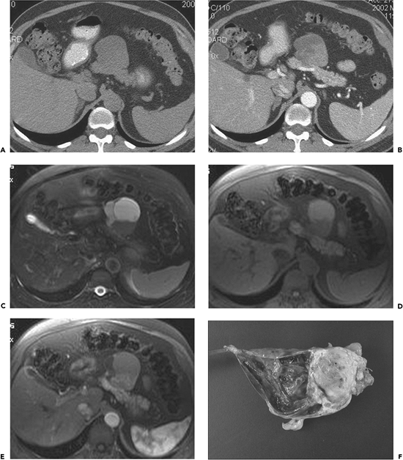
A: Pre-intravenous contrast computed tomography (CT) image B: Pancreatic parenchymal phase CT image same level C: T2 fat suppressed magnetic resonance. D: T1 fat suppressed MR image E: T1 fat-suppressed gadolinium-enhanced MR image
Notes:
Figure 15-61 Pancreatic malignant fibrous histiocytoma (MFH). A: Pre-intravenous contrast computed tomography (CT) image demonstrates a well circumscribed smooth low attenuation mass extending anteriorly from the body. B: Pancreatic parenchymal phase CT image same level shows cystic and hypovascular solid components of the lesion. Note focal intrapancreatic low attenuation tumor and normal enhancement of remainder of pancreas. C: T2 fat suppressed magnetic resonance (MR) image demonstrates fluid signal within the cystic component. D: T1 fat suppressed MR image reveals high signal intensity within the cystic component, indicating proteinaceous or hemorrhagic material. Note normal high signal within the normal pancreatic parenchyma, and focal low signal in the body indicating the intrapancreatic tumor. E: T1 fat-suppressed gadolinium-enhanced MR image shows hyperenhancement of the solid component of the tumor, more so than on CT. F: Surgical specimen cut open to reveal hemorrhagic cystic and yellow-tan solid portions of tumor, completely resected with extended distal pancreatectomy and splenectomy.

Slide 11
Notes:
Figure 15-60 Pancreatic involvement by systemic lymphoma in a 36-year-old woman with abdominal pain. A: Portal venous phase 7-mm computed tomography (CT) image through the pancreatic body and tail demonstrates heterogeneously enhancing expansion of this region. Note obstruction of left renal collecting system. B: Delayed 5-mm CT image through the pelvis demonstrates bulky lymphadenopathy filling the deep pelvis. At pathology, high grade B-cell lymphoma with some features of Burkitt's was found.

Slide 12
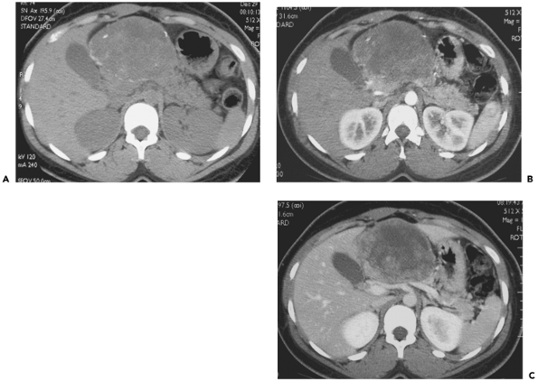
27-year-old woman
Notes:
Figure 15-59 Solid pseudopapillary tumor in a 27-year-old woman undergoing evaluation as potential renal donor. A: Pre-intravenous contrast 3.8-mm computed tomography (CT) image through the superior pancreatic head region demonstrates a heterogeneous 7 Ã— 9 cm mass extending anteriorly from the neck. There are focal calcifications along the periphery and within the substance of the mass. B: Pancreatic parenchymal phase 2.5-mm CT image through the same level demonstrates heterogeneous enhancement within the lesion. C: Portal venous phase 3.8-mm CT image through the same level demonstrates progressive enhancement from the periphery of the mass. There is displacement of the vascular structures posteriorly. The lesion was resectable.

Slide 13
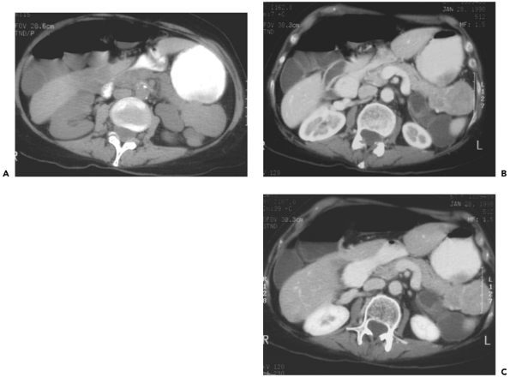
Notes:
Figure 15-57 VIPoma in a 67-year-old woman with unexplained diarrhea for 1 year. A: Pre-intravenous contrast computed tomography (CT) image demonstrates isoattenuating expansion of the pancreatic tail region. B: Early portal venous phase 5-mm CT image demonstrates heterogeneous hyperenhancing mass in the tail of pancreas. The mass contains several large vascular channels, and appears clearly separate from the fluid filled adjacent jejunal loops. C: Portal venous phase 5-mm CT image demonstrates diminished, but persistent, enhancement within the mass, which now appears more isoattenuating with the remainder of the pancreas.

Slide 14
Notes:
Figure 15-56 Multiple gastrinomas in a 53-year-old woman. A: Arterial phase 5-mm contrast-enhanced computed tomography (CT) image through the superior pancreatic head level demonstrates brightly enhancing heterogeneous 3 Ã— 5 cm mass to the right of the superior mesenteric vein (v) B: Arterial phase 5-mm CT image 2 cm inferiorly demonstrates a round 1 cm hyperenhancing lesion within the medial duodenal wall (arrow). C: Next caudal image demonstrates two less than 1-cm hyperenhancing lesions along the posterior aspect of the duodenal wall in the third portion. D: Portal venous phase 5-mm image through the suprapancreatic gastrinoma demonstrates diminished enhancement. E: Portal venous phase image through the third portion of the duodenum demonstrates diminished enhancement within the duodenal wall lesions as well. Note benefit of water (low density) oral contrast in visualizing these lesions. The patient underwent Whipple procedure and is disease free 8 years later.

Slide 15
. A: Precontrast 5-mm computed tomography (CT) image B: Pancreatic parenchymal phase 5-mm CT image through the lesion C: Portal venous phase 5 mm CT image D: Pancreatic parenchymal phase CT image E: Portal venous phase 5-mm CT image same level
Notes:
Figure 15-55 Nonfunctioning islet cell tumor and pancreatic adenocarcinoma in a 92-year-old woman with abdominal pain. A: Precontrast 5-mm computed tomography (CT) image through the pancreatic tail demonstrates a lobular, heterogeneous left upper quadrant mass that contains coarse calcifications. B: Pancreatic parenchymal phase 5-mm CT image through the lesion demonstrates minimal enhancement. C: Portal venous phase 5 mm CT image shows enhancement of the irregular peripheral wall with central tumor necrosis. Findings are consistent with a nonfunctioning islet cell tumor. The calcifications disbursed throughout the substance of the tumor are unlike those of mucinous cystic neoplasms which, when present, are peripheral, and also unlike the stellate central calcification of microcystic adenoma. D: Pancreatic parenchymal phase CT image through the head of pancreas reveals a heterogeneously enhancing mass encasing the superior mesenteric artery (SMA) (arrow). E: Portal venous phase 5-mm CT image same level demonstrates lack of visualization of the superior mesenteric vein, large middle colic collateral vein seen entering the mass (arrow), and encasement of the SMA, consistent with nonresectable adenocarcinoma. GB, gallbladder.

Slide 16
A: Postgadolinium portal venous phase T1-weighted fast multiplanar spoiled gradient recalled echo (FMPSPGR) breathhold image B: Feridex-enhanced T2-weighted magnetic resonance image through the same level
Notes:
Figure 15-54 Von Hippel-Lindau patient with numerous pancreatic cysts. A: Postgadolinium portal venous phase T1-weighted fast multiplanar spoiled gradient recalled echo (FMPSPGR) breathhold image through the pancreas demonstrates near total replacement of the pancreatic glandular tissue by low signal cysts (arrows). Larger higher signal intensity cystic lesion is seen in the tail, likely representing a protein containing cyst. Also noted are two enhancing soft tissue adrenal masses, consistent with pheochromocytomas (P). B: Feridex-enhanced T2-weighted magnetic resonance image through the same level demonstrates markedly diminished signal intensity within the liver due to the iron containing contrast agent. Note varied fluid signal within the cysts replacing both the pancreas and the kidneys. Once again, soft tissue adrenal masses consistent with pheochromocytomas are seen.

Slide 17
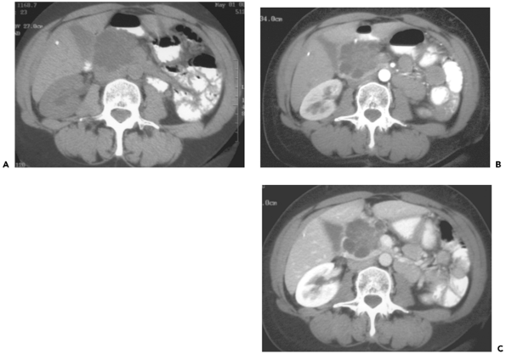
Notes:
Figure 15-53 Microcystic adenoma with large cysts. A: Pre- intravenous contrast 5-mm computed tomography (CT) image demonstrates a lobular low attenuation mass in the pancreatic neck. B: Pancreatic parenchymal phase 5-mm CT image reveals multiloculated cystic mass. Individual cysts measure up to 2.0 cm diameter. C: Portal venous phase 5-mm CT image shows the mass abutting the right margin of the superior mesenteric vein, without narrowing, and a thin rim of normally enhancing pancreatic parenchyma posteriorly. The imaging appearance suggests a mucinous cystic neoplasm, likely resectable. Histologic evaluation after resection demonstrated microcystic adenoma with several large cysts.

Slide 18
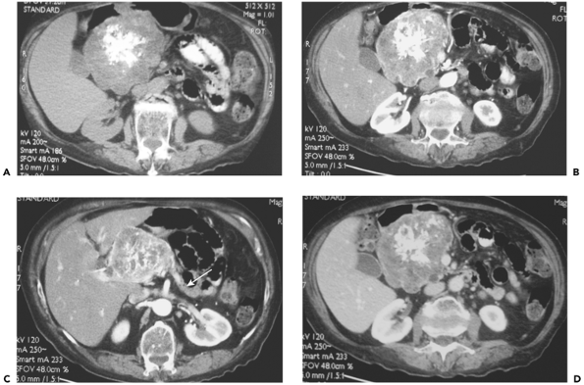
Notes:
Figure 15-52 Microcystic adenoma in a 72-year-old woman with vague abdominal pain. A: Pre-intravenous contrast 5-mm computed tomography (CT) image demonstrates heterogeneous lobular 13 cm mass extending superiorly from the pancreatic head and neck. Note central branching calcifications. B: Pancreatic parenchymal phase 5-mm CT image same level demonstrates enhancement of the capsule and numerous very fine septa within the lesion. C: Pancreatic parenchymal phase CT image slightly more cephalad reveals atrophy of the body and tail (arrow). Note absence of biliary ductal dilatation despite large size of tumor. D: Portal venous phase 5-mm CT image through the lesion reveals the better opacification of the septa with two cysts measuring up to 1 cm. The CT appearance suggests a cut surface of a natural sponge, in this classic microcystic adenoma.

Slide 19
Notes:
Figure 15-51 Unilocular mucinous cystic neoplasm. A: Preintravenous contrast 10-mm computed tomography (CT) image demonstrates a round, low attenuation lesion expanding the antero- superior pancreatic head. B: Pancreatic parenchymal phase 5-mm CT image demonstrates a unilocular cystic mass with a perceptible, slightly irregular wall. No peripancreatic stranding is seen; however, the main pancreatic duct is dilated. In the absence of a history of pancreatitis or prior unexplained abdominal pain, finding is suspicious for mucinous cystic neoplasm, confirmed at surgery.

Slide 20
Notes:
Figure 15-50 Mucinous cystic neoplasm in a 47-year-old woman with nausea. Portal venous phase 7-mm computed tomography image demonstrates a 7-cm low attenuation mass within the pancreatic body. The mass contains multiple enhancing septations, slightly irregular wall, and mild nodularity of the wall and septa. At resection, hyperplasia but no malignancy was found.

Slide 21
Notes:
Figure 15-49 Unilocular mucinous cystic neoplasm. Pancreatic parenchymal phase 5-mm computed tomography image demonstrates a 3-cm well-circumscribed low-attenuation lesion at the pancreatic body tail junction, consistent with unilocular mucinous cystic neoplasm; benign histology was noted in the resected specimen. Low attenuation foci in liver are unopacified hepatic vein branches.

Slide 22
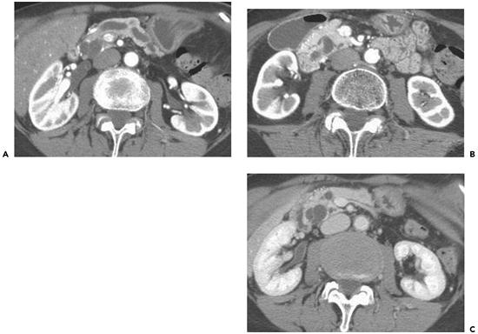
Notes:
Figure 15-47 Side branch intraductal papillary mucinous tumor (IPMT) in a 77-year-old woman with abdominal pain. A: Contrast-enhanced portal venous phase image through the pancreatic body demonstrates dilatation of the main pancreatic duct. No intraductal calculi are evident. B: Portal venous phase image through the pancreatic head demonstrates connection of dilated side branch cystic lesion to the main pancreatic duct. C: A 2.4-cm cystic mass in the posterior aspect of the pancreatic head is consistent with the side branch tumor, proven at surgery. Histologically, the tumor did not extend into the main duct, which was dilated due to increased mucin production.

Slide 23
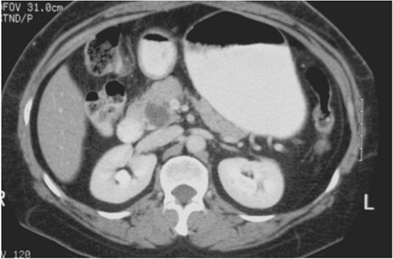
Notes:
Figure 15-46 Side branch intraductal papillary mucinous tumor (IPMT) of uncinate in a 52-year-old asymptomatic woman. Portal venous phase 5-mm computed tomography image demonstrates a 2.0-cm, partially septated low attenuation mass within the uncinate process that is typical of small side branch IPMT. Note absence of main pancreatic duct dilation.

Slide 24
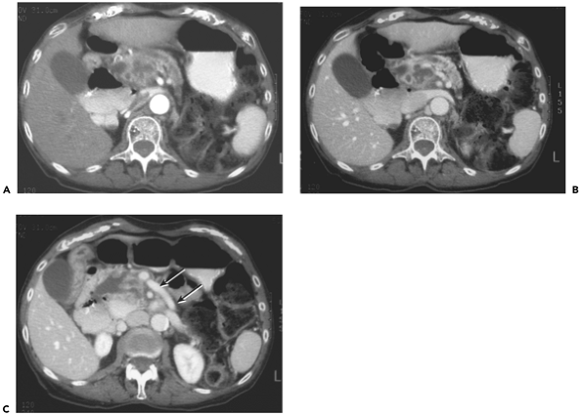
Notes:
Figure 15-41 Nonresectable pancreatic adenocarcinoma due to arterial encasement in an 81-year-old woman with 36 pound weight loss over 2 years and left abdominal pain. A: Pancreatic phase 5-mm computed tomography (CT) demonstrates a heterogeneous, partially necrotic 5-cm mass in the superior pancreatic head, with main pancreatic duct dilatation and atrophy of the body and tail. The left margin of the mass abuts approximately 90 degrees of the superior mesenteric artery. The superior mesenteric vein is not visible. B: Portal venous phase 5-mm CT image through the same level demonstrates the heterogeneity of the infiltrating mass, with more apparent near circumferential encasement of the superior mesenteric artery. The superior mesenteric vein is absent, and more inferiorly on C, a dilated collateral vessel, likely representing first jejunal branch, is present (arrows)

Slide 25
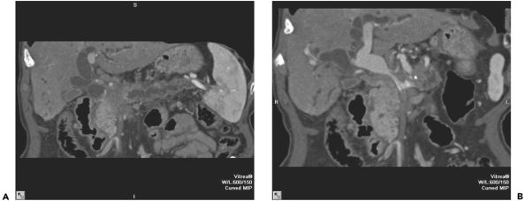
Notes:
Figure 15-40 Unresectable pancreatic adenocarcinoma of the neck. A: Curved planar reformation aligned with the main pancreatic duct demonstrates the hypovascular mass at the point of duct obstruction in the neck region. B: Curved planar reformation aligned with the superior mesenteric vein/portal confluence shows circumferential venous encasement in this nonresectable patient.

Slide 26
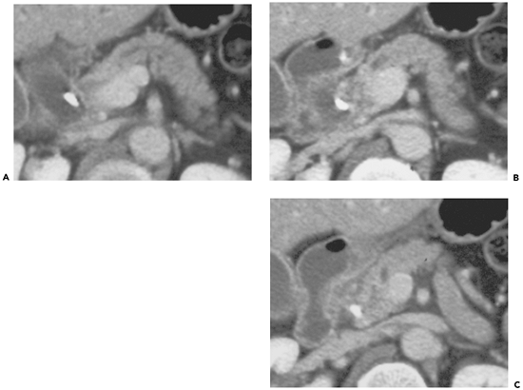
Notes:
Figure 15-39 False-negative computed tomography (CT) for pancreatic tumor resectability due to undetected superior mesenteric vein (SMV) involvement. A: Portal venous phase 5-mm CT image through the superior pancreatic head demonstrates marked dilatation of the common bile duct, which contains a biliary stent. Mild pancreatic duct dilatation is also present. B: Next caudal CT image demonstrates heterogeneous mass measuring approximately 1.8 cm surrounding the stent and abutting approximately 160 degrees of the splenoportal confluence circumference. C: Next caudal 5-mm CT image demonstrates abutment of the poorly defined mass with approximately 100 degrees of the SMV; however, no SMV or portal narrowing or collateral veins were evident, the fat plane surrounding the SMA was well preserved, and the mass was thought to be resectable. At surgery, the mass could not be separated from the SMV, and the patient was unresectable.

Slide 27
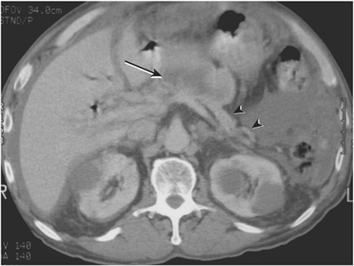
Notes:
Figure 15-37 Pancreatic adenocarcinoma with peritoneal carcinomatosis. Contrast-enhanced 5-mm computed tomography image demonstrates lobular, centrally necrotic 7- Ã— 3-cm mass (arrow) extending anteriorly from the pancreatic neck and body region and pancreatic tail atrophy (arrowheads). Soft tissue density within the greater omentum, ascites, and nodular thickening of the peritoneum are present, consistent with peritoneal carcinomatosis due to pancreatic adenocarcinoma

Slide 28
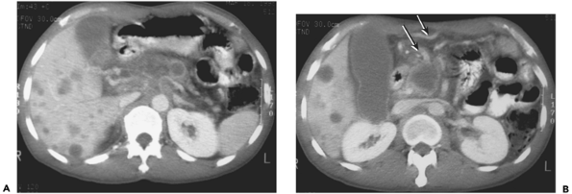
Notes:
Figure 15-36 Widely metastatic inoperable pancreatic adenocarcinoma in a 51-year-old man with cachexia and abdominal pain. A: Portal venous phase 7-mm computed tomography (CT) image through the superior pancreas demonstrates a 5 Ã— 7 cm heterogeneously enhancing hypovascular mass producing encasement of the celiac axis as well as occlusion of the main portal vein. Numerous low-attenuation hepatic metastases are present. B: Portal venous phase 7-mm CT image 3 cm inferiorly demonstrates necrotic, low-attenuation tumor in pancreatic head. Large venous collaterals can be seen anteriorly (arrows), due to the obstruction of the superior mesenteric vein at this level and portal confluence more superiorly.

Slide 29
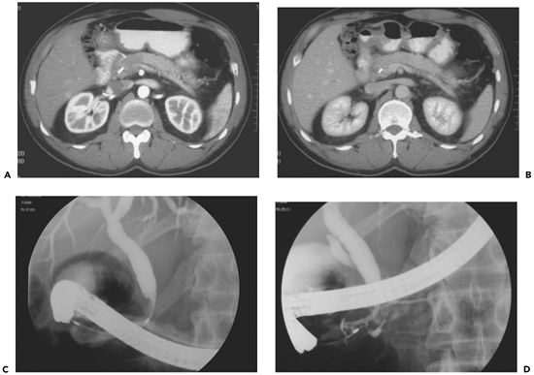
Notes:
Figure 15-35 Chronic pancreatitis mimicking pancreatic adenocarcinoma. A: Pancreatic parenchymal phase 5-mm computed tomography (CT) image demonstrates differential enhancement of the head of the pancreas compared to the body and tail, with the hypoattenuating area surrounding the stent within the distal common bile duct. B: Portal venous phase 5-mm CT image same level demonstrates decreased conspicuity of the mass in the pancreatic head. C: Endoscopic retrograde cholangiopancreatography (ERCP) spot radiograph demonstrates eccentric shelf like narrowing of the distal 1.5 cm of bile duct, corresponding to the site of abnormal enhancement on the CT. D: ERCP spot radiograph during pancreatic duct injection reveals irregularity of the distal most main pancreatic duct near the ampulla. Because of the combined findings, the patient underwent Whipple resection, with focal chronic pancreatitis diagnosed histologically. No tumor was present.

Slide 30
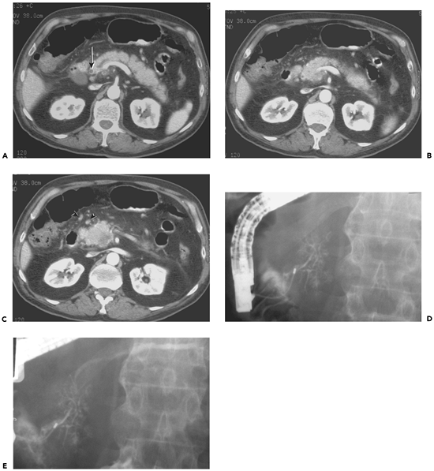
Notes:
Figure 15-33 Pancreatic adenocarcinoma producing abrupt duct termination, also with superior mesenteric vein thrombosis/occlusion in a 68-year-old without jaundice. A: Contrast-enhanced portal-venous phase 5-mm image through the pancreatic neck demonstrates mild dilatation of the main pancreatic duct to 5 mm. Note the normal caliber bile duct (arrow). B: Next caudal portal-venous phase image demonstrates termination of the pancreatic duct dilatation by a heterogeneous, low-attenuation mass measuring 4.2 Ã— 4.0 cm replacing the pancreatic head. Note absence of enhancement in the expected location of the superior mesenteric vein, which normally lies just to the right of the superior mesenteric artery, and enlarged peripancreatic lymph nodes (arrowheads). D, E: Two spot radiographs from same patient's ERCP reveals pseudodivisum. In D, filling of branching structures in the pancreatic head is present without dorsal duct opacification; however, with further injection (E), filling of the slightly dilated dorsal portion of the main pancreatic duct is noted. There is an irregular stricture within the superior pancreatic head produced by the tumor, which was not resectable because of venous invasion.

Slide 31
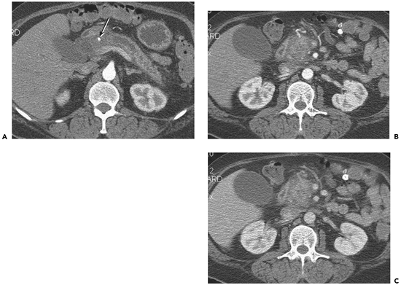
Notes:
Figure 15-32 Pancreatic ductal width greater than 0.5 width of gland. A: A 3-mm pancreatic parenchymal phase computed tomography (CT) image demonstrates dilation of the main pancreatic duct to greater than 0.5 the width of the gland through the body level. There is abrupt termination of the pancreatic duct into a large hypoattenuating mass in the head, surrounding the gastroduodenal artery (arrow) and abutting the portal confluence. B: A 3-mm pancreatic parenchymal phase CT image inferiorly shows hypovascular mass abutting the superior mesenteric artery. The vein is not evident, but at this phase is not yet filled. C: A 5-mm portal venous phase CT image through same level as B demonstrates lack of visualization of the superior mesenteric vein indicating occlusion and nonresectability.

Slide 32
Notes:
Figure 15-30 Pancreatic inflammation produced by carcinoma involving the body region. A: Angled axial computed tomography (CT) image reconstructed from pancreatic parenchymal phase demonstrates 4 Ã— 2 cm low attenuation mass in the pancreatic neck and body producing encasement of the celiac axis and its branches. Focal pseudocyst is present extending from the tail, due to ductal obstruction by the tumor. B: Standard axial 7-mm pancreatic parenchymal phase CT image shows sharp demarcation between the mass and normal enhancement of the pancreatic head region.

Slide 33
A: Pancreatic parenchymal phase 3-mm computed tomography (CT) image through the superior pancreatic head B: Portal venous phase CT image same level C: Coronal endoscopic ultrasound (EUS) image
Notes:
Figure 15-27 Nonresectable pancreatic adenocarcinoma due to SMV better seen on portal phase in a 74-year-old man with pain. A: Pancreatic parenchymal phase 3-mm computed tomography (CT) image through the superior pancreatic head demonstrates a heterogeneously enhancing hypovascular mass within the anterior portion of the pancreas at this level. The SMA appears uninvolved. The SMV is not opacified sufficiently to determine potential invasion. B: Portal venous phase CT image same level demonstrates 180 degrees abutment and transverse narrowing of the SMV, consistent with involvement. C: Coronal endoscopic ultrasound (EUS) image demonstrates heterogeneous, hypoechoic mass adjacent to and narrowing the superior SMV, with indistinct vessel wall. D, duodenal lumen; SMV, superior mesenteric vein; mass, pancreatic adenocarcinoma.

Slide 34
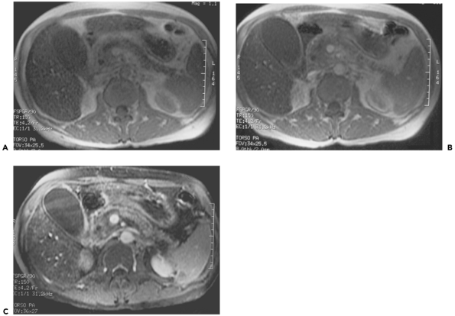
A: Precontrast T1-weighted FSPGR breathhold MR image through the pancreas B: Initial FSPGR post intravenous (IV) gadolinium axial image C: Dynamic post IV gadolinium pancreatic phase fat-suppressed T1-weighted FSPGR axial image
Notes:
Figure 15-26 Pancreatic adenocarcinoma demonstrated by gadolinium enhanced T1-weighted fat suppressed fast spoiled gradient (FSPGR) breathhold magnetic resonance imaging (MRI). A: Precontrast T1-weighted FSPGR breathhold MR image through the pancreas demonstrates normal appearance of the gland without a focal mass evident. B: Initial FSPGR post intravenous (IV) gadolinium axial image demonstrates no differential enhancement, the lack of conspicuity exacerbated by lack of fat suppression. C: Dynamic post IV gadolinium pancreatic phase fat-suppressed T1-weighted FSPGR axial image through the pancreas shows normally enhancing pancreatic body and tail and heterogeneously hypoenhancing lower signal within the pancreatic head, surrounding but not narrowing the superior mesenteric vein. Note the better depiction of slightly dilated main pancreatic duct compared to A, and that the subtle difference in enhancement may be the only indication of tumor.

Slide 35
Notes:
Figure 15-24 Nonresectable pancreatic adenocarcinoma with arterial encasement. A: Portal venous phase 7-mm computed tomography image demonstrates hypovascular mass extending superiorly from the pancreatic neck and body, producing classic encasement of the celiac axis and its branches. B: At 1.5 cm inferiorly, a cuff of neoplastic soft tissue is seen also surrounding the superior mesenteric artery in a pattern typical of neurovascular tracking of pancreatic adenocarcinoma.

Slide 36
Notes:
Figure 15-23 Small pancreatic adenocarcinoma with liver metastases in a 60-year-old man with abdominal pain. Contrast-enhanced portal venous phase image through the body of the pancreas demonstrates a 2.5-cm low-attenuation lesion expanding the pancreas body, immediately adjacent to the splenic vein. Upstream pancreatic duct dilatation is present in the tail. There is no dilatation of the duct in the neck and head. An adjacent 3-cm well-circumscribed pseudocyst is seen anterior to the mass. Also noted are two 1-cm liver lesions in the right hepatic lobe, indicating inoperability.

Slide 37
Notes:
Figure 15-21 Annular pancreas in a 52-year-old woman with computed tomography (CT) for renal disease. A: A 10-mm CT image obtained after oral and before intravenous (IV) contrast demonstrates high-density contrast within the stomach and duodenum. Homogeneous soft tissue encircling the right lateral margin of the duodenum is the same attenuation as the pancreatic head, which lies medial to the duodenum. B: Same level after IV contrast administration, 5-mm portal venous phase CT image, demonstrates similar enhancement of the soft tissue surrounding the duodenum, indicating annular pancreas.

Slide 38
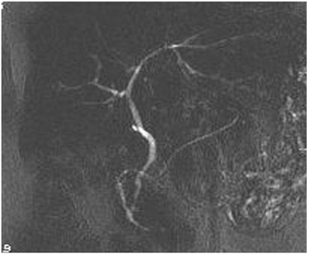
Notes:
Figure 15-20 Magnetic resonance cholangiopancreatography (MRCP) pancreas divisum. A 5-cm slab half-Fourier acquisition single-shot turbo spin echo (HASTE) angled coronal image demonstrates the dorsal pancreatic duct (Santorini) extending to the medial duodenal wall through the minor papilla, superior to the exit of the distal common bile duct through the major papilla.

Slide 39
Notes:
Figure 15-19 Chronic pancreatitis due to pancreas divisum. A: Endoscopic retrograde cholangiopancreatography (ERCP) spot radiograph demonstrating injection into the major papilla shows opacification of the ventral pancreatic duct with arborizing pattern. B: Spot radiograph from ERCP demonstrating injection into the minor papilla shows extensive dilatation of the dorsal pancreatic duct and side branches in a pattern consistent with severe chronic pancreatitis. A minor papilla sphincterotomy was performed. C: A 5-mm portal venous phase computed tomography image demonstrates beadlike dilatation of the dorsal pancreatic duct, corresponding to the ERCP. D: 1.5 cm inferiorly, the stent within the dorsal duct is seen in cross section, along with a small amount of retroperitoneal gas from limited perforation during the minor papilla sphincterotomy. Note the more normal appearance of ventral pancreatic parenchyma. E: Next caudal image shows path of minor papilla stent into the duodenum, anterior to the nondilated distal common bile duct (arrow). A dilated side branch of the dorsal ductal system (*) is also apparent.

Slide 40
Notes:
Figure 15-18 Pancreatic adenocarcinoma with superior mesenteric vein encasement clearly evident on reformatted images. A: Axial 1.3-mm image obtained in pancreatic parenchymal phase through the superior pancreatic body demonstrates hypovascular mass encasing proximal portions of the celiac axis arteries, consistent with nonresectable pancreatic adenocarcinoma. B: Portal venous phase axial image (same level, same technique) demonstrates suboptimal venous filling with still perceptible narrowing of the portal vein confluence (arrow). C: portal venous phase image slightly inferior to B demonstrates barely perceptible sliver of the nearly occluded SMV (arrow). D: Portal venous phase image more inferiorly shows slightly dilated middle colic vein and multiple anterior mesenteric collaterals due to near occlusion of the more superior SMV. E: Angled sagittal volume rendered image through the mesenteric/ splenic confluence demonstrates obstruction of the superior aspect of the SMV, despite poor contrast dynamics. F: Angled coronal volume rendered image through the mesenteric/ splenic confluence demonstrates obstruction of the superior aspect of the SMV. G: Axial maximum intensity projection image demonstrates arterial encasement of the celiac axis by the nonresectable tumor.

Slide 41
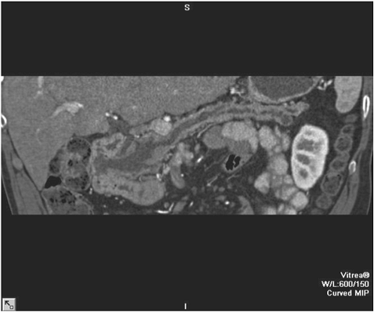
Notes:
Figure 15-16 Moderately differentiated IPMT. Curved planar reformation demonstrates diffuse main pancreatic duct dilation, with the dilated papilla bulging into the duodenal lumen.

