Slide 1
SPOTS

Slide 2
Unenhanced CT image (A) Arterial (B), portal venous (C), and equilibrium phase (D)
Notes:
Figure 12-65 Epithelioid hemangioendothelioma. Unenhanced CT image (A) shows two peripheral hypoattenuating liver masses (M). The large right lobe mass represents coalescence of several smaller lesions that were present on prior examinations. Arterial (B), portal venous (C), and equilibrium phase (D) images demonstrate peripheral enhancement with gradual centripetal progression. Note the capsular retraction (arrows) associated with the masses and hypertrophy of the remaining normal hepatic parenchyma.

Slide 3
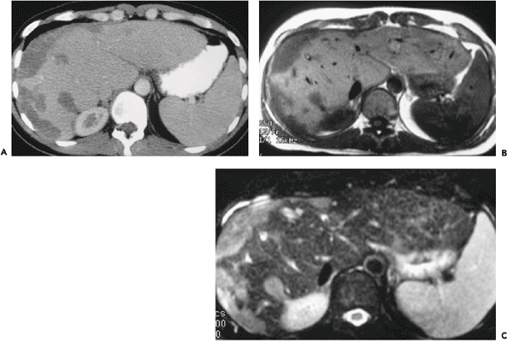
Postcontrast CT (A) T1-weighted (B) and hyperintense on T2-weighted (C) MR images
Notes:
Figure 12-66 Epithelioid hemangioendothelioma. Postcontrast CT (A) demonstrates a large peripheral confluent mass with mild enhancement. The mass is hypointense on T1-weighted (B) and hyperintense on T2-weighted (C) MR images

Slide 4
Notes:
Figure 12-67 Angiosarcoma. Contrast-enhanced CT image shows a vascular right hepatic lobe mass with irregular areas of central and peripheral enhancement. The high attenuation material (arrowheads) adjacent to the lesion represents perihepatic blood secondary to capsular rupture.

Slide 5
Notes:
Figure 12-68 Hepatic non-Hodgkin lymphoma in two patients. Contrast-enhanced CT image (A) shows a large confluent hypoattenuating mass in the left hepatic lobe, with adjacent gastrohepatic ligament lymphadenopathy (arrows). Contrast-enhanced CT image (B) shows multiple relatively homogeneous hypoattenuating hepatic masses in a patient with primary nasopharyngeal lymphoma.

Slide 6
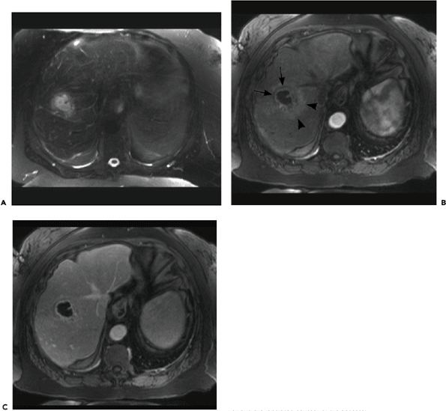
Unenhanced T2-weighted MR image (A) Arterial phase gadolinium-enhanced T1-weighted image (B) Portal venous phase image (C)
Notes:
Figure 12-77 Pyogenic abscess. Unenhanced T2-weighted MR image (A) shows a small hyperintense hepatic mass. The mass is surrounded by a local area of slightly increased signal intensity due to perilesional edema. Arterial phase gadolinium-enhanced T1-weighted image (B) shows that the mass is cystic with an enhancing wall. The wall is bordered by a partial hypointense rim (arrows) due to edema and an irregular area of hyperintensity (arrowheads) related to hyperemia. Portal venous phase image better demonstrates the enhancing wall and the lobulated contour of the abscess.

Slide 7
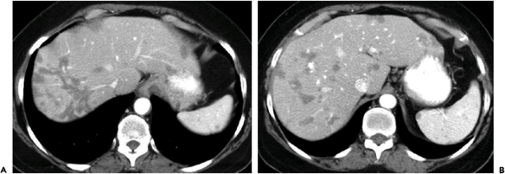
Notes:
Figure 12-85 Multifocal hepatic steatosis. Contrast-enhanced CT images (A, B) demonstrate multiple round and irregular hypoattenuating areas throughout the liver. Note that many of the lesions, particularly those near the dome, have a perivascular distribution.

Slide 8
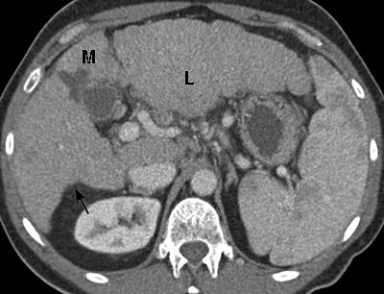
Notes:
Figure 12-87 Cirrhosis. Contrast-enhanced CT image shows nodularity of the liver contour with atrophy of the medial segment (M) and enlargement of the lateral segment (L) of the left hepatic lobe. Note the characteristic prominent notch (arrow) in the right posterior surface of the liver.

Slide 9
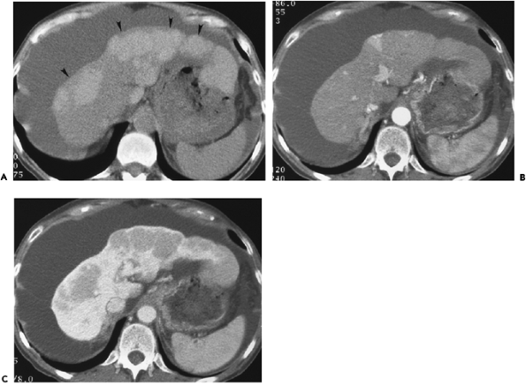
prior to contrast medium administration (A) the hepatic arterial phase (B) and portal venous phase (C).
Notes:
Figure 12-89 Regenerative nodules. Multiple peripheral hepatic nodules (arrowheads) appear relatively hyperattenuating prior to contrast medium administration (A), owing to a combination of high iron content and steatosis of the remaining liver parenchyma. The nodules are isoattenuating during the hepatic arterial phase (B) and hypoattenuating during the portal venous phase (C).

Slide 10
Unenhanced (A) and delayed contrast-enhanced (B) T1-weighted spoiled gradient echo i
Notes:
Figure 12-90 Cirrhosis. Unenhanced (A) and delayed contrast-enhanced (B) T1-weighted spoiled gradient echo images demonstrate nodularity of the liver contour secondary to innumerable small regenerative nodules. Fibrotic septa surrounding the regenerative nodules appear hypointense precontrast (A) and hyperintense on the delayed postcontrast image (B).

Slide 11
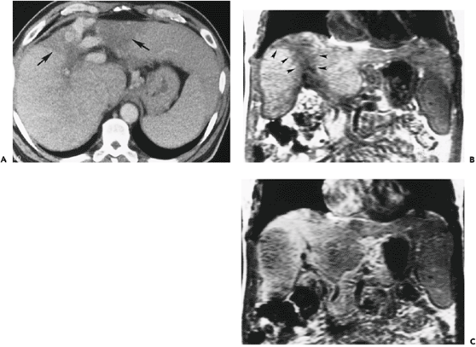
Contrast-enhanced CT (A) Unenhanced coronal T1-weighted gradient echo MR image (B) delayed gadolinium-enhanced image (C),
Notes:
Figure 12-91 Confluent hepatic fibrosis. Contrast-enhanced CT (A) shows a wedge-shaped area of hypoattenuation (arrows) extending from the porta hepatis to the liver capsule. Note the slight capsular retraction. Unenhanced coronal T1-weighted gradient echo MR image (B) shows a wedge-shaped hypointense area (arrowheads) radiating from the porta hepatis to the dome of the liver. On a delayed gadolinium-enhanced image (C), the area of fibrosis has become hyperintense due to prolonged retention of contrast material.

Slide 12
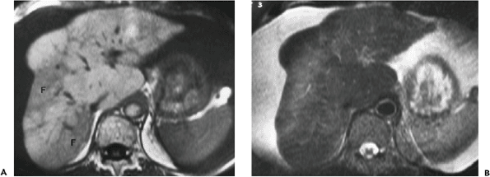
T1-weighted spin-echo MR image (A) T2-weighted spin-echo image (B),
Notes:
Figure 12-92 Confluent hepatic fibrosis. A T1-weighted spin-echo MR image (A) shows two areas of peripheral hypointensity in the right hepatic lobe (F). Note retraction of the overlying liver capsule. On a T2-weighted spin-echo image (B), the areas of fibrosis are mildly hyperintense.

Slide 13
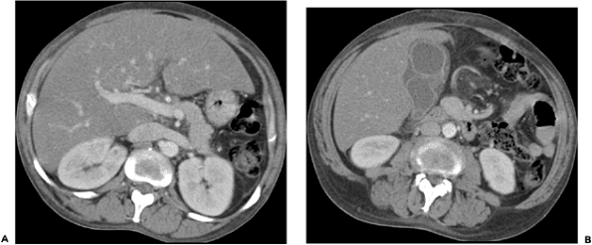
Notes:
Figure 12-98 Hepatitis. Contrast-enhanced CT images (A, B) show hepatomegaly with mild diffuse steatosis and gallbladder wall thickening.

Slide 14
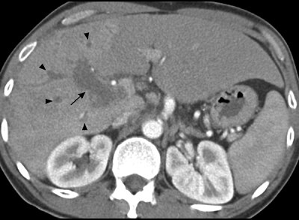
Notes:
Figure 12-102 Portal vein thrombosis. Contrast-enhanced CT image shows enlargement and lack of enhancement of the main right portal vein (arrow) and peripheral right portal vein branches (arrowheads). Note the transient hepatic attenuation difference (THAD) resulting in increased attenuation of the right hepatic lobe.

Slide 15
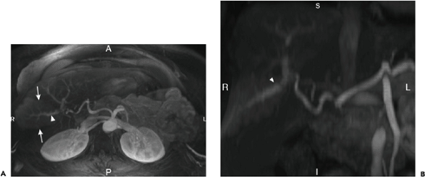
Arterial phase maximum intensity projection (MIP) image (A) from a gadolinium-enhanced T1-weighted MR acquisition .Coronal arterial phase reconstruction (B)
Notes:
Figure 12-105 Transient hepatic intensity difference (THID) caused by arterioportal shunting in a patient with cirrhosis. Arterial phase maximum intensity projection (MIP) image (A) from a gadolinium-enhanced T1-weighted MR acquisition shows a wedge-shaped area of peripheral enhancement (arrows) in the anterior segment of the right hepatic lobe with early drainage into a portal vein branch (arrowhead). A coronal arterial phase reconstruction (B) shows similar findings including early drainage into the right portal vein (arrowhead).

Slide 16
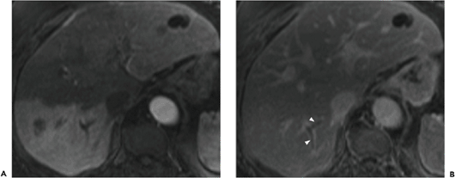
Arterial phase gadolinium-enhanced T1-weighted MR i (A) Delayed postcontrast image (B)
Notes:
Figure 12-106 Intrahepatic portal vein thrombosis with transient hepatic intensity difference (THID). Arterial phase gadolinium-enhanced T1-weighted MR image (A) shows diffusely increased signal intensity within the posterior segment of the right hepatic lobe due to segmental portal vein thrombosis. Delayed postcontrast image (B) shows equilibration of the hepatic parenchymal signal intensity. Thrombus can be seen within peripheral branches of the portal vein (arrowheads).

Slide 17
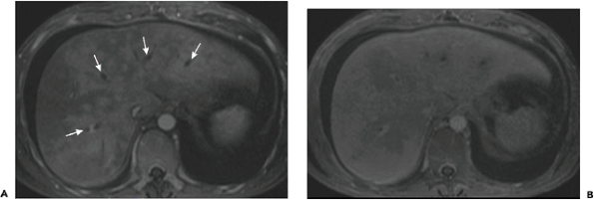
Arterial phase gadolinium-enhanced T1-weighted MR image (A) Delayed postcontrast image (B)
Notes:
Figure 12-108 Budd-Chiari syndrome. Arterial phase gadolinium-enhanced T1-weighted MR image (A) shows preferential enhancement of the central portions of the liver surrounding the unenhanced hepatic veins (arrows). Note the perihepatic ascites. Delayed postcontrast image (B) demonstrates reversal of the earlier enhancement pattern, with more enhancement peripherally than centrally. The thrombus-containing hepatic veins remain unenhanced.

Slide 18
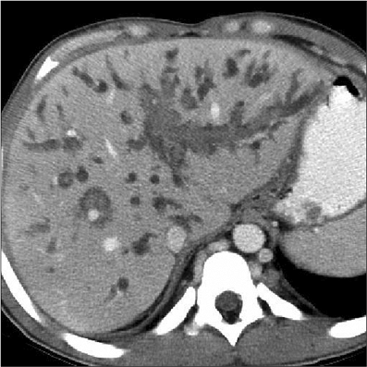
Notes:
Figure 13-55 Hematobilia. CT demonstrates high attenuation clot throughout the biliary system after a liver biopsy

Slide 19
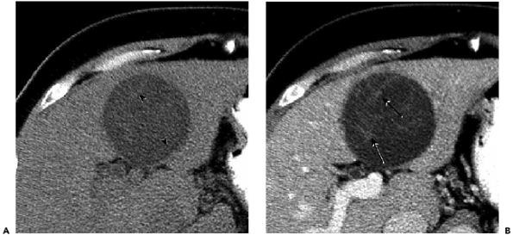
Notes:
Figure 13-46 Biliary cystadenoma. A: Noncontrast computed tomography (CT) of the liver demonstrates a focal low-density mass with subtle septations (arrowheads). B: Contrast-enhanced CT shows enhancement of the septations (arrows), but no enhancement in the cystic components of the mass.

Slide 20
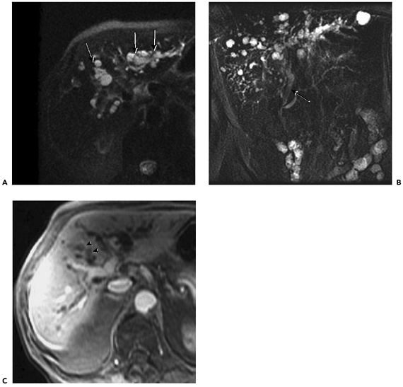
A: Axial T2-weighted magnetic resonance image B: Coronal oblique thick-slab MRCP C: Contrast-enhanced T1-weighted image
Notes:
Figure 13-45 Magnetic resonance cholangiopancreatography (MRCP) of cholangiocarcinoma. A: Axial T2-weighted magnetic resonance image shows dilated intrahepatic ducts with homogenous high T2 signal (arrows). B: Coronal oblique thick-slab MRCP demonstrates extensive intrahepatic hyperintense T2 signal duct dilatation to the level of the hepatic hilum, with a normal caliber of the extrahepatic bile duct (arrow). C: Contrast-enhanced T1-weighted image of the liver shows low T1 signal in the dilated intrahepatic ducts (arrowheads).

Slide 21
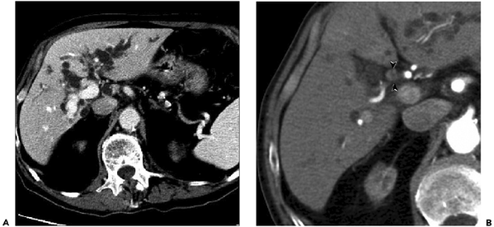
Notes:
Figure 13-44 Extrahepatic cholangiocarcinoma. A: Contrast-enhanced computed tomography (CT) scan through the liver shows extensive intrahepatic ductal dilatation. B: Contrast-enhanced CT at the level of the liver hilum shows a short segment of a concentrically thickened common bile duct with mural enhancement (arrowheads).

Slide 22
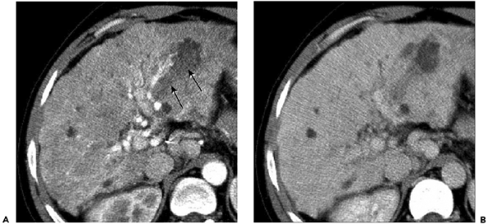
Notes:
Figure 13-43 Intrahepatic cholangiocarcinoma. A: Contrast-enhanced computed tomography of the liver shows biliary dilatation with dense material (arrows) filling the bile ducts in the left hepatic lobe. B: Delayed image demonstrates persistent high density in this region.

Slide 23
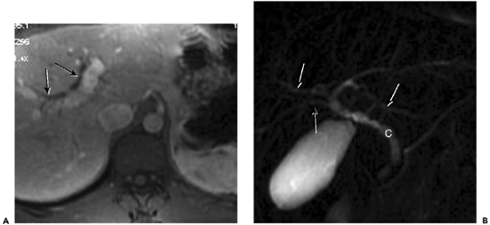
A: Contrast-enhanced T1-weighted images of the liver B: Thick-slab magnetic resonance cholangiopancreatography
Notes:
Figure 13-40 Primary sclerosing cholangitis. A: Contrast-enhanced T1-weighted images of the liver show intrahepatic biliary dilatation (arrows). B: Thick-slab magnetic resonance cholangiopancreatography shows multifocal strictures with a â€œbeadedâ€ appearance of the intrahepatic ducts (arrows). The common duct (C) is irregular, but has a normal caliber.

Slide 24
Notes:
Figure 13-38 Primary sclerosing cholangitis. Endoscopic retrograde cholangiopancreatography shows multifocal strictures (arrows) involving the intrahepatic and extrahepatic biliary ducts.

Slide 25
Notes:
Figure 13-35 Cholangitis. Thick-slab magnetic resonance cholangiopancreatography shows irregularity of the intrahepatic bile ducts (arrowheads).

Slide 26
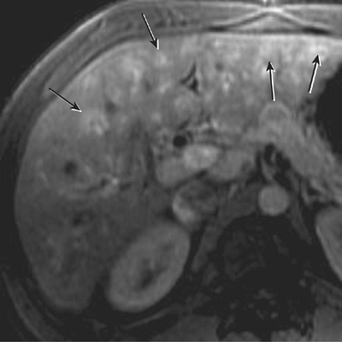
Contrast-enhanced T1-weighted magnetic resonance image
Notes:
Figure 13-34 Cholangitis. Contrast-enhanced T1-weighted magnetic resonance image of the liver shows bright enhancement of the intrahepatic biliary radicals (arrows), consistent with biliary inflammation.

Slide 27
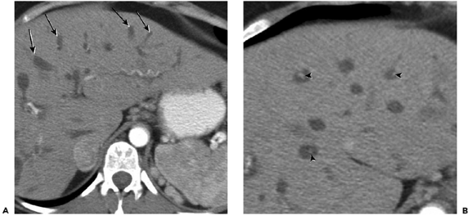
Notes:
Figure 13-31 Caroli disease. A: Contrast-enhanced computed tomography of the liver shows numerous non-enhancing cystic structures (arrows) in the hepatic parenchyma. These represent focally dilated biliary ducts. B: Magnified image of the liver shows central foci of high density (arrowheads), which represent vessels surrounded by the dilated ducts, the â€œcentral dotâ€ sign.

Slide 28
Notes:
Figure 13-26 Adenomyomatosis. Grayscale ultrasound of the gallbladder demonstrates echogenic â€œcomet tailâ€ artifacts (arrows) arising from the wall and projecting into the gallbladder lumen.

Slide 29
Notes:
Figure 13-24 Porcelain gallbladder. A: Contrast-enhanced computed tomography (CT) shows extensive calcification in the wall of a contracted gallbladder. When it is this diffuse, the wall calcification may be difficult to differentiate from cholelithiasis. B: CT image of another patient demonstrates discontinuous mural calcification.

Slide 30
Notes:
Figure 13-5 Hematobilia. Contrast-enhanced computed tomography image shows high-attenuation clot (C) in the gallbladder.

Slide 31
Notes:
Figure 14-40 Splenic artery aneurysm (A) in a patient with a history of pancreatitis. Note pancreatic calcifications (arrowheads). S, spleen.

Slide 32
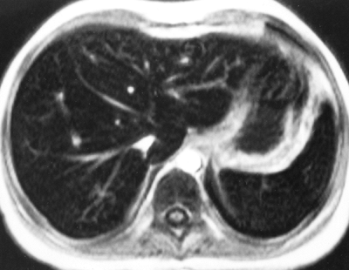
T1-weighted magnetic resonance image
Notes:
Figure 14-36 Secondary hemochromatosis. Iron deposition in the reticuloendothelial system has caused loss of signal in both liver and spleen on this T1-weighted magnetic resonance image (repetition time, 140 ms; echo time, 4 ms; flip angle, 80 degrees).

Slide 33
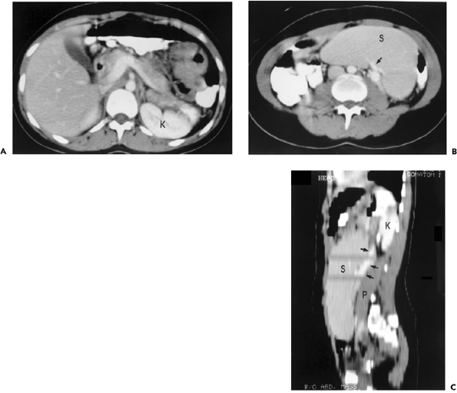
Notes:
Figure 14-10 Wandering spleen. A: No splenic shadow is seen in the left upper abdomen. K, kidney. B: The spleen (S) is seen in the lower midabdomen and mimics the appearance of an abdominal tumor, Arrow, splenic hila. C: Sagittal reconstruction shows the splenic vein (arrows) running cephalad. Marked splenomegaly in this case is secondary to mononucleosis. K, kidney; P, psoas muscle.

Slide 34
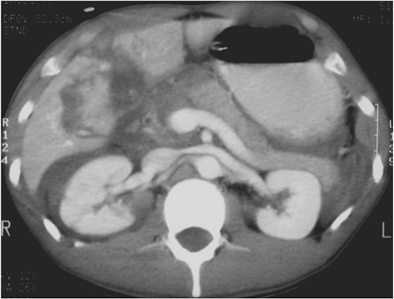
Notes:
Figure 15-103 Traumatic pancreatic laceration in a 23-year-old man involved in a motor vehicle collision. Contrast-enhanced computed tomography through the level of the portal confluence demonstrates abrupt discontinuity of pancreatic enhancement at the junction of the neck and head, consistent with pancreas laceration. Fluid is seen tracking into the anterior pararenal space bilaterally. Large stellate hepatic laceration with active extravasation is also noted. The pattern of small bowel and adrenal enhancement is consistent with shock (hypotension and hypovolemia).

Slide 35
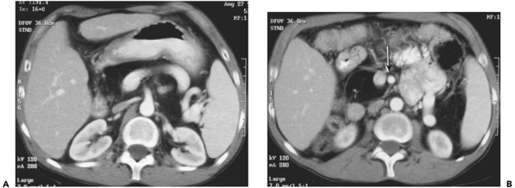
Notes:
Figure 15-101 Fatty replacement of the pancreas in a 35-year-old man with cystic fibrosis. A: Portal venous phase 7-mm computed tomography image at the level of the splenic vein portal confluence demonstrates slightly heterogeneous fat replacing the superior head, neck, and body of the pancreas. B: 3 cm inferiorly, faint soft tissue capsule is seen surrounding the fat replacing the pancreatic head, normally located to the right of the superior mesenteric vessels (arrow).

Slide 36
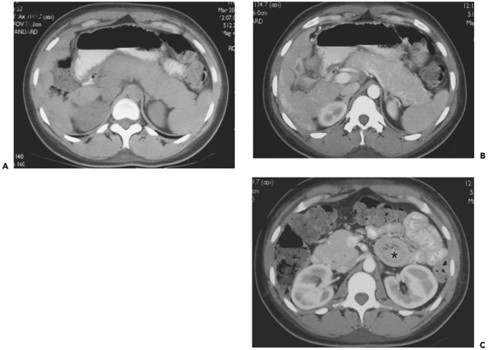
Notes:
Figure 15-100 Autoimmune pancreatitis in a 27-year-old woman with autoimmune hepatitis. A: Pre-intravenous contrast 5-mm image demonstrates global enlargement of the pancreas. B: Portal venous phase 5-mm computed tomography image demonstrates homogeneous enhancement with several large vascular channels seen in the grossly enlarged pancreas. C: Diffuse enlargement included the pancreatic head, which is smooth in contour, normal and homogeneous in attenuation, and without evidence of ductal dilatation. No low attenuation peripheral capsule is seen, as has been reported in some patients with autoimmune pancreatitis. Note incidental jejunal intussusception (*).

Slide 37
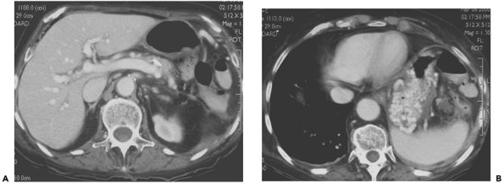
Notes:
Figure 15-97 Chronic pancreatitis with chronic splenic vein thrombosis. A: A 5-mm portal venous phase computed tomography image demonstrates atrophy of the pancreatic body and tail with 1 cm calcification, possibly within the main pancreatic duct. Note patency of splenic vein to the tail/body junction. Upstream to this level, no normal splenic vein could be seen coursing towards the hilum. B: 5 cm cephalad, extensive varices of the posterior gastric wall in the gastroepiploic distribution are noted due to chronic thrombosis of the splenic vein near the hilum.

Slide 38
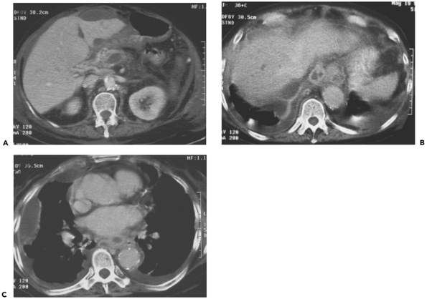
Notes:
Figure 15-96 Chronic pancreatitis with pancreatico-pleural fistula. A: A 7-mm portal venous phase computed tomography (CT) image through the superior pancreatic head level demonstrates an ovoid 2.5 (1.5 cm fluid collection in the pancreatic neck. Note fluid also dissecting around the left hepatic lobe. B: A 7-mm CT image located 8 cm superior to the pancreatic neck demonstrates well-defined track of fluid in the posterior mediastinum. C: 15 cm superiorly to A, focal tubular fluid collections in the posterior mediastinum have tracked further into the chest. Note partial loculation of pleural fluid within the right hemithorax. Communication between the pancreatic duct, retroperitoneal and posterior mediastinal fluid tracks, and right pleural space was demonstrated on subsequent endoscopic retrograde cholangiopancreatography.

Slide 39
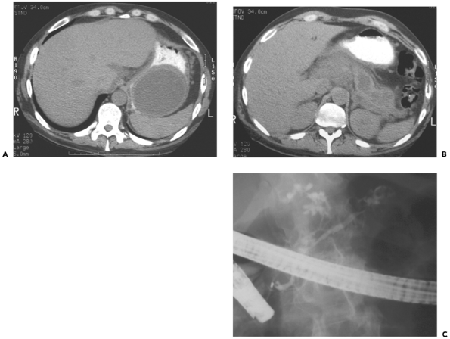
Notes:
Figure 15-95 Chronic pancreatitis with pseudocyst dissecting into wall of stomach. A: A 5-mm oral-contrast-only computed tomography (CT) image through the upper abdomen demonstrates well-circumscribed 8 Ã— 7 cm fluid collection dissecting within the posterior gastric wall. B: 4 cm inferiorly, inflammatory change is seen surrounding the superior pancreatic body, which contains several low attenuation collections representing either intrapancreatic pseudocysts or dilated duct. No calcifications are noted. C: Spot radiograph from endoscopic retrograde cholangiopancreatography (ERCP) with injection into the major papilla shows irregularity of the nondilated main pancreatic duct with several focal strictures and two areas of extravasation into complex tracks, likely leading to the pseudocysts seen on CT. By Cambridge classification, this represents severe chronic pancreatitis.

Slide 40
Notes:
Figure 15-94 Chronic pancreatitis with pseudocyst dissecting into the superior recess lesser sac. A 7-mm portal venous phase computed tomography image demonstrates well-defined focal fluid collection within the potential space of the peritoneal folds creating the superior recess of the lesser sac, producing some adjacent mass effect on the hepatic parenchyma.

Slide 41
Notes:
Figure 15-90 Post pancreatitis splenic artery pseudoaneurysm. A: Well-circumscribed, ovoid, 4 Ã— 2 cm structure is seen anterior to the body of the pancreas on precontrast computed tomography (CT). The curvilinear high density within the right aspect of the lesion represents fresh clot. B: Contrast-enhanced CT through the same level demonstrates enhancement of blood within the lumen of the pseudoaneurysm, surrounded by clot.

