Slide 1
SPOTS

Slide 2
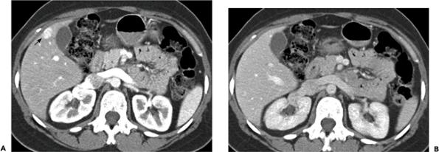
Notes:
Figure 12-6 Focal nodular hyperplasia. CT image acquired during the arterial phase of hepatic contrast enhancement (A) demonstrates a small subcapsular enhancing mass (arrow). During the portal venous phase of enhancement (B) the lesion is isoattenuating and can no longer be identified.

Slide 3
Notes:
Figure 12-10 Biliary hemartomas. Contrast-enhanced CT shows multiple small low attenuation lesions scattered throughout the liver.

Slide 4
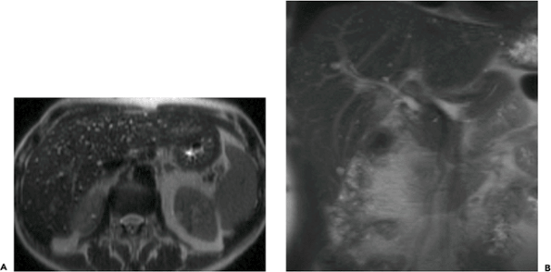
Transaxial (A) and coronal (B) half-Fourier single shot turbo spin echo (HASTE) MR images
Notes:
Figure 12-11 Biliary hamartomas in two patients. Transaxial (A) and coronal (B) half-Fourier single shot turbo spin echo (HASTE) MR images show multiple small hyperintense lesions scattered throughout the liver in each patient.

Slide 5
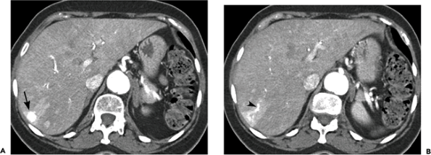
Arterial phase CT image (A) A slightly more caudal image (B)
Notes:
Figure 12-17 Hemangioma with arterioportal shunting. Arterial phase CT image (A) shows a small, round rapidly enhancing mass (arrow) with attenuation similar to that of the aorta. A slightly more caudal image (B) demonstrates a wedge-shaped area of parenchymal enhancement adjacent to the mass caused by arterioportal shunting. Note the early drainage of blood into a peripheral portal vein branch (arrowhead).

Slide 6
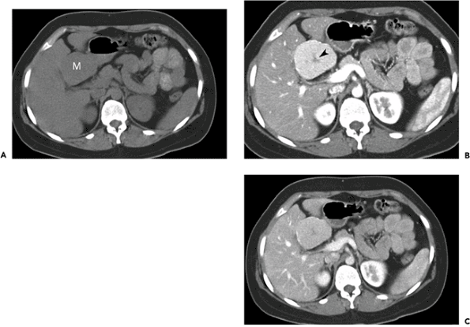
Precontrast CT image (A. Arterial phase image (B)the portal venous phase (C)
Notes:
Figure 12-20 Focal nodular hyperplasia. Precontrast CT image (A) shows a large isoattenuating mass (M) in segment IVb of the liver. Arterial phase image (B) demonstrates marked homogeneous enhancement of the mass, which contains a hypoattenuating central scar (arrowhead). During the portal venous phase (C) the mass becomes nearly isoattenuating with the liver parenchyma.

Slide 7
Notes:
Figure 12-21 Focal nodular hyperplasia. A large mass (M) in the right hepatic lobe is isoattenuating on the precontrast CT image (A), homogeneously hyperattenuating during the arterial phase (B) and nearly isoattenuating relative to liver during the portal venous phase (C). A central scar was seen on more caudal images. Note the slight hyperattenuation of the adjacent liver on the portal venous phase image (arrowheads) due to compression of surrounding parenchyma. Sagittal (D) and coronal (E) maximum intensity projection (MIP) images demonstrate the large feeding hepatic artery (arrow) and the large early draining hepatic vein (open arrows).

Slide 8
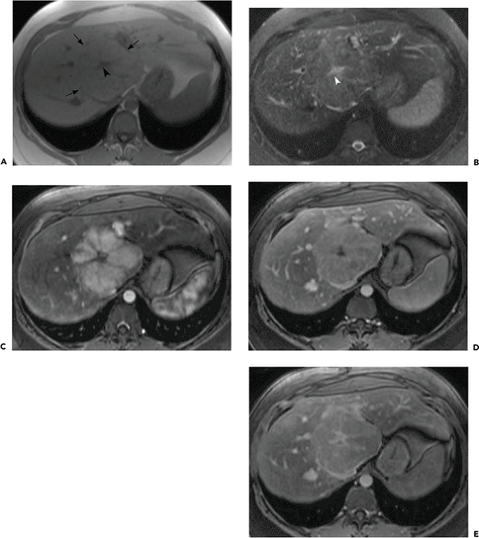
T1-weighted (A) and T2-weighted (B) images. Arterial phase gadolinium-enhanced image (C) portal venous phase image (D) A later image (E)
Notes:
Figure 12-22 Focal nodular hyperplasia. A large mass (arrows) in the caudate lobe is isointense on T1-weighted (A) and T2-weighted (B) images. A central scar (arrowhead) is hypointense on the T1-weighted image and hyperintense on the T2-weighted image. Arterial phase gadolinium-enhanced image (C) shows intense enhancement of the mass except for the central scar and radiating fibrous septa. On the portal venous phase image (D) the mass is nearly isointense relative to the liver parenchyma and the central scar remains hypointense. A later image (E) shows delayed enhancement of the central scar.

Slide 9
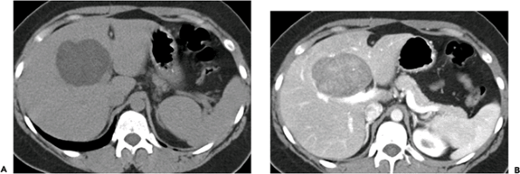
Notes:
Figure 12-23 Hepatocellular adenoma. Precontrast CT image (A) shows a large hypoattenuating hepatic mass. A postcontrast portal venous phase image (B) shows moderate heterogeneous enhancement of the mass.

Slide 10
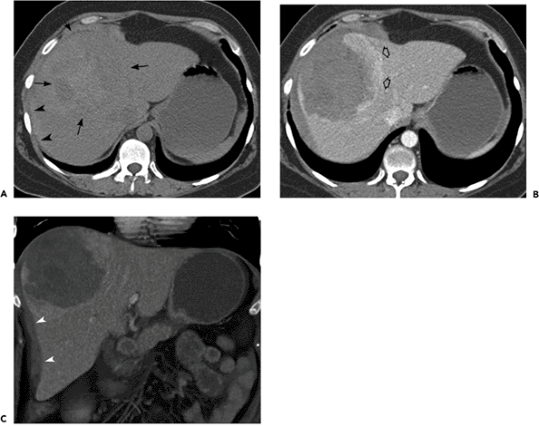
Notes:
Figure 12-24 Ruptured hepatocellular adenoma. Precontrast CT image (A) shows a large heterogeneous mass (arrows) near the dome of the liver. Central areas of hyperintensity represent hemorrhage. Note the high attenuation perihepatic blood (arrowheads). Contrast-enhanced image (B) shows enhancement of the peripheral intact portion of the mass (open arrows). The hemorrhagic portion of the mass does not enhance. Note loss of integrity of the liver capsule anterolaterally. Coronal volume-rendered image (C) shows the peripherally enhancing mass, ruptured liver capsule, and perihepatic blood (arrowheads).

Slide 11
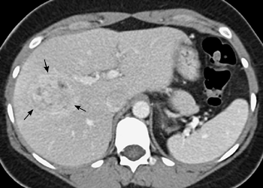
Notes:
Figure 12-25 Hepatocellular adenoma. Contrast-enhanced portal venous phase CT image demonstrates a slightly hyperattenuating, heterogeneously enhancing vascular hepatic mass (arrows).

Slide 12
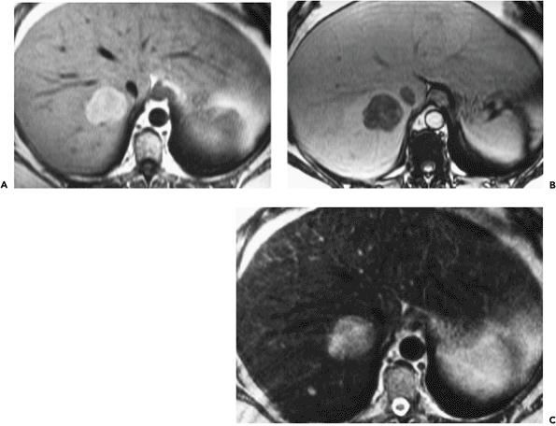
in-phase T1-weighted gradient echo image (A) opposed-phase image (B)T2-weighted image (C).
Notes:
Figure 12-26 Hepatocellular adenoma. A mass in segment VII of the liver is hyperintense on an in-phase T1-weighted gradient echo image (A) and shows marked signal loss on an opposed-phase image (B), indicating that it contains lipid. The mass is high in signal intensity on a T2-weighted image (C).

Slide 13
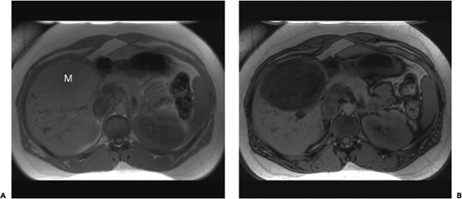
In-phase T1-weighted spoiled gradient-echo MR image (A) Out-of-phase image (B)
Notes:
Figure 12-27 Hepatocellular adenoma. In-phase T1-weighted spoiled gradient-echo MR image (A) shows a large isointense hepatic mass (M). Out-of-phase image (B) demonstrates diffuse decrease in signal intensity within the mass due to the presence of intracellular lipid.

Slide 14
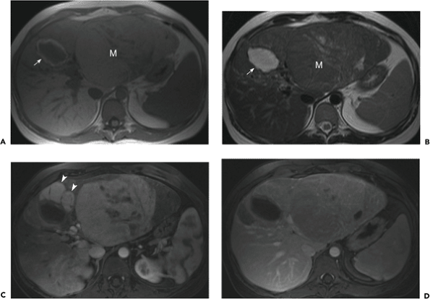
T1-weighted (A) and T2-weighted (B) images arterial phase gadolinium-enhanced image (C) and portal venous phase image (D).
Notes:
Figure 12-28 Hepatocellular adenomas. A large mass (M) in the left lobe of the liver is isointense on T1-weighted (A) and T2-weighted (B) images except for internal heterogeneity. A smaller mass (arrow) that is hypointense with a hyperintense rim on the T1-weighted image and hyperintense on the T2-weighted image is a hemorrhagic adenoma. The mass becomes hyperintense on the arterial phase gadolinium-enhanced image (C) and slightly hypointense on the portal venous phase image (D). The smaller enhancing masses (arrowheads) on the arterial phase image are additional adenomas.

Slide 15
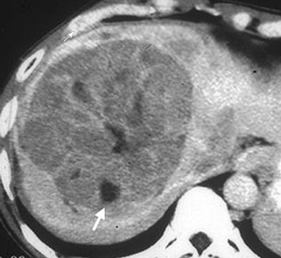
Notes:
Figure 12-29 Hepatic angiomyolipoma. Contrast-enhanced CT image shows a heterogeneously enhancing hepatic mass that contains foci of macroscopic fat (arrow).

Slide 16
In-phase T1-weighted spoiled gradient echo MR image (A)Out-of-phase image (B) T2-weighted image (C) T2-weighted image with fat suppression (D) Arterial phase T1-weighted gadolinium-enhanced image (E)
Notes:
Figure 12-30 Hepatic angiomyolipoma. In-phase T1-weighted spoiled gradient echo MR image (A) shows a hypointense mass in the right hepatic lobe that contains several foci of hyperintensity (arrow) due to macroscopic fat. Out-of-phase image (B) demonstrates a black ring surrounding one of the high signal intensity foci indicating an interface between fat protons and surrounding water protons (arrowhead). T2-weighted image (C) shows that the mass is hyperintense and that the internal foci of fat are higher in signal intensity relative to the rest of the lesion. T2-weighted image with fat suppression (D) shows that the hyperintense foci within the lesion on the nonâ€“fat-suppressed image (C) become hypointense, confirming that they represent foci of macroscopic fat. Arterial phase T1-weighted gadolinium-enhanced image (E) shows marked heterogeneous enhancement of the nonâ€“fat-containing portions of the mass.

Slide 17
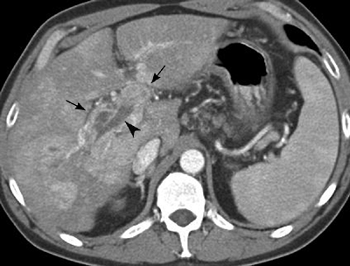
Notes:
Figure 12-31 Diffusely infiltrating hepatocellular carcinoma with portal vein invasion. Arterial phase CT image shows enhancing tumor thrombus expanding the left and right portal veins (arrows). The elongated hypoattenuating area within the portal vein (arrowhead) is bland thrombus.

Slide 18
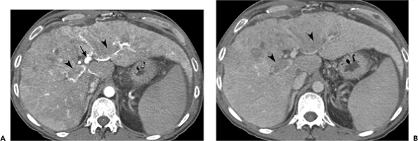
Arterial phase CT image (A)Portal venous phase image (B)
Notes:
Figure 12-32 Diffusely infiltrating hepatocellular carcinoma with arterioportal shunting and portal vein invasion. Arterial phase CT image (A) of the liver shows diffuse heterogeneity within the anterior segment of the right lobe and medial segment of the left lobe. Note that the portal vein (arrow) enhances brightly on this arterial phase image, indicating arterioportal shunting. Tumor thrombus incompletely fills the right and left portal veins (arrowheads). Portal venous phase image (B) more clearly demonstrates the hepatic parenchymal heterogeneity and portal vein tumor thrombus (arrowheads).

Slide 19
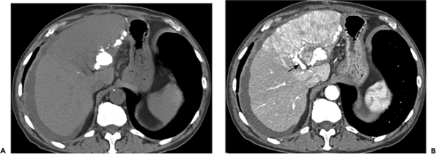
Precontrast CT image (A) Arterial phase contrast-enhanced image (B)
Notes:
Figure 12-33 Hepatocellular carcinoma with arterioportal shunting. Precontrast CT image (A) in a patient with cirrhosis shows slight hypoattenuation of the left hepatic lobe. Very dense iodized oil from chemoembolization of a large hepatocellular carcinoma is present at the periphery of the left lobe. Arterial phase contrast-enhanced image (B) demonstrates that only a small portion of the diffuse left lobe tumor has been embolized. Intense arterial phase enhancement of the portal vein (arrow) indicates arterioportal shunting.

Slide 20
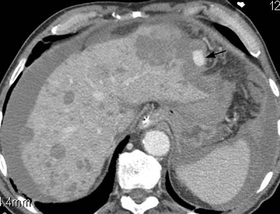
Notes:
Figure 12-34 Hemorrhagic hepatocellular carcinoma. Contrast-enhanced CT image shows multiple low attenuation lesions scattered throughout the liver. A larger subcapsular lesion in the left hepatic lobe has ruptured, resulting in hemoperitoneum. The area of bright contrast enhancement at the periphery of the liver indicates active extravasation (arrow).

Slide 21
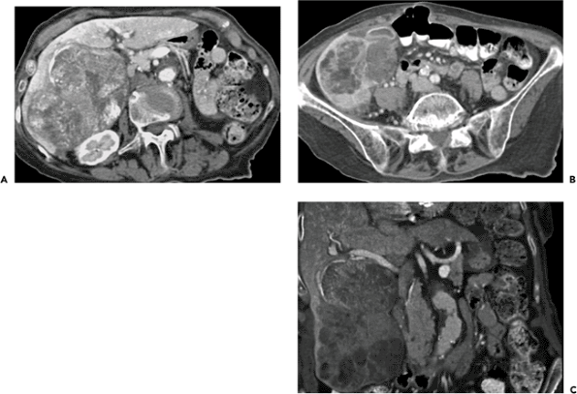
Notes:
Figure 12-35 Hepatocellular carcinoma. Contrast-enhanced CT images (A, B) show a large heterogeneously enhancing mass in the right hepatic lobe. Internal septations and areas of degeneration give the mass a â€œmosaicâ€ pattern, which is also demonstrated on a coronal volume-rendered image (C). The very low attenuation areas in the inferior portion of the mass are areas of fatty degeneration.

Slide 22
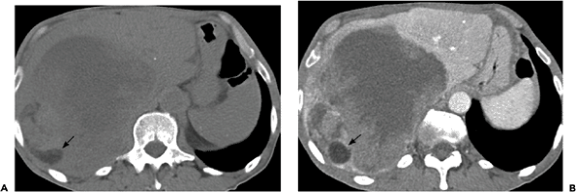
Notes:
Figure 12-36 Hepatocellular carcinoma with fatty metamorphosis. Precontrast (A) and contrast-enhanced (B) CT images show a large hypoattenuating mass in the right hepatic lobe. An area of fat attenuation posteriorly (arrow) represents fatty metamorphosis within the tumor.

Slide 23
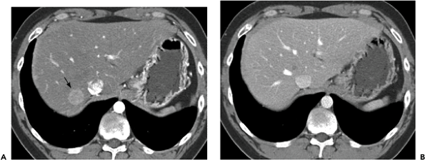
Arterial phase CT image (A) portal venous phase image (B)
Notes:
Figure 12-37 Hepatocellular carcinoma. Arterial phase CT image (A) shows a well-defined hyperattenuating mass (arrow) in segment VII of the liver. On the portal venous phase image (B) the mass has become isoattenuating and is no longer identified.

Slide 24
Arterial phase CT images (A, B)
Notes:
Figure 12-38 Multifocal hepatocellular carcinoma. Arterial phase CT images (A, B) show a large heterogeneously enhancing mass with multiple adjacent satellite lesions. A thin hypoattenuating fibrous capsule (arrowheads) surrounds the large mass.

Slide 25
Notes:
Figure 12-39 Multifocal hepatocellular carcinoma. Arterial phase contrast-enhanced CT image shows diffuse nodular, heterogeneous hyperattenuation of the right hepatic lobe and medial segment of the left lobe with multiple additional lesions involving the left lateral segment and caudate lobe.

Slide 26
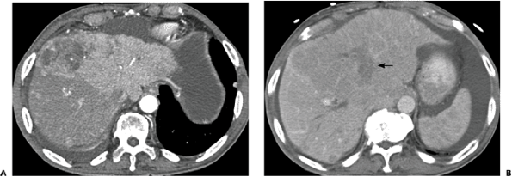
Arterial phase CT image (A) Portal venous phase image (B)
Notes:
Figure 12-40 Diffuse hepatocellular carcinoma with portal vein thrombosis. Arterial phase CT image (A) shows intense heterogeneous enhancement of the left hepatic lobe with multiple smaller tumor nodules involving the right lobe. Portal venous phase image (B) shows enlargement and hypoattenuation of the entire left hepatic lobe and anterior segment of the right lobe from the diffusely infiltrating tumor. The expanded left portal vein (arrow) is filled with tumor thrombus.

Slide 27
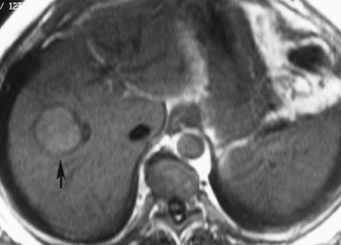
T1-weighted MR image
Notes:
Figure 12-42 Encapsulated hepatocellular carcinoma. T1-weighted MR image shows a hyperintense mass (arrow) with a hypointense capsule.

Slide 28
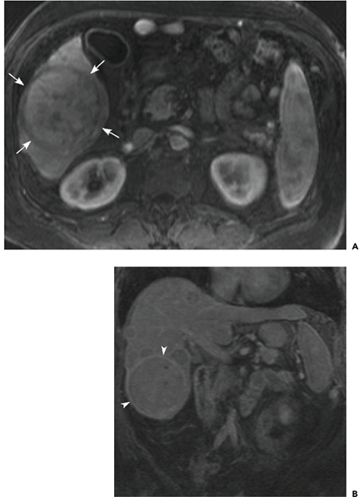
Arterial phase gadolinium-enhanced T1-weighted spoiled gradient echo image (A) Delayed postcontrast coronal image (B)
Notes:
Figure 12-43 Hepatocellular carcinoma. Arterial phase gadolinium-enhanced T1-weighted spoiled gradient echo image (A) shows a large heterogeneously enhancing hepatic mass. A hypointense fibrous capsule (arrows) surrounds the lesion. Delayed postcontrast coronal image (B) demonstrates enhancement of the tumor capsule (arrowheads). Note multiple additional encapsulated lesions.

Slide 29
Arterial phase gadolinium-enhanced T1-weighted spoiled gradient echo image with fat suppression (A) Portal venous phase image (B) at the same level
Notes:
Figure 12-44 Small hepatocellular carcinomas with contrast enhancement â€œwashout.â€ Arterial phase gadolinium-enhanced T1-weighted spoiled gradient echo image with fat suppression (A) shows two small hyperintense lesions (arrows) at the dome of the liver. Portal venous phase image (B) at the same level shows that the more anterior lesion has become hypointense and is surrounded by an enhanncing capsule (arrowhead).

Slide 30
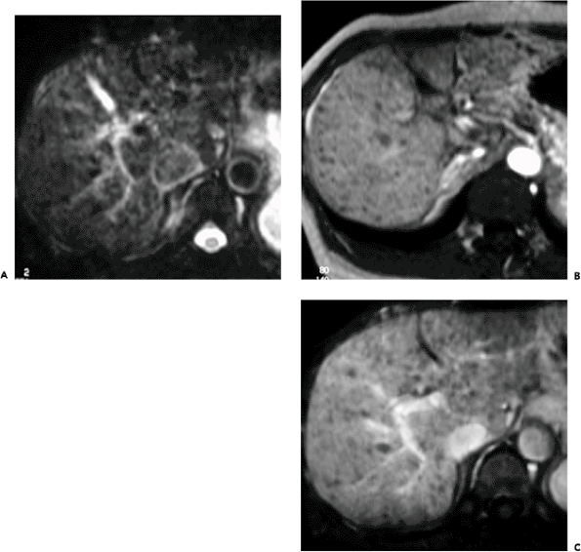
T2-weighted (A), arterial phase (B), and portal venous phase (C) gadolinium-enhanced T1-weighted MR images
Notes:
Figure 12-45 Regenerative nodules. T2-weighted (A), arterial phase (B), and portal venous phase (C) gadolinium-enhanced T1-weighted MR images show multiple hypointense nodules throughout the liver.

Slide 31
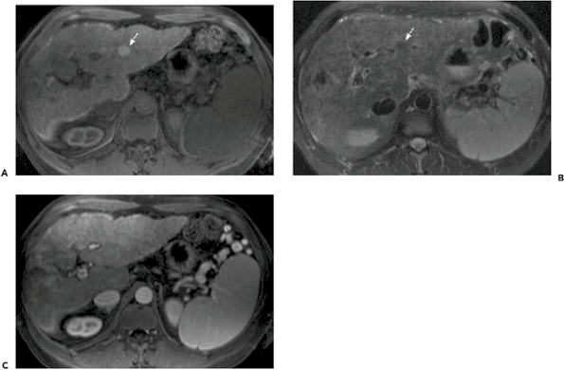
Preconstrast T1-weighted spoiled gradient echo MR image with fat suppression (A) T2-weighted image (B). arterial phase gadolinium-enhanced T1-weighted image (C)
Notes:
Figure 12-46 Dysplastic nodule in a patient with cirrhosis. Preconstrast T1-weighted spoiled gradient echo MR image with fat suppression (A) shows a well-defined hyperintense nodule (arrow) in the left hepatic lobe. The nodule (arrow) is hypointense on a T2-weighted image (B). On an arterial phase gadolinium-enhanced T1-weighted image (C), the lesion enhances to the same degree as the surrounding liver.

Slide 32
Unenhanced T2-weighted MR image
Notes:
Figure 12-47 Hepatocellular carcinoma arising within a dysplastic nodule. Unenhanced T2-weighted MR image shows a slightly hypointense round hepatic mass (arrow) that contains a central area of hyperintensity, giving the mass a â€œnodule-within-noduleâ€ appearance.

Slide 33
Notes:
Figure 12-48 Fibrolamellar hepatocellular carcinoma. Late hepatic arterial phase contrast-enhanced CT image shows a large heterogeneously enhancing mass in the left hepatic lobe. Note the transient hepatic attenuation difference (THAD) surrounding the lesion.

Slide 34
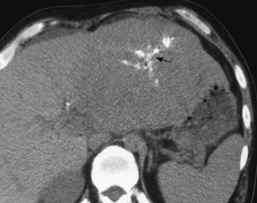
Notes:
Figure 12-49 Fibrolamellar hepatocellular carcinoma. Unenhanced CT image shows a large, slightly hypoattenuating left hepatic lobe mass with a calcified central scar (arrow).

Slide 35
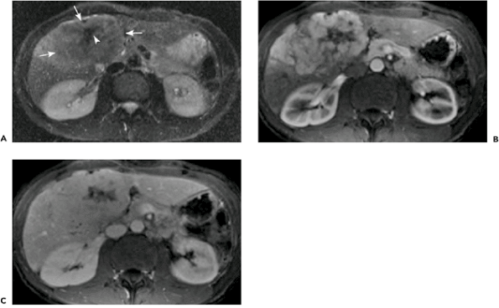
T2-weighted MR image with fat suppression (A) Arterial phase T1-weighted image (B) delayed postcontrast image (C).
Notes:
Figure 12-50 Fibrolamellar hepatocellular carcinoma. T2-weighted MR image with fat suppression (A) shows a large mass (arrows) in the medial segment of the left hepatic lobe. The mass is minimally hyperintense and contains a hypointense central scar (arrowhead). Arterial phase T1-weighted image (B) demonstrates intense heterogeneous enhancement of the mass, except for the central scar. The scar remains unenhanced on a delayed postcontrast image (C).

Slide 36
Arterial phase T1-weighted MR image (A) delayed postcontrast image (B)
Notes:
Figure 12-51 Intrahepatic cholangiocarcinoma. Arterial phase T1-weighted MR image (A) shows a small hypointense left lobe mass (arrow) with mild peripheral enhancement. The mass has caused biliary ductal dilation (arrowhead) and segmental hepatic atrophy (open arrow). On the delayed postcontrast image (B) the mass is more conspicuous because of its hyperintensity caused by pooling of contrast medium within it.

Slide 37
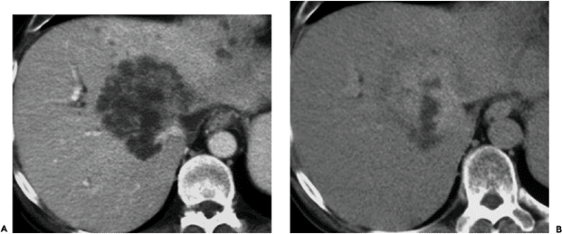
Portal venous phase contrast-enhanced CT image (A) 30-minute delayed postcontrast image (B)
Notes:
Figure 12-52 Intrahepatic cholangiocarcinoma. Portal venous phase contrast-enhanced CT image (A) shows a large central hepatic mass with mild peripheral enhancement. A 30-minute delayed postcontrast image (B) shows persistent hyperattenuation of a large portion of the mass due to pooling of contrast medium within the lesion.

Slide 38
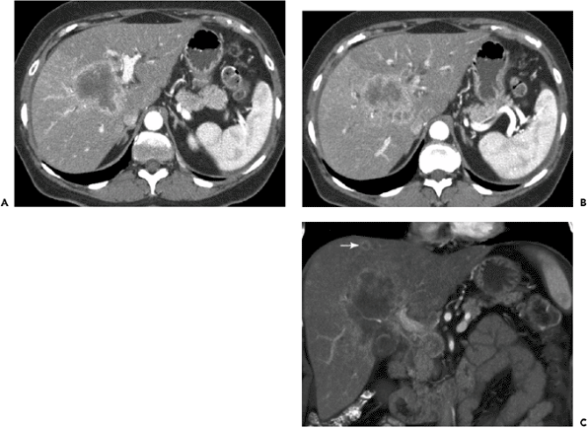
Late hepatic arterial phase image (A) A slightly more cephalad image (B) coronal 3D-volume rendered image (C)
Notes:
Figure 12-53 Intrahepatic cholangiocarcinoma. Late hepatic arterial phase image (A) shows a large lobulated central hepatic mass with peripheral enhancement. A slightly more cephalad image (B) shows dilation of bile ducts peripheral to the mass and transient hepatic attenuation difference (THAD) with diffusely increased attenuation of the right hepatic lobe. A coronal 3D-volume rendered image (C) shows a satellite lesion (arrow) near the dome of the liver

Slide 39
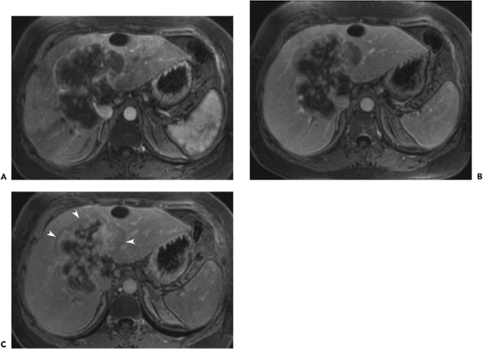
Arterial phase T1-weighted gadolinium-enhanced MR image (A Portal venous phase image (B) Delayed phase image (C)
Notes:
Figure 12-54 Intrahepatic cholangiocarcinoma. Arterial phase T1-weighted gadolinium-enhanced MR image (A) shows a large hepatic mass with a rim of peripheral enhancement. Portal venous phase image (B) shows mild inward progression of the enhancement. Delayed phase image (C) shows continued centripetal progression of enhancement with pooling of contrast medium within the lesion. Note the thin hypointense peripheral rim (arrowheads) that corresponds to the portion of the lesion that was enhanced on the arterial phase image.

Slide 40
Notes:
Figure 12-58 Calcified hepatic metastases in a patient with mucinous adenocarcinoma of the colon.

Slide 41
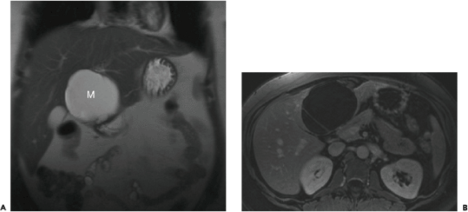
A) Unenhanced coronal T2-weighted MR. Gadolinium-enhanced T1-weighted image (B)
Notes:
Figure 12-64 Biliary cystadenoma. (A) Unenhanced coronal T2-weighted MR image shows a large homogeneously hyperintense mass (M) arising from hepatic segment IVb. Gadolinium-enhanced T1-weighted image (B) demonstrates a single septation within the mass.

