Slide 1
SPOTS

Slide 2
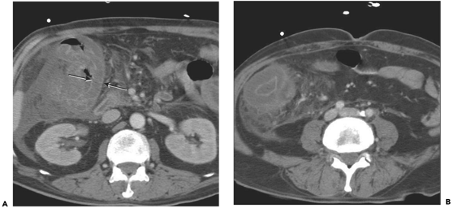
54-year-old man undergoing chemotherapy for lung cancer
Notes:
Figure 11-77 Neutropenic colitis of the right colon in a 54-year-old man undergoing chemotherapy for lung cancer. A: There is concentric mural thickening in the hepatic flexure. The wall thickening is severe (arrows) and low-density. Also noted is adjacent fluid. B: Image through the cecum demonstrates mural edema and pericolonic inflammation

Slide 3
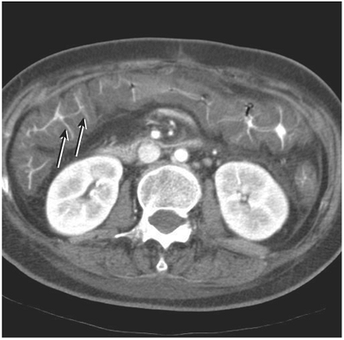
Notes:
Figure 11-76 Pseudomembranous colitis. There is severe low-density mural thickening of the transverse colon. The positive oral contrast material (arrows) is insinuating between grossly edematous colonic folds in an accordion-like fashion.

Slide 4
Notes:
Figure 11-74 Ulcerative colitis involving the rectum and sigmoid colon. There is sigmoid (large arrow) and rectal (small arrow) thickening. Perirectal fatty proliferation is also present.

Slide 5
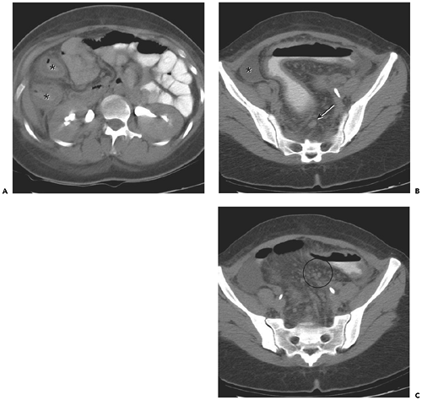
Notes:
Figure 11-73 Multisegmental Crohn colitis. A: There is symmetric mural thickening at the hepatic flexure (asterisks) and pericolonic inflammation. B: Similar findings are identified in the sigmoid colon with a small amount of ascites (asterisk) and reactive lymph node (arrow). Note the irregular appearance of the serosa, a finding not typically seen in UC. C: The vessels in the sigmoid mesocolon are dilated with multiple small nodes (arrow). Patient was having profuse diarrhea and abdominal pain at the time of the examination.

Slide 6
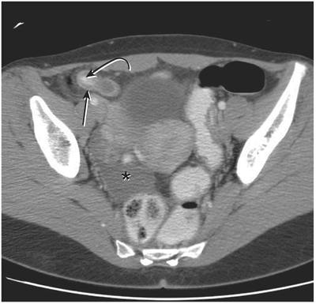
Notes:
Figure 11-71 Uncomplicated appendicitis. The appendix is dilated, measuring 1.6 cm, and has a thickened wall (arrow). An appendicolith (curved arrow) is present. Minimal peri-appendiceal inflammatory changes are present. Note reactive ascites in right hemipelvis (asterisk).

Slide 7
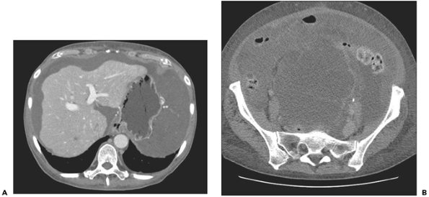
Notes:
Figure 11-64 Pseudomyxoma peritonei secondary to mucinous cystadenocarcinoma of the appendix. A: Low-density material surrounds the liver and stomach. It has mass effect, resulting in a scalloped appearance to the liver. B: Heterogeneous, low-density mass fills the pelvis. The appendix could not be identified on this study. At surgery, a normal-sized appendix was resected, revealing a well-differentiated mucinous cystadenocarcinoma

Slide 8
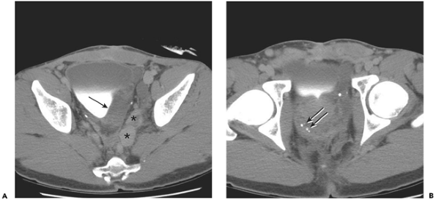
26-year-old man who presented with rectal bleeding
Notes:
Figure 11-63 Rectal cavernous hemangioma. 26-year-old man who presented with rectal bleeding. A: Multiple lobular masses are present in the pelvis. Enhancing tubular structures along the left pelvic sidewall are patent vascular channels (asterisks), while the lower-density mass abutting the bladder (arrow) is probably a thrombosed vein. B: There is irregular, circumferential thickening of the rectum. Scattered phleboliths are present (arrows).

Slide 9
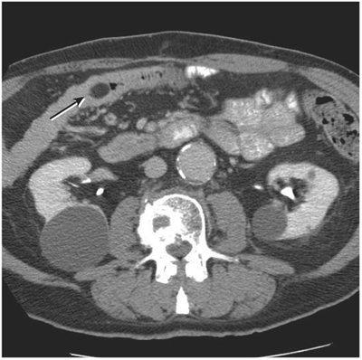
Notes:
Figure 11-62 Colonic lipoma. There is a 2-cm fat-density mass in the proximal transverse colon (arrow). It is well defined and nonobstructing. This was an incidental finding. Lipomas can be distinguished from fat-density bowel contents by their notable lack of internal gas.

Slide 10
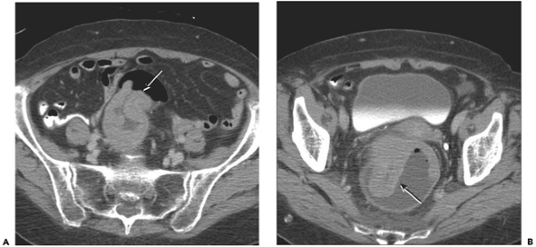
80-year-old woman presented with severe diarrhea, hypokalemia, and rectal bleeding
Notes:
Figure 11-61 Giant villous adenoma. 80-year-old woman presented with severe diarrhea, hypokalemia, and rectal bleeding. A: CT scan reveals a large, low-density mass in the rectum. There is abrupt shouldering at superior aspect of the mass (arrow). B: In the mid rectum, the mass is circumferential. C: Inferior aspect of the mass has a papillary extension into the rectum (arrow), which is filled with fluid. No rectal contrast was administered. Pathologically, the mass proved to be a 16-cm villous adenoma; no invasive carcinoma was identified. Villous lesions can secrete copious mucoid material containing potassium, which explains the presentation with hypokalemia

Slide 11
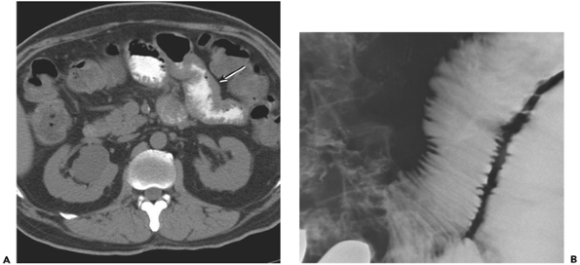
Notes:
Figure 11-57 Scleroderma. A: Oral contrast material delineates abnormal jejunum, which is mildly dilated. There is apparent mural thickening (arrow), which actually represents the very closely spaced folds collapsed on one another. B: This was confirmed on a small-bowel study, which reveals abnormally close folds, which are not thickened or nodular.

Slide 12
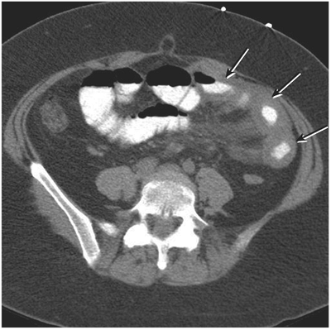
Notes:
Figure 11-56 Intramural hematoma of the small bowel. There is homogeneous thickening of several segments (arrows) of jejunum in the left abdomen in this patient who was over-anticoagulated. There is hematoma extending centrally into the mesentery, a finding that helps distinguish hematoma from ischemia.

Slide 13
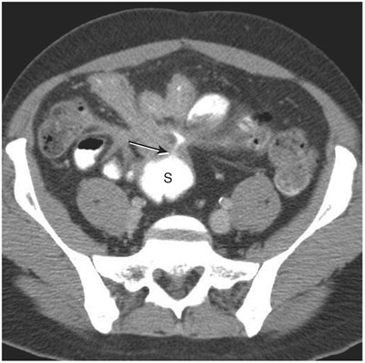
Notes:
Figure 11-53 Crohn disease with enterocolic fistula. 37-year-old man with Crohn disease of the ileum secondarily involving the sigmoid colon. Multiple tethered segments of ileum have mural thickening. A fistula (arrow) extends from the convergence of these abnormal segments to the adjacent sigmoid colon (S). Note that only oral contrast material was administered, and it had not reached the proximal colon at the time of scanning. Contrast material in sigmoid colon is from the fistulous communication.

Slide 14
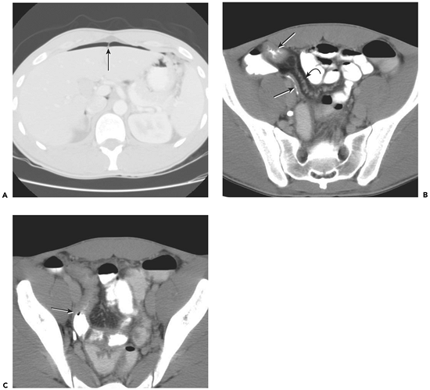
Notes:
Figure 11-52 Perforated Crohn disease. A: Lung window images through the upper abdomen reveal pneumoperitoneum outlining the falciform ligament (arrow). B: There is circumferential terminal ileal thickening (arrow) and congestion of the mesenteric vessels, giving a comb-like appearance (curved arrow). Secondary wall thickening is seen in the adjacent appendix (long arrow). Note that the appendix is not dilated. C: There is an abrupt transition (arrow) to normal wall thickness in the more proximal ileum.

Slide 15
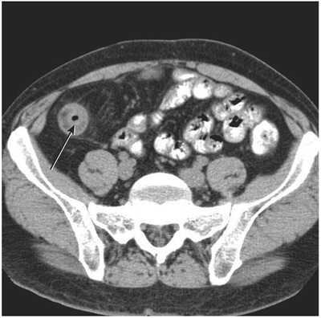
Notes:
Figure 11-51 Crohn ileitis with fibrofatty proliferation. There is concentric thickening of the neoterminal ileum (arrow) in this patient who has had resection of the terminal ileum and proximal ascending colon. There is fibrofatty proliferation (creeping fat) in the adjacent mesentery.

Slide 16
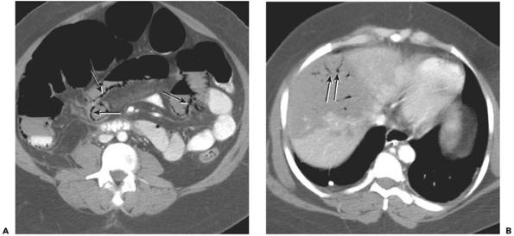
Notes:
Figure 11-49 Small-bowel infarction in a patient with overwhelming sepsis and hypotension. A: There is extensive small-bowel pneumatosis (arrows). B: There is large wedge-shaped area of low attenuation in the liver, thought to be an infarct with portal venous gas (arrows).

Slide 17
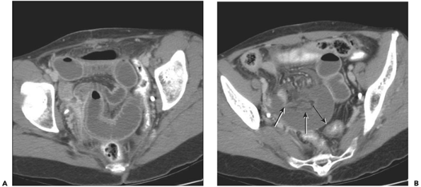
Notes:
Figure 11-48 Closed-loop obstruction with infarcted bowel. A: Dilated loops of fluid-filled small bowel lie in the pelvis. There is enhancement of the bowel wall, which demonstrates a layered appearance because of mural edema. B: The mesentery has a congested appearance, and â€œUâ€-shaped small-bowel loop lacks enhancement mural (arrows). An internal hernia with infarcted bowel was confirmed surgically

Slide 18
Notes:
Figure 11-47 Closed-loop obstruction. A: There is dilatation of fluid-filled loops of small bowel with a B: whirled appearance of mesenteric vessels. An internal hernia was reduced surgically, but there was no bowel ischemia.

Slide 19
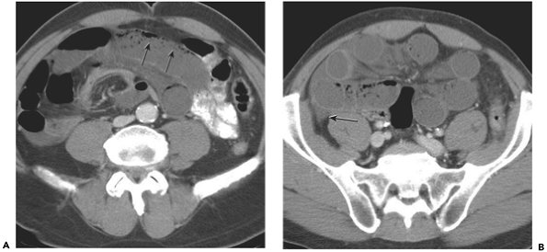
Notes:
Figure 11-46 Closed-loop obstruction with ischemia. A: There are several dilated, fluid-filled loops of small bowel. The contents of the bowel loops have a feces-like appearance (arrows). It is important not to confuse this with pneumatosis, which is limited to the wall and seen on both dependent and nondependent sides of the lumen. There is a whirled configuration of the mesenteric vessels, which are congested. B: Slightly more inferior image shows the dilated loops in a radial configuration with increased attenuation in the mesentery. There is a small amount of ascites (arrow). An internal hernia with ischemia but no infarction was identified at surgery.

Slide 20
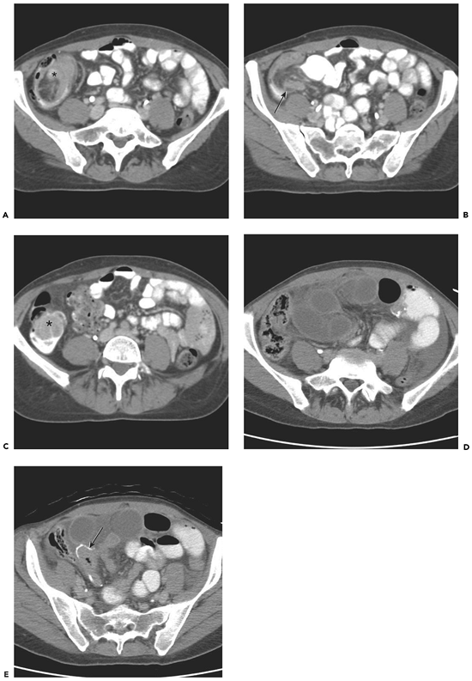
Notes:
Figure 11-45 Ileocolic intussusception and subsequent infarcted closed-loop obstruction. 44-year-old woman with metastatic melanoma. A: There is an intussusception in the ascending colon (asterisk). It contains fat and soft tissue. B: Slightly more caudal image demonstrates the intussusceptum to contain terminal ileum (arrow) and mesenteric fat with vessels. C: More cranial image reveals soft tissue mass (asterisk) as the lead point. Melanoma metastasis was identified at surgery. This was resected and a primary anastomosis performed. Patient presented 9 months later with abdominal pain and vomiting. D: CT image demonstrates a closed-loop obstruction with a whirled appearance of loops of dilated, fluid-filled small bowel. There is mild bowel wall thickening with inflammatory changes in the mesentery and ascites. Collapsed distal small bowel lies adjacent to anastomotic line (arrow) from prior metastasis resection. Second surgery confirmed an internal hernia from a postsurgical rent in the mesentery with bowel infarction.

Slide 21
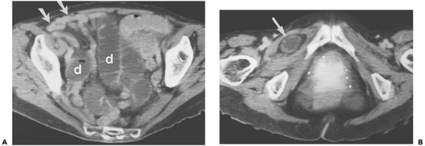
Notes:
Figure 11-43 Obturator hernia. A: Dilatation of the mid small bowel (d) in the presence of collapsed distal ileum (arrows) indicates small bowel obstruction. B: More inferior image, at the level of the obturator foramen, reveals a loop of small bowel (arrow) in the hernia sac, which lies between the pectineus and obturator externus muscles on the right.

Slide 22
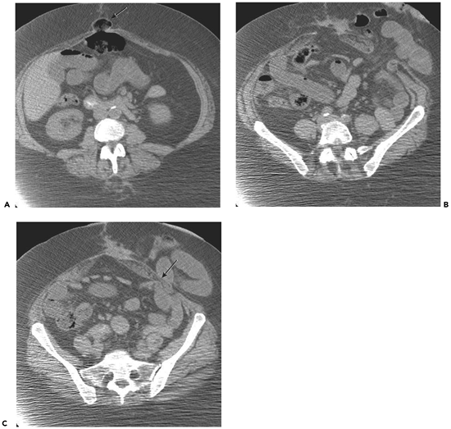
Notes:
Figure 11-42 Richter and parastomal hernias. A: There is an umbilical hernia (arrow) that contains one wall of the transverse colon, a Richter hernia. B: More caudal in the pelvis, there is a complex parastomal hernia containing large and small bowel. The neck of this hernia is wide. C: However, there is a small bowel obstruction inferior to this, secondary to an adhesion adjacent to the hernia. The angulated transition point (arrow) lies adjacent to the anterior abdominal wall.

Slide 23
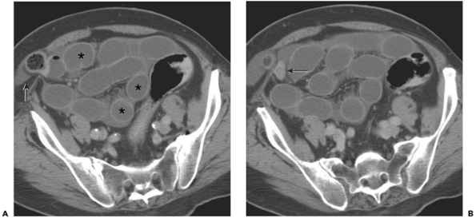
Notes:
Figure 11-41 Spigelian hernia with small bowel obstruction. A: There are several dilated loops of small bowel (asterisks). A segment herniates through the linea semilunaris, an aponeurosis lateral to the rectus abdominis muscle. The contents of segment of bowel in the hernia sac have the appearance of feces, which occurs in the setting of small bowel obstruction secondary to the resorption of water from the obstructed lumen. There is a small amount of ascites in the abdomen and in the hernia sac (arrow). B: The exiting small bowel loop (arrow) is completely decompressed.

Slide 24
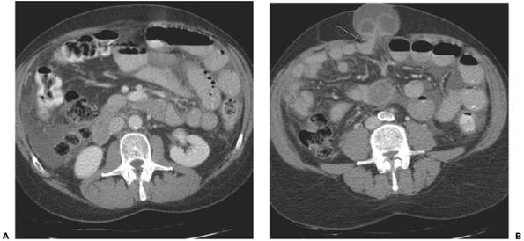
Notes:
Figure 11-40 Incarcerated umbilical hernia. A: Images through the upper abdomen reveal several dilated loops of small bowel. Ascites is present. B: Umbilical hernia contains loop of obstructed small bowel. The transition point is easily identified as the collapsed segment exits the hernia (arrow), which also contains ascites. Decompressed distal small bowel lies in the right abdomen. The segment of bowel in the hernia has mildly thickened walls, and with adjacent ascites, ischemia was a concern. This was surgically confirmed.

Slide 25
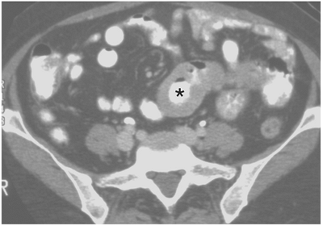
Notes:
Figure 11-37 Small bowel lymphoma. There is focal, concentric thickening of a loop of small bowel (asterisk). There is excavation of the inner lumen of the mass, resulting in mild so-called aneurysmal dilatation, unlike adenocarcinoma, which typically results in an annular stricture.

Slide 26
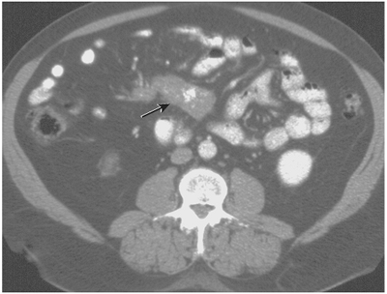
Notes:
Figure 11-36 Sclerosing mesenteritis. There is an oblong soft tissue mass (arrow) in the mesenteric root. There are central calcifications but no mural thickening in adjacent bowel. This was surgically resected, and histologic evaluation revealed sclerosing mesenteritis

Slide 27
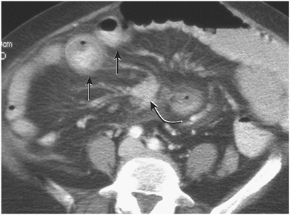
Notes:
Figure 11-35 Metastatic mesenteric carcinoid tumor. The spiculated mass (curved arrow) in the mesenteric root does not represent the primary tumor but metastatic lymph nodes. The primary is often small and not seen, as in this case. Vasoactive amines secreted by the tumor have caused mural thickening of adjacent loops of small bowel loops (arrows).

Slide 28
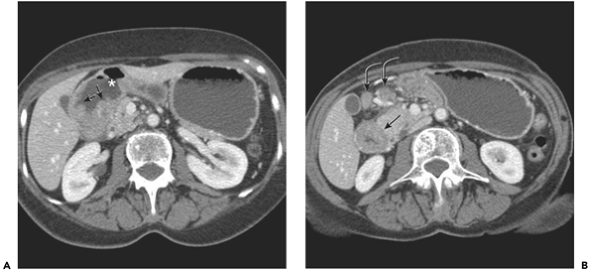
Notes:
Figure 11-34 Duodenal adenocarcinoma. The tumor circumferentially involves the descending duodenum. A: The superior margin has shouldering (arrows), and there is gastric outlet obstruction with moderate dilatation of the proximal duodenum (asterisk) and stomach. B: There is circumferential thickening in the duodenum (arrow). Two enlarged regional lymph nodes (curved arrows) heterogeneously enhance and were pathologically proven to have metastatic involvement

Slide 29
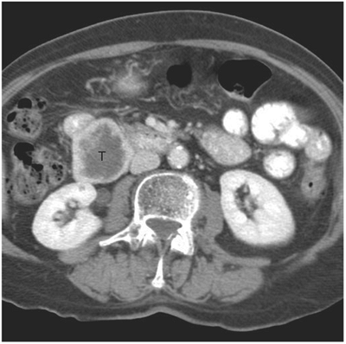
Notes:
Figure 11-33 Duodenal gastrointestinal tumor incidentally diagnosed in a 79-year-old woman. The mass (T) is exophytic and heterogeneous with central necrosis. It extends from the distal descending duodenum and measures 5 cm. Note lack of obstructive findings. Pathologically, the tumor was of intermediate malignant potential.

Slide 30
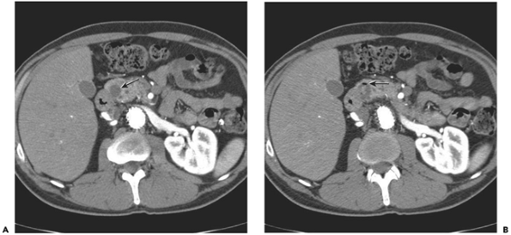
Notes:
Figure 11-30 Duodenal diverticulum mimicking a cystic pancreatic neoplasm. A: There is a small cystic lesion (arrow) in the head of the pancreas. B: Slightly more inferior image reveals a small gas bubble (arrow), confirming it is a duodenal diverticulum.

Slide 31
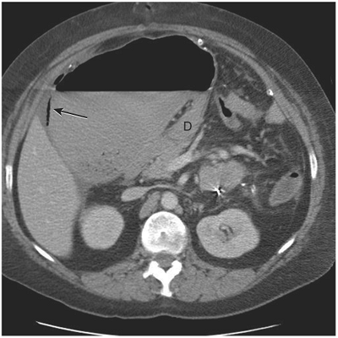
Notes:
Figure 11-25 Mesoaxial gastric volvulus. Patient was status post distal pancreatectomy and splenectomy for pancreatic pseudocyst. Image through the upper abdomen shows the dilated stomach lying in the right-upper quadrant, to the right of the descending duodenum (D). Note the extraluminal gas adjacent to the stomach (arrow). Gastric ischemia with necrosis was identified at endoscopy.

Slide 32
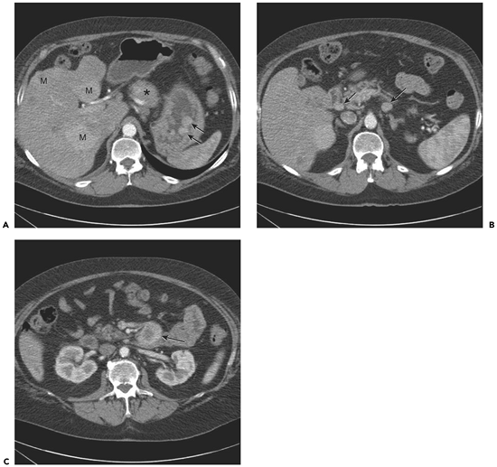
Notes:
Figure 11-24 Multiple gastric carcinoid tumors in a 57-year-old man with MEN I. A: Multiple small, hyperenhancing nodules (arrows) are present in the stomach. There is a poorly defined pancreatic body mass (asterisk), which was biopsy-proven gastrinoma. There are multiple liver metastases (M). B: Small gastrinomas lie adjacent to the duodenum (arrows). C: Another larger gastrinoma lies anterior to fourth duodenum (arrow). It has a necrotic center.

Slide 33
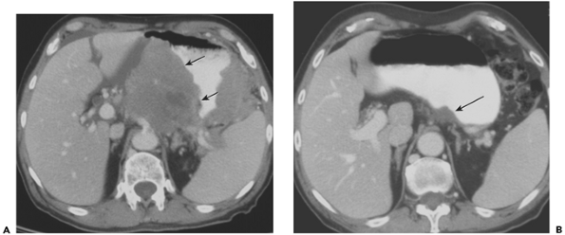
Notes:
Figure 11-23 Gastric mucosa-associated lymphoid tumor. A: There is marked thickening of the gastric wall (arrows) that extends into the gastrohepatic ligament and celiac axis. The patient was H. pylori positive. This appearance is somewhat atypical for MALT lymphoma, which tends to have less bulky thickening. B: Follow-up CT scan performed 6 months after antibiotic treatment reveals a normal gastric wall with minimal thickening of the gastric cardia (arrow).

Slide 34
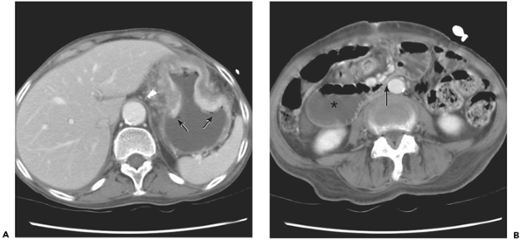
Notes:
Figure 11-20 Gastric adenocarcinoma and superior mesenteric artery syndrome. A: There is mural thickening of the gastric body in an hourglass configuration. Notice the abrupt shouldering (arrows). The three-layered enhancement pattern is maintained, but there is hyperenhancement of the thickened mucosa. B: Image at the level of the third and fourth portions of the duodenum reveals duodenal dilatation proximally (asterisk) with complete collapse of the lumen as it courses between the aorta and superior mesenteric artery (arrow). Because of the gastric cancer and subsequent chemotherapy, the patient had profound, rapid weight loss that was thought to be the contributing factor for SMA syndrome.

Slide 35
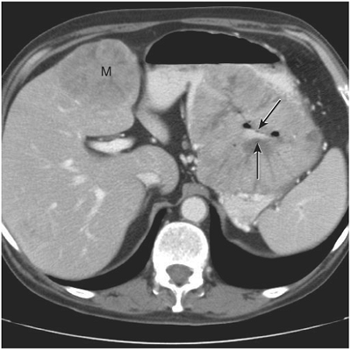
Notes:
Figure 11-19 Gastric adenocarcinoma mimicking a GIST. There is a large heterogeneous mass in the body of the stomach. It is round and contains an ulcer (arrows). A large metastasis lies in the medial segment of the liver (M). It has similar enhancement characteristics as the primary tumor. Diagnosis of GIST was entertained because of the exophytic, ulcerated appearance, but endoscopic biopsy confirmed it to be a well-differentiated adenocarcinoma.

Slide 36
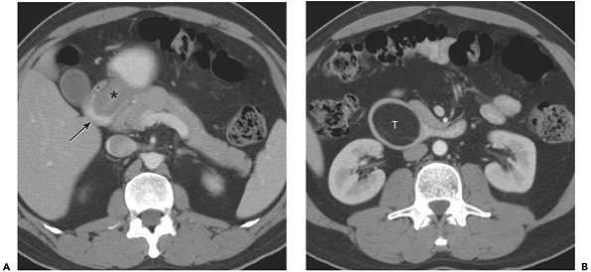
Notes:
Figure 11-17 Intussuscepting gastric lipoma. A: The gastric intussusceptum (asterisk) is telescoping into the more distal duodenal intussuscipiens (arrow). B: The fatty gastric tumor is lying in the third portion of duodenum (T).

Slide 37
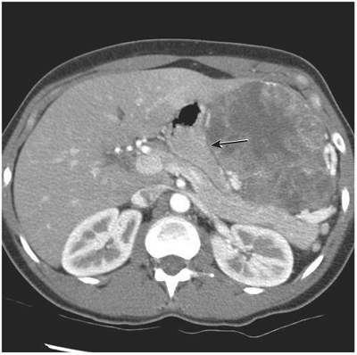
Notes:
Figure 11-16 Gastrointestinal stromal tumor of the stomach. The mass occupies the left upper quadrant and is displacing the stomach medially (arrow). The mass heterogeneously enhances with central areas of necrosis.

Slide 38
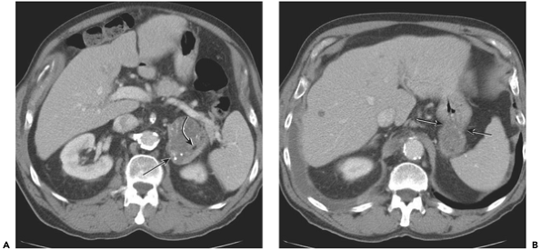
Notes:
Figure 11-15 Large gastric fundal diverticulum mimicking a complex adrenal mass. A: The left adrenal pseudomass (arrow) contains fluid and flocculated oral contrast material. Small bubbles of gas are also present (curved arrow). B: Slightly more cranial image demonstrates the connecting neck (arrows) to the gastric fundus.

Slide 39
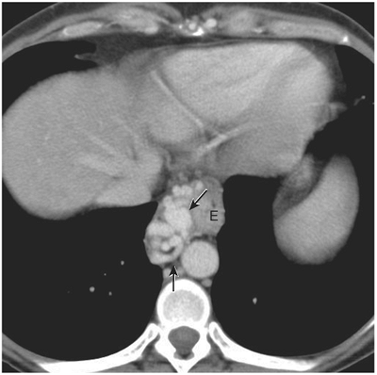
Notes:
Figure 11-8 Multiple large esophageal varices (arrows) appear as enhancing tubular structures alongside the esophagus (E). Notice their density is equal to the adjacent aorta.

Slide 40
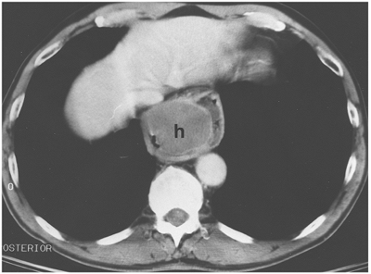
Notes:
Figure 11-7 Esophageal intramural hematoma (h) that developed during pneumatic dilatation of lower esophagus for treatment of achalasia. The fluid-filled lumen of the esophagus drapes around the hematoma. At the time of the examination, the hematoma was 10 days old and no longer of high attenuation.

Slide 41
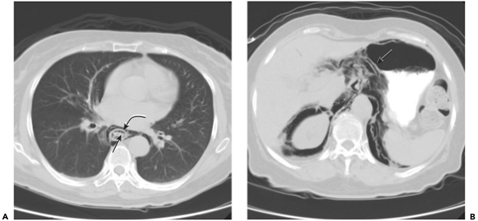
Notes:
Figure 11-6 Esophageal perforation. The patient is a 61-year-old woman with history of benign distal esophageal stricture secondary to reflux. Patient presented with severe chest pain after eating fish. Endoscopy revealed a long segment stricture that was actively bleeding. Initial water-soluble swallow did not reveal a leak, and a CT was performed. A: Image through the chest using lung windows shows extensive mediastinal gas, presumably introduced during endoscopy. Air is also identified within the esophageal wall. This mural gas is lying in the submucosa, nicely delineating the inner mucosal layer (arrow) and the muscular layer (curved arrow). B: Extensive retroperitoneal gas is present on this upper-abdominal image. Note the intramural gas (arrow) that has dissected into the stomach. The patient was treated conservatively and recovered.

