Slide 1
SPOTS

Slide 2
Notes:
Figure 29.26 Appendicitis. (A) US shows a thickened hypoechoic tubular blind-ended structure in the right iliac fossa. The surrounding fat is hyperechoic. (B) CT shows the thickened inflamed appendix (arrow).

Slide 3
Notes:
Figure 29.27 Appendicitis. Coronal CT in a patient referred with renal colic. This unenhanced curved coronal CT along the length of the appendix shows the distended appendix along with subtle induration of the adjacent fat. The plain radiograph was normal.

Slide 4
Notes:
Figure 30.3 Contrast study demonstrating a combined-type hiatus hernia. Note the rolling component with a large portion of stomach above the diaphragm, but in addition the gastro-oesophageal junction has also migrated cranially.

Slide 5
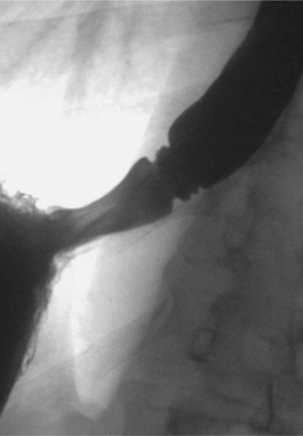
Notes:
Figure 30.4 An example of a fixed sliding hiatal hernia together with several B or Schatski rings.

Slide 6
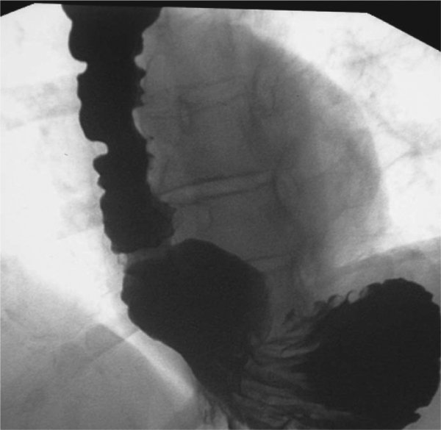
Notes:
Figure 30.6 View of a large sliding hiatal hernia that demonstrates gross spontaneous gastro-oesophageal reflux when the patient lifts the left side whilst in the supine position. Note also the marked oesophageal inco-ordination produced by the reflux.

Slide 7
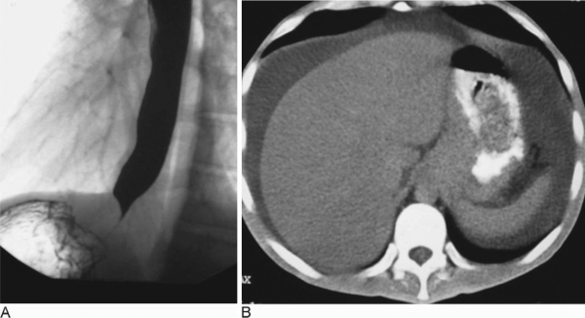
Notes:
Figure 30.12 (A & B) Pseudo achalasia appearance. Note the tapered appearance of the distal oesophagus which superficially resembles an achalasia, but the clue to the sinister nature of this lesion is from the impression on the fundus of the stomach (A). CT study (B) performed 3 months later confirms malignancy, with the tumour at the cardia now involving the crus. Also note the ascites.

Slide 8
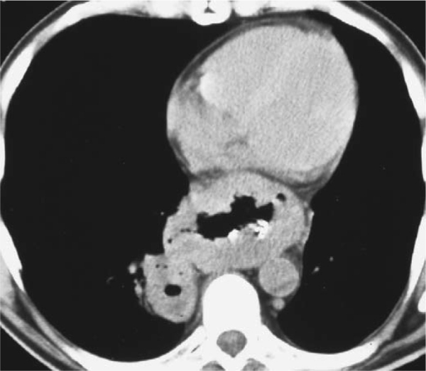
Notes:
Figure 30.15 CT showing gross thickening of the oesophageal wall due to an extensive carcinoma that has also extended into the right lung base, producing an associated thick-walled cavity.

Slide 9
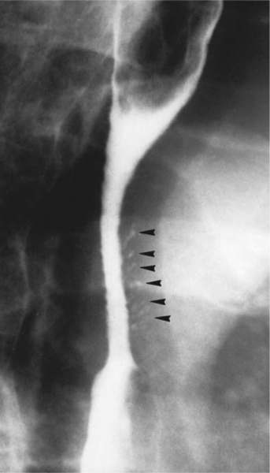
Notes:
Figure 30.23 Barium swallow demonstrating the typical appearances of oesophageal intramural pseudodiverticulosis. The small flask-shaped pits of contrast (arrowheads) represent dilated mucous glands and are associated with a stricture at the level of the aortic knuckle.

Slide 10
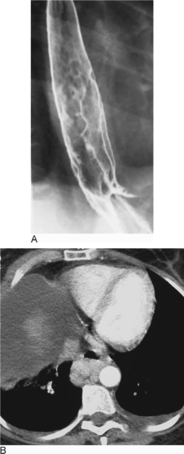
Notes:
Figure 30.24 Varices. These may be demonstrated on a barium swallow as typical serpiginous filling defects in the lower oesophagus when caused by uphill varices (A). They may be equally well demonstrated at CT examination as enhancing masses either within or as in this case posterior to the lower oesophagus (B). In the latter case note the presence of ascites.

Slide 11
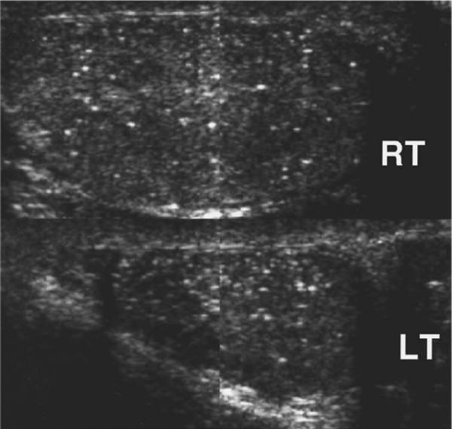
testes.
Notes:
Figure 44.11 Microlithiasis of the testes. Longitudinal US views demonstrate unilateral atrophy. The cause was unknown. Microlithiasis involves both the normal and atrophic testis.

Slide 12
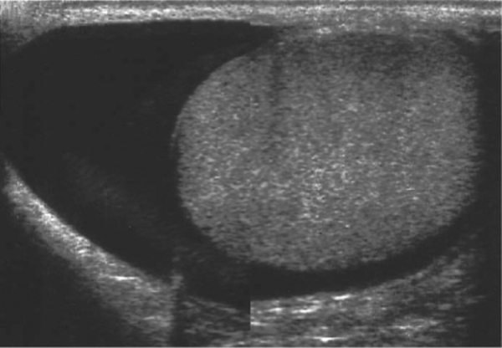
Testis
Notes:
Figure 44.13 Longitudinal US view of normal testis and moderately sized hydrocele.

Slide 13
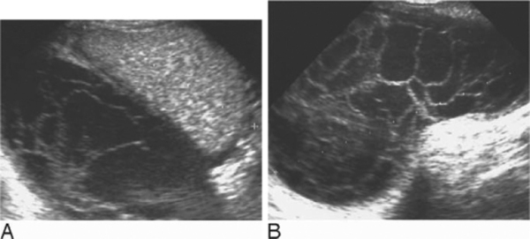
Longitudinal (A) and transverse (B) US views of scrotum
Notes:
Figure 44.14 Longitudinal (A) and transverse (B) US views of organizing scrotal haematoma following trauma. The adjacent testis is compressed but otherwise normal. A septated hydrocele may present a similar appearance

Slide 14
Notes:
Figure 43.4 Subcapsular renal haematoma. The haematoma compresses the right renal parenchyma leading to delay in renal perfusion and contrast excretion. The renal parenchyma otherwise appears intact

Slide 15
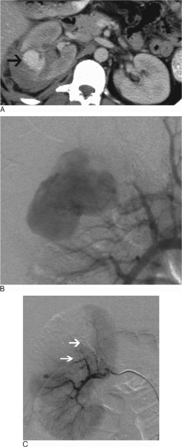
Notes:
Figure 43.12 Renal vascular pseudoaneurysm. (A) Contrast-enhanced CT shows a rounded collection of arterial contrast (arrow) in the right renal parenchyma representing a pseudoaneurysm. (B) Selective renal arteriogram verifies the lesion. (C) Post-embolization angiogram shows occlusion of vessels feeding the pseudoaneurysm (arrows) with preservation of the remainder of the renal parenchyma.

Slide 16
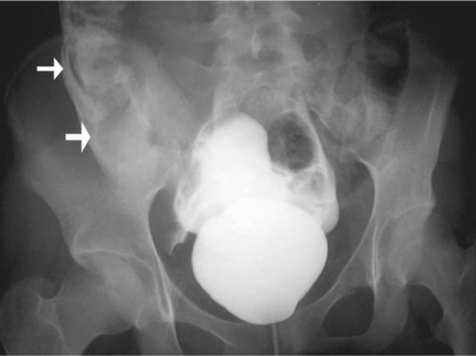
Notes:
Figure 43.17 Cystogram of intraperitoneal bladder rupture. Conventional cystogram shows injected contrast material outlining the paravesical space in the dependent portion of the pelvis, tracking up the right paracolic gutter (arrows) and surrounding bowel loops.

Slide 17
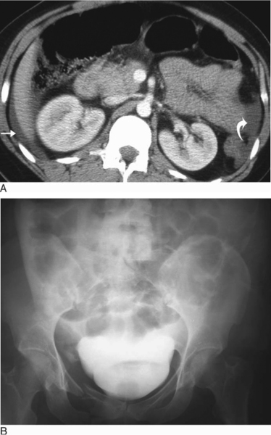
Notes:
Figure 43.18 CT of intraperitoneal bladder rupture. (A) CT image obtained through the upper abdomen in the arterial phase shows low-attenuation fluid (nonopacified urine) in the perihepatic space (arrow) and left paracolic gutter (curved arrow). (B) Cystogram shows contrast medium over the dome of the bladder in a ‘molar tooth’-shaped configuration and ascending up the right paracolic space.

Slide 18
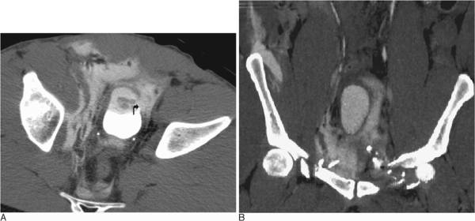
Notes:
Figure 43.19 CT of extraperitoneal bladder rupture. (A) Delayed postcontrast injection CT image across the pelvis reveals urine extravasation into the extraperitoneal fascial planes around the bladder and tracking to the presacral space. The bladder wall defect is directly observed (curved arrow). (B) A coronal reformation shows the distribution of leaked iodinated urine, including the right lateral abdominal wall, elevation of the bladder and comminuted fractures of the superior pubic rami

Slide 19
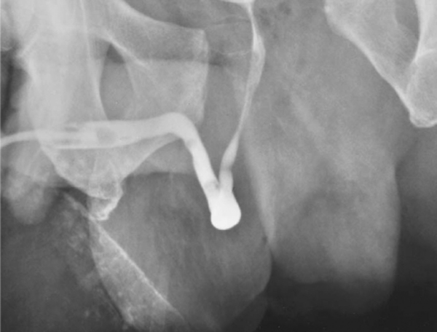
Notes:
Figure 43.23 Grade I urethral injury. Retrograde urethrogram shows a stretched but intact urethra with elevation of the bladder base. Marked diastasis of the pubic symphysis is evident.

Slide 20
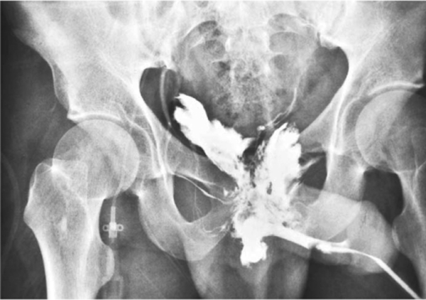
Notes:
Figure 43.24 Grade III urethral injury. Retrograde urethrogram performed with a Foley catheter in the distal penile meatus reveals extravasation of contrast material from the posterior urethra extending above and below the level of the urogenital diaphragm. Some venous uptake is also seen.

Slide 21
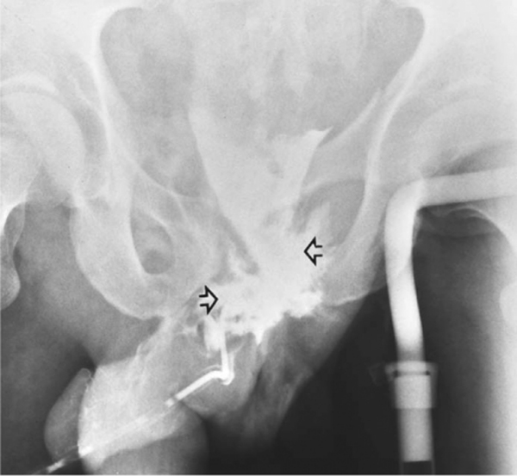
Notes:
Figure 43.25 Grade IV urethral injury. Cystogram shows extravasated contrast from the region of the bladder neck and proximal posterior urethra (arrows). There is vertical displacement of the left hemipelvis. The urogenital diaphragm is disrupted.

Slide 22
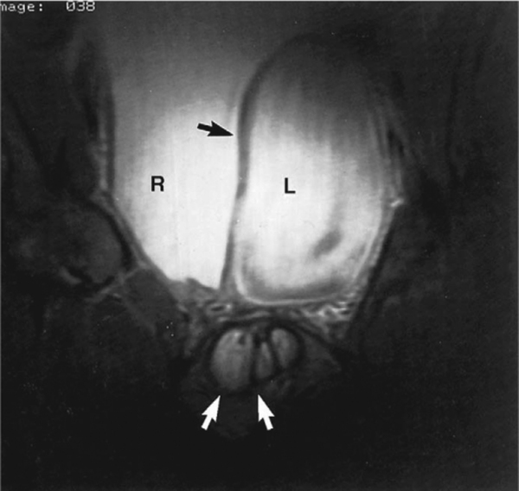
T2W CORONAL
Notes:
Figure 42.4 Congenital bladder duplication in a patient with multiple genitourinary anomalies including penis didelphys (white arrows): T2-weighted MRI. Both right (R) and left (L) urinary bladders are fully distended. The bladder septum (black arrow) is well visualized.

Slide 23
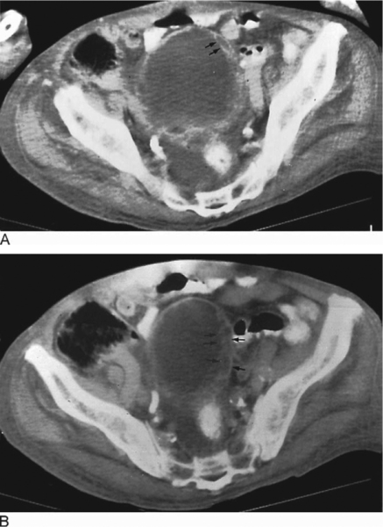
Notes:
Figure 42.7 Cystitis cystica. (A) and (B) are two contiguous CT images. Cystic lesions (arrows) are seen within the thickened bladder wall.

Slide 24
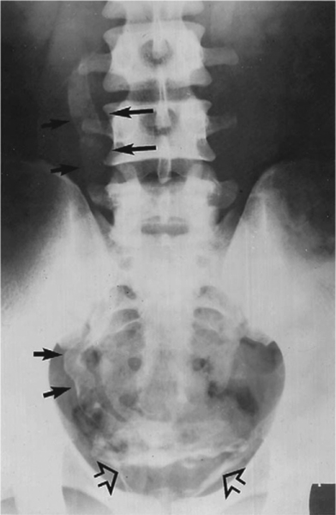
Notes:
Figure 42.8 Urinary schistosomiasis. Calcification within the bladder wall (open arrows) and ureter (solid arrows) characteristic of schistosomiasis infection.

Slide 25
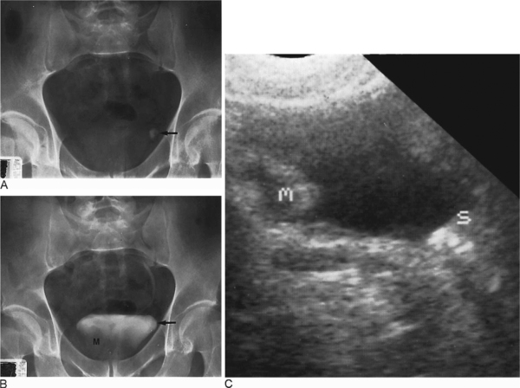
Notes:
Figure 42.9 Bladder calculus and a transitional cell carcinoma in a patient presenting with gross haematuria. A plain radiograph of the abdomen (A) shows a calcific density (arrow) on the left. Image obtained during IVU study. (B) shows a filling defect at the right lateral base of the bladder, indicating a mass lesion (M). The calculus (arrow), however, which is within the urinary bladder, is not well seen. The US study (C) demonstrates the mass (m) as well as the calculus (s) which is causing acoustic shadowing.

Slide 26
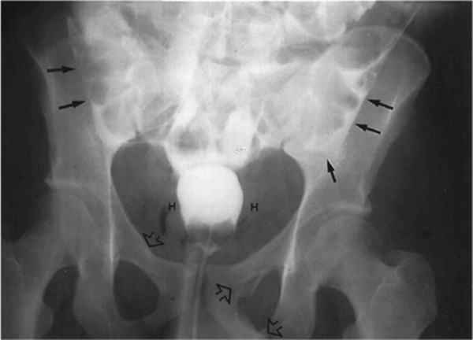
Notes:
Figure 42.11 Intraperitoneal rupture of the urinary bladder. Image taken during a cystogram study shows the contrast medium extravasating and outlining bowel loops (arrows). Bilateral perivesical haematomas are present (H). There are bilateral compound fractures of the superior and inferior pubic rami (open arrows).

Slide 27
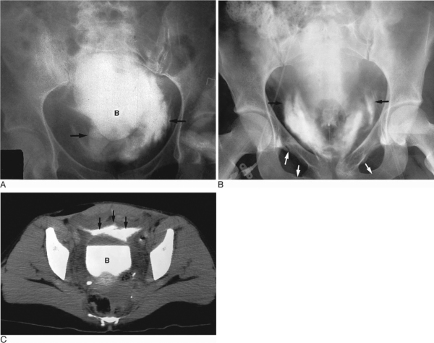
Notes:
Figure 42.12 Extraperitoneal bladder rupture. Cystogram study(A) of one patient and cystogram study (B) and CT (C) of another patient show irregular streaks of contrast medium (arrows) extravasating into the extraperitoneal space. CT shows the bladder rupture into the space of Retzius. In addition, there is a suggestion of a mass haematoma in the right pelvis inferior to the urinary bladder (A). Pelvic fractures are also present (B) (white arrows). B = bladder.

Slide 28
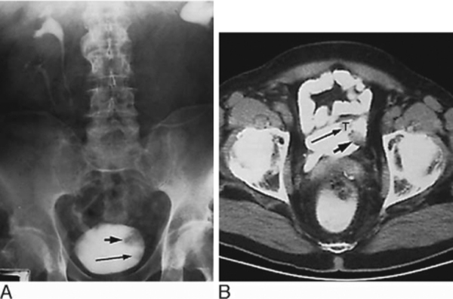
Notes:
Figure 42.16 CT in bladder carcinoma. Stage T2 bladder carcinoma with histological diagnosis of tumour extension to the superficial muscle layer. Bilateral duplex systems with obstruction of the collecting system on the left side. (A) IVU and (B) CT. On the IVU, there are two filling defects within the urinary bladder (arrows). Except for their anatomical location, tumour and ectopic ureterocele are difficult to distinguish. A similar problem occurs on CT where the density measurement of the tumour (T) seen anteriorly is very similar to that of the pus-filled ureterocele seen posteriorly (short arrow).

Slide 29
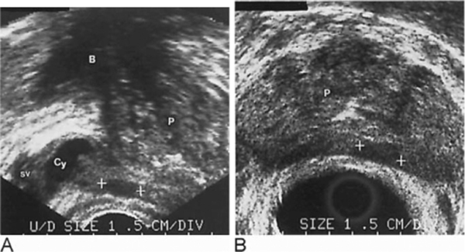
Notes:
Figure 42.31 US demonstration of seminal vesicle cyst. In this patient, the clinical diagnosis was a Müllerian duct cyst but the US demonstrates a cystic structure (Cy) within the seminal vesicle (SV). The patient also had an incidental finding of a hypoechoic area within the peripheral zone (++) seen on both the (A) sagittal and (B) transaxial planes of imaging. This subsequently proved to be a prostatic carcinoma. Adenomatous changes are seen in the prostate (P). B = urinary bladder.

Slide 30
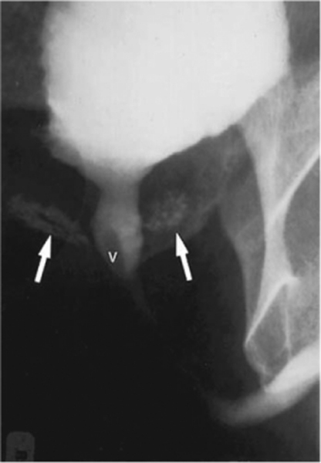
Notes:
Figure 42.32 Reflux into the prostatic duct and visualization of prostatic acini (arrows) during a voiding cystourethrogram. The reflux was secondary to chronic prostatitis and was associated with a previous urethral stricture. V = verumontanum.

Slide 31
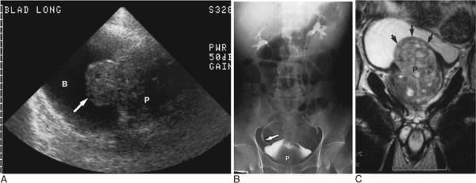
Notes:
Figure 42.35 Benign nodular hyperplasia demonstrated on a (A) suprapubic US scan: markedly enlarged prostate gland (P) with enlargement of the intravesical portion (arrow) which protrudes into the urinary bladder (B). Benign nodular hyperplasia on (B) IVU and (C) coronal plane T2-weighted MRI. On the IVU study the enlarged prostate gland (P) elevates the bladder floor and causes a J-hooking (fish-hooking) deformity of the distal ureters (arrow). No obstruction is seen. The MRI provides direct visualization of the prostate (P) and its impression upon the bladder floor (arrows).

Slide 32
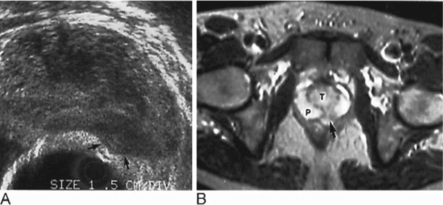
Notes:
Figure 42.37 Stage T3 prostatic carcinoma. (A) TRUS and (B) T2-weighted MRI. On TRUS an ill-defined hypoechoic area (arrows) is seen within the peripheral zone. The tumour is causing a localized bulge of the prostatic outline beyond the expected contour of the gland. This is the most reliable finding in diagnosing transcapsular invasion. On the MRI (B) the carcinoma (arrow) shows low signal intensity within an otherwise normal peripheral zone (P). T = transition zone. Transcapsular extension on MRI was not suspected.

Slide 33
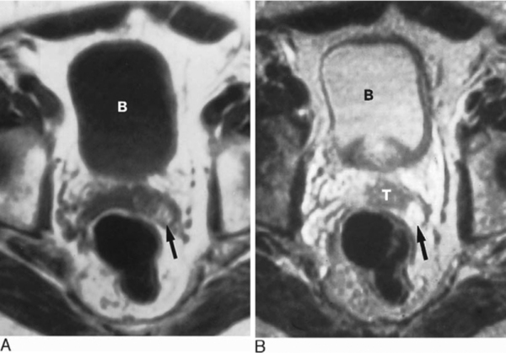
. (A) On the T1-weighted (B) On the T2-weighted image
Notes:
Figure 42.42 Tumour invasion of the seminal vesicle causing bleeding in its distal portion. (A) On the T1-weighted image the tip of the left seminal vesicle (arrow) shows a high signal intensity. (B) On the T2-weighted image, tumour invasion of the seminal vesicle (T) causes a decreased signal intensity. Blood in its distal portion (arrow) remains at a high signal intensity. B = urinary bladder.

Slide 34
Notes:
Figure 42.44 Stage N1 prostatic carcinoma. (A) CT (B) T1-weighted MRI and (C) T2-weighted MRI. The seminal vesicles are enlarged (arrowheads) and although the angle between the urinary bladder and the seminal vesicles (small white arrow) is preserved, its enlargement suggests tumour invasion. On the T2-weighted MRI, however, in addition to the enlargement of the seminal vesicles, their low signal intensity (black arrowheads), indicating tumour invasion, can be appreciated. Similarly, on MRI the diagnosis of invasion of the bladder base (small black arrows) is better appreciated than on the corresponding CT. Pronounced adenopathy on the left (curved arrow) can be seen equally well on CT and MRI.

Slide 35
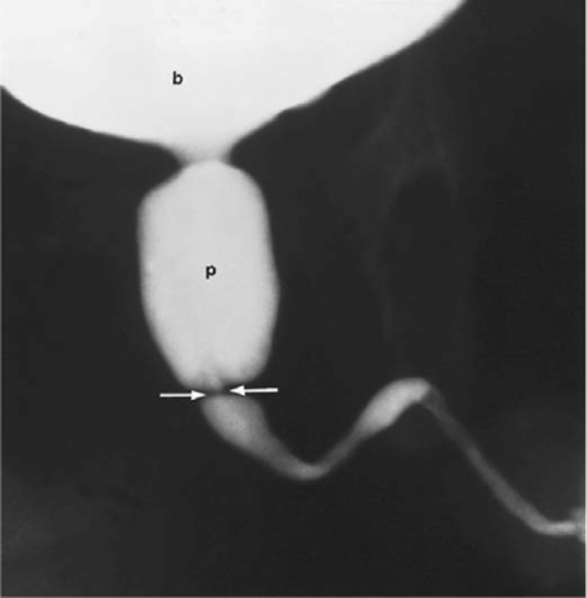
Notes:
Figure 42.49 Posterior urethral valves. Voiding cystourethrogram demonstrating posterior urethral valves (arrows) with proximal dilatation of the posterior urethra (p). b = bladder.

Slide 36
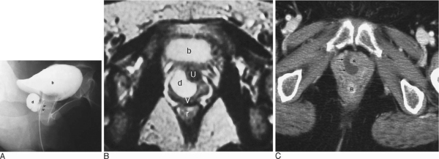
Notes:
Figure 42.50 Urethral diverticulum. (A) Voiding cystourethrogram and (B) axial T2-weighted MR image of urethral diverticulum (d) posterolateral to the urethra (u) in a female patient. There is also posterior displacement of the vagina (v). Arrows = catheter in urethra, b = bladder, r = rectum. (C) Axial CT image of a urethral diverticulum (arrows) in another female patient seen arising from the right wall of the urethra (*). R = rectum

Slide 37
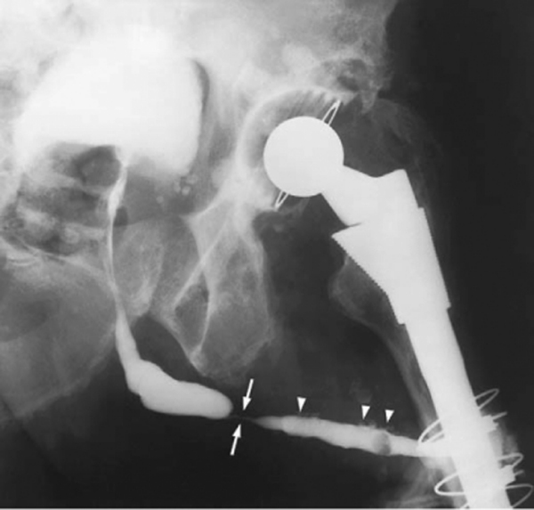
Notes:
Figure 42.51 Urethral stricture with reflux into the glands of Littre. Retrograde urethrogram shows a tight stricture along the penile urethra (arrows). Reflux of contrast medium into the glands of Littre (arrowheads) is also demonstrated.

Slide 38
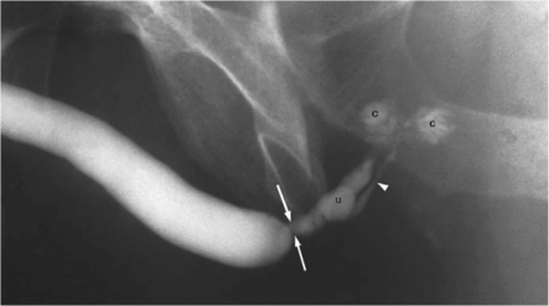
Notes:
Figure 42.52 Urethral stricture with reflux into Cowper's glands. Retrograde urethrogram shows a tight bulbar stricture (arrows) with reflux on contrast seen into the Cowper's gland duct (arrowhead) and into Cowper's glands (c). u = urethra.

Slide 39
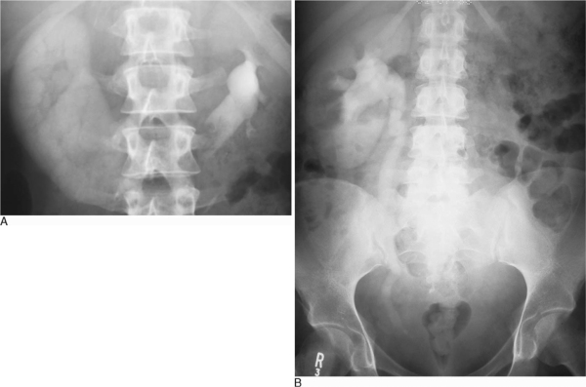
another patient
Notes:
Figure 41.1 Ureteric obstruction. (A) IVU demonstrates high-grade obstruction in the right side of a horseshoe kidney with a dense and persistent nephrogram. Normal excretion is seen in the left side. (B) IVU in another patient demonstrates a persistent nephrogram on the right side with a full column of opacified urine down to a stone in the distal right ureter.

Slide 40
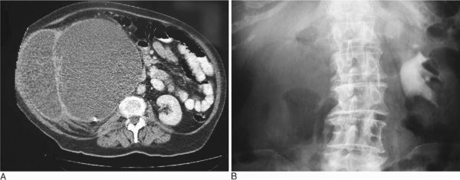
Notes:
Figure 41.3 (A) CT of long-standing hydronephrosis of the right kidney with the appearance of a shell nephrogram. The appearance was diagnosed as a PUJ obstruction although nephroureterectomy demonstrated tumour obstructing the distal ureter. An incidental small calculus is also noted in the calyceal system. (B) A similar appearance is seen on an IVU with no visible contrast medium excretion on the right side.

Slide 41
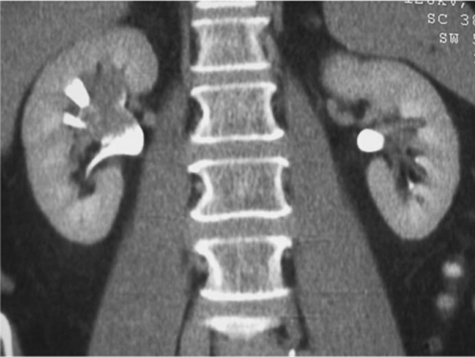
Notes:
Figure 41.6 Transitional cell tumour seen on a coronal reformat CT urogram.

