Slide 1
SPOTS

Slide 2
Notes:
Figure 32.39 Adhesive small bowel obstruction. Enhanced CT, coronal reformation image shows the transition zone (white arrow), distended, fluid-filled proximal jejunal loops and collapsed distal loops (black arrow). No mass is seen.

Slide 3
Enhanced CT
Notes:
Figure 32.40 Mesenteric venous thrombosis. Enhanced CT, coronal reformation image shows circumferential thickening of distended jejunal loops (white arrows) and haziness of the adjacent mesentery. Nonopacification of superior mesenteric and jejunal branches is noted (black arrows). Ascites is also present.

Slide 4
Notes:
Figure 32.42 Meckel's diverticulum. A blind-ending sac is shown arising from the antimesenteric border of the distal ileum (arrow).

Slide 5
Notes:
Figure 32.43 Systemic sclerosis. (A) Sacculation shown as broad-based outpouchings. (B) Dilatation of a segment of intestine with the ‘hide-bound’ appearance of the valvulae conniventes seen on a spot compression view.

Slide 6
Notes:
Figure 31.3 Radiating folds on the dependent surface converge at a scar from a healed benign gastric ulcer.

Slide 7
Notes:
Figure 31.8 En face appearance of benign gastric ulcer. (A) Posterior wall ulcer is nearly filled with barium in this RPO projection. Thin regular radiating folds (best seen around the inferior border of the ulcer) are seen converging to the ulcer. (B) Unfilled benign ulcer crater is outlined by a ‘ring’ shadow. This ulcer is surrounded by a prominent ring of oedema – the lucent area around the crater.

Slide 8
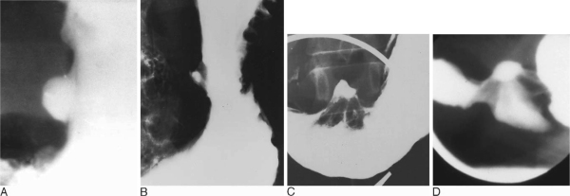
Notes:
Figure 31.9 Profile views of benign gastric ulcer. (A) Hampton's line, a thin line of radiolucency crossing the opening of an ulcer, a virtually infallible sign of a benign ulcer. (B) Lesser curvature ulcer with a clearly visible ulcer collar. (C) Large lesser curvature ulcer niche, its projection from the lumen of the stomach strongly suggesting a benign lesion. (D) Smooth, straight radiating folds converge at the ulcer crater.

Slide 9
Notes:
Figure 31.10 Healing gastric ulcer. (A) Focal retraction along the incisura angularis with small residual out-pouching is present. Converging smooth folds no longer fill an ulcer crater. (B) Radiating folds converging to a linear scar. (C) Scarred antrum with constriction at site of previous ulcer causing narrowing and deformity.

Slide 10
Notes:
Figure 31.11 Gastric erosions. (A) Complete or ‘varioliform’ erosions in antrum seen on double-contrast views. (B) Incomplete erosions in antrum on compression view. The erosions do not have a rim of oedema.

Slide 11
Notes:
Figure 31.12 Diffuse erosive gastritis with thick nodular folds. Erosions are scattered along the folds.

Slide 12
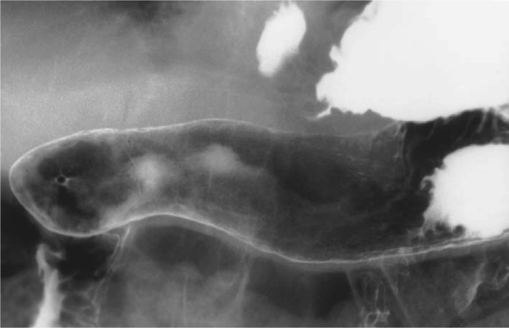
Notes:
Figure 31.13 Atrophic gastritis. Featureless narrowed stomach. Note pyloric channel seen ‘end on’.

Slide 13
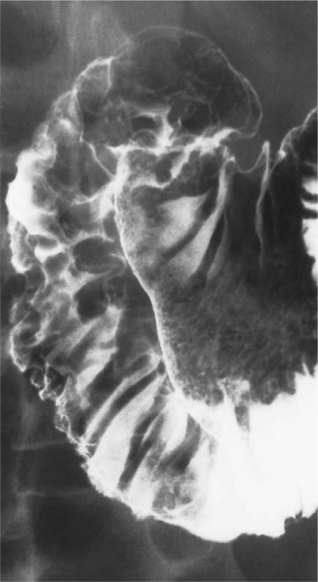
Notes:
Figure 31.14 Crohn's disease. Multiple aphthous erosions are present on the antrum. Duodenal folds are thick and nodular

Slide 14
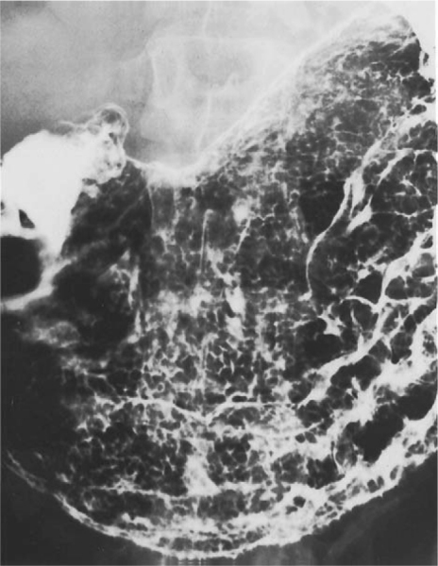
Notes:
Figure 31.15 Hypertrophic gastritis in a patient with a recently healed lesser curvature gastric ulcer. This characteristic enlargement and prominence of the areae gastricae can be correlated with an increased incidence of gastric hypersecretion and PUD.

Slide 15
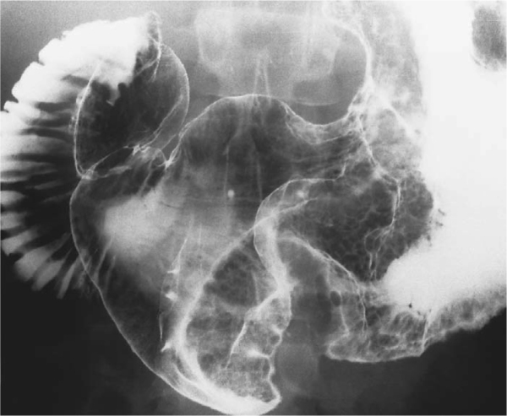
Notes:
Figure 31.16 Ménétrier's disease. Classic appearance with massively distended folds in the body without abnormality in the antrum.

Slide 16
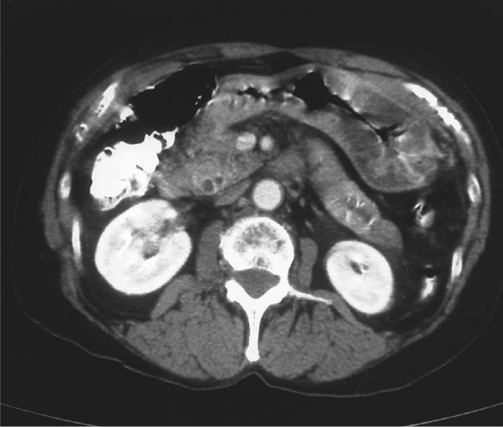
Notes:
Figure 31.17 CT shows diffuse thickening of the gastric wall in a patient proven to have eosinophilic gastroenteritis. No ascites was present. Symptoms resolved with steroid therapy.

Slide 17
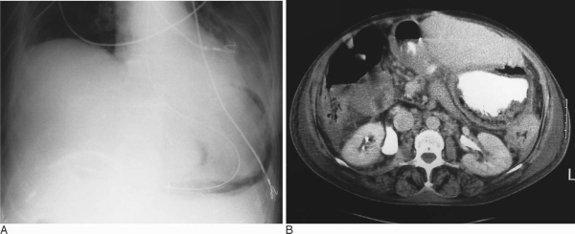
Notes:
Figure 31.19 (A) Gastric emphysema on abdominal radiograph in a patient with ischaemic gastritis after extensive abdominal surgery. (B) CT of patient with infectious, emphysematous gastritis.

Slide 18
Notes:
Figure 31.20 (A) Sliding hiatal hernia. Chest X-ray shows a large air collection overlying the heart shadow. (B) CT shows a large part of the barium-filled stomach is in the chest. (C) In this patient, an upper GI exam shows that the gastric fundus and most of the body of the stomach is intrathoracic

Slide 19
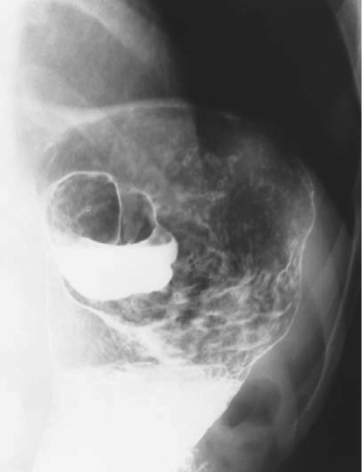
Notes:
Figure 31.22 Large fundal diverticulum. The patient is upright and a barium/air level is present in the diverticulum.

Slide 20
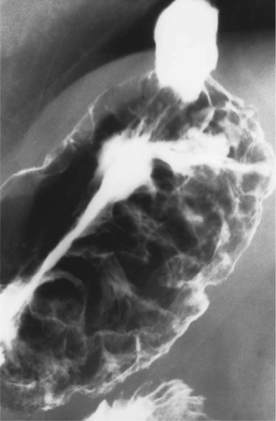
Notes:
Figure 31.23 Multiple nodular and curved submucosal masses in the fundus are a common appearance of gastric varices.

Slide 21
Notes:
Figure 31.25 Gastric outlet obstruction – cancer of the antrum. Markedly distended stomach with air/fluid level on CT. In this case, a mass in the distal antrum is seen (arrowheads).

Slide 22
Notes:
Figure 31.29 Gastric bezoar. Large mass in stomach – solidified retained ingested fibrous material mixed with air in the patient after a Billroth II anastomosis

Slide 23
Notes:
Figure 31.30 Gastric cancer after Billroth II anastomosis. There is narrowing, irregularity and lack of distensibility around the anastomosis

Slide 24
Notes:
Figure 31.33 Leiomyoma adjacent to the gastro-oesophageal junction shown on CT as a smooth soft tissue mass in the contrast-filled stomach

Slide 25
Notes:
Figure 31.34 Early gastric cancer at the incisura angularis. The lesion was slightly elevated and irregular in shape with central ulceration (Type IIC). The folds are thick and stop at the edge of the tumour.

Slide 26
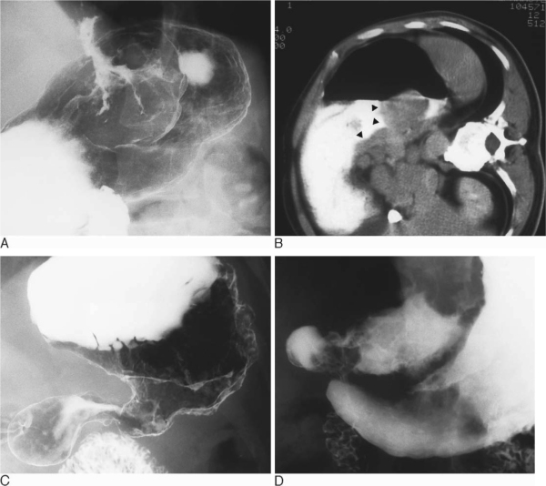
Notes:
Figure 31.35 Advanced gastric cancer. (A) Large polypoid mass of the cardia. Tumours in this region are becoming more common for unknown reasons. (B) Polypoid mass of the cardia shown on CT (arrowheads). This patient was imaged in the right lateral decubitus position. (C) Large circumferential mass in the body of the stomach with a shelf at the proximal margin sharply demarcating the cancer from the proximal stomach. (D) Large ulcerated mass in the antrum. This is often referred to as a ‘Carman’ ulcer.

Slide 27
Notes:
Figure 29.2 Pneumoperitoneum resulting from perforation of a duodenal ulcer. Erect chest radiograph. Typical free gas between the liver and the right hemidiaphragm. Note also the small triangular collection between the loops of the splenic flexure of the colon, beneath the left hemidiaphragm.

Slide 28
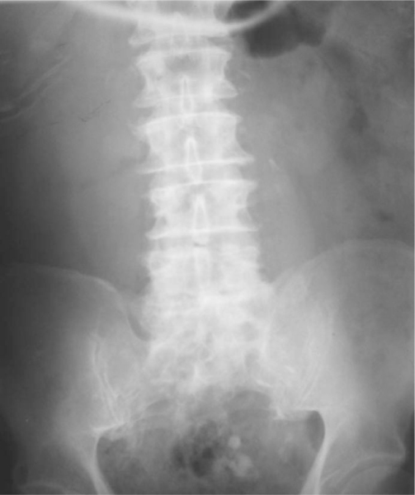
Notes:
Figure 29.3 Leaking abdominal aortic aneurysm. A curvilinear soft tissue shadow is seen to the left of the lumbar spine due to the aneurysm, with some calcification in its wall. The right psoas muscle outline is lost on the right due to haematoma

Slide 29
Notes:
Figure 29.4 Gastric volvulus: supine. Gas-filled, grossly dilated stomach, spherical in outline. Note also the linear gas within the wall of the stomach and visualization of both sides of the stomach wall indicating free gas. At laparotomy a perforated gangrenous stomach had undergone volvulus around its transverse axis.

Slide 30
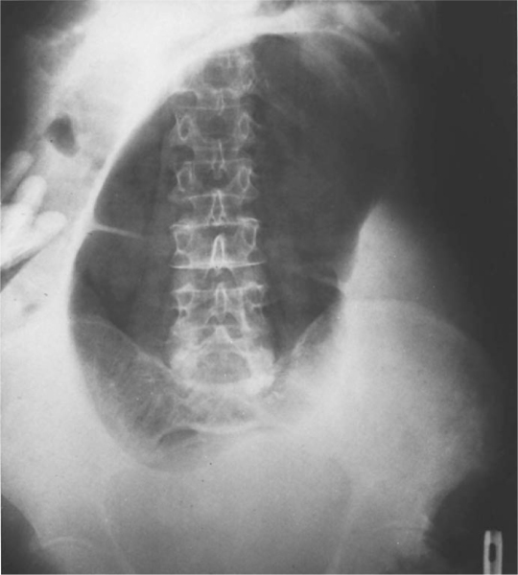
Notes:
Figure 29.14 Caecal volvulus. The dilated caecum lies with its pole under the left hemidiaphragm. In spite of the dilatation the haustra are preserved. There is no dilated large bowel elsewhere in the abdomen. The small bowel is fluid filled in this case.

Slide 31
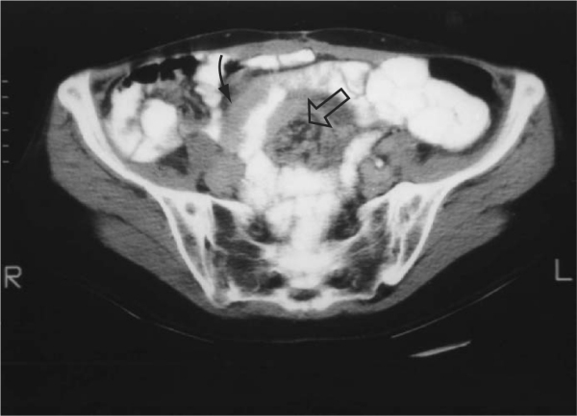
Notes:
Figure 29.8 Small-bowel volvulus. CT showing a thick-walled small-bowel loop (curved black arrow) around a mesenteric whirl (white arrow).

Slide 32
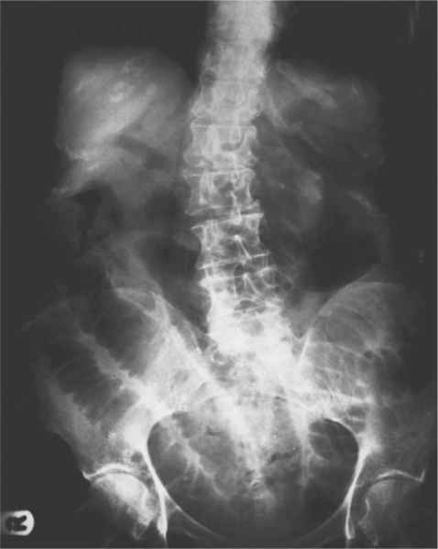
Notes:
Figure 29.9 Gallstone ileus. Supine radiograph showing evidence of small-bowel obstruction. In addition gas can be identified within the right and left hepatic ducts and the common bile duct. The 79-year-old woman presented with a 5-day history of abdominal pain and vomiting.

Slide 33
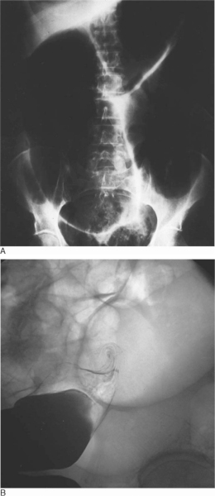
Notes:
Figure 29.15 Sigmoid volvulus in a 64-year-old woman. (A) Massively dilated distended gas-filled loop of sigmoid colon. Most of the features listed in Table 29.5 are present. (B) Contrast enema showing the twisted sigmoid colon (bird of prey sign).

Slide 34
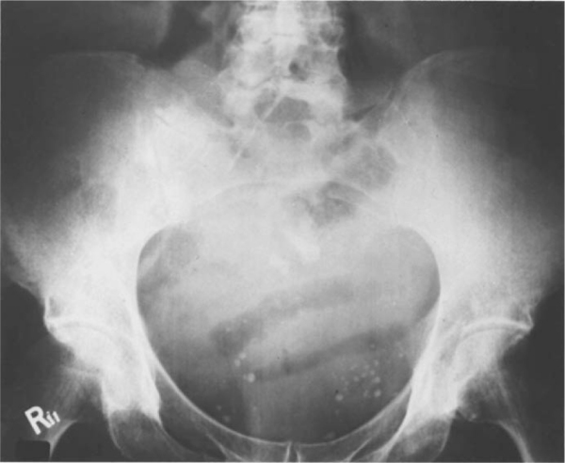
Notes:
Figure 29.18 Mesenteric infarction. Supine. Several gas-filled loops of small bowel lie in the pelvis. Note the abnormal irregular outline of the mucosa and the thickening of the bowel wall.

Slide 35
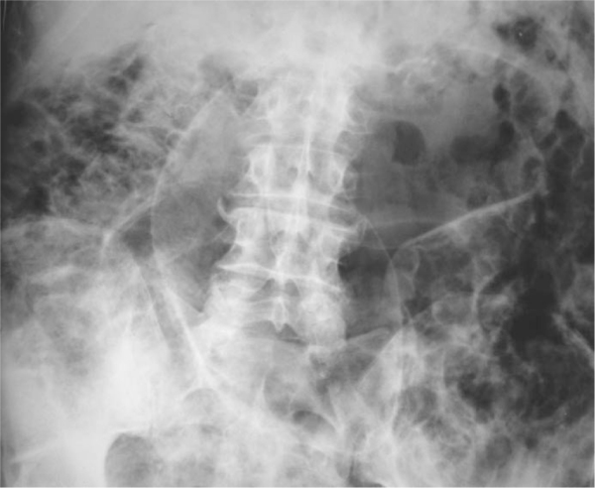
Notes:
Figure 29.19 Pneumatosis coli. Multiple small gas-filled cysts are seen in association with the colon. There is also free peritoneal gas.

Slide 36
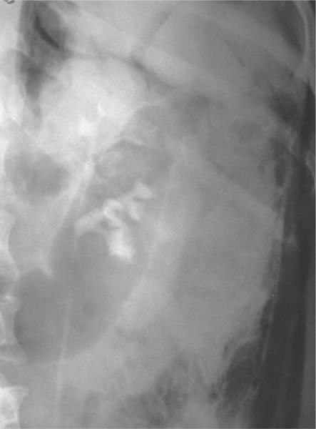
Notes:
Figure 29.20 Retroperitoneal gas due to perforated sigmoid diverticular disease. Film from an IVU series. There is gas between the layers of the abdominal wall and around the upper pole of the left kidney.

Slide 37
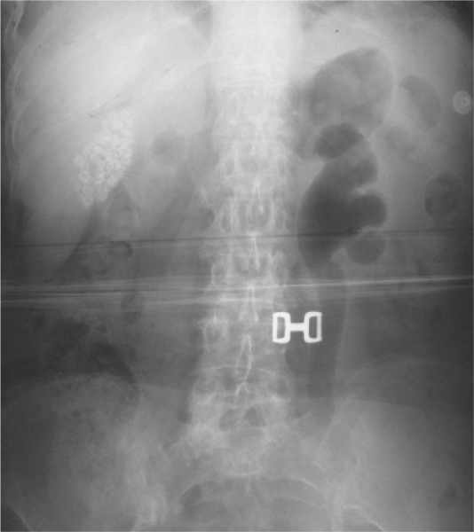
Notes:
Figure 29.21 Emphysematous pyelonephritis. Patient with diabetes mellitus and sepsis. The left renal collecting system and ureter are distended and gas filled. There are also multiple dense gallstones in the gallbladder.

Slide 38
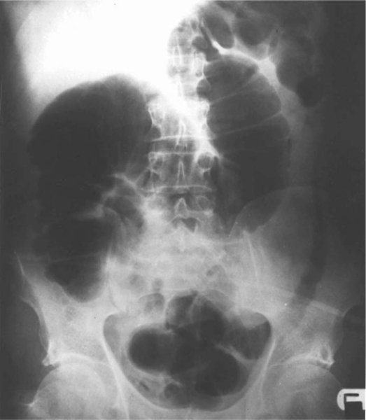
Notes:
Figure 29.22 Ischaemic colitis. A thick-walled oedematous descending colon outlined by gas. Slightly distended colon from caecum to splenic flexure, but with normal haustra and no evidence of abnormal mucosa.

Slide 39
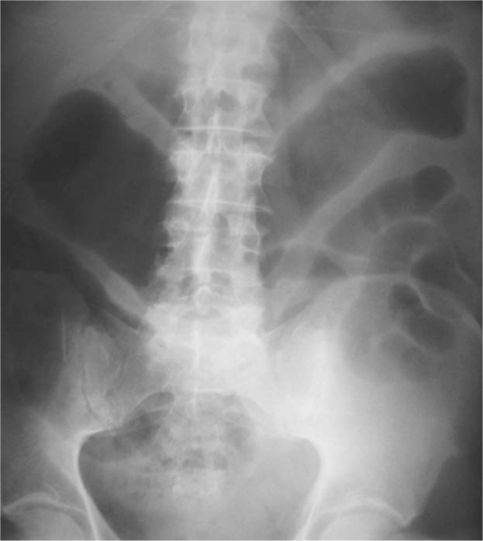
Notes:
Figure 29.23 Toxic megacolon. The ascending and transverse colon appears gas-filled and dilated with a thickened wall. There is an absence of haustral markings, indicating full-thickness mural inflammation.

Slide 40
Notes:
Figure 29.24 Pseudomembranous colitis. There is gross mucosal oedema in the transverse colon. Clostridium difficile was grown

Slide 41
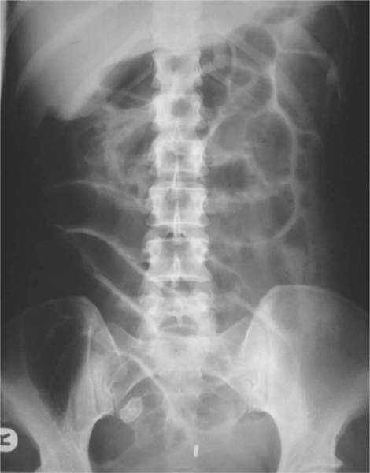
Notes:
Figure 29.25 Appendicitis. There is generalized ileus and an appendicolith in the right iliac fossa overlying the right side of the sacrum. At operation the appendix was gangrenous and perforated.

