Slide 1
SPOTS

Slide 2
Notes:
Figure 37.18 Infected pseudocyst. Gas is seen in the pseudocyst (arrow), which lies anterior to the stomach (arrowhead). This was successfully treated by percutaneous drainage.

Slide 3
Notes:
Figure 37.19 Haemorrhage into a pseudocyst. High attenuation fresh blood (arrow) is seen within a well-defined pseudocyst.

Slide 4
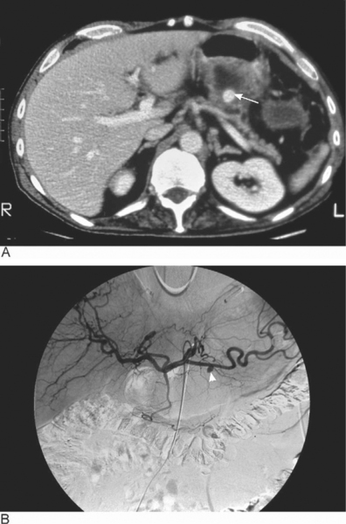
Notes:
Figure 37.22 Pseudoaneurysm formation. (A) Enchanced CT shows high-density contrast collection (arrow) within a small retrogastric pseudocyst. (B) Coeliac axis angiogram confirms the presence of a pseudoaneurysm (arrowhead). This was embolized successfully.

Slide 5
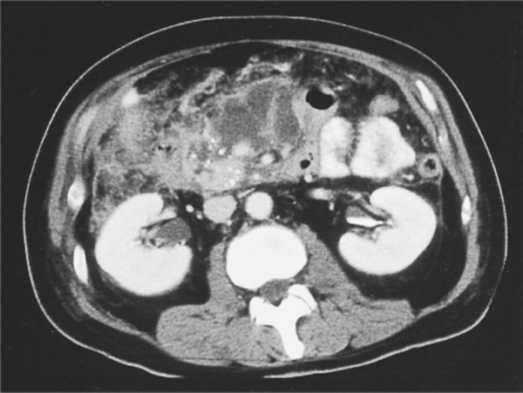
Notes:
Figure 37.23 Acute on chronic pancreatitis. Enhanced CT showing acute inflammatory changes in the pancreas superimposed on chronic pancreatitis with calcification

Slide 6
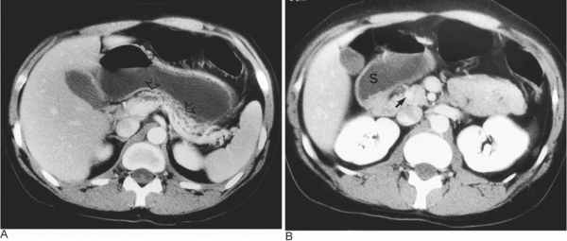
Notes:
Figure 37.25 (A & B) Chronic calcific pancreatitis. (A) CT at the level of the body-tail of the pancreas (arrows) shows a small organ with multiple small intraductal areas of calcification. (B) CT at the level of the head of the pancreas shows a dominant calcification site in the main pancreatic duct (arrow). S = stomach

Slide 7
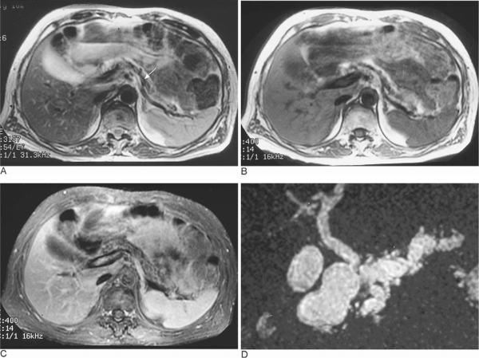
Notes:
Figure 37.27 Chronic pancreatitis. MR images of the pancreas. (A) T2-weighted. (B) T1-weighted. (C) Fat-saturated image. All three images show pancreatic gland atrophy with a prominent duct (arrow). (D) MR pancreatogram in the same patient delineates a very abnormal main pancreatic duct with dilated side branches.

Slide 8
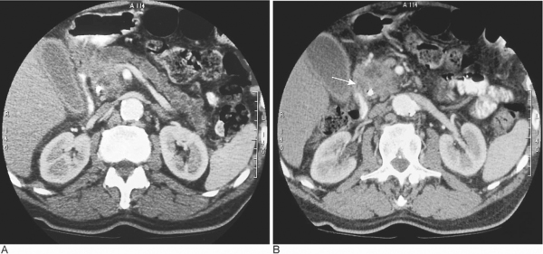
Notes:
Figure 37.30 Pancreatic carcinoma. (A) Atrophy of the body and tail is seen, with a markedly dilated pancreatic duct and atrophy of the parenchyma. (B) The pancreatic head mass involves the duodenal wall (arrow).

Slide 9
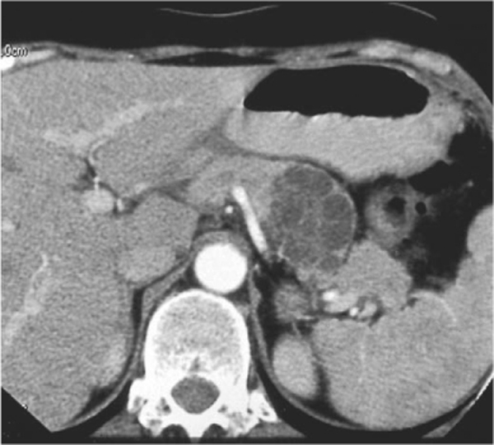
Notes:
Figure 37.36 Benign serous cystadenoma. The tumour at the junction of the pancreatic body and tail shows the typical appearance of numerous small cysts.

Slide 10
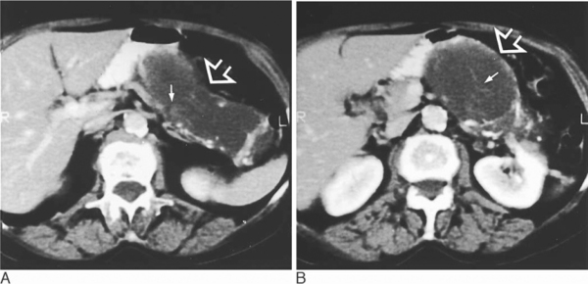
Notes:
Figure 37.37 Mucinous cystadenocarcinoma. (A & B) Contiguous CT images through the pancreas show a cystic mass (open arrow) replacing most of the body and tail of the gland. Areas of dystrophic calcification are noted within the wall of the cystic mass and small papillary excrescences and septa are also seen (small white arrows).

Slide 11
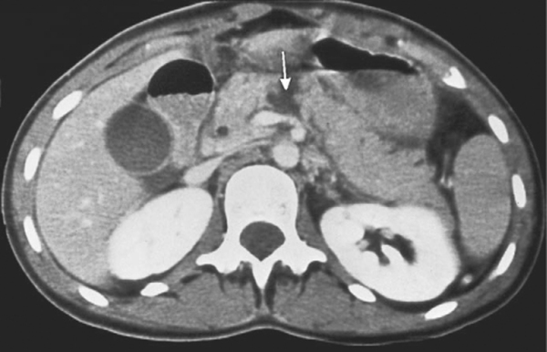
Notes:
Figure 37.38 Pancreatic trauma. Following direct blunt trauma to the abdomen the pancreas is seen to be fractured (arrow). There was disruption of the main pancreatic duct.

Slide 12
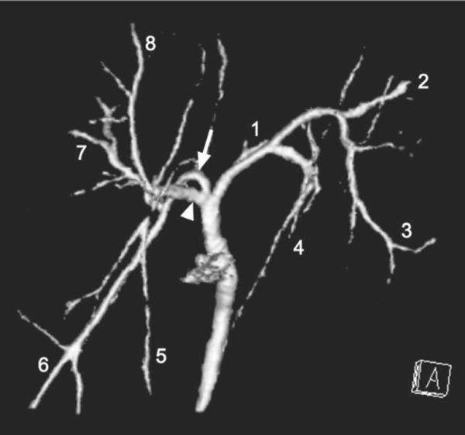
Notes:
Figure 36.3 Biliary duct anatomy. CT-IVC (surface rendered maximum intensity reformat) shows trifurcation at the biliary confluence and segments numbered according to Couinaud. Arrowhead shows right anterior sectoral duct; arrow shows right posterior sectoral duct.

Slide 13
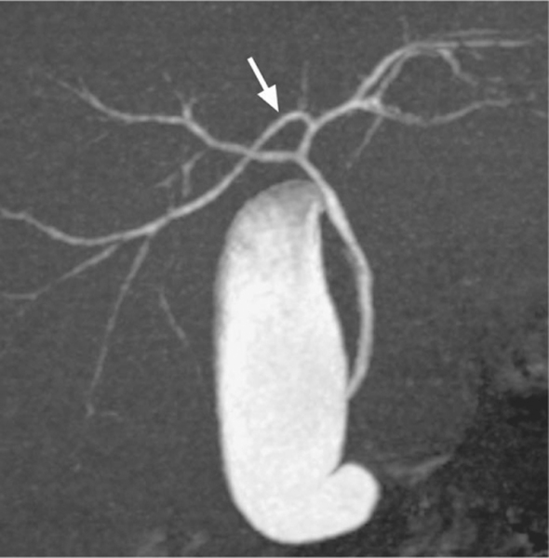
Notes:
Figure 36.4 Biliary duct anatomy. CT intravenous cholangiography (CT-IVC) (maximum intensity reformat). Right posterior sectoral duct (arrow) passes to the left to drain into left hepatic duct.

Slide 14
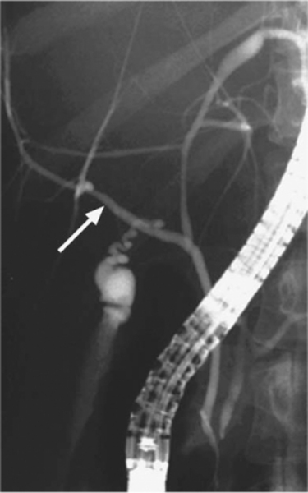
Notes:
Figure 36.5 Biliary duct anatomy. ERCP shows right posterior sectoral duct (arrow) passing inferiorly to join the common duct. In this instance the cystic duct drains into the right posterior sectoral duct.

Slide 15
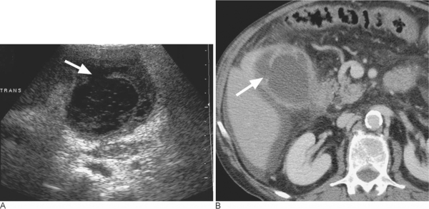
Notes:
Figure 36.12 Acute cholecystitis with localized perforation on (A) US and (B) CT. The thickened gallbladder wall shows a local defect (arrow) and on CT there is small amount of intraperitoneal fluid and oedema of adjacent fat.

Slide 16
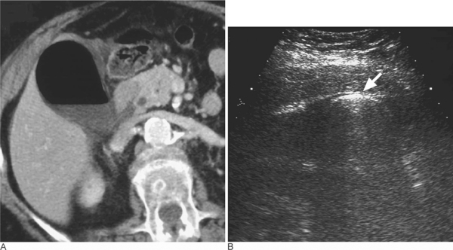
Notes:
Figure 36.14 Emphysematous cholecystitis. (A) CT – Intraluminal gas; (B) US – intraluminal gas appears as a bright curvilinear echogenic band (arrow) with ‘dirty’ shadowing.

Slide 17
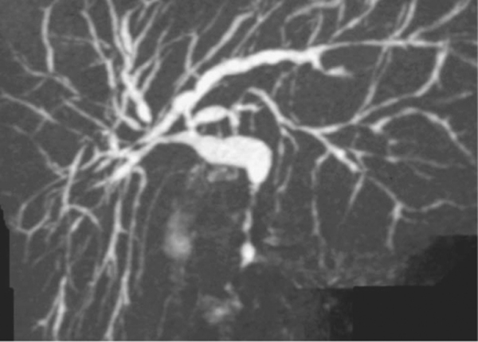
Notes:
Figure 36.26 Primary sclerosing cholangitis. CT-IVC (maximum intensity, oblique coronal reformat) shows multiple intrahepatic and extrahepatic segments of stricturing.

Slide 18
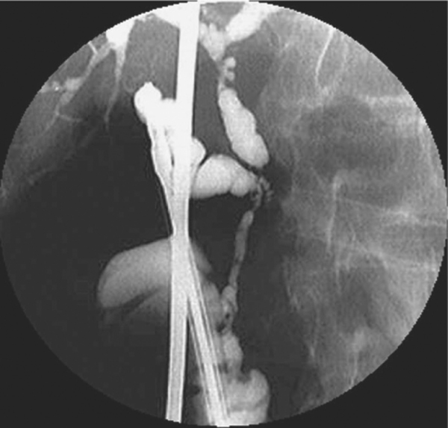
Notes:
Figure 36.27 Primary sclerosing cholangitis. An intraoperative cholangiogram shows strictures and characteristic diverticula-like outpouchings affecting the common duct

Slide 19
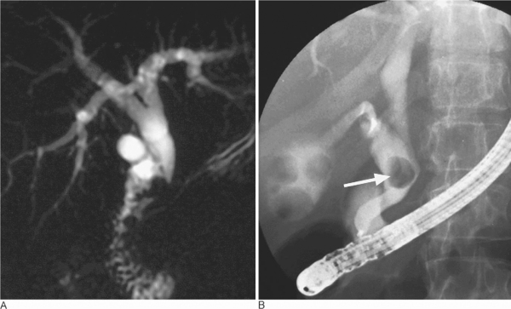
Notes:
Figure 36.29 Mirizzi syndrome. MRCP (A) shows a stricture of the lower common duct caused by a stone (arrow) lying in an expanded cystic duct on ERCP (B). Multiple gallbladder stones are also seen.

Slide 20
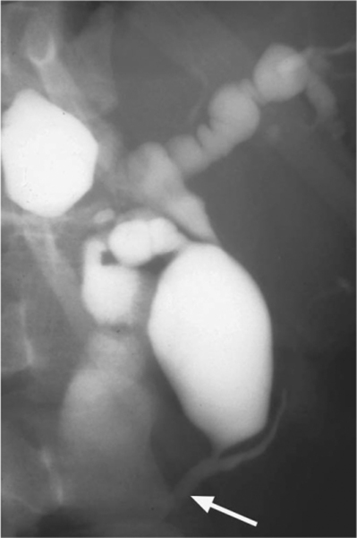
Notes:
Figure 36.33 Type IV choledochal cyst on PTC with extrahepatic as well as intrahepatic cystic dilatation of bile ducts and a characteristic long common channel shared by the common bile duct and pancreatic duct (arrow).

Slide 21
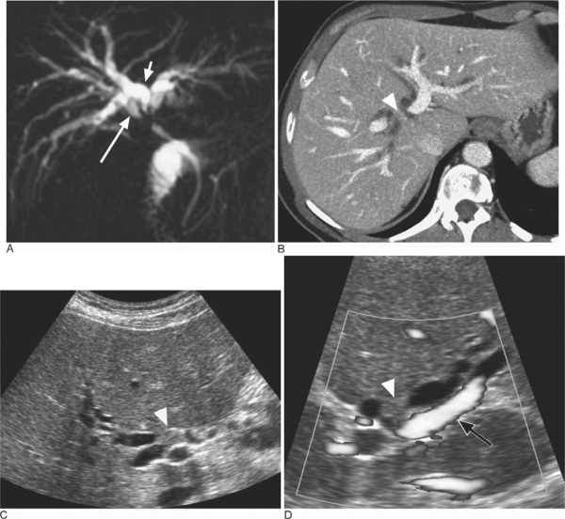
Notes:
Figure 36.34 Small hilar cholangiocarcinoma (arrowhead) producing obstruction of the right posterior sectoral duct (short arrow), right anterior sectoral duct (long arrow) and left hepatic duct. (A) Thick section oblique coronal MRCP. (B) Axial portal phase CT. (C) Longitudinal US. (D) Transverse colour Doppler US (open arrow: normal left portal vein).

Slide 22
Notes:
Figure 36.39 Hilar cholangiocarcinoma associated with marked right-lobe atrophy and left-lobe hypertrophy, treated by a left-sided transhepatic metal stent. (A) MRCP shows a Bismuth Type II stricture with very dilated and crowded ducts in a small atrophic right lobe. Arrowhead = segment II; long arrow = segment III (partially out of section). (B) left-sided PTC and catheterization of segment III (long arrow), with short stricture of first-order left hepatic duct (short arrow). (C) A metal biliary stent has been placed across the hilar stricture.

Slide 23
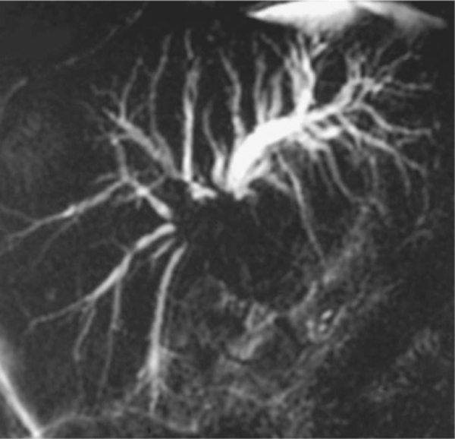
Notes:
Figure 36.41 Gallbladder carcinoma producing a Bismuth Type IIIa hilar stricture with third-order stricturing on the right and first order on the left.

Slide 24
Two different cases
Notes:
Figure 35.15 T2w MRI images demonstrating abnormally low liver signal in (A) Haemochromatosis and (B) Haemosiderosis. Note the spleen is abnormally low signal in haemosiderosis as the reticuloendothelial system becomes iron loaded compared with predominantly hepatocyte accumulation in haemochromatosis.

Slide 25
Notes:
Figure 35.16 Haemochromatosis. Unenhanced CT section through the liver of a patient with haemochromatosis showing diffuse increased attenuation of the liver compared with the spleen

Slide 26
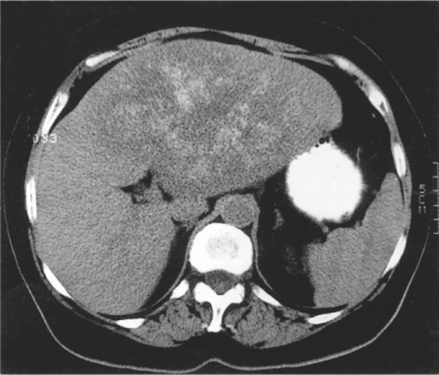
Notes:
Figure 35.17 Liver calcification. Unenhanced section, showing a large metastatic deposit in the left lobe of the liver from a primary colonic adenocarcinoma. Faint calcification is visible in the metastasis, which could be masked following IV contrast medium enhancement.

Slide 27
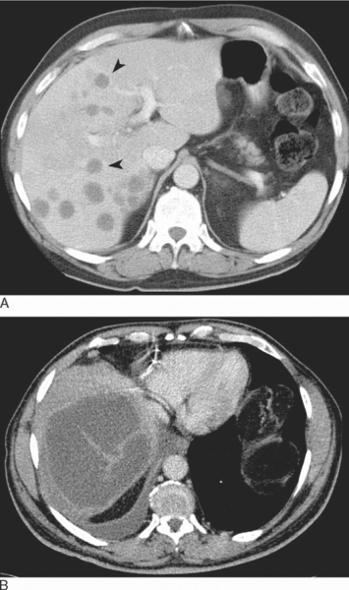
Notes:
Figure 35.24 Liver abscess. Portal phase CT examinations in two different cases. (A) Multiple low attenuation lesions with ring enhancement (arrowheads); these appearances are often nonspecific on CT and often overlap with those of metastatic deposits. In (B) the presence of septae, central low attenuation along with a sympathetic pleural effusion aid the diagnosis

Slide 28
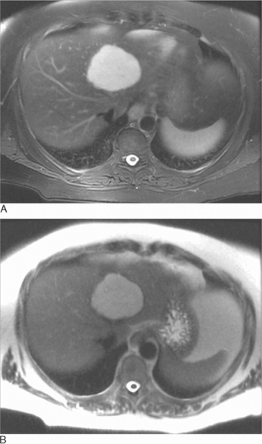
T2w MR sections (A) TEeffective 60 ms multi-shot RARE, (B) TEeffective160 ms single-shot RARE
Notes:
Figure 35.25 Haemangioma. Typical appearance on T2w MR sections (A) TEeffective 60 ms multi-shot RARE, (B) TEeffective160 ms single-shot RARE. On T2w imaging haemangiomas are typically well-defined homogeneous lesions of higher signal intensity than spleen and approaching that of fluid, particularly on the extended echo time image (B).

Slide 29
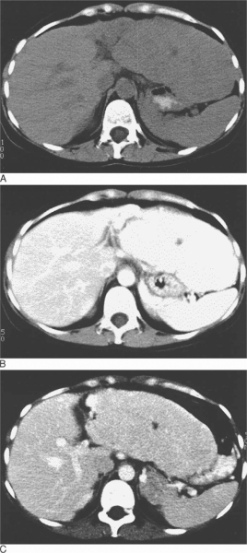
Notes:
Figure 35.29 Focal nodular hyperplasia. A large lesion (homogeneous except for a low attenuation central scar) expands and replaces much of the left lobe. The attenuation is almost identical to normal liver on the unenhanced section (A) but the lesion demonstrates transient avid and even enhancement during the arterial phase (B) becoming indistinguishable on the portal phase section (C).

Slide 30
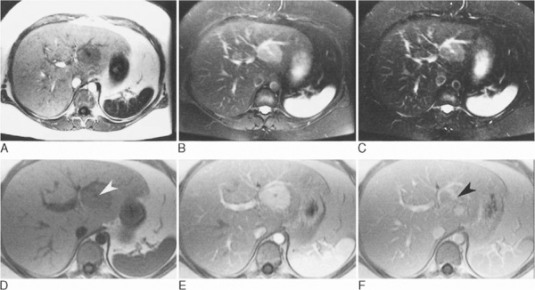
A-D T1W, T2w (TE 60 ms (B), TE 120 ms (C)). Following IV gadolinium DTPA in the arterial phase (E) on delayed sections (F).
Notes:
Figure 35.30 Focal nodular hyperplasia. A well-defined lesion in the left lobe that is homogeneous except for a central scar, low signal on T1w (A, D) and increased signal on T2w (TE 60 ms (B), TE 120 ms (C)). Following IV gadolinium DTPA the whole lesion enhances transiently in the arterial phase (E) with the exception of the scar, which enhances on delayed sections (F).

Slide 31
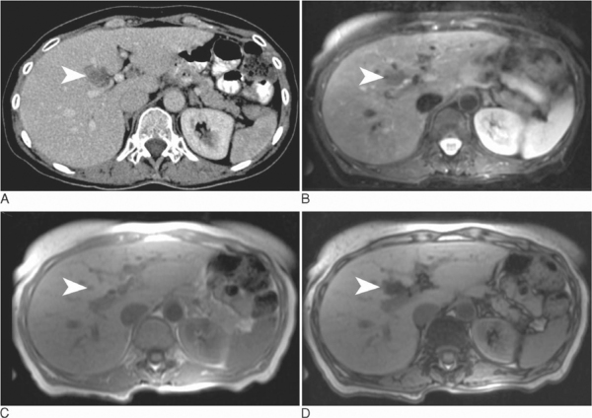
portal phase CT (A) fat-suppressed T2w imaging (B), in- (C) and out- (D) -of-phase gradient-echo imaging
Notes:
Figure 35.33 Focal fat infiltration. On portal phase CT (A) focal fat infiltration (arrowheads) in the posterior aspect of the left lobe medial segment (Couinaud IV) has a similar appearance to a metastasis. On fat-suppressed T2w imaging (B), the low signal makes metastasis unlikely but does not characterize the lesion. However the demonstration of signal loss (relative to the spleen) on in- (C) and out- (D) -of-phase gradient-echo imaging is diagnostic.

Slide 32
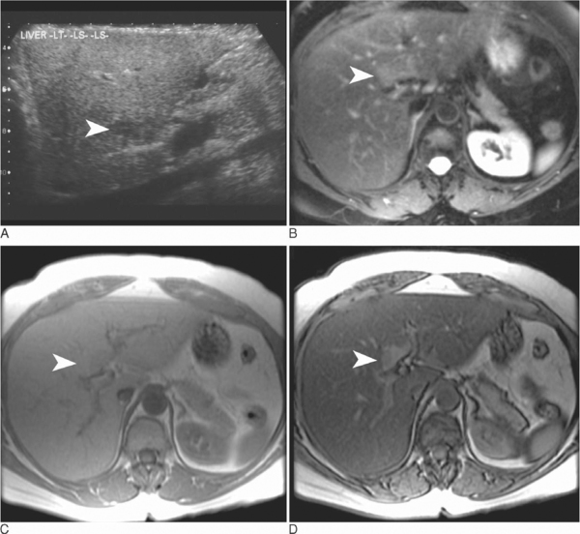
US (A), fat-suppressed T2w imaging (B), in- (C) and out- (D) -of-phase gradient-echo imaging, out-of-phase image (D).
Notes:
Figure 35.34 Focal fat sparing. On US (A) an area of focal fat sparing (arrowheads) in the posterior aspect of the left lobe medial segment (Couinaud IV) in an otherwise fatty liver has a similar appearance to a metastasis. On fat-suppressed T2w imaging (B) this will appear of increased signal suggesting a malignant lesion but the use of in- (C) and out- (D) -of-phase gradient-echo imaging indicates that the ‘lesion’ is in fact normal liver surrounded by fatty liver that has reduced in signal on the out-of-phase image (D).

Slide 33
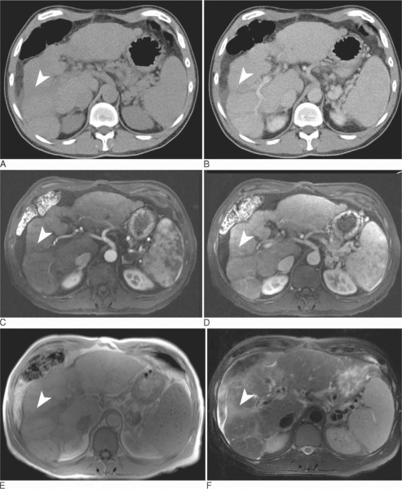
On unenhanced (A), and portal phase CT (B) arterial phase (C) and portal phase (D) T1w gadolinium-enhanced MRI and conventional T1w imaging (E), T2w (F)
Notes:
Figure 35.35 Focal confluent fibrosis. The right lobe has contracted and confluent bands of fibrosis are present (arrowheads). On unenhanced (A), and portal phase CT (B) these appear of low attenuation and may mimic malignant lesions when focal. Unlike the majority of hepatocellular carcinomas on the arterial phase (C) and portal phase (D) T1w gadolinium-enhanced MRI and conventional T1w imaging (E), the fibrosis remains low signal but on T2w (F) the fibrosis is usually of increased signal and can mimic HCC.

Slide 34
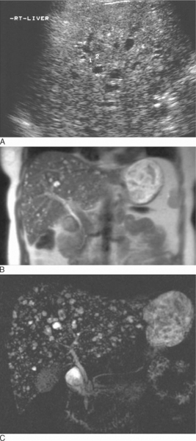
On US (A, conventional T2w (B) and MRCP type T2w (C)
Notes:
Figure 35.36 Multiple biliary hamartomas. On US (A) only the larger cystic lesions are seen clearly and the background texture of the liver is heterogeneous and often misinterpreted as malignant infiltration. On conventional T2w (B) and MRCP type T2w (C) imaging the extent and number of the multiple cystic lesions is more obvious. The solid components may be indistinguishable from metastases.

Slide 35
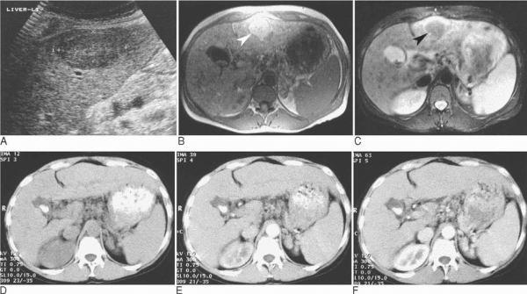
US (A) T1w (B) T2w (C)
Notes:
Figure 35.37 Atypical regenerative nodule. Regeneration in cirrhosis often results in heterogeneity of the parenchyma. Occasionally nodules may become large, ‘atypical’ or ‘dominant’ as in this patient. US (A) demonstrates a reduced echoreflectivity lesion in the left lobe, initially interpreted as probable tumour. However on MRI the relatively homogeneous lesion (arrowheads) is of increased signal on T1w (B) and decreased signal on T2w (C). These appearances are not typical of malignancy and are recognized as a feature of regenerative nodules (in this case, confirmed on biopsy). Similar smaller nodules are widespread in the liver.

Slide 36
T1w MRI (A) and T2w MRI (B)
Notes:
Figure 35.38 Hepatocellular carcinoma and regenerative nodule. T1w MRI (A) and T2w MRI (B) demonstrating a hepatocellular carcinoma (white arrowhead) and an adjacent atypical regenerative nodule (black arrowhead). Although the majority of hepatomas have decreased signal intensity on T1w occasionally they have increased signal, thought to relate to fat or glycogen content. Note the heterogeneity in the hepatoma, particularly on T2w. The findings were confirmed at subsequent liver transplantation.

Slide 37
Notes:
Figure 35.43 Epithelioid haemangioendothelioma. CT demonstrates peripheral low-attenuation lesions (arrowheads) that have coalesced to form a rind of tumour enclosing the central normal liver parenchyma. The patient presented with Budd–Chiari syndrome secondary to the tumour, diagnosed on needle biopsy and confirmed at subsequent liver transplantation.

Slide 38
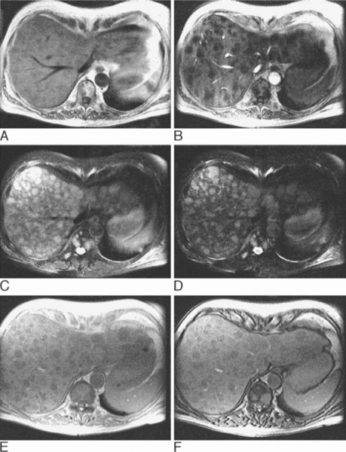
T1w spin-echo sections (A) and T1w magnetization prepared gradient-echo sections (B), T2w sections (TE 60 ms (C), TE 120 ms (D)), in- (E) and out- (F) of-phase gradient-echo
Notes:
Figure 35.46 Multiple metastases. MRI demonstrates lesions within both the liver and the vertebral bodies. They are of reduced signal intensity on T1w spin-echo sections (A) and T1w magnetization prepared gradient-echo sections (B), moderately increased signal intensity on T2w sections (TE 60 ms (C), TE 120 ms (D)), and do not significantly change in relation to the splenic signal on in- (E) and out- (F) of-phase gradient-echo imaging indicating the lack of any lipid content.

Slide 39
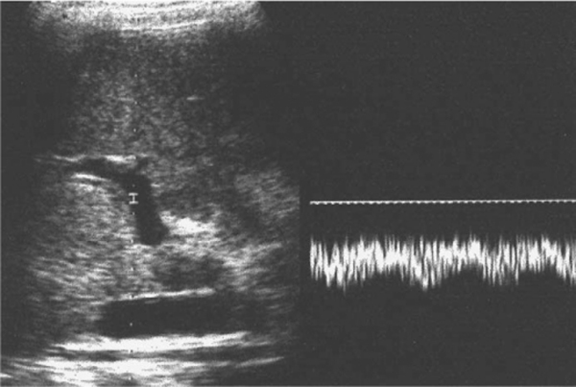
Notes:
Figure 35.49 Portal venous hypertension: reversed portal vein flow. Duplex examination demonstrates continuous reversed (hepatofugal) flow in the portal vein, usually reflecting underlying severe cirrhosis and portal venous hypertension with varices

Slide 40
Notes:
Figure 35.52 Hepatic arteriogram in a patient who had undergone percutaneous cholangiography 2 days earlier. (A) Arterial phase: arrows point to small arterioportal fistulae. (B) Capillary phase: dense ‘blushes’ due to early portal venous staining.

Slide 41
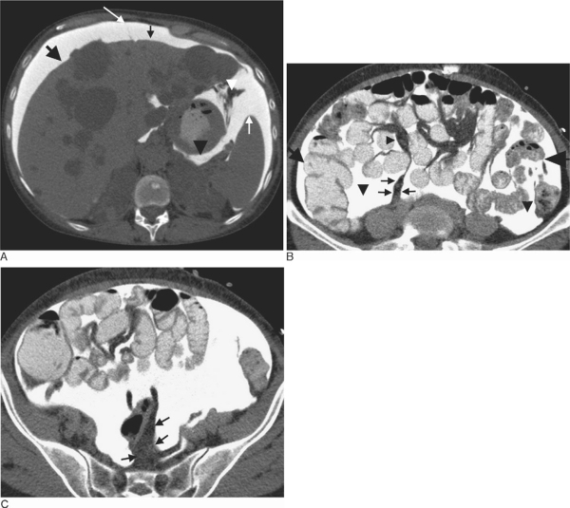
after intraperitoneal injection of water-soluble contrast material on CT
Notes:
Figure 34.2 Peritoneal spaces of a woman suffering chronic renal failure, after intraperitoneal injection of water-soluble contrast material on CT. (A) Contrast medium opacifies right subphrenic (large black arrow) and left posterior subphrenic (small white arrow) space. Left anterior perihepatic space (small black arrow) is bounded on the right by the falciform ligament (large white arrow). The lesser sac (black arrowhead) is delineated behind the stomach and its superior extension around caudate lobe of the liver is demonstrated. The gastrosplenic ligament (white arrowhead) is demonstrated as the fatty space between the lesser sac and the splachnic splenic surface. The bare area of the liver at reflection of the right coronary ligament is uncovered by contrast material. (B) Inframesocolic compartment. The opacified fluid delineates the right (large black arrow) and the left paracolic gutters. The right and the left inframesocolic spaces are also opacified (large arrowheads). A triangle-shaped opacified area (small arrowhead) intervenes between folds of small-bowel mesentery that are seen as lucent bands. The fat within the root of the small-bowel mesentery (small arrows) is outlined by fluid. (C) The opacified fluid in the left inframesocolic space is partly bounded by the sigmoid mesocolon seen as the fatty plane extending from the sigmoid colon to sacrum (arrows).

