Slide 1
SPOTS

Slide 2
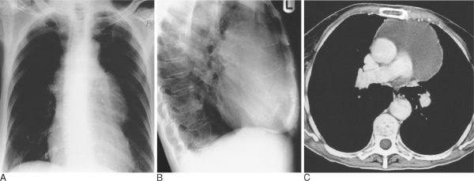
Notes:
Figure 14.4 Thymic cyst producing an anterior mediastinal mass on (A) AP and (B) lateral chest radiographs, filling in the normal retrosternal window and widening the mediastinum. (C) The cystic nature is best demonstrated by CT.

Slide 3
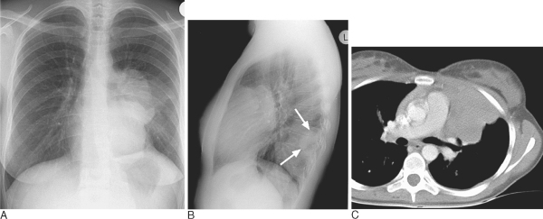
Notes:
Figure 14.5 Thymic enlargement on (A) PA and (B) lateral radiographs of a patient with a malignant thymic mass. The lateral view demonstrates pleural metastases posteriorly (arrows). (C) CT confirms the anterior position of the primary tumour suspected from the filling of the retrosternal window apparent on the lateral radiograph (B).

Slide 4
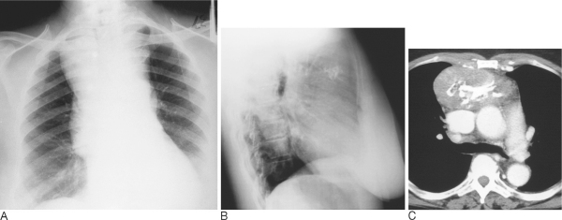
Notes:
Figure 14.7 Thymoma presenting on a chest radiograph obtained before orthopaedic surgery in an otherwise asymptomatic elderly female patient. There is a large anterior mediastinal mass (A) with coarse calcification visible on (B) the lateral view and (C) contrast-enhanced CT.

Slide 5
Notes:
Figure 14.8 Invasive thymoma in a young man. (A) Shows a lobular anterior mediastinal mass associated with a pleural effusion. (B) Image obtained through the lower chest demonstrates mixed soft tissue (arrows) and fluid attenuation owing to transpleural spread of tumour.

Slide 6
Notes:
Figure 14.9 Teratoma in a young man undergoing an immigration chest radiograph. (A) There are no specific features on the plain radiograph to indicate the nature of the mass. (B) CT demonstrates that the opacity visible on the chest radiograph is well defined and contains soft tissue and fat densities.

Slide 7
Notes:
Figure 14.10 Malignant germ-cell tumour in a 25 year old man presenting with chest pain, dyspnoea, malaise and features of pericardial tamponade. The CT shows a lobular asymmetrical mass with low attenuation areas corresponding to necrotic tumour intersected by neoplastic septation.

Slide 8
9-year-old boy . The two radiographs were taken 7 d apart.
Notes:
Figure 14.18 (A,B) Acute lymphocytic leukaemia in a 9-year-old boy showing rapid resolution of massive mediastinal adenopathy following chemotherapy. The two radiographs were taken 7 d apart.

Slide 9
Notes:
Figure 14.19 Oesophageal duplication cyst on (A) chest radiography and (B) CT. This case shows the typical features of a well-defined spherical mass projecting from the mediastinum

Slide 10
Notes:
Figure 14.20 Bronchogenic cyst. (A) Bronchogenic cyst in right paratracheal area in a young asymptomatic man. (B) In this instance the CT attenuation was almost the same as that of the other soft tissue structures and it was not possible to predict the cystic nature of the mass. The cyst was surgically removed.

Slide 11
Notes:
Figure 14.21 Neurofibrosarcoma showing widening and pressure deformity of adjacent ribs. It was not possible to predict the malignant nature of this tumour from the plain radiographs. A benign neurofibroma would have had identical features

Slide 12
Notes:
Figure 14.22 Neurofibroma in left paravertebral region. This coronal T1-weighted, spin-echo image demonstrates the tumour well and shows that it does not enter the spinal canal or encroach significantly on the adjacent foramina.

Slide 13
Notes:
Figure 14.23 Extramedullary haematopoiesis showing smooth pleurally-based masses and altered bone texture in this patient with thalassaemia. There is also a small right pleural effusion

Slide 14
Notes:
Figure 14.32 Complete absence of the pericardium. (A) PA radiograph. The heart is displaced into the left chest, obscuring the right heart border by the spine. The cardiac apex (arrow) is elevated, and air-filled lung is seen beneath it. (B) On lateral barium swallow, the increased density of the left ventricle surrounded by the air-filled lung (arrows) is apparent.

Slide 15
Notes:
Figure 14.33 Partial absence of the pericardium. Axial spin-echo MRI. (A) Image through the aortic valve and proximal ascending aorta (Ao). The heart is displaced into the left chest and rotated in a clockwise manner. (B) Image 1-cm cephalad through the pulmonary valve (PV). A sliver of lung (arrow) invaginates to come into contact with the ascending aorta. (C) Image 1-cm cephalad to the main (MP) and transverse right (RP) pulmonary arteries. The MP protrudes to the left and is in contact with the lung.

Slide 16
Notes:
Figure 14.34 Pericardial cyst. Axial spin-echo MRI at the base of the heart. (A) An intermediate signal intensity smooth mass extrinsic to the heart is identified (arrow). Ao = ascending aorta, LA = left atrium, PA = main pulmonary artery, S = superior vena cava. (B) Chest radiograph, lateral view. The smooth lobulated density superimposed on the cardiac silhouette (arrows) is a pericardial cyst.

Slide 17
Notes:
Figure 14.35 Pericardial effusion. (A) Small pericardial effusion is present in the anterior pericardial sac in a patient with advanced pulmonary artery hypertension. Note the dilated right-sided cardiac chambers. (B) Large haemopericardium complicating a type A aortic dissection. This is an unenhanced image and the haemopericardium is the same density as soft tissue structures (compare to A). (C) The dissection flap can be seen on this enhanced CT within the transverse arch.

Slide 18
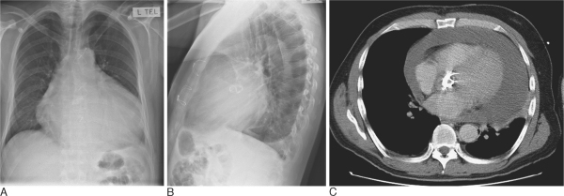
Notes:
Figure 14.36 Large pericardial effusion. (A) The heart had become rapidly enlarged in this patient who had previously undergone aortic valve replacement. (B) Lateral view demonstrates the pleural fluid lying posteriorly. (C) Unenhanced CT through the level of the valve replacement demonstrates the large pericardial effusion

Slide 19
Notes:
Figure 14.37 Dense pericardial calcification demonstrated on (A,B) chest radiograph (arrows) and (C) CT. There are bilateral pleural effusions in this patient with constrictive calcific pericarditis due to previous tuberculosis.

Slide 20
Notes:
Figure 13.1 Left mastectomy. The left hemithorax is more transradiant than the right.

Slide 21
Notes:
Figure 13.2 Invasive malignant T-cell lymphoma. (A) High-resolution chest wall ultrasound image through the intercostal space showing echoic cortical rib and consecutive echo void behind. Within the intercostal space hypo-echoic tumour tissue (arrowheads) is seen invading the posterior chest wall. (B) Same patient, transverse contrast-enhanced CT. Enhancing peripheral tumour tissue is widely invading the posterior chest wall. Exact definition of invasive tissue is impaired owing to low soft tissue contrast resolution in CT. (C) Same patient, sagittal T1-weighted MRI pre- (left) and post- (right) contrast medium nicely display the widespread invasion of the posterior chest wall by enhancing tumour tissue. There is already invasion of two ribs, including cortical rib destruction (arrowheads). The central nonenhancement of the tumour is due to necrosis

Slide 22
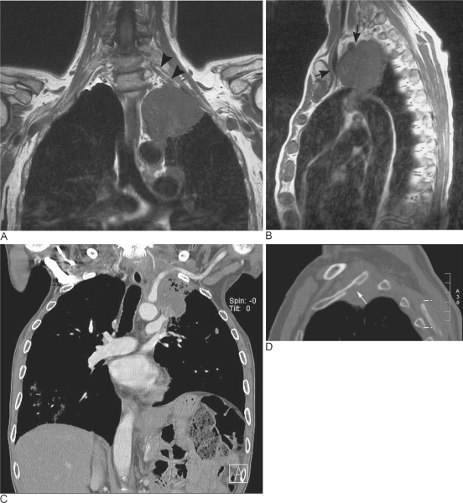
Notes:
Figure 13.3 Pancoast's tumour. (A,B) MRI. (A) Coronal and (B) sagittal image. Large tumour in the left upper lobe invading the soft tissues and displacing the vascular structures anteriorly (arrows). The brachial plexus has also been invaded (arrowheads). (C,D) CT (different patient). (C) Coronal and (D) sagittal image bone window setting. Large tumour in the left upper lobe invading the soft tissues, displacing and invading the left subclavian artery and invading a rib (arrow).

Slide 23
Notes:
Figure 13.4 Fibrous dysplasia in a rib; chest radiograph detail of the left lung. Compared with the other ribs the ninth rib shows an increase in density and is slightly broadened

Slide 24
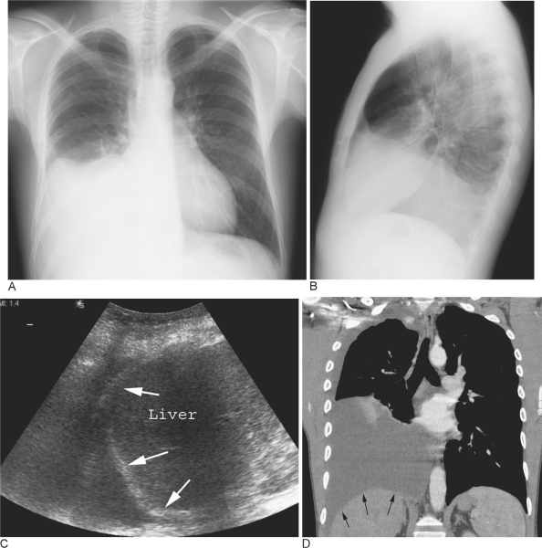
Notes:
Figure 13.20 Subpulmonary pleural effusion. On the (A) erect PA and (B) lateral radiograph the effusion simulates a high hemidiaphragm. (C) Ultrasound and (D) CT clearly show that the effusion is located above the diaphragm. Arrows = diaphragmatic area.

Slide 25
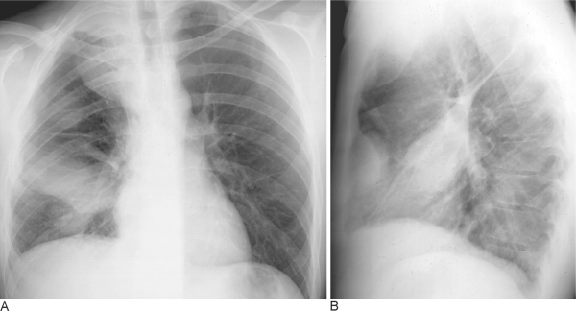
Notes:
Figure 13.8 Encapsulated fluid on (A) PA and (B) lateral chest radiographs. Pleural fluid is encapsulated in the major fissure and against the anterior chest wall. These encysted fluid collections can mimic a lung tumour.

Slide 26
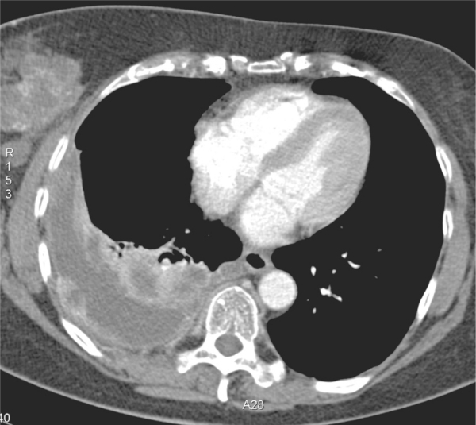
Notes:
Figure 13.10 CT of malignant pleural disease. In this right pleural effusion CT identifies the extensive and irregular pleural thickening characteristic of a malignant process (pleural metastases). Note also the primary tumour in the right breast.

Slide 27
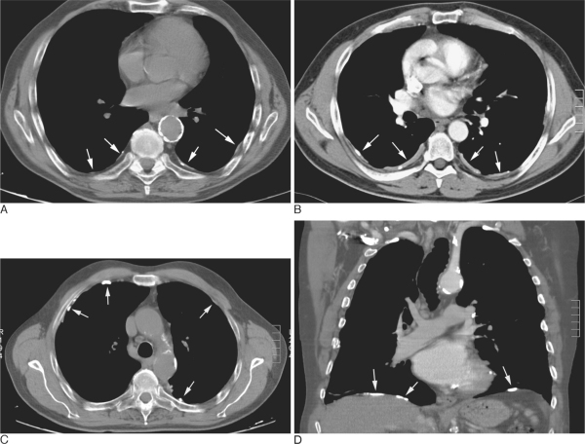
Notes:
Figure 13.15 (A–D) Pleural plaques caused by asbestos exposure. Pleural plaques are most commonly found along the lower thorax, on the diaphragmatic pleura and, when involvement is extensive, also along the lateral and anterior thorax (arrows). They can partially or completely calcify or ossify.

Slide 28
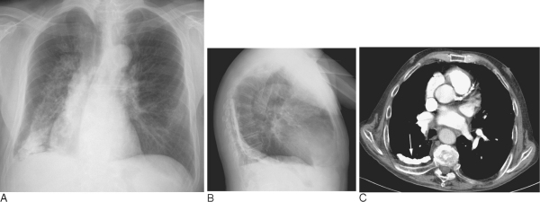
Notes:
Figure 13.16 Pleural calcification. (A,B) On the chest radiograph an extensive sheet-like calcification of the right pleura with additional pleural thickening (old tuberculous empyema) is seen. (C) CT demonstrates the extent and thickness of the pleural calcification (arrow).

Slide 29
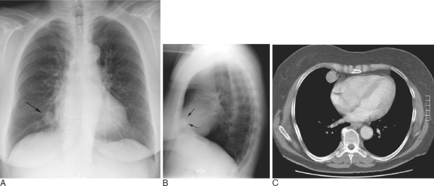
Notes:
Figure 13.17 Benign pleural fibroma. (A) Frontal and (B) lateral radiographs show a small well-demarcated, homogeneous, slightly lobulated mass (arrows). (C) CT shows that the mass is pleural based, sharply defined, and slightly enhancing.

Slide 30
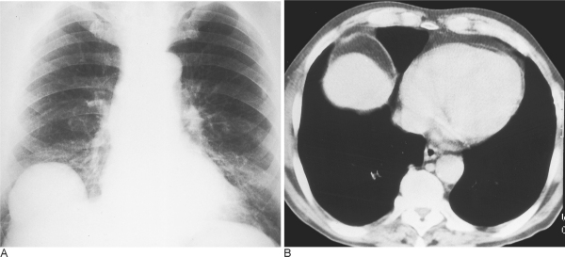
Notes:
Figure 13.21 Focal eventration. (A) PA chest radiograph reveals a soft tissue opacity arising from the diaphragm. (B) CT shows the presence of fat and liver under the elevated part of the diaphragm.

Slide 31
Notes:
Figure 13.22 Bochdalek hernia. (A) Lateral chest radiograph shows a focal bulge on the diaphragmatic contour just above the posterior costophrenic recess (arrows). (B) CT shows a fatty mass abutting the defect in the posteromedial aspect of the left hemidiaphragm (arrowheads).

Slide 32
(A) Normal anatomy as demonstrated on MRCP
Notes:
Figure 37.4 (A & B) MRCP of normal pancreas and pancreas divisum. (A) Normal anatomy as demonstrated on MRCP. (B) Dorsal pancreatic duct drains into the minor papilla. The common bile duct drains separately into the major papilla.

Slide 33
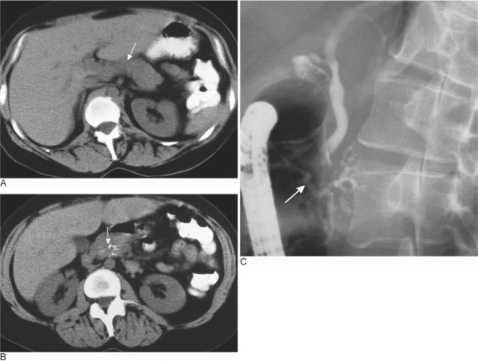
Notes:
Figure 37.5 Pancreatitis in pancreas divisum. (A) Normal unenhanced CT of the pancreatic body (white arrow). (B) Coarse calcification in the pancreatic head (white arrow). (C) ERCP showing pancreas divisum with a normal dorsal duct and abnormal separate ventral duct (white arrow) with dilatation and irregularity of side branches.

Slide 34
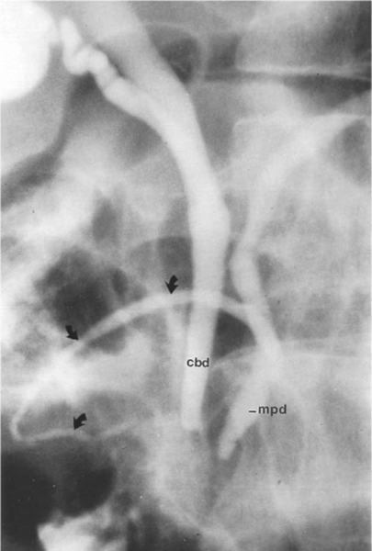
Notes:
Figure 37.6 Annular pancreas. ERCP shows the main pancreatic duct (mpd) with the accessory duct surrounding the duodenum (arrows). cbd = common bile duct.

Slide 35
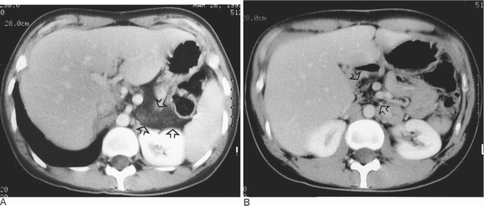
Notes:
Figure 37.7 (A & B) Cystic fibrosis. (A) CT through the level of the body and tail of the pancreas (arrows) shows fatty replacement of the gland. (B) CT at the level of the pancreatic head (arrows) shows almost complete replacement of the pancreas by fat. Only a few strands of enhancing pancreatic parenchyma are identified.

Slide 36
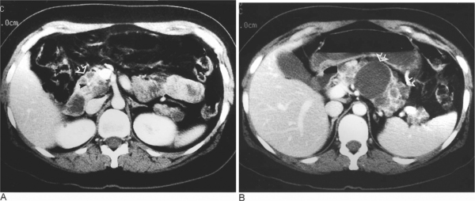
Notes:
Figure 37.8 (A & B) von Hippel–Lindau disease. (A) CT through the level of the head of the pancreas (open arrow) shows multiple small cysts and a central area of calcification (arrowhead) sited in a small serous cystadenoma. (B) Scan at the level of the body and tail of the pancreas (arrows) shows multiple cysts of different sizes. These were simple cysts, as distinct from the serous cystic neoplasm in the head of the pancreas.

Slide 37
Notes:
Figure 37.9 (A & B) Pancreatitis secondary to cholelithiasis. (A) Axial CT shows dilated CBD with contained calculus. (B) Reformatted image of dilated duct with stone.

Slide 38
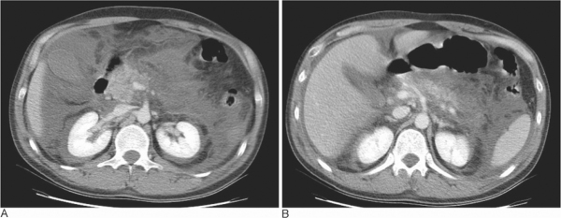
Notes:
Figure 37.12 (A & B) Acute necrotizing pancreatitis. (A) Dynamic CT shows enlargement of the pancreatic head, ascites and perirenal fluid collections. (B) Largely necrotic, nonenhancing body and tail of pancreas.

Slide 39
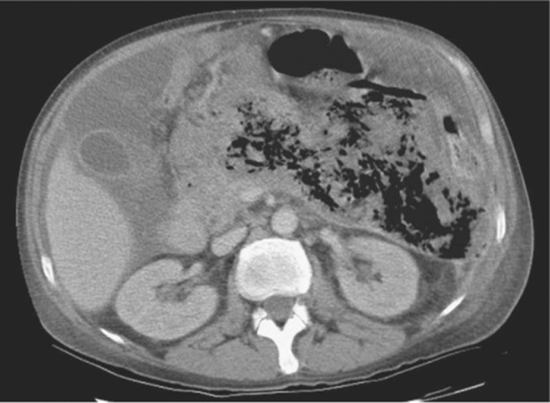
Notes:
Figure 37.13 Infected pancreatic necrosis. Dynamic CT shows nonenhancement of pancreatic tissue with secondary gas forming infection.

Slide 40
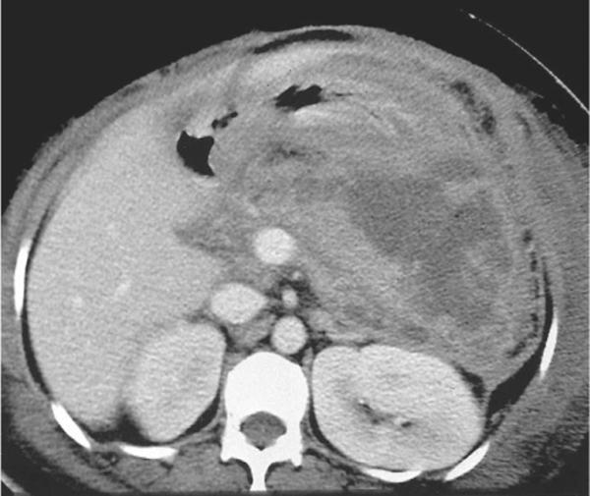
Notes:
Figure 37.15 Pancreatic abscess containing necrotic debris. The more solid necrotic tissue contained within the abscess will not be adequately drained by percutaneous catheter drainage. The collection was successfully drained surgically.

Slide 41
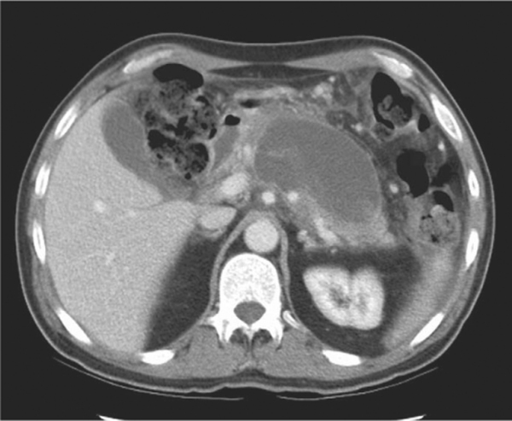
Notes:
Figure 37.16 Developing pancreatic pseudocyst. Three weeks after the onset of acute pancreatitis, a fluid collection persists. This is developing a thin capsule.

