Slide 1
SPOTS

Slide 2
Notes:
Figure 19.21 Sjögren's syndrome—lymphoid interstitial pneumonia and amyloid. There are numerous thin-walled cysts in association with multiple irregular solid nodules, some of which are heavily calcified. Histopathological examination showed marked thickening of the interstitium with an infiltrate of small, mature lymphocytes and plasma cells. Multiple deposits of amyloid were seen throughout the specimen and there was no evidence of malignancy.

Slide 3
Notes:
Figure 19.22 Scleroderma. (A,B) Two patients with scleroderma showing ground-glass opacification in association with traction bronchiectasis and a fine reticular pattern. The pattern of fibrosis is closest to that of non-specific interstitial pneumonia. Note the dilated oesophagus in both examples.

Slide 4
Notes:
Figure 19.24 Wegener's granulomatosis. Images through the (A) mid and (B) upper zones in a patient with Wegener's granulomatosis. Thick-walled cavitating mass in the left upper lobe (A). Note also the focal narrowing of the mid intrathoracic trachea (B) reflecting focal involvement by Wegener's granulomatosis.

Slide 5
Notes:
Figure 19.30 Progressive massive fibrosis in coalworker's pneumoconiosis. Mass-like opacities are seen bilaterally in the upper lobes in association with multiple small nodules and calcified mediastinal lymphadenopathy.

Slide 6
Notes:
Figure 19.31 Atelectasis. Two examples of rounded atelectasis in association with (A) pleural thickening and (B) a pleural effusion. In both cases, there is evidence of lobar volume loss as evidenced by displacement of fissures. The most common location of rounded atelectasis is in the lower lobes.

Slide 7
Notes:
Figure 19.32 Asbestosis. (A) HRCT features of early asbestosis include subpleural lines (arrowheads) and fine reticulation (arrows). These subtle abnormalities persisted on prone sections. (B) In more advanced disease, a coarse reticular pattern with honeycombing, often indistinguishable from usual interstitial pneumonia on HRCT, is seen. Note the calcified pleural plaques in both examples.

Slide 8
Notes:
Figure 18.1 Bronchial carcinoma in the left lower lobe showing typical rounded, slightly lobular configuration. The mass shows a notch posteriorly.

Slide 9
Notes:
Figure 18.3 (A) Squamous cell carcinoma resembling pneumonia. The entire opacity seen on this radiograph is due to the carcinoma itself. (B) Apical bronchiolo-alveolar cell carcinoma of the left upper lobe with ground-glass attenuation margins.

Slide 10
Notes:
Figure 18.4 Examples of neoplastic cavitation on chest radiography. (A) The cavity is eccentric (large cell undifferentiated carcinoma). (B) The inner wall of the cavity is irregular and an air–fluid level is present (squamous cell carcinoma). (C) The cavity wall is very thin (squamous cell carcinoma).

Slide 11
Notes:
Figure 18.5 CT showing cavitating squamous cell carcinoma. The wall of the cavity is variable in thickness

Slide 12
Notes:
Figure 18.6 Calcified infectious granuloma engulfed by lung cancer. CT shows a cluster of densely calcified small nodules almost at the centre of a small carcinoma.

Slide 13
Notes:
Figure 18.8 Lobe collapse. (A) Collapse of a lobe around a central mass. (B) The middle lobe has undergone collapse, but there is a central mass causing the central portion of both the oblique and horizontal fissures to bulge outwards (arrows).

Slide 14
Notes:
Figure 18.10 Dense hilum. The right hilum is dense owing to a mass superimposed directly over it. The mass proved to be a squamous cell carcinoma

Slide 15
Notes:
Figure 18.11 Massive mediastinal adenopathy in a patient with small (oat) cell carcinoma of the bronchus. The primary carcinoma is not visible because it lies centrally in the bronchial tree.

Slide 16
Notes:
Figure 18.12 Bronchiolo-alveolar carcinoma occupying the right lower lobe. The appearance is identical to consolidation with partial collapse. Air bronchograms are present.

Slide 17
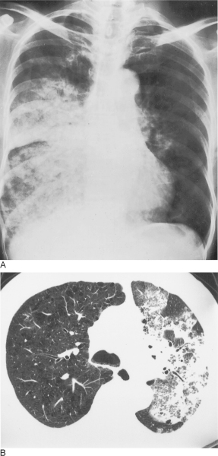
Notes:
Figure 18.13 Bronchiolo-alveolar carcinoma. (A) Bronchiolo-alveolar carcinoma with widespread lung involvement. The appearance closely resembles bronchopneumonia or pulmonary oedema. (B) CT of a similar case showing the typical airspace filling with an obvious air bronchogram.

Slide 18
Notes:
Figure 18.14 Bronchiolo-alveolar carcinoma. (A) Bronchiolo-alveolar carcinoma demonstrating lepidote growth in the left upper lobe. CT obtained during fine needle aspiration biopsy. (B,C) Biopsy-proven bronchiolo-alveolar cell carcinoma presenting as diffuse consolidation and ground-glass shadowing on chest radiography (B) and CT (C).

Slide 19
Notes:
Figure 18.25 Carcinoid tumour. (A) A small tumour is completely occluding the right main bronchus and causing extensive collapse in the right lung. The endoluminal component is well seen (arrows), but there is poor differentiation of the tumour from adjacent collapsed lung. (B) A well-defined perihilar carcinoid tumour (arrows) is demonstrated anterior to the artery to the right lower lobe. (C) On lung windows there is only a small band of atelectasis in the middle lobe. (D) A small peripheral carcinoid tumour indistinguishable from a number of other causes of a solitary pulmonary nodule.

Slide 20
Notes:
Figure 18.27 Primary pulmonary lymphoma. This appearance had been very slowly progressive over several years

Slide 21
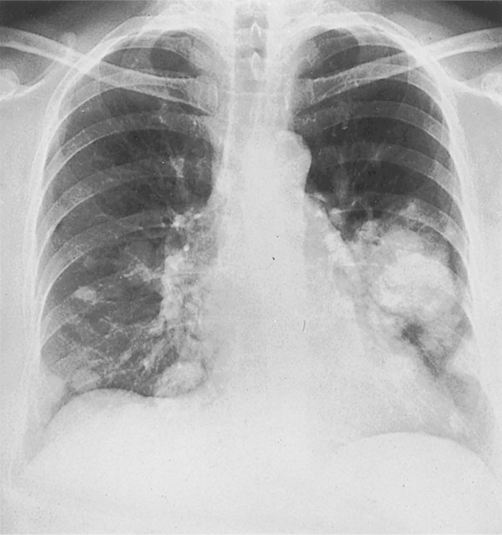
Notes:
Figure 18.28 Pulmonary involvement by lymphocytic lymphoma showing multiple pulmonary masses.

Slide 22
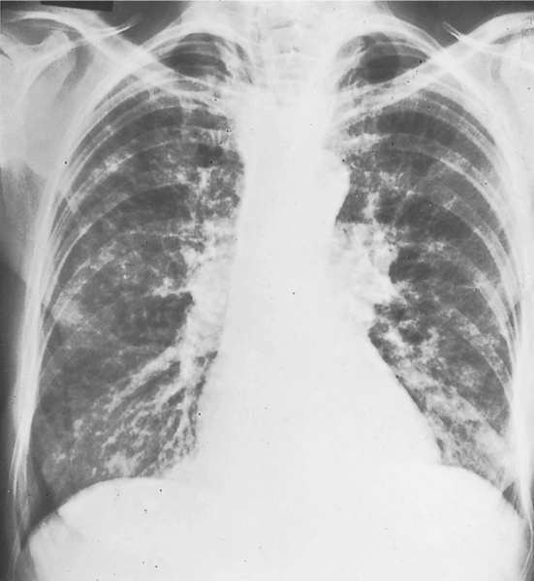
Notes:
Figure 18.29 Pulmonary involvement by non-Hodgkin's lymphoma showing an appearance closely resembling lymphangitis carcinomatosa with widespread nodules and thickened septal lines.

Slide 23
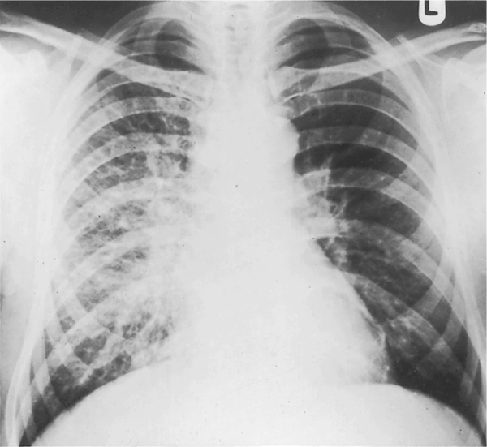
Notes:
Figure 18.33 Unilateral lymphangitic carcinomatosis due to carcinoma of the bronchus, showing thickened septal lines and nodules confined to the right lung.

Slide 24
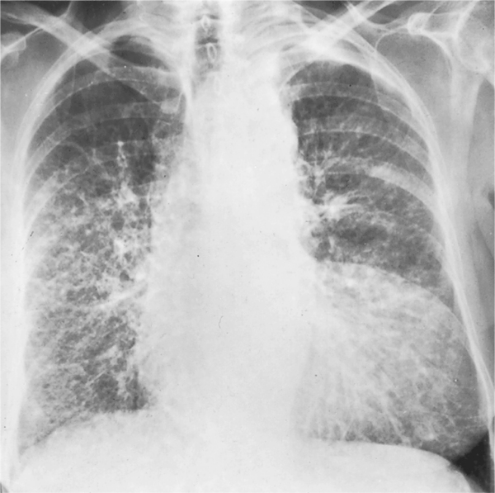
Notes:
Figure 18.34 Bilateral lymphangitic carcinomatosis showing bilateral thickened septal lines together with widespread nodulation of the lungs. The primary tumour in this 71 year old woman was presumed to be a bronchial carcinoma (a diagnosis based on sputum cytology).

Slide 25
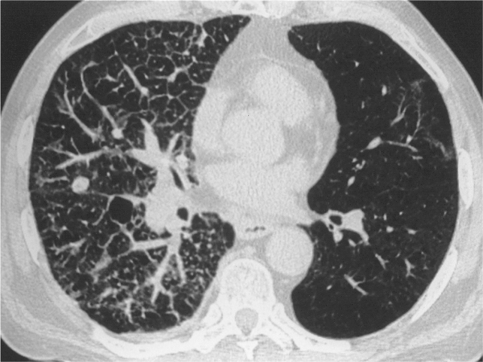
Notes:
Figure 18.35 High-resolution CT of lymphangitic carcinomatosis. Note the variable thickening of the interlobular septa and the enlargement of the bronchovascular bundle in the centre of the secondary pulmonary lobules. The polygonal shape of the walls (septa) of the secondary pulmonary lobules is particularly well shown anteriorly. The pulmonary nodule is due to a discrete metastasis, a relatively frequent finding in this condition.

Slide 26
Notes:
Figure 17.1 Total left lung collapse. (A) Frontal and (B) lateral chest radiographs. The cause of the collapse is a bronchogenic carcinoma; the endobronchial component is visible as an abrupt cut-off of the left main bronchus. Note the marked displacement of the right lung anteriorly and posteriorly across the midline (arrows). Note the marked anterior hyperlucency of the thorax on the lateral view (B).

Slide 27
Notes:
Figure 17.2 Total right lung collapse in a neonate. The patient was ventilated for respiratory distress syndrome and the cause of the total lung collapse was a mucus plug.

Slide 28
Notes:
Figure 17.3 Shifting granuloma sign. (A) Pre and (B) post right lower lobe collapse.

Slide 29
Notes:
Figure 17.4 Luftsichel sign. (A) A left upper lobe collapse demonstrating paramediastinal lucency (arrow). (B) CT shows interposition of aerated lung between the collapse and the mediastinum (arrow). There is also a large right paratracheal node causing some distortion of the SVC.

Slide 30
Notes:
Figure 17.5 Juxtaphrenic peak sign. A small triangular density (arrow) is seen in a left upper lobe collapse. The sign is due to reorientation of an inferior accessory fissure.

Slide 31
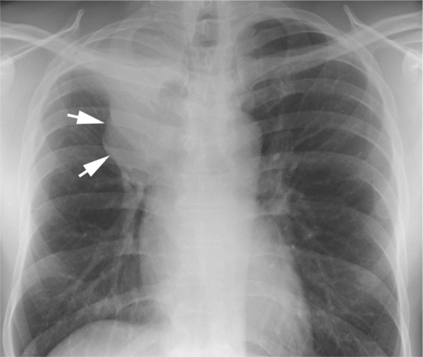
Notes:
Figure 17.6 Golden's S sign. A right upper lobe collapse demonstrating peripheral concavity and central convexity (arrows) due to an underlying bronchogenic carcinoma resulting in a reverse S shape.

Slide 32
Notes:
Figure 17.7 Air bronchograms in a collapsed and consolidated right lower lobe. The sign can be helpful in excluding a central obstructing mass and in this case the cause was a bacterial pneumonia.

Slide 33
Notes:
Figure 17.8 CT of a collapsed right upper lobe due to a squamous cell carcinoma. Note the peripheral air bronchograms (arrow) in (A) despite a central obstructing mass with amorphous calcification (B). There is a convex border of the collapsed lobe (arrows) (B) which is the CT equivalent of Golden's S sign.

Slide 34
Notes:
Figure 17.9 CT of right upper lobe collapse due to bronchogenic carcinoma. Note how the attenuation of the necrotic tumour is lower than the adjacent collapsed lung which enhances with intravenous contrast medium.

Slide 35
Notes:
Figure 17.10 Left lung collapse. (A, B) Contrast-enhanced CT sections of whole lung collapse due to a squamous cell carcinoma in the left main bronchus (arrow in A). There is also a left pleural effusion and a small pericardial effusion. Note the low-attenuation areas relative to the densely enhancing left lower lobe parenchyma (B) which represent mucus-filled airways—the CT mucous bronchogram sign.

Slide 36
Notes:
Figure 17.11 Left lower lobe collapse. Contrast-enhanced CT showing a tight left lower lobe collapse. Normal mediastinal structures (particularly left-sided) may cause a focal bulge in the contour of a lobar collapse (in this case by the well opacified descending thoracic aorta) and should not be confused with a Golden's S sign due to tumour.

Slide 37
Notes:
Figure 17.12 Resolution of left lower lobe collapse. (A) An initial high-resolution CT of a young female patient with symptoms of recurrent respiratory tract infections shows a collapsed left lower lobe with possible bronchiectatic airways, raising the possibility of chronicity. (B) Follow-up conventional CT at the same level several months later shows complete resolution of the left lower lobe collapse and normal airways. This case illustrates the difficulty in making an accurate assessment of the airways in patients with lobar collapse.

Slide 38
Notes:
Figure 17.13 Right upper lobe collapse. Typical example of a collapsed right upper lobe demonstrating the slightly concave inferior border of the opacified lung due to the horizontal fissure.

Slide 39
Notes:
Figure 17.14 Right upper lobe collapse. An example of right upper lobe collapse mimicking an apical cap of fluid (arrow).

Slide 40
Notes:
Figure 17.15 Tight right upper lobe collapse. Note how the collapsed lobe (due to a central bronchogenic carcinoma) results in increased right paramediastinal density.

Slide 41
Notes:
Figure 17.16 CT of right upper lobe collapse. The collapsed lobe forms a triangular wedge of soft tissue anteriorly in the right hemithorax.

