Slide 1
SPOTS

Slide 2
Notes:
Figure 21.1 Pneumonia. Chest radiograph in a young male patient. The presence of focal (cavitating) consolidation in a patient with pyrexia and a productive cough should prompt a radiological diagnosis of pneumonia.

Slide 3
Notes:
Figure 21.2 (Noninfective) organizing pneumonia in a patient following allogeneic bone marrow transplantation. (A) Chest radiograph and (B) CT through the lower zones demonstrating characteristic bilateral mid and lower zone airspace opacification.

Slide 4
Serial chest radiographs over roughly a 48-h period
Notes:
Figure 21.3 (A–C) Rapid changes in radiographic appearances in pulmonary oedema. Serial chest radiographs over roughly a 48-h period show striking changes in the extent/severity of airspace opacification reflecting relatively rapid shifts of fluid between the intravascular compartment and the airspaces/interstitium.

Slide 5
Notes:
Figure 21.4 Nodular airspace opacities on chest radiography. Targetted image of the right lung showing numerous ill-defined nodules in a patient with disseminated pulmonary tubercul

Slide 6
Notes:
Figure 21.5 Ground-glass opacification on (A) chest radiography and (B) CT in a patient with pulmonary cytomegalovirus reactivation following bone marrow transplantation. On plain chest radiography there is veil-like opacification in the mid and lower zones of both lungs, which obscures vessel markings. In comparison, on CT, bronchovascular markings are clearly visible within regions of increased opacification.

Slide 7
Notes:
Figure 21.6 Variable causes of ground-glass opacification on CT due to airspace and/or interstitial processes. (A) Diffuse pulmonary haemorrhage in a patient with disseminated malignancy. (B) Ground-glass opacification and thickened inter- and intra-lobular septa in pulmonary oedema. (C) Ground-glass opacification due to a predominant interstitial lung disease; there are grossly dilated segmental and subsegmental airways (‘traction bronchiectasis’) within ground-glass indicating fine fibrosis.

Slide 8
Notes:
Figure 21.7 ‘Black bronchus’ sign on CT: there is an almost imperceptible increase in lung density. However, air within the segmental bronchi is clearly of lower attenuation than the surrounding parenchyma.

Slide 9
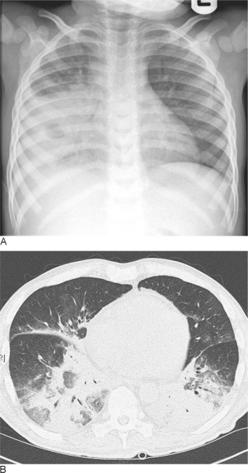
Notes:
Figure 21.8 (A) Consolidation on plain chest radiography in a patient with proven tuberculosis; there is evidence of cavitation within the area of consolidation. (B) Consolidation on CT in a patient with adenovirus infection following allogeneic bone marrow transplantation. In both cases, there is obscuration of bronchovascular markings by areas of dense parenchymal opacification.

Slide 10
Notes:
Figure 21.10 (A) Normal appearance of segmental bronchus seen ‘end-on’ (arrow) adjacent to its accompanying pulmonary artery branch. The wall of the bronchus is well defined and thin. (B) Peribronchial cuffing. The wall of the anterior segmental bronchus appears thickened and ill-defined (arrows) in early interstitial oedema due to (iatrogenic) fluid overload.

Slide 11
Notes:
Figure 21.12 Pulmonary oedema on chest radiography demonstrating the characteristic ‘bat's wing’ distribution, with airspace opacification principally within the central lung.

Slide 12
Notes:
Figure 21.15 Pulmonary oedema on CT. There is diffuse ground-glass opacification, smooth thickening of multiple interlobular septa and peribronchovascular cuffing. Bilateral pleural effusions are also seen.

Slide 13
Notes:
Figure 21.16 (A–C) Chest radiographs and (D) HRCT in a patient with idiopathic pulmonary haemosiderosis. (A) There is diffuse ground-glass opacification with no zonal predilection during an acute hospital admission with haemoptysis. (B) Radiograph taken 4 d later shows striking (but incomplete) resolution of airspace opacities. There is residual opacification around the right hilum. (C) Chest radiograph obtained 1 month following admission demonstrates ground-glass opacification in the right mid zone. (D) HRCT through the lower zones (concurrent with the radiograph in [A]) shows patchy ground-glass opacification with a somewhat unusual geographical distribution; there are thickened interlobular septa in areas of ground-glass opacification.

Slide 14
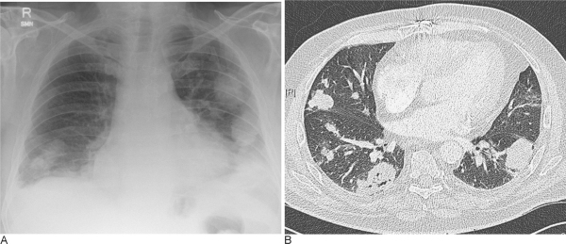
Notes:
Figure 21.17 Wegener's granulomatosis. (A) Multiple intrapulmonary nodules within both lungs on chest radiography in a patient with elevated c-ANCA titres. (B) CT through the lower zones also demonstrates multiple pulmonary nodules. However, there is clear evidence of cavitation (not seen on the chest radiograph) in one of the lesions in the right lower lobe.

Slide 15
Notes:
Figure 21.20 Cryptogenic organizing pneumonia. (A) Patchy multifocal consolidation in the mid and upper zones in a patient presenting with a cough, breathlessness and weight loss. (B) One month after commencing corticosteroids there is complete clearing of the airspace opacities. (C) Five months after stopping treatment there is recurrence with consolidation in the right mid zone.

Slide 16
Notes:
Figure 21.21 Cryptogenic organizing pneumonia (COP). CT through the (A) apex, (B) carina and (C) lower lobes in COP. Multifocal consolidation and ground-glass opacification are seen, predominantly in the peripheral lung. Note that all lung zones are affected.

Slide 17
Notes:
Figure 21.22 Cryptogenic organzing pneumonia in a young female patient. CT at (A) the level of the carina and (B) the lung bases demonstrating an arcade-like appearance due to perilobular curvilinear opacities.

Slide 18
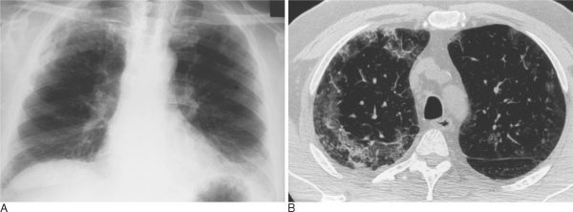
Notes:
Figure 21.23 Chronic eosinophilic pneumonia. (A) Chest radiograph in a male patient with a dry cough, weight loss and marked blood eosinophilia. There is ill-defined airspace opacification in both upper zones and the changes appear to parallel the chest wall. (B) HRCT through the upper lobes with bilateral (but asymmetrical) areas of ground-glass opacification and a fine reticular component in a peripheral distribution.

Slide 19
Notes:
Figure 21.24 Alveolar proteinosis. Chest radiograph in a 28 year old woman with alveolar proteinosis. There is bilateral symmetrical airspace opacification in the mid and lower zones with a predilection for the central lung, an appearance which can simulate the ‘bat's wing’ appearance of pulmonary oedema.

Slide 20
Notes:
Figure 21.25 HRCT of the ‘crazy paving’ pattern in alveolar proteinosis: patchy but geographical ground-glass opacification is seen and there are numerous thickened interlobular septa in areas of ground-glass opacification.

Slide 21
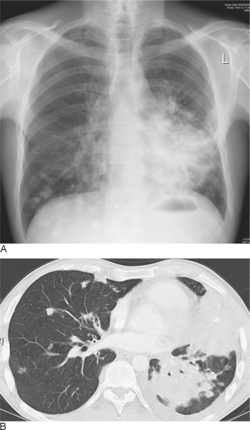
Notes:
Figure 21.26 Primary pulmonary lymphoma. (A) Chest radiograph and (B) CT through the lower zones in a patient with pulmonary non-Hodgkin's lymphoma. There are bilateral foci of consolidation; the bronchocentric nature of the disease can be easily appreciated on CT

Slide 22
Notes:
Figure 20.1 Blunt trauma. CT image following blunt trauma to the right side of the chest demonstrating a rib fracture with associated extrapleural haematoma (arrowhead).

Slide 23
Notes:
Figure 20.2 Flail chest. Chest radiograph with multiple left-sided lateral and posterior rib fractures resulting in a flail chest. There is associated left lung contusion.

Slide 24
Notes:
Figure 20.3 Flail chest. CT image of a left-sided flail chest with a segment of the chest wall pushed inwards. This is known as a ‘stove-in-chest’.

Slide 25
Notes:
Figure 20.9 Pulmonary contusion. (A) CT image in the axial plane and (B) coronal reformatted image illustrating bilateral post-traumatic pulmonary contusion. Note the subpleural predominance of the contusion.

Slide 26
Notes:
Figure 20.16 Fallen lung sign. Chest radiograph in a patient injured in a farming accident. The right lung is seen sagging to the floor of the right hemithorax (the ‘fallen lung sign’) and a completely ruptured right main bronchus was found at surgery.

Slide 27
Notes:
Figure 20.17 Aortic rupture and mediastinal haematoma. Chest radiograph in a patient with a post-traumatic aortic rupture and mediastinal haematoma. Features present include a widened mediastinum, filling in of the aortopulmonary bay and the development of a left apical pleural cap.

Slide 28
Notes:
Figure 20.22 Acute respiratory distress syndrome (ARDS). CT images in two patients. (A) This patient's ARDS was due to an extrapulmonary cause and the CT shows increased opacification in the posterior, dependent portions of the lungs and ground-glass opacity more anteriorly. A right-sided intercostal tube is also present and part of a Swan–Ganz catheter can be seen in the left main pulmonary artery. (B) This patient's ARDS was related to pulmonary infection and there is patchy airspace opacity present with no gradation from dependent to nondependent lung being seen.

Slide 29
Notes:
Figure 19.1 Usual interstitial pneumonia. HRCT abnormalities predominate in the posterior, subpleural regions of the lower lobes and comprise honeycombing and traction bronchiectasis within the abnormal lung.

Slide 30
Notes:
Figure 19.2 Usual interstitial pneumonia. In the upper lobes anteriorly there are peripheral irregular lines with areas of honeycombing.

Slide 31
Notes:
Figure 19.4 Tuberculosis on a background of usual interstitial pneumonia. Biopsy of the area of consolidation in the right lower lobe confirmed tuberculosis.

Slide 32
Notes:
Figure 19.5 Non-specific interstitial pneumonia. The predominant abnormality is patchy, bilateral ground-glass opacification, mild reticulation and traction bronchiectasis. There is no frank honeycombing destruction

Slide 33
Notes:
Figure 19.6 Cryptogenic organizing pneumonia. HRCT through the upper lobes demonstrates areas of consolidation in a subpleural and peribronchial distribution in association with areas of ground-glass opacification (left upper lobe).

Slide 34
Notes:
Figure 19.8 Respiratory bronchiolitis–interstitial lung disease. HRCT shows (A) subtle areas of ground-glass opacification and (B) ill-defined centrilobular nodul

Slide 35
Notes:
Figure 19.12 Sarcoidosis. Typical HRCT features are (A) nodular opacities which (B) may become confluent, and (C) interlobular septal thickening.

Slide 36
Notes:
Figure 19.13 Fibrotic sarcoidosis. There are areas of conglomerate fibrosis in a perihilar distribution with associated bronchial distortion and volume loss. The appearances superficially mimic progressive massive fibrosis seen in the pneumoconioses

Slide 37
Notes:
Figure 19.15 Hypersensitivity pneumonitis. (A) Inspiratory image shows patchy density differences reflecting both the interstitial infiltrate of subacute hypersensitivity pneumonitis and coexisting small airways disease. (B) End-expiratory image enhances the density differences revealing several secondary pulmonary lobules of decreased attenuation

Slide 38
Notes:
Figure 19.17 Langerhans cell histiocytosis. (A) Shows the characteristic combination of thin-walled cysts and poorly defined nodules, some of which are just beginning to cavitate. (B) Image from a patient with more advanced disease. There are numerous irregularly-shaped cysts bilaterally and a pneumothorax on the right.

Slide 39
Notes:
Figure 19.18 Lymphangioleiomyomatosis. (A) There is a profusion of thin-walled cystic airspaces scattered evenly throughout the lungs. The cysts are relatively uniform in size. (B) In a more advanced case of LAM, note the small left-sided pleural effusion.

Slide 40
Notes:
Figure 19.19 Rheumatoid arthritis with a usual interstitial pneumonia (UIP)-type pattern. In this case the HRCT appearances of peripheral reticular abnormality and honeycombing are indistinguishable from that of UIP.

Slide 41
Notes:
Figure 19.20 Rheumatoid arthritis. HRCT demonstrates both mild cylindrical bronchiectasis and constrictive obliterative bronchiolitis (reflected by areas of low attenuation in which there is a reduction in the number of vessels present) in this patient with rheumatoid arthritis.

