Slide 1
SPOTS

Slide 2
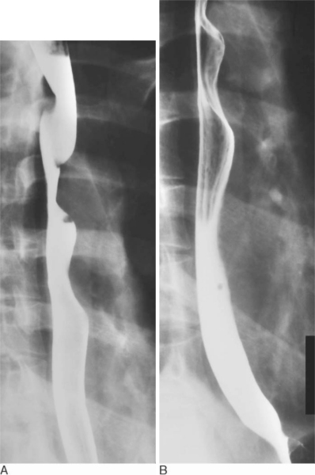
Notes:
Figure 27.7 (A,B) Barium swallow in a child with a vascular ring. Note the constant posterior impressions on the oesophagus

Slide 3
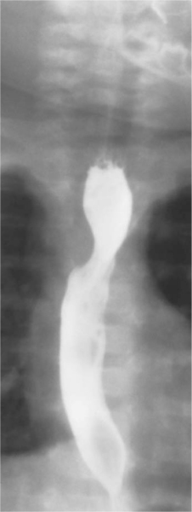
Notes:
Figure 27.8 Barium swallow in a child with a double aortic arch. Note the constant impressions on either side of the oesophagus.

Slide 4
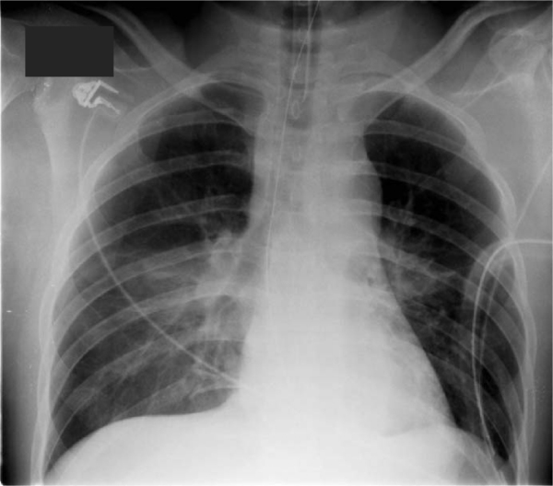
Notes:
Figure 27.13 Supine chest radiograph of a patient involved in a road traffic accident demonstrates signs of traumatic aortic injury. There is widening of the superior mediastinum (M/C ratio approximately 3). The right paratracheal stripe is widened and there is deviation of the trachea and the nasogastric tube to the right of the midline. The contour of the aortic knuckle is enlarged and partially obscured by mediastinal haematoma.

Slide 5
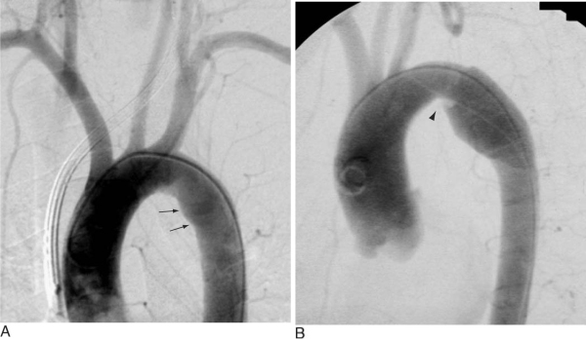
Notes:
Figure 27.15 Aortograms of two patients demonstrating the difference between (A) a normal ductus diverticulum and (B) a traumatic pseudoaneurysm. The ductus diverticulum has a smooth symmetrical contour with obtuse margins at its junction with the ‘normal’ aorta (arrows). In comparison the pseudoaneurysm is asymmetric and has an acute proximal margin with the normal aorta (arrowhead).

Slide 6
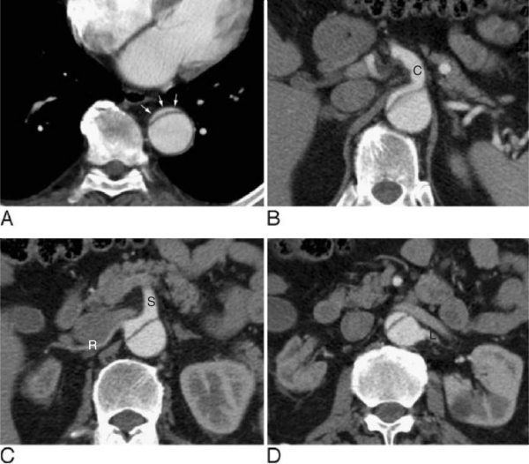
Notes:
Figure 27.21 Acute type B dissection in a patient presenting with mesenteric ischaemia. There is true lumen collapse in the descending thoracic aorta (A); the true lumen is seen as an opacified crescent anteriorly (arrows). The coeliac axis (B) and superior mesenteric/right renal arteries (C) arise from the true lumen and are thus compromised. The left renal artery arising from the false lumen (D) allows normal perfusion to the left kidney. C = coeliac axis, L = left renal artery, R = right renal artery, S = superior mesenteric artery.

Slide 7
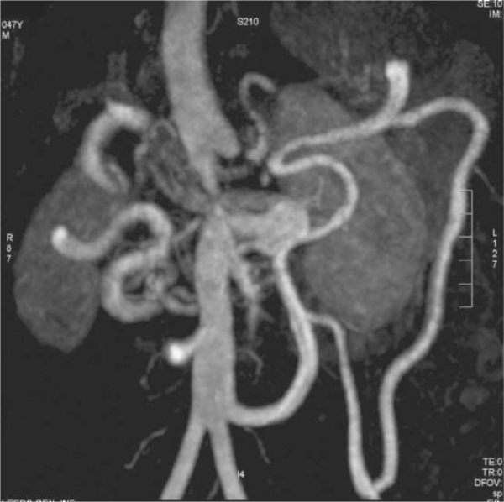
Notes:
Figure 27.26 A 47 year old man presenting with acute pulmonary oedema and uncontrolled hypertension. A contrast-enhanced MRA confirms mid aortic syndrome with focal occlusion of the juxtarenal aorta. The distal aorta is perfused by the mesenteric arteries. There is a grossly hypertrophied inferior mesenteric artery together with hypertrophied marginal artery and arc of Riolan. The source images (not shown) demonstrated a high grade right renal artery stenosis but normal left renal and superior mesenteric arteries. Axial FISP images (not shown) confirmed a thickened aortic wall at the level of the occlusion consistent with Takayasu's disease

Slide 8
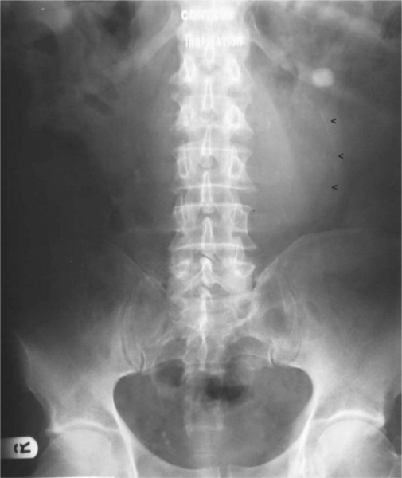
Notes:
Figure 27.30 Control image from intravenous urogram requested because of left renal colic. Curvilinear calcification (arrowheads) is consistent with a significant size calcified abdominal aortic aneurysm.

Slide 9
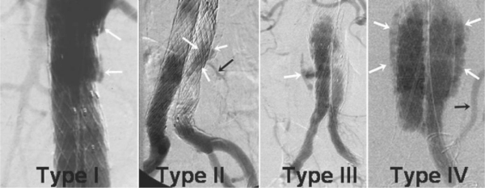
Notes:
Figure 27.33 Four types of endoleak are identified which can complicate the exclusion of an aneurysm by stent graft. Type I is the most dangerous and is due to failure to obtain a seal either proximally or distally. This should not be left and is usually solved with a moulding balloon and/or a cuff. Type II is caused by retrograde flow into the sac from lumbar or inferior mesenteric arteries. Mostly these resolve themselves but if they do not and the sac continues to enlarge they have to be embolized retrogradely. Type III is due to a failure of the stent graft material. This can be due to a manufacturing problem or long-term wear and tear and changes in aneurysm morphology causing holes in the graft or dislocations of modular components. They can be fixed either by repeat stent grafting or open surgery. Type IV is unimportant and rarely occurs now. It was due to graft porosity. The term endotension (Type V) is applied where there is sac expansion in the absence of a recognizable Type I to IV endoleak.

Slide 10
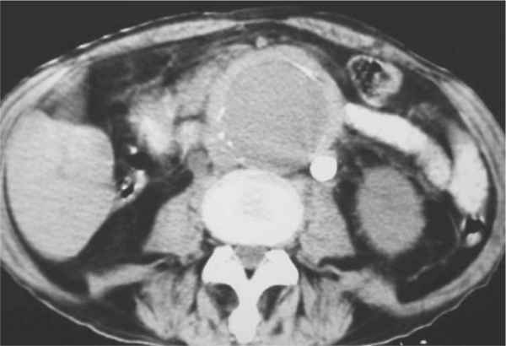
Notes:
Figure 27.34 Contrast-enhanced CT demonstrates a significant sized abdominal aortic aneurysm with a thick well-defined outer wall. There is hydroureter on the left and a hydroureter with a nonfunctioning kidney on the right. These features are typical of inflammatory abdominal aortic aneurysm.

Slide 11
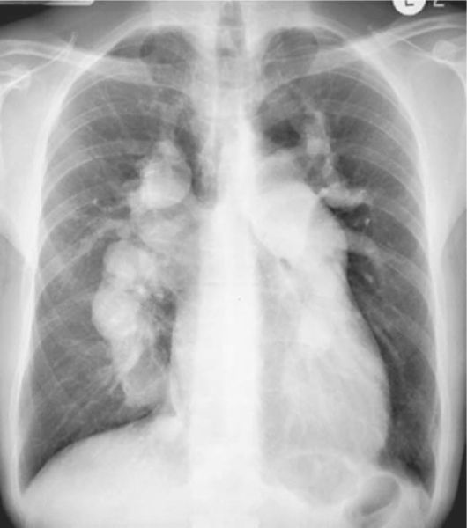
Notes:
Figure 26.5 Pulmonary arterial hypertension. Chest radiograph demonstrates gross dilatation of the main, left and right pulmonary arteries in a patient with Eisenmenger atrial septal defect.

Slide 12
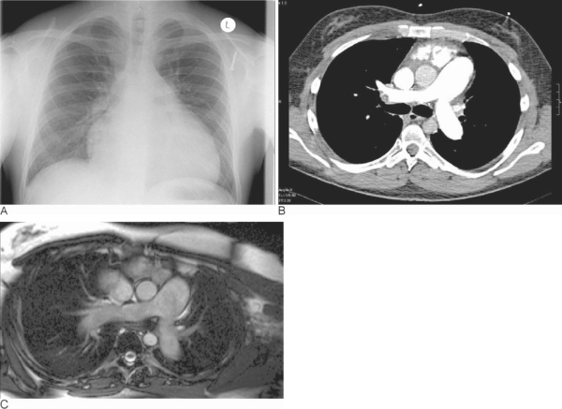
Notes:
Figure 26.6 Pulmonary arterial hypertension. (A) Chest radiograph demonstrating cardiomegaly and enlargement of central pulmonary arteries. (B) CT section demonstrating an enlarged main pulmonary artery when compared to the ascending aorta. (C) MR angiogram showing the enlarged main pulmonary artery. This series of images shows the relative ease with which even minor degrees of pulmonary artery dilation (inferring raised arterial pressures in the pulmonary system) can be detected on cross-sectional imaging. This may not have been adequately recognized on chest radiography alone

Slide 13
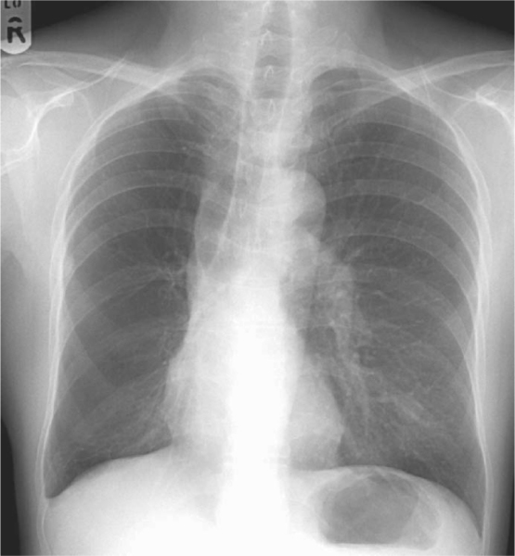
Notes:
Figure 26.10 Uneven vascularity. In a patient with Macleod's syndrome a hypoplastic right main pulmonary artery leading to a reduction in vascular markings and a small right hemithorax are seen

Slide 14
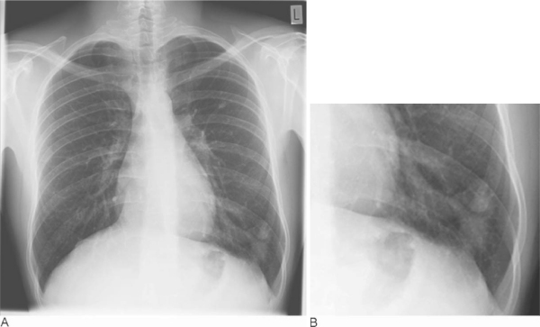
Notes:
Figure 26.11 Pulmonary arteriovenous malformation. (A) Plain chest radiograph shows a band-like opacity leading to a nodular opacity in the left lower lobe. (B) close-up of (A).

Slide 15
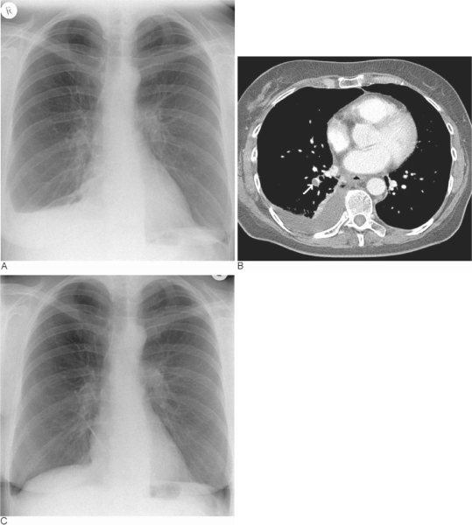
Notes:
Figure 26.14 Pulmonary thromboembolism. (A) Chest radiograph demonstrating a moderate right pleural effusion on the day of symptom onset. (B) CT image taken 2d after symptom onset reveals a filling defect (representing thrombus) in the right lower lobe pulmonary artery. (C) Further chest radiograph taken 10d after (A) with the patient on anticoagulant therapy reveals resolution of the previous effusion. As a sequelae, a thin band of atelectasis is seen in the right lower zone.

Slide 16
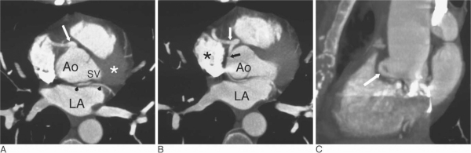
Notes:
Figure 25.19 Anomalous origin of stenosed left coronary artery. (A) Axial maximum intensity projection (MIP) reconstruction from ECG-gated MDCTA shows an abnormally large origin to the right coronary artery (RCA) which arises directly anteriorly (arrow) and the course of an anomalous left main coronary artery (LMCA, arrowheads) running between the left atrium (LA) and the aortic root (Ao). There is no left coronary artery in the normally expected area (asterisk) adjacent to the left sinus of Valsalva (SV). (B) Axial MIP reconstruction from ECG-gated MDCTA immediately inferior to (A) shows an abnormal bifurcation (white arrow) of the RCA giving off the anomalous LMCA (black arrow) running between the left atrium (LA) and the aortic root (Ao). Note the effect of the beam hardening effect from dense contrast medium in the right atrium (asterisk) obscuring part of the proximal LMCA. In most cases this anomaly has a benign prognosis. In this case an atherosclerotic stenosis (black arrow) has developed causing symptoms. (C) Sagittal MIP reconstruction from ECG-gated MDCTA showing the curve of the anomalous LMCA (arrow) as it passes under the right sinus of Valsalva.

Slide 17
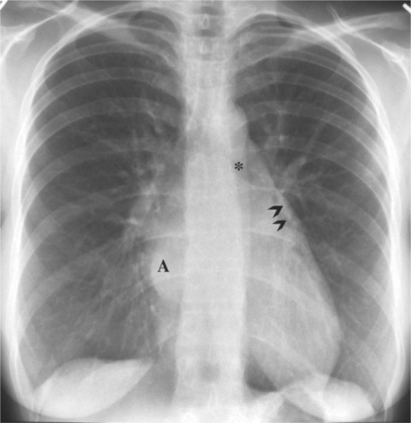
Notes:
Figure 24.1 Classical appearance of rheumatic mitral stenosis. PA view of the chest. The heart size is normal. The enlarged left atrium (A) displaces the left bronchus upwards (asterisk) and creates a right retrocardiac double density. The left atrial appendage is enlarged (arrowheads). There is severe pulmonary venous hypertension.

Slide 18
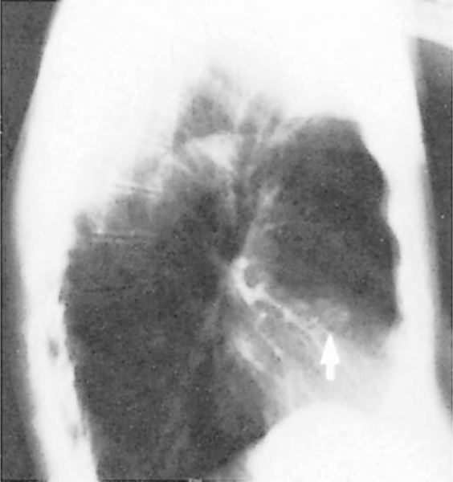
Notes:
Figure 24.2 Aortic valve calcification. Lateral chest radiograph shows several calcifications in the aortic valve (arrow).

Slide 19
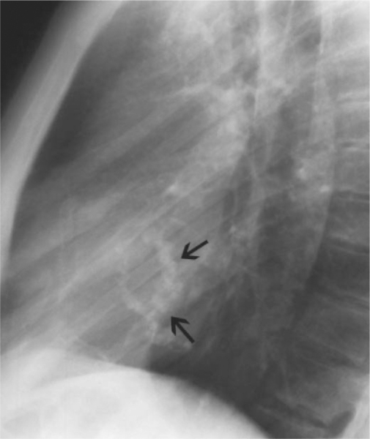
Notes:
Figure 24.3 Lateral view of chest shows C-shaped dense calcification of the mitral annulus (arrows).

Slide 20
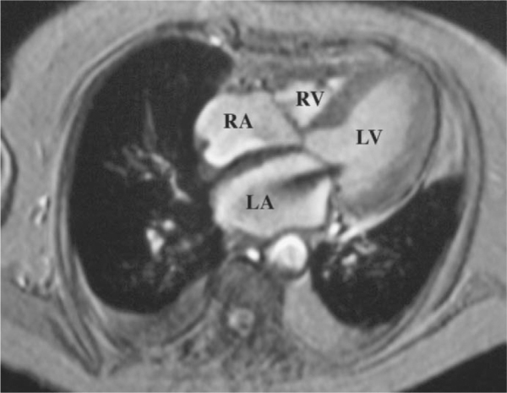
Notes:
Figure 24.8 Mitral regurgitation. Axial gradient-echo systolic MRI shows a jet-like signal void in the left atrium due to moderate mitral regurgitation. LA = Left atrium, LV = left ventricle, RA = right atrium, RV = right ventricle.

Slide 21
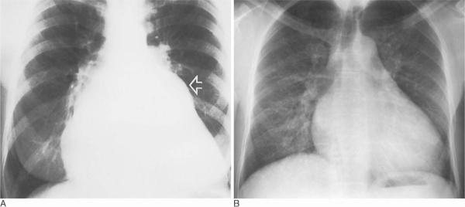
Notes:
Figure 24.10 (A) Severe mitral valve disease. The left atrial appendage is large, producing a convex bulge (arrow). The heart is considerably enlarged. (B) Pulmonary haemosiderosis in mitral stenosis. Long-standing severe mitral stenosis. The heart and left atrium are enlarged. Bilateral nodular interstitial prominence is due to pulmonary haemosiderosis

Slide 22
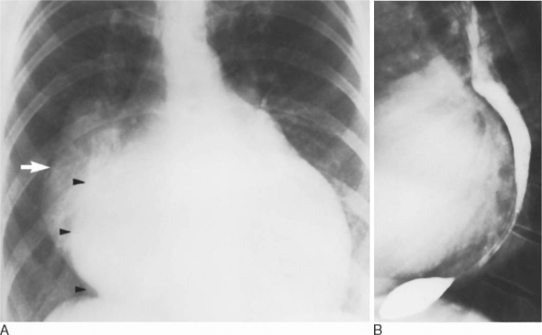
Notes:
Figure 24.11 Severe mitral valve disease. (A) The left atrium (white arrow) has enlarged to the right, protruding well beyond the border of the right atrium (black arrowheads). (B) It is also enlarged posteriorly, displacing the barium-filled oesophagus (and the left bronchus) posteriorly. The left atrial appendage is not grossly enlarged.

Slide 23
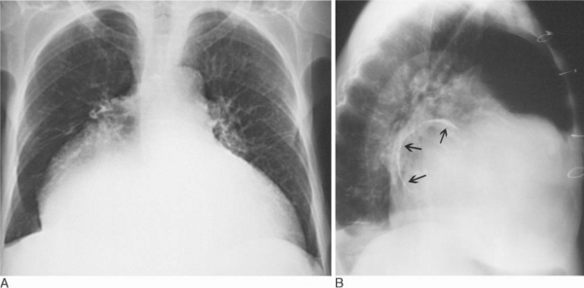
Notes:
Figure 24.12 Mitral stenosis and regurgitation following mitral commissurotomy. (A) PA and (B) lateral views of the chest. There is massive left atrial dilatation and partly calcified mural thrombus in the dilated left atrium (arrows in B). Note the left thoracotomy.

Slide 24
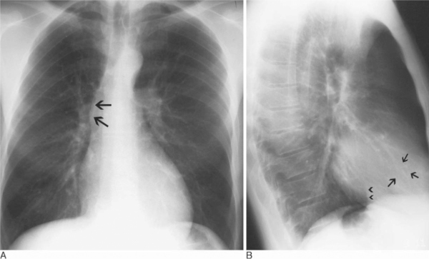
Notes:
Figure 24.17 Aortic valve calcification. (A) PA and (B) lateral views of chest. A 45 year old male with calcific stenosis of bicuspid aortic valve. There is prominence of the ascending aorta in the PA view (arrows). In the lateral view, left ventricular hypertrophy is identified by the positive Rigler sign. Arrows = Calcified aortic valve, arrowheads = outline of inferior vena cava.

Slide 25
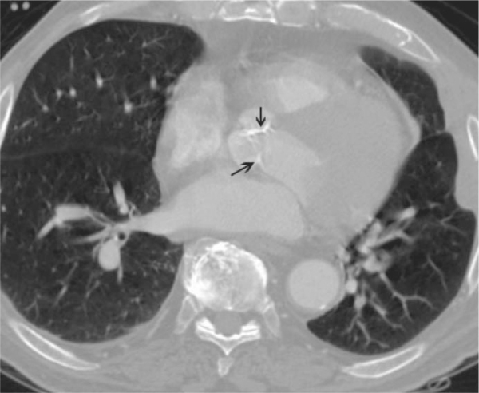
Notes:
Figure 24.19 Aortic valve calcification. Axial CT at aortic valve level shows calcification of the aortic leaflets (arrows).

Slide 26
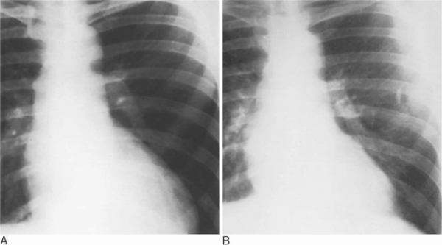
Notes:
Figure 24.23 Chest radiographs in pure aortic regurgitation. (A) Pre-operative radiograph. There is marked left ventricular enlargement. The aorta is slightly prominent but there is no post-stenotic dilatation. (B) Radiograph 8 years later after aortic valve replacement. There has been a marked reduction in the heart size.

Slide 27
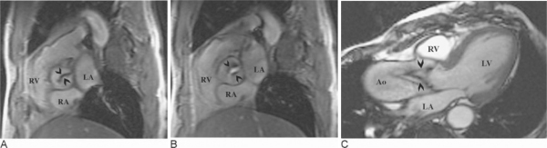
Notes:
Figure 24.24 Calcified, stenotic bicuspid aortic valve. CMR, aortic valve view in (A) diastole and (B) systole. The calcified leaflets result in a signal void in diastolic frame (arrowheads). In systole the signal outlines the small opening of the stenotic valve orifice. (C) Left ventricular outflow tract view shows signal loss in the ascending aorta due to aortic stenosis. Note the doming of the aortic valve (arrowheads) and dilated ascending aorta (Ao). LA = Left atrium, RA = right atrium, RV = right ventricle. Compare to Fig. 24.21 .

Slide 28
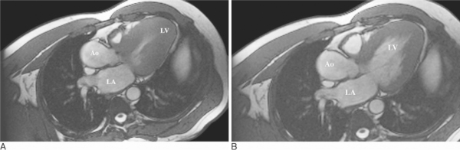
Notes:
Figure 24.43 Hypertrophic cardiomyopathy. CMR, left ventricular outflow tract view of (A) systolic and (B) diastolic phases show massive hypertrophy of the left ventricle, with near complete obliteration of the left ventricle (LV) cavity in systole (A). Ao = Ascending aorta, LA = left atrium.

Slide 29
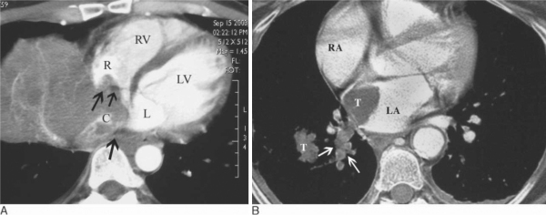
Notes:
Figure 24.48 Intravascular extension of tumours into the heart. (A) Contrast-enhanced CT in a patient with hepatocellular carcinoma extending directly into the right atrium via the inferior vena cava (arrows). Renal cell carcinoma and adrenal carcinoma also commonly spread this way. (B) Direct extension of lung cancer via the pulmonary vein into the left atrium. Contrast-enhanced CT in a patient with right lower lobe bronchogenic carcinoma (T) shows tumour growing into the left atrium via the right inferior pulmonary vein (arrows). C = Inferior vena cava; L = left atrium; LV = left ventricle; R = right atrium; RV = right ventricle.

Slide 30
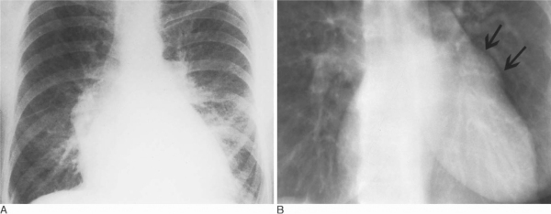
Notes:
Figure 24.51 Left atrial myxoma. (A) PA view of the chest shows a large heart with all chambers involved. There is interstitial pulmonary oedema. (B) Chest radiograph in a patient with known left atrial myxoma demonstrating enlargement of the left atrial appendage (arrows). This finding is commonly seen in rheumatic mitral valve disease and is rare in atrial myxoma.

Slide 31
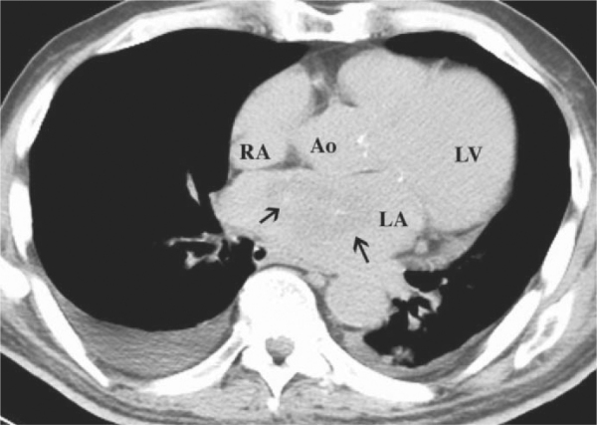
Notes:
Figure 24.52 Left atrial myxoma. Unenhanced CT at the level of the aortic root shows a faintly calcified soft tissue mass (arrows) in the left atrium (LA) attached to the interatrial septum. Ao = Aortic root, LV = left ventricle, RA = right atrium

Slide 32
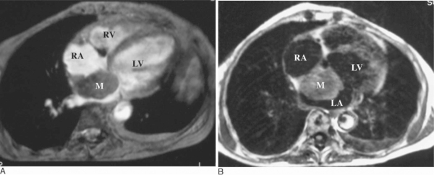
Notes:
Figure 24.53 Left atrial myxoma. CMR (A) gradient-echo and (B) post gadolinium contrast-enhanced axial images demonstrate lobulated soft tissue mass (M) in the left atrium attached to the interatrial septum, exhibiting significant enhancement after contrast medium administration (B). The typical location and post contrast enhancement helps in differentiating myxoma from thrombus. Compare to Fig. 24.55 . LV = Left ventricle, RA = right atrium, RV = right ventricle.

Slide 33
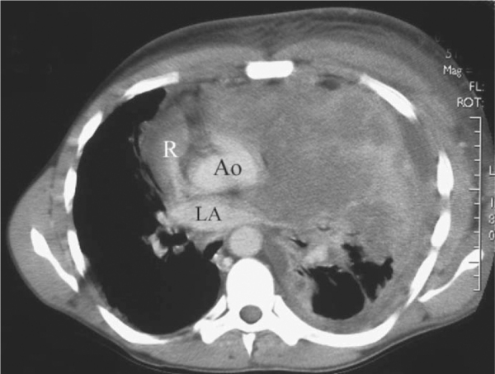
Notes:
Figure 24.58 Patient with human immunodeficiency virus (HIV) infection and aggressive B-cell lymphoma invading the mediastinum and heart. A large heterogeneous soft tissue mass is invading the mediastinum, pericardium, heart, and left pleural space displacing the cardiac structures to the right. Ao = Aortic root; LA = left atrium; R = right atrial appendage

Slide 34
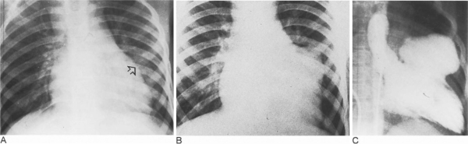
Notes:
Figure 24.61 Traumatic false aneurysm. Plain radiographs (A) immediately after a car accident involving chest trauma, showing an insignificant bulge on the left heart border, and (B) 16 months later, a large bulge has developed in the mid left heart border. (C) Left ventriculogram shows that the bulge is a narrow-necked false aneurysm filling from the upper left ventricular cavity

Slide 35
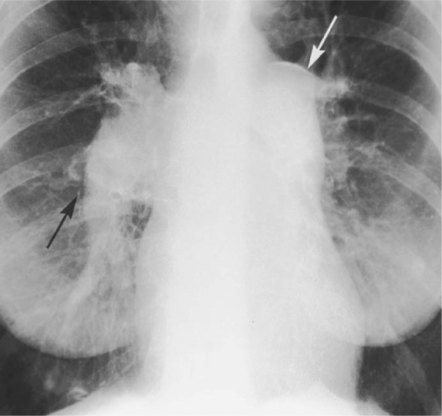
Notes:
Figure 23.4 Obstructive pulmonary arterial hypertension (Eisenmenger syndrome) complicating a large atrial septal defect with previous major left-to-right shunt. Very large central pulmonary arteries with small peripheral vessels. Linear calcification of the central pulmonary arteries. Moderate cardiac enlargement.

Slide 36
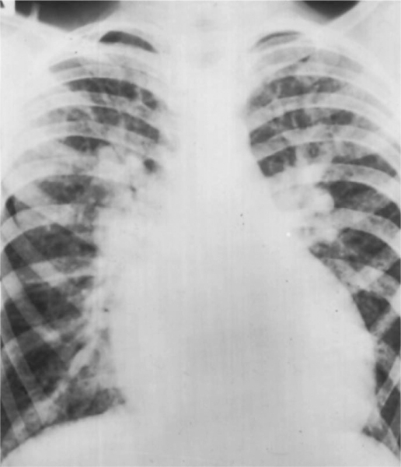
Notes:
Figure 23.2 Pulmonary plethora in atrial septal defect. Large heart, large central and peripheral pulmonary arteries. Note the recruitment of the upper zone vessels into the active pulmonary circulation.^{[1]} There is no evidence of pulmonary congestion or oedema.

Slide 37
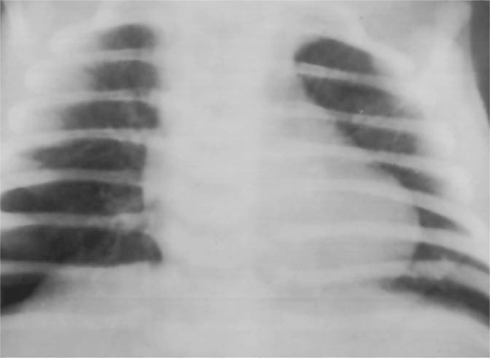
Notes:
Figure 23.3 Pulmonary oligaemia. Very sparse small calibre vessels in all zones and small hila (tetralogy of Fallot).

Slide 38
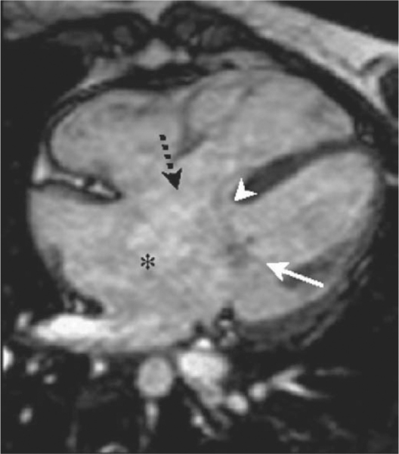
Balanced steady-state free precession four-chamber view MRI
Notes:
Figure 23.7 Complete atrioventricular septal defect. Balanced steady-state free precession four-chamber view MRI. Arrowhead = small ventricular septal defect, asterisk = complete absence of the atrial septum, white arrow = left atrioventricular valve, dashed arrow = position of right atrioventricular valve.

Slide 39
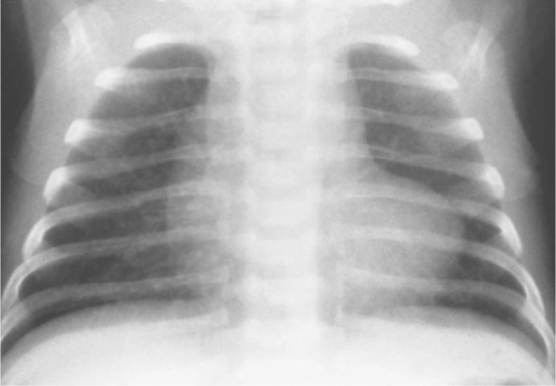
Notes:
Figure 23.9 Tetralogy of Fallot. Boot-shaped heart, small hila and pulmonary oligaemia.

Slide 40
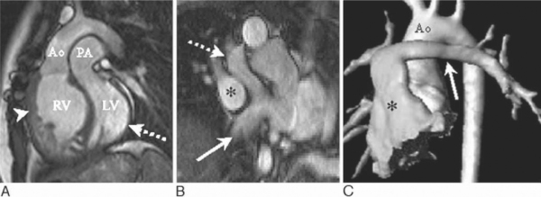
Notes:
Figure 23.11 Transposition of the great arteries. (A) Balanced steady-state free precession (SSFP) sagittal image; the aorta (Ao) arises anteriorly from the hypertrophied right ventricle (arrowhead); the posterior pulmonary artery (PA) arises from the left ventricle (dashed arrow). LV = left ventricle, RV = right ventricle. (B) Balanced SSFP images of intra-atrial baffles in a patient who has undergone the atrial switch Senning operation—pulmonary venous blood into the right atrium (asterisk), systemic venous blood into the left atrium, superior pathway of systemic venous blood (dashed arrow), inferior pathway (arrow). (C) 3D volume-rendered MRA of the aorta (Ao) after the arterial switch operation. Anterior pulmonary arteries are marked: asterisk = pulmonary trunk, arrow = left pulmonary artery.

Slide 41
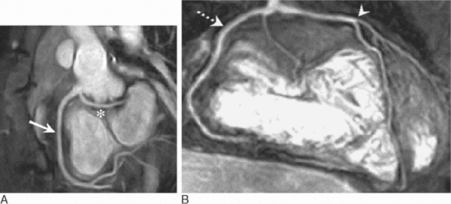
Notes:
Figure 23.14 Anomalous coronary arteries. Maximum intensity projection images reconstructed from the 3D coronary MRAs. (A) Oblique sagittal view demonstrating an anomalous origin of the left circumflex (asterisk) from the right coronary artery (arrow). (B) Coronal view demonstrating an anomalous accessory left anterior descending artery (arrowhead) arising from the same ostia as the right coronary artery (dashed arrow).

