Slide 1
SPOTS

Slide 2
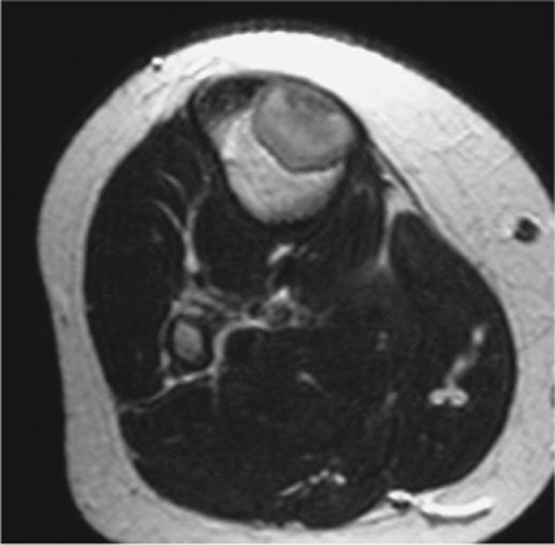
Axial T2-weighted MRI
Notes:
Figure 47.36 AP radiograph of the ankle showing a classical distal tibial nonossifying fibroma. Figure 47.37 Axial T2-weighted MRI showing a proximal tibial nonossifying fibroma with relatively low SI due to its fibrous nature.

Slide 3
Notes:
Figure 47.38 AP radiograph of the distal femur showing a benign fibrous histiocytoma.

Slide 4
Notes:
Figure 47.39 AP radiograph of the proximal tibia showing a desmoplastic fibroma

Slide 5
Notes:
Figure 47.40 Cortical desmoid (Bufkin lesion). (A) AP radiograph of the knee showing a distal femoral metaphyseal cortical desmoid (arrow) appearing as a poorly defined lytic lesion. (B) Sagittal T1-weighted MRI showing the lesion (arrow) at the site of origin of the medial head of gastrocnemius (arrowhead).

Slide 6
Notes:
Figure 47.41 Haemangioma of bone. (A) Coned lateral radiograph of the thoraco-lumbar junction showing a diffuse haemangioma of the T12 vertebral body. (B) AP radiograph of the little finger metacarpal showing a haemangioma with multiple intraosseous vascular channels.

Slide 7
Notes:
Figure 47.42 Haemangioma of bone. (A) Axial CT through the L3 vertebra showing a haemangioma with fatty matrix and thickened primary trabeculae. (B) Sagittal T1-weighted MRI of the lumbar spine showing a haemangioma of L5 with high SI due to fat. (C) Axial T2-weighted fast spin-echo MRI showing typical features of a vertebral haemangioma in the right side of L2.

Slide 8
Notes:
Figure 47.43 Coronal CT multiplanar reconstruction showing a haemangioma of the skull vault.

Slide 9
Notes:
Figure 47.44 Coronal oblique CT multiplanar reconstruction showing angiomatosis affecting the vertebrae and adjacent ribs. Cystic angiomatosis^{[55]}
Cystic angiomatosis is a multifocal condition of either blood or lymphatic vessels. The age at presentation is variable, although 50% are diagnosed before the age of 20 years. Most patients present in adolescence due to pain and swelling as a result of enlargement of viscera, especially the spleen. Skeletal lesions are usually discovered incidentally unless pathological fracture occurs. Diffuse skeletal angiomatosis embraces these cases but covers a wider spectrum of angiomatous lesions.
Radiological features
Numerous lytic lesions are present, especially in the ribs ( Fig. 47.44 ) and pelvis. The disease is centripetal in its distribution, with few lesions occurring distal to the elbow or knee. Individual lesions are round or oval with a fine sclerotic rim, although mainly sclerotic lesions have been reported. The prognosis of the disease is unrelated to the bone lesions and is worse with visceral involvement. In a proportion of patients with cystic lymphangiomatosis, chylous pleural effusions may develop.

Slide 10
Notes:
Figure 47.45 Gorham's disease of the fibula. AP radiograph showing extensive lytic destruction of the fibular metaphysis and diaphysis. Massive osteolysis (Gorham's disease, vanishing bone disease)
This rare, non-inheritable disorder has also been called ‘haemangiomatosis’. It predominates in children and young adults and is characterized by a non-malignant proliferation of vascular or lymphatic structures of bone, which results in progressive bony destruction, often with extension into surrounding soft tissues. Commonly affected sites include the shoulder region, mandible and pelvis. Progressive resorption of a single bone occurs, but paired bones, several contiguous ribs and segments of the spine have also been affected. Spontaneous arrest is rarely reported.
Radiological features
Purely lytic destruction of the metaphysis or diaphysis of a long bone with associated cortical erosion is seen ( Fig. 47.45 ). Subsequent pathological fracture produces little or no callus and no attempt at healing. Further resorption produces tapering of the bone ends. When the spine or thorax is involved, life may be threatened by the relentless bone destruction. Only complete excision of the affected bone can halt the progress of the disease. CT and MRI^{[56]} are useful in delineating the local extent of the lesion but do not show any characteristic appearances except for the absence of a major soft tissue mass.

Slide 11
Notes:
Figure 47.46 Intraosseous lipoma of the calcaneus. (A) Lateral radiograph showing a geographic, calcified lytic lesion. (B) Sagittal T1-weighted spin-echo MRI showing the hyperintense fatty nature of the lesion.

Slide 12
Notes:
Figure 47.47 AP radiograph of the proximal thigh showing a parosteal lipoma of the femur.
Lipomatous lesions of bone
Two types of this rare benign lesion of bone occur: 1 True intraosseous lipoma^{[59]} arises in the medulla and produces expansion, sometimes with endosteal scalloping and trabeculation, resembling a cyst or even fibrous dysplasia. Calcification is also seen. Most affect the lower limb, with a predilection for the calcaneus ( Fig. 47.46A ). CT and MRI aid in diagnosis by demonstrating the fatty nature of the matrix ( Fig. 47.46B ). 2 Parosteal lipoma^{[60]}, which may cause benign pressure erosion of the bone and the formation of circumferential periosteal new bone ( Fig. 47.47 ). The combination of such peripheral ossification with a tumour of otherwise fatty matrix establishes the radiological diagnosis.

Slide 13
Notes:
Figure 47.48 Lateral radiograph of the distal tibia showing a large implantation epidermoid.

Slide 14
Notes:
Figure 47.49 Fibrous dysplasia. AP radiograph of the proximal femur showing a well-defined expanded lesion with typical ground-glass matrix mineralization and a thick, sclerotic margin (rind sign). A stress fracture is present in the lateral cortex (arrow).

Slide 15
Notes:
Figure 47.51 Fibrocartilaginous dysplasia. AP radiograph of the left lower limb showing changes consistent with fibrous dysplasia in the fibula, but with associated cartilaginous matrix mineralization.

Slide 16
Notes:
Figure 47.52 Osteofibrous dysplasia. Lateral radiograph of the tibia showing anterior cortical expansion and ground-glass mineralization. Osteofibrous dysplasia^{[65]}
Osteofibrous dysplasia⁶⁶ (OFD, ossifying fibroma of Kempson) is a rare lesion that histologically resembles fibrous dysplasia and the stroma of adamantinoma. However, it has a specific clinical and radiological picture. Presentation is from birth to 40 years, with almost 50% occurring under the age of 10 years. The male to female ratio is equal. The tibia is affected in over 90% of cases and in two-thirds of these the anterior mid-diaphyseal cortex is involved. Multiple lesions may occur in the same bone, but the ipsilateral fibula is affected in 20% of cases. Bilateral involvement may be seen.
Radiological features
In early infancy the lesion expands and bows the tibia with a sclerotic rim. After 3 months of age, the lesion is eccentric, multilocular and may show a ground-glass matrix mineralization similar to FD ( Fig. 47.52 ). Cross-sectional imaging confirms its intracortical origin, but otherwise it shows no characteristic features. The lesion is typically active on scintigraphy. If surgery can be withheld in early infancy, spontaneous healing can occur. It seems very possible that in some patients OFD is a precursor of, or at least associated with, adamantinoma.

Slide 17
Notes:
Figure 48.4 Osteosarcoma metastasis. Coronal STIR MR image through the posterior pelvis showing a sclerotic osteosarcoma metastasis of the right ischium with a hyperintense ‘halo’ (arrow) surrounding the lesion.
Any region of unexplained abnormal uptake should be examined by MRI, which is more sensitive than radiography, and more specific than scintigraphy. Most metastases are located in the medulla and show reduced signal intensity (SI) on T1-weighted sequences, with increased SI on T2-weighted or fat-suppressed sequences. The identification of a hyperintense ‘halo’ around a lesion is a highly specific feature of metastasis on T2-weighted sequences^{[12]} ( Fig. 48.4 ).

Slide 18
Notes:
Figure 48.5 Sunburst periosteal reaction. AP radiograph of the femoral diaphysis showing a spiculated periosteal reaction mimicking osteosarcoma in a patient with prostatic metastasis.

Slide 19
Notes:
Figure 48.6 Renal carcinoma metastasis. AP radiograph of the knee showing a lytic, subarticular tibial lesion mimicking giant cell tumour.

Slide 20
Notes:
Figure 48.7 Chondrosarcoma. AP radiograph of the proximal tibiofibular joint showing a mineralized lesion of the fibula due to low-grade chondrosarcoma. The lesion cannot be radiologically differentiated from a chondroma

Slide 21
Notes:
Figure 48.8 Chondrosarcoma. AP radiograph of the proximal humerus showing a typical low-grade chondrosarcoma with extensive chondral mineralization and endosteal scalloping.

Slide 22
Notes:
Figure 48.9 Myxoid chondrosarcoma. Lateral radiograph of the femur showing a grade 2 myxoid chondrosarcoma. Bone expansion indicates a more aggressive behaviour.

Slide 23
Notes:
Figure 48.10 Dedifferentiated chondrosarcoma. AP radiograph of the left femur showing a proximal femoral chondrosarcoma with an adjacent area of lytic destruction and pathological fracture, due to associated dedifferentiation to malignant fibrous histiocytoma.

Slide 24
Notes:
Figure 48.11 Chondrosarcoma of the left ilium. Axial CT (A) and T2-weighted MRI (B) show a large extraosseous mass.

Slide 25
Notes:
Figure 48.12 Chondrosarcoma of the femur. (A) Coronal T1-weighted spin-echo and (B) STIR MR images show a large lobulated intramedullary lesion, which is particularly hyperintense on STIR.

Slide 26
Notes:
Figure 48.13 Peripheral chondrosarcoma. (A) AP radiograph of the ankle showing an osteochondroma of the distal fibula (arrows). (B) Axial fat-suppressed T2-weighted FSE MR image shows a large malignant cartilage cap surrounding the osteochondroma (arrow) and causing pressure erosion of the adjacent tibia (arrowheads).

Slide 27
Notes:
Figure 48.14 Clear-cell chondrosarcoma of the proximal femur appearing as a subarticular, lobulated lytic lesion.

Slide 28
Notes:
Figure 48.15 Conventional central osteosarcoma. (A) AP radiograph of the distal femur showing a classical osteosarcoma with mixed lytic and sclerotic areas, tumour bone formation in the extraosseous mass (arrow), and a proximal Codman's triangle (arrowhead). (B) AP radiograph of the proximal tibia showing dense metaphyseal sclerosis due to an osteoblastic osteosarcoma.

Slide 29
Notes:
Figure 48.16 Lytic osteosarcoma. Lateral radiograph of the distal femur showing a lytic osteosarcoma

Slide 30
Notes:
Figure 48.17 Pseudocystic osteosarcoma. AP radiograph of the proximal fibula showing an expanded, lytic lesion mimicking an aneurysmal bone cyst.

Slide 31
Notes:
Figure 48.18 Telangiectatic osteosarcoma. AP radiograph of the distal femur showing the classical ‘iron-filing’ type destruction of the cortex.

Slide 32
Notes:
Figure 48.19 Low-grade central osteosarcoma. AP radiograph of the proximal humerus showing the lytic, trabeculated pattern.

Slide 33
Notes:
Figure 48.20 Parosteal osteosarcoma. (A) Lateral radiograph of the knee showing a dense, lobulated mass of bone arising from the posterior distal femur. (B) Axial CT shows a lucent line (arrow) separating the lesion from the underlying cortex. (C) Sagittal T1-weighted spin-echo MR image shows the low SI mass with central intermediate SI (arrow) indicating a region of dedifferentiation to high-grade tumour. Note also the intramedullary extension (arrowhead).

Slide 34
Notes:
Figure 48.21 Periosteal osteosarcoma. (A) AP radiograph of the knee showing a spiculated periosteal reaction from the lateral femoral condyle and nodular matrix mineralization. (B) Axial fat-suppressed T2-weighted FSE MR image shows a lobular, hyperintense surface lesion consistent with a chondroblastic tumour

Slide 35
Notes:
Figure 48.22 High-grade surface osteosarcoma of the proximal tibia. (A) AP radiograph shows a vertical periosteal reaction (arrows) arising from the medial metaphysis. (B) Sagittal CT multiplanar reconstruction shows the large associated soft tissue component. The features are similar to periosteal osteosarcoma, but more aggressive.

Slide 36
Notes:
Figure 48.23 Paget's sarcoma. (A) AP radiograph of the proximal femur showing Paget's disease. (B) Axial T1-weighted spin-echo MR image shows an associated large soft tissue mass due to sarcomatous change.

Slide 37
Notes:
Figure 48.26 Malignant fibrous histiocytoma. AP radiograph of the proximal femur showing a moth-eaten destructive lesion with no characteristic features.

Slide 38
Notes:
Figure 48.27 Ewing's sarcoma. (A) Typical appearance in the proximal humeral metadiaphysis with permeative marrow destruction, ‘hair-on-end’ and multilaminated periosteal reaction. (B) AP radiograph of the femur showing cortical ‘saucerization’ (arrowheads). (C) AP radiograph of the pelvis showing a sclerotic Ewing's sarcoma of the right ilium (arrows).

Slide 39
Notes:
Figure 48.28 Ewing's sarcoma of the proximal fibula. (A) Coronal T1-weighted spin-echo and (B) axial STIR MR images show a large extraosseous mass (arrows).

Slide 40
Notes:
Figure 48.29 Primary lymphoma of bone. (A) AP radiograph of the proximal humerus shows a permeative destructive lesion in the metadiaphysis. (B) Axial CT in a patient with primary bone lymphoma of the left ilium shows multiple sequestra. (C) Coronal T1-weighted spin-echo MRI of the proximal humerus shows a large soft tissue extension

Slide 41
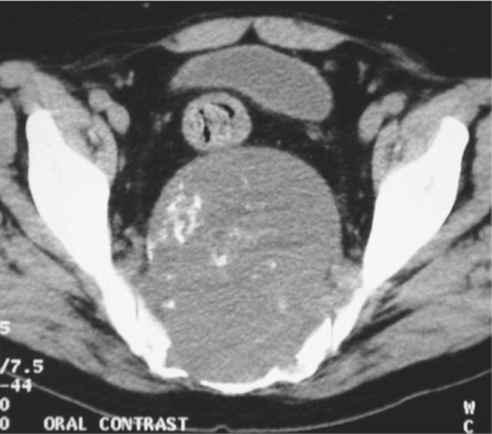
Notes:
Figure 48.30 Sacral chordoma. AP radiograph of the sacrum shows a central, lytic destructive lesion (arrows).
CT shows a predominantly lytic mass with small foci of calcification.

