Slide 1
SPOTS

Slide 2
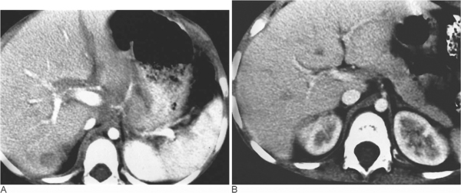
POST CHEMO
Notes:
Figure 72.10 Periportal lymphoma. (A) Contrast-enhanced CT in a child with NHL, showing infiltration of low-density lymphomatous tissue from the porta hepatis, encasing the main portal vein, extending alongside the right portal vein. A solitary focal abnormality is seen posteriorly within the liver.(B) A follow-up after chemotherapy shows complete resolution of the disease.

Slide 3
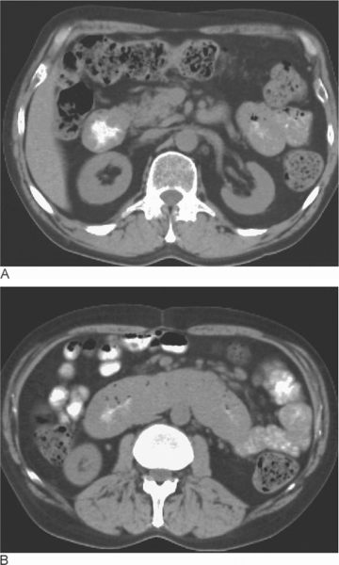
Notes:
Figure 72.13 Non-Hodgkin's lymphoma involving the duodenum. (A, B) Diffuse concentric gross thickening of the duodenal wall due to lymphomatous infiltration. Note multiple prominent lymph nodes in the mesentery and retroperitoneum.

Slide 4
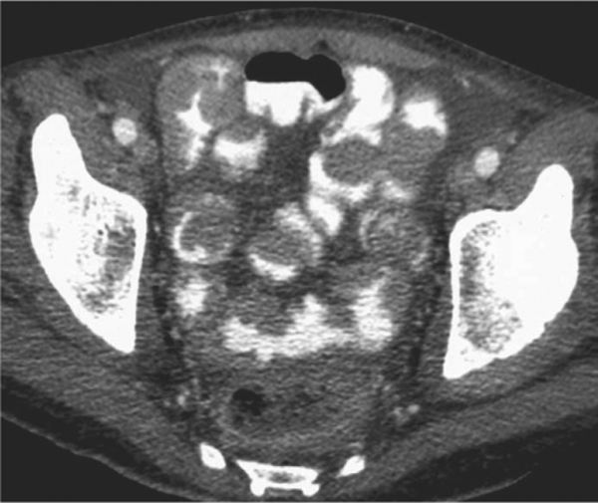
Notes:
Figure 72.14 Small bowel involvement in lymphoma. CT showing marked nodular thickening of multiple loops of ileum secondary to infiltration by low-density lymphomatous material.

Slide 5
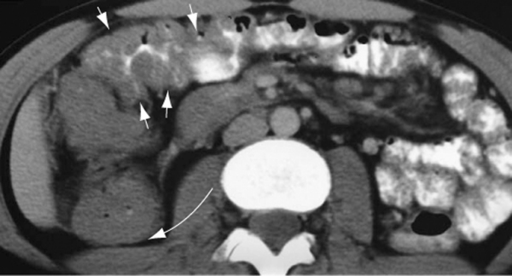
Notes:
Figure 72.15 Involvement of large bowel in non-Hodgkin's lymphoma. CT showing marked and extensive diffuse, uniform thickening of the wall of the transverse colon (arrow). Mesenteric nodes can also be identified. There is also very marked thickening of the wall of the ascending colon (curved arrow) and caecum.

Slide 6
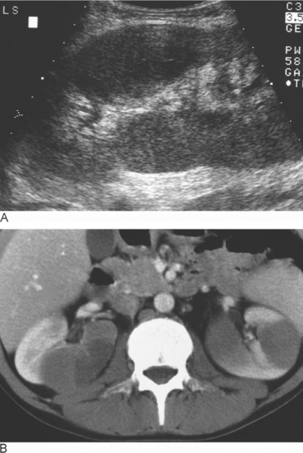
Notes:
Figure 72.16 Multiple lymphomatous renal masses. (A) Longitudinal ultrasound of the left kidney showing multiple hypoechoic masses. (B) CT in the same patient showing multiple masses, well defined from the normally enhancing adjacent renal parenchyma. Note the absence of retroperitoneal lymph node enlargement.

Slide 7
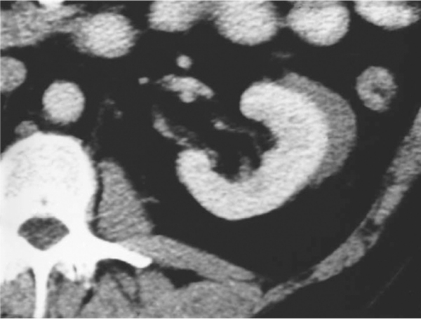
Notes:
Figure 72.18 Perirenal lymphoma. Postcontrast CT showing a mass in the perirenal space.

Slide 8
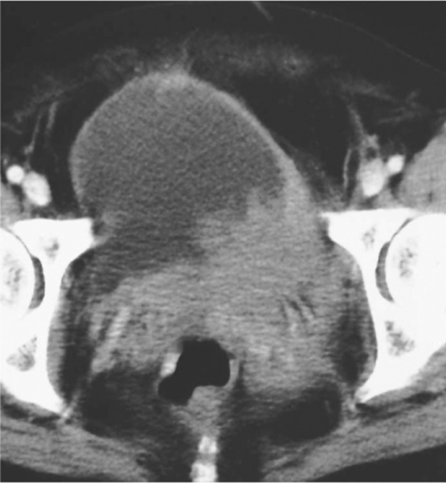
Notes:
Figure 72.19 Bladder lymphoma. Contrast-enhanced CT of the pelvis in a female patient showing an irregular soft-tissue mass of lymphomatous tissue infiltrating the lumen at the base of the bladder and resulting in asymmetrical thickening of the left bladder wall.

Slide 9
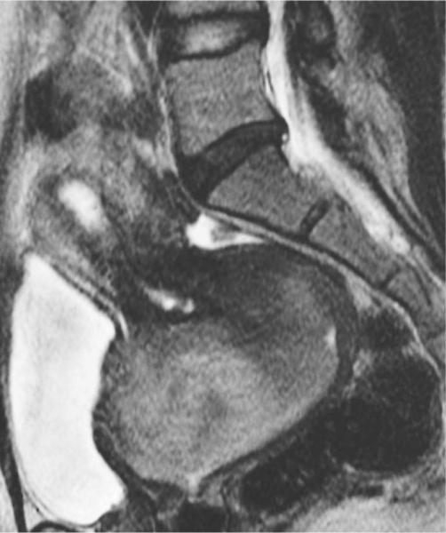
Notes:
Figure 72.20 Lymphoma of the cervix. Sagittal T2-weighted MRI showing a large mass of intermediate to high signal intensity. The mass is substantially larger than is usually seen in a squamous carcinoma of the cervix. Biopsy showed an aggressive B-cell lymphoma.

Slide 10
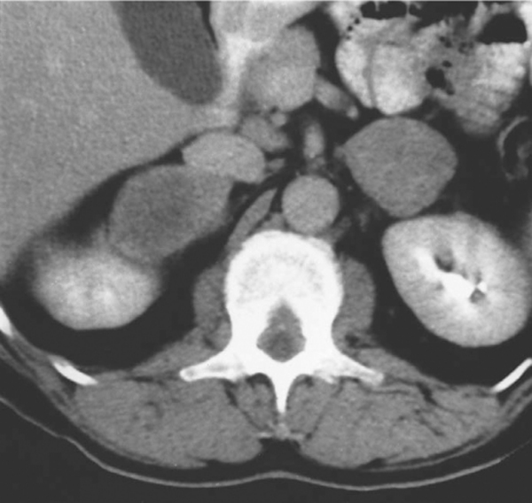
Notes:
Figure 72.21 Adrenal lymphoma. Contrast-enhanced CT showing bilateral large inhomogeneous soft-tissue masses. No other evidence of disease could be detected elsewhere and a core biopsy showed the presence of non-Hodgkin's lymphoma.

Slide 11
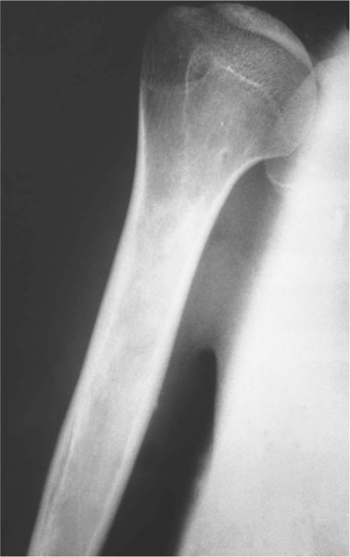
Notes:
Figure 72.22 Primary non-Hodgkin's lymphoma of bone. Plain radiograph of the humerus of a 14-year-old child showing a poorly defined sclerotic lesion in the proximal humerus. Further investigation revealed no other sites of lymphomatous disease.

Slide 12
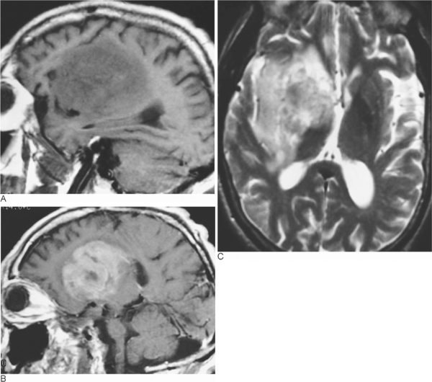
Notes:
Figure 72.24 Cerebral non-Hodgkin's lymphoma. (A) T1-weighted (TR = 500, TE = 16) sagittal MRI showing a mass of low signal intensity within the right parietal lobe. (B) This enhances intensely following intravenous administration of gadolinium-DTPA and can be seen to be causing marked mass effect with compression of the right lateral ventricle on (C), an axial T2-weighted (TR = 3800, TE = 95) image.

Slide 13
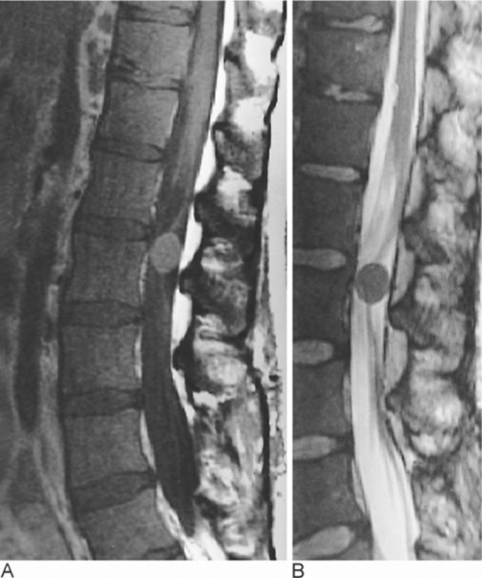
Notes:
Figure 72.25 Meningeal deposits in lymphoma. (A) Sagittal T1-weighted MRI (TR = 500, TE = 14) showing a well-defined lesion within the dura due to a lymphomatous deposit within the meninges. (B) The lesion is also clearly seen on a fast spin-echo T2-weighted image (TR = 6000, TE = 95/Ef).

Slide 14
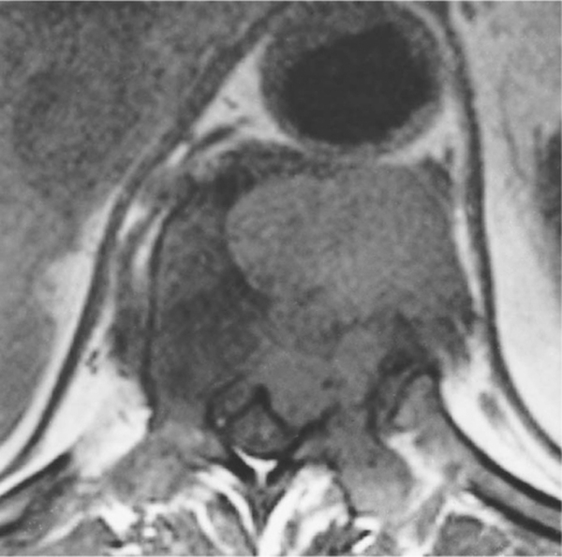
Notes:
Figure 72.26 Lymphomatous infiltration of the spinal canal. T1-weighted (TR = 800, TE = 12) MRI showing a mass of intermediate to high signal intensity in the paravertebral soft tissues, extending into the vertebral body and into the spinal canal. The mass is displacing the theca.

Slide 15
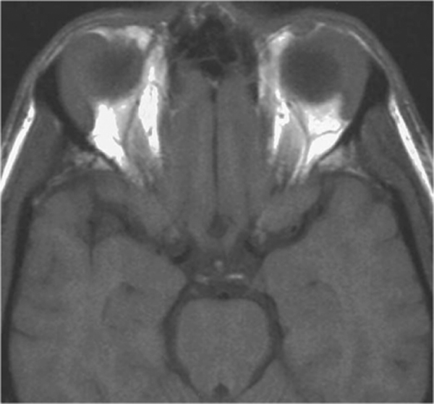
Notes:
Figure 72.27 Bilateral orbital lymphoma. T1-weighted MRI in the axial plane demonstrating bilateral orbital masses arising in the region of the lacrimal glands.

Slide 16
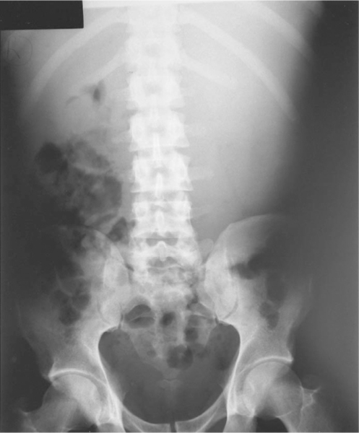
Notes:
Figure 73.1 Splenomegaly. Plain radiograph showing the splenic outline in a patient with splenomegaly due to chronic myeloid leukaemia.

Slide 17
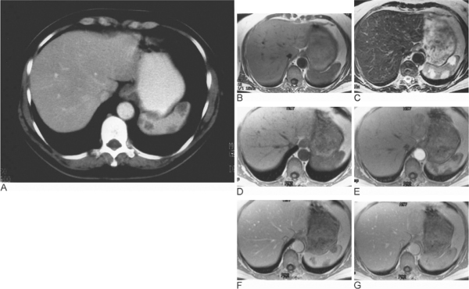
Notes:
Figure 73.9 Multiple splenic haemangiomata. (A) Contrast-enhanced CT shows multiple poorly enhancing lesions in the spleen. On the (B) axial T1-weighted spin-echo no lesions can be seen but the (C) T2-weighted fast-spin-echo shows multiple haemangiomata with the typical high signal intensity. Dynamic breath-hold T1-weighted spoiled gradient-echo images acquired (D) before, (E) immediately after, (F) 60 s after and (G) 3 minutes after bolus injection of intravenous gadolinium shows the typical enhancement pattern for haemangioma. On the early phase images, there is peripheral enhancement of the lesions and the delayed image shows the haemangioma to be isointense to the rest of the spleen.

Slide 18
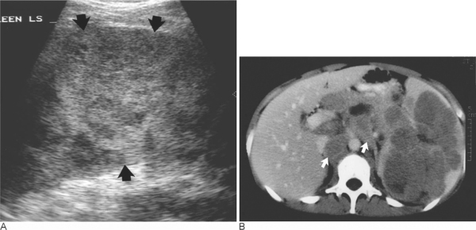
Notes:
Figure 73.10 Lymphoma. (A) Ultrasound and (B) contrast-enhanced CT in a patient with non-Hodgkin's lymphoma involving the spleen. The ultrasound shows a large spleen (arrows) with multiple, poorly defined hypoechoic lesions. On the CT, enlarged intra-abdominal lymph nodes (arrows) can also be seen.

Slide 19
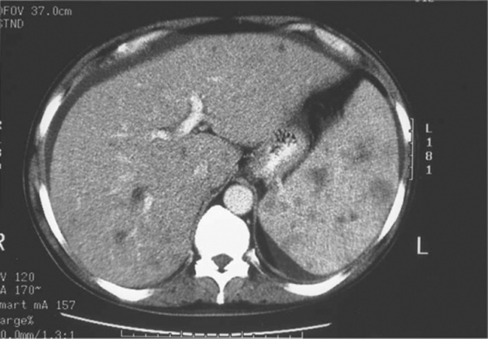
Notes:
Figure 73.11 Lymphoma. Contrast-enhanced CT in a patient with non-Hodgkin's lymphoma involving the liver and spleen. Multiple small poorly defined nodules can be seen in both liver and spleen. A trace of ascites can also be seen anterior to the liver.

Slide 20
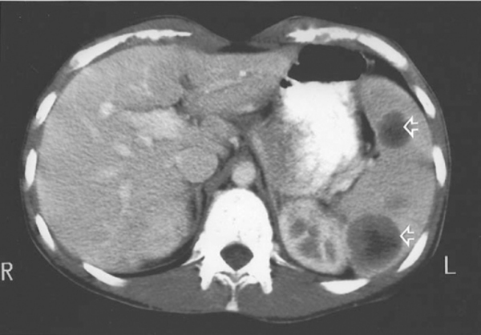
Notes:
Figure 73.12 Splenic metastases. Contrast-enhanced CT showing multiple deposits (arrows) from malignant melanoma.

Slide 21
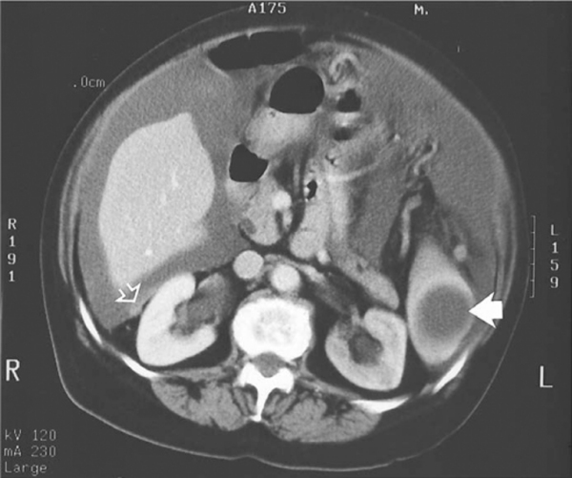
Notes:
Figure 73.13 Cystic splenic metastasis. Contrast-enhanced CT shows a cystic splenic metastasis (arrow) in a patient with advanced ovarian cancer. There are also peritoneal deposits (open arrow) and malignant ascites present

Slide 22
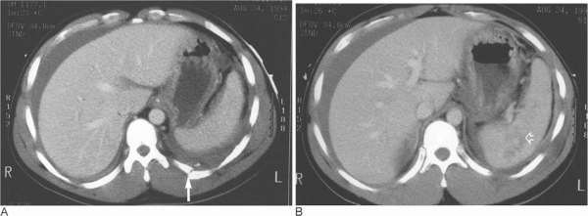
Notes:
Figure 73.16 Splenic injury. Contrast-enhanced CT in a man who fell from a ladder. (A)There is fracture of the left 10th rib (arrow) with perisplenic fluid and ascites. (B) Splenic laceration (open arrow) was also identified on CT.

Slide 23
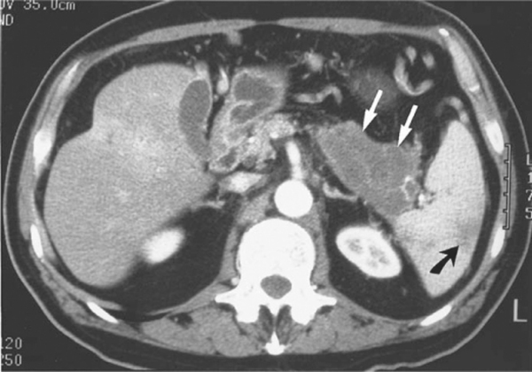
Notes:
Figure 73.17 Splenic infarct. Contrast-enhanced CT shows a tumour mass (arrows) in the tail of the pancreas is causing occlusion to the splenic vein and a splenic infarct (black arrow)

Slide 24
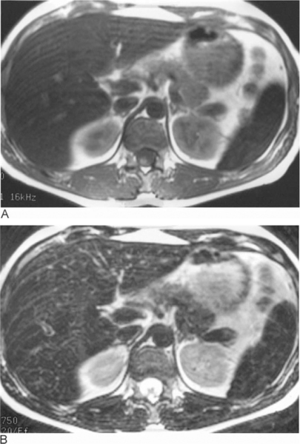
Notes:
Figure 73.18 Haemosiderosis. Axial (A) T1-weighted spin-echo and (B) T2-weighted fast-spin-echo images show the very low signal intensity of the liver and spleen with respect to the skeletal muscle due to iron deposition in a patient with leukaemia who has had multiple blood transfusions.

Slide 25
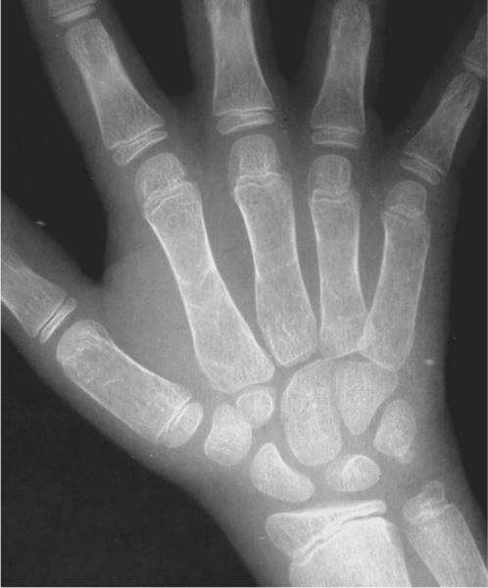
Notes:
Figure 74.1 Thalassaemia. Hand showing osteopenia with thinning of the cortices, loss of tubulation and a coarsened medullary pattern.

Slide 26
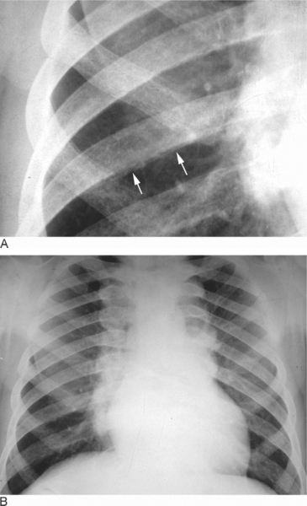
Notes:
Figure 74.2 Thalassaemia. (A) The ribs appear mildly expanded with periostitis producing a bone-within-a-bone appearance (arrows). (B) Chest radiograph showing generalized osteopenia and massive paraspinal widening due to extramedullary erythropoiesis.

Slide 27
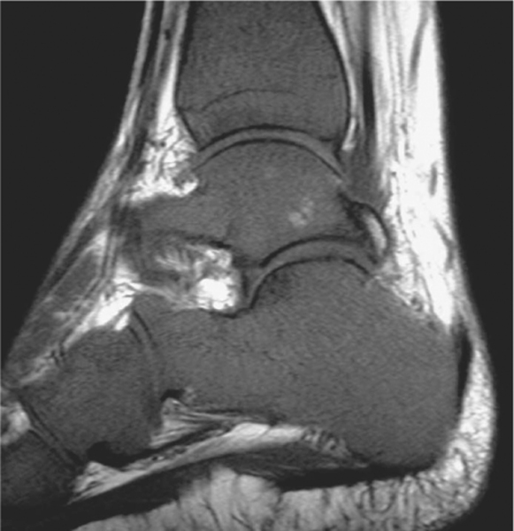
Sagittal T1-weighted spin-echo
Notes:
Figure 74.3 Thalassaemia. Sagittal T1-weighted spin-echo MRI of the ankle showing diffuse reduction of marrow signal intensity due to reconversion.

Slide 28
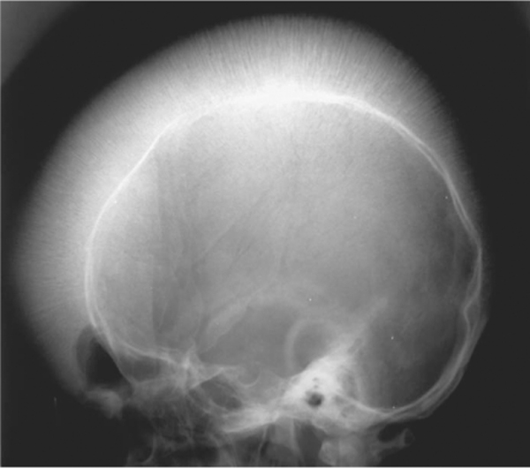
Notes:
Figure 74.4 Thalassaemia. Lateral radiograph of the skull showing gross expansion of the diploë and loss of definition of the outer table with sparing of the occipital bone. A gross ‘hair-on-end’ appearance is shown.

Slide 29
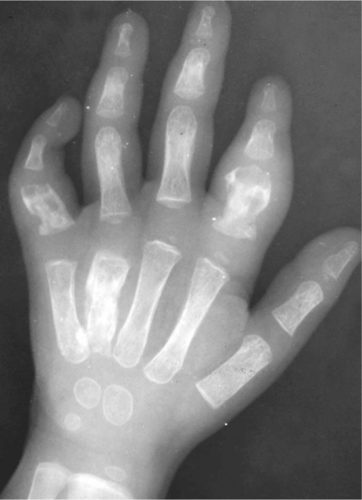
Notes:
Figure 74.5 Sickle-cell disease. Infarction in several of the metacarpals and proximal phalanges has resulted in bone destruction and swelling of the soft tissues

Slide 30
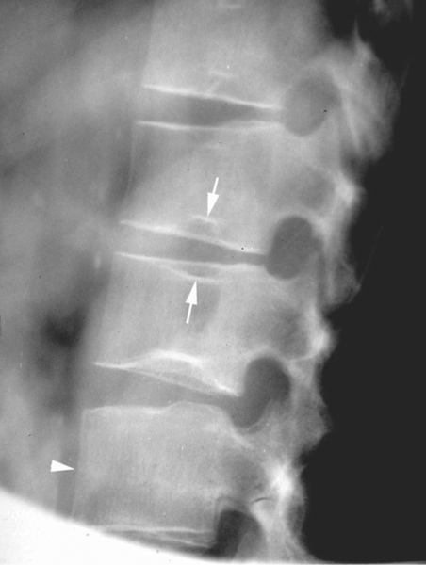
Notes:
Figure 74.6 Sickle-cell disease. The classical ‘stepped depression’ of the vertebral end plates is seen (arrows). Note increased height of the adjacent ‘tower’ vertebra (arrowhead).

Slide 31
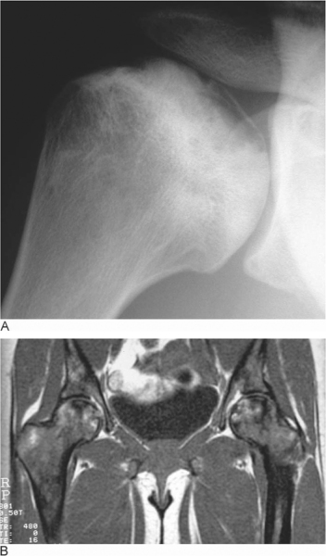
Notes:
Figure 74.7 Sickle-cell disease. (A) Infarction of the humeral head has led to the separation of an osteochondral fragment of the subarticular bone with adjacent reactive medullary sclerosis. (B) Coronal T1-weighted spin-echo MRI of the proximal femora showing patchy hypointensity within the marrow due to marrow hyperplasia and bilateral femoral head osteonecrosis.

Slide 32
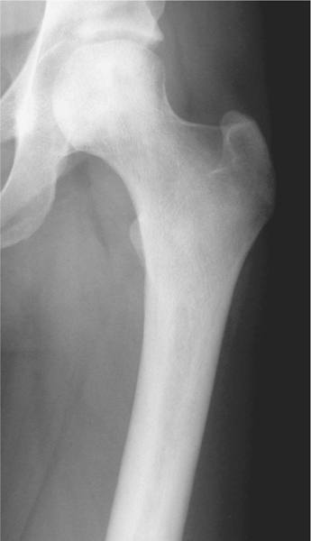

Slide 33
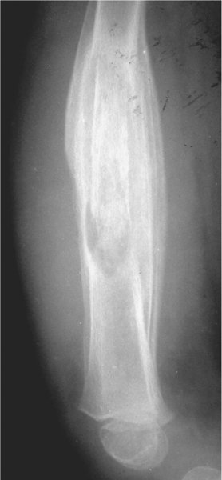
Notes:
Figure 74.9 Sickle-cell disease. Lateral radiograph of the femur showing features of chronic salmonella osteomyelitis with gross cortical thickening and a central sequestrum.

Slide 34
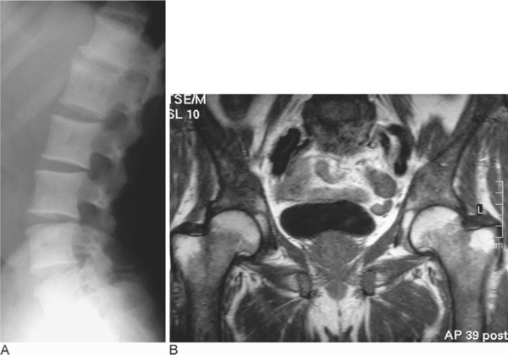
Notes:
Figure 74.10 Myelofibrosis. (A) Lateral radiograph of the lumbar spine showing diffuse vertebral body sclerosis. (B) Coronal T1-weighted spin-echo MRI showing patchy reduction of marrow signal intensity in the pelvic bones and proximal femora.

Slide 35
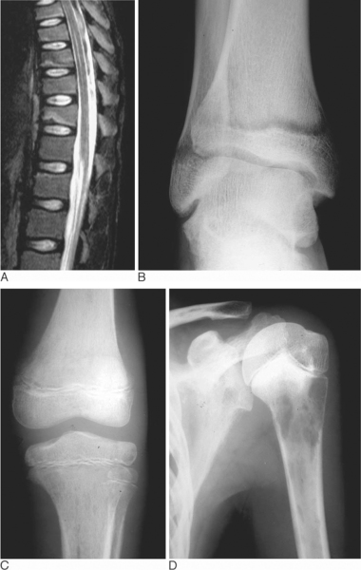
Notes:
Figure 74.11 Acute leukaemia. (A) Sagittal fat-suppressed T2-weighted fast spin-echo MRI of the thoracic spine showing multilevel wedge compression fractures due to osteopenia as the presenting feature of acute myeloblastic leukaemia (AML). (B) Metaphyseal lucent bands in the distal tibia in a patient with acute lymphocytic leukaemia (ALL). (C) Permeative pattern of bone destruction in the distal femoral and proximal tibial metaphyses. (D) Multiple lytic areas of bone destruction in the proximal humeral metaphysis and scapula.

Slide 36
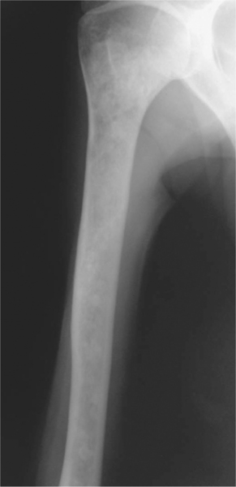
Notes:
Figure 74.12 Mastocytosis. Radiograph of the humerus demonstrating multiple small osteoblastic lesions.

Slide 37
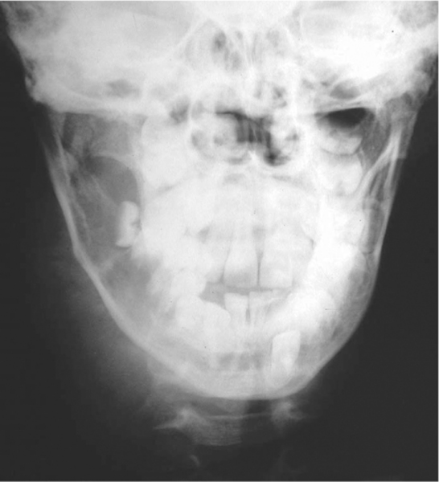
Notes:
Figure 74.14 Burkitt's lymphoma. Destruction of the right side of the mandible has resulted in ‘floating teeth’ and an associated large soft tissue mass

Slide 38
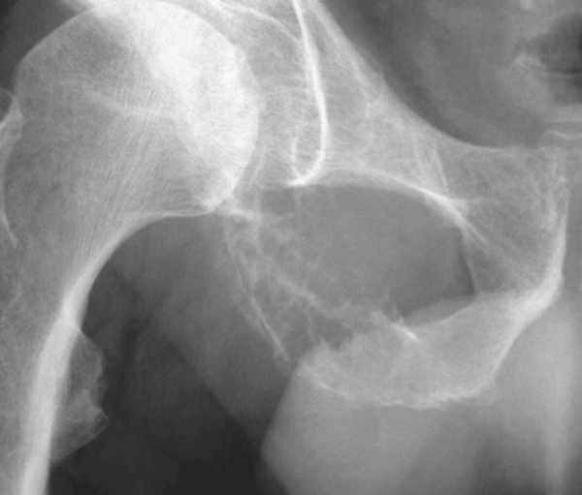
Notes:
Figure 74.15 Plasmacytoma. Antero-posterior radiograph shows a slightly expanded lytic lesion with apparent trabeculation in the inferior pubic ramus.

Slide 39
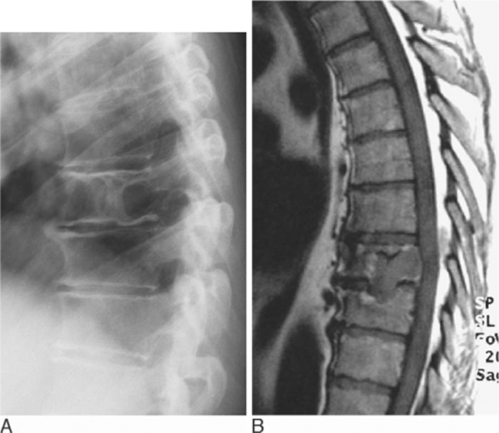
Notes:
Figure 74.16 Plasmacytoma of the spine. (A) Lateral radiograph shows a lytic destructive lesion showing minor collapse. (B) Sagittal T1-weighted spin-echo MRI demonstrates extension across the disc space

Slide 40
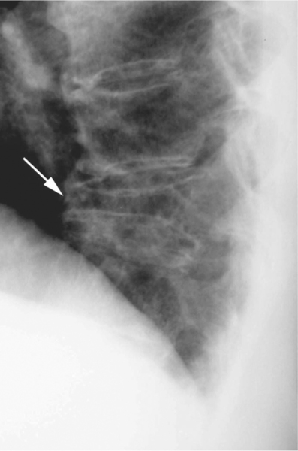
Notes:
Figure 74.17 Multiple myeloma. Lateral radiograph of the lower thoracic spine showing diffuse osteopenia and pathological collapse of T11 (arrow

Slide 41
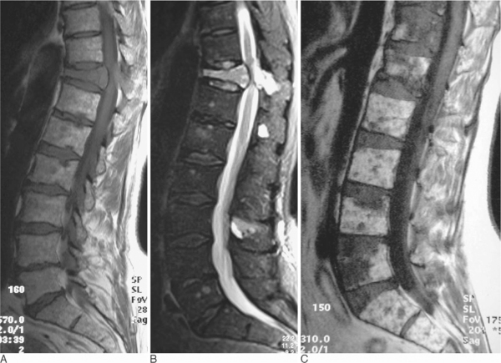
Notes:
Figure 74.18 Multiple myeloma. (A) Sagittal T1-weighted spin-echo and (B) fat-suppressed T2-weighted fast spin-echo MRI showing pathological collapse of T11 with cord compression and multiple smaller areas of focal marrow involvement. (C) Sagittal T1-weighted spin-echo MRI showing the variegated pattern of marrow involvement.

