Slide 1
SPOTS

Slide 2
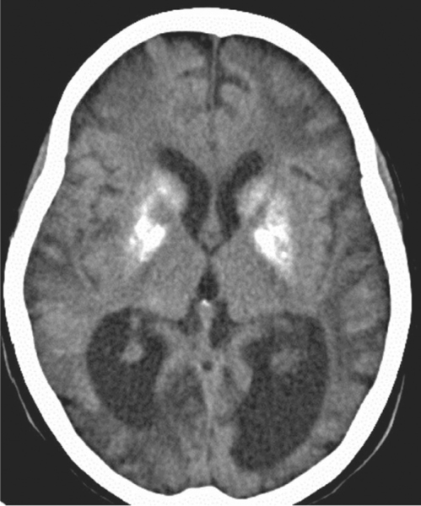
Pt of mitochondrial cytopathy
Notes:
Figure 70.57 Strokes occurring in mitochondrial cytopathy. Bilateral symmetrical lentiform and caudate calcification and extensive cerebral infarction crossing arterial territories in a child with a mitochondrial disorder (MELAS).

Slide 3
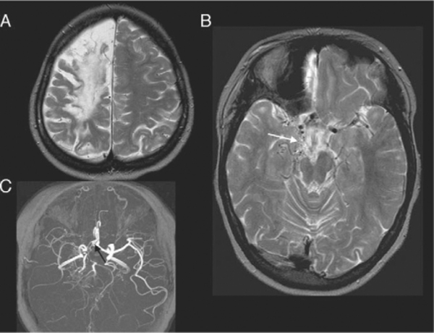
Notes:
Figure 70.58 Sickle cell disease and moya moya syndrome. Child with extensive frontal, deep and posterior watershed infarction (A). (B) Shows extensive perimesencephalic ‘moya moya’ collaterals (arrow) and attenuated right middle cerebral artery (MCA) flow voids. (C) Compressed maximum intensity projection image shows narrowed terminal internal carotid artery (ICA), reduced filling of right MCA, and A1 segment of the anterior cerebral artery. There is an aneurysm at the A1/anterior communicating artery (ACOM) junction (arrow).

Slide 4
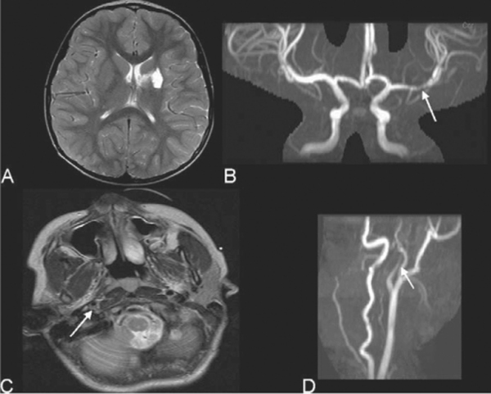
Notes:
Figure 70.59 Vasculitis. (A,B) In a child with chicken pox vasculitis, axial T2 and maximum intensity projection (MIP) image of time of flight (TOF) circle of Willis MRA show a mature proximal left middle cerebral artery branch infarct with reduced and turbulent flow (arrow) and reduced distal filling. Arterial dissection. (C,D) In a 14 year old girl with acute onset left hemiplegia, large right middle cerebral artery territory infarct, and internal carotid artery (ICA) dissection is seen. On the axial T2-weighted image there is an eccentric filling defect within the lumen of the right internal carotid artery which is narrowed, confirming the presence of dissection (arrow). The MIP image of the TOF MRA shows a typical rat's tail appearance of a tapering stenosis distal to the right ICA bifurcation (arrow).

Slide 5
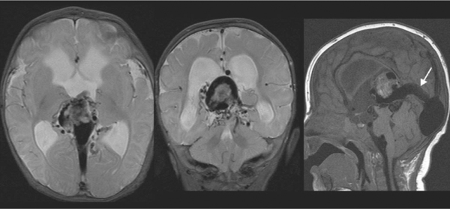
Notes:
Figure 70.60 Vein of Galen malformation (partly occluded by embolization glue) showing residual flow through the promesencephalic vein, containing a combination of glue and thrombus, via the falcine sinus (arrow) towards the venous confluence. Arterial supply is via a number of choroidal vessels

Slide 6
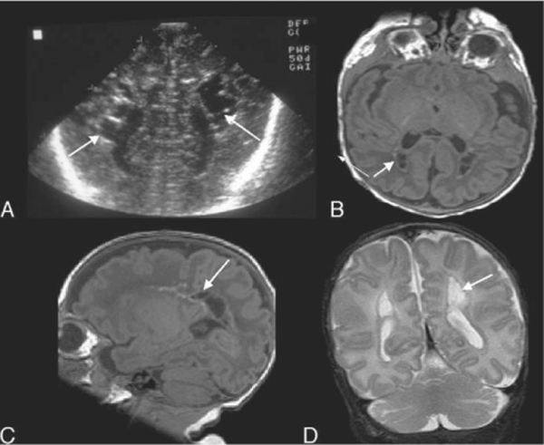
Notes:
Figure 70.61 Early sign of periventricular leukomalacia. (A) US shows periventricular echolucencies (arrows), one of the earliest signs of periventricular leukomalacia. (B,C) On T1-weighted MRI sequences, these are seen posteriorly in the peritrigonal area and are lined by small focal regions of T1 shortening in keeping with haemorrhage (arrows).
PVL results in infarction with oedema seen in the periventricular region. This may be seen as increased echogenicity on US. The damaged tissue undergoes cystic degeneration 10–20 d after the insult. Small, often confluent, cysts form in the periventricular white matter; these are usually transient and subsequently collapse. The detection of these cysts is the most reliable US finding of PVL in its early development ( Fig. 70.61 ).

Slide 7
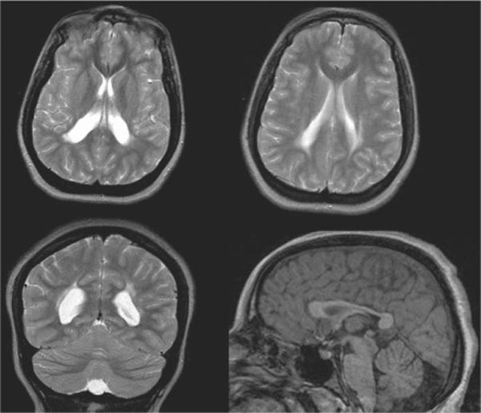
Notes:
Figure 70.62 End-stage changes of periventricular leukomalacia. A child with spastic diplegia scanned much later in life (15 years) has the typical chronic changes of periventricular leukomalacia. There is posterior periventricular increased signal on T2-weighted images and enlargement of the ventricles posteriorly with irregular, scalloped margins, indicating white matter loss. The corpus callosum seen on the sagittal T1-weighted MRI is markedly thinned, particularly affecting the posterior body.

Slide 8
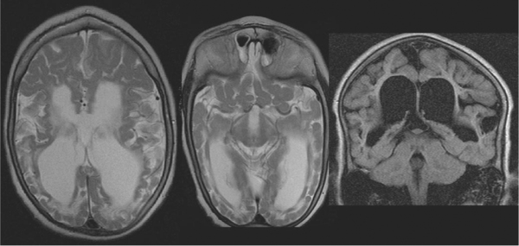
Notes:
Figure 70.63 Hypoxic ischaemia at term, imaged in childhood. The gyri are thinner at their bases than at their apices. This is known as ulegyria and dates the hypoxic–ischaemic event to term. Note the relative preservation of the cerebellum and brainstem.

Slide 9
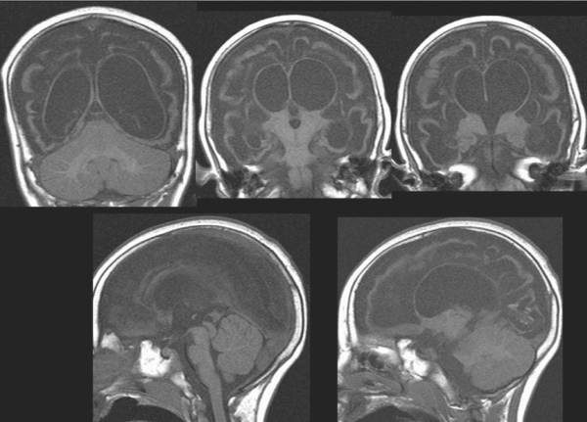
Notes:
Figure 70.64 Prolonged hypoxic ischaemia resulting in multicystic encephalomalacia. There is cystic cavitation of most of the white matter with grossly thinned corpus callosum, leaving only a very thin rim of preserved cortical mantle.

Slide 10
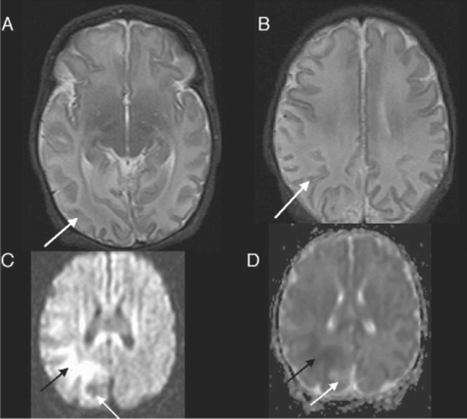
Notes:
Figure 70.65 Neonate with seizures and hypoglycaemia shows (A,B) increased signal within the parieto-occipital cortex and white matter, with patchy loss of the normal cortical low signal (arrow). (C) Diffusion-weighted image and (D) ADC map show that the diffusion changes are a mixture of restricted (black arrows) and increased diffusion (white arrows). All of these changes, including the T2 and restricted areas of diffusion, completely resolved on follow-up.

Slide 11
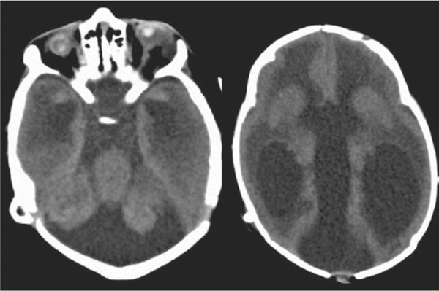
Notes:
Figure 70.66 CT of a neonate with congenital TORCH infection. Both the globes are small and calcified (phthisis bulbi). There is a Dandy–Walker malformation and hydrocephalus with transependymal oedema

Slide 12
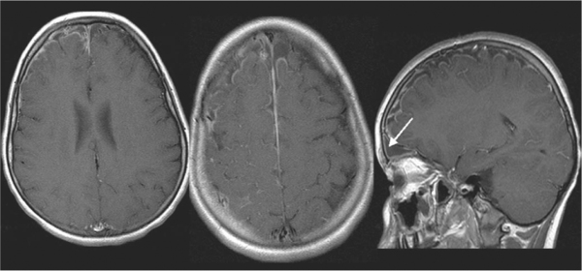
Notes:
Figure 70.67 Bilateral subdural empyemas. There is leptomeningeal and pachymeningeal enhancement (arrows) most marked over the right cerebral convexity and extending back to the vertex (on the sagittal view). There is enhancing debris within the subdural space and the signal is slightly increased compared to cerebrospinal fluid. The source of infection was from the frontal sinus (arrow).

Slide 13
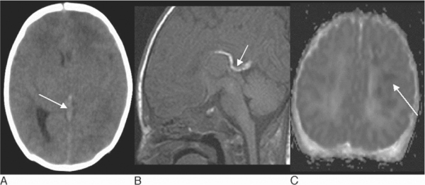
Notes:
Figure 70.68 Venous sinus thrombosis in a child with recent history of nausea and vomiting. (A) CT shows hyperdense thrombus within the vein of Galen just reaching the internal cerebral veins (arrow). There is diffuse cerebral swelling with more hypodense change and swelling affecting the left hemisphere and thalami (B) Sagittal T1-weighted MRI confirms the diagnosis with T1 shortening in keeping with methaemoglobin in the internal cerebral veins and vein of Galen (arrow). (C) The ADC map shows patchy restricted diffusion (low signal) (arrow) within the deep white matter in keeping with infarction.

Slide 14
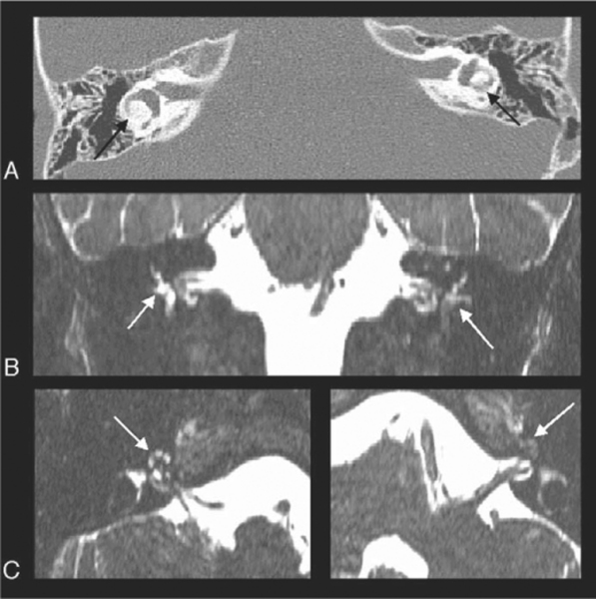
Notes:
Figure 70.69 Child with recent meningitis and new sensorineural deafness. (A) High-resolution axial CT through the petrous bones shows increased density in keeping with calcification within the lateral semicircular canals (arrows). (B) Coronal and (C) axial CISS MRI shows reduced T2 signal within all the semicircular canals (arrows), particularly the left, confirmed on the oblique axial views (C). There is reduced signal within the cochlea, again worse on the left (arrows). These are typical features of labyrinthitis ossificans.

Slide 15
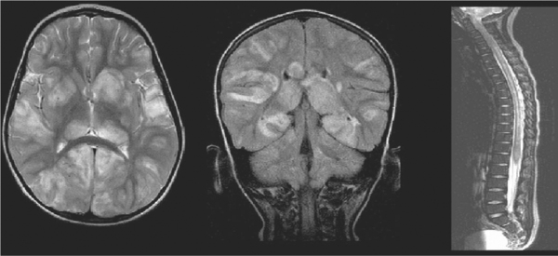
recent viral illness
Notes:
Figure 70.70 Acute disseminated encephalomyelitis in an 11 year old boy with recent viral illness and acute impaired consciousness. MRI shows bilateral, asymmetrical, mainly subcortical, cerebral hemisphere white matter lesions but also involving the cortex and deep grey matter. The cerebellum and spinal cord are also involved. There is focal swelling of the involved regions. The imaging features are typical of acute disseminated encephalomyelitis. The child made a full recovery.

Slide 16
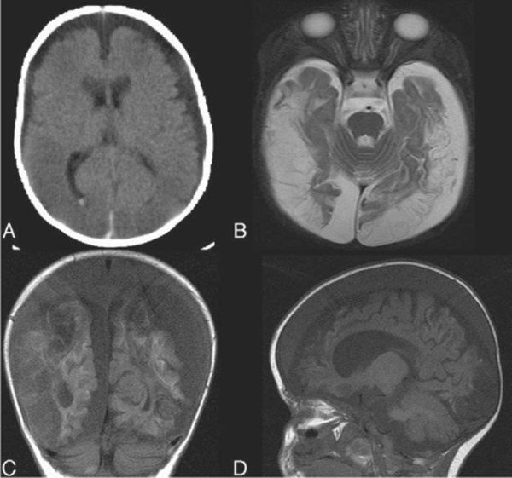
Notes:
Figure 70.72 Brain injury in ‘shaken baby syndrome’. (A) The initial CT shows posterior interhemispheric subdural and intraventricular blood. There are bilateral hypodense subdural collections overlying both hemispheres. Extensive bilateral hypodense parenchymal lesions consistent with contusions or infarction are seen. (B) Follow-up MRI shows evolution of the parenchymal damage with marked atrophy and large chronic subdural collections. (C) Coronal and (D) sagittal T1-weighted sequence shows the subdural collections have signal slightly greater than cerebrospinal fluid in keeping with proteinaceous contents from previous haemorrhage. There is cortical T1 shortening suggesting the parenchymal lesions are regions of cerebral infarction.

Slide 17
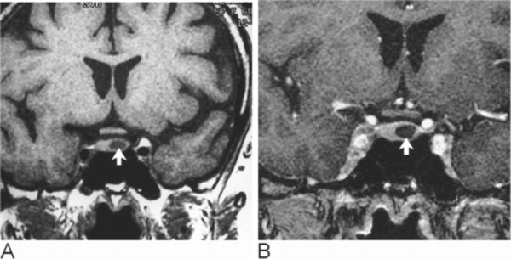
Notes:
Figure 71.2 Pituitary microadenoma. Coronal T1-weighted spin echo images before (A) and after (B) gadolinium enhancement demonstrates a microadenoma (arrow) in the left side of the gland. The adenoma enhances less avidly than the rest of the gland.

Slide 18
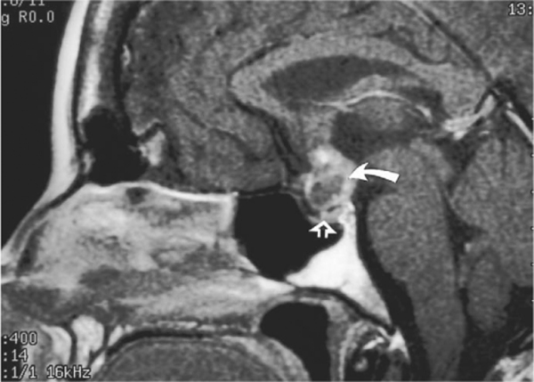
Notes:
Figure 71.5 Craniopharyngioma. Enhanced sagittal T1-weighted spin echo images demonstrates a recurrent craniopharyngioma (curved arrow). The mass is suprasellar and clearly separate from the normal pituitary gland (open arrow). There is patchy enhancement but no cystic component is visible.

Slide 19
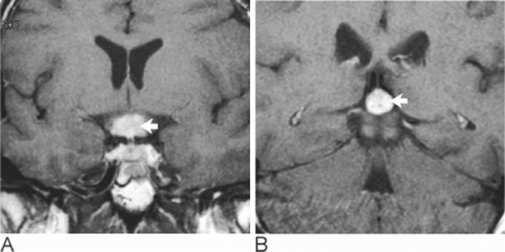
Notes:
Figure 71.6 Germinoma. Coronal T1-weighted spin echo image after intravenous injection of gadolinium demonstrates homogeneously enhancing masses (arrow) in the (A) suprasellar and (B) pineal regions. The masses were isointense prior to contrast (not shown)

Slide 20
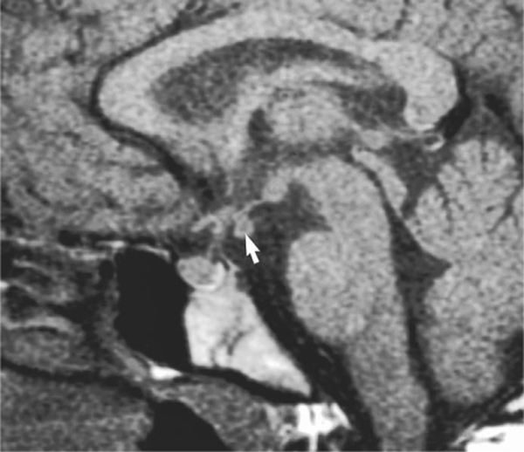
Notes:
Figure 71.7 Hypothalamic hamartoma. Unenhanced sagittal T1-weighted spin echo image demonstrates a hypothalamic hamartoma (arrow). This arises from the inferior surface of the tuber cinereum and is isointense with other grey matter.

Slide 21
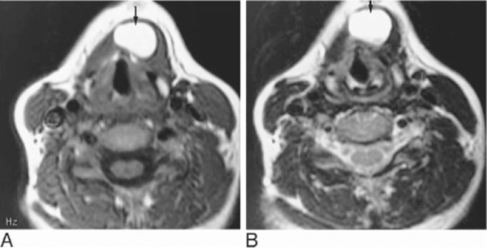
Notes:
Figure 71.12 Thyroglossal duct cyst. (A) Axial T1-weighted spin-echo and (B) T2-weighted fast spin-echo images show a well-defined high signal intensity thyroglossal duct cyst just anterior to the hyoid bone.

Slide 22
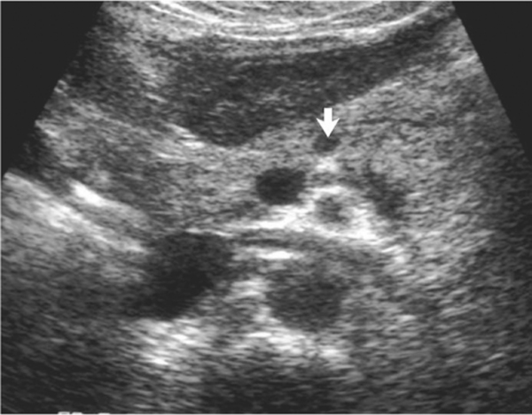
Notes:
Figure 71.15 Insulinoma. Transverse ultrasound through the upper abdomen shows a small hypoechoic insulinoma (arrow) in the neck of the pancreas.

Slide 23
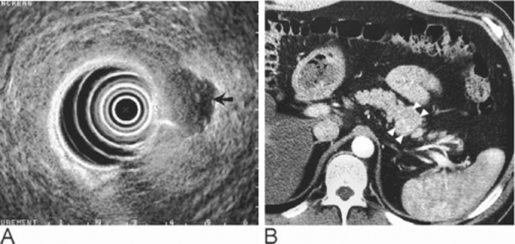
Notes:
Figure 71.16 Insulinoma on endoscopic ultrasound. (A) Endoscopic ultrasound shows a hypoechoic tumour (arrow) in the tail of the pancreas, which is seen on the (B) contrast-enhanced CT as a bulge in the tail of the pancreas (arrowheads).

Slide 24
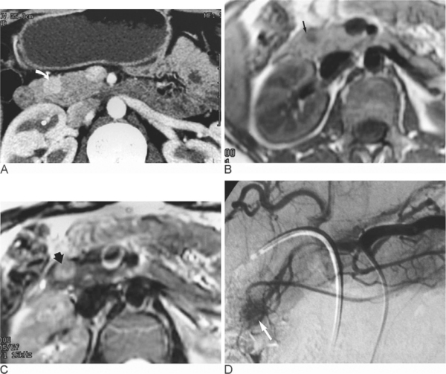
Notes:
Figure 71.17 Insulinoma. (A) Contrast enhanced spiral CT demonstrating a small brightly enhancing insulinoma (curved arrow) in the head of the pancreas. (B) Axial T1-weighted spin echo MR image and (C) T2-weighted fast spin echo image show the corresponding lesion (arrow) on MRI of low signal intensity on the T1- and high signal intensity on the T2-weighted images. (D) A coeliac arteriogram in the same patient shows the vascular blush of the insulinoma (arrow).

Slide 25
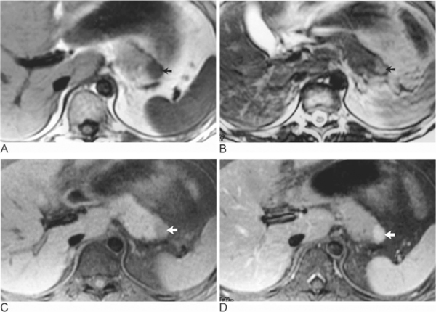
Notes:
Figure 71.18 A small non-functioning islet-cell tumour in a patient with MEN type 1 syndrome. Axial T1-weighted spin-echo (A), T2-weighted fast spin-echo (B), and fat-suppressed T1-weighted spin echo image before (C) and after (D) intravenous gadolinium administration show the typical signal intensity pattern for islet-cell tumour on the various sequences in addition to the marked enhancement following intravenous gadolinium.

Slide 26
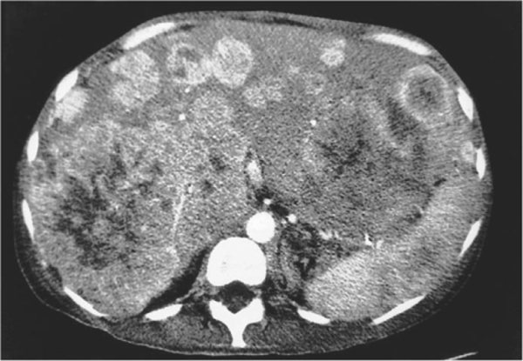
Notes:
Figure 71.19 Carcinoid liver metastases. ‘Arterial’ phase contrast enhanced CT shows multiple highly vascular lesions typical of metastases from a primary neuroendocrine tumour

Slide 27
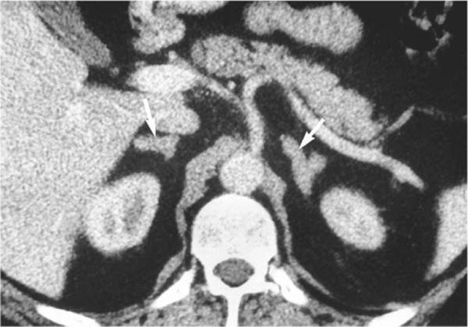
Notes:
Figure 71.21 Bilateral adrenal hyperplasia (arrows) in a patient with Cushing's disease.

Slide 28
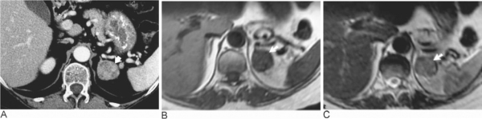
Notes:
Figure 71.22 Cushing's syndrome due to adrenocortical adenoma. (A) Contrast enhanced CT, (B) T1-weighted spin-echo and (C) T2-weighted fast spin-echo images all showing a 3 cm adenoma (arrows) in the left adrenal gland.

Slide 29
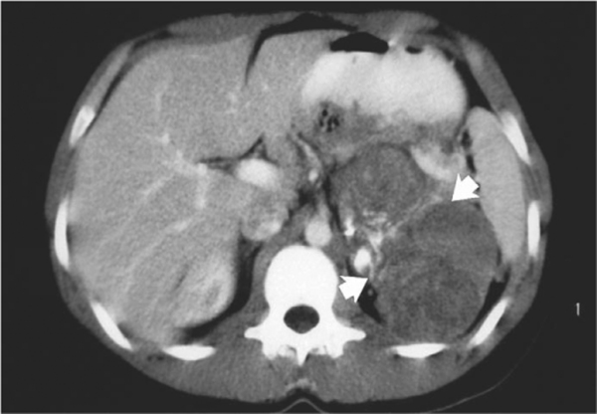
Notes:
Figure 71.23 Adrenal carcinoma. Contrast-enhanced CT demonstrating a large partly calcified, inhomogeneously enhancing left adrenal cancer (arrows).

Slide 30
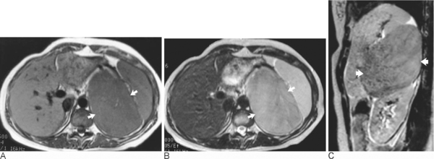
Notes:
Figure 71.24 Adrenal carcinoma on MRI. (A) Axial T1-weighted spin-echo, (B) axial and (C) sagittal T2-weighted fast spin-echo images show a large left adrenal cancer (arrows). The size of the lesion and the high signal intensity on the T2-weighted images are typical of an adrenal carcinoma.

Slide 31
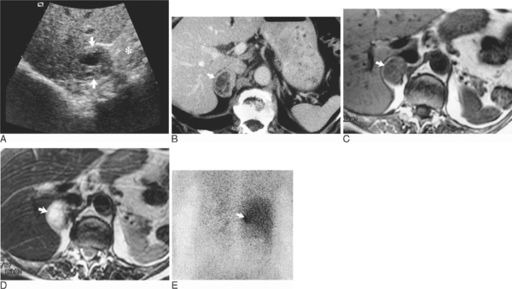
Notes:
Figure 71.27 Phaeochromocytoma with necrosis. (A) A longitudinal US examination showing an adrenal mass (arrows) lying above the kidney (*) and behind the liver. (B) Contrast-enhanced CT shows a necrotic right adrenal tumour (arrow). Axial (C) T1-weighted spin-echo and (D) T2-weighted images showing the typical signal intensity pattern of a phaeochromocytoma (arrow) in the right adrenal gland. (E) Posterior coronal view from an ¹³¹I-MIBG scintigram showing the increased focal uptake in a phaeochromocytoma (arrow) in the right adrenal gland.

Slide 32
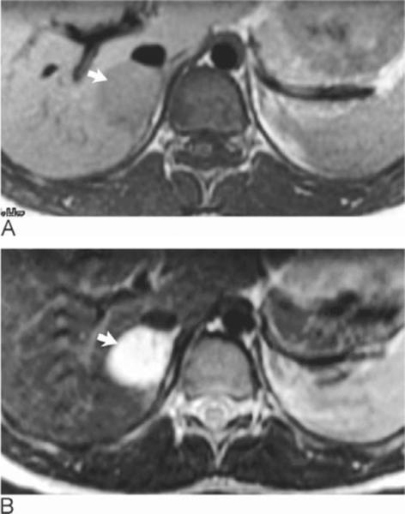
Notes:
Figure 71.28 Phaeochromocytoma on MRI. Axial (A) T1-weighted spin-echo and (B) T2-weighted fast spin-echo images showing a right adrenal phaeochromocytoma (arrow). The very high signal intensity is typical of a phaeochromocytoma

Slide 33
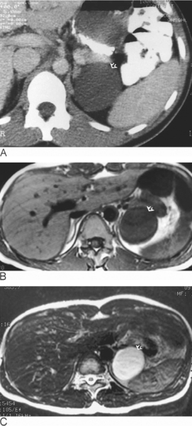
Notes:
Figure 71.29 Adrenal cyst. (A) Contrast-enhanced CT showing the typical appearance of a cyst (arrow) within the left adrenal gland. (B) T1-weighted spin-echo image shows the low signal intensity of a simple cyst (arrow). (C) T2-weighted fast spin-echo image shows the uniformly high signal intensity of a fluid filled lesion (arrow).

Slide 34
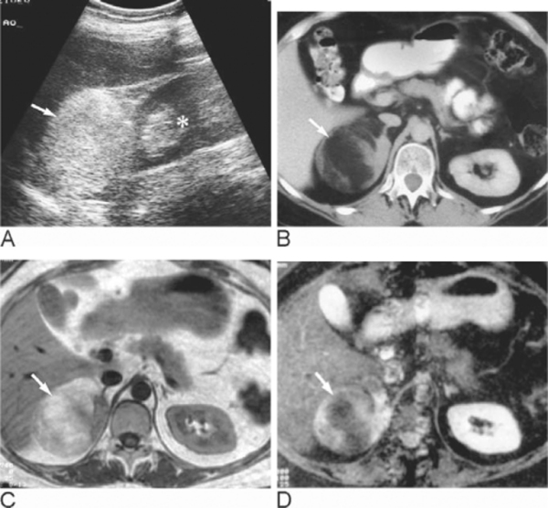
Notes:
Figure 71.30 Myelolipoma. (A) A longitudinal ultrasound showing a hyperechoic mass (arrow) lying above the right kidney (*) and behind the liver. (B) Contrast-enhanced CT showing large right adrenal mass (arrow) consisting predominantly of fat. (C) Corresponding T1-weighted MRI showing a mass consists predominantly of fat of similar intensity to the surrounding perirenal fat. (D) STIR sequence showing suppression of the signal from fat within the mass (arrow).

Slide 35
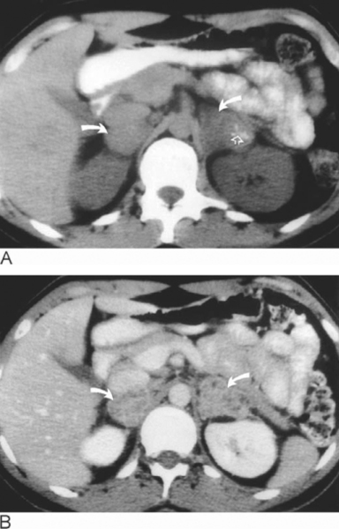
Notes:
Figure 71.31 Adrenal gland tuberculosis. (A) Nonenhanced CT showing bilateral adrenal masses (curved arrows) with punctuate calcification in the left adrenal gland (open arrow). (B) Following intravenous injection of contrast media there are the typical nonenhancing areas within the gland (curved arrows) corresponding to multiple small caseating granulomata

Slide 36
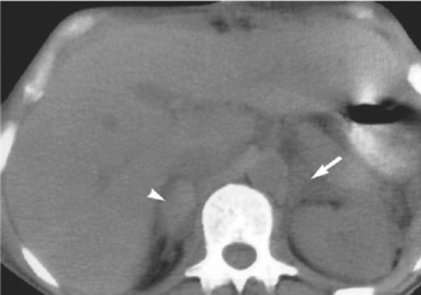
Notes:
Figure 71.32 Adrenal haemorrhage. Non-enhanced CT showing bilateral enlargement due to adrenal haemorrhage (arrow). An area of high attenuation due to bleeding is demonstrated within the right adrenal gland (arrowhead

Slide 37
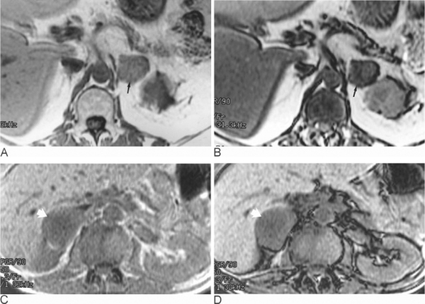
In-phase (A,C) and out-of-phase (B,D) images
Notes:
Figure 71.33 Chemical shift imaging to evaluate incidentally discovered adrenal masses. In-phase (A) and out-of-phase (B) images in a benign adrenal adenoma (arrow). The out-of-phase image shows marked loss of signal intensity within the adenoma indicating presence of intracellular lipid in keeping with a benign adenoma. In-phase (C) and out-of-phase (D) images in an adrenal metastasis from a colon cancer (arrow). The out-of-phase images show that there has been no loss of signal intensity and, therefore, the presence of intracellular fat has not been demonstrated.

Slide 38
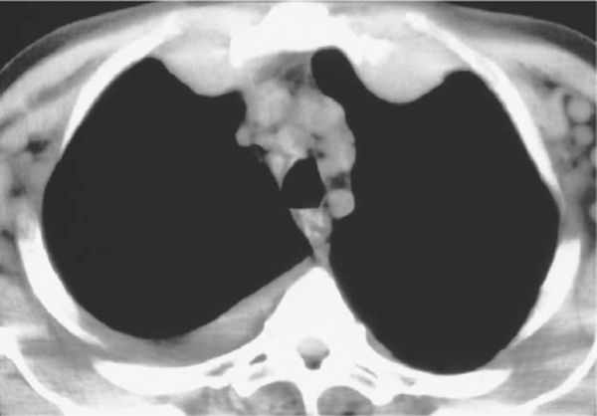
Notes:
Figure 72.1 Internal mammary lymphadenopathy. Unenhanced CT showing marked enlargement of the internal mammary lymph nodes bilaterally. Note the minimal bilateral axillary and paratracheal lymph node enlargement and small right pleural effusion.

Slide 39
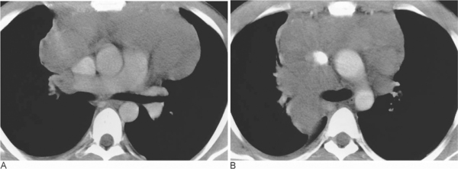
Notes:
Figure 72.3 Mediastinal masses in lymphoma. (A) Contrast-enhanced CT showing a large anterior mass in a young patient with Hodgkin's disease. No other disease was demonstrated. (B) Contrast-enhanced CT in a patient with mediastinal diffuse large B-cell lymphoma (non-Hodgkin's). The mass is involving the anterior and middle mediastinum. This subtype of non-Hodgkin's lymphoma carries a poor prognosis and, as in this patient, often involves the abdominal viscera.

Slide 40
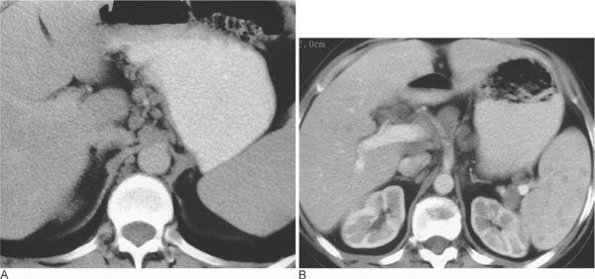
Notes:
Figure 72.4 Upper abdominal lymph node enlargement. (A) Contrast-enhanced CT showing enlarged lymph nodes in the gastrohepatic ligament. Minimal lymph node enlargement (exceeding 6 mm) is also seen in the right retrocrural region. (B) Contrast-enhanced CT showing lymph node enlargement in the region of the splenic hilum around the coeliac axis and in the porta hepatis. Multiple small, nonenhancing foci are demonstrated within the spleen, typical of splenic involvement

Slide 41
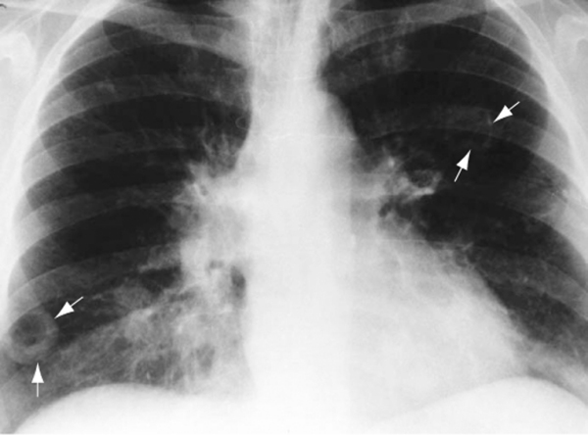
Notes:
Figure 72.5 Hodgkin's disease with cavitating lung lesions. Chest radiograph showing bilateral hilar lymph node enlargement and multiple cavitating lung nodules (arrows). The radiographic appearances are extremely variable, but the commonest pattern is that of one or more discrete nodules, with or without cavitation, which tend to be less well defined and less dense than those of primary or metastatic carcinoma, which they otherwise resemble

