Slide 1
SPOTS

Slide 2
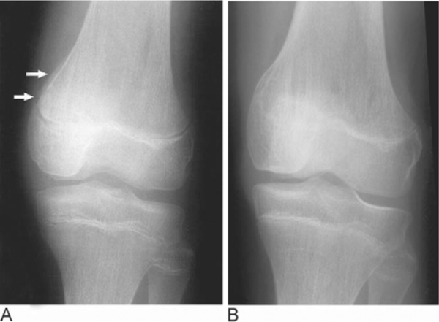
Notes:
Figure 68.12 Epiphyseal injury of the distal femur. (A) Healing epiphyseal injury (arrows) of the medial aspect of the distal femur. (B) Delayed radiograph demonstrating growth arrest due to premature fusion of the medial half of the epiphysis.

Slide 3
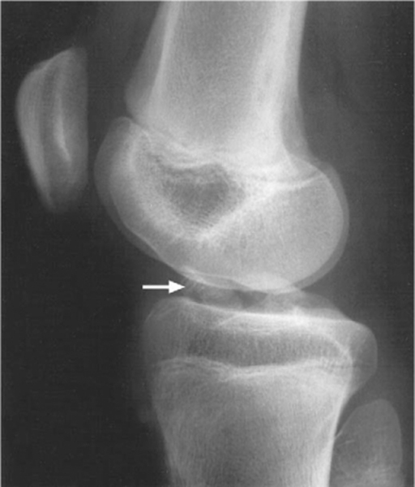
Notes:
Figure 68.13 Fracture of the anterior intercondylar eminence of the tibia (arrow).

Slide 4
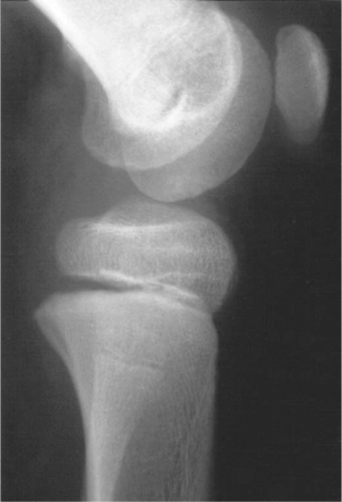
Notes:
Figure 68.14 Salter–Harris Type I epiphyseal separation of the proximal tibia.

Slide 5
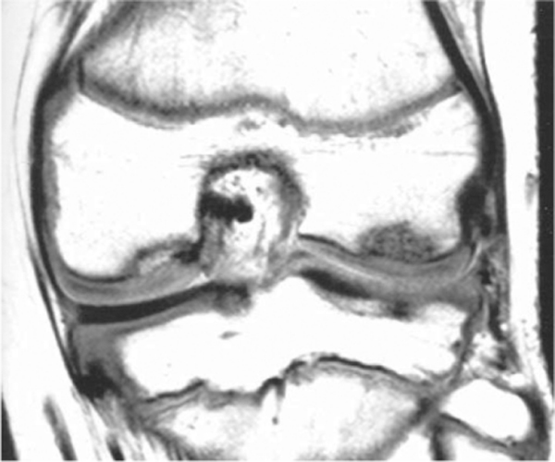
Notes:
Figure 68.15 Osteochondritis dissecans. Coronal proton density MRI demonstrating characteristic defects in both femoral condyles due to osteochondritis dissecans.

Slide 6
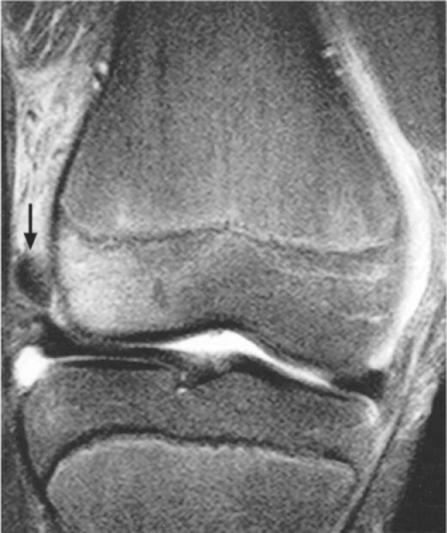
Notes:
Figure 68.16 Chondral fragment. Coronal T2-weighted MRI (with fat saturation) showing a chondral fragment (arrow) avulsed following patellar dislocation with a ‘bone bruise’ of the adjacent distal femoral epiphysis

Slide 7
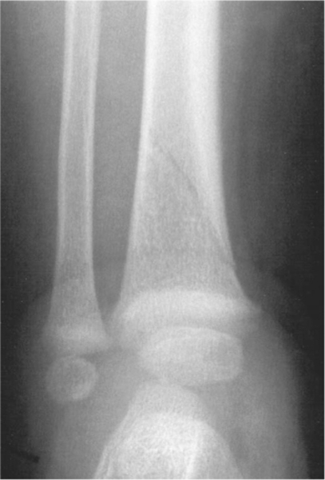
Notes:
Figure 68.17 Toddler's fracture of the distal tibial metaphysis.

Slide 8
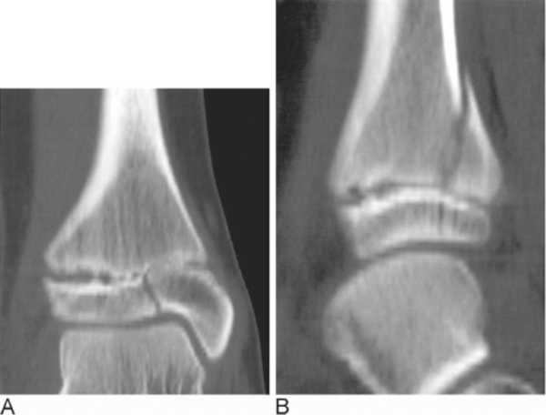
Notes:
Figure 68.18 Assessment of the extent of a triplane fracture. (A) Coronal reformat of an axial CT demonstrating epiphyseal and physeal components of a triplane fracture. (B) Saggital reformat of the same case demonstrating metaphyseal extension of the fracture.

Slide 9
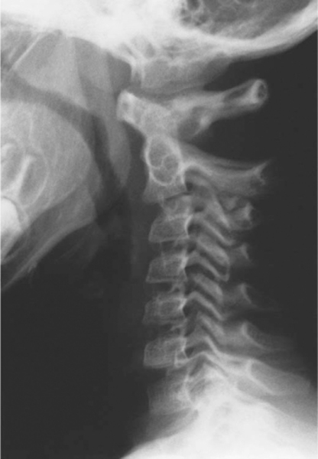
Notes:
Figure 68.21 Pseudosubluxation of C2 upon C3.

Slide 10
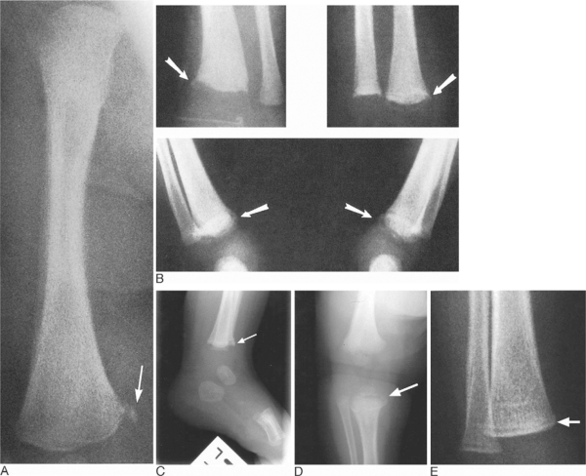
Notes:
Figure 68.24 Metaphyseal fractures. (A,B) Radiographs of the right femur (A) and both ankles (B) of a 2 month old abused infant demonstrating metaphyseal corner fractures of the distal femur and both distal tibia (arrows). The angled tangential view reveals the ‘bucket handle’ appearance of the fracture. (C) Radiograph of the left ankle of an infant demonstrates a metaphyseal corner fracture of the distal tibia (arrow). (D) Angled tangential view of the right lower limb of an abused infant demonstrates the ‘bucket handle’ appearance (arrow). (E) Radiograph of the right ankle of a 6 week old abused baby with subtle metaphyseal fractures evident as a metaphyseal lucent line (arrow).

Slide 11
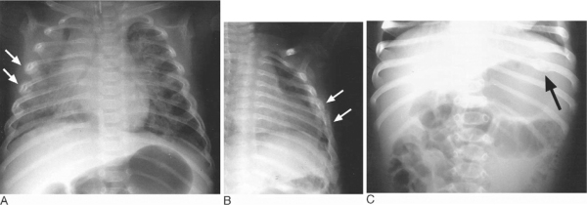
Notes:
Figure 68.26 Rib fractures. (A) Chest radiograph of an intubated 3 month old abused infant demonstrating fractures of the angles of the right third, fourth and fifth ribs associated with pulmonary contusion (arrows). (B) Oblique left-sided rib views demonstrating multiple fractures of the angles of the left third to eighth ribs at different stages of healing (arrows). (C) Healing fractures of the posterior aspects of the left seventh and eighth ribs picked up as an incidental finding on a baby who presented with abdominal signs (arrow). Nonaccidental injury was later confirmed.

Slide 12
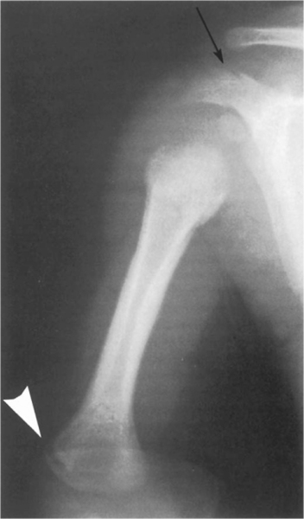
Notes:
Figure 68.27 Fracture of the acromion. AP radiograph of the right shoulder and humerus of an abused child demonstrates a fracture of the right acromion process (black arrow). There is also a metaphyseal fracture of the distal humerus (white arrowhead). A thick pathological periosteal reaction of the proximal humerus extending into the metaphysis is evident.

Slide 13
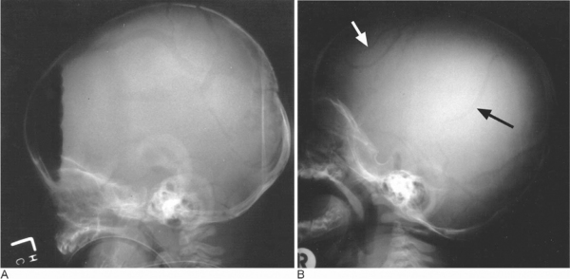
Notes:
Figure 68.28 Skull fractures. (A) Lateral skull radiograph demonstrating complex, diastatic temporoparietal skull fractures associated with pneumocephalus. A linear occipital component is also present. (B) Lateral skull radiograph demonstrating multiple skull fractures in the frontal and parietal regions (arrows).

Slide 14
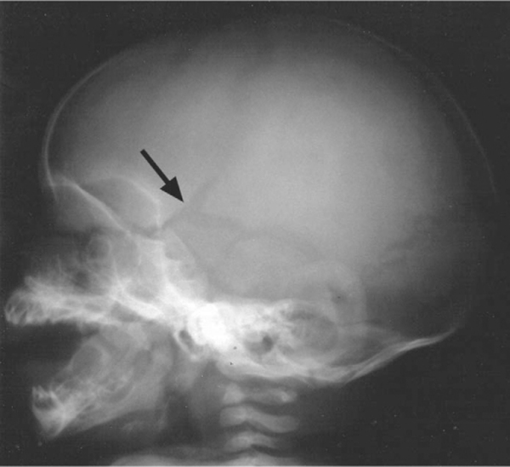
Notes:
Figure 68.29 Diastatic skull fracture. Lateral projection of the skull of an 8 month old abused infant demonstrating a complex diastatic temporal fracture (arrow).

Slide 15
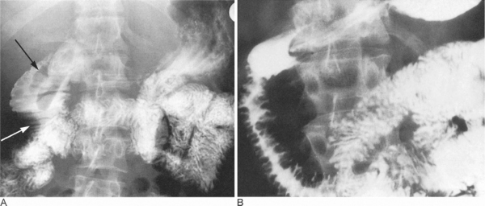
Notes:
Figure 68.31 Duodenal haematoma. (A) Upper gastrointestinal contrast study following blunt trauma to the midline demonstrates the haematoma as two low density filling defects in the second part of the duodenum (black arrow) associated with prominent thickened folds giving a coiled spring appearance (white arrow). (B) Resolving duodenal haematoma of the second part of the duodenum seen as localized intramural masses associated with prominent mucosal folds

Slide 16
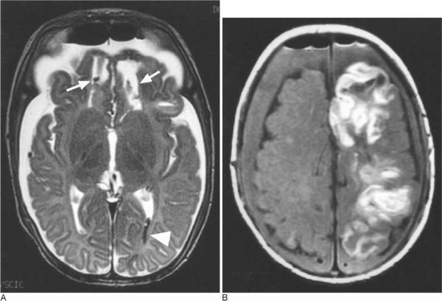
Notes:
Figure 68.33 Bilateral subdural haematoma. (A) Axial T2-weighted image of an abused infant after drainage of bilateral subdural collections demonstrating bilateral frontal, parasagittal haemorrhagic contusions (arrows). Intraventricular blood is also noted in the posterior horn of the left lateral ventricle (arrowhead). (B) Axial T1-weighted image demonstrating bilateral iso-intense subdural haemorrhages and pneumocephalus. There is an extensive area of high signal accompanied by punctate areas of low signal consistent with laminar cortical necrosis demonstrated in the left hemisphere.

Slide 17
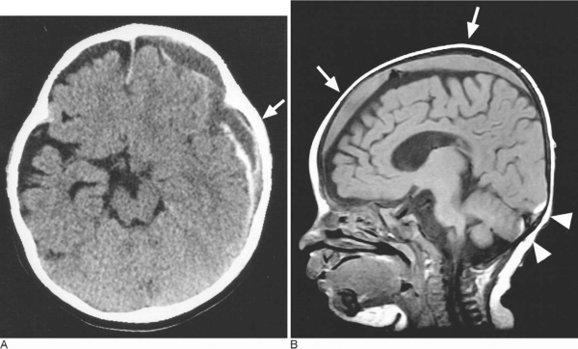
Notes:
Figure 68.35 Subdural haematomas of differing ages. (A) Acute on chronic subdural haematoma. Axial unenhanced CT demonstrating subdural blood of differing ages in the left frontal and temporal regions (arrow). (B) Sagittal T1-weighted MRI slice demonstrating fresh iso-intense subdural haemorrhage over the frontal and parietal convexities (arrows). A small amount of hyperintense subdural blood is also noted in the occipital and posterior parietal region (arrowheads).

Slide 18
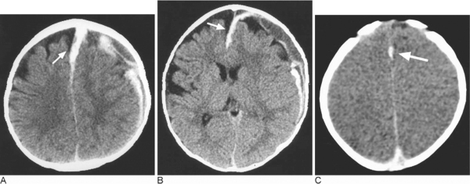
Notes:
Figure 68.36 Acute interhemispheric subdural haematoma. (A) Axial unenhanced CT demonstrating acute interhemispheric fissure subdural blood (arrow). Acute on chronic subdural haemorrhage is also present over the left frontal and parietal convexity. (B) Fresh subdural blood is seen tracking along the interhemispheric fissure anteriorly (arrow). (C) Axial unenhanced CT of a different abused baby demonstrates a thickened, bright interhemispheric fissure due to the presence of fresh subdural blood (arrow). The brain is of generalized low density due to associated oedema.

Slide 19
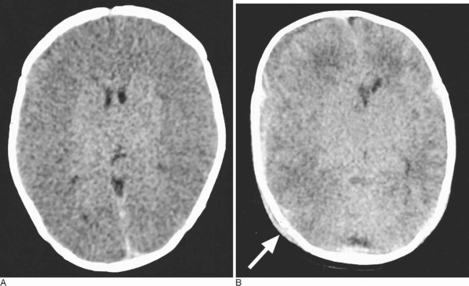
Notes:
Figure 68.37 Reversal sign in hypoxic ischaemic encephalopathy. (A) Axial unenhanced CT of an abused baby who was shaken, demonstrating the ‘reversal sign’. The brain is oedematous with loss of grey–white matter differentiation and reduced density. There is relative preservation in density of the thalami and basal ganglia. (B) Axial unenhanced CT demonstrating an oedematous, swollen brain with reduced grey–white matter differentiation and mass effect. Small bilateral hyperdense subdural bleeds are present. A right posterior parietal skull vault fracture is present and is associated with an overlying scalp haematoma (arrow).

Slide 20
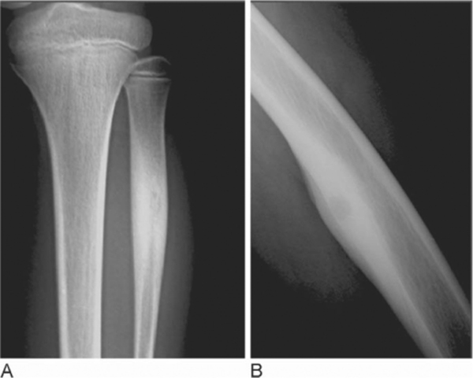
Notes:
Figure 69.1 Osteoid osteoma. (A) Intracortical osteoid osteoma of the left fibular shaft: typical oval radiolucent area, representing the nidus, with calcification inside and reactive bone sclerosis. (B) Intracortical osteoid osteoma of the left femoral shaft without calcification in the radiolucent area and perifocal osteosclerosis.

Slide 21
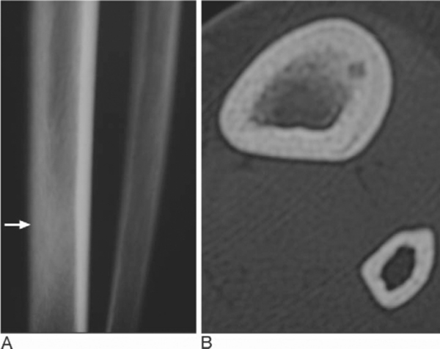
Notes:
Figure 69.2 Osteoid osteoma. Intramedullary pattern. (A) Conventional radiograph shows a minimal peri-ostosis and reactive bone sclerosis (arrow). (B) CT demonstrates the nidus.

Slide 22
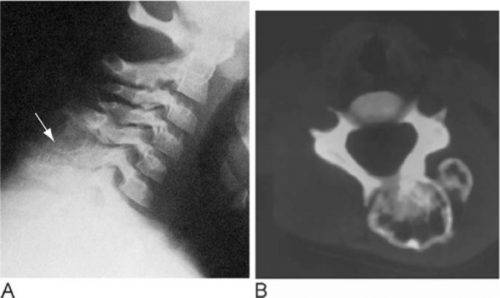
Notes:
Figure 69.3 Osteoblastoma. (A) C6 posterior arch is markedly expanded by a large lucent lesion with a sclerotic rim (arrow). (B) CT confirms the lytic nature of the lesion, with lobulated regular margins and internal septa.

Slide 23
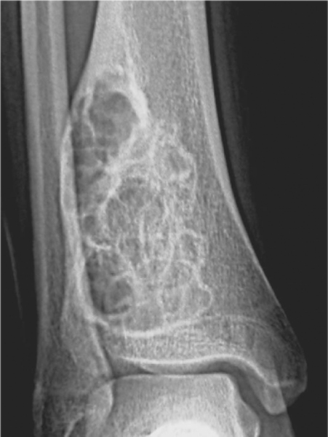
Notes:
Figure 69.4 Nonossifying fibroma with a ‘soap bubble’ appearance eccentrically located in the right distal tibia displaying a characteristic scalloped border.

Slide 24
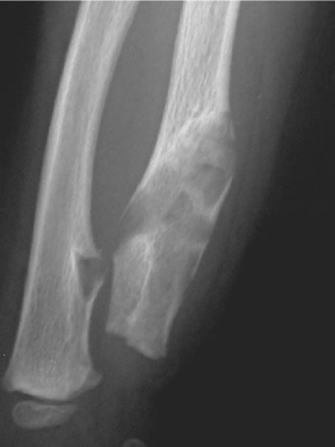
Notes:
Figure 69.5 Enchondromatosis. Multiple enchondromas in the right distal forearm.

Slide 25
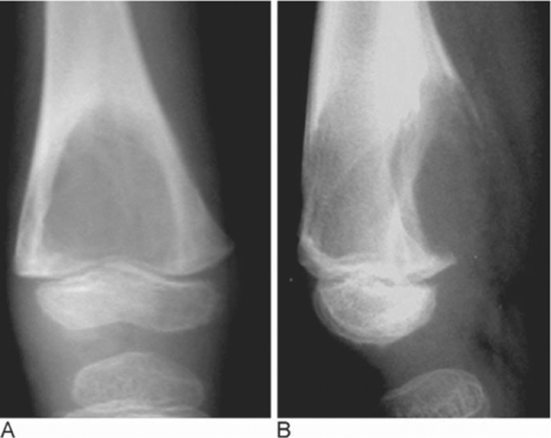
Notes:
Figure 69.7 Chondromixoid fibroma of the distal femoral metaphysis. (A,B) Large osteolytic defect bulging outward.

Slide 26
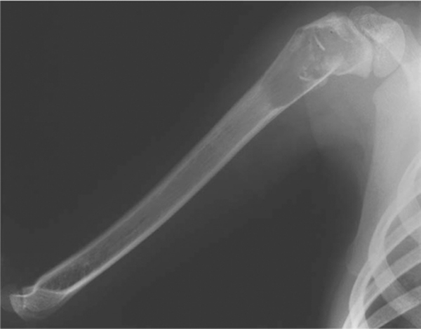
Notes:
Figure 69.8 Solitary bone cyst. Large radiolucent area of the right humerus with pathological fracture, and a ‘fallen’ fragment.

Slide 27
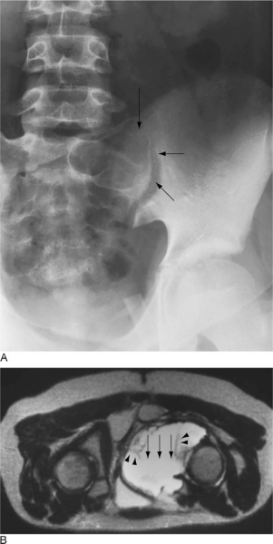
Notes:
Figure 69.9 Aneurysmal bone cyst. (A) Large well-defined cystic lesion of the left part of the sacrum (arrows), showing the ‘blow out’ pattern, with septa and bridges. (B) MRI: T2-weighted sequence, axial view. Large hyperintense mass, ‘soap bubble’-shaped lesion arising from the right ischiopubic region. Fluid–fluid level (arrows) and hypo-intense septa (arrowheads) are evident.

Slide 28
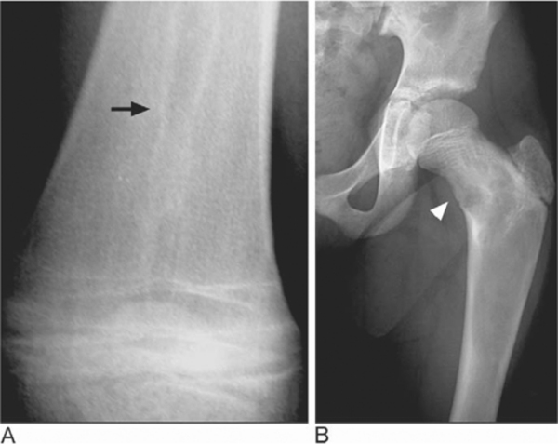
Notes:
Figure 69.10 Monostotic fibrous dysplasia. (A) Initial ‘candle flame’ aspect (arrow). (B) Cystic-like appearance (arrowhead).

Slide 29
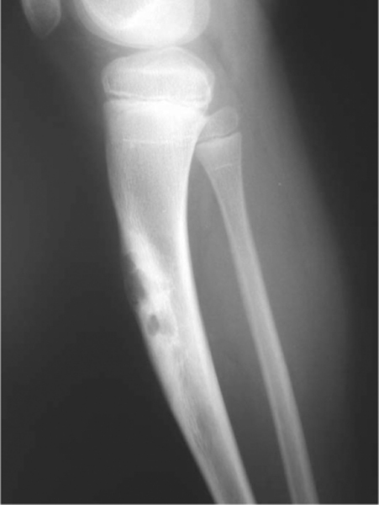
Notes:
Figure 69.11 Osteofibrous dysplasia of the tibial shaft. Multicystic lesion surrounded by sclerotic bone.

Slide 30
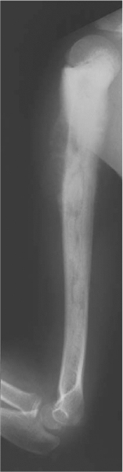
Notes:
Figure 69.12 Osteosarcoma. Mixed sclerotic and lytic lesion of the right humerus, extending into the soft tissues and sparing the growth plate. A Codman triangle is visible at the upper limit of the tumour

Slide 31
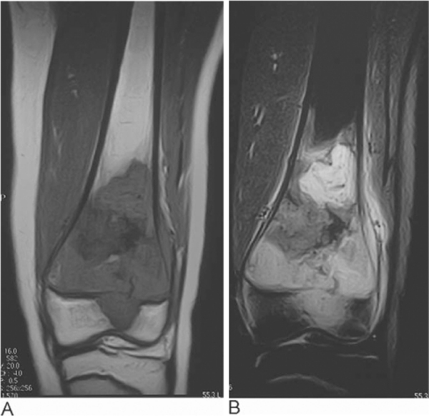
Notes:
Figure 69.13 Osteosarcoma. (A) T1- and (B) T2-weighted MRI sequences of osteosarcoma in the distal femur with transphyseal extension and a small soft tissue component laterally.

Slide 32
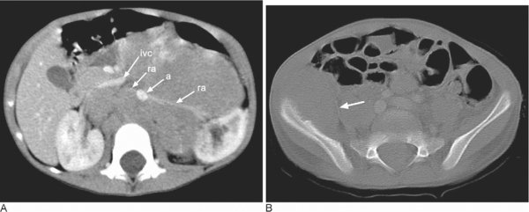
Notes:
Figure 69.15 Abdominal neuroblastoma. Contrast-enhanced CT. (A) A prevertebral tumour extends across the midline in the retroperitoneum, displaces and encases the aorta (a) anteriorly and encases the renal arteries (ra). The inferior vena cava (ivc), partially encased, is displaced anterolaterally and compressed by the tumour and nodes. The mass extends to both the renal hili. (B) Infiltrative lesion to the right iliac bone with a large soft tissue component (arrow) that projects inward as a space-occupying mass.

Slide 33
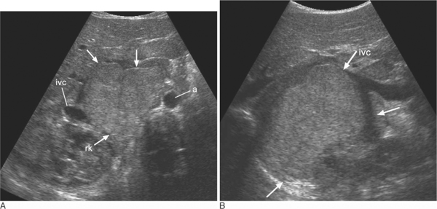
Notes:
Figure 69.16 Abdominal neuroblastoma. (A) Transverse ultrasound through the right abdomen shows a solid paraspinal mass (arrows) anterior to the right kidney (rk). The aorta (a) and inferior vena cava (ivc) are displaced by the mass. (B) Longitudinal image through the right flank shows the mass (lower arrows) and the stretched inferior vena cava (ivc).

Slide 34
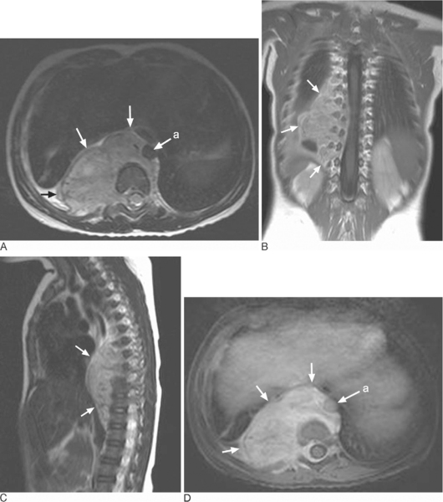
Notes:
Figure 69.17 Thoracic neuroblastoma with intraspinal extension. MRI. (A–B) axial and coronal T1-weighted images with Gd-DOTA enhancement. (C) sagittal T1-weighted image with Gd-DOTA enhancement. (D) Axial T2-weighted image. Large posterior mediastinal mass (arrows) with anterior and lateral displacement of the aorta (a), which is encased. There is massive tumour extension into the canal through the right neural foramina to displace the spinal cord to the left. Extension into the right paraspinal soft tissues is evident.

Slide 35
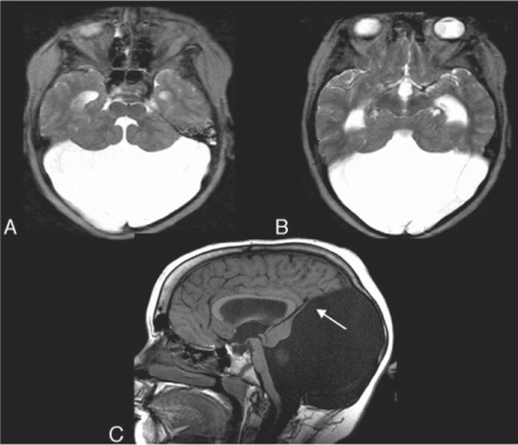
Notes:
Figure 70.5 Dandy–Walker malformation. (A,B) The fourth ventricle opens into a large posterior fossa cyst. There is associated hydrocephalus. (C) The cerebellum is hypoplastic and a thin rim of cerebellar tissue is seen forming the wall of the posterior fossa cyst (arrow). The vein of Galen, straight sinus, and venous confluence are elevated above the level of the lambdoid suture.

Slide 36
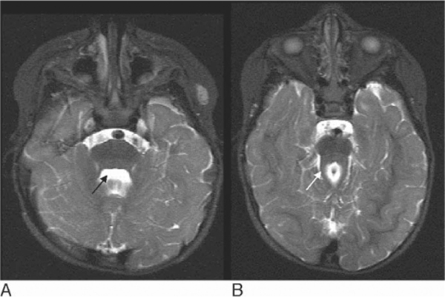
Notes:
Figure 70.6 Child with Joubert's syndrome. (A) Typical batwing appearance to the fourth ventricle (arrow) and (B) prominent superior cerebellar peduncles with failure of the normal midline decussation (arrow). This gives the typical ‘molar tooth’ appearance. The midbrain is hypoplastic in this condition.

Slide 37
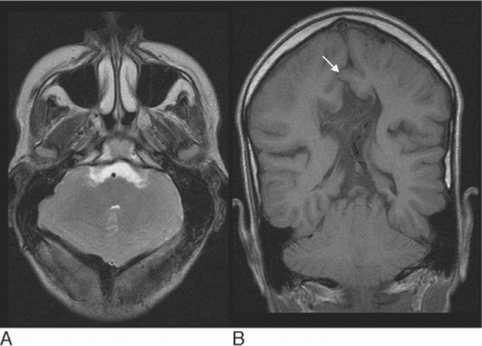
Notes:
Figure 70.8 Chiari II malformation. (A) The posterior fossa is enlarged and ‘shield shaped’. The fourth ventricle is small and slit-like. (B) The cerebellum towers superiorly through the tentorium and there is interdigitation of a cerebral gyrus through the fenestrated falx (arrow).

Slide 38
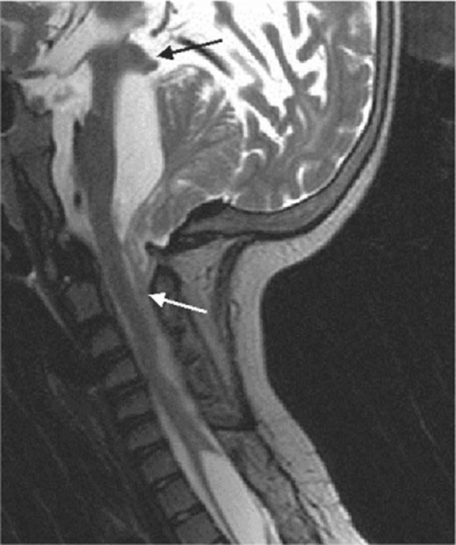
Notes:
Figure 70.9 Chiari II malformation. The fourth ventricle, which should normally be small and slit-like in this condition, is enlarged, indicating hydrocephalus. There is cascading tonsillar tissue herniating through the foramen magnum (white arrow). Beaking of the tectal plate is also seen (black arrow), as well as a cervical spinal cord syringomyelic cavity.

Slide 39
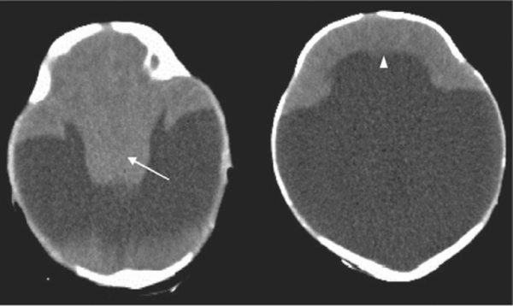
Notes:
Alobar holoprosencephaly Figure 70.10 CT brain of this infant shows that the cerebral hemispheres have failed to form and there is no interhemispheric fissure or corpus callosum. Instead there is a thin pancake of cerebral tissue crossing the midline anteriorly (arrowhead) and a single holoventricle continuous with a large dorsal cyst. The midbrain and deep grey structures are fused into a single indiscriminate mass (arrow).

Slide 40
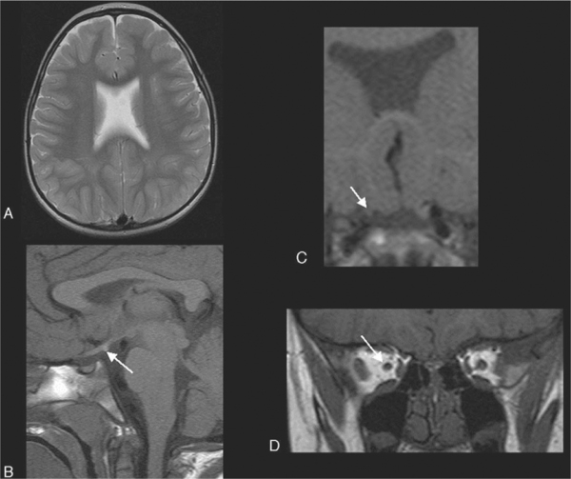
Notes:
Figure 70.11 Septo-optic dysplasia in a child with HESX1 gene mutation. (A) The septum pellucidum is absent and the frontal horns have a typical box-like configuration. (B) The posterior pituitary gland is ectopic (arrow). (C,D) The right optic nerve is small (arrows).

Slide 41
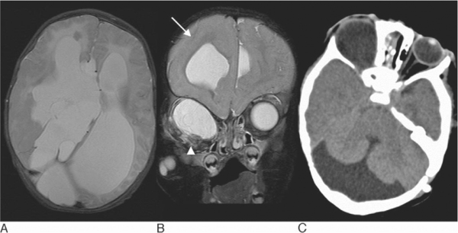
Notes:
Figure 70.12 Child with skin lesions and right orbital cyst in oculocerebrocutaneous syndrome or Delleman's syndrome . (A) There is callosal agenesis with dorsal interhemispheric cysts. (B) The right cerebral hemisphere is dysplastic with thickening of the cortex and an indistinct grey–white matter junction (arrow). There is a cyst expanding the orbit with a small calcified globe seen inferiorly (arrowhead). (C) An associated Dandy–Walker posterior fossa malformation is also present.

