Slide 1
PORTAL HYPERTENSION
Dr. MONICA PATIL
Senior resident
Department of Radiodiagnosis
BJMC & SGH Pune
Moderator-Dr PAWAR MAM

Slide 2
Anatomy and collateral circulation
The portal system consists of all the veins which carry blood from the abdominal part of the alimentary tract except lower rectum and anal canal.
It also receives drainage from the pancreas, spleen and gall bladder.

Slide 3
The main portal vein is 6-8 cm long formed by the union of splenic vein and superior mesenteric vein dorsal to the neck of pancreas at the level of L1-L2 vertebrae.
The terminal branches of portal vein and hepatic artery open into sinusoids at different levels.
The sinusoids normally represent the only connection between hepatic artery and portal vein on one hand and the hepatic veins on the other which carry blood away from the liver and drain into the IVC.

Slide 4
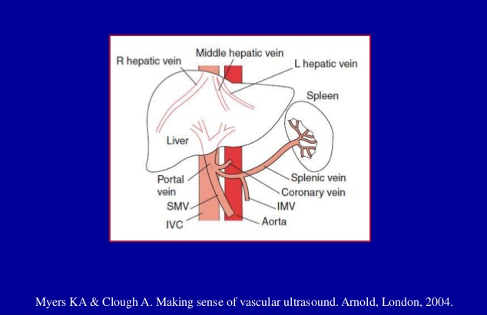
Normal Portal Venous Circulation

Slide 5
The portal system is unique in certain aspect as blood is not pumped into the portal system but is driven by pressure gradient between the portal and systemic venous systems.
Portal vein and its tributaries are devoid of valves. This plays an important role in the development of collaterals.

Slide 6
Normal hepatic circulation

Slide 7
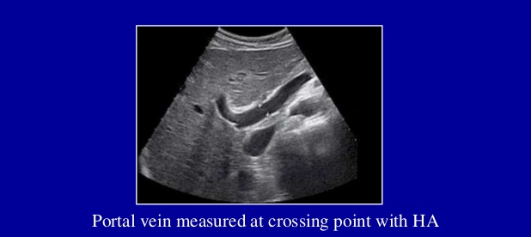
Portal Vein
On fasting state upper normal limit of portal vein is 13-14 mm.

Slide 8
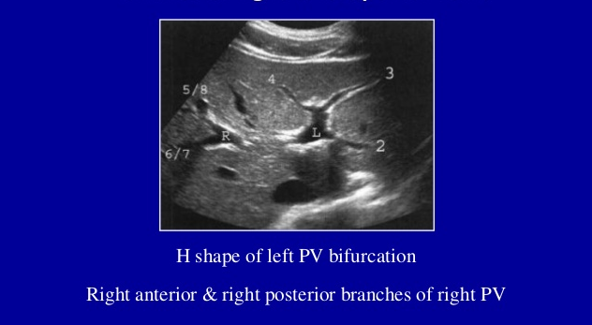
Branches of right and left portal vein

Slide 9
Major anatomical variant of portal system

Slide 10
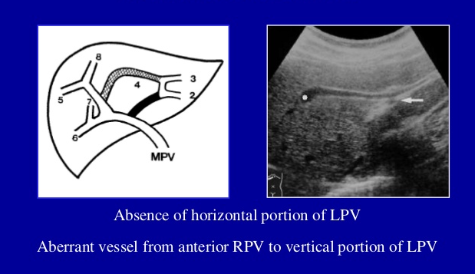
Agenesis of left portal vein

Slide 11
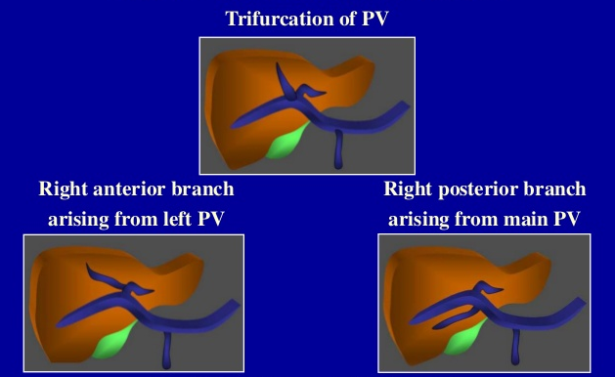
Anatomic variants of portal vein

Slide 12
Splenic Vein

Slide 13
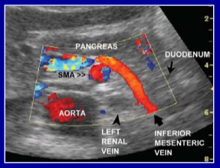
Inferior Mesenteric Vein
Anterior to left renal vein and SMA and posterior to duodenum.
Upper limit of normal is 7 mm.
IMV inserting into portal confluence 33%.

Slide 14
Jejunal Vein

Slide 15
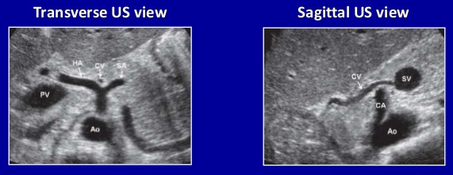
Normal left gastric (coronary) vein
Coronary vein seen anterior to bifurcation of celiac artery.
Coronary vein draining into splenic vein.
Upper normal limit is 5-6 mm.

Slide 16
Umblical vein remnant Normal < 3mm
Transverse view of LT
Longitudinal view of LT
Color Doppler view
No detectable flow within UV remnant
Ligamentum Teres hypoechoic remnant of UV.
Communicates with LPV

Slide 17
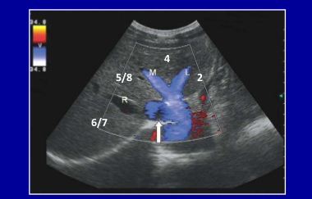
Normal hepatic veins
Three hepatic veins enter IVC 2 cm caudad to right atrium.
Middle and left hepatic veins form common trunk (60 %).

Slide 18
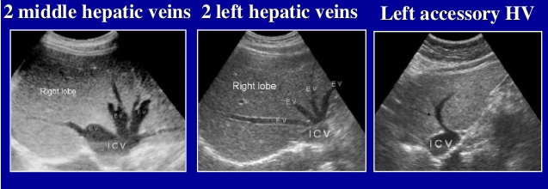
Hepatic vein variant

Slide 19
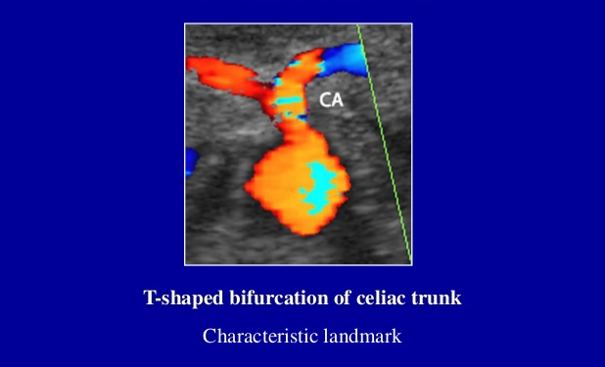
Normal Hepatic Artery

Slide 20
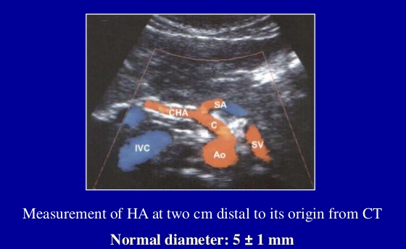
Normal Hepatic Artery
CT : Celiac trunk

Slide 21
Hepatic Artery

Slide 22
Anatomical variations of hepatic artery

Slide 23
CLASSIFICATION OF PORTAL HYPERTENSION
A]HYPERKINETIC- Arterioportal fistula formation Tumor: HCC – Hemangioma
Percutaneous liver biopsy , Percutaneous biliary drainage, Rupture vein aneurysm
B]INCREASED PORTAL VEIN RESISTANCE
1}INTRAHEPATIC
i)Presinusoidal: NCPF, schistosomiasis, congenital hepatic fibrosis, sarcoidosis, lymphoma
ii)Postsinuisoidal: alcoholic, postnecrotic, veno-occlusive disease
2}EXTRAHEPATIC
i)Prehepatic: SMV, SV thrombosis, portal cavernoma formation
ii)Posthepatic-hepatic vein obstruction, suprahepatic IVC obstruction, CHF, constrictive pericarditis.

Slide 24
Portal hypertension is defined as an increase in portal pressure above the normal range of 6-10 mm of Hg between hepatic veins and portal vein
or
portal vein pressure of more than 30 cm of saline measured at surgery

Slide 25
Porto-systemic collaterals High sensitivity & specificity for PHT
Tributary collaterals
“Drain normally into PS”
Coronary vein (left gastric)
Short gastric veins
Branches of SMV & IMV
Recanalized umbilical vein
Spleno-renal collateral
Gastro-renal collateral
Spleno-retroperitoneal collateral
Developed collaterals
“Developed or recanalized”
Robinson KA et al. Ultrasound Quarterly 2009 ; 25 : 3 – 13.

Slide 26
Bridging collaterals
In extra hepatic obstruction of the portal venous system, bridging collaterals help restore hepatopetal flow.
A- Splenic vein occlusion- Portal flow is diverted via the short gastric veins to portal vein via LGV or via gastroepiploic veins to SMV to portal vein.
B - Portal vein thrombosis- Blood flow is directed to the liver via parabiliary venous plexus(cavernoma).

Slide 27
Investigations in portal hypertension include
Plain X rays
Barium contrast examinations
Sonography and CDFI
CT and CT portography
MR and MR portography

Slide 28
Plain X rays
Plain X rays are of limited value.
Chest X ray may show a dilated azygous system while x ray abdomen may show nonspecific findings of hepatosplenomegaly and haze due to ascitis.

Slide 30
Barium contrast examination
In the left anterior oblique position after administration of anti cholinergic agents with Valsalva maneuver is optimally suited for demonstration of oesophageal varices which are seen as thickened serpiginous folds.
Gastric varices and rectal varices can also be detected using barium contrast studies however their role has become limited with the widespread use of endoscopy.

Slide 31
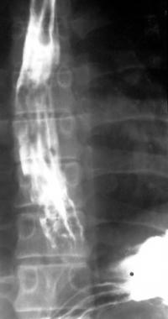
Barium swallow study showing esophageal

Slide 32
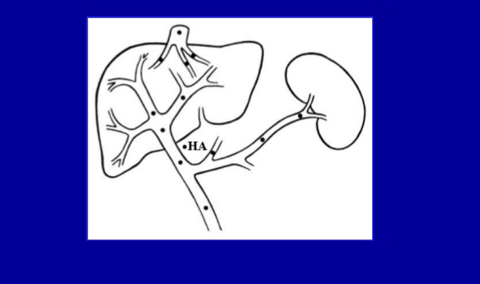
Sites of duplex insonation of portal system

Slide 33
Prerequisite for doppler USG
Color box/ Overlay
Adjusting color velocity scale
Adjusting color gain
Changing color baseline to avoid aliasing
Inversion of color flow
Changing color doppler wall filter
Angle of Insonation

Slide 34
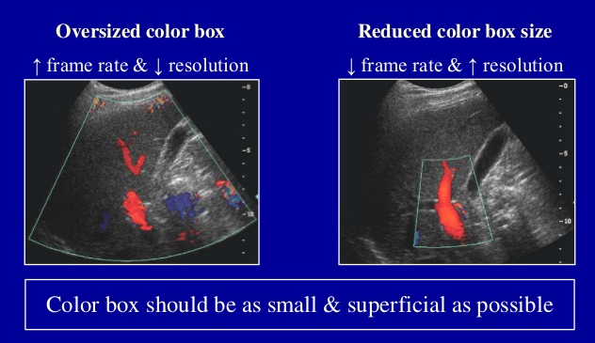
Color box/ Overlay

Slide 35
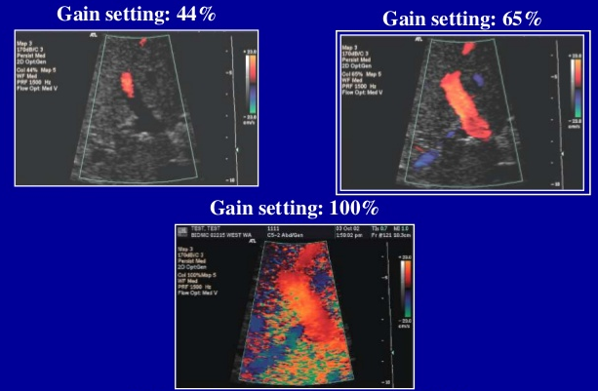
Adjusting color gain

Slide 36
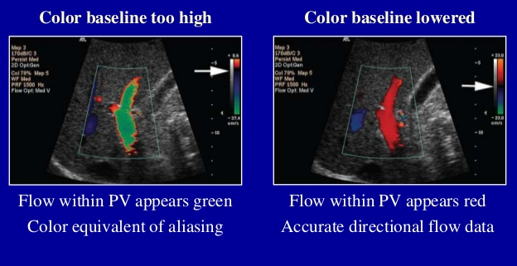
Changing color baseline to avoid aliasing

Slide 37
Inversion of color flow

Slide 38
Changing color doppler wall filter

Slide 39
Angle of Insonation

Slide 40
Obtain waveform at end of normal breath-out

Slide 41
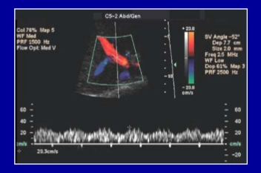
Normal pulsed doppler of portal vein
Sample gate placed in middle of portal vein.
Width of sample gate approximately half the lumen.
Pulsed Doppler obtained at end of normal breath out.

Slide 42
Measurement of portal vein velocity

Slide 43
Normal Portal Vein
Diameter: Upper limit of normal in fasting state: 13-14mm
Age related variation add 1 for every 10 years after 60years.
> 20-30% increase with food and inspiration.
Flow Direction: Towards liver (hepatopetal)
Through entire cardiac cycle.
Velocity: Varies greatly
Mean Velocity : 15-18 cm/sec
Varies with cardiac and respiration activity undulating appearance of waveform

Slide 44
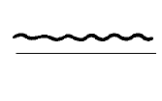
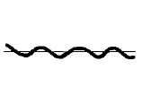
Cirrhosis & PHT / Portal vein flow
Normal flow
To and fro flow
Reversed flow
Advanced PHT
Heart failure
Arterio-portal fistula
Advanced PHT
Porto-systemic shunt
SOS
SOS: Sinusoidal obstruction syndrome
Kok Th et al. Scand J Gastroenterol 1999 ; 34 (Suppl 230) : 82 – 88.

Slide 45
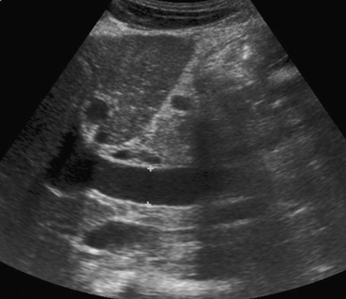
Cirrhosis & PHT / Diameter of portal vein
Longitudinal view of MPV
Contoversy on normal PV diameter
Up to 13 mm in one study¹
Up to 16 mm in another study²
Unusual large PV: sign of PHT
Normal PV size: does not exclude PHT
Diameter: 16.9 mm
Sign of portal hypertension
¹ Weinreb J et al. Am J Roentgenol 1982 ; 139 : 497 – 499.
² Goyal AK et al. J Ultrasound Med 1990 ; 9 : 45 – 48.
Robinson KA et al. Ultrasound Quarterly 2009 ; 25 : 3 – 13.

Slide 46
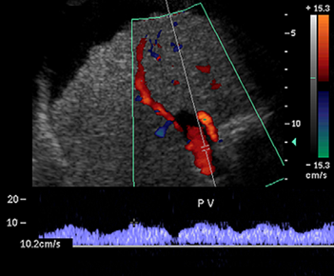
Cirrhosis & PHT / Portal vein velocity
Triplex image of PV
Controversy on normal PV velocity
Normal mean velocity: 15 – 18 cm/sec
Low velocity: good indicator of PHT
Normal velocity: does not exclude PHT
Shrunken liver & irregular margin
Vmax: 10 cm/s
Diagnosis of PHT
Swart J et al. Ultrasound Clin 2007 ; 2 : 355 – 375.

Slide 47
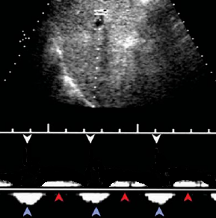
Cirrhosis & PHT / To-and-fro flow in PV Cardiac cycle
Duplex US of LPV during suspended respiration
Hepatopetal & hepatofugal with each heart beat
Seen before frank hepatofugal flow
Wachsberg RH et al. RadioGraphics 2002 ; 22 : 123 – 140.

Slide 48
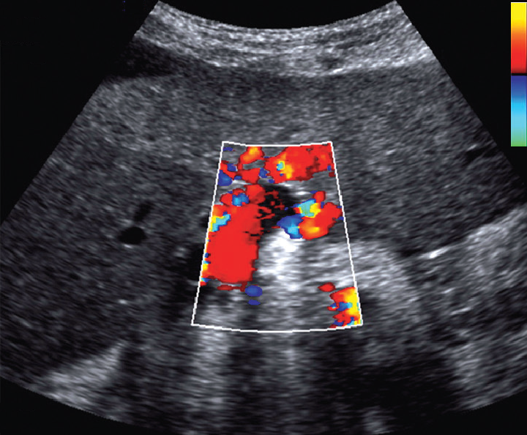
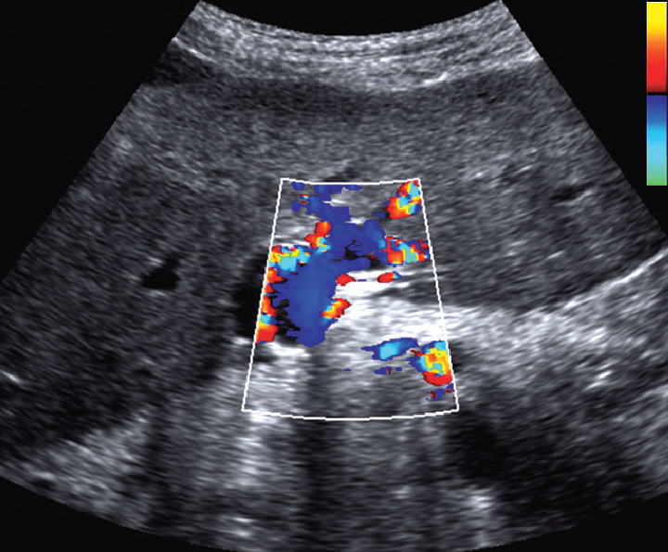
Cirrhosis & PHT / To-and-fro flow in PV Respiratory cycle
Transverse color Doppler US of left portal vein
Hepatopetal flow
Hepatofugal flow
On real-time US, these alterations corresponded to respiratory cycle
Robinson KA et al. Ultrasound Quarterly 2009 ; 25 : 3 – 13.

Slide 49
Causes of to-and-fro flow
- Portal hypertension
- Tricuspid regurgitation
- Right heart failure
- Arterio-portal vein fistula
Exaggerated pulsatility
Minimum velocity below baseline
Robinson KA et al. Ultrasound Quarterly 2009 ; 25 : 3 – 13.

Slide 50
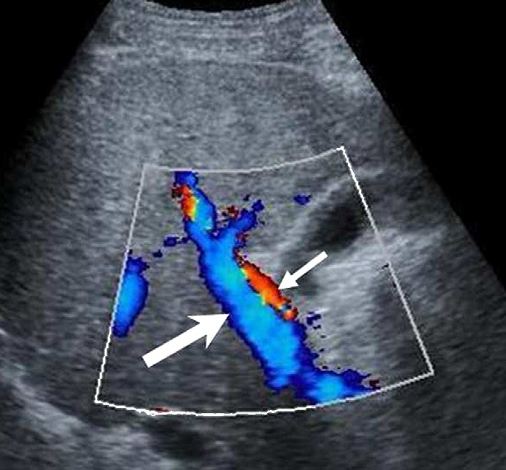
Cirrhosis & PHT / Reversed flow of PV
Severe PHT – Rare
Hepatofugal flow in PV
Not pathognomonic feature of cirrhosis
Robinson KA et al. Ultrasound Quarterly 2009 ; 25 : 3 – 13.
Notes:
Hepatic artery and the portal vein have blood flowing in opposite directions.

Slide 51
Normal cardiac pulsatility of portal vein

Slide 52
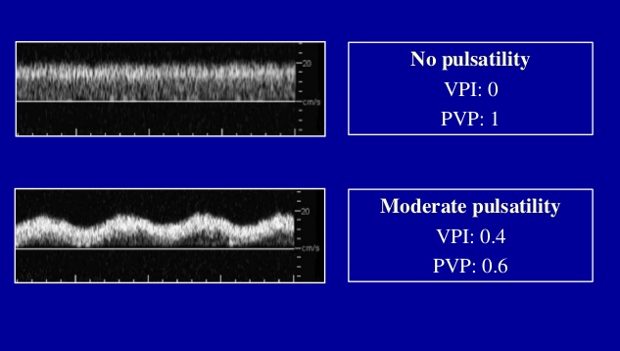
Normal cardiac pulsatility of portal vein

Slide 53
Normal cardiac pulsatility of portal vein

Slide 54
Congestion index of portal vein

Slide 55
Portal vein flow volume

Slide 56
Laminar and helical flow in portal vein

Slide 57
Helical portal vein flow

Slide 58
Helical portal vein flow near bifurcation

Slide 59
Helical portal vein flow- mimic of hepatofugal flow

Slide 60
Color Doppler of normal hepatic vein
Normal diameter < 10mm 2 cm before entrance into IVC.

Slide 61
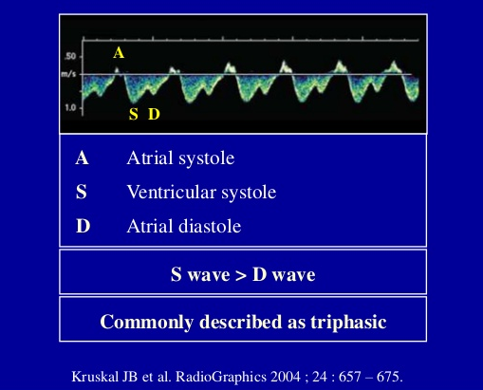
Normal hepatic vein waveform- 3 components

Slide 62
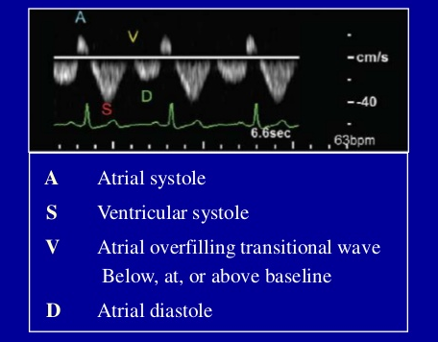
Normal hepatic vein waveform- 4 components

Slide 63
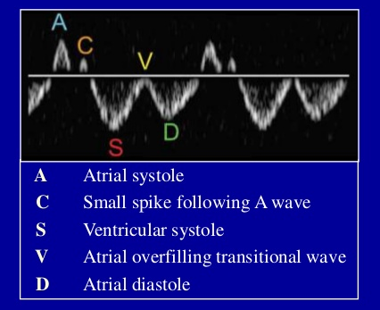
Normal hepatic vein waveform- 5 components

Slide 64
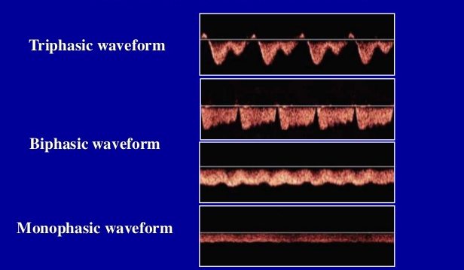
Classification of Doppler HV waveform Measurement taken in RHV/MHV
RHV: Right hepatic vein
LHV: Left hepatic vein

Slide 65
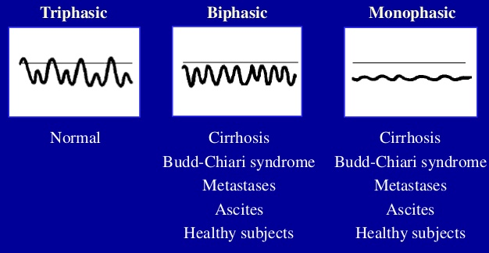
Interpretation of hepatic vein flow

Slide 66
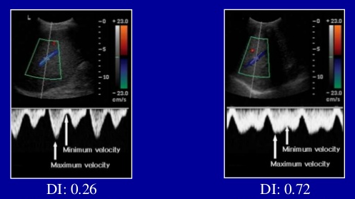

Slide 67
Interpretation of HV spectral waveform
Notes:
BCS: Budd chiari syndrome.

Slide 68
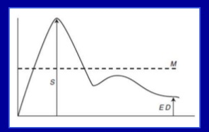
Normal hepatic artery- Impedance indices
RI: S – ED / S Normal value = 0.65 +/- 0.1
PI: S – ED / M Normal Value = 0.92 +/- 0.1

Slide 69
Normal hepatic artery

Slide 70
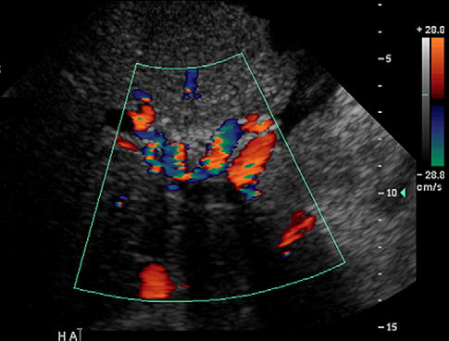
Cirrhosis & PHT / Prominent hepatic artery
Enlarged HA with tortuous or ‘‘corkscrew’’ appearance
Increased flow in HA to compensate decreased flow in PV
Swart J et al. Ultrasound Clin 2007 ; 2 : 355 – 375.

Slide 71
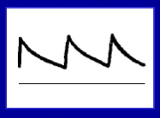
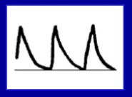
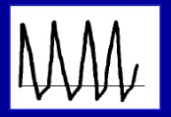
Interpretation of hepatic artery flow
Low resistance flow – Normal
Decreased diastolic flow – ESLD
Reversed diastolic flow – ESLD
ESLD: End stage liver disease

Slide 72
Doppler US signs of PHT in cirrhosis
P-S collaterals Highly sensitive & specific
Portal vein Dilated PV
Decreased mean velocity (< 15 cm/sec)
To-and-fro flow /Hepatofugal flow
Increased pulsatility (VPI) >0.48+/-0.31
Arterio-portal fistula
Hepatic vein Compression (Pseudo-portal flow)
Hepatic artery Enlargement & tortuosity
Increased RI & PI
P-V: portovenous, VPI: Venous pulsatility index
Harkanyi Z. Ultrasound Clin 2006 ; 1 : 443 – 455.
Notes:
Venous pulsatility index= Vmax-Vmin/Vmax NI= 0.48 +/- 0.31
Portal vein pulsatility = Vmin/Vmax = 0.31 +/- 0.1

Slide 73
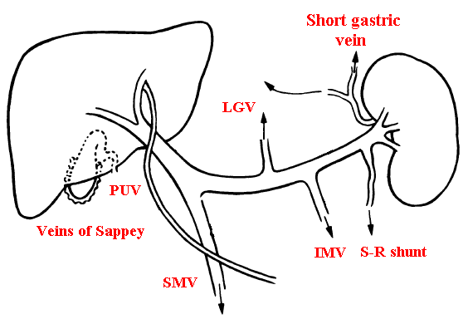
Common spontaneous porto-systemic collaterals More than 20 P-S collaterals described
Most common: LGV – PUV – Spleno-renal – Gastro-renal
Patnquin1 H et al. Am J Roentgenol 1987 ; 149 : 71 – 76.

Slide 74
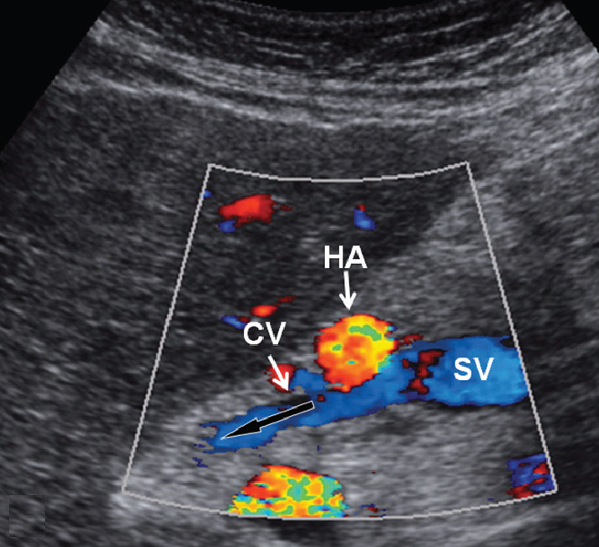
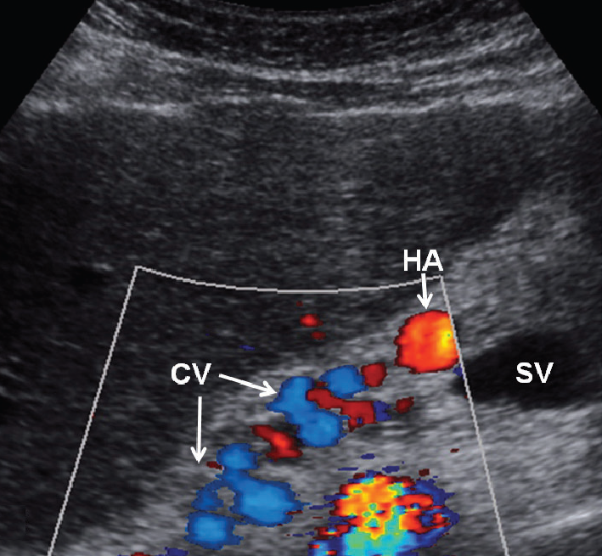
P-S collaterals / Coronary vein Most prevalent (80-90%) – Most clinically important
Sagittal paramedial view
Sagittal view slightly superior
Flow in CV directed superiorly
& away from splenic vein
Tortuosity of CV as it extends
superiorly toward GE junction
Robinson KA et al. Ultrasound Quarterly 2009 ; 25 : 3 – 13.
Notes:
Most prevalent portal systemic collateral present in 80% to 90%of patients with portal hypertension.
Most clinically important of the portal systemic collaterals because its presence implies an increased risk for variceal hemorrhage.

Slide 75
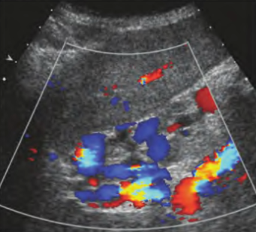
P-S collaterals / Gastroesophageal collaterals
Longitudinal view of left liver lobe
Gastroesophageal collateral veins close to diaphragm
McGahan J et al. Diagnostic ultrasound, Informa Healthcare, 2nd edition, 2008.

Slide 76
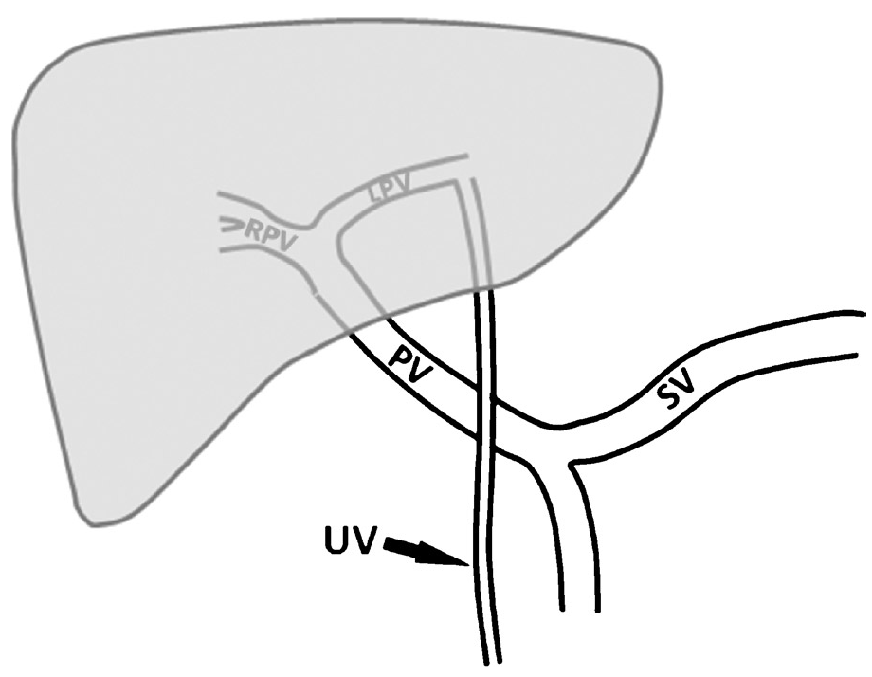
Normal umbilical vein anatomy
UV communicates with umbilical segment of LPV,
travels down the anterior abdominal wall towards umbilicus.
Eventually it drains into systemic circulation via inferior epigastric vein.
Robinson KA et al. Ultrasound Quarterly 2009 ; 25 : 3 – 13.

Slide 77
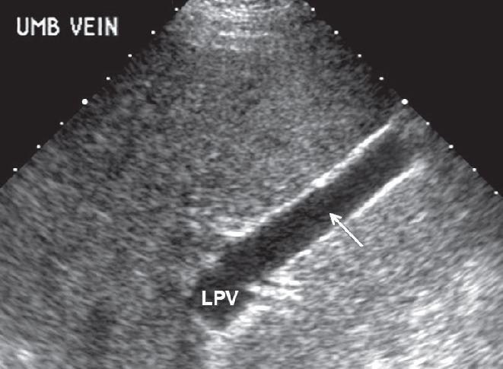
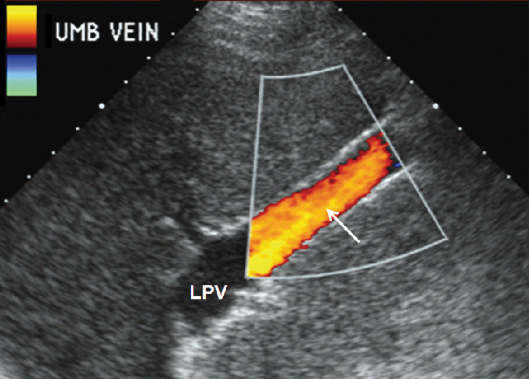
P-S collaterals / Recanalized umbilical vein
Longitudinal US of LLL
Similar color Doppler view
Dilated umbilical vein (10 mm)
PUV observed only in hepatic or suprahepatic blockage
LLL: Left lobe of Liver
Robinson KA et al. Ultrasound Quarterly 2009 ; 25 : 3 – 13.

Slide 78
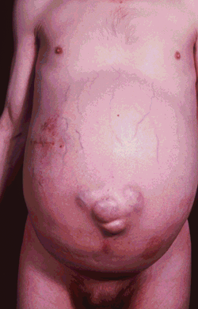
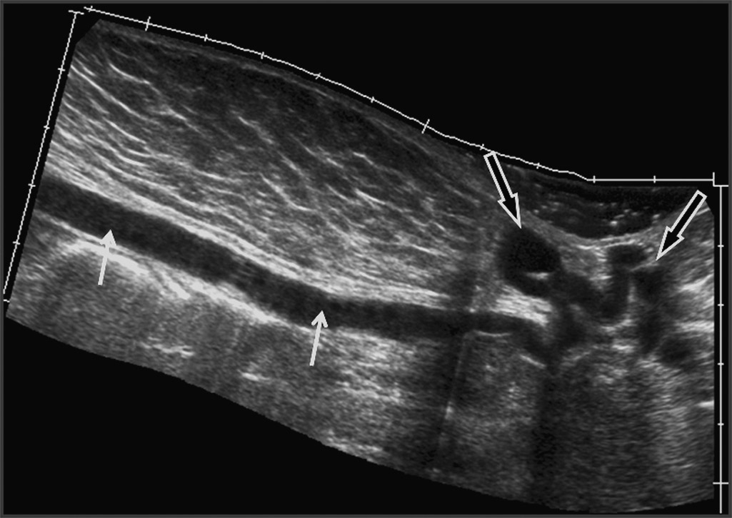
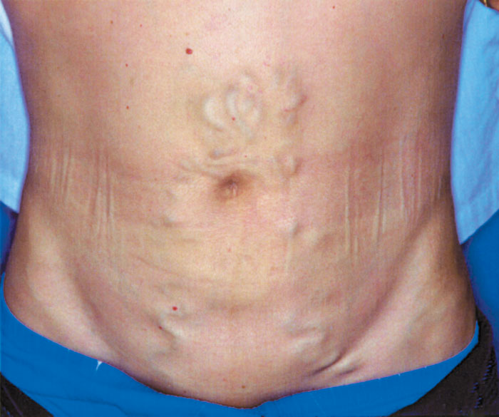
P-S collaterals / Recanalized umbilical vein Caput medusae
Sagittal panoramic view
PUV traveling to periumbilical region where it becomes tortuous.
UV ramifies into smaller PU collaterals when it proceeds inferiorly

Slide 79
Porto-systemic collaterals
Coronary vein & umbilical vein are the easiest
& most productive to analyze
Other collaterals detected sonographically
albeit with more difficulty in some cases
Robinson KA et al. Ultrasound Quarterly 2009 ; 25 : 3 – 13.

Slide 80
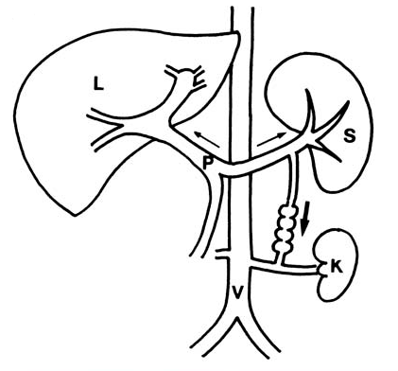
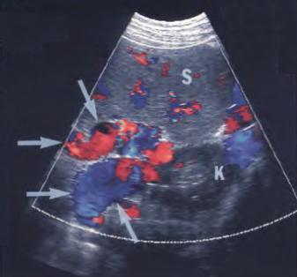
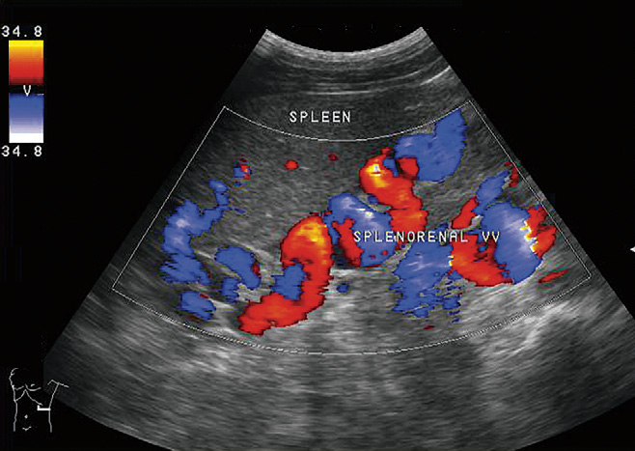
P-S collaterals / Spleno-renal collateral
Schematic drawing
Transverse color Doppler US
Flow direction from SV to LRV
Reversed or to-and-fro flow in SV
Splenic vein feeding large
splenorenal collaterals
Yamada M et al. Abdom Imaging 2006 ; 31:701 – 705.
Mansour MA et al. Vascular Diagnosis. Elsevier-Saunders, Philadelphia, 1st edition, 2005.
Notes:
Determination of flow direction in splenic vein increases the diagnostic confidence of S-R shunt.

Slide 81
P-S collaterals / Short gastric veins
Short gastric vein as inflowing vessel to gastric varices
Sato T et al. J Gastroenterol 2002 ; 37 : 604 – 610.

Slide 82
P-S collaterals / Inferior mesenteric vein
Hepatofugal flow in IMV originating from PV confluence
Mansour MA et al. Vascular Diagnosis. Elsevier-Saunders, Philadelphia, 1st edition, 2005.

Slide 83
P-S collaterals / IMV & rectal venous drainage
Left parasagittal CDUS
Transverse US posterior to bladder
Hepatofugal flow in dilated IMV
Peri-rectal varices
Wachsberg RH. Am J Roentgenol 2005 ; 184 : 481 – 486.

Slide 84
P-S collaterals / Gallbladder varices
Serpentine area in wall of GB
Cystic vein to anterior abdominal wall or patent PV branches
Most commonly observed in PV thrombosis (30%)
Harkanyi Z. Ultrasound Clin 2006 ; 1 : 443 – 455.

Slide 85
P-S collaterals / Spleno-retroperitoneal collateral
Prominent varices surrounding posterior aspect of spleen
Owen C et al. J Diag Med Sonography 2006 ; 22 : 317 – 328.

Slide 86
Cirrhosis & PHT / Reversed flow in PV branches
Color Doppler of peripheral liver
Duplex Doppler of same area
Hepatopetal flow in HA
Hepatofugal flow in PV
Arterial flow above baseline
Portal venous below baseline
Robinson KA et al. Ultrasound Quarterly 2009 ; 25 : 3 – 13.

Slide 87
Computed Tomography imaging
Computed tomography can demonstrate the portal venous system and portosystemic collaterals in any part of the body with minimum interference from gas, bone or fat unlike sonography.
Dynamic contrast scans are mandatory for detection of varices.

Slide 88
Subsequently 100-120 ml of contrast medium is administered via a pressure injector at the rate of 3.0-3.5 ml/sec.
However, three dimensional (3D) CT angiography provides precise delineation and extent of portosystemic collaterals

Slide 92
Transjugular Intrahepatic Portosystemic Shunt TIPS
Highly effective for
– Reducing ascites
– Recurrent variceal hemorrhage
– Improving quality of life
High rate of stenosis or thrombosis
High rate of hepatic encephalopathy
Notes:
Absolute contraindications to TIPS:
1- Severe hepatic encephalopathy and liver failure
2- Chronic portal vein thrombosis, especially those with narrowed and fibrotic veins or cavernous transformation
Experienced centers are often successful in placing a shunt in patients with acute or subacute thrombosis.
3- Severe right-heart failure with elevated central venous pressure
Relative contraindications to TIPS
1- Polycystic liver disease
2- Systemic hepatic infections
3- Hypervascular liver tumors
Technical success rate for placement of TIPS is greater than 90%.
The procedural complication rate ranges from 10 to 16%.
Mortality related to the TIPS procedure is usually less than 2%.
Primary patency:
1 year: 25 - 66%
2 years: 5 - 42%
3 years: 21%
4 years: 13%
5 years 13%
Radiologic revision of malfunctioning shunt usually successful, resulting in primary assisted patency rate of approximately
1 year: 85%
2 year: 61%
3 years: 46%
4 years: 42%
5 years: 36%

Slide 93
Normal Doppler parameters for TIPS
Portal vein Hepatopedal flow – Velocity > 30 cm/sec
IHPV Hepatofugal flow
Hepatic artery Increased PSV
Stent Flow completely filling the stent
Monophasic pulsatile flow
Vmin: 90 cm/sec – Vmax: 190 cm/sec
Vmax – Vmin: 50 – 100 cm/sec
Temporal changes: ↑ or ↓ less 50 cm/sec
Middleton WD et al. Ultrasound Quarterly 2003 ; 19 : 56 – 70.
Notes:
Early stenosis would be missed if one waited until the stent velocity dropped to 50 to 60 cm/second.

Slide 94
Follow-up of TIPS by Doppler US
24 to 48 hours (baseline)
3 months
6 months
12 months
Annually thereafter
Real goal of surveillance
Detect stenosis before complete thrombosis
Middleton WD et al. Ultrasound Quarterly 2003 ; 19 : 56 – 70.

Slide 95
Hepatofugal portal / TIPS Right portal vein to right hepatic vein
Immediately after TIPS
1 week after TIPS
Hepatofugal flow in RPV
Vigorous color flow in stent
Reversion of hepatofugal flow
Stent devoid of color signals
Malfunction of TIPS
Hwang HJ et al. J Clin Ultrasound 2009 ; 37 : 511 – 524.

Slide 96
TIPS / Normal
Color Doppler of TIPS
Color & pulsed Doppler of TIPS
Stent within liver parenchyma
Hepatopetal flow in MPV
Hepatofugal flow in RPV
Monophasic pulsatile flow
Velocity: 106 cm/sec
Middleton WD et al. Ultrasound Quarterly 2003 ; 19 : 56 – 70.

Slide 97
TIPS / Mirror image artifact
Mirror image artifact
Variant of mirror image artifact
Stent above diaphragm
True TIPS visible by rotating probe
Stent on either side of diaphragm
If not recognized: migration into heart (emergency intervention)
If uncertainty persists: chest radiograph
Wachsberg RH. Ultrasound Quarterly 2003 ; 19 : 139 – 148.

Slide 98
TIPS / migration
Longitudinal view of TIPS
Proximal portion migrated out of PV into parenchymal tract
This resulted in complete thrombosis of stent
Middleton WD et al. Ultrasound Quarterly 2003 ; 19 : 56 – 70.

Slide 99
TIPS / occlusion
Homogeneous hyperechoic intraluminal material
without any color flow within TIPS
Ricci P et al. J Ultrasound 2007 ; 10 : 22 – 27.

Slide 100
THANK YOU

