Slide 1
SPOTTERS
GUIDE: DR. BIKAS PARIDA
ASSISTANT PROFESSOR
DEPT OF RADIODIAGNOSIS
PRESENTER: DR. ASHOK SHARMA
JUNIOR RESIDENT-1

Slide 3
Congenital Cytomegalovirus Infection
NECT in new with CMV shows large ventricle, shallow sylvian fissure, striking periventricular calcification
NECT scan shows intracranial calcification and ventriculomegaly in the majority of symptomatic infants.
Calcification predomiently in periventricular with a predilection for the germinal matrix zone
Calcification vary from numerious bilateral calcification to subtle or faint punctate foci

Slide 4
Radiograph Shoulder

Slide 5
Osteosarcoma
Highly malignat tumor mainly involved metaphysis
Most commonly in second decade of life, incidence slighter higher in male
2nd most common primary malignancy of bone

Slide 6
Skeletal distribution
Distal femur
Proximal tibia
Proximal humerus
(sites of rapid bone growth)
others
Metaphyseal(89%)>diaphyseal(10%)>epiphyseal(1%)

Slide 7
Plain X-ray (Most valuable)
Lytic
sclerotic
Mixed (most common)

Slide 8
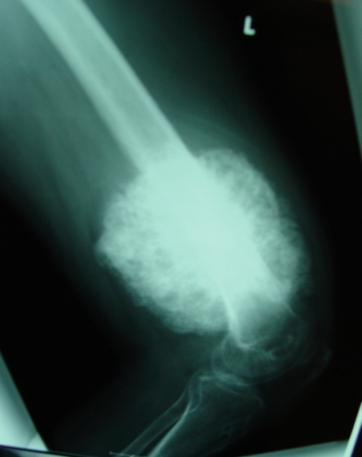
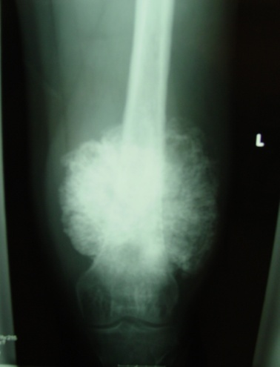
Plain X-ray
Lesions are usually permeative
Associated with destruction of the cancellous and cortical elements of the bone
Ossification within the soft tissue component, if tumour has broken through cortex
Intra medullary
Borders are ill defined

Slide 9
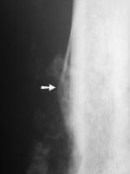
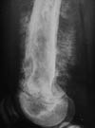
Plain X-ray
Periosteal reaction may appear as the characteristic Codman triangle.
Extension of the tumor through the periosteum may result in a so-called “sunburst” or “hair on end” appearance.

Slide 10
Notes:
Lateral skull radiograph reveals thickening of the outer and inner tables, widening of the diploe and several areas of focal sclerosis that produce cotton wool appearance. These imaging findings reflects the mixed osteolytic and osteoblastic phages of Paget's diseases resulting in accelerated bone turn over with bone deposition and expansion.

Slide 11
Paget's Disease
Paget's disease is a chronic bone disorder characterized by abnormal bone remodeling
Frequently affect pelvis, spine, skull and proximal long bones in old age (11% in 80Y)
There are three stages of pagets’s diseases
1] Lytic
2] Mixed
3] Blastic

Slide 12
Radiographic features
Skull
Osteoporosis circumscripta
Cotton wool appearance
Diploic widening
Tam o shanter sign

Slide 13
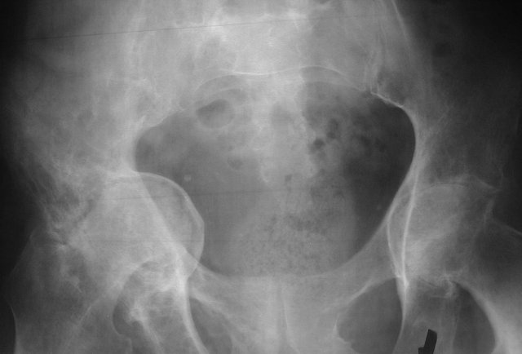
Spine
Picture fame sign
Squaring of vertebrae
Vertical trabecular thickening
Pelvis
Cortical thickening and sclerosis of iliopectineal and ischiopubic line
Acetabular protrusio

Slide 14
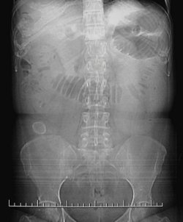
Notes:
The radiograph abdominal Erect AP view shows air in the biliary tree, a thickened inflamed gallbladder containing a stone, multiple, dilated small bowel loops and a large calcified gallstone in the right lower quadrant. The findings were also apparent on the digital localizer view of the abdomen shown below.

Slide 15
Gallstone ileus
Perforation of the gallbladder is an infrequent complication of cholecystitis.
Gallstone ileus occurs when a gallstone of 2.5 cm in diameter and typically occurs in females of age > 40
Classic radiographic findings
1. Pneumobilia: air within the biliary tree
2. Evidence of small bowel obstruction
3. Radiopaque gallstone on abdominal radiograph out side to GB

