Slide 1
CNS TRAUMA (PART – II)
BY DR. PAVAN KUMAR
JR1 in Department of Radiology
Sassoon general Hospital.

Slide 2
Cortical contusions
Contusions are formed in 2 ways:
Direct trauma causes injury at the site of impact, which is termed a coup contusion .
Acceleration / deceleration causes injury at a site opposite to the site of impact, which is termed a countercoup contusion.
Cortical injury occurs adjacent to the floor of the anterior or posterior cranial fossa, the sphenoid wing, the petrous ridge, the convexity of the skull, and the falx or tentorium.
The inferior frontal and temporal lobes are particularly vulnerable.

Slide 3
The most worrisome trait of these contusions is their tendency to expand. This usually occurs from 24 hours to as long as 7-10 days after the initial injury. For this reason, cerebral contusions are often followed with a repeat head CT scan within 24 hours after injury.
On NECT they appear as petechial gyral haemorrhages adjacent to calvaria.
FLAIR is the most sensitive sequence .
Appear hyperintense on FLAIR images and Hypointense on T2W images with associated peripheral edema. Blooming is seen on GRE images .

Slide 4
The main differential diagnosis to be considered is of DAI.
DAI is also associated with contusions but it is most commonly found in the corona radiata and along compact white matter tracts such as internal capsule and corpus callosum.

Slide 5
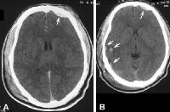
Evolution of an acute brain contusion. (A) Axial CT scan obtained immediately following severe blunt trauma to the head shows a small, left frontal epidural hematoma (arrow). Note that the previously isoattenuating contusion in the right posterior temporal area is now evident

Slide 7
DIFFUSE AXONAL INJURY
It is also known as traumatic axonal stretch injury.
It is the second most common parenchymal lesion seen after contusions.
Patients with DAI exhibit severe discrepancy between clinical status and initial imaging findings.

Slide 8
Cortex moves at different speed in relationship to underlying deep brain structures.
This results in axonal stretching especially where brain tissues of different density intersect(at grey-white matter interface).
Traumatic axonal stretching causes impaired axoplasmic transport, depolarisation, ion flux and release of excitatory amino acids with resultant development of cellular swelling and cytotoxic edema.

Slide 9
LOCATION:- Sub cortical and deep white matter is most commonly affected.
Cortex is typically spared.
Lesions in compact white matter tracts such as corpus callosum, especially genu and splenium, fornix and internal capsule are frequent.
STAGING AND GRADING:-
MILD- Lesions are seen in fronto-temporal grey-white matter interface.
MODERATE- Lobar white matter and corpus callosum are affected.
SEVERE- dorsolateral mid brain and upper pons are involved.

Slide 10
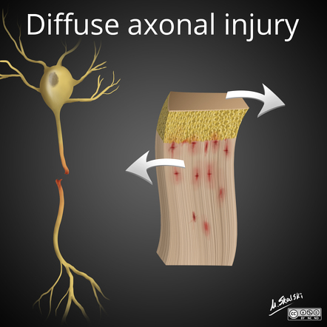

Slide 11
Peak incidence is in young adults (15-24 years old).
Males are affected more than females.
DAI often presents as immediate loss of consciousness which may be transient or progress to coma.
DAI itself rarely causes death but may result in persistent vegetative state.

Slide 12
IMAGING
Initial NECT is often normal or minimally abnormal.
Mild diffuse brain swelling with sulcal effacement may be present.
Few small round or ovoid sub cortical haemorrhages may be visible.
On MRI T2W and FLAIR images show hyper intensities in sub cortical white matter and corpus callosum.
T2* images show blooming in these areas s/o micro bleeds.
DWI may show restricted diffusion especially within the lesions of corpus callosum.
DTI Tractography may show whte matter disruption.
MRS shows widespread decrease in NAA with increase in choline.

Slide 13
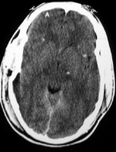
Note that the hemorrhages are characteristically located at the gray-white matter interface.

Slide 14
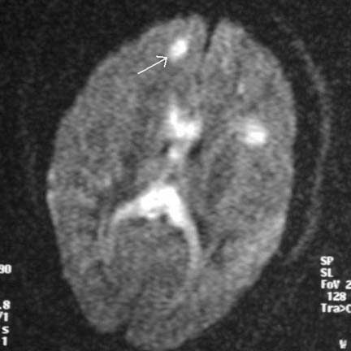
MRI) diffusion sequence demonstrating multiple foci of abnormal increased signal at the gray-white matter junction (arrow) and within the corpus callosum in a patient with diffuse axonal injury

Slide 15
PNEUMOCEPHALUS
It means presence of gas or air within the skull.
It can be intra-axial or extra-axial.
Tension pneumocephalus is collection of intracranial air that is under pressure and causes mass effect on brain.
It is most often associated with trauma, surgery or infection by gas forming organisms.
Any breach in skull base, mastoid or paranasal sinuses can cause pneumocephalus.
Intra-arterial air is seen in air embolism.

Slide 16
On imaging air is extremely hypodense on CT having CT value of -1000 HU.
Epidural air is unilateral , solitary, biconvex and does not move with change in head position.
Subdural air is confluent, crescentic often bilateral and moves with changes in head position.
Subarachnoid air is seen as multifocal dots or droplets of air within and around cerebral sulci
Intraventricular air forms air-fluid levels most often in frontal horns.

Slide 17
The mount Fuji sign of tension pneumocephalus is seen as bilateral subdural air collections that separate and compress the frontal lobes.
Frontal lobes are displaced posteriorly by air under pressure and are typically pointed where they are tethered to the dura and arachnoid by cortical veins mimicking the silhouette of mount Fuji.

Slide 20
SECONDARY LESIONS
1.CEREBRAL HERNIATION
2. TRAUMATIC ISCHEMIA AND INFARCTS
3.HYPOXIC INJURY
4.DIFFUSE CEREBRAL OEDEMA

Slide 21
BRAIN HERNIATION
Herniations of the brain are divided into 5 major categories, as follows:
Transtentorial herniation
Subfalcine/cingulate herniation
Foramen magnum/tonsillar herniation
Sphenoid/ Trans-alar herniation
Trans dural or Trans cranial herniation

Slide 22
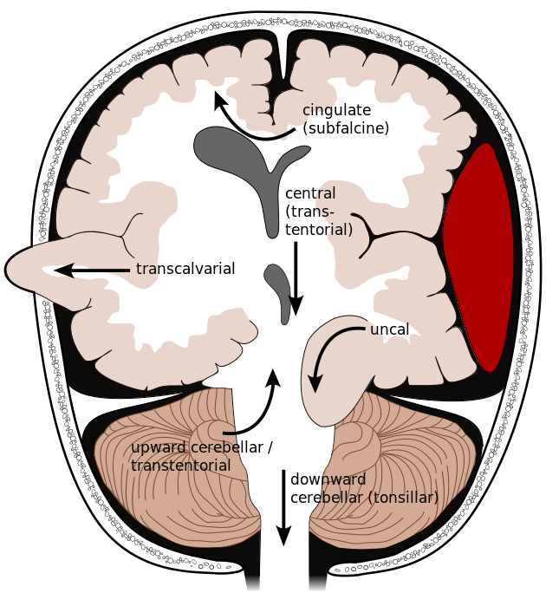

Slide 23
SUBFALCINE HERNIATION
It is the most common herniation .
An enlarging supratentorial mass in one hemicranium causes the brain to begin shifting towards the opposite side.
Herniation occurs as the affected hemisphere pushes across the midline under the inferior free margin of falx extending into contralateral hemicranium.
Axial and coronal images show that the cingulate gyrus, ACA and Internal cerebral vein are pushed from one side to the other under the falx cerebri.
The ipsilateral ventricle appears compressed and displaced across midline.

Slide 24
Complications:- Early complications include unilateral hydrocephalus seen as enlargement of contralateral ventricle
As the mass effect increases there is progressive displacement of lateral ventricle with eventual occlusion of foramen of monro.
As the production of CSF in contralateral ventricle continues with occlusion of foramen of monro, t leads to severe unilateral obstructive hydrocephalus. Associated periventricular ooze may also be seen.
If subfalcine herniation becomes severe the herniating ACA can be pinned against the inferior free margin of falx cerebri with its occlusion causing secondary infarction of cingulate gyrus.

Slide 26
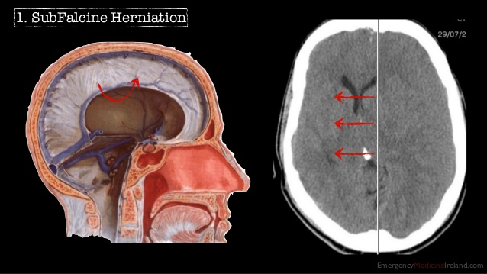

Slide 27
DESCENDING TRANSTENTORAL HERNIATION
Transtentorial herniations are brain displacements that occur through the tentorial incisura.
These displacements can be ascending r descending but descending transtentorial herniations are from supratentorial masses are more common.

Slide 28
Initially hemispheric mass produces side to side displacement of brain parenchyma causing subfalcine herniation.
But as the mass effect increases uncus of temporal lobe is pushed medially and there is effacement of suprasellar cistern.
Later on hippocampus follows and there is effacement of ipsilateral quadrigeminal cistern.
With progressive mass effect both uncus and hippocampus herniate inferiorly through tentorial incisura.
In bilateral DTH sometimes called complete or central descending herniation in which both temporal lobes herniate into tentorial incisura.

Slide 29
TENTORIAL INCISURA

Slide 30
On axial CT scans in unilateral DTH the uncus is displaced medially and ipsilateral suprasellar cistern is effaced.
Later on hippocampus also herniates compressing quadrigeminal cistern and pushing the midbrain towards opposite side of incisura.
In severe case entire suprasellar and quadrigeminal cistern are effaced.

Slide 31
In bilateral DTH both hemispheres become swollen and whole central brain is flattened against the skull base.
All basal cisterns are obliterated.
Midbrain is completely squeezed from both sides.
Midbrain is displaced inferiorly through the tentorial incisura pushing pons downwards.
The angle between midbrain and pons is progressively reduced from nearly 90 degrees to 0 degrees.

Slide 32
COMPLICATIONS:- Cranial nerve III compression can occur even in mild form of descending transtentorial herniation as it exits from the interpeduncular fossa and cause pupil involving IIIrd nerve palsy.
Secondary PCA infarct( occipital infarct) can occur because of compression of PCA by displaced temporal lobe below the tentorial incisura.
As the herniating temporal lobe pushes midbrain towards other side, the contralateral cerebral peduncle is forced against the contralateral edge of tentorium cerebelli forming an indentation in the crus called as kernohans notch.
The integrity of crus cerebri and its descending corticospinal tracts is disturbed and a contralateral (to crus cerebri) motor deficit is produced.
A hemiparesis ipsilateral to the expanding mass is known as kernohans phenomenon which is a false localising sign.

Slide 33
Because of inferior displacement of mid brain perforating arteries that arise from the top of basilar artery are compressed and buckled and eventually occluded causing secondary hemorrhagic midbrain infarct known as duret haemorrhages.
With complete bilateral DTH perforating arteries that arise from circle of Willis are compressed against the central skull base causing hypothalamic and basal ganglia infarcts
If the rising intracranial pressure exceeds intra-arterial pressure perfusion is drastically reduced and eventually ceases causing brain death.

Slide 36
ASCENDING TRANSTENTORIAL HERNIATION
It is much less common then DTH.
Posterior fossa mass although neoplasm are more common cause than trauma.
In this the cerebellar vermis and hemispheres are pushed upward through the tentorial incisura into the supratentorial compartment.
The superiorly herniating cerebellum initially flattens and displaces , then effaces the quadrigeminal cistern and compresses the midbrain.

Slide 37
Quadrigeminal cistern is first compressed and then obliterated by upwardly herniating cerebellum.
Later on tectal plate becomes compressed and flattened.
In severe cases the dorsal midbrain may appear concave instead of convex.
The most common complication of ATH is acute intraventricular obstructive hydrocephalus caused by compression of cerebral aqueduct.

Slide 39
TONSILLAR HERNIATION
In this cerebellar tonsils are displaced inferiorly and are impacted in foramen magnum.
MC cause is posterior fossa mass pushing tonsils downwards.
On imaging herniation of tonsils causes obliteration of CSF in cisterna magna.
On sagittal images , tonsils more than 5mm below the foramen magnum are generally abnormal especially if they are peg like.

Slide 41
TRANS ALAR HERNIATION
It occurs when brain herniates across the greater wing of sphenoid .
It can be either ascending or descending.
Ascending trans alar herniation is caused by large middle cranial fossa mass.
An intratemporal or large extra axial mass displaces part of temporal lobe together with sylvian fissure and middle cerebral artery over the greater sphenoid wing.
It is best depicted on sagittal MRI.
MCA branches and sylvian fissure are elevated and superior temporal gyrus is pushed above greater sphenoidal wing .

Slide 42
In descending trans alar herniation usually there is a large anterior cranial fossa mass.
Gyrus rectus is forced posteroinferiorly over the greater wing of sphenoid displacing sylvian fissure and MCA backward.
Posterior displacement of frontal lobe can cause compression of MCA against sphenoidal ridge resulting in MCA territory infarction.
Superior displacement of temporal lobe can compress supra-clinoid internal carotid artery against anterior clinoid process resulting in infarction of anterior and middle cerebral artery territories.

Slide 44
TRANS DURAL/TRANS CRANIAL HERNIATION
For this herniation to occur the dura must be lacerated, a skull defect(fracture or craniotomy) must be present and intracranial pressure must be elevated.
Traumatic herniations are common in infants and young children with comminuted displaced fracture lacerating dura and arachnoid.
When intracranial pressure increases brain can herniate through the torn dura and across the skull fracture into subgaleal space.

Slide 45
Iatrogenic herniations occur when burr hole or craniotomy is performed in a patient with severely elevated intracranial pressure.
When dura is opened brain under pressure extrudes out of the defect.
MR best shows these defects.
Disrupted dura is seen as black line on T2W images.
Brain tissue, together with accompanying blood vessels and CSF is extruded through the dural and calvarial defects into subgaleal space.

Slide 46
POSTTRAUMATIC BRAIN SWELLING
It is one of the serious secondary traumatic lesion.
It may be focal, regional or diffuse.
It may be caused by increased tissue fluids (cerebral edema) or elevated blood volume (cerebral hyperaemia) secondary to vascular dysregulation.
Children and young adults are more commonly affected.
Delayed onset is typical.
Severe cerebral edema generally takes between 24 and 48 hours to develop.

Slide 47
Initially mild hemispheric mass effect with sulcal/cisternal compression is seen on NECT.
In the early stages grey-white matter differentiation may be preserved with minimal effacement of ventricles.
MRI show swollen gyri that are hypointense on T1W images and hyperintense on T2W images.
Restricted diffusion may be seen on DW images.
As the swelling progresses demarcation between cortex and underlying white matter becomes indistinct.
Lateral ventricles appear smaller than normal and superficial sulci are no longer visible.

Slide 49
POST TRAUMATIC CEREBRAL ISCHAEMIA AND INFARCTS
The most common brain herniation that causes secondary cerebral infarction is descending transtentorial herniation.
DTH displaces PCA inferiorly into tentorial insicura and may cause occlusion leasing to occipital lobe infarction.
Cingulate gyrus infarction may be seen after occlusion f callosomarginal branch of ACA due to subfalcine herniation.
Basal ganglia and hypothalamic infarcts are seen with complete bilateral DTH compromising penetrating arteries arising from circle ofwillis.
Cerebral ischaemia may also occur because of reduced arterial perfusion because of mass effect of extra axial hematomas.
NECT cans show hypo density with loss of grey white matter differentiation .
CT perfusion may show decreased CBF.

Slide 51
BRAIN DEATH
It is defined patho-physiologically as complete, irreversible cessation of brain function.
Three clinical findings are necessary to confirm irreversible cessation of brain function- coma, absence of brain stem reflexes and apnoea.
Imaging findings may be helpful in confirming brain death but neither replace or substitute for clinical diagnosis.

Slide 52
NECT scans in brain death show diffuse, severe cerebral edema.
The normal attenuation relationship between grey and white matter is inverted with grey matter becoming hypodense relative to white matter (Reversal sign).
The cerebellum appears normal in density whereas supratentorial structures appear hypodense this is called as white cerebellum sign.
All the sulcal spaces, sylvian fissure and basal cisterns appear effaced.

Slide 53
On T1W images complete descending central herniation is noted with buckling of midbrain through tentorial incisura.
T2W images show swollen gyri with hyperintense cortex.
DWI may show restricted diffusion in both cerebral cortex and white matter.
On CTA lack of opacification of cortical segments of MCA and internal veins is an efficient method for demonstrating Brain death.
Tc-99m Scintigraphy shows scalp uptake but absent brain activity which is called as light bulb sign.

Slide 56
POST TRAUMATIC ENCEPHALOMALACIA
It is chronic effect of CNS trauma.
Focal areas of encephalomalacia are more commonly found in areas with high incidence of cortical contusions i.e. anteroinferior frontal lobes and anterior temporal lobes.
Encephalomalacic changes appear low density foci on NECT.
On MRI, Hypointense areas on T1W images that appear hyperintense on T2W and FLAIR are typical. T2* sequences may show hemorrhagic residua around encephalomalacic foci.
Sulcal spaces appear prominent with increased ventricular size due to generalised cerebral atrophy.

Slide 57
Reduced cerebellar volume may also be seen.
On MR spectroscopy reduced levels f neurometabolities is seen. NAA levels are low even in normal appearing brain.
FDG PET may show focal areas of glucose hypo metabolism.

Slide 58
POST TRAUMATC PITUITARY DYSFUNCTION
Between 25-40% of traumatic brain injury survivors develop hormonal deficiencies within 6-12 months after injury.
Diagnosis is based on clinical evaluations, lab testing and neuroimaging.
MRI findings include hypothalamic or posterior pituitary haemorrhage, anterior pituitary lobe infarction and stalk transection.
Traumatic pituitary stalk interruption shows partially empty sella with thin or transected stalk.
Decreased vascularisation on dynamic contrast enhanced scans may be present.

Slide 60
THANK YOU!!!

