Slide 1
Radiographic Quality
Presenter
Dr. Ashok Sharma
Dept of Radiodiagnosis, BJMC, Pune

Slide 2
Quality of Radiograph
The visible sharpness of image of structural details
OR
Is the exactness of the representation of the patient’s anatomy.
The most important characteristic of radiographic quality are: Spatial Resolution, Contrast Resolution, Noise & Artifacts

Slide 3
There are five main factors which influence quality of radiograph
Blur
Density
Contrast
Distortion
Noise

Slide 4
1. Blur
It is related to sharpness of image.
There are four factors responsible for blurring of image
Geometric in origin
Motion
Screen blur
Object blur

Slide 5
Geometric / Focal Spot Blur :
It depends on three factors :
Effective focal spot size
Source to image receptor distance
Object to image receptor distance

Slide 6
Focal Spot
Area on the target bombarded by electron stream during X-ray production is called focus or focal spot.
Smaller the focal spot better the recorded details and sharpness of image.
Width of blur depend on the focal spot size with inverse relation.
focal spot size ranges from 0.3 to 2 mm.

Slide 7
Large penumbra caused by wider focal spot
Smaller penumbra caused by smaller focal spot
Notes:
Ideally point source will give no penumbra.
Impossible coz of limited heating capacity of the x-ray tubes.unsharness of intensifying screens.

Slide 8
Source to Image Receptor Distance (SID) :
Shine a flashlight on a 3-D object, shadow borders will appear “fuzzy”
-On a radiograph called Penumbra
Penumbra (fuzziness) obscures true border – umbra
Farther the flashlight from object = sharper borders. Same with radiography.

Slide 9
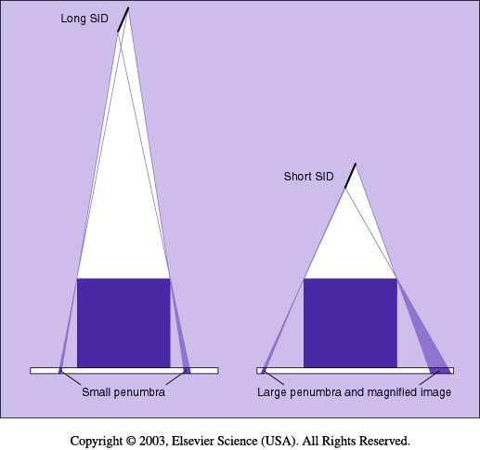

Slide 10
Object to Image Receptor Distance (OID)
The closer the object to the film, the sharper the detail.
OID ⬇, penumbra ⬇, sharpness ⬆
OID ⬆, penumbra ⬆, sharpness ⬇

Slide 12
By combining all three factors an equation can be drawn as follows
(focal spot size) × OID
Blur Width(B) = (cm)
(source to object distance)

Slide 13
Motion Blur
Due to motion of object to be radiograph.
It can minimize by
Immobilisation of part
Suspension of respiration
Using exposure as short as possible(using intensifying screen)
Notes:
Extremities can be immobilised by applying tractions.
Suspension of respiration is for radiograph of all parts except extremities.
Like irritable patient , for mediastinum, angiography.

Slide 14
Screen blur
When fast exposure are needed to minimize effect of uncontrolled motion, screen is used
It depends on screen and film used
Better recorded details result from fast film and medium speed screen combination.
Notes:
Blur with medium speed screen is about half that of fat speed screen.
Blur with fast and medium speed film is negligible in radiography.

Slide 15
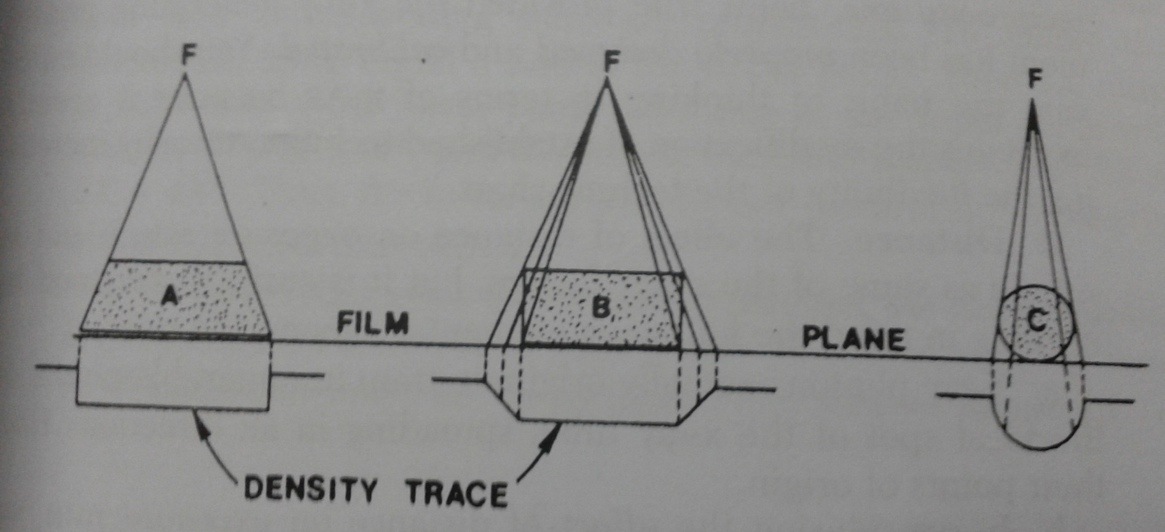
Object Blur
it depends on the edges of object and its angulation to the X-ray beam.
Notes:
In shape of object A conform to X-ray beam so density fall of sharply at the edge of image
In object B progressively smaller thickness of object intercept X-ray beam toward edge so density fall grdually and less sharp image form
Same in object C.

Slide 16
2. Density
Depends on amount of radiation reaching a particular area of the film and the resulting mass of silver deposited during development.
Density = log[(incident light intensity)/(transmitted light intensity)]

Slide 17
Factors affecting density are
kV
mA
Time
Distance
Thickness and nature of part.

Slide 18
Kilovoltage (kV) :
It represent penetrating power of X-ray.
More the kV across the tube more power full x-ray produce with more penetrating power.
Milliampere (mA) :
Measure of electron flow per second from cathode to anode in X-ray tube.
Double the mA double is x-ray exposure rate.
Time :
It is related to the amount of X-ray produce
More the mA flowing through filament more electrons emitted and more X-rays are produce.
Notes:
Increase of 15% in kV doubles the exposure.

Slide 19
Distance :
The intensity or exposure rate of radiation a given distance from point source is inversely proportional to the square of distance.
Intensity is directly related to density.
ID2 = id2 , for given value of kV and mA.
Notes:
If distance is double keeping mA and kV constant then intensity will be reduced to 1/4th.

Slide 21
Radiographic object :
Human body consist tissues and organs with different thickness and density.
Density of objects from greater to least:
Dental enamel Bone water density tissue
Gas Fat

Slide 22
3. Contrast
Radiographic Contrast is range of density variation among light and dark areas on radiograph.
The difference between density of adjacent areas must be at least 2%to be perceptible to human eye.
Density represent amount of silver deposited in various areas while contrast represent relative distribution of silver in various areas.

Slide 23
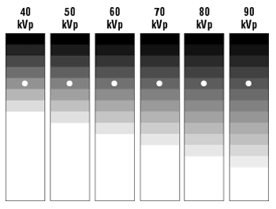
Radiographic contrast is of two type :
Long scale (low) contrast
Short scale (high) contrast
Low High
Contrast Contrast
Notes:
If there are many squares with very little difference in density of successive squares -> long scale or low contrast
If there are relatively few squares with large differences in density between successive squares -> small scale or high contrast.
Good contrast radiograph achieve by medium scale contrast.

Slide 24
Radiographic contrast depends on
Subject contrast
Film contrast

Slide 25
Subject Contrast:
Defined as the contrast in aerial image.
Aerial image - spatial distribution of photons in the cross section of the exit beam, which will be recorded on the film as radiographic image.
Aerial image also contain unwanted information in the form of noise which impair quality of image.
These noise factor include : scattered radiation , quantum mottle and fogging,

Slide 26
Subject contrast depend on following factors :
Radiation quality
Radiographic object
Scattered radiation
fogging
Notes:
kV and mA determine quality of radiation beam
Atomic no., density of object and thickness are objective factors
Scattered radiation impairs contrast by fogging which can be controlled by devices like grid .

Slide 27
Film contrast :
Depends on following factors
Type of image receptor
With or without screen
Processing system.

Slide 28
Type of image receptor (films):
There are special films for long , medium and short scale contrast.
It depends on the composition of emulsion present on radiographic films.
Developing process:
It depends on the compositions of chemicals used for developing films
Temperature during development and time for development also affect film contrast.

Slide 29
4. Distortion
Misrepresentation of true size and shape of object is called distortion
It is not possible to avoid distortion but only minimise as image is two dimensional and object is three dimensional.
Two types of distortion
Size
Shape

Slide 30
Size Distortion
Magnification :
It depends on the distance between source and object.
If distance is more, less magnification and sharper image
If distance is less, more magnification and more burr too.

Slide 32
Magnification Factor
source-to-image receptor distance
MF = source-to-object distance
SOD difficult to measure accurately
*usually an estimated value
SID
MF = SOD

Slide 33
Shape Distortion
Depends on:
Object thickness
Object shape
Object position

Slide 34
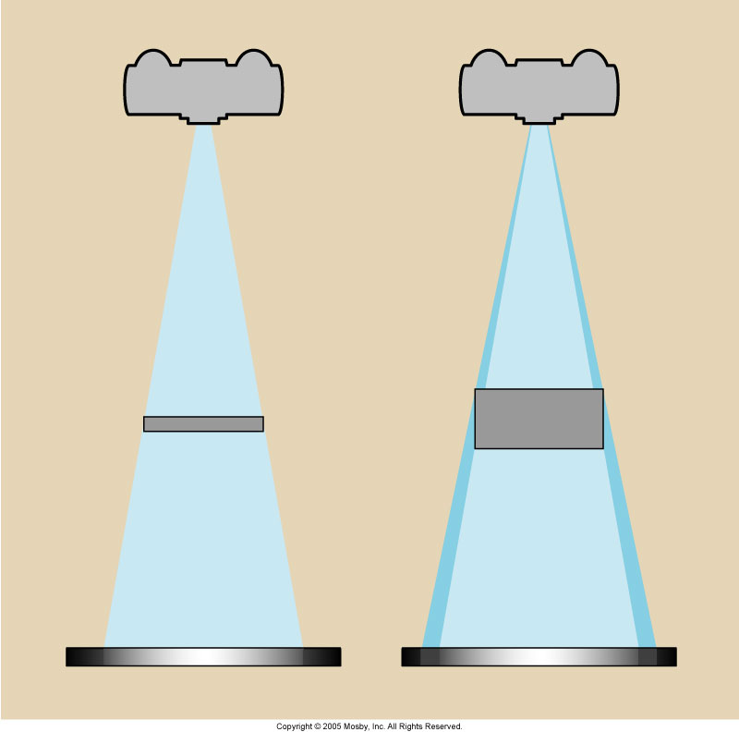
Object Thickness
Thick objects have more OID and are more distorted than thinner structures

Slide 36
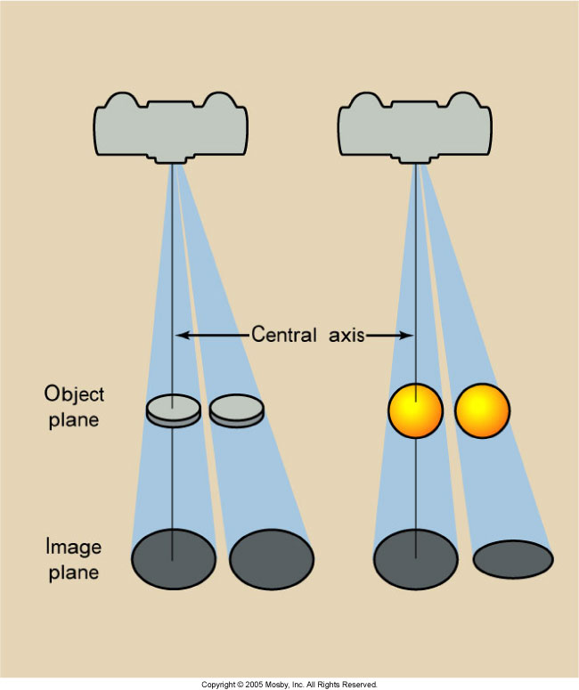
Object Position
If the object plane and the image plane are parallel, the image is not distorted
CR perpendicular to the part

Slide 37
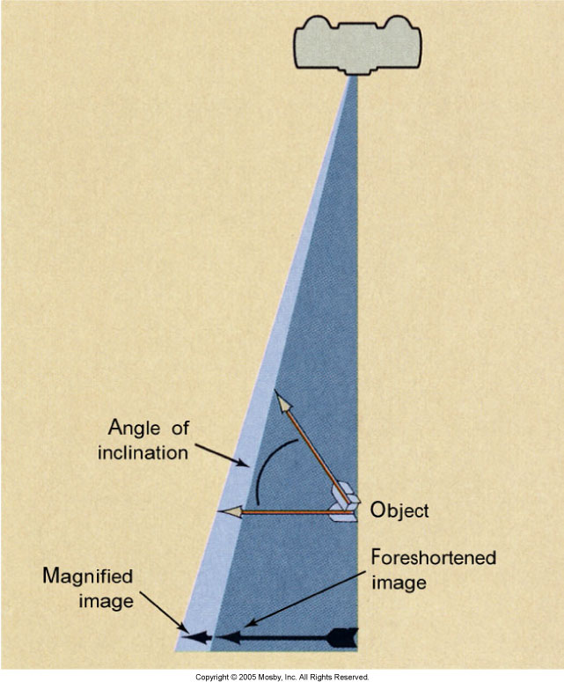
Position Distortion
Foreshortened = anatomy at an incline to the CR displays smaller than true size

Slide 38
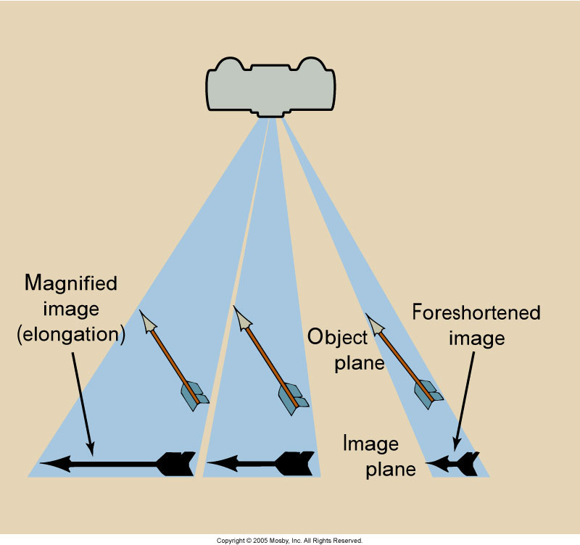
Position Distortion
Elongation: anatomy at an incline and lateral to the central axis
Could be foreshortened
as well elongation

Slide 39
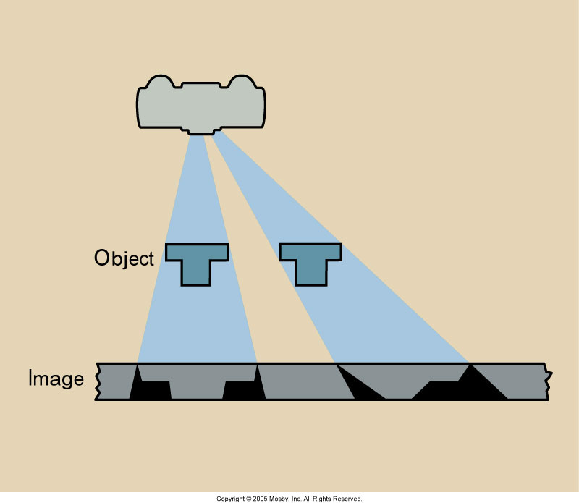
Position Distortion – Irregular Anatomy
Anatomy or objects can cause considerable distortion when imaged off the central axis

Slide 40
5. “Noise”
Borrowed from electrical engineering
Audio noise = hum or flutter heard from a stereo
Video noise = “snow” on a TV
Radiographic noise = random fluctuation on the OD of the image

Slide 41
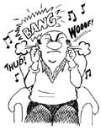
Radiographic Noise
Four components:
Quantum mottle, Film graininess, structure mottle & scatter radiation

Slide 42
QUANTUM MOTTLE
Due to non-uniform intensity over the cross section of the x-ray beam as it leaves the tube port.
Hence it exposes different areas of film with different number of photons.
In Slow screen film combination – more photons required for same density
High speed screen film – smaller no of photons can provide the same over all density – Fewer photons reaching the image receptor can cause an undesirable fluctuation in image densities- mottled/grainy appearance.

Slide 43
Quantum Mottle
An image produced with just a few x-rays will have more quantum mottle.
The use of very fast intensifying screens or not enough mAs or kVp will increase quantum mottle

Slide 44
Radiographic Noise
Film graininess – distribution & size of the silver halide grains in the emulsion
Structure mottle – uneven distribution of phosphor
Not under the control of the technologist

Slide 45
Image Noise
Speckled background on the image
Caused when fast screens and high kVp techniques are used. Noise reduces image contrast
The percentage of x-rays absorbed by the screen is the detective quantum efficiency (DQE)
The amount of light emitted for each x-ray absorbed is the conversion efficiency (CE)

Slide 47
Devices and Measures to Improve Radiograph Quality
Removal scattered radiation
There are various devices to remove scattered radiation
Grid
Air Gap method
Aperture Diaphragm
Cones
Variable Aperture Beam Limiting Devices(Collimator)
Moving Slit radiograph
Anode Heel Effect

Slide 48
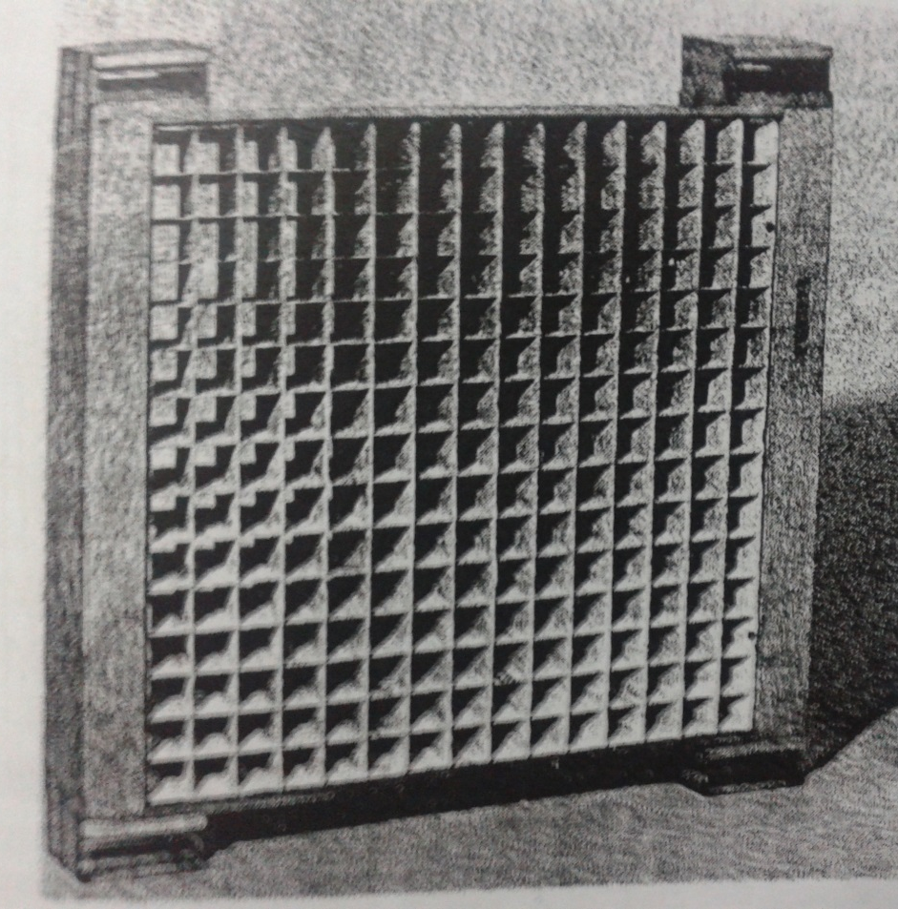
Grids
Grid is device made of thin lead
strips closely placed separated
by radiolucent material.
Working of grid:
Lead plates in grid absorb
scattered X-rays and prevent
them from reaching to film

Slide 49
Types of Grid :
Stationary grid
Parallel or non focal grid
Focal grid
Moving grid

Slide 50
Air-Gap (Air Filtration)
Principle
radiation scatters uniformly
decrease in scatter
air gap decreases angle of capture; increases angle of escape
air gap very effective in removing scatter originating closest to film
mAs increased 10% per cm gap
Magnification results unless SID is increased

Slide 51
Air Gap method

Slide 52
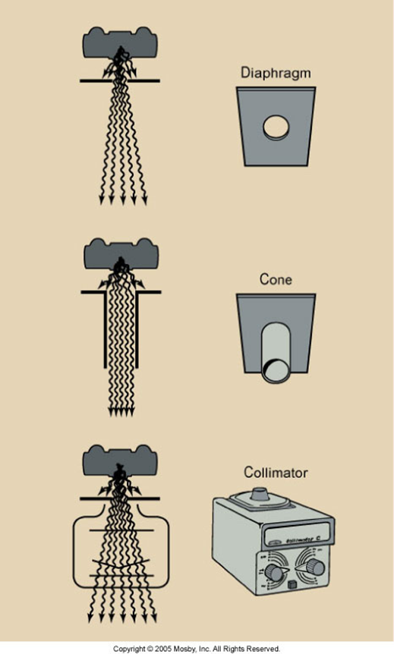
Beam restrictors
Aperture Diaphragm
Cones or Cylinders
Variable aperture
collimator

Slide 53
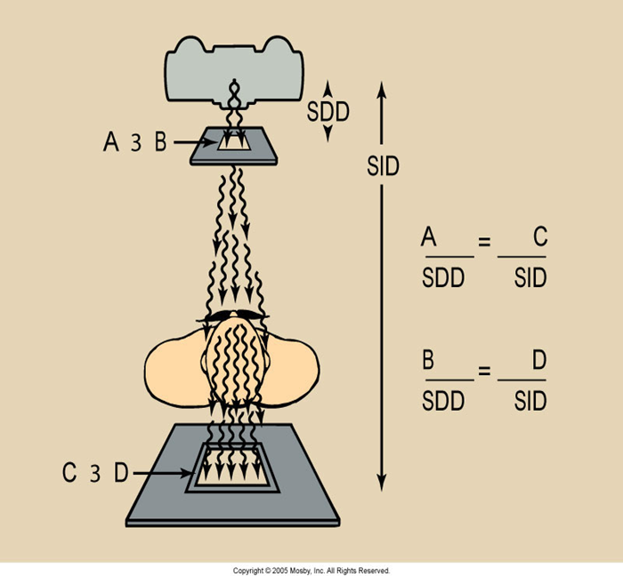
Aperture Diaphragm
Fixed lead opening
Fixed image receptor size
Constant SID
Source-to-diaphragm distance = SDD

Slide 54
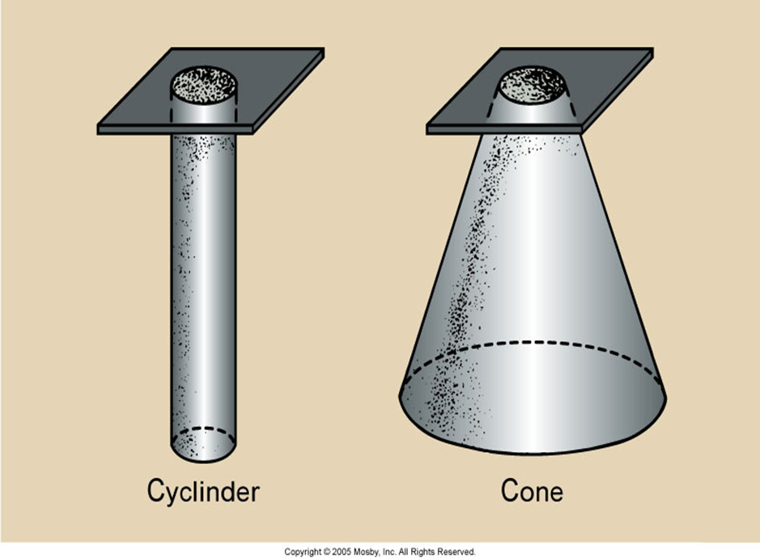
Cones and Cyclinder
Are modifications of the aperture diaphragm
Alignment
is one difficulty
when using
cones

Slide 55
Cones

Slide 56
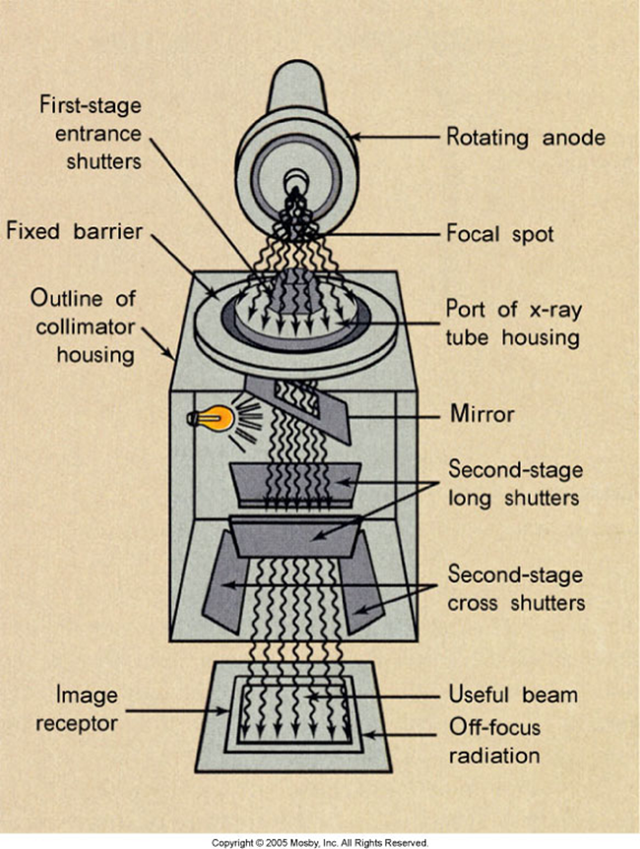
Variable Aperture Collimator
The most common beam-restricting device is the light-localizing variable aperture collimator
The first part of the collimator serves to control off-focus radiation.

Slide 57
Variable aperture beam limiting devices (Collimator)

Slide 58
Filters
Used in radiographing parts of body that differ greatly in thickness or density so as to record them with more uniform density on a single film.
Made of Aluminum or barium-plastic compounds.

Slide 59
Anode Heel effect :

Slide 60
SUMMARY
RADIOGRAPHIC QUALITY
GEOMETRIC
FACTORS
SUBJECT FACTORS
FILM FACTORS
1. CONTRAST
THICKNESS
1.CHARACTERISTIC
1.DISTORTION
CURVE
DENSITY
DENSITY
2. MAGNIFICATION
CONTRAST
ATOMIC NUMBER
3. BLUR
2.PROCESSING
2. MOTION
TIME
TEMPERATURE

Slide 61
Measures to Improve Radiographic Quality
Choosing machine with appropriate focal spot size (0.3 to 2 mm)
Proper adjustment of OID , SID and source to object distance.
Immobilisation of part to be radiograph
Use appropriate screen and film combination
Proper factors kV and mA.
Use of Anode heel effect.
Proper positioning of part to be radiograph.
Keeping dark room dust free, lightproof and with proper illuminations
Cassette surface should be kept clean.
Maintaining film development process.

Slide 62
THANK YOU ☺

