Slide 1
SPOTTERS
Under guidance of
DR BIKASH PARIDA
Asst. Prof.

Slide 2
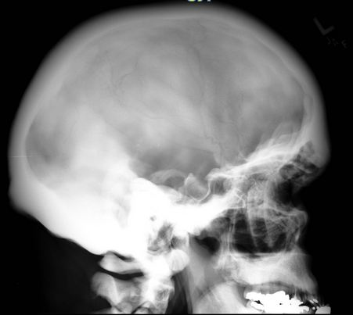

Slide 3
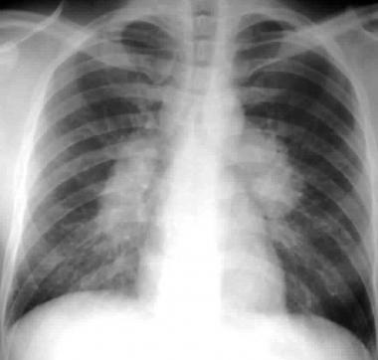

Slide 4
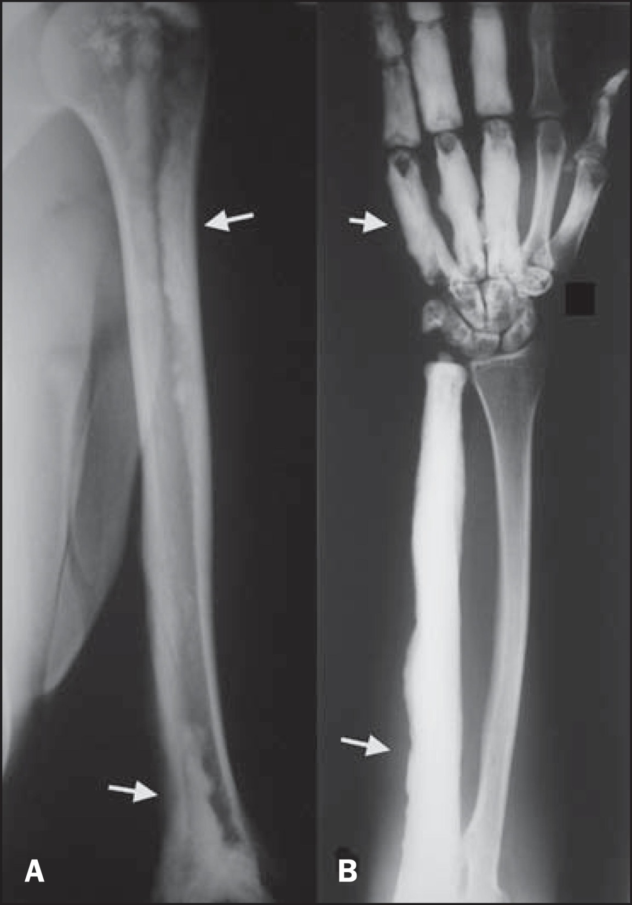

Slide 5
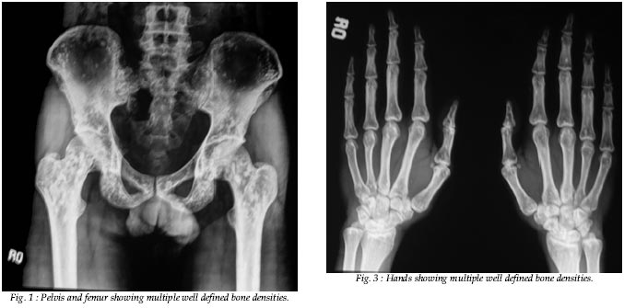

Slide 6
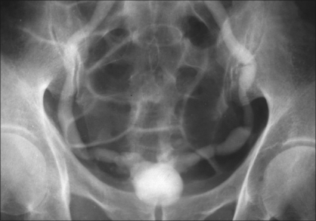

Slide 7
Osteopetrosis
AKA: Albers-Schönberg Disease = Marble Bone Disease
Rare hereditary disorder with defective osteoclast function and overgrowth of bone: which become thick, dense and sclerotic results in brittle bones
Mandible : triangular opacity representing calcification within the secondary condylar cartilage ossification center.
Defective dentition with incomplete enamel formation and denatal caries.

Slide 8
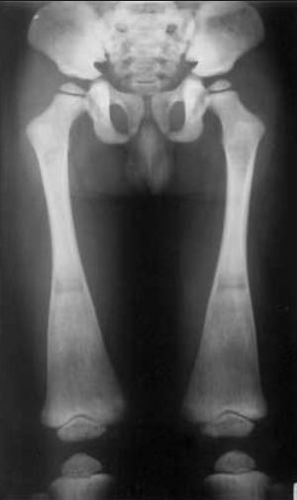
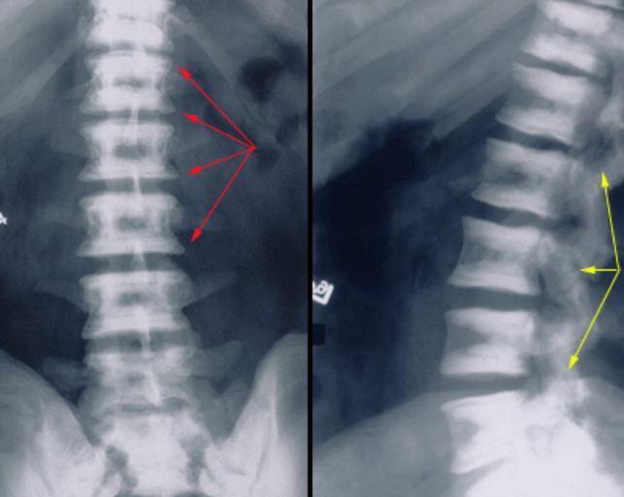
poorly pneumatized paranasal sinuses (ethmoid sinuses least severely affected)
Calvarium : high-attenuation inner table, a broad, low-attenuation diploic space, and a less high-attenuation outer table
Hair-on-end appearance : areas of increased haematopoietic activity.

Slide 11
MELORHEOSTOSIS
One of a rare group of sclerosing bone disorders
Produces thickening of the endosteum and periosteum and common in lower extremities.
Monostotic, monomelic or polyostotic
Candle-wax appearance (classic)

Slide 12
Osteopoikilosis
Uncommon benign sclerosing bone dysplasia with an autosomal dominant inheritance
It is characterized by the presence of dense spots that are round, oval, or lanceolate, with their long axes parallel to the long axis of the bone. They are usually uniformly dense, and are grouped towards the end of long bones and pelvis.
The skull, ribs, and vertebrae are usually spared. The patients may also have disseminated white spots on the skin called dermatofibrosis lenticularis disseminata.

Slide 13
Thimble Bladder
Markedly contracted and small capacity urinary bladder, with diffuse asymmetric bladder wall thickening. Proximal hydroureteronephrosis is seen bilaterally.

Slide 14
THANK YOU

