Slide 1
DNB QUESTION PAPERS JUNE 2018

Slide 2
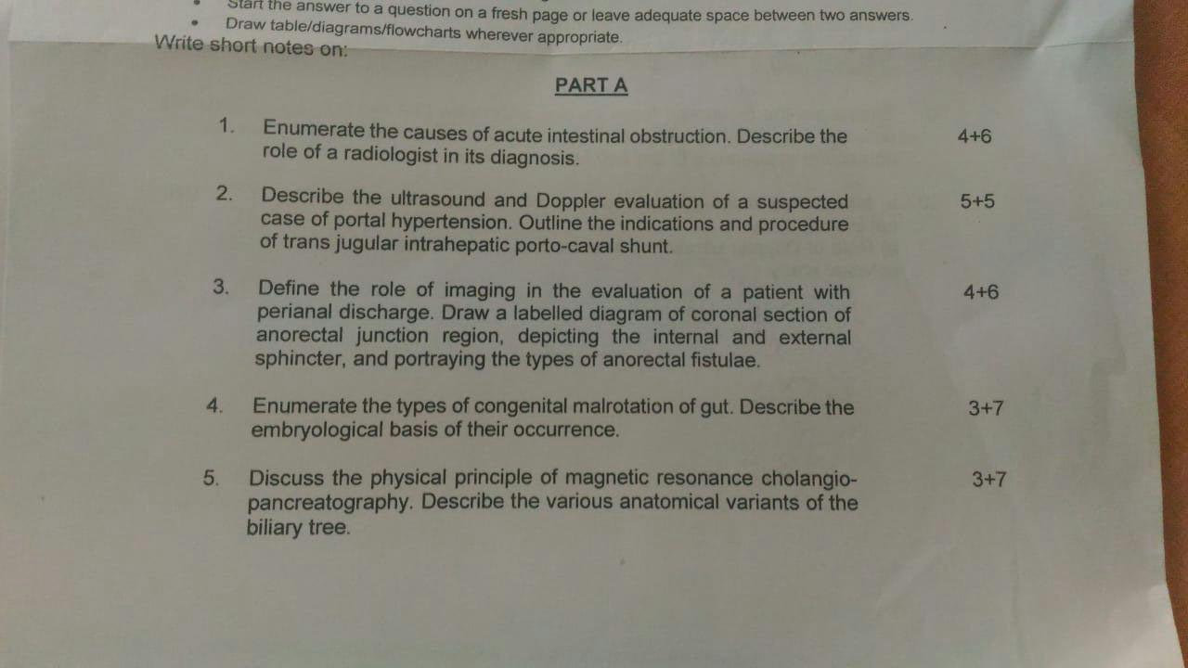

Slide 3
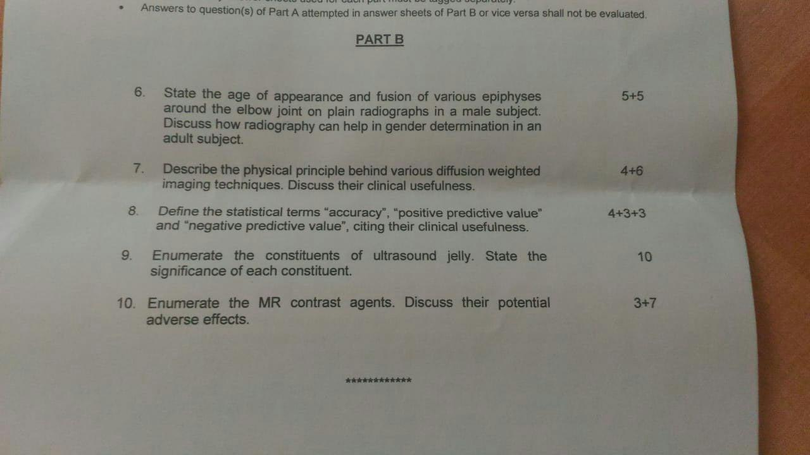

Slide 4
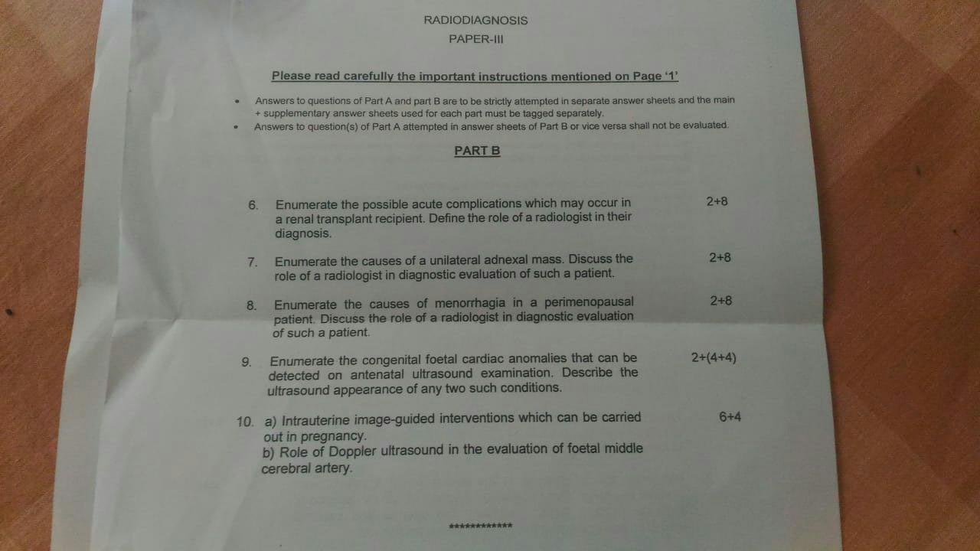

Slide 5
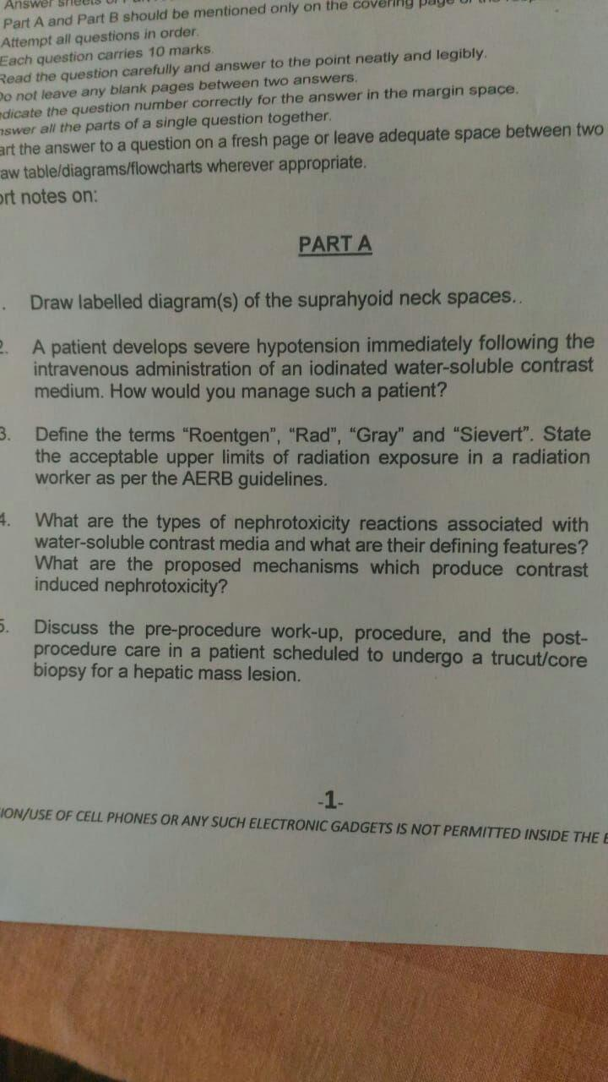

Slide 6
PAPER 1, 2018

Slide 7
PAPER II

Slide 8
PAPER II

Slide 9
THANK YOU
DOWNLOAD FILE AT RADIOLOKSABHA.COM

