Slide 1
QUIZ
DR SHRINIVAS B DESAI
JASLOK HOSPITAL AND RESEARCH CENTER
MUMBAI

Slide 3
Silent sinus syndrome (SSS), also known as Maxillary atelectasis with enophthalmos and imploding antrum, is the painless (silent) involution of the maxillary sinus with associated enophthalmos due to gradual collapse of the orbital floor.
It is thought that SSS is caused by hypoventilation of the maxillary sinus due to obstruction of the ostiomeatal complex
Patients present with enophthalmos (2-5 mm). Diplopia and other ocular symptoms are uncommon, likely due to the gradual course of the disease

Slide 4
Complete or near-complete unilateral obstruction of the maxillary sinus
Obstruction of the ostiomeatal unit
Lateral retraction of the uncinate process, resulting in relative enlargement of the middle meatus
Nasal septal deviation
A variable degree of retraction and collapse of all the walls of the maxillary sinus, manifested as concavity, resulting in inferior displacement of the globe and orbital contents into the maxillary sinus
Demineralization of sinus walls Increased retroantral fat pad on the affected si

Slide 5
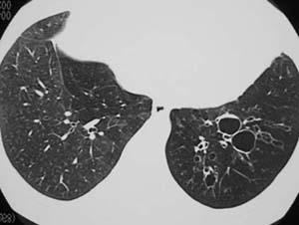
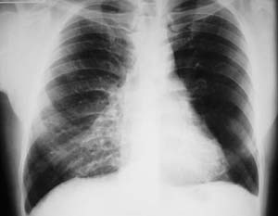
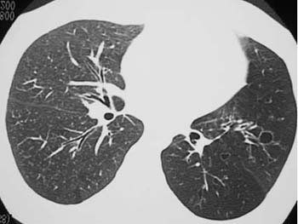

Slide 6
Swyer-James (McLeod) syndrome is a condition characterized by bronchiolitis obliterans involving predominantly one lung or, less commonly, a lobe or segment. It typically follows an early childhood infection, most commonly a viral pneumonia.
1. Hyperlucency of the involved lung or lobe. 2. Decreased vascularity. 3. Small hilum. 4. Decreased volume of the involved lung or lobe. 5. Air trapping on expiratory radiographs.
High resolution CT demonstrates similar findings as the radiograph but is superior to radiography in demonstrating the presence of bronchiectasis in the involved lung. High resolution CT also frequently shows mild abnormalities in the contralateral lung.

Slide 7
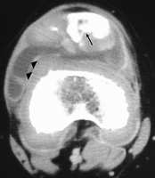
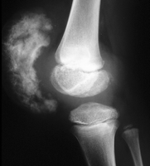
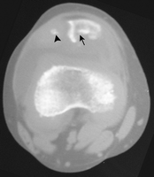

Slide 8
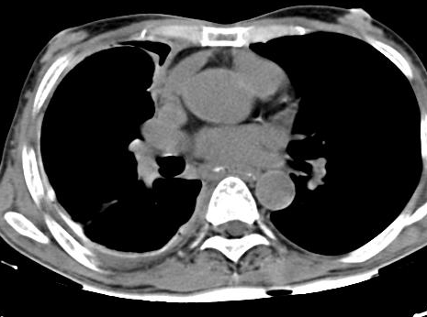
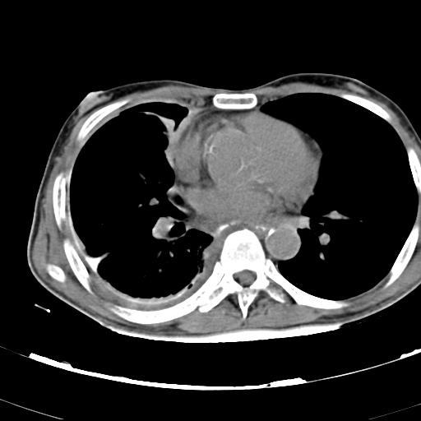
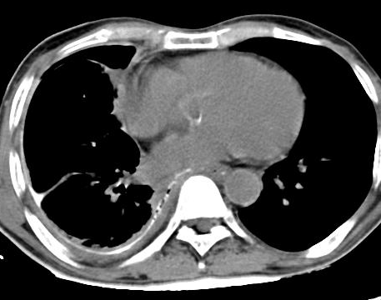
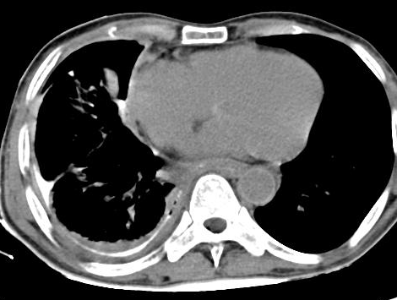
SEVERE CHEST PAIN

Slide 9
MACROCEPHALY SEIZURES

Slide 10
K/C/O CA BREAST WITH DIMINISHED VISION

Slide 11
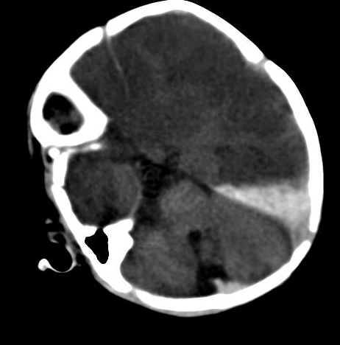
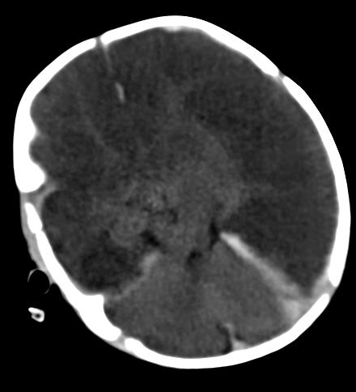
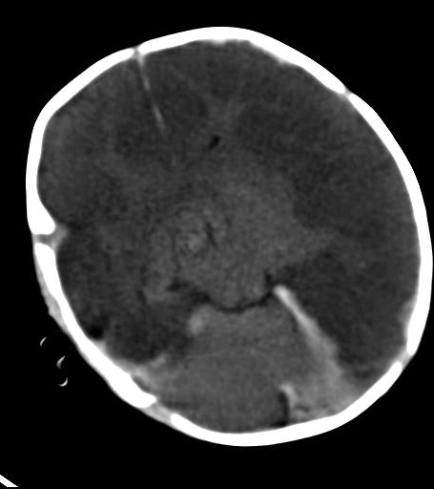
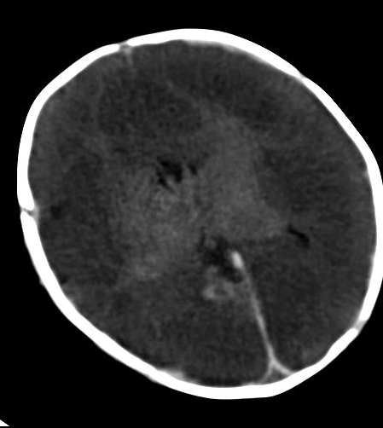
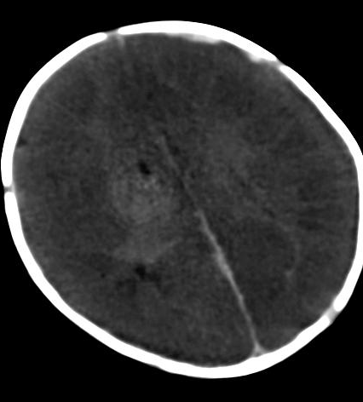
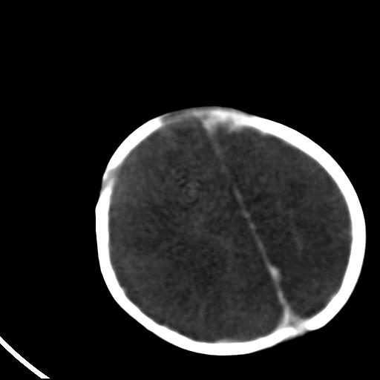
NEONATE WITH DROWSINESS,CONVUSIONS
HYPOXIA WITH REVERSAL SIGN

Slide 12
DECREASED HEARING IN RIGHT EAR
SINCE BIRTH

Slide 13
VAGUE ABDOMINAL PAIN

Slide 14
CASE 1
39 yr female came with history of pain in left side of abdomen
On examination,
-no abdominal tenderness
-BP- 180/140mm Hg
- Se. creatinine 1.0 mg/dl
USG S/O mass in abdomen so CT scan was done for further characterization.

Slide 15
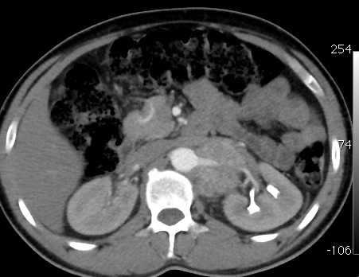
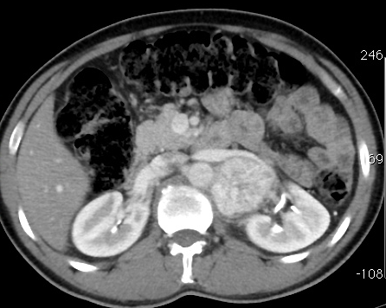
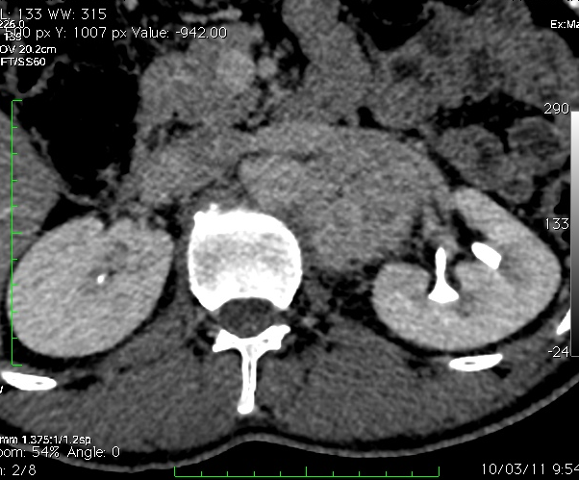
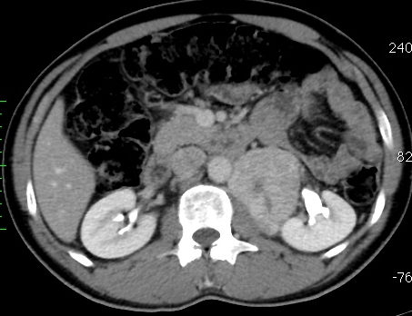
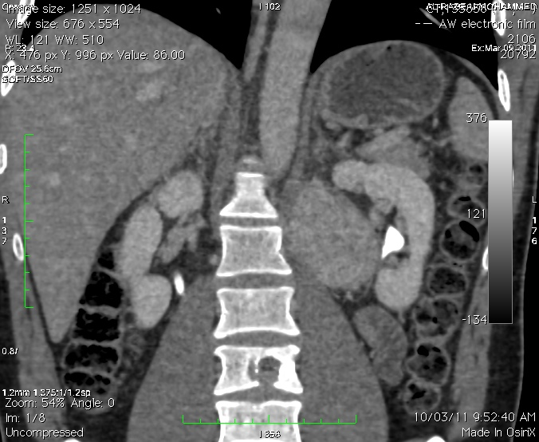
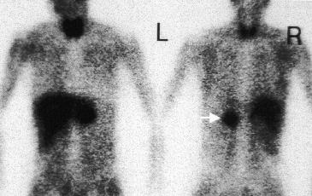
39 yr female came with history of pain in left side of abdomen,palpitataions

Slide 16
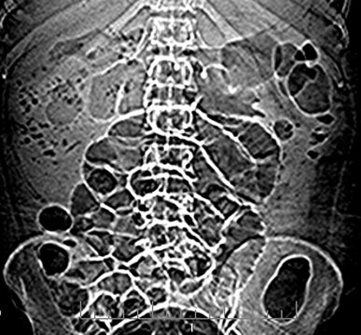
CASE 2

Slide 18
CASE 3

Slide 19
CVASE 4
Seropositive with cough

Slide 20
25 yr old female with left hypochondiac pain

Slide 21
CASE 6
30 yr old male ,
Asymptomatic

Slide 22
CASE 7
Cirrhosis of liver with hepatoma

Slide 23
CASE 8
25 yr old
Female with pain
In RIF

Slide 24
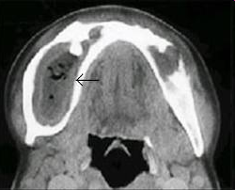
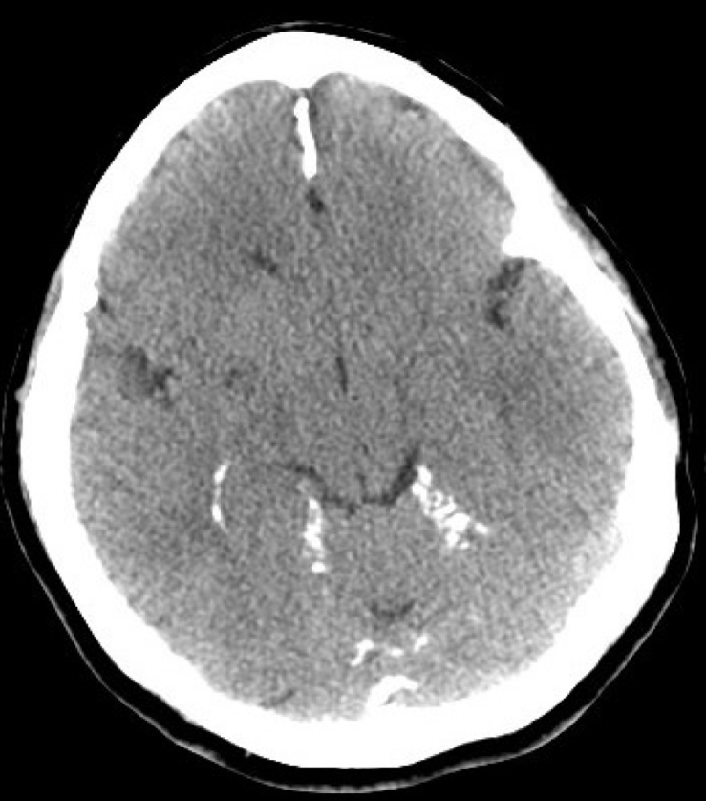
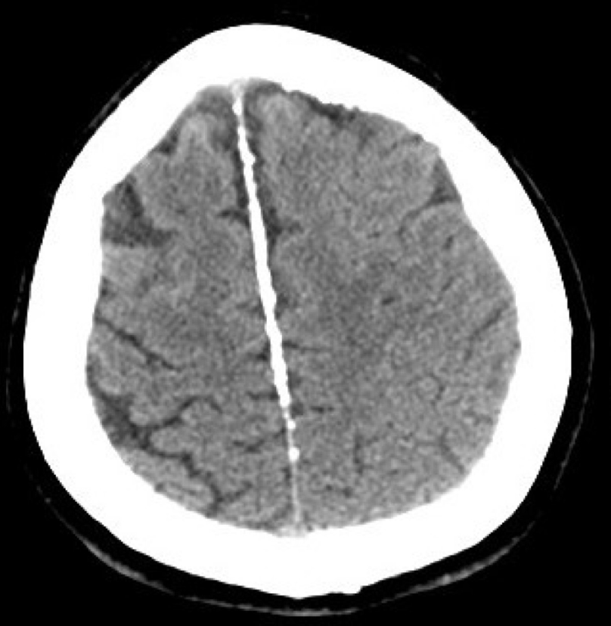
10 YR OLD WITH FACIAL DEFORMITY ,JAW PAIN

Slide 25
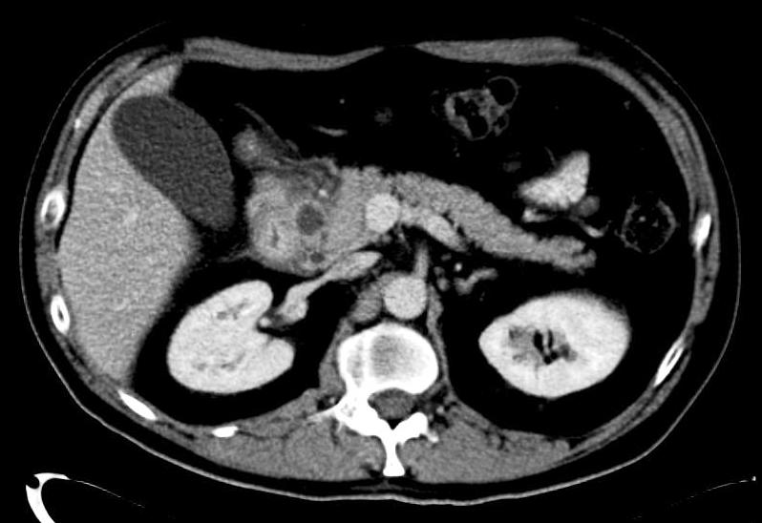
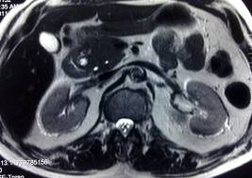
PAIN IN EPIGASTRIC
REGION

Slide 26
CASE 11
40 YR OLD FEMALE C/O PAIN IN ABDOMEN

