Slide 1
SPOTS 1
MR UPDATE

Slide 2
1

Slide 3
Osgood-Schlatter disease
1

Slide 4
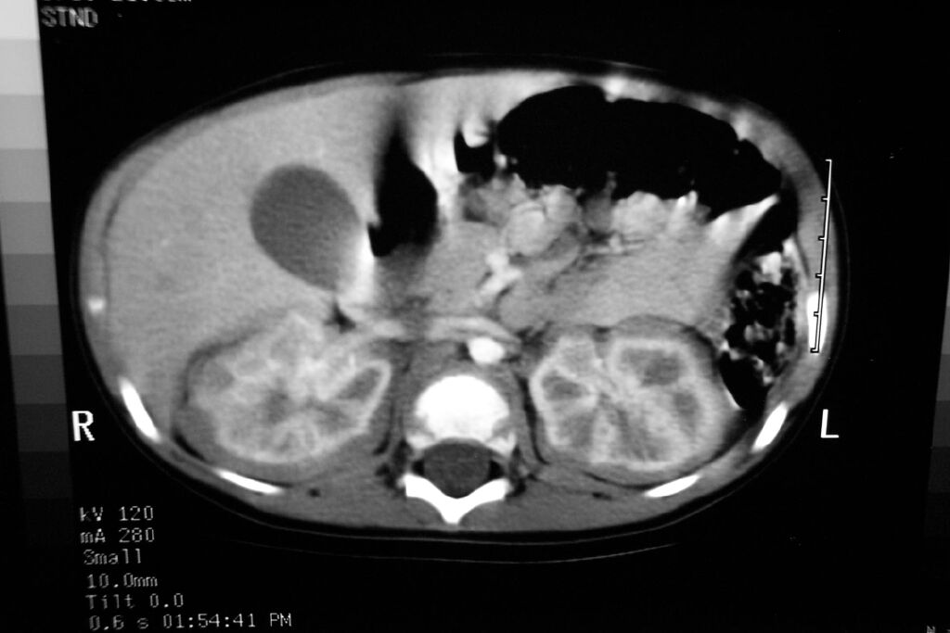
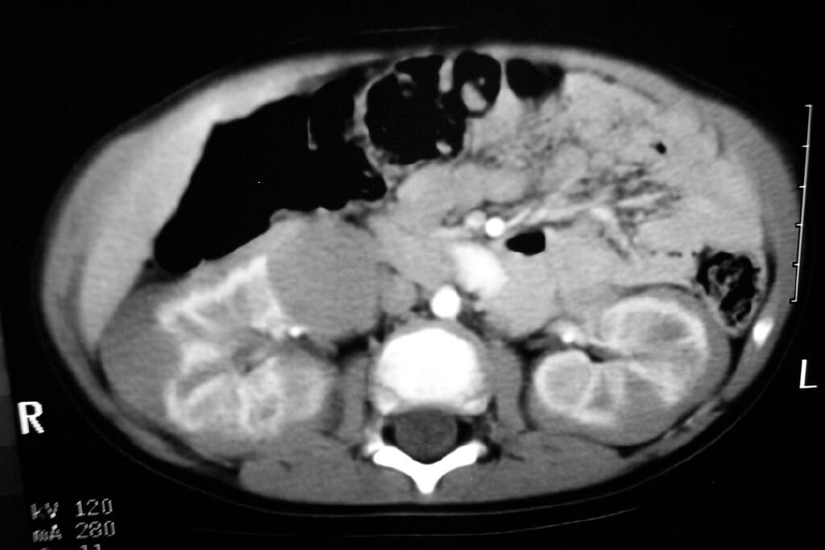
2
8 MO OLD MALE

Slide 5
NEPHROBLASTOMATOSIS

Slide 6
3

Slide 7
Foreign body in subglottic trachea
3

Slide 8
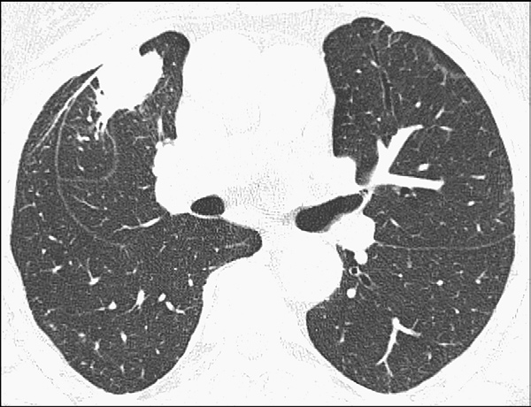
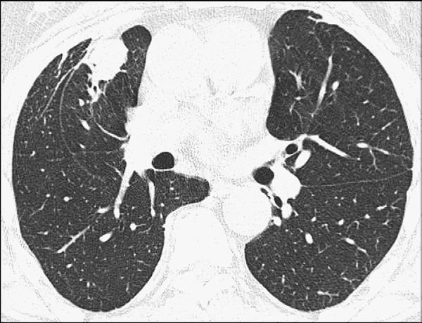
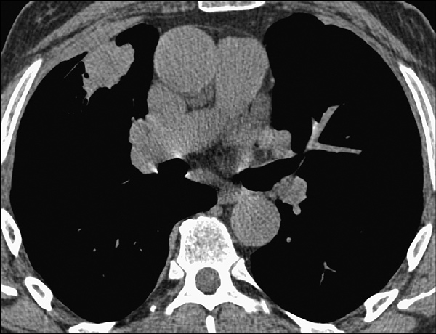
4
Cough with breathlessnesss

Slide 9
ROUND ATELECTASIS
4

Slide 10
5

Slide 11
Pellegrini-Stieda (PS) lesions
5
ossified post-traumatic lesions at (or near) the medial femoral collateral ligament adjacent to the margin of the medial femoral condyle.

Slide 12
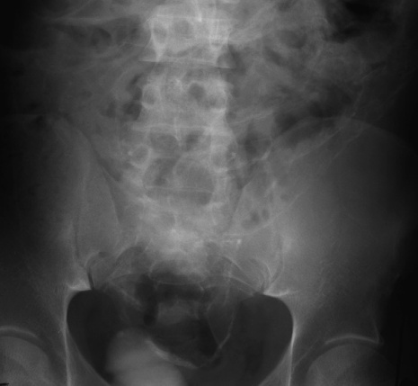
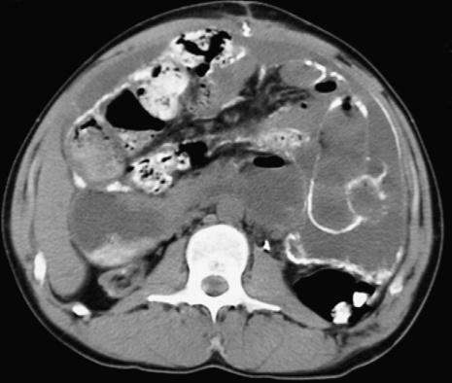
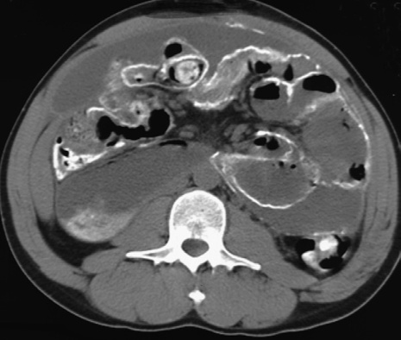
Acute abdominal pain
Diagnosis and systemic disorder patient suffers from
6

Slide 13
SCLEROSING CALCIFIC PERITONITIS
6

Slide 14
CAPD RELATED CALCIFYING PERITONITIS IN END STAGE RENAL DISEASE PATIENTS .
Postulated causes of progressive calcifying peritonitis include the harmful effects of dialysate
an elevated serum calcium-phosphate product may contribute
with sclerosing peritonitis include peritoneal thickening, peritoneal and mesenteric calcifications, loculated fluid collections, and small bowel tethering .

Slide 15
7

Slide 16
Osteopoikilosis
7

Slide 17
WHICH SYNDROME AND WHAT WILL YOU SCREEN NEXT
8

Slide 18
TS
8

Slide 19
9

Slide 20
CPP
9

Slide 21
10

Slide 22
NEURENTERIC CYSTS
10
Enteric lined cysts that present within spinal canal and show definite connection with cord and/or vetrebrae
May communicate with mesenteric or mediastinal cyst around a hemivertebra
Most common cervicothoracic region,conus
93% intradural extramedullary ,5% intramedullary
May be hyperintense on t1 w images

Slide 23
11

Slide 24
RETROCAVAL RT URETER
11

Slide 25
12
RECENTLY DIAGNOSED HYPERTENSION ,STARTED ANTIHYPERTENSIVE
DEVELOPED SWELLING OF LIPS AND ABDOMINAL PAIN

Slide 26
12
ACE INHIBITOR RELATED ANGIONEUROTIC EDEMA

Slide 27
12
ACE inhibitor-induced angioedema is postulated that the use of ACE inhibitors increases bradykinin levels ,which is a potent vasodilator.
May involve oral cavity ,pharynx ,GIT ,GUT .
mural stratification reflecting submucosal oedema with mucosal and subserosal enhancement
Involved small bowel folds show regular thickening
Angioedema attacks can last from 1 to 5 days without treatment

Slide 28
13

Slide 29
TEF-H TYPE
13

Slide 30
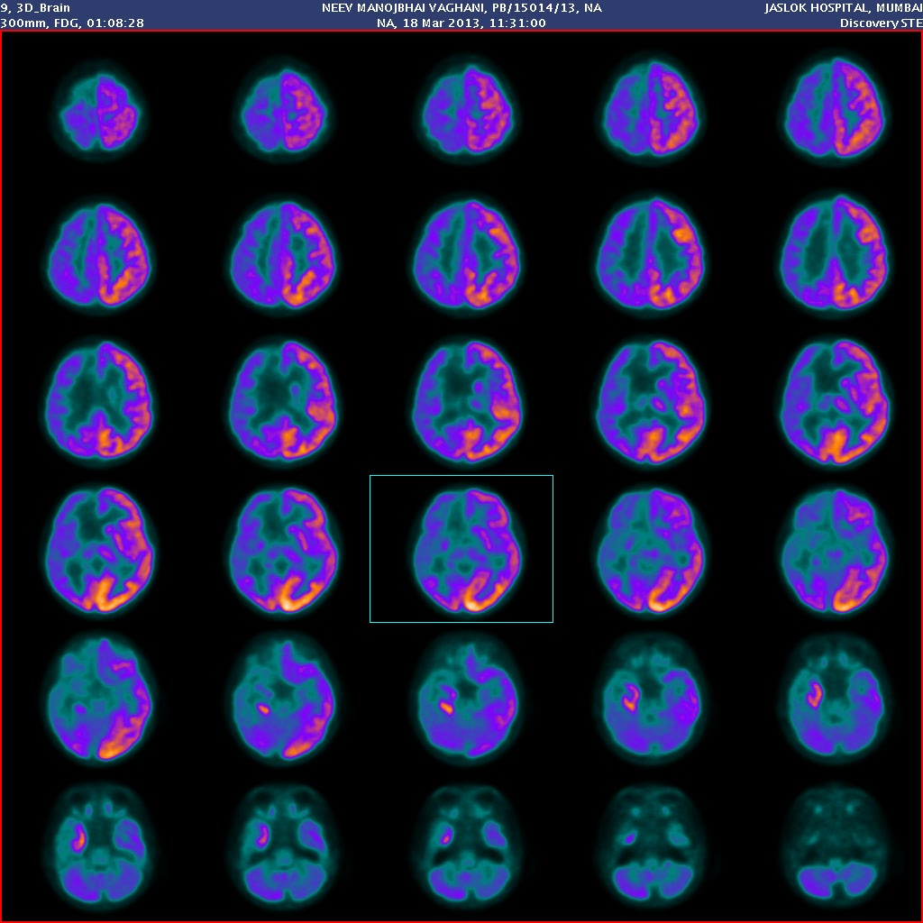
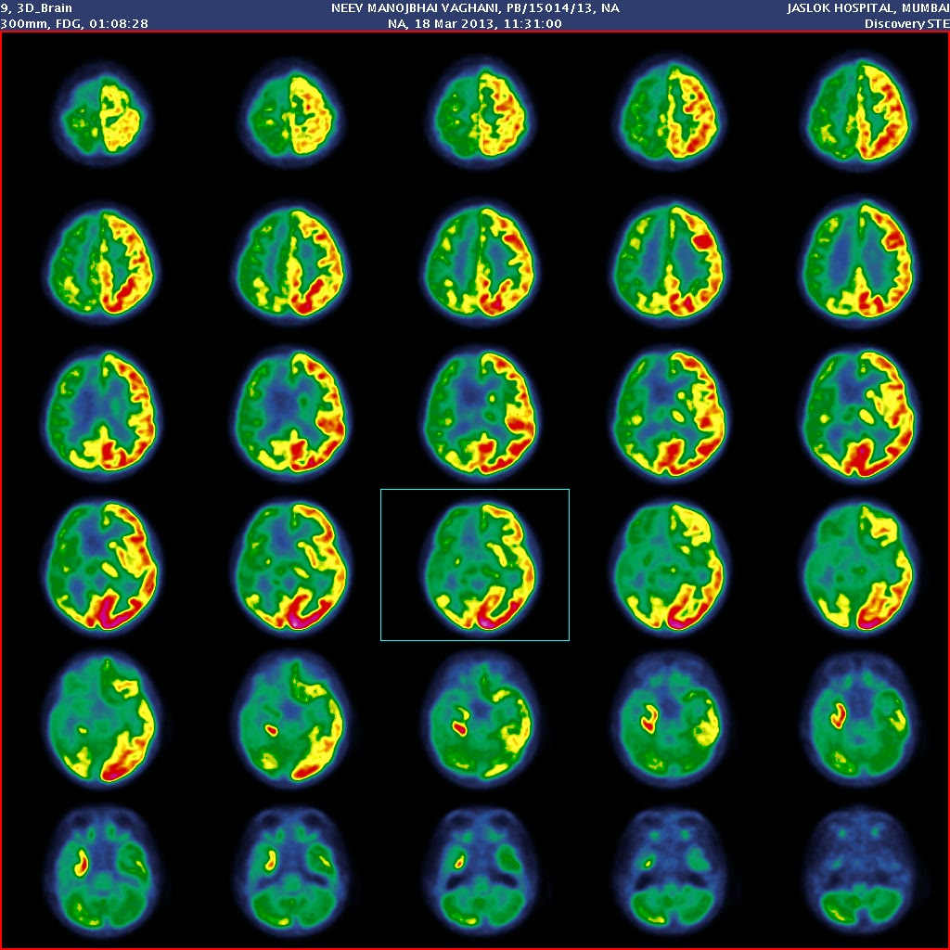
14
8 yr old male with intractable seizures

Slide 31
RASMUSSENS ENCEPHALITIS
14

Slide 32
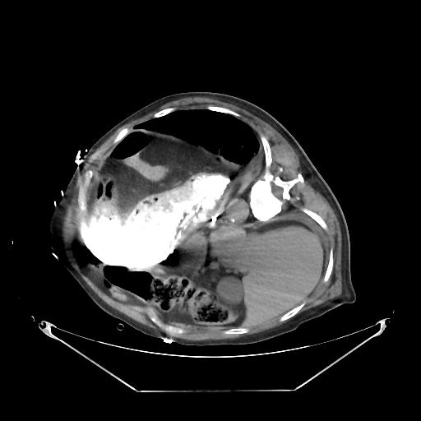
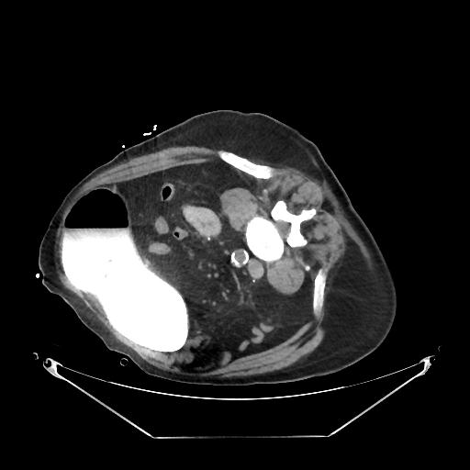
65 yr year old male with acute onset
Abdominal pain ,non bilious vomiting
15

Slide 33
Gastric volvulus
15

Slide 34
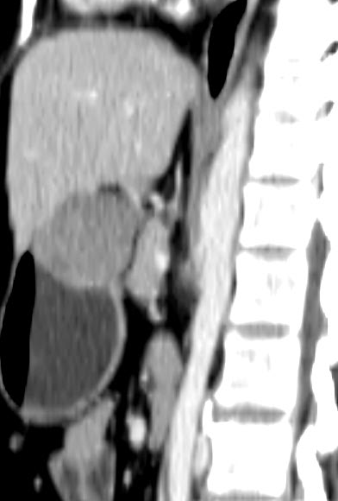
Pain in abdomen
16

Slide 35
GIST
16

Slide 36
17

Slide 37
Pneumomediastinum
17
The angel wing sign.

Slide 38
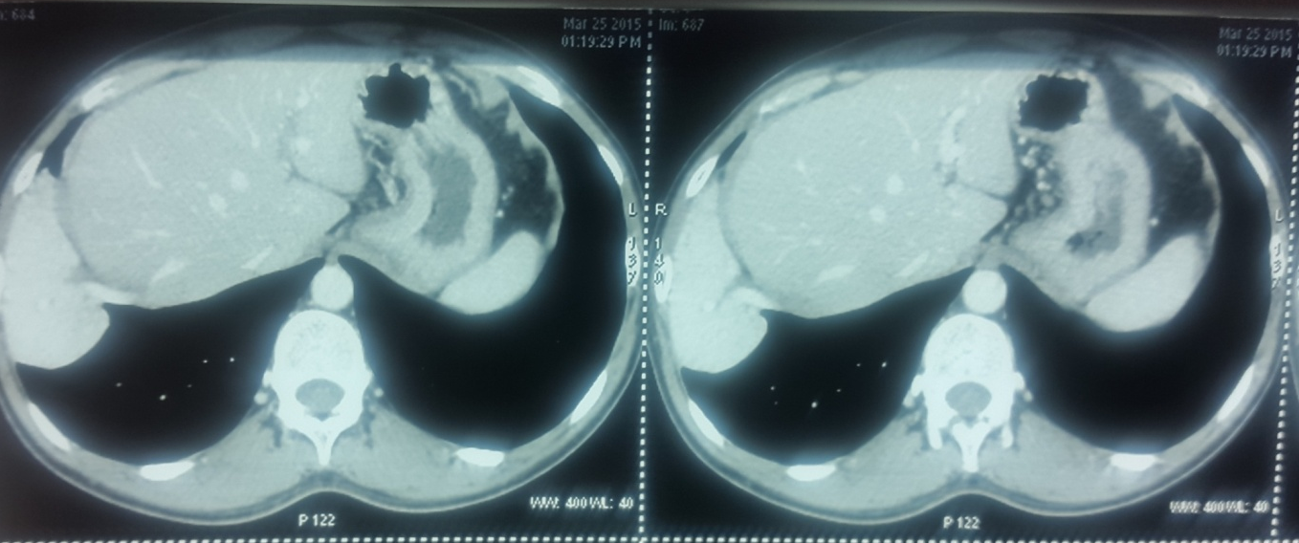
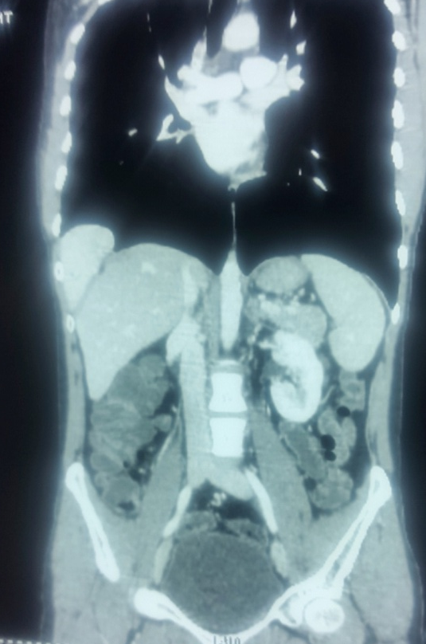
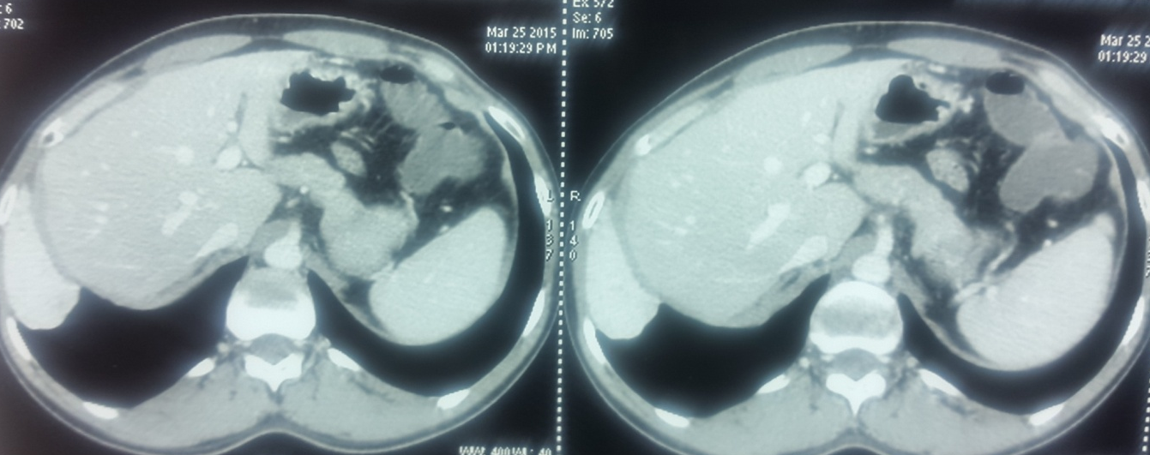
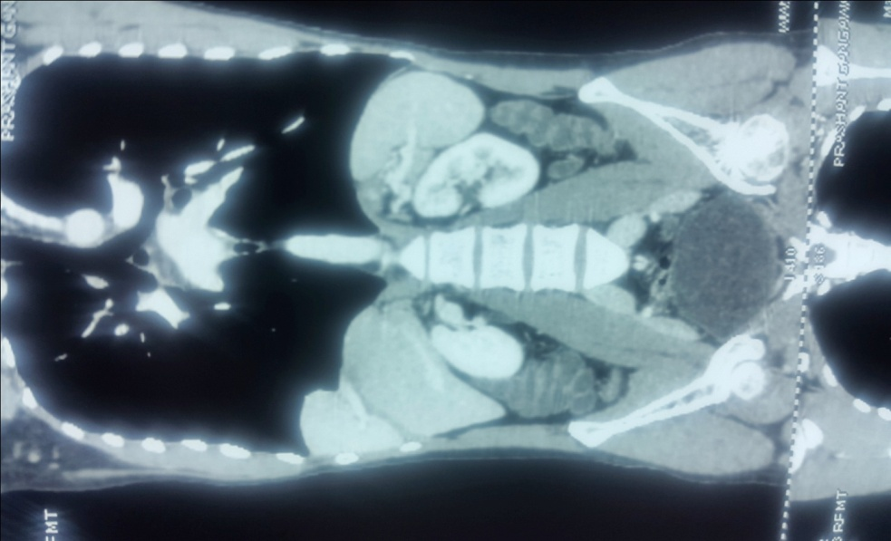
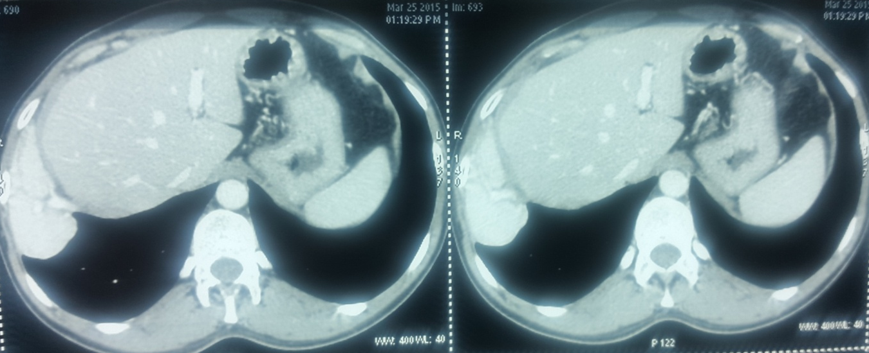
18
DYSPNEA

Slide 39
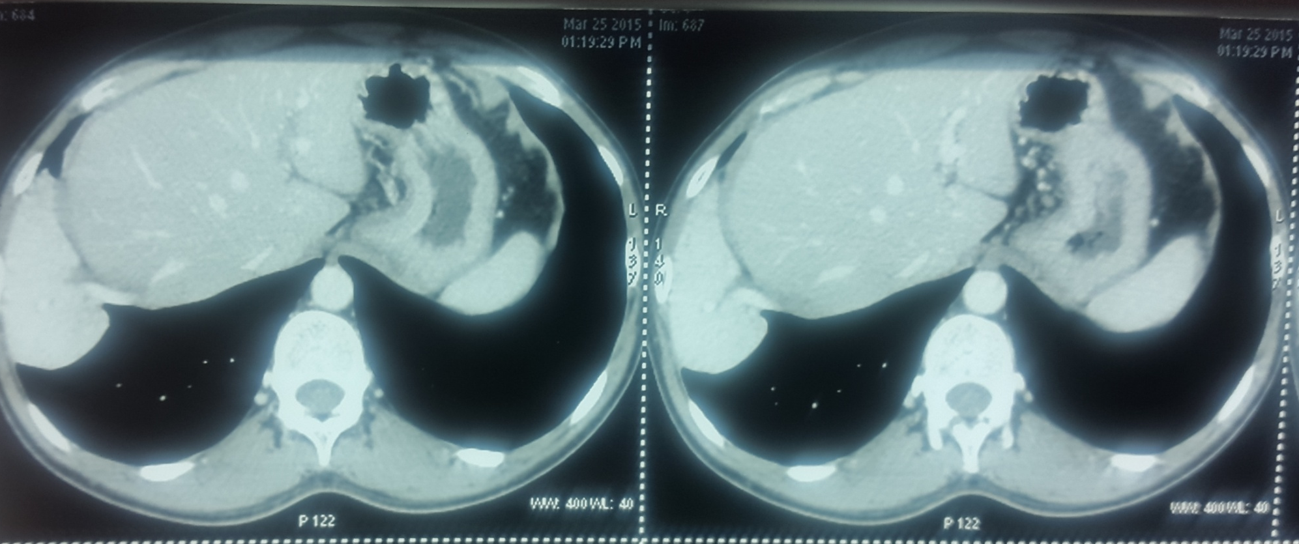
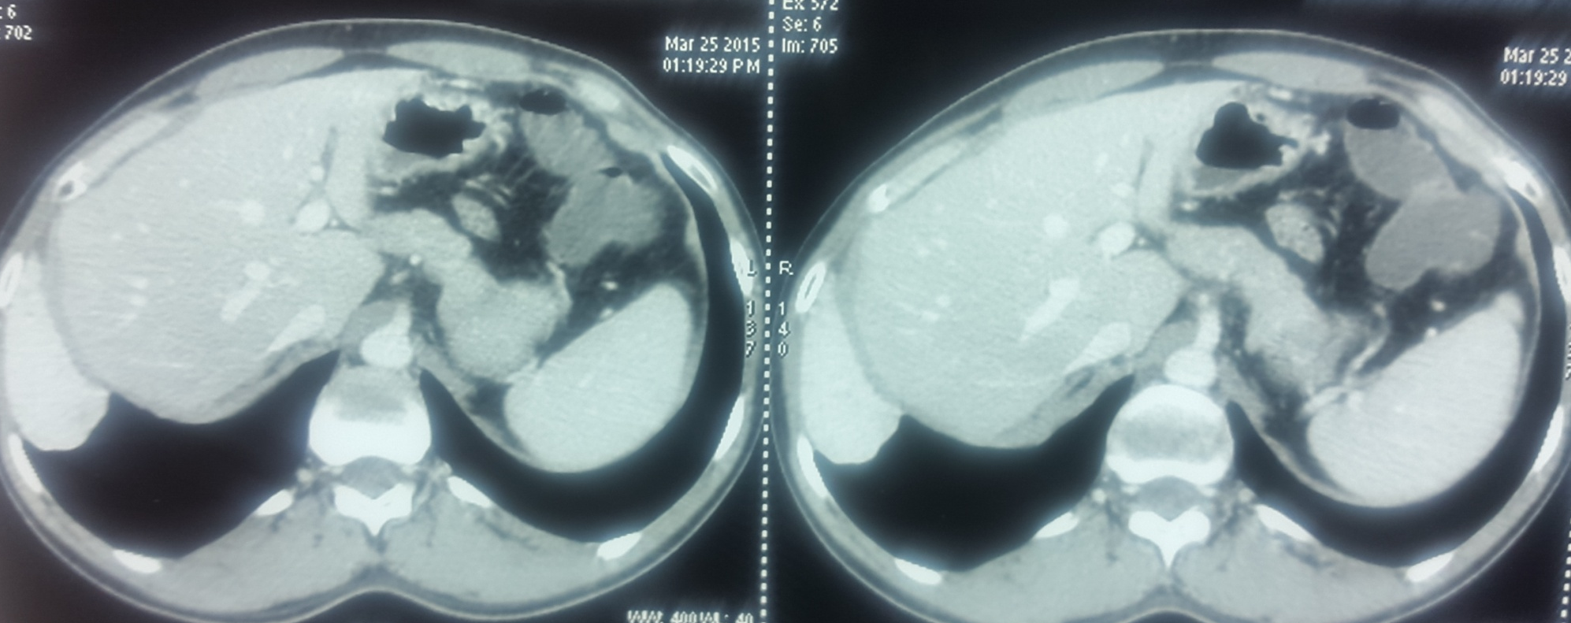
18

Slide 40
18

Slide 41
18

Slide 42
Intrathoracic Accessory lobe of liver
The most common localization is the abdominal cavity, but very rarely it can also be found in the thoracic cavity.
18

Slide 43
19

Slide 44
COPPER BEATEN SKULL
19

Slide 45
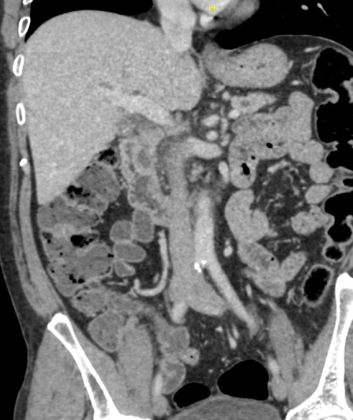
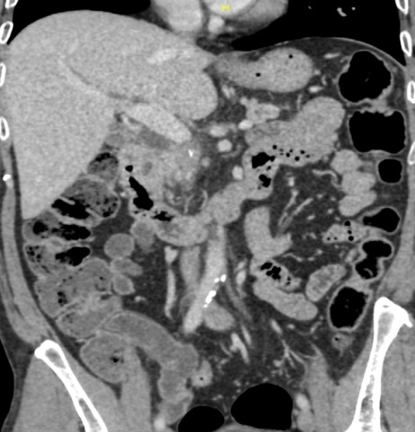
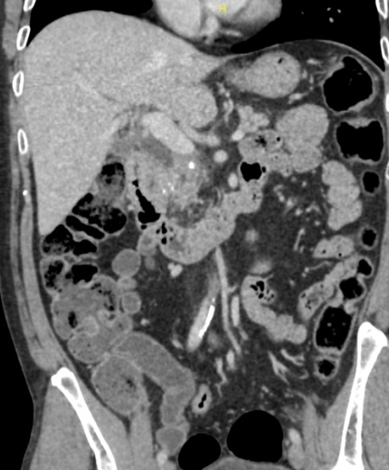
20

Slide 46
GROOVE PANCREATITIS
20
uncommon type of focal chronic pancreatitis affecting the groove between the head of the pancreas, the duodenum and the common bile duct
predominantly seen in males with a history of ethanol abuse.
Peak incidence is roughly 40–50 years old
presents with nausea and vomiting due to duodenal stenosis
Groove pancreatitis is usually classified into two forms, pure and segmental:
Pure form - affects exclusively the groove.
Segmental form - extends to the pancreatic head despite a clear predominance in the groove.
CT
cystic thickening of the duodenal wall with or without duodenal stenosis
fibrous tissue within the pancreaticoduodenal groove (may show late enhancement after contrast administration)
common bile duct dilatation

