Slide 1

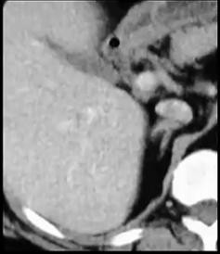
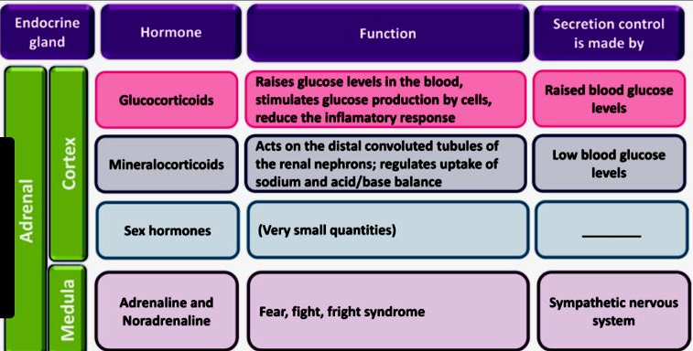
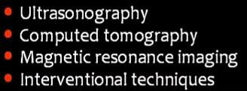
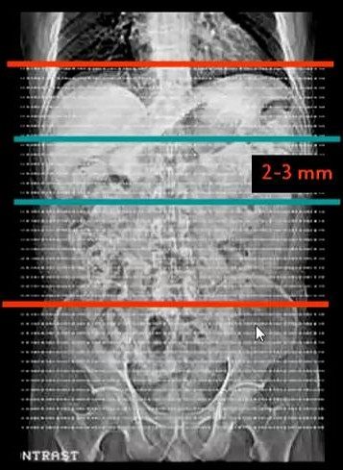
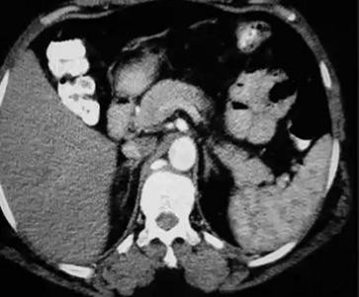
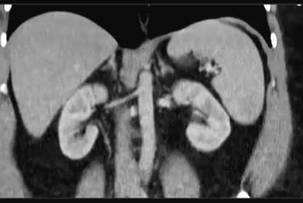
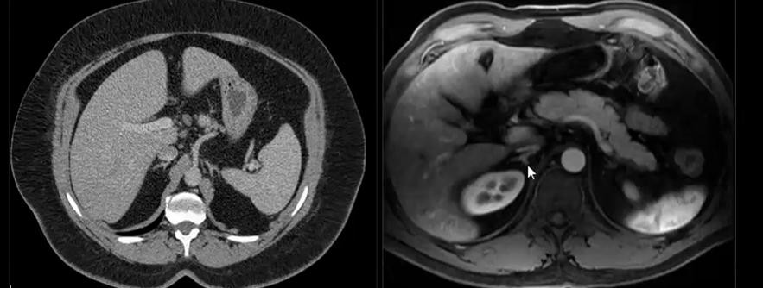
SUMMARY OF ADRENAL IMAGING
SUMMARY OF ADRENAL IMAGING
ANATOMY
Triangle "Y" shape endocrine gland on top of kidneys.
Ad = Near / At Renes = Kidney
Secrete Cortisone & Adrenaline → Control stress
1/2 inch height – 3 inch length
Best seen by CT & MRI
Normal : Seen @ Peri-renal space – Y shape

Slide 2
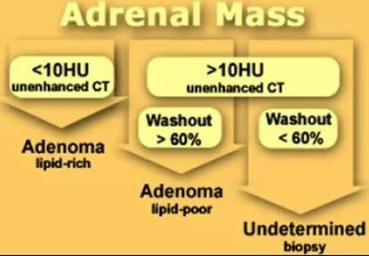
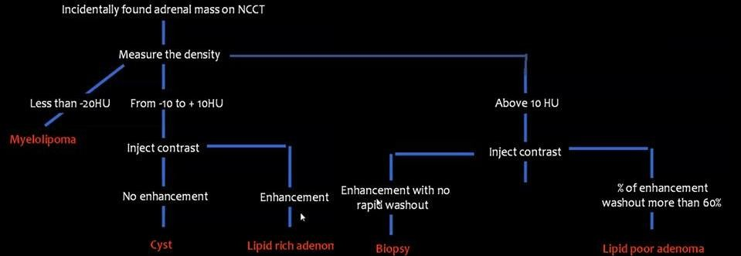

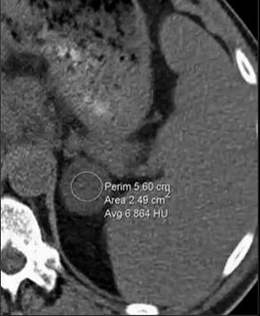
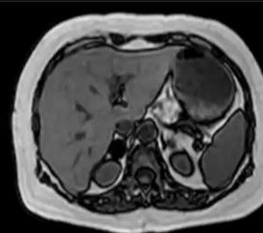
SUMMARY OF ADRENAL IMAGING
ADRENAL PATHOLOGY
MASS | HYPERPLASIA | INFECTION | CYST | HAEMORRHAGE
➔ADRENAL MASSES⬅
Adenoma
Pheochromocytoma
Carcinoma
Deposites
Lymphoma
MyeloLipoma
1- Adenoma
▪
▪
▪
For confident diagnosis of LIPID RICH ADENOMA :
Commonest Adrenal gland Mass * Lesion < 10 Hu NECT = 90 % Adenoma
Lipid Rich or Lipid poor Adenoma
Diagnostic = < 0 Hu in NECT
CT
NECT → < 10 Hu
@ 60 Sec normal enhance
@ 10 min significant washout
MRI
Out of Phase T1 →Signal Drop

Slide 3
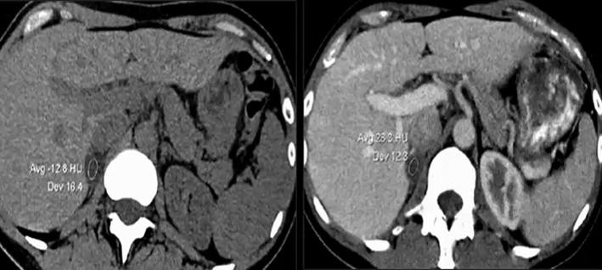
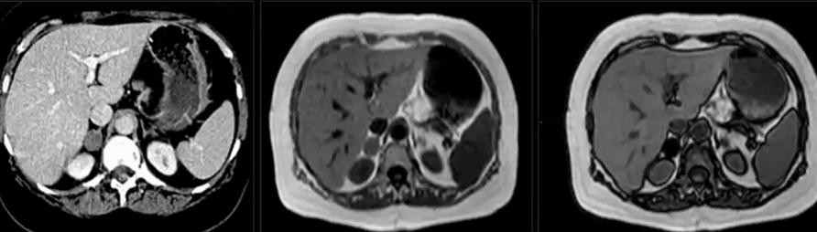
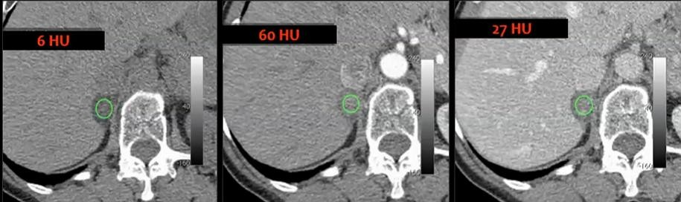
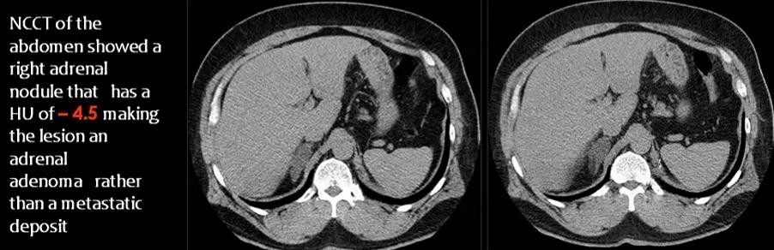
SUMMARY OF ADRENAL IMAGING

Slide 4
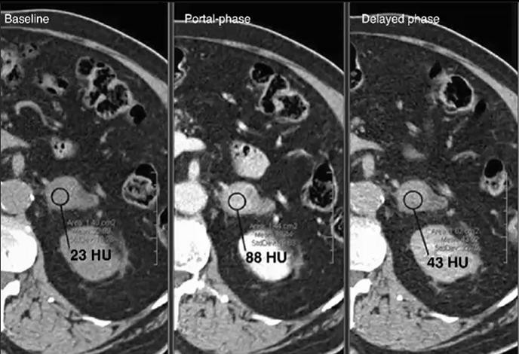
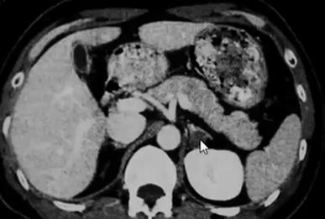
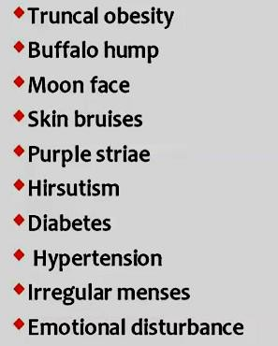
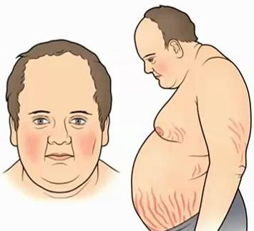
SUMMARY OF ADRENAL IMAGING
⇨ Lipid Poor Adenoma :
30 % of adenomas
@ 60 sec it enhance as other lesions
But @ 15 min → Wash out > 60 %
o > 10 Hu in NECT
NB. Hu assessed at center of lesion avoiding necrosis or calcification.
⇨ D.D. of Adenoma:
METS
Lipid Poor Adenoma
Adrenocortical Carcinoma
Pheochromocytoma
Adrenal Graneulomatus disease
⇨ Conn's Disease:
-Excess mineralocorticoid production
- 1 M : 2 F - 30 : 50 Y
Causes :
  Adenoma 70 %
  Hyperplasia or Carcinoma
C.P.: Hypertension / HypoKalimeia
⇨ Cushing Syndrome:
Excess Gluco-corticoid production
o
Causes:
⇨ Pituitary adenoma
⇨ Adrenal Adenoma 20%
⇨ Adrenocortical Carcinoma 10%
⇨ Adrenal Hyperplasia
Main C.P.:
- D.M. II - Hypertension -Hypercholest. – Abd pain

Slide 5

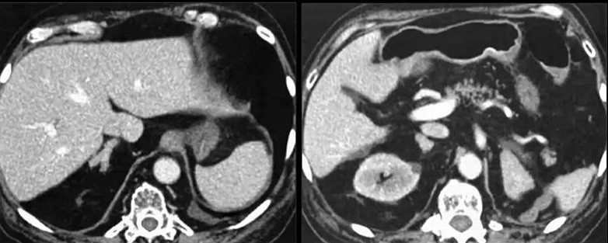
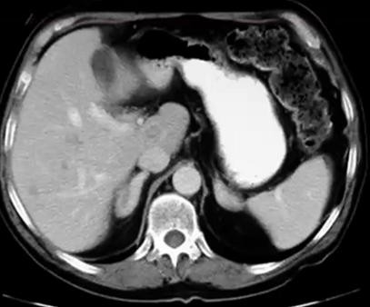
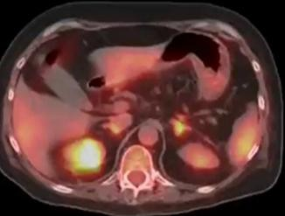

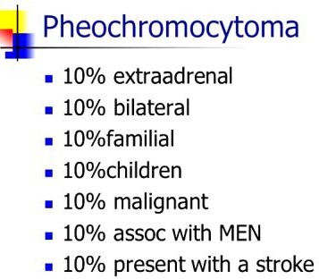
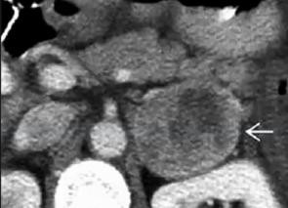
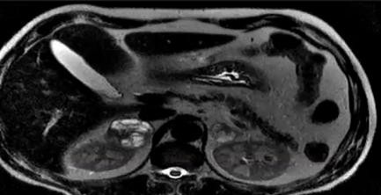
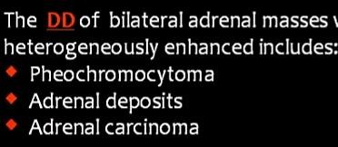
SUMMARY OF ADRENAL IMAGING
2- Adrenal Hyperplasia
⇨ Causes : - Pituitary Adenoma → over ACTH ← - Stress
- Aging Process
Bilateral Adrenal H
perplasia
y
⇨ D.D. Adrenal Hyperplasia :
Adenoma
Haemorrhage
Aging
Adren
al Hyperplasia→ Active in PET CT
3- PHEOCHROMOCYTOMA
IV CONTRAST IS CONTRAINDICATED →HYPERTENSIVE CRISIS may OCCUR
⇨ Age: 4th : 6th decade
⇨ From Adrenal Medulla
⇨ NON SOECIFIC IMAGING FINDING
⇨ Lab Diagnosis :
Elevated Catecholamines :
  In Urine → 97 % sensitivity
  In Plasma → 99% sensitivity
Role of
10
⇨ Adrenal Mass + VM Vanillyl Mandelic Acid in urine + Hypertension
= Mostly PHEOCHROMOCYTOMA

Slide 6

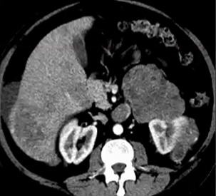
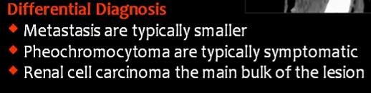
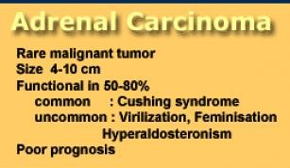

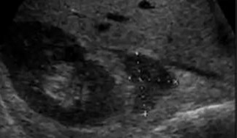
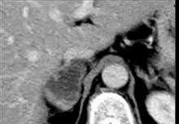

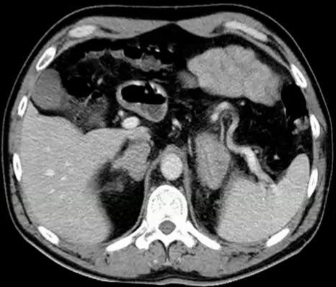

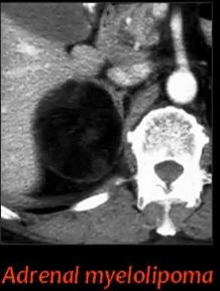
SUMMARY OF ADRENAL IMAGING
4- Adeno-cortical Carcinoma
⇨ Arise from Adrenal Cortex
→ Small amount of hormones "No symptoms"
⇨ Large "> 6 cm" up to 20 cm
⇨ Heterogenous enhancement
⇨ Calcification → 30 % of cases
⇨ Can invade adjacent structures
5- Adrenal Deposits
⇨ Source : Lungs, Breast & Skin ….& may Others
⇨ NON SOECIFIC IMAGING FINDING
⇨ +/- Signs of malignancy :
⇨ Known primary + Metabolic active lesion
6- Adrenal Lymphoma
⇨ Unilateral or Bilateral
⇨ + Lymphadenopathy
7- Adrenal Myelolipoma
⇨ Rare (FAT CONTAINING)
⇨ Benign , No malignant transformation
⇨ Adults usually
⇨ Incidentally Discovered
⇨ Non Functioning usually
⇨ Complication : Hemorrhage

Slide 7
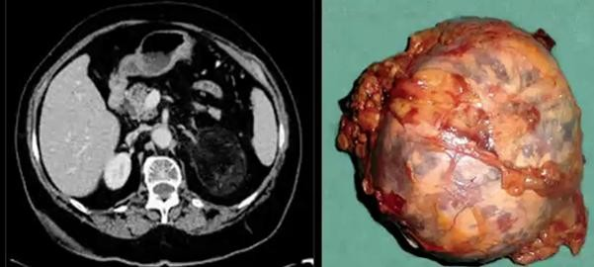
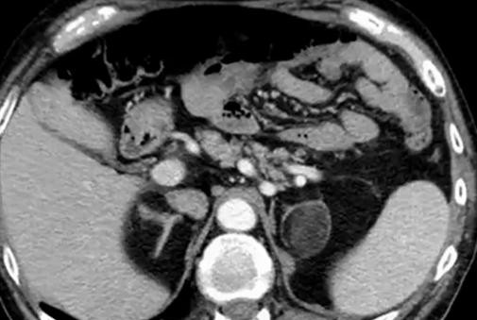
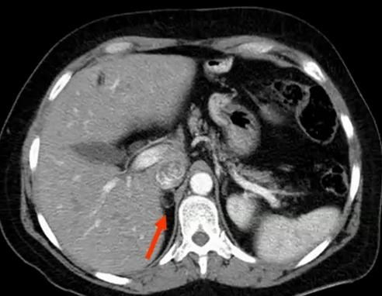
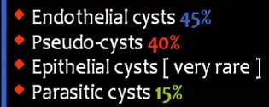
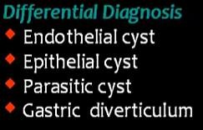
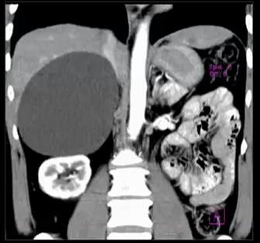
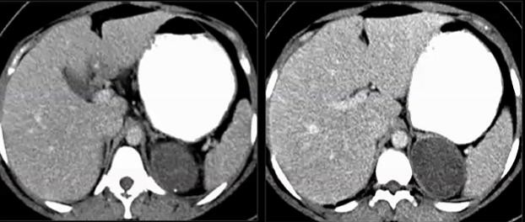
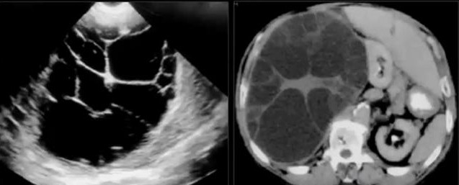
SUMMARY OF ADRENAL IMAGING
Small Adrenal
My
elolipoma
ADRENAL CYST
⇨ Rare
⇨ F 2 : 1 M
⇨ 30 : 50 y
⇨ C.P.:
o Usually asymptomatic
⇨ Complecations:
-Rupture - Haemorrhage - Infection
CYST = NO CONTRAST – Fluid signal
CECT → Cyst is not enhancing
ADRENAL HYDATID CYST

Slide 8
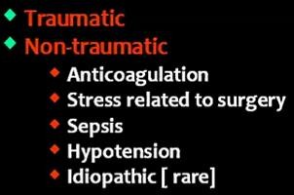
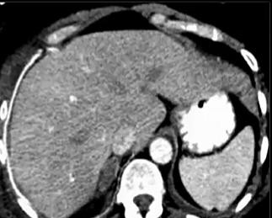
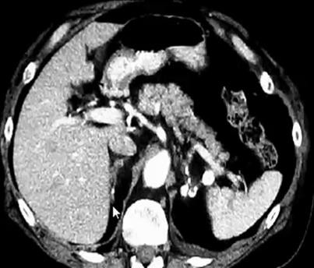
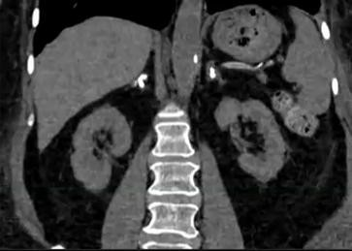
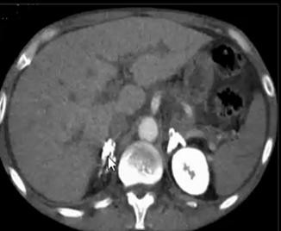
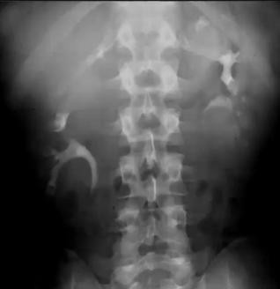

SUMMARY OF ADRENAL IMAGING
ADRENAL HAEMORRHAGE
⇨ Blood Density oval Lesion
⇨ 90% Rt ← Between live & spine
⇨ If + Primary → Mets to be considered
ADRENAL INFECTION
⇨ Bilateral enlarged + Ca → Highly suggestive of TB
⇨ +ve skin Tubreculin test → Diagnostic
BILATERAL ADRENAL CALCIFICATION
Previous Haemorhage | Familial Medtrainian Fever | Incidental Finding
SOURCES : Lecture of Prof. Mamdouh Mahfouz
http://www.radiologyassistant.nl/en/p421aee
By A.M.Abodahab – Ass.Lecturer of radiology Sohag University
JULY 2018

