Slide 1
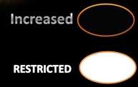
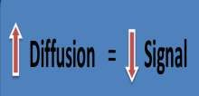
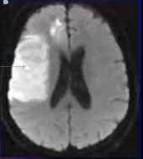
BASICS OF DIFFUSION MRI
BASICS OF DIFFUSION MRI
DWI is a fast sequence , Consuming not more than 2 m.
it is a sequence of great value , in few time
Diffusion : 2 Types - Isotropic = Free
- Non isotropic = inbetween cells
What is the appearance of lesions in DW MRI ?
Either Restricted or Free Diffusion.
• Free → Rapid Motility Molecules → Low signal.
• Restricted → low motility → High signal.
Sequences & parameters in Diffusion are the same in T2
But The Gradient added in Diffusion
→ inversion of T2 effect on fluids ……..i.e.
physiological fluids in Diffusion appears of low signal “Black”.
CSF = Free Diffusion
Bright lesion = Restricted Diffusion

Slide 2
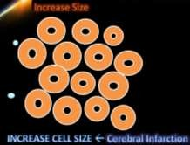
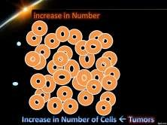
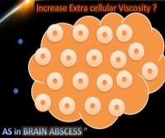
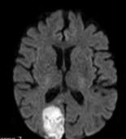
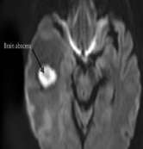
BASICS OF DIFFUSION MRI
* What are the pathological principles of DWI ?
Fluid Molecules diffuse in between Cells
Thus, ……. increase in Cells
– Size - Number - Viscosity of intercellular Fluid
→ DECREASE “Restrict “ Diffusion
What are the main 3 states of Restricted Diffusion ?
Increase Cell Size → as in Cerebral Infarction
Increase Cell Number → as in Tumors
Increase Viscosity of intercellular Fluid → As in Brain Abscess

Slide 3
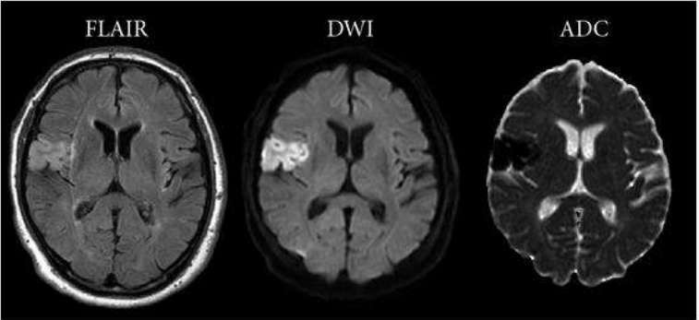
BASICS OF DIFFUSION MRI
Cerebral Infarction
In cerebral infarction
Cut off blood supply → disturbance of salts exchange→Na in ward
→Cells swollen i.e. “cytotoxic edema “
Swelling of the cells = increase its size → Diffusion Restriction
.DWI is the Fastest method to diagnose Cerebral Infarction
1st 3 Hours are the golden time for Thrombolytic therapy
DWI can diagnose infarction in hyper acute stage
This early state not diagnosed by CT or may Not by MRI
BUT DWI can diagnose in …… WITH IN MINUTES of occurrence !!!
Infarction Stage | Duration
Hyper-acute | < 6 H
Acute | 6 h : 3 Days
Sub-acute | 3 days : 3 weeks
Chronic | >3 weeks

Slide 4
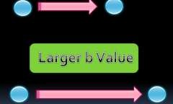
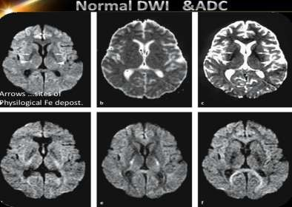
BASICS OF DIFFUSION MRI
⇨ ADC MAP
ADC = Apparent Diffusion Coefficient
it represent the rate of an anisotropic diffusion.
What is b Factor ?
= Degree of diffusion “mm2/sec”
it depend on :
Gradient amplitude
Time
intervals in-between
…………………….Thus , More b Factor ……. More Chance of Diffusion
ADC Map is a computerized image.
Obtained by taking multiple Diffusion images on different b Factors.
This series of images make the rate of diffusion of different molecules can be calculated in numbers.
The ADC Map image is inverted in colors ……. i.e. restricted is black & Free is White

Slide 5
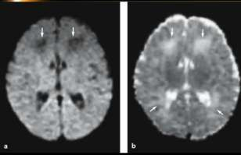
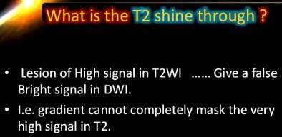
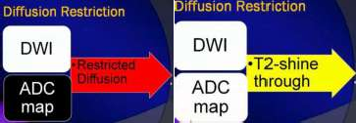
BASICS OF DIFFUSION MRI
Normal neonatal brain. normal to have low DW signal intensities in the frontal deep white matter
(arrows.(
The appearance of the pediatric brain on DW images varies with age
b - ADC values of the corresponding areas are high in neonatal brain,
= To interpret ADC Image :
Look at : Diffusion Image & ADC Map
•Area of Restricted Diffusion: -High signal in DWI & Low in ADC ……..& Vice versa
Thus
As regarding DWI ……. Restricted Diffusion & lesions of very high signal in T2 →
appears Bright
➔ How to Differentiate ?
Area of Restriction Bright in DWI Dark in ADC
Very Hi T2 lesion Bright in DWI Bright in ADC

Slide 6
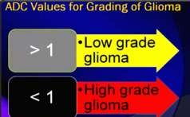
BASICS OF DIFFUSION MRI
⇨ Value of Diffusion in ADC Map is represented by ADC Value.
Malignant Vs Benign
Low grade Vs High Grade
→Higher Cell number →More Restricted Diffusion → Less ADC Value
ADC Value & Tumors
⇨ ADC Value & Tumor Cellularity?
⇨ Tumors of High Cellularity :
⇨ Lymphoma ……… ADC Value 0.51 : 0.71
⇨ High grade Glioma ……… 0.58 : 0.88
⇨ Metastasis
⇨ Medulloblastoma
⇨ Tumors of Low Cellularity :
⇨ Low grade Glioma …….. ADC Value > 1.05

Slide 7
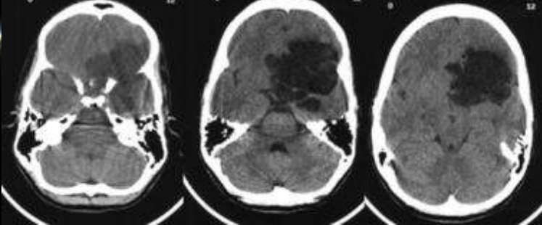
BASICS OF DIFFUSION MRI
⇨ All Malignancy has High Cellularity ? ?
⇨ Usually Yes
But Few Malignancies has Low Cellularity .
Best Example → CHORDOMA
Chordoma has low celularity → High ADC value
Epidermoid Cysts
Benign & non-neoplastic , Congenital or Acquired cysts.
Contain dense fluid + epidermal elements → restricted diffusion.
DWI differentiate it from other cysts, especially :
– arachnoid cyst, → do not show any restricted diffusion. "CSF LIKE"

Slide 8
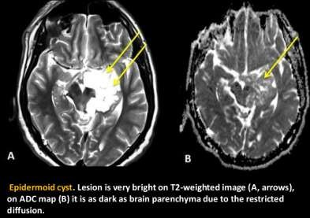
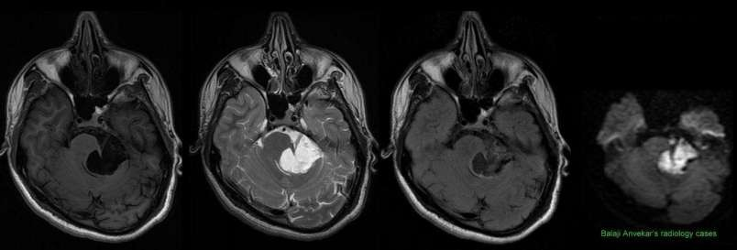
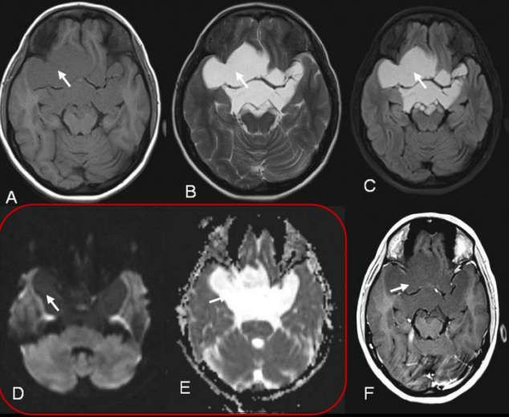
BASICS OF DIFFUSION MRI

Slide 9
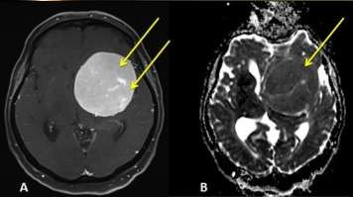
BASICS OF DIFFUSION MRI
Meningiomas
Extra-axial Dural Neoplasm
Homogenous intense enhancing +/- Dural tail.
Their typical appear → easier to be diagnosed on routine MR images.
Subtypes : * Typical, * Atypical * Malignant
– A typical and malignant meningiomas show much more prominent restricted
diffusion.
Meningioma. Post-contrast T1-weighted image (A) shows intense enhancement of
.)the tumor (arrow
On ADC map, the mass is dark, due to the restricted diffusion. Pathology: Atipic
.meningioma, WHO grade 2

Slide 10
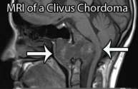
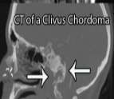
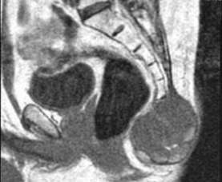
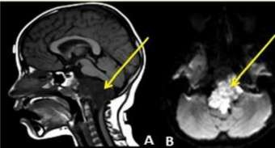
BASICS OF DIFFUSION MRI
Chordomas
Chordomas Vs chondro-sarcomas
Rare
Primary bone tumors
•it Involves:
skull base, especially the clivus.
sacrococcigeal region.
DWI :
– Especially poorly differentiated chordomas →more restricted diffusion than chondro- sarcomas

Slide 11
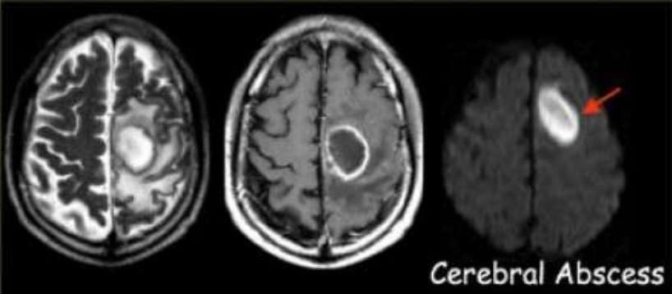
BASICS OF DIFFUSION MRI
Lymphomas
Lymphoma Vs Glial Tumors.
•Site: periventricular/sub ependymal.
•Intense Homogenous enhancement.
•Their diffusion is more restricted compared to glial tumors
Also, they show lower perfusion than glial tumors.
Abscess .
Sometimes can be mistaken as necrotic tumors on imaging,
•Both show peripheral contrast enhancement.
•Clinical presentation is important for the differential diagnosis.
•On MRI, liquid content of the abscesss how markedly restricted diffusion , →
extremely helpful for the diagnosis .

Slide 12
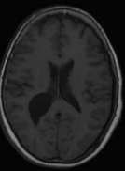
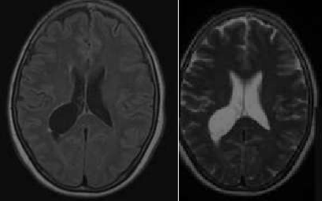
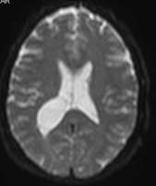
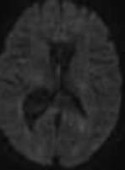
BASICS OF DIFFUSION MRI
Choroid Plexus Cyst
Diffusion-weighted MRI (DWI) has been applied to extracranial sites
since the 1990s.
Several investigators have reported that 3-T DWI can improve :
– the diagnostic accuracy of tumor detection,
Assessment of Hepatic Tumors
Assessment of body lymphoma
Evaluation of Prostate Cancer
staging,
targeted biopsy,
posttreatment follow-up,
Assessment of therapeutic response

Slide 13
BASICS OF DIFFUSION MRI
SUMMARY
→ DWI is a fast sequence * Gradient its magic
ink
DWI is the best to assess hyper acuteinfarction
Restricted diffusion = high signal in DWI / Low in ADC……vice versa
Increase in “cells size/Infarction- “ Numbers / Tumors “ – "Fluid Viscosity
/ Cyto-toxic edema"
ADC Map give a numerical values as in CT Hu.
→ Highest ADC value of freeDiffusion is 3
ADC value of :
– high grade Tumors < 1 , Low grade >1
DWI is an important part of MR imaging for the evaluation of brain masses.
DWI can not be used alone.
Data obtained from routine T1, T2 and FLAIR sequences as well as post contrast images should be evaluated altogether.
Perfusion imaging → evaluate vascularity of masses.

