Slide 1
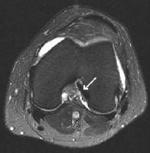
KNEE IMAGING
SUMMARY OF KNEE IMAGING
"Source: Handout & Lectures of Prof. Mamdouh Mahfouz"
Indications:
History of trauma
Pain and/ or swelling
Deformity
Limitation of movement
Technique of examination:
Patient preparation:
  No preparation required unless the patient will be injected with contrast material or will receive anesthesia then the patient is instructed to fast for 4-6 hours.
  Contrast material is Gadolinium DTPA, dose is 0.1-0.2 mmol/ Kgm body weight.
  Anesthesia → to patients who cannot remain stable the time of examination [Pediatric and uncooperative patients]
Procedure:
Supine position of the patient
Surface coil [single knee is examined at a time]
When contrast material is injected axial, sagittal and coronal T₁ WIs are obtained.
SCAN PROTOCOL
MRI
Scout | Axial
Axials | T2 or Gradient
Coronal | STIR
Sagital | T1 - T2 - PD
If + Contrast | Ax. – Sag. – Cor T1
Slice Thickness | 4 mm
FOV | 16
MANDATORY | Sagital / PD
NB Contrast is injected whenever inflammatory or neoplastic lesions are suspected.
NB Wrong angle of ACL SCAN = wrong diagnosis of Torn ACL Steps to select the right examination plane for ACL
Select the axial image which show the intercondylar notch
Draw a line tangential to
the posterior aspect of femoral condyles [line A].
Draw a line perpendicular to line A [line B]
The examination plane should be 10° from line B [line C]

Slide 2
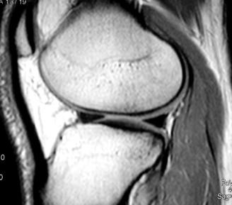
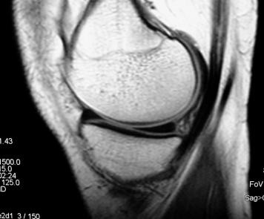
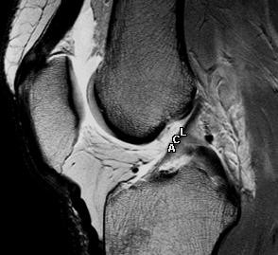
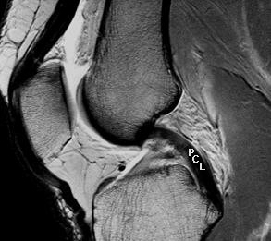
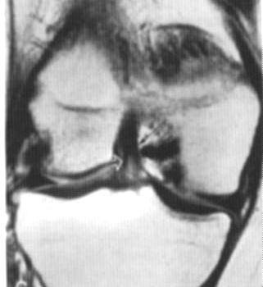
SUMMARY OF KNEE IMAGING
Image interpretation [ Normal anatomy]
Items to assessed: Medical and lateral menisci, anterior and posterior cruciate ligaments, collateral ligaments, retinacular ligaments, bone marrow, the presence of synovial effusion or not.
Menisci : → [ assessed in the sagittal PD]
Each meniscus has : anterior and posterior horns & body
Homogenously black in all pulse sequences.
Landmarks :
  The lateral meniscus → fibula and ( anterior and posterior horns is equal),
  Medial meniscus, → posterior horn is larger than the anterior horn
The meniscal horn is triangular with 3 surfaces,:
  the superior surface facing the femer,
  the inferior surface facing the tibia and
  the menisco-capsular attachment which is the base of the triangle.
Cruciate ligaments [assessed in the sagittal PD]
o Anterior cruciate ligament
[ACL]
& Posterior cruciate ligament
[PCL]

Slide 3
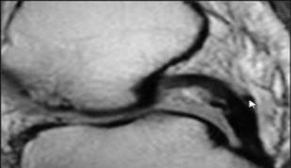
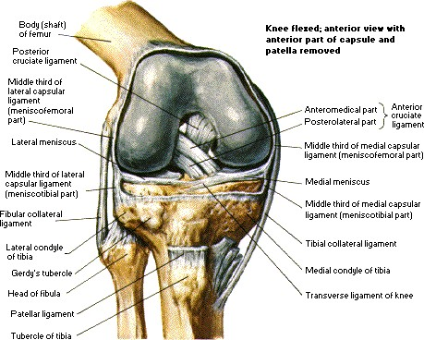
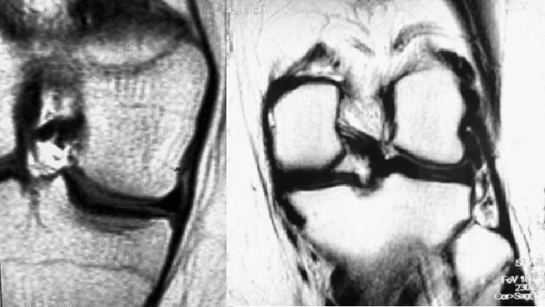
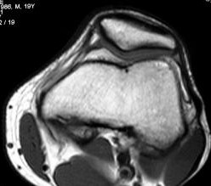
SUMMARY OF KNEE IMAGING
 | ACL | PCL
Arise from | posterior aspect of the femer
Insert In | tibia / anterior aspect of | femer / posterior aspect
Apperance | low signal in all pulse sequences | low signal in all pulse sequences
Exceptions | High signal lines within the ligament =in T₁ (normal intraligamentous fat) =in T₂ WIs (synovial recesses within the ligament, normal variant) | no exceptions
Coronal | vertical band in the lateral aspect of intercondylar notch | Horizontal part of the ligament is seen in the intercondylar notch attached to the medial femoral condyle.
NB. Small Ligaments , Humphery at Ant aspect & Wrisperg at Post aspect of PCL
NB. Small Ligaments, Humphery at Ant aspect & Wrisperg at Post aspect of PCL
Collateral ligaments [assessed in the coronal images]
The medial collateral ligament is intimately related to the medial femoral and tibial condyles "8 : 11 cm"
The lateral collateral ligament attaches to the fibular head " 5 : 7 cm"
Both ligaments are normally of low signal in all pulse sequences
Both ligaments are not usually seen in the same image
Retinacular ligaments [assessed in the axial images]
The patella has two articular surfaces with the femoral condyles
The Lateral surface is Longer than the medial surface
The medial retinacular is attached to the patella by two fasicles
Both retinaculae are normally
of low signal in all pulse sequences.

Slide 4
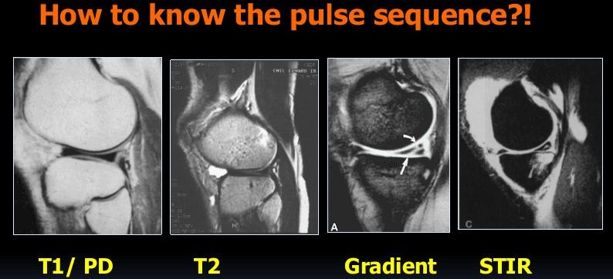
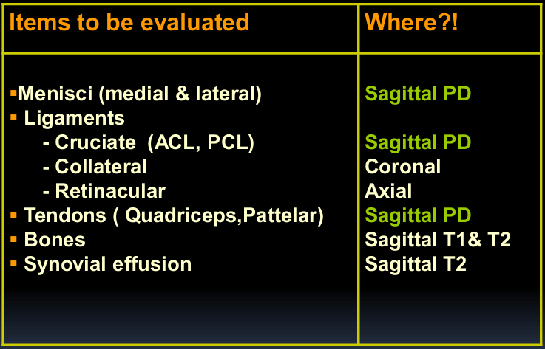
SUMMARY OF KNEE IMAGING
Bone marrow [assessed in all images]
Normally the bone marrow is bright in T₁ and less bright in T₂ with dark signal in gradient images and very dark signal in STIR images which represent the normal signal of marrow fat.
NB STIR images are the best for evaluation of bone marrow lesions such as edema, contusion, infection, neoplasms,…
Synovial effusion
Normally the knee joint contains minimal amount of synovial fluid which appears black in T₁
WIs and bright in T₂ WIs
NB
Assessment for synovial effusion is usually done in T₂ WIs
[Conventional T₂, T₂* , gradient and STIR images]
MRI FINDING

Slide 5
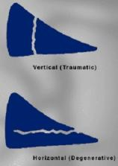
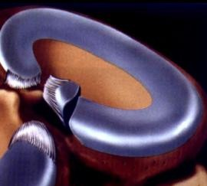
SUMMARY OF KNEE IMAGING
Meniscal Lesions
Tear
Degeneration
Extrusion
Contusion
Cyst
Discoid
Degeneration :
Abnormal intermediate signal NOT REACHING articular surface.
Reporting of Degeneration :
an abnormal intermediate signal seen at …… horn of……. Meniscus , Not reaching articular surface, not reaching menisco -capsular sueface , representing minor degenrative
➔ Impression : Essential Normal scan
o TEAR :
Abnormal intermediate signal NOT REACHING articular surface.
Types : - Simple - Complex - Special type
Meniscal Tear | Subtypes
Simple | Horizontal "degenerative" Vertical "traumatic" Radial "Root" " vertical tear of free edge of meniscus →Ghost
Complex | Flab "oblique" →Fish Mouth Bucket Handle Menisco-capsular separation "only medial, only traumatic"
Special type
Reporting : Linear band of , intermediate signal is seen traversing ….horn
of ….meniscus disrupting menisco-capsular attachment as well as lower surface
…… ➔ Impression : Horizontal Tear of

Slide 6
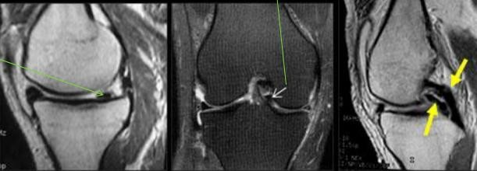
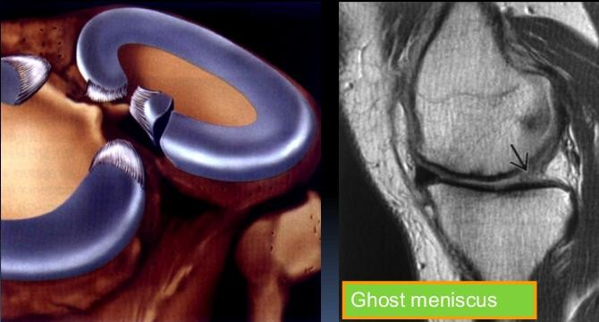
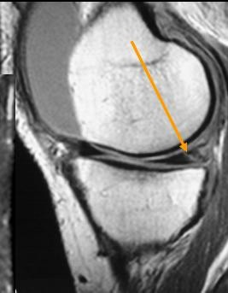
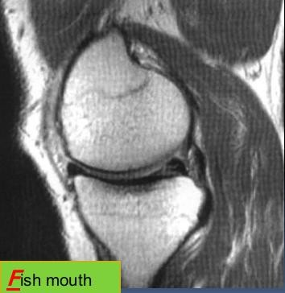
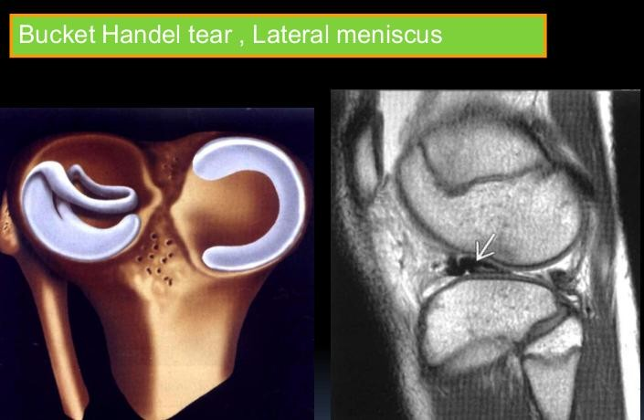
SUMMARY OF KNEE IMAGING
Bucket Handle Tear → 3signs
-PHMLM smaller than AHMM “Main sign ”
-Torn Fragment seen below PCL in coronal “Medialy displaced ”
-Double PCL sign in Sagittal
Vertical tear
Double Delta Sign of AHLM
& Absent PHLM

Slide 7
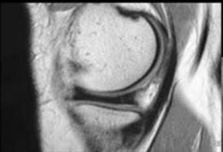
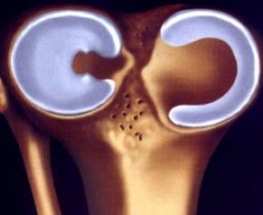
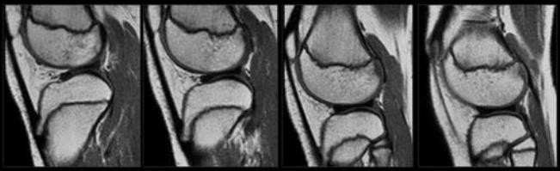
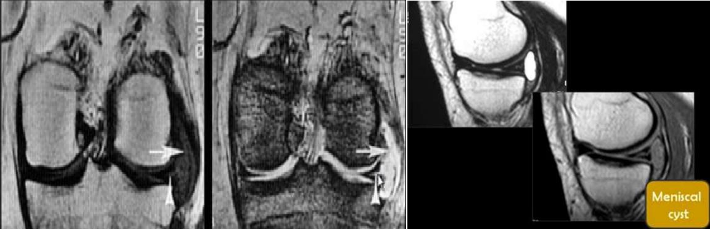
SUMMARY OF KNEE IMAGING
MC Separation
Only Medial
Only Traumatic
As Lateral meniscus is already Loss
DISCOID (Meniscal body segment seen in 3 or more sagittal images)
Congenital lesion
Dysplastic meniscus → loss of normal semi lunar shape
Most common in lateral meniscus
More susceptible to Degen & Tear.
.
⇨ MENISCAL CYST “Parameniscal Cyst”
Cyst at base of Meniscus , extending from tear
Common in : AHLM & PHMM

Slide 8
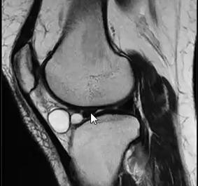
SUMMARY OF KNEE IMAGING
➔ If Cyst Adjacent to intact meniscus = Ganglion Cyst
Ganglion Cyst
Notice Intact Meniscus
DONOT FORGET
Behind posterior horn of Lateral Meniscus PHLM, a tendon = “popliteus tendon”-
→wrongly diagnosed as Tear or Cyst
*** D.D. of Parameniscal Cyst :
Ganglion cyst “intact Meniscus”
Bursitis
Cystic Mass “Hematoma – Hemangioma – Rarly cystic neoplasm”
Tendon Popliteus sheath filled with fluid.

Slide 9
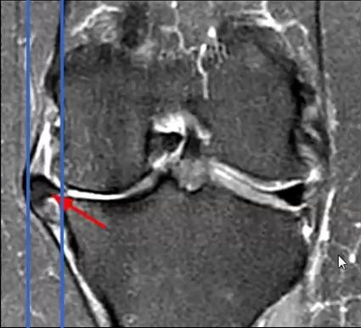
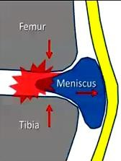
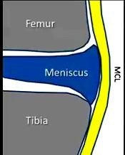
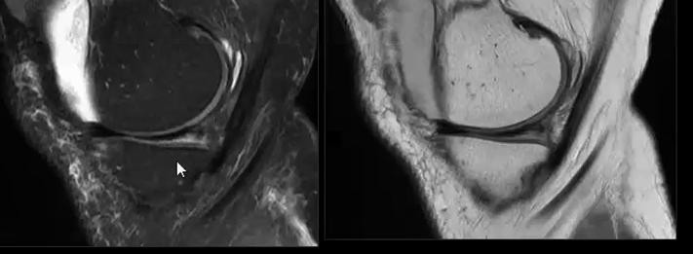

SUMMARY OF KNEE IMAGING
MENISCAL EXTRUSION
Occurs in Medial Meniscus
Main cause osteoarthritis →decrease joint space → Extrusion
Measured in Coronal in mm , from :
  medial Tibial aspect “without osteophytes
  To periphery of extruded Meniscus
⇨ > 7 mm = sever extrusion
⇨ MENISCAL Contusion
Trauma → Irregular surface * Occurs in Medial Meniscus
Was diagnosed as an artifact

Slide 10
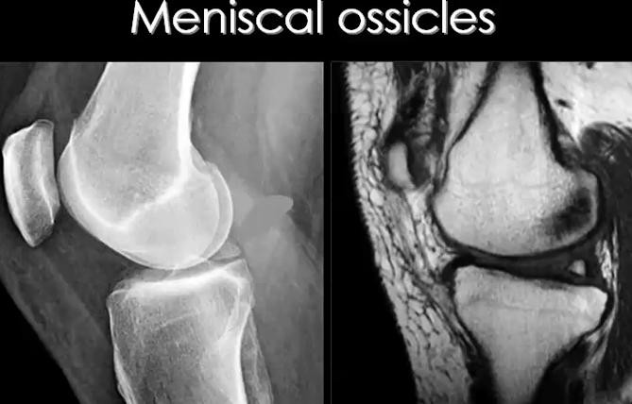
SUMMARY OF KNEE IMAGING
Meniscal Ossicle
Small bone fragment with in meniscus
Contains Bone marrow → same signal of bone marrow in different sequences. So, best seen in T1 / Not visualized in STIR

Slide 11
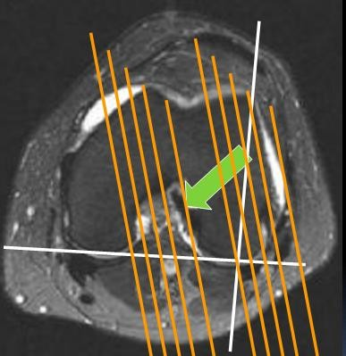
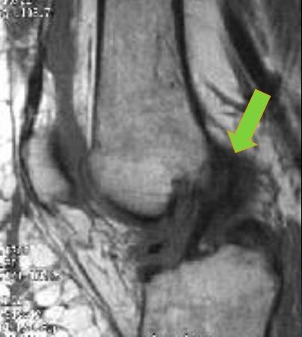
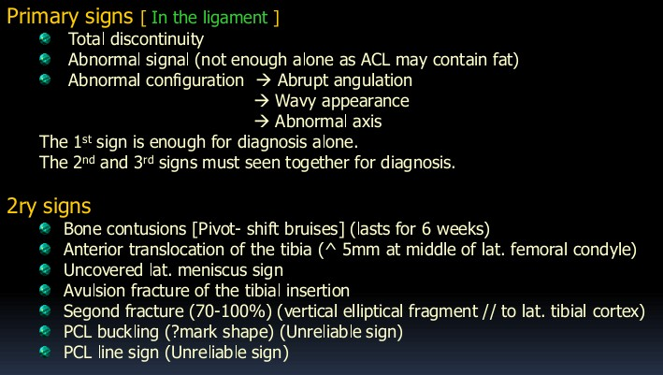
SUMMARY OF KNEE IMAGING
LIGAMENTOS
Lesions
ACL
Good Angle of scan is mandatory to see ACL
When ACL is Not seen in Sagittal scan → Look at Coronal , if seen "at lateral aspect of intrecondylar notch" = wrong angle scan.
Partial volume of lateral condyle → False appearance of ACL tear
Notice preserved stretched fibers
Signs of Anterior cruciate ligament injury:

Slide 12
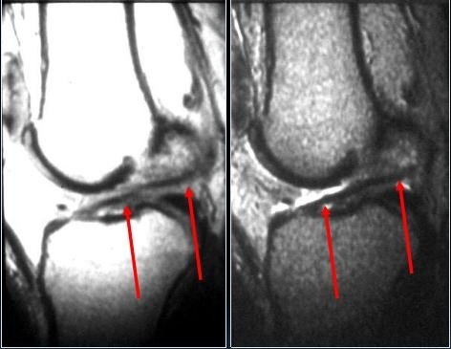
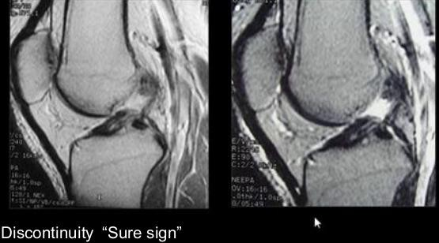
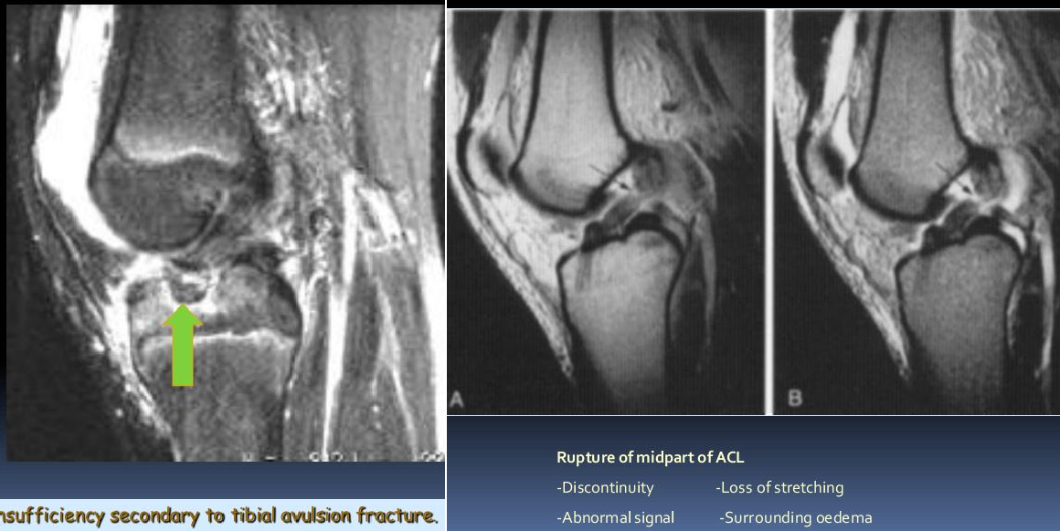
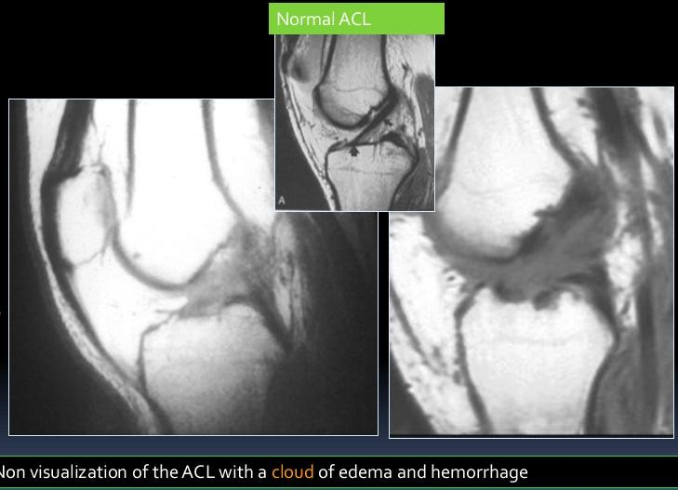
SUMMARY OF KNEE IMAGING

Slide 13
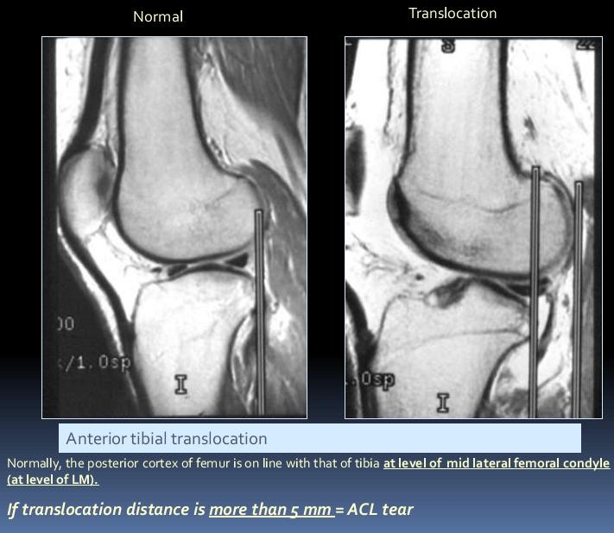
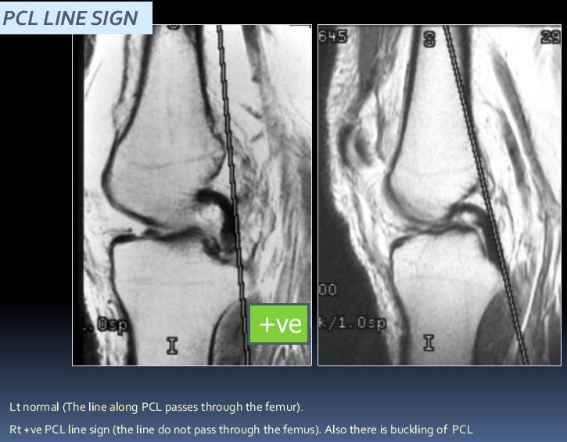
SUMMARY OF KNEE IMAGING

Slide 14
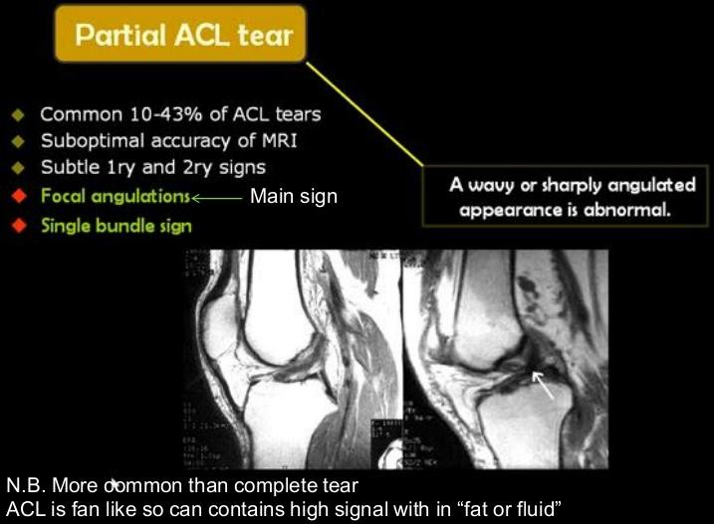
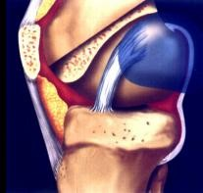
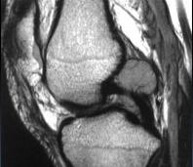
SUMMARY OF KNEE IMAGING
CHRONIC ACL INJURY
ABSENT Bone contusions
Fragmented ACL "Main sign" 3- ACL attached to PCL
4- Empty Notch sign "in coronal scan"
INTER CONDYLAR NOTCH CYST
1% of knee MRIs - More common in the ACL
Usually an incidental finding
Painful = erodes the bone
post-traumatic chronic partial cruciate ligament tear with internal degeneration
Oval , rounded may be multilocular
Rim enhancement = inflamed
ttt: Arthroscopic drainage

Slide 15
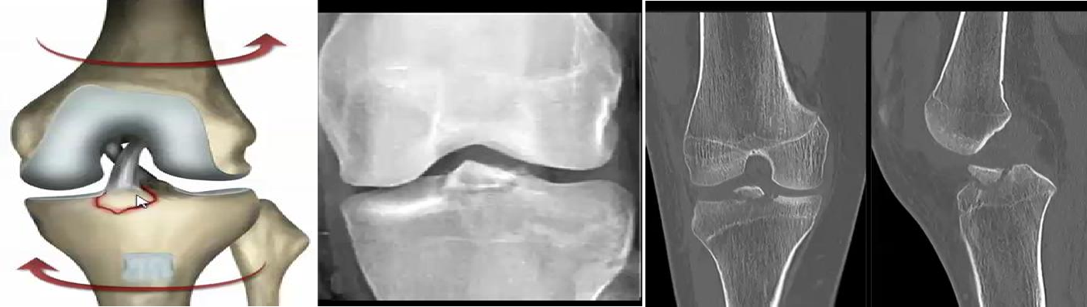
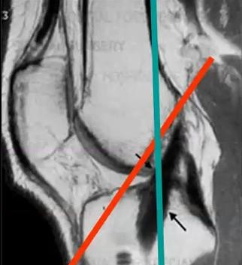
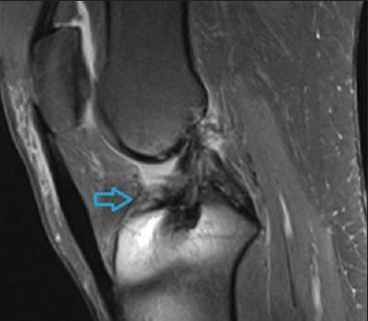
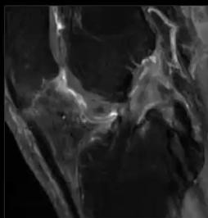

SUMMARY OF KNEE IMAGING
N.B. In X ray Film , Fracture in Tibial spine “site of tibial attachment of ACL”
= ACL Avulsion Tear
IN ACL reconstruction, Assess Graft & Its complications:
⇨ Site of Graft = Attachment behind these Lines “Tibial Attach behind Red line –Intercondylar” “Femoral “ “ behind Green Line- F. Shaft paral
⇨
⇨
Graft Shape
→ Stretched “if Curved = Impengment”
Graft Nature
→Become total signal loss after
1 Year , before 1 Y any signal accepted
⇨ Cyclops Lesion “commonest complication”
Rounded Fibrotic lesion , formed Ant to the graft → prevent knee extension
- Best seen in Saggital
⇨ Tunnel Cyst > in Tibial tunnel of the screw
⇨ Screw Displacement

Slide 16

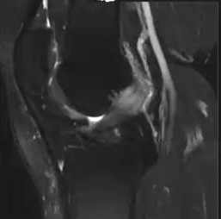
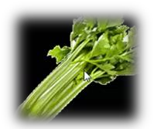

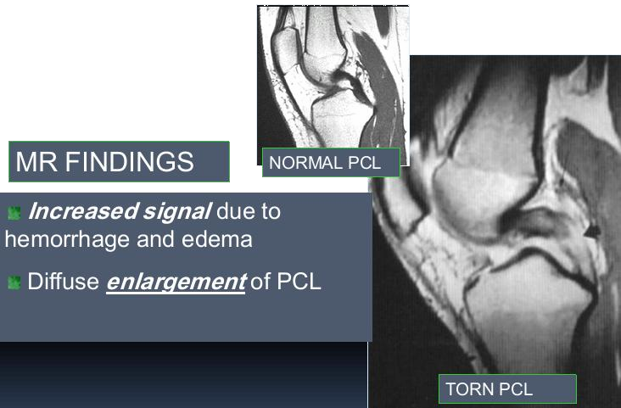
SUMMARY OF KNEE IMAGING
NEW
Mucoid Degeneration → Swollen ACL ‘Pain + No Trauma’
In T2 alternative black normal fibers & white degn. Fibers
➔ Celery stalk سفركلا ناديع
➔ ttt: Mucoid clean by arthrography
➔ Usually Recurrent in few years
PCL
Major stabilizer of the knee
Uniform low signal , no striations
Twice strong as the ACL
PCL injuries represent about 12% of knee injuries
Combined PCL injuries represent 97%
  With ACL 65%
  With MCL 50%
  With MM 30%

Slide 17
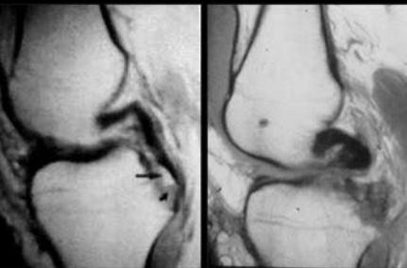
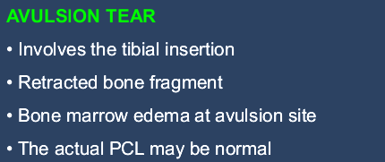



SUMMARY OF KNEE IMAGING
PCL AVULSION TEAR
COLLATERAL LIGAMENTS
CL INJURY GRADES | FINDUNG
I | Just Focal Edema
II | Edema + Thickening "MCL elevation from cortical surface"
III | Complete tear "Disrupted Ligament"

