Slide 1
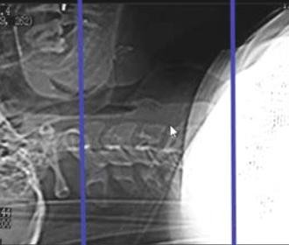
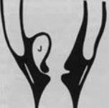
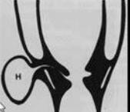
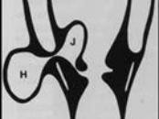
LARYNX IMAGING
SUMMARY OF LARYNX IMAGING
SCAN PROTOCOL
MRI |  |  | CT
Scout | Axial "Both Hips" |  | Scout | Lateral
Axials | T1 & T2 & PD |  | Position | Supine – Hyperextended neck
• |  |  | Scan | Tounge base : Trachea
Sagital | T1 o T2 for disased
 |  |  | Windows | = Soft Tissue "main" = Bone →Cartilage Invasion
Slice Thickness | 5 mm |  |  | 2 – 3 mm
FOV | 20 cm
MANDATORY | FAT SUPREES Pre & post Contrast
LESIONS OF THE LARYNX
1. LARYNGEOCELE
نويلبان بيبط – ىرلا .د مسا يلع
Voice abuse → Dilated laryngeal sacule
Contains :air – fluid or air/fluid
Three Types : Internal - External - Maixed
15 % + Cancer
40% | 16% | 44%
Cyst Inside Larynx | Outpouch through thyro-hyoid membrane | Cyst on both sides of thyroid membrane

Slide 2
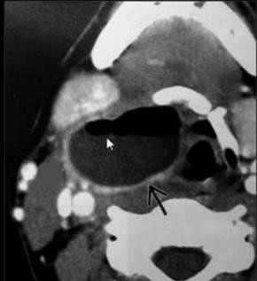
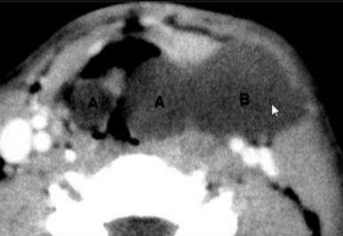
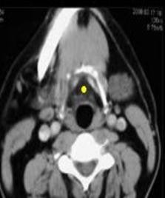
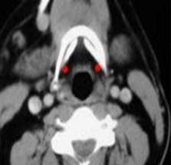
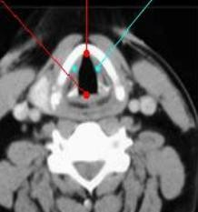
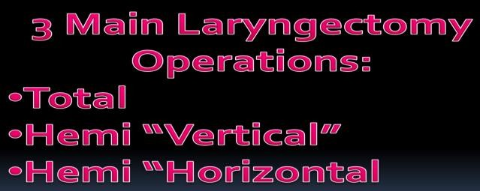
SUMMARY OF LARYNX IMAGING
Air fluid level in External & Mixed
2. CANCER LARYNX
Mostly Squamous cell carcinoma
 | Incidence | Lymphatic spread
Supra-glotic | 70 : 60 % | 30 %
Glottic | 25 : 35% | 1%
Sub Glottic | 5 % | 30 %
Transglottic | Involve 3 levels
Role of Imaging :
CT & MRI Assess site & extension of Mass
In supraglottic lesions : Extension to pre epiglottic space & Para Glottic Space & Ant. Commisure

Slide 3
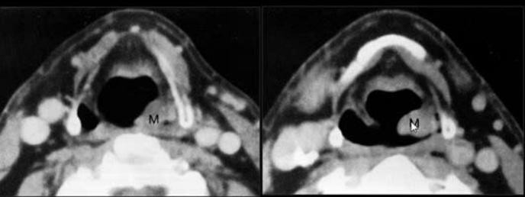
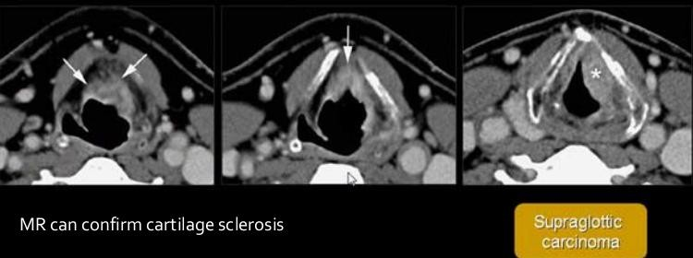
SUMMARY OF LARYNX IMAGING
Lt Laryngeal mass invading Lt ary-epiglottic fold

Slide 4
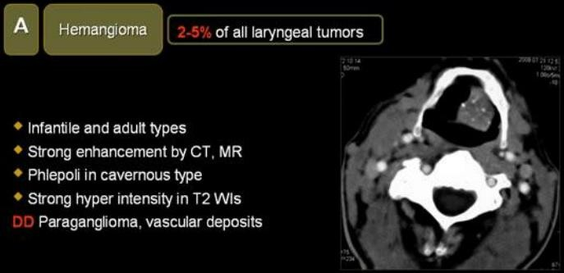
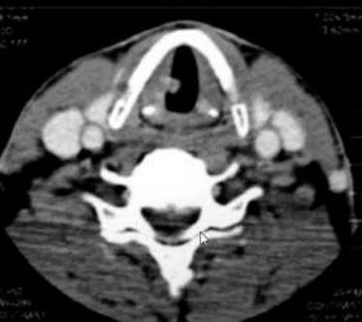
SUMMARY OF LARYNX IMAGING
3. OTHERS
HAMANGIOMA
POLYP
Voice Abuse

Slide 5
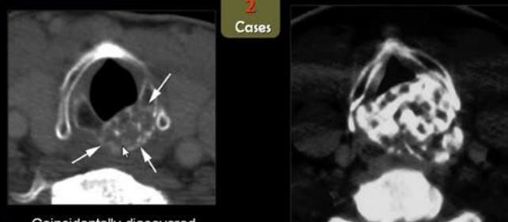
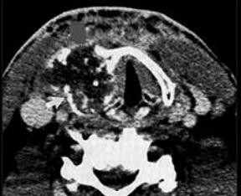
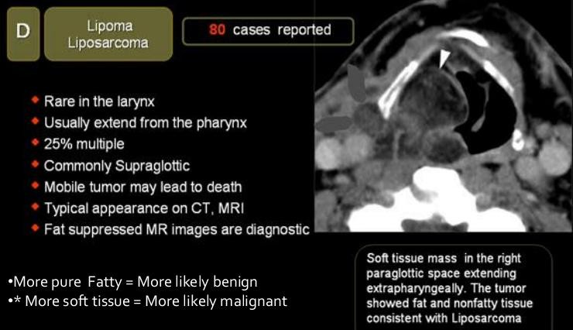
SUMMARY OF LARYNX IMAGING

Slide 6
SUMMARY OF LARYNX IMAGING

