Slide 1

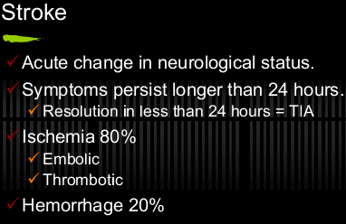
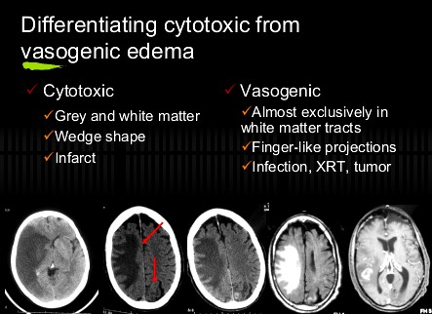
SUMMARY OF BRAIN IMAGING
 | BRAIN IMAGING
 | C.V.STROKE
MR Diffusion The Fastest Modality to detect Infarction – within 2 minutes ➔ Restricted Diffusion ➔
Ischemic Stroke CT
1st 6 Hours |  | 12 : 24 Hours |  | After 24 hours
60% normal Vague hypodensity Insular ribbon sign “If MCA” Sulcal effacement from slight swelling Loss grey/white interface Dense artery sign |  | -More apparent hypodensity -Minimal mass effect |  | Well circumscribed hypodensity
3 : 5 Days |  | LONG TERM
Peak mass effect Mass effect gone by 2- 4 weeks |  | -Ex vacuo dilatation of ventricles -Encephalomalacia in infarcted area
-Enhancement in infraction
begins after about 3 days
-Enhancement > 6-8 weeks after
→ Suggests another etiology
➔New role: Perfusion
.Infusion scans of brain with rapid IV contrast

Slide 2
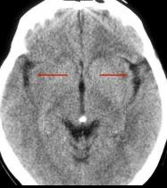
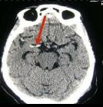
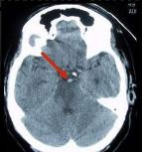
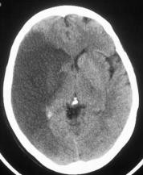
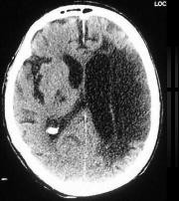
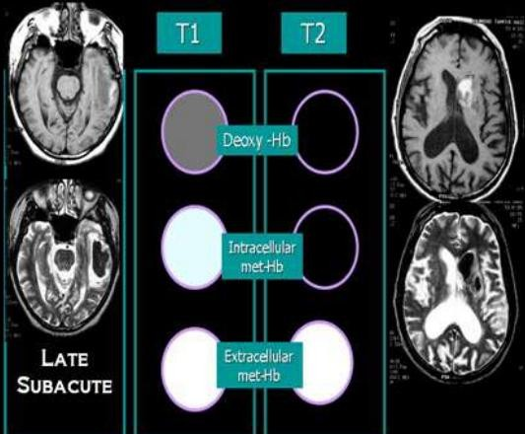
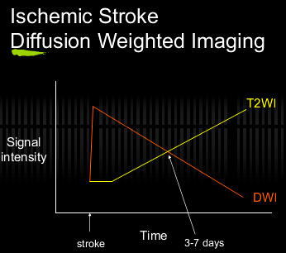
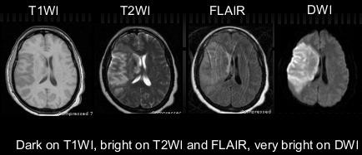
SUMMARY OF BRAIN IMAGING
INSULAR RIBON SIGN | DENSE A. SIGN |  | Basilar A. Thrombus
ACUTE INFARCTION |  |  | CHRONIC INFARCTION
 |  | ➔Ischemic Stroke MRI: Acute stroke appears as Normal to low signal on T1WI High signal on T2WI High signal on FLAIR High signal on DWI FLAIR and DWI most sensitive
Signal Of Blood In different MRI Sequences
Subacute Infarct

Slide 3
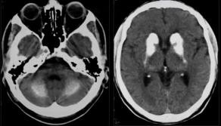
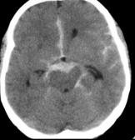


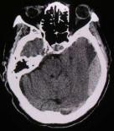
SUMMARY OF BRAIN IMAGING
➔Intracranial hemorrhage - possible locations:
Intra-parenchymal
Intra-ventricular
Subarachnoid
Subdural / epidural
)usually symmetric( Normal variant: calcification in the basal ganglia & Dentate Neucli in Cerebellum
)Hypertensive bleed - most common (80%)
-Basal ganglia -Pons
-Thalamus -Cerebellum
Subdural Hage | Intraparynchymal | Intraventricular
Subdural With Hematocrit effect

Slide 4
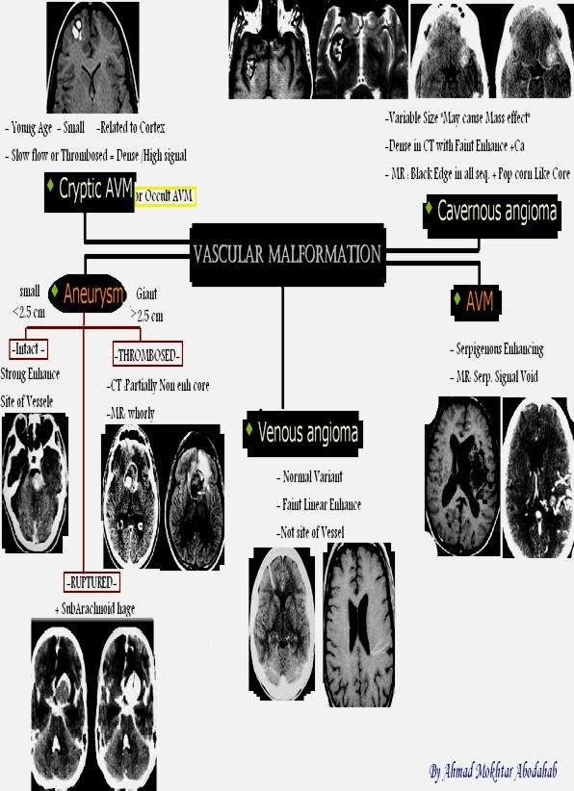
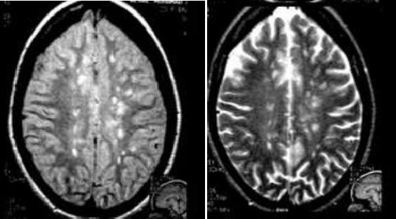
SUMMARY OF BRAIN IMAGING
MULTIPLE SCLEROSIS
Clinical Diagnosis
Young Adult “20 : 40 y”
Plaques Near
& perpendicular to Ventricles
High signal in PD & FLIR
Enhancing Active lesions

Slide 5
SUMMARY OF BRAIN IMAGING
BRAIN TUMORS
HOMOGENOUS EHNANCING
MENINGIOMA Dural Based • +/- Dural tail | LYMPHOMA Peri-ventricular | GIANT CELL ASTROCYTOMA With Tuberous Sclerosis Near 3rd Ventricle
HETEROGENOUS EHNANCING
ANAPLASTIC ASTROCYTOMA | GLIOBLASTOMA MULTIFORM
MARGINAL EHNANCING
 | GLIOBLASTOMA MULTIFORM Of Non Uniform Thickness
CYST with EHNANCING MURAL NODULE
Pilocytic Astrocytoma Usually Infra-tentorial D.D. Hamangioblastoma "Less common" | Pleomomorphic Xanso Astrocytoma “Never in Post Fossa” Supra tentorial Superficial nodule | Hamangioblastoma 10:20 with VHL syndrome
2-6 % of all Brain Primaries |  | 1:2 % of Primary
5 : 15 y 4F : 3M |  | Most common Post Fossa T. in
 |  |  | ADULTS
 |  | STRONGLY ENHANCING NODULE
ANY PATTERN
 | METs Multiple Known Primary Significant Edema

Slide 6
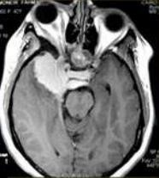
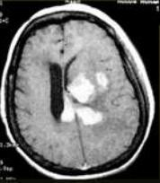
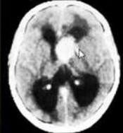
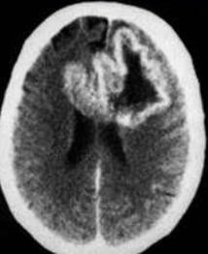
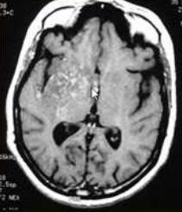
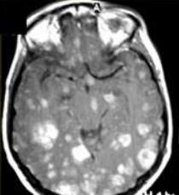
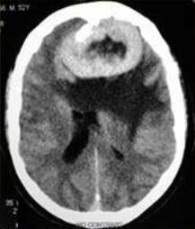
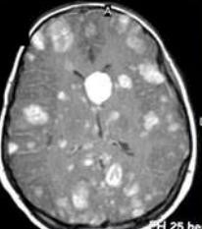
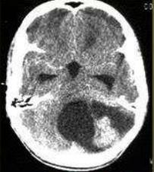
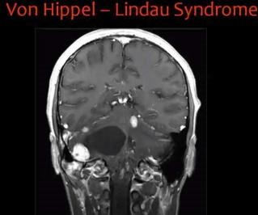
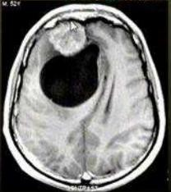
SUMMARY OF BRAIN IMAGING
Meningioma | Lymphoma | GCA
Glioblastoma Multiform | Anaplastic Astrocytoma | METS
Pilocytic Astrocytoma | Pleomomorphic Xanso Astrocytoma | Multiple Hemangioblastomas

Slide 7
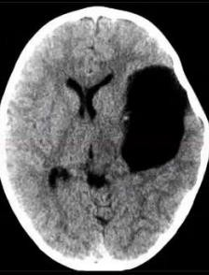
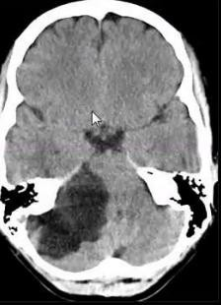
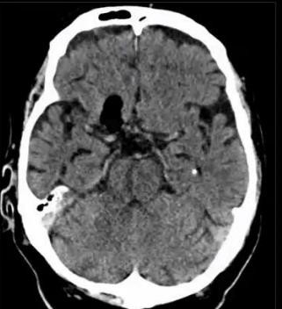
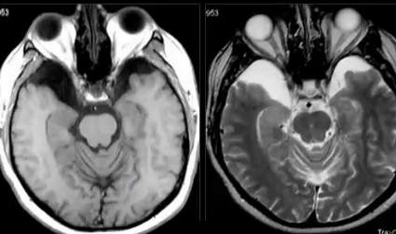
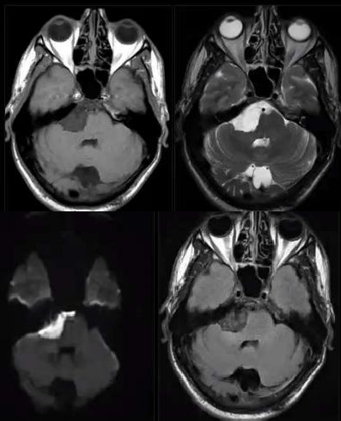
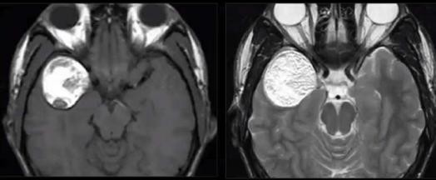
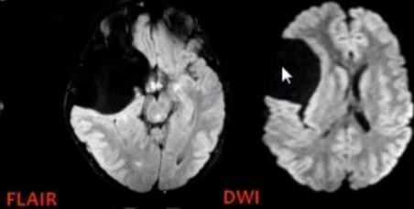
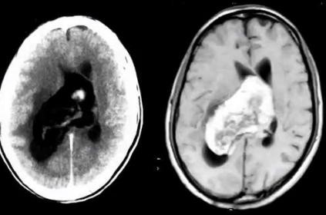
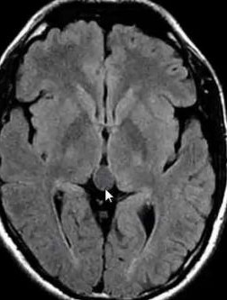
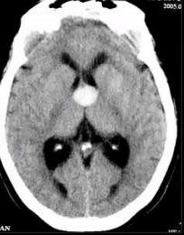
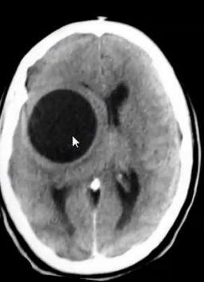
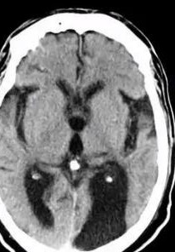
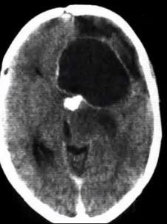
SUMMARY OF BRAIN IMAGING
INTRA CRANIAL CYST
EXTRA-AXIAL | INTRA-AXIAL | Others
ARACHNOID | Astrocytoma | Abscess
EPIDERMOID | Hydatid | Cystecercosis
DERMOID | Porencephalic | Meningioma
PINEAL |  | Deposites
Arachnoid "CSF – No Enh." | Epidermoid Lobulated +/- Ca T1 Low<CSF / T2 Hi>CSF Never iso in FLIR RESTRICTED DIFFUSION | Dermoid Rare Fat +/- Ca Rupture → Fat – Fluid level
Pineal Cyst
Colloid Cyst
Hydatid Cyst
Porencephalic
Craniophryngeoma

Slide 8

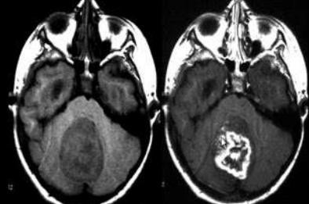
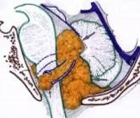
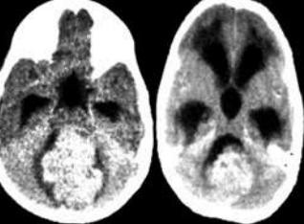
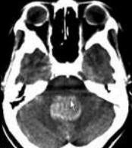


SUMMARY OF BRAIN IMAGING
POSTERIOR FOSSA LESIONS
BRAIN STEM | CEREBELLAR
Hage / Infarction Tumors / Cysts Calcification
4th Ventricle | CPA
Ependymoma | Acoustic Neuroma 90 %
Medulloblastoma | Meningioma 2-4%
Others | Dermoid 1%
 | Others
 | Age | Site |  | CT | MRI
Ependymoma | Child : Adult 5 : 1 -9% of all Gliomas -10% of ped.Cranial T | 4th Vent. Commonest +Hydroecph. | Ca 25:30% | Lobulated – isodense Homo or Hetero Enh | T1 → iso : Hypo T2 → Hyper
Medullo | Commonest Post Fossa |  |  | Hetero Enh. | Hetero Enh.
blastoma | T. in Children |  |  | Ca 15% | Lo : ISo T1
 |  |  |  | Cystic 65% | Hi T2
 |  |  |  | CSF Seeding 40%
Medulloblastoma |  |  | Ependymoma

Slide 9
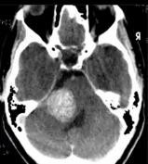
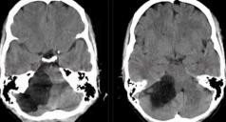
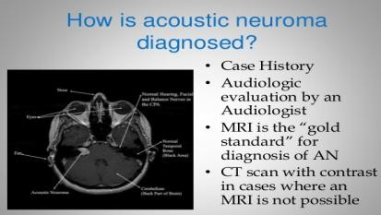
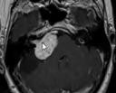
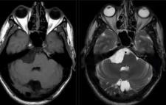
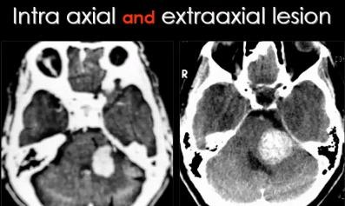
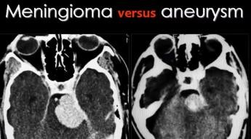
SUMMARY OF BRAIN IMAGING
CPA LESIONs
 | Acoustic Neuroma | Meningioma | EpiDermoid
Incidence | 5-10 % of Brain T. 90% of CPA T. | 2-4 % of CPA | 2 % of Brain Masses 1 % of CPA
M : F | 1 : 2 | F > M
Age | 35 : 60 y | Adults
Associated | NF II “Bilateral Acoustic Neuroma”
 |  |  | CPA / SUPRA & PARA CELLAR Cisterna Magna
Character | Arise from IAM Cystic Change in Large | Extra-axial→ wide CPA | NEVER AS CSF IN PD & FLIR
CT | Iso to Hypo | ISO | Hypo “CSF Like”
ENHANCE | Homogenous | Homogenous | NO
Ca | No | + Ca | UNCOMMON
MRI | *T1→ Iso : Hypo *T2→ Hyper *Enh. → Strong Homo |  | *T1→ Hypo “between parenchyma & CSF *T2→ Hyper > CSF *Diffusion → Restricted
D.D. |  | BASILAR ANEURYSM

Slide 10









SUMMARY OF BRAIN IMAGING
INTRA CRANIAL INFECTION
Toxoplasosis | CMV
ADEM |  | Ependymitis= Ventriculitis | Cerebritis
 |  | Cysticircosis

Slide 11









SUMMARY OF BRAIN IMAGING
INTRA VENTRICULAR LESIONS
COMMON | OTHERS
Ependymoma Sub Ependymoma Papilloma Choroid Plexus Meningioma Neurocytoma SGC Astrosytoma | CYSTS | TUMORS
 | Arachnoid Epidermoid > Dermoid Colloid | Astrocytoma Medulloblastoma Mets
➔SUBEPENDYMOMA:
⇨ Choroid Plexus Papilloma:
-Variant of Ependymoma
-3% of Ped. I.C.T - 85% < 5 y
-Benign -No CSF Seeding
-CT : 25 Ca & hage
- Males
₆₀th
- Hyperdense - Lobulated توتلا هبش
-Strong Hetero -“T1 Iso / T2 Hyper”
- Solid / Homogenous
60% → No Enh
+/- Cyst , Ca , Hage - No Edema
  CT → Iso
  T1 iso / T2 Hyper
-
⇨ Central Neurocytoma :
Why Choroid Plexus Papiloma
Commonest
I.V. T in
Young Adult
→ Hydrocephalus
Increase CSF
Mechanical
Haemorhage
IV Meningioma
“Multiple in NFII”
-80 % trigone of Lat. V
- 15 % 3rd Vent.
- 0.5% 4^{t}
^{h} Vent. I.V. Meningioma |  | Choroid Plexus Papiloma
Middle Age |  | - Children
Smooth margin |  | - Nodular surface
Homogenous enh |  | - Hetero. Enh
Focal Hydrocephalus |  | - Diffuse Hydroceph

Slide 12












SUMMARY OF BRAIN IMAGING
CORTICAL FORMATION DISORDERS
Hemimegaencephaly |  |  | Focal Cortical Dysplasia
Band Heterotopia “Double Cotex” | Lissencphaly “Agyria” | DNET .Notice skull inner Scalloping
Focal Heterotopia | Pachygyria |  | Ganglioglioma
Subeoendymal Heterotopia | Polymicrogyria |  | Schizencephaly Closed/ Open

Slide 13


SUMMARY OF BRAIN IMAGING

Slide 14
SUMMARY OF BRAIN IMAGING
 | Metabolites of MR SPECTROSCOPY
Metabolite |  |  | Locate / ppm | Phys. Significance | Diminish in | Absent in | Increased in
 | N-Acetyl Aspartate |  | 2.02 | Marker on Neuron Health seen only in neuronal tissue | Neuronal Damage | Tissue of no neurons (Mets/Meningioma) | Rare "Canavan's Dis."
 | NAA
 | Creatine |  | 3.03 3.94 | -Stable in many Dis. -Used as control -Energy Metabolism | Hypoxia Tumors |  | Trauma Hyper osmolar
 | Cr
 | Choline |  | 3.2 | - Marker of memb. Synthesis & number of cells |  |  | Active Tumor Inflammations MS Chronic Hypox.
 | Cho
 | Lactate |  | Double peak | -Product of anaerobic metabolism -Released in cell destruct | Normally absent or very low |  | Necrotic Tumor Stroke Abscess
 | Lac
 | Lipids |  | 0.9:1.2 | -May due to contamination of scalp | Normally absent |  | In aggressive disease process
 | Myoinositol |  | 3.56 | -only short TE -Astrocytes Marker | Hepatic encephalo- pathy |  | Alzheimer Demylenation Low g Glioma Gliomatosis C.
 | ml
 | Glutamate & Glutamine |  | 2.1:2.5 | -only short TE -Close to each=Glx -Regulate neurotransmitter activities |  |  | Tumefactive MS Hepatic Enceph. Sever Hypoxia
 | Glu – Gln
 | OTHERS |  | Succinate = 2.4 Acetate = 1.9 Amino Acids = 0.9 |  |  |  | Pyogenic Abcs.
 |  |  |  |  |  |  | Alanine→ Meningioma
ABC …….. When Cho > Cr & NAA = Disease After 2 y of age → Spectrum as in Adult
AGE VARIATION
 | Neonates | Adult
NAA | Gradual increase ←Neuronal Maturation | Diminished
Cho. | High | Elevated
mi | High
Cr. |  | Increased

