Slide 1
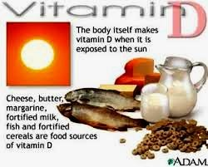
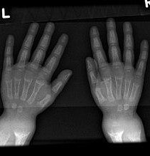
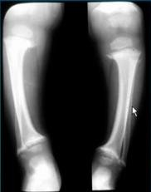
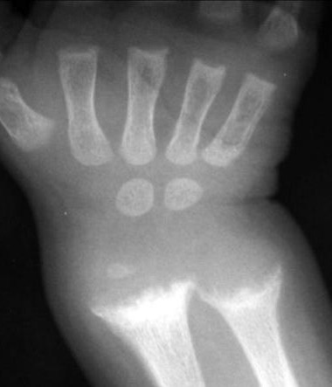
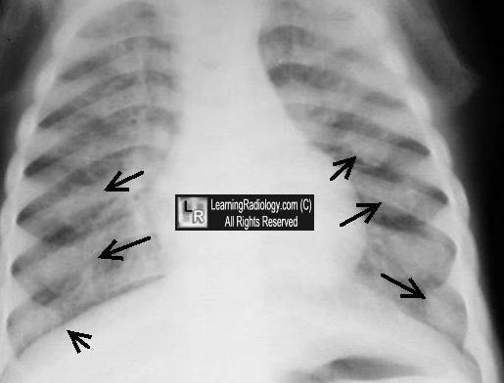
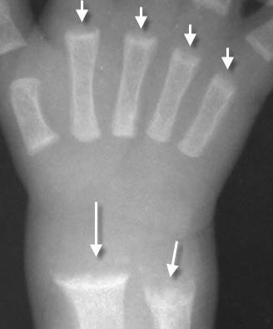
METABOLIC BONE DISEASES
SUMMARY
Vitamin D Deficiency
(in Children → Rickets / In Adults → Osteomalacia
)
Rickets
Def. : Increase uncalcefied osteoid in immature bone.
3 Stages: 1-Active 2- Healing 3- & Healed
Radiological “Active “ manifestation : “7”
Growth plate → Wide
Metaphysis → Cupping & Fraying
Cortex → Indistinct
Bone Density → Deceased
Bone Growth→ Retarded “Delayed oss. Centers”
Ribs /Ant ends “like metaphysis” → Rosary Beads
Bone softening → Bowing , Kyphoscoliosis
Healing Rickets , “patient on ttt / Vit D & Ca”
→ Metaphyseal Calcification Bands
Healed Rickets : Absence of all manifestations
- But one deformities may prolonged.

Slide 2
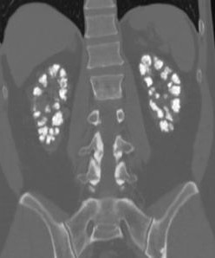
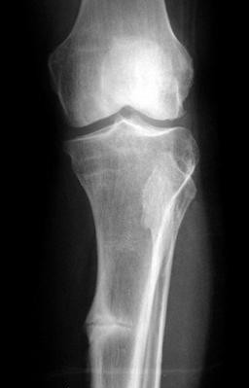
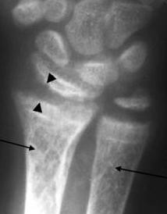
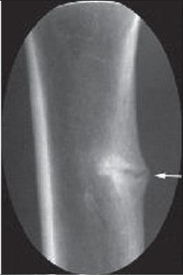
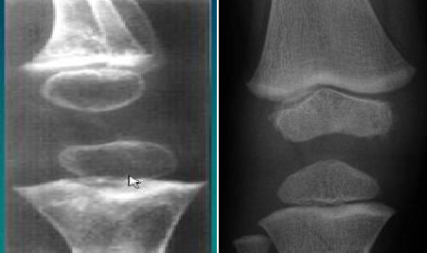
SUMMARY
HYPO PHOSPHATASIA ’Vit D Resistance Rickets’
Autosomal recessive.
Like Rickets , But when ttt with vitD → Worsen
Low serum Alkaline Phosphatase → Mild to sever form of Rickets.
Manifest as Rickets + Craniostenosis + Nephrocalcinosis
OSTEOMALACIA
Def: Increased uncalcefied osteoid in Mature bone.
1- Multiple LOOSER’s Zones 2-Dec. Bone Density 3-Coarse faint trabeculae 4.Softening
Incomplete fracture “Looser zone”..multiple
NB. Looser zone = Milk Man Fracture.
SCURVY
o Vit C deficiency - 6 m : 2 y
Scurvy
Normal
Manifestation best seen at Knee joint : 1- Osteoporosis = Dec. bone density
Pencil Thin cortex epiphysis
Provisional Zone of calcification 4- Metaphyseal Lucency
Pelkan spur “Metaphyseal tibial spur”
Sub periosteal hematoma → Periost. Reaction
3
4

Slide 3
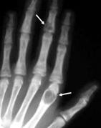
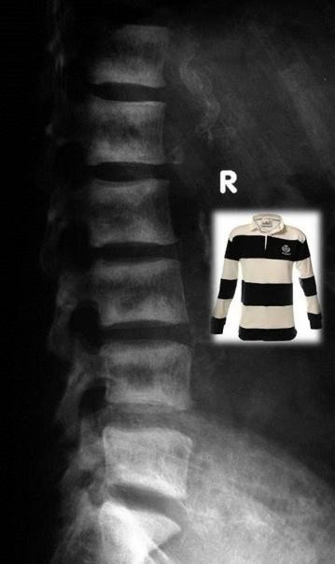
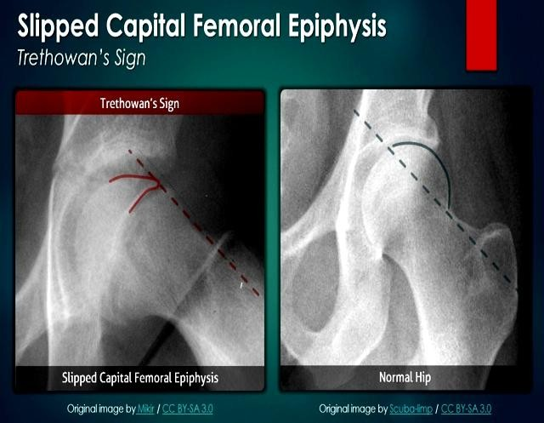
SUMMARY
RENAL OSTEODYSTROPHY
⇨ Renal impairment → Bone dystrophy
⇨ Consists of : (Osteomalacia or Rickets + osteosclerosis + 2ry Hyperparathyroidism)
⇨
MANIFESTATIONs
2ry Hyper Para → Sub periosteal erosions +/- Brown tumor
Soft tissue calcifications “mainly Arteries”
Osteosclerosis → Rugger Jersey spine
Osteomalacia → Looser’s Zones
In Children → Rickets + Slipped capital femoral Epiphysis
Sclerosis + malacia → Mosaic Bone
Superior femoral Line
⇨ OSTEOPOROSIS

Slide 4
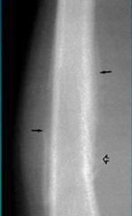
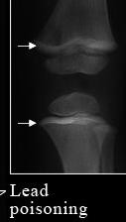
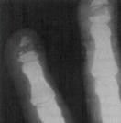
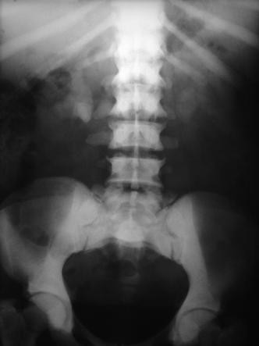
SUMMARY
⇨ Causes of Localized osteoporosis:
Immobility
Infection
Arthritis
Post Fractures
Sudeck’s Atrophy : dysfunction of the sympathetic nervous system, which is involved in the regulation of blood supply to the affected part.
TOXIC EFFECTS ON THE SKELETON
Hyper Vit A | Lead Poisoning | Vinyl Chloride |  |  | Fluorosis
*Sub periosteal reaction +/- Pain *> 1 y age *ttt Stop vit A | *Metaphys SCLEROTIC BANDS *+/- Toxic Encephalitis |  | * Osteolysis of middle |  | DIFFUSE Hyperostosis
 |  |  | part of distal phalanx
 | ديارجلا قرو – ريساوملا | كيتسلابلا عناصم |  |  | موينمللاا عناصم
Source : Lecture of Dr. Ahmed Wafei
https://www.youtube.com/watch?v=doo1tKelnTI
A.M.Abodahab
21 Oct 2017

