Slide 1
by dr sagar m raul pg teacher dr manali rahalkar
POSTERIOR CRANIAL FOSSA or INFRA TENTORIAL TUMORS

Slide 2
Tumors in the posterior fossa can arise from
Brain tissue (brainstem, fourth ventricle & cerebellum),
Cranial nerves,
Meninges and
Skull.

Slide 3
CLASSIFICATION 1) Cerebellum Medulloblastoma Pilocytic Astrocytoma Ependymoma Haemangioblastoma Atypical tertoid / rhabdoid tumor Metastasis Dysplastic cerebellar gangliocytoma

Slide 4
2) Brain stem and cervicomedullary junction Brainstem glioma 3) CP Angle tumors Vestibular Schwannoma Meningiomas Facial nerve Schwannomas Metastasis Epidermoid cyst Dermoid Arachnoid cyst Lipoma Endolymphatic sac tumor (rare)

Slide 5
4) Fourth ventricle tumor Medulloblastoma Ependymoma Choroid plexus papilloma/ carcinoma Subependymoma 5) Skull Base (posterior fossa) Paraganglioma Meningioma

Slide 6
In children, 48% of the primary intracranial neoplasms are infratentorial in location. Medulloblastoma Cerebellar Astrocytomas Brainstem Gliomas Ependymomas. In adults, most infratentorial neoplasms are extra axial in location. Most Common extraaxial Schwannoma -> Meningioma -> Epidermoid. Most Common intraaxial Metastasis -> Haemangioblastoma -> Glioma.

Slide 7
EXTRA AXIAL INTRAAXIAL DISPLACES NORMAL BRAIN COMPRESSES CISTERNS ENLARGED I/L CISTERN WELL DEFINED MARGINS ILL DEFINED BLENDS INTO BRAIN TISSUE CSF CLEFT PRESENT CSF CLEFT ABSENT DISPLACES SUBARACHNOID DISPLACES SUBARACHNOID VESSELS MEDIALLY VESSELS LATERALLY

Slide 8
Medulloblastoma
Malignant primitive ectodermal tumor.
WHO Grade IV tumor.
MC posterior fossa tumor in children.
Age 5-15 years.
Usually midline can be paramedian.
MC site vermis and inferior medullary velum.
Roof of 4th Ventricle.
Rare in adults, Location cerebellar hemispheres.

Slide 9
Medulloblastoma
C/F raised ICT.
CSF seeding occurs in 10-30 %.
Pathological variants
Classical and Desmoplastic.
Later variant arises from cells in superficial part of molecular layer hence invasion into leptomeningeal space possible. Needs Spine Screening.

Slide 10
Medulloblastoma
IMAGING
Well circumscribed midline mass filling fourth ventricle, extension through Foramen of Magendie into cisterna magna.
CT- MB is highly cellular and appears homogenously iso-hyperdense.
MRI- Iso-hypointense on T1 and T2.
moderate enhancement on contrast adm.

Slide 11
Medulloblastoma
IMAGING
Calcification (20%)
Cystic and necrotic degeneration (adult)
These are responsible for signal heterogenesity.
Higher celullarity is responsible for high signal on DWI and low signal on ADC.
MR Spectroscopy- increased taurine and choline peaks.

Slide 14
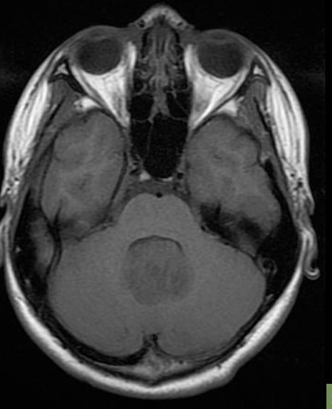
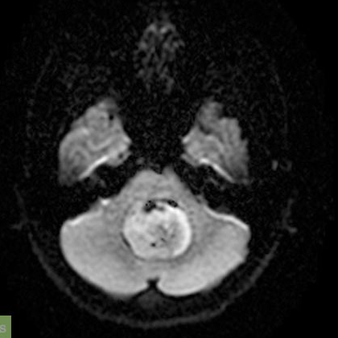
DWI
T1W
T2W

Slide 15
Notes:
Sagittal TlWI MR shows large PNET-MB expanding 4th ventricle and uplifting posterior tectal plate Interface with superior medullary velum is
poorly defined (curved arrow). (Right) Sagittal Tl C+ MR shows mildly heterogeneous enhancement in same tumor. Interface with dorsal brainstem is relatively well defined (arrow), pointing to origin of tumor from roof of 4th ventricle.

Slide 16
Classic desmoplastic
variant of PNET-MB in a young aged female.
Atypical lateral
cerebellar location.
Rare PNET-MB with extensive
nodularity.
No focal dominant mass
Multiple "grape-like" tumor
nodules are present.

Slide 17
Notes:
(Left) Sagittal Tl C+ MR shows multiple enhancing nodules in cervical spinal canal and posterior fossa in child previously treated with surgery and radiation for posterior fossa PNET-MB. (Right) Axial Tl C+ MR shows enhancing PNET-MB in 4th ventricle and metastatic tumor in both CP
angles. Up to one-third of PNET-MB will have subarachnoid metastatic disease at presentation.

Slide 18
EPENDYMOMAS Slow growing tumor of ependymal cells 2/3rd are infratentorial: from floor of 4th ventricle Third most common brain tumor in children. Soft or "plastic" tumor: Squeezes out through 4th ventricle foramina into cisterns Spread via CSF throughout the subarachnoid space is reported, esp. with the higher-grade tumors Anaplastic variant have greater incidence of CSF dissemination and poorer prognosis.

Slide 19
EPENDYMOMAS Peak age 1-5 years. Infratentorial in location in 70% cases. Arises from ependymal cells lining the 4th Ventricle and Foramen of Lushka. C/f Hydrocephalus , Vomiting and nausea. WHO Classification- Subependymoma (grade I) Myxopapillary ependymoma (grade I) Ependymoma (grade II) Anaplastic ependymoma (grade III)

Slide 20
Notes:
Sagittal T7 WI MR
shows tumor filling and
enlarging 4th ventricle and
extending inferiorly through
foramen magnum. Jet of CSF
flow can be seen in cerebral
aqueduct (

Slide 21
EPENDYMOMAS IMAGING CT Irregular, lobulated Isodense mass with cystic component. Calcification (45%). MRI Heterogenous T1 hypo, T2 hyper, heterogenous enhancement. MR Spectroscopy- Elevated Choline and reduced NAA PEAKS.

Slide 22
EPENDYMOMAS Intratumoral microcysts, necrosis or haemorrhage. Peritumoral edema is usually absent. CSF seeding is present but less as compared to MB. Extension of tumor through Foramina of Lushka into CP angle and into upper cervical cord through Foramina of Magendie. This feature is not pathognomic.

Slide 23
CT:
4th ventricle tumor, extends into CPA/cisterna magna,
Typically hyperdense
• Ca++ common (50%);
+/- cysts, hemorrhage
• Hydrocephalus common
• CECT: Variable heterogeneous enhancement
Notes:
Axial NECT shows
irregularly shaped 4th
ventricular tumor with Ca++
and cyst (open arrow)
extending laterally into right
CPA (curved arrow). Classic
ependymoma extending
from 4th V into CPA cistern.
(Right) Axial T7 C+ MR in
the same case shows mild to
moderate heterogeneous
enhancement of the tumor.
Note extension from 4th V
(open arrow) through
foramen of Luschka into CPA
cistern (

Slide 25
MRI
TlWI
o Heterogeneous, iso- to hypointense
• T2WI
o Heterogeneous, iso-to hyperintense
o Hyperintense cystic foci
• FLAIR: Tumor cysts very hyperintense to CSF
• Tl C+: Mild to moderate, heterogeneous enhancement
• MRS
o NAA reduced, Cho raised
• NAA:Cho ratio higher than in PNET-MB
MR spectroscopy alone does not reliably differentiate ependymoma from astrocytoma or PNET-MB

Slide 27
PILOCYTIC ASTROCYTOMA Benign tumor of CNS (grade I) First decade of life. Site- Cerebellum (MC) Hypothalamus Optic nerve /chaisma Brain stem. Excellent prognosis with 90 % pt having 25 yr survival rate.

Slide 28
Pilocytic astrocytoma
Cystic cerebellar mass with enhancing mural nodule
• Location: Cerebellum > optic nerve/chiasm> adjacent to 3rd ventricle> brainstem

Slide 29
PILOCYTIC ASTROCYTOMA Cyst with solid mural nodule. Cyst wall do not include tumor cells. Tumor is supplied by leaky capillaries that lack complete BBB hence cause intense enhancement and production of protenacious fluid that accumulate into cyst of the tumor.

Slide 30
CT Findings
o Discrete cystic/solid mass
O Little or no surrounding edema
o Solid component hypo- to isodense
o Ca++ 20%
o Often cause obstructive hydrocephalus
• 50% non enhancing cyst, strongly enhancing
mural nodule
• 40% solid with necrotic center, heterogeneous
enhancement
• Contrast may accumulate in the cyst on delayed images

Slide 32
MR Findings
• TlWI
o Solid:iso/hypointense
o Cyst: iso to slightly hyperintense to CSF
• T2WI
o Solid: hyperintense
o Cyst: hyperintense
FLAIR: Cyst contents do not suppress: Hyperintense to CSF
Notes:
Suppliied by vessels lacking a bbb have open tight junction so intense enhancement and proteinaceous fluid in the cyst

Slide 33
Intense heterogeneous enhancement of solid portion
MRS: High choline, low NAA, high lactate

Slide 34
HAEMANGIOBLASTOMA Benign tumor (WHO grade I) Site- Cerebellum (85%) Brainstem Spinal cord Cerebrum (rare) Association with Von Hipple-Lindau disease. Well circumscribed mass with smooth margins. Either Solid (40%) Cystic with enhancing mural nodule (60%).

Slide 35
Hemangioblastoma

Slide 36
HAEMANGIOBLASTOMA IMAGING- CT- Well marginated cystic lesion with a mural nodule. Cystic lesion appears hypodense, Mural nodule isodense, Strong homogenous enhancement post cont. SOLID HB – hyperdense on CT. MRI – Cystic component is iso-hyper to CSF on T1 & T2 Nodule is hypo on T1 and hyper on T2. Strong homogenous enhancement post Gd. Peritumoral edema is slight or absent.

Slide 37
HAEMANGIOBLASTOMA MRI- Low signal (Do not show restricted diffusion) on DWI and high signal on ADC. Flow voids within and at periphery of tumor represent abnormal tumor vessels. Perfusion MR reveals high rCBV.

Slide 38
HAEMANGIOBLASTOMA Super selective catheterization of the feeding vessels allows preoperative embolization of tumor and significantly reduces mortality and morbidity of surgical resection.

Slide 39
CT
Hypodense cyst with isodense nodule
Intense homogeneous enhancing nodule

Slide 40
MRI
Cyst and nodule hyperintense on T2WI.
Flow voids may be seen.

Slide 41
METASTASIS MC infratentorial intraaxial neoplasms in adults. Ususally multiple but may be solitary. Primary site- Lung/ Breast RCC/ Thyroid CA GI malignancy. Well defined round masses with nodular or ring enhancement (central necrosis)

Slide 42
METASTASIS IMAGING – Hypodense on CT, Hypointense on T1W, Hyperintense on T2W, Varying enhancement with surrounding edema, May have areas of hemorrhage and calcification. MR Spectroscopy- Elevated choline and reduced NAA. Lactate and Lipids are usually high.

Slide 43
METASTASIS D/D s of primary ca having metastases showing hyperintense signal on T1W pre contrast – Melanoma Renal Carcinoma Lung Ca Choriocarcinoma Bowel Ca (Mucinous)

Slide 44
Metastasis
Breast, lung, melanoma, lymphoma, leukemia
Can mimic benign tumors of the CPA
When an unusual aggressive schwannoma-like mass is encountered, possibility of metastases should be considered.
Correlate with a clinical history of carcinoma.

Slide 45
Metastases in a 67-year-old man with Ca lung and rt-sided ear pain. Axial T2WI shows a metastasis to the right CPA that mimics a vestibular schwannoma with intense enhancement of the lesion.

Slide 46
En plaque meningeal thickening with enhancement . Inner ear enhancement bilaterally suggests diagnosis of multiple metastatic foci.

Slide 47
Atypical Rhabdoid/ Teratoid tumor
Extremely rare
Highly malignant
Infants, usually less than 3 years
56% in cerebellum

Slide 48
Large at presentation
Moderate surrounding edema
Solid/mixed
Hyperdense on NECT
Cysts/necrosis/ca +/-
Inhomogeneous enhancement
Notes:
(Left) Axial NECT shows large hyperattenuating mass centered in right cerebellar hemisphere exerting mass effect upon fourth ventricle,
with small cystic focus at posterior aspect (arrow). (Right) Axial FLAIRMR shows mass as isointense to brain with region of hyperintense signal (arrow) corresponding to cystic focus
seen on NECT.

Slide 49
Dysplastic cerebellar gangliocytoma
Also known as Lhermite – Duclos disease
Hamartoma/ malformation/ tumor
Rare disorder
Characterized by distortion of the normal cerebellar laminar cytoarchitecture
Characteristic folial /laminated/striated pattern
A/w Cowden syndrome.
Occur in adults, usually in 3rd and 4th decades.

Slide 50
CT: noncalcified isodense cerebellar mass
Usually located in the cerebellar hemisphere
Special preference for the left side
Occasionally extends to the vermis.
Notes:
Axial TlWI MR shows Lhermitte-Ouclos disease involving the cortex of the eft cerebellar hemisphere. Note that mass is isointense to normal cerebellum= (arrow). (Right) Axial T2WI MR shows the mass to be slightly hypointense to gray matter (arrows

Slide 51
Nonenhancing mass in the cerebellar hemisphere an alternating striated/gyriform /corduroy/tiger-striped pattern
Notes:
hyperI lesion in rt cerebellum with little mass effect, striations. Corduoroy sign, no pce

Slide 52
Brainstem Gliomas
Heterogeneous group of focal or diffuse gliomas involving midbrain, pons, or medulla
75% of brain stem gliomas: younger than 20 years
Account 10-15% of pediatric brain tumors
Less than 1% of adult brain tumors.
Increased incidence of low-grade brain stem gliomas in patients with NF type 1.

Slide 53
Brainstem glioma
focal
Tectal
Cervico-
Medullary
diffuse
Pontine
Focal tegmental mesencephalic
Dorsal exophytic medullary

Slide 54
Diffuse pontine glioma
Fibrillary variety
Mean age 7 yrs
Often large when present
Most are infiltrative
Dissemination occurs in 50%
Poor survival despite chemo/radiotherapy
Hydrocephalus late

Slide 56
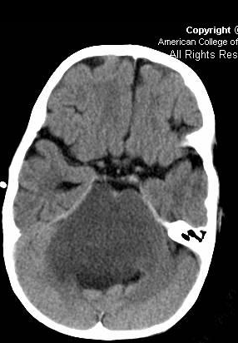
Imaging findings:
Non-enhancing mass markedly expands pons;
Engulfs basilar artery
CT
Decreased density;
Variable enhancement
Worse prognosis if enhancement present at initial diagnosis

Slide 57
MRI FINDINGS
TlWI: Low signal
T2WI: High signal T2
expands pons
engulfs basilar artery
FLAIR: High signal
Variable enhancement

Slide 58
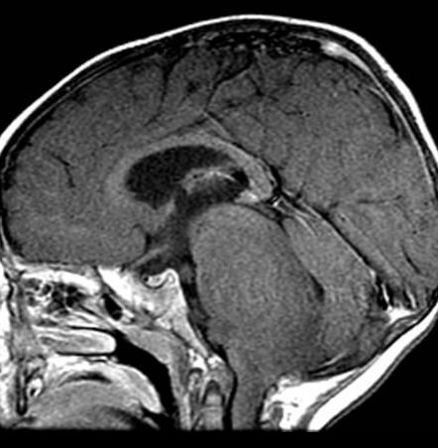
Notes:
(Left) Axial T2WI MR shows engulfment of basilar artery (open arrow) by pons swollen with intrinsic pontine glioma (fibrillary astrocytoma). (Right) Coronal T7 C+ MR shows pontine expansion by predominantly low T7 signal mass. Minimal focal (arrow) enhancement is present. Note absence of hydrocephalus despite size of mass

Slide 59
DD
FASI in NF I
Osmotic demyelination syndrome
Brainstem encephalitis
ADEM

Slide 60
Focal brainstem glioma
Pilocytic: cyst with mural nodule
Tectal: Indolent course, most only need CSF diversion
Even small tectal gliomas will obstruct aqueduct, cause early hydrocephalus
Variable signal mass expands tectal plate
Ca++ may be seen
Comma-shaped, extends along cerebral crus to thalamus
• T1 C+: Variable enhancement

Slide 61
Notes:
Presumed pi/ocytic
astrocytoma.

Slide 62
Mesencephalic glioma
Notes:
Axial T7 C+ MR shows expansion of the mesencephalic tegmentum and cerebral peduncle by a sharply delineated "comma-shaped" cystic mass with enhancing nodule. Pi/ocytic astrocytoma. (Right) Coronal T7 C+ MR in the same case shows expansion into thalamus and displacement and partial obstruction of 3rd ventricle. egmental pi/ocytic astrocytoma, WHO grade

Slide 63
C-P ANGLE TUMORS
6%–10% of all intracranial tumors
Most common:
Acoustic schwannomas
Meningiomas
Account for 85%–90% of all CPA tumors

Slide 64
Notes:
Axial graphic shows normal dorsal (arrow) & ventral
(open arrow) cochlear nuclei in lateral inferior
cerebellar peduncle margin. Note cochlear nerve
(curved arrow) in anterior CPAcistern

Slide 65
Symptomatology
Related to location rather the pathology.
SNHL
Cranial neuropathies
Headache, nausea, vomiting, disequilibrium, ataxia
Meningial signs – SAH d/t aneurysm, ruptured dermoid

Slide 66
Imaging Protocol
Screening MRI Brain ( DWI, GRE, FLAIR.)
Thin (3 mm) axial & coronal T1W and T2W images through posterior fossa
Post-contrast thin (3 mm) T1W Axial and Coronal images
Highly T2W, high resolution images i.e. 3D FIESTA
Reformat perpendicular to the course of 7th and 8th nerve in IAC to L/F individual nerves
FS - if hyperintense on T1

Slide 67
Extra-axial if….
Ipsilateral CPA angle cistern enlarged.
CSF cleft between mass and CB
Displaced G-WM interface around mass
Convex surface towards brainstem
Brainstem rotated, no edema
Normal structures that can be confused with CPA mass – CB flocculus, prominent choroid plexus at foramen of Lushka, High jugular bulb, prominent jugular tubercles

Slide 68
Vestibular Schwannoma
Encapsulated benign, slow growing neoplasm.
Sporadic / Asso. With NF-2. (5-20%)
B/L schwannomas – Hallmark of NF 2, with multiple meningioma, schwannomas and ependymomas.
Most common lesion in patients with unilateral SNHL (> 90%)
Most common CPA-lAC mass.
2nd most common extra-axial neoplasm in adults
Most lesions arise on the vestibular portion of 8th cranial nerve

Slide 69
Small – Intracanalicular
Large – Ice-cream cone CPA+IAC mass
centered on porus acousticus,
enlarged IAC
CT –
Well-defined, enhancing mass of CPA-lAC cistern
Calcification not present
Smaller intracanalicular lesions (« 6 mm) may be missed with CECT
Notes:
Axial graphic of a large
acoustic schwan noma
reveals the typical "ice
cream on cone" CPA-lAC
morphology. Mass effect on
middle cerebellar peduncle
(arrows) is evident. (Right)
Axial T1 C+ MR
demonstrates an enhancing
intermediate to large
acoustic schwan noma filling
all but the most lateral lAC
(open arrow), extending out
into CPA to compress the
lateral brachium pontis
(arrows).

Slide 70
TlWI
Intermediate signal most common
T2WI
High-resolution T2 MR: "Filling defect" in high signal CSF of CPA-lAC cistern
T1 C+
Focal, enhancing mass of CPA-lAC cistern centered on porus acusticus
0.5% associated arachnoid cyst

Slide 71
small intracanalicular acoustic
schwannoma from superior vestibular nerve.
Notes:
Axial graphic shows (arrow

Slide 72
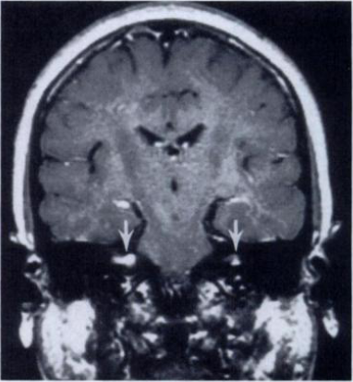

Slide 73
DD
Main differential – Meningioma
Location – Eccentric to porus acausticus
Broad dural base
Calcification +
Dural Tail +
Always make sure there is no "labyrinthine tail" on all AS to avoid misdiagnosing a facial nerve schwannoma

Slide 74
Facial nerve schwannoma
Rare lesion
Can involve any segment of facial nerve
Predeliction for geniculate ganglion
Rarely in CP angle cistern: No specific parameters to diff from vestibular scnwannoma
Enhancement of the geniculate ganglion and the
labyrinthine portion of the facial nerve are
very suggestive of facial nerve schwannoma.

Slide 75
Meningioma
Encapsulated, benign,slow growing
Arise from arachnoid cap cells in the arachnoid granulations
Female predilection
Age – 45-55 yrs
10% occur in posterior fossa
In CPA – arises from posterior surface of petrous temporal bone / clivus

Slide 76
Morphology
"Mushroom cap" (hemispherical) with broad base towards posterior petrous wall (75%)
Plaque-like (en plaque), +/- bone invasion with hyperostosis (20%)
Ovoid mass mimics acoustic schwannoma (5%)
CSF-vascular "cleft" between mass & brain

Slide 77
NECT
o 70% hyperdense
o 25% calcified;
• Homogeneous, sand-like
o Bone window findings
• Hyperostotic/sclerotic bone changes
• CECT: 90% strong, uniform enhancement;

Slide 78
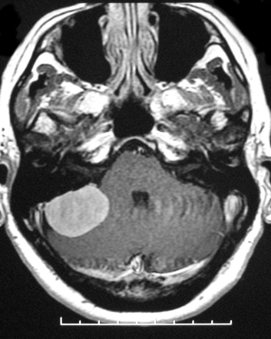
TlWI: Iso-hyperintense
T2WI: variable
CSF-vascular cleft
Pial blood vessels seen as surface flow voids between tumor & brain
Arterial feeders seen as arborizing flow voids
T1 C+
o Enhancing dural-based mass with dural "tails“ centered along posterior petrous wall

Slide 80
extensive low CPA en-plaque meningioma Left vertebral artery & ICA in carotid space are engulfed by tumor.
large CPA meningioma filling both CPA and lAC

Slide 81
Angiographic Findings
o Dural vessels supply tumor center, pial vessels supply rim
o "Sunburst" pattern of enlarged dural feeders
o Prolonged vascular "stain" into venous phase
o Arteriovenous shunting may occur
CPA meningioma: Selective angio- of rt occipital artery shows focal hypervascularity through auricular artery.

Slide 82
Epidermoid cyst
Inclusion cyst, Not a true neoplasm
Congenital intradural lesion arising from inclusion of ectodermal epithelial elements into neural tube
Posterior fossa mc site
• CPA 75%, 4th ventricle 25%
Age – 4th -5th decade at presentation

Slide 83
Extensive lesion at the time of diagnosis with adherance to adjacent structures .
Mass insinuates into cisterns, engulfs cranial nerves & vessels.
large CPA epidermoid cyst in typical "bed of pearls" appearance. 5thand 7th & 8th cranial nerves are characteristically engulfed

Slide 84
CT –
Near CSF attenuation,
Calcification : 20%, mostly at margins
No enhancement .
Pressure erosion of temporal bone

Slide 85
MRI
T1W, T2W: iso-hyperI to CSF
FLAIR: incomplete attenuation
DWI: restricted diffusion
White epidermoid:Epidermoid cyst with high protein content causing high signal on Tl, lower signal on T2
No enhancement.

Slide 86
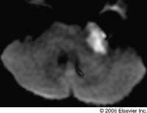

Slide 87
Epidermoid cyst – DDs
Arachnoid cyst –
Smooth surface.
No restricted diffusion
FLAIR attenuation
Displaces vessels and nerves
Cholesteatoma / Aquired epidermoid
Extradural, centered at middle ear
Asso. With middle ear disease
Cholesterol granuloma
Heterogenous with hyperintense foci on T1W images

Slide 88
ARACHNOID CYST
Arachnoid or collagen-lined cavities that do not communicate directly with ventricular system or subarachnoid space
33% of all AC occur in posterior fossa
• CPA = most common infra tentorial site

Slide 89
CT
Non-calcified extra axial lesion
Similar to CSF in attenuation
Non enhancing on contrast study
Pressure erosion of adjacent calvarium rare

Slide 90
MRI
CSF signal intensity lesion on pulse sequences
Attenuated completely on FLAIR
No restricted diffusion on DWI
No internal architecture.
No enhancement

Slide 91
LIPOMA
Benign, congenital fatty lesion of CPA
80% Supratentorial
MC posterior fossa site CPA
Focal benign-appearing CPA mass
Follows fat density (CT) & intensity (MR)
Linear along course of cranial nerves 7 & 8 in CPA

Slide 92
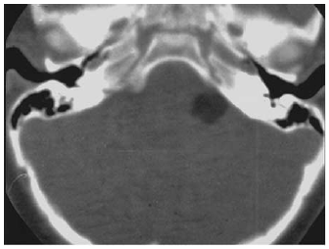
CT
Hypodense lesion( -50 to -100HU)
No “Enh”

Slide 93
MRI
Hyper intense on T1W
Fat suppression for confirmation
Use fat-saturated postcontrast sequence: no enhancement.

Slide 94
Subependymoma
Rare, benign well-differentiated intraventricular ependymal tumor
Inferior 4th ventricle (60%)
Usually incidental /asymptomatic
Often protrudes through foramen of Magendie
Typically small, 1-2 cm
Notes:
Sagittal graphic shows a solid, well-circumscribed mass
arising from the floor of the 4th ventricle with mild mass
effect (arrow). Note lack of hydrocephalus, typical of
subependymoma. Sagittal T2WI MR shows a solid hyperintense mass
along the inferior 4th ventricle

Slide 95
Isodense to hypodense intraventricular mass with no/mild enhancement
Cysts or Ca++ may be present
Iso-hypointense on T1WI
Iso-hyperintense on T2WI
Mild enhancement
No perilesional edema

Slide 97
Endolymphatic sac tumor
Notes:
Endolymphatic sac tumor in a 26-year-old woman with von Hippel–Lindau disease and vertigo.
(a) Contrast-enhanced axial T1-weighted MR image shows an endolymphatic sac tumor that destroys the right
temporal bone and invades the CPA with hyperintense blood and a protein-filled cyst. (b) Axial T2-weighted
MR image shows the cystic component of the tumor more clearly (

Slide 98
CPA Lesion
Intra-axial
Extra-axial
Solid
Cystic

Slide 99
Extra-axial Cystic
T1 Hypointense
T1 hyperintensity
Invert on FLAIR
Fat
Yes
No
+
-
Dermoid
F-F level
Calci - +
Arachnoid cyst
Epidermoid
Show RD
RD
+
-
White epidermoid
Neurenteric cyst

Slide 100
Extra-axial - Solid
T1 Hypointense
T1 hyperintensity
Homogenous, inverts on FS Lipoma
Heterogenous , Not inverting on FS
Paraganglioma - Epicentre at jugular foramen, Salt and pepper appearance, Flow-voids
Melanoma
Ice-cream cone - Schwannoma
Dural tail - Meningioma
Irregular bone destruction - ELST

Slide 101
Choroid plexus papilloma
Intraventricular, papillary neoplasm
Derived from choroid plexus epithelium
40% fourth ventricle (posterior medullary velum) and foramina of Luschka
Fourth ventricular rarely in children, commonest site in adults.

Slide 102
CT:
Intraventricular mass
iso- or hyperdense
Ca++ in 25%,
Hydrocephalus
Intense, homogeneous enhancement
Heterogeneous enhancement suggests choroid plexus carcinoma

Slide 103
MRI
Well delineated, lobulated mass
Iso- to hypointense on T1W
CSF trapped between papillae =:> a mottled appearance
T2WI: Internal linear and branching vascular flow voids
Robust homogeneous enhancement
Imaging alone cannot reliably distinguish CPP from CPCA
Final diagnosis is histologic

Slide 104
Paraganglioma
Tumours of chemoreceptor system
May be multicentric (10% /25-50%)
At jugular foramen along the vagus nerve (glomus jugulare tumor)
Along the Jacobson nerve on the promontory of the middle ear (glomus tympanicum tumor).
Benign but locally aggressive tumors
Can destroy the petrous bone

Slide 105
CT
well-defined, enhancing soft-tissue masses
moth-eaten erosion of the bony margins of the site of tumor origin (ie, jugular foramen or promontory).

Slide 106
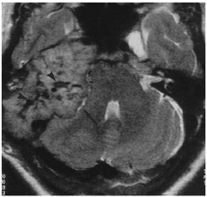
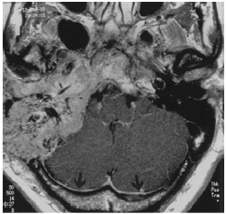
MR
Soft-tissue masses with hypervascularity;
Punctate and serpentine signal voids : Speckeled/ Salt and pepper appearance
Intense enhancement

Slide 107
THANK-YOU

