Slide 2
CLASSIFICATION OF LESIONS
Spinal tumors are subdivided according to their point of origin:
Intramedullary,
Extramedullary – Intradural,
Extradural.

Slide 4
Intramedullary Tumors
Single: Multiple:
Ependymoma, Hemangioblastomas,
Myxopapillary ependymoma, Metastases
Astrocytoma, Lymphoma
Ganglioglioma,
Hemangioblastoma,
Subependymoma,
Paraganglioma

Slide 5
Intradural-extramedullary Tumors
Single: Multiple:
Meningiomas, All except
Nerve sheath tumors, paragaglioma
Intradural metastases,
Lymphoma/leukemia,
Paraganglioma

Slide 6
Extradural Tumors
Single: Multiple:
Aneurysmal bone cyst, Metastatic disease
giant cell tumor, Hemangiomas
osteoblastoma, Multiple myeloma
osteochondromas, Lymphoma.
chordoma,
chondrosarcoma,
chondroblastoma,
metastasis,
hemangioma,
solitary plasmacytoma,
lymphoma.

Slide 7
Epidural Lesions:
Angiolipoma
Angiomyolipoma,
Epidural,
Lipomatosis,
Lymphoma

Slide 8
Intramedullary tumors
Intramedullary spinal cord neoplasms are rare, accounting for about 4-10 percent of all central nervous system tumors.
Intramedullary tumors include
Gliomas (ependymomas, astrocytomas and gangliogliomas) and
Nonglial tumors (such as hemangioblastomas, lymphoma and metastases).

Slide 9
Intramedullary Tumors
Single: Multiple:
Ependymoma, Hemangioblastomas,
Myxopapillary ependymoma, Metastases
Astrocytoma, Lymphoma
Ganglioglioma,
Hemangioblastoma,
Subependymoma,
Paraganglioma

Slide 10
Ependymomas
The most common intramedullary neoplasm in adults.
Usually occurs in the cervical region.
Slightly more common in women of 40 to 50 years of age.
Increased incidence of these tumors in patients with NF-2.

Slide 11
The symptoms are chronic and consist mainly of pain, myelopathy and radiculopathies.
Occasionally, these ependymomas may bleed and produce subarachnoid hemorrhage or hematomyelia and hence acute symptoms.

Slide 12
Ependymomas are characterized by slow growth and compress rather than infiltrate adjacent spinal cord tissue, generally yielding a cleavage plane that aids in surgical resection.
These lesions arise from ependymal cells that line the central canal and therefore tend to be central in location with respect to the spinal cord. Almost all spinal cord ependymomas are low grade, classified as either grade I or grade II by the World Health Organization (WHO);
Malignant ependymomas are quite rare.

Slide 13
Imaging
On MRI, iso- to hypointense on T1WI and hyperintense on T2WI.
Ependymomas tend to produce symmetric spinal cord expansion and usually have solid and cystic components.
Cysts can be intratumoral, located within the solid tumor, or peritumoral (polar), occurring at the cranial or caudal aspects of the tumor.
These cysts are not specific for ependymomas and can be seen with astrocytomas, hemangioblastomas and gangliogliomas.

Slide 14
Intratumoral cysts should be resected with the solid tumor, as they may contain tumor cells within them. However, polar cysts do not contain malignant cells and, therefore, need not be resected. The solid components of ependymomas usually enhance avidly, although the degree of enhancement may vary considerably.
In addition, ependymomas can hemorrhage, resulting in the “cap sign”, a hypointense rim at the periphery of the tumor on T2-weighted imaging that is related to hemosiderin deposition from prior hemorrhage

Slide 15
Clear tumor margins, more uniform enhancement and central locations can help differentiate ependymomas from other intramedullary spinal cord tumors.
Spinal cord ependymomas may result in metastases in the subarachnoid space.

Slide 16
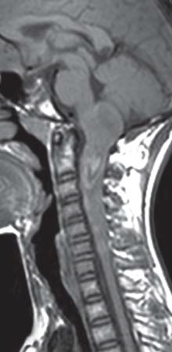
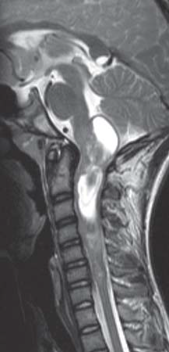
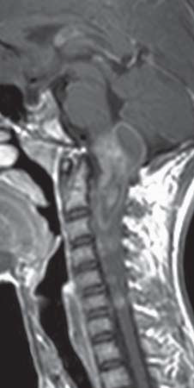

Slide 17
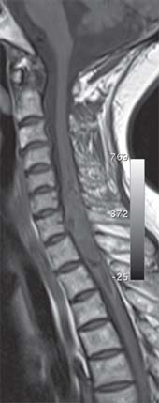
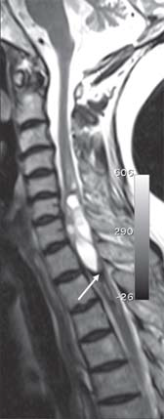
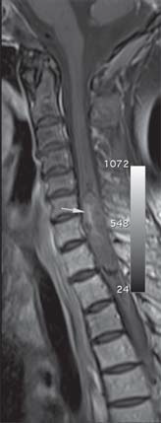

Slide 18
Myxopapillary Ependymoma
Myxopapillary ependymomas represent the most frequent type of ependymomas found at the conus medullaris-cauda equina- filum terminale level.
Neuroectodermal tumors.
Mainly observed during the fourth decade of life.

Slide 19
Pediatric cases have been rarely described at an age range of 10 to 13 years.
Myxopapillary ependymomas usually manifest with lower back, leg, or sacral pain and weakness or sphincter dysfunction.

Slide 20
Thought to arise from the ependymal glia of the filum terminale.
Occasionally, they occur in the extradural space, probably arising from the coccygeal medullary vestige at the distal portion of the neural tube.

Slide 21
Imaging
Myxopapillary ependymomas are lobulated, soft, sausage-shaped masses that are often encapsulated.
Isointense relative to the spinal cord on T1WI and hyperintense on T2WI
Hyperintensity on both T1 and T2WI may be noted occasionally, a finding that reflects mucin content or hemorrhage.
Superficial siderosis may be seen but is not specific, as it has been noted in association with other highly vascular tumors.

Slide 22
The differential diagnoses of a mass arising in the filum terminale are:
Ependymoma,
Astrocytoma,
Nerve sheath tumor,
Metastases,
Paraganglioma,
Hemangioblastoma.

Slide 23
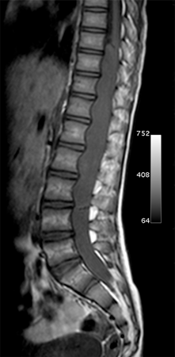
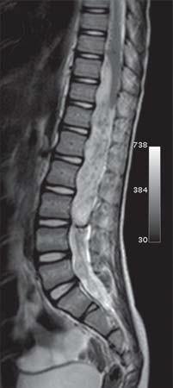
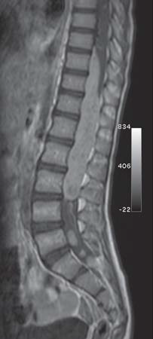

Slide 24
Subependymoma
Represent a variant of CNS ependymomas that may also occur in the spinal cord.
Originally thought to arise from the pluripotential cells of the subependymal plate, these tumors are now believed to have their origin from tanycytes cells that bridge the pial and ependymal layers.

Slide 25
Similar to ependymomas, these tumors produce a slowly progressive clinical course with pain as the most common symptom.
Sensory and motor dysfunctions are reported less frequently.

Slide 26
Imaging.
At MR imaging, they manifest with fusiform dilatation of the spinal cord with well-defined borders.
Unlike other ependymomas, they are eccentrically located.
Enhancement had sharply defined margins (50 % of cases), whereas those that did not enhance have diffuse symmetric spinal cord enlargement.

Slide 27
Edema may or may not accompany the main lesion.
Spinal subependymoma may manifest as an extramedullary lesion within the subarachnoid space, perhaps secondary to leptomeningeal heterotopic glial cells.

Slide 28
Astrocytomas
They are the most common childhood intramedullary neoplasms of the spinal cord and are second only to ependymomas in adults.
Clinical presentation varies from nonspecific backpain to sensory and motor deficits, according to the size and location.
In contradistinction to ependymomas, astrocytomas are located eccentrically within the spinal cord.

Slide 29
The vast majority of spinal cord astrocytomas in adults are of low malignancy, classified either as pilocytic (grade I) or low-grade astrocytomas (grade II), although anaplastic astrocytomas and glioblastomas rarely occur.
However, spinal cord astrocytomas tend to infiltrate the cord and are, therefore, difficult to resect completely and have worse prognosis.

Slide 30
Imaging.
The cervicomedullary junction and the cervico-thoracic cord .
On MR imaging, pilocytic astrocytomas are characterized by enlargement of the spinal cord within a widened spinal canal.
They frequently involve a large portion of the cord, spanning multiple vertebral levels in length.

Slide 31
True ‘‘holocord’’ tumors are rare; in most cases, involvement of the whole length of the spinal cord is caused by extensive spinal cord edema rather than by a tumor. Tumors can show areas of necrotic-cystic degeneration (60 % of cases), can have a ‘‘cyst with mural nodule’’ appearance, or can be structurally solid (about 40 % of cases).
The solid components are iso- to hypointense on T1WIs and hyperintense on T2WIs , whereas necrotic-cystic components display higher relaxation times on T1 and T2WIs.

Slide 32
The pattern of enhancement can be focal nodular, patchy or inhomogeneous, diffuse enhancement and does not define tumor margins.
Nonenhancing intramedullary astrocytomas are not uncommon and comprise between 20 percent and 30 percent of intramedullary astrocytomas.
Like ependymomas, they can have intratumoral or polar cysts but do not tend to hemorrhage and, therefore, do not usually display a cap sign.

Slide 33
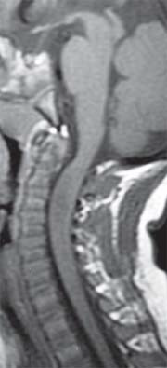
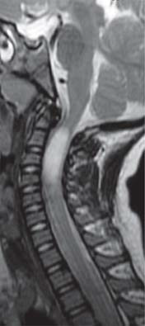
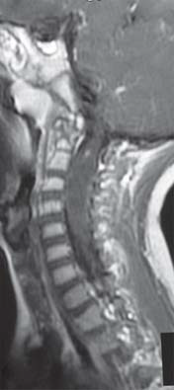
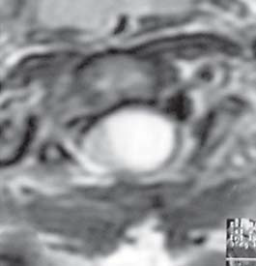
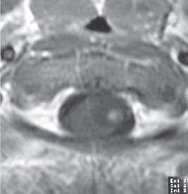

Slide 34
Rarely, astrocytomas arise following radiation therapy, either for a primary central nervous system lesion or for a lesion occurring outside the spine.
There are no specific imaging findings for radiation-induced astrocytomas and the main differential for these lesions is tumor recurrence (if there was a spinal cord tumor present initially) or radiation necrosis.
Radiation-induced astrocytomas tend to be of a higher grade than idiopathic astrocytomas.

Slide 35
An acute cord lesion in patients with multiple sclerosis (MS) may be virtually indistinguishable from an astrocytoma. MS lesions, however, generally appear more homogeneous than astrocytomas and typically demonstrate a surrounding rim of normal cord intensity, which is less common in astrocytomas.

Slide 36
Gangliogliomas
Gangliogliomas are composed of a mixture of ganglion cells and neoplastic glial elements; the majority of neoplastic glial cell types are of astrocytic subtype.
Gangliogliomas are the second most common intramedullary tumor in the pediatric age group (15 % of cases) and mostly affect children between 1 and 5 years of age, as do pilocytic astrocytomas.10 Spinal cord gangliogliomas are found more often in the cervical spine, followed by the thoracic region, but also may occur in the filum terminale.

Slide 37
These tumors tend to have a low malignant potential, slow growth, but they have a significant propensity for local recurrence. Gangliogliomas tend to be extensive on presentation, occupying an average length of 8vertebral segments, compared with ependymomas andastrocytomas, which average 4 vertebral segments in length.

Slide 38
Imaging
Calcification is probably the single most suggestive feature of gangliogliomas.
In the absence of gross calcification, the MR imaging appearance of gangliogliomas is nonspecific and does not allow differentiation from astrocytomas.
Solid portions have mixed iso-hypointensity on T1WI and heterogeneous iso- hyperintensity on T2WI.

Slide 39
Gangliogliomas are perhaps the second most common tumor after astrocytomas to have a holocord distribution.
Like astrocytomas, gangliogliomas tend to be eccentrically located within the spinal cord.
Tumoral cysts are more common in gangliogliomas than in either astrocytomas or ependymomas.

Slide 40
Chronic bony changes, including scoliosis and erosions, are often seen with gangliogliomas due to their relatively slow growth; these are rarely seen with ependymomas or astrocytomas.
T1 signal characteristics of gangliogliomas are most often mixed, possibly secondary to the fact that gangliogliomas have a dual cell population composed of ganglion cells and glial elements.

Slide 41
T2 signal characteristics of gangliogliomas are generally hyperintense, although surrounding edema is not as commonly seen as with ependymomas or astrocytomas.
The majority of gangliogliomas show patchy enhancement.

Slide 42
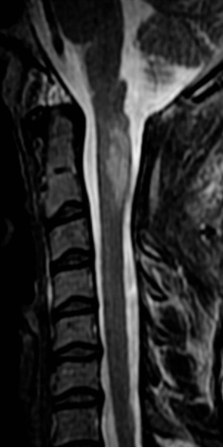
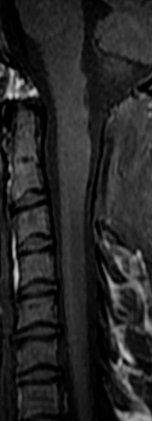
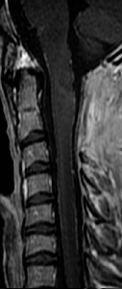
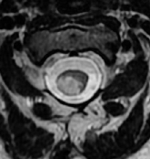
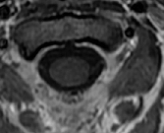

Slide 43
The upper cervical cord is expanded (opposite C1 and C2) by an eccentric mass which is high on T2 and iso-intense to cord on T1 weighted images. The region demonstrates no convincing contrast enhancement and no evidence of haemorrhage. There is evidence of previous surgery in the area.
An astrocytoma is the more likely diagnosis, as the mass is eccentric and slightly expansile. Other tumours to be considered include ganglioglioma, PNET, metastases, although in all cases absence of enhancement is unusual. Non-neoplastic lesions to be considered are demyelination / transverse myelitis - in the setting of an exam, the fact that someone thought it was likely enough to be a tumour to undergo the risk of biopsy is helpful :)
This mass is very eccentric, clearly located in the lateral aspect of the cord. There are no cysts, no features of haemorrhage and enhancement.

Slide 44
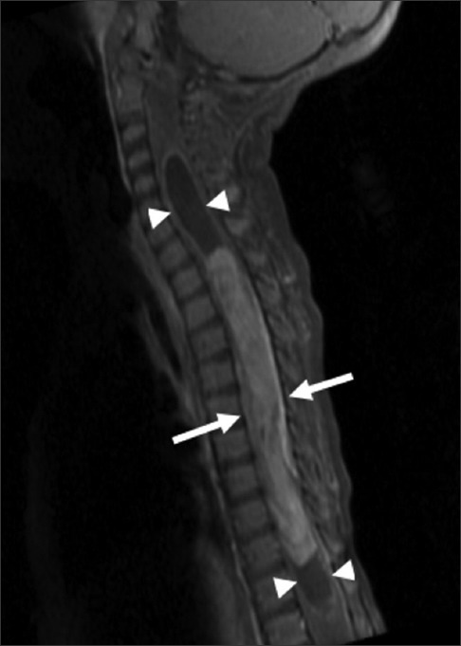
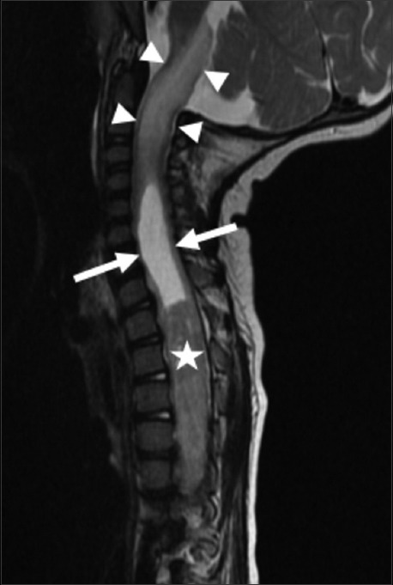

Slide 45
14-month-old female child with spinal cord ganglioglioma. Sagittal T1 fat-suppressed gadolinium contrast-enhanced MR image of the cervical and thoracic spine shows a long segment enhancing intramedullary lesion (arrows) extending from T1 to T11 with cord expansion and syringomyelia (arrowheads) at the rostral and caudal aspects of the enhancing tumor.

Slide 46
Hemangioblastomas
Hemangioblastomas are nonglial, highly vascular neoplasms of unknown cell origin.
Although most of these tumors (75%) are intramedullary, they may involve the intradural space or even be extradural.
Thoracic spinal cord > cervical spinal cord.
Most spinal hemangioblastomas occur sporadically, but approximately one-third of cases occur in association with von Hippel-Lindau disease.14

Slide 47
Imaging.
MR features of spinal hemangioblastoma depend on the size of the tumor.
Small (<10 mm)- isointense on T1WI
hyperintense on T2WI homogeneous enhancement,
Large (>10mm) - hypo or mixed onT1WI heterogeneous on T2WI heterogeneous enhancement

Slide 48
Small hemangioblastomas are located at the surface of the spinal cord, most frequently at the posterior aspect and show well-demarcated, intense enhancement.
A hemangioblastoma larger than 24 mm is usually accompanied by vascular flow-voids.
A tumor is not likely to be a hemangioblastoma if it is 25 mm or larger and is not associated with vascular flow voids on MR images.

Slide 49
Spinal hemangioblastomas may be associated with syrinx that are usually more extensive than those seen with ependymomas or astrocytomas.
In patients with von Hippel- Lindau disease, hemangioblastomas are often multiple and this necessitates screening of the entire spine and brain.

Slide 50
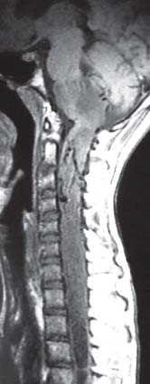
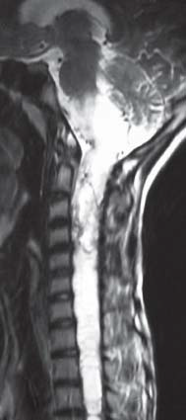
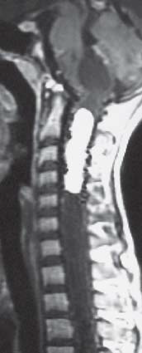

Slide 51
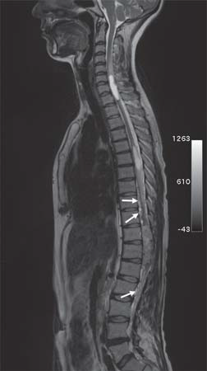
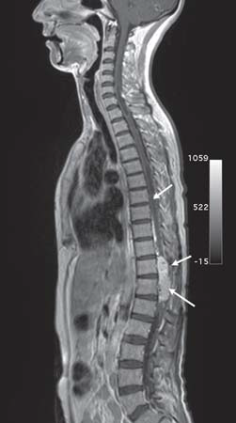

Slide 52
Paraganglioma
Although spinal paragangliomas are rare, they are the third most common primary tumor to arise in the filum terminale (after ependymoma and astrocytoma).
MR imaging studies of these lesions typically reveal a well-circumscribed mass that is isointense relative to the spinal cord on T1WI and iso- to hyperintense on T2WI

Slide 53
Hemorrhage is common (third most common after ependymoma and hemangioblastoma) and a low signal- intensity rim (cap sign) may be seen on T2WI.
Heterogeneous and intense enhancement is virtually always seen.
Multiple punctate and serpiginous structures of signal void due to high-velocity flow may be seenaround and within the tumors on all sequences.

Slide 54
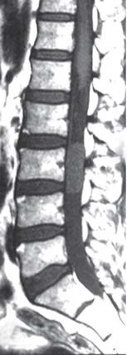

Slide 55
Intramedullary Lymphoma
Primary intramedullary spinal lymphomas are extremely rare.
These tumors are of the non-Hodgkin variety and can occur in both the immunocompromised and immunocompetent patients.
The majority of these tumors occur in the cervical or thoracic regions of the spinal cord.

Slide 56
They are solid tumors without necrosis.
Marked T2 hyperintensity and enhance following gadolinium administration.
There is no associated syringomyelia.
Clinically, these patients initially respond to steroid treatment for a short time but usually recur after treatment.

Slide 57
Intramedullary Metastases
Intramedullary spinal cord metastases are rare but, with increasing use of MR imaging are being encountered with increasing frequency.
These represent approximately 2 percent of all metastases to the central nervous system; these usually involve the cervical cord.
The most common primary tumors that metastasize to the spinal cord include lung, breast, colon, lymphoma and kidney; rarely, intramedullary spinal cord metastasis may be
the initial presentation of the malignancy.

Slide 58
On MRI, intramedullary spinal cord metastases are T1- hypointense, T2-hyperintense and demonstrate homogeneous
enhancement.
The amount of surrounding edema is out of proportion to the size of the lesion.

Slide 59
EXTRADURAL TUMORS
METASTASES.
Spinal metastasis is the most common tumor of the spine.
Multiple in 90 % of cases.
In adults, the most common primary tumors are adenocarcinomas of lung, prostate and breast.
In children, most vertebral metastases arise from neuroblastoma and Ewing’s sarcoma.
Thoracic > lumbar > cervical spine.

Slide 60
The metastatic foci may be in posterior elements or the vertebral bodies.
Symptomatic spinal metastases produce a characteristic clinical
syndrome beginning with local back or neck pain. Pain is followed by weakness, numbness and sphincter dysfunction.
Most spinal metastases are lytic.
Densely sclerotic metastases are typical for prostrate and rare cancers such as carcinoid tumors.

Slide 61
Although nuclear medicine studies are very sensitive, however, the specificity is low and uptake of most tracers requires destruction of cortical bone and thus metastases limited to bone marrow may be missed. Because of this reason, MRI is the imaging method of choice in these patients.
Not only does MRI provide information regarding bone, it demonstrates overt or impending compression of the bone.

Slide 62
Metastases to spine generally present as T1-hypointense and T2- hyperintense lesions that replace normal marrow.
Most metastases enhance.
MRI may be helpful to differentiate between an osteoporotic and a neoplastic compression fracture.

Slide 63
The latter tends to show complete replacement of the fatty marrow in the vertebral body and a possible soft tissue component that extends beyond the bone.
Osteoporotic compression fractures may only demonstrate a band of marrow replacement representing edema.

Slide 64
Gradual return to the normal fatty marrow on follow-up.
Studies indicates an osteoporotic fracture.
Diffusion weighted imaging may be helpful in differentiating benign osteoporotic.
Vertebral body fractures (which have low signal intensity) from malignant ones (which have relatively high signal intensity).

Slide 65
Multiple Myeloma
Multiple myeloma (MM) is a malignancy characterized by monoclonal proliferation of malignant plasma cells.
Nearly always, the disease is systemic, but occasionally it may be isolated (plasmacytoma).
In most patients, plasmacytoma is the initial manifestation of the disease and MM develops in most of the cases 5 to 10 years after the initial diagnosis.
MM is most common primary neoplasm of spine with the majority occurring in the thoracic and lumbar spine.

Slide 66
Most patients are men, 60 years of age or older.
Plasmacytomas are expansile lytic masses that may extend into the epidural space; as with other tumors of the spine, they may undergo pathologic fracture.
On plain film or CT, they usually appear as focal lytic lesions, but often the disease may present innocuously, appearing only as diffuse osteopenia.
In case of POEMS (polyneuropathy,organomegaly, endocrinopathy, myeloma and skin changes) syndrome, the lesion may be sclerotic rather than lytic.
Treated myeloma, after chemotherapy and/or radiation, may also exhibit reconversion to fatty marrow can be seen.

Slide 67
MRI is superior to radiography for both, focal and diffuse involvement.
Five different infiltration patterns can be differentiated:
(1) normal appearance of bone marrow despite minor microscopic plasma cell infiltration
(2) focal involvement
(3) homogeneous diffuse infiltration
(4) combined diffuse and focal infiltration
(5) “salt-and-pepper” pattern with inhomogeneous bone marrow with interposition of fat islands.

Slide 68
In general, abnormalities are identified as hypointensities on T1WI, hyperintensities on STIR images and enhancement on gadolinium-enhanced images.
These imaging features are not pathognomonic for MM and may also be seen in other diseases that affect the marrow.
In general, however, MM is suspected whenever MR images depict an expansile focal mass; multiple focal masses in the axial skeleton; diffuse marrow involvement, particularly at known sites of normal hematopoiesis or multiple compression fractures in a patient with no known primary malignancy.

Slide 69
Diffuse involvement manifests as homogeneous signal reduction on T1WI. It can be quantified objectively by calculation of the percentage of signal intensity increase after contrast material injection.
Recently, MRI has been implemented in the clinical staging of patients with multiple myeloma and guiding biopsies.

Slide 70
MRI may also monitor response to therapy.
Signs of good response in cases with focal involvement are: reduction of signal intensity on T2WI, lack of rim-like enhancement after contrast material injection or even a normalization of bone marrow signal.
In case of diffuse involvement a partly patchy reconversion to fatty marrow can be
seen.

Slide 71
Lymphoma
Spinal lymphoma is found most often between the 5th and 7th decades of life.
Most patients have underlying non-Hodgkin’s lymphoma.
Spinal involvement develops in approximately 2 % of these patients and affects mostly epidural space.
Bone lesions also occur, most frequently in the dorsal and lumbar spine

Slide 72
Osteolysis is the rule, but patchy sclerosis and “ivory vertebrae” as well as mixed lytic and blastic lesions are frequently seen.
Vertebral collapse is also common.
On MRI, lymphoma appears as a nonspecific mass that is hyperintense on T1 images and hypointense or bright on T2 images.
The T2 signal characteristics are related to the fact that lymphomas have a high nuclear-to-cytoplasmic ratio.
For similar reasons, lymphomas have restricted diffusion on DWI.

Slide 73
Lymphomas demonstrate intense enhancement and may narrow the spinal canal, resulting in compression of the spinal cord.
Accurate diagnosis is of particular importance with lymphomas, since radiation therapy can result in rapid reduction in the size and compressive effects of these lesions.
Paravertebral soft-tissue masses occur consistently.
Gouge defects of the anterior border of the vertebrae are frequently the result of erosion by lymph nodes.

Slide 74
Hemangioma
Vertebral body hemangiomas are the most common primary bone tumor and are found in over 10 percent of population.
They are composed of thin-walled vessels lined by endothelial cells
infiltrating the medullary cavity between bone trabeculae.
They are most commonly found in the fourth to sixth decades with slight female predominance.

Slide 75
They may be solitary (70%) or multiple (30%).
The most common locations are the thoracic, lumbar and cervical regions.
Most of the hemangiomas arise in the body of the vertebra, but may also involve the pedicles. The majority of hemangiomas that involve bone are discovered incidentally in asymptomatic patients, but occasionally they may present as large and aggressive masses destroying a vertebra and producing pain and even compression of the spinal canal.
Some hemangiomas enlarge and become symptomatic during pregnancy.

Slide 76
At radiography, vertebral hemangiomas classically have a coarse, vertical, trabecular pattern, with osseous reinforcement (trabecular thickening) adjacent to the vascular channels that have caused bone resorption. This appearance on radiographs represents a response to stress and has been likened to corduroy.
At CT, the thickened trabeculae are seen in cross section as small punctate areas of sclerosis, often called the ‘polka-dot’ appearance.

Slide 77
The histopathologic features of hemangiomas -highvascularity, interstitial edema and interspersed fat—dictate the MR imaging appearance.
The presence of high signal intensity on T1 and T2WI is related to the amount of adipocytes or vessels and interstitial edema, respectively.
Thick, low signal- intensity vertical struts may be seen within hemangiomas.
Fatty vertebral hemangiomas may represent inactive forms of this lesion, whereas low signal intensity at MR imaging may indicate amore active lesion with the potential to compress the spinal cord.

Slide 78
Mottled high signal intensity on T1WI can be expected in only about 50 percent of compressive vertebral hemangiomas and signal voids are the most useful additional
MR imaging sign in lesions that are hypointense on T1-weighted images.
CT or MR images obtained after intravenous administration of contrast material demonstrate lesion enhancement.

Slide 79
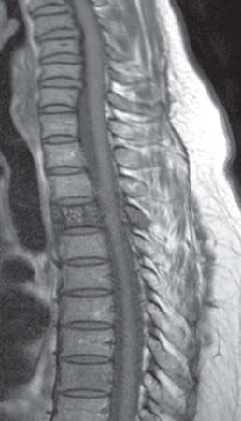
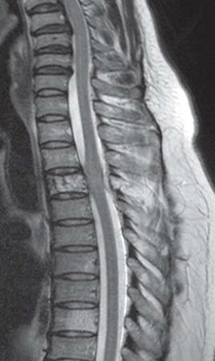
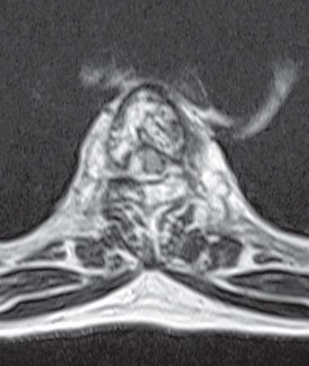

Slide 80
Solitary Lesions
Aneurysmal Bone Cyst.
Aneurysmal bone cyst (ABC) represents fewer than 1 percent of all primary bone tumors.
Approximately 20 percent of all ABCs are located in the spine, particularly in the cervical and thoracic regions, where the posterior elements are typically involved; sacral involvement represents fewer than 20 percent of all spinal ABCs

Slide 81
The peak incidence is in the second decade of life with a slight female predominance.
Patients complain of back pain and neurologic symptoms resulting from encroachment on the spinal canal.
ABC may be primary (70%) or secondary.
Secondary ABC may be associated with GCT, osteoblastoma, chondroblastoma, metastases and osteosarcoma.
Pathologically, ABC often has a characteristic appearance consisting of multiloculated blood-filled spaces, which are not lined by endothelium and, therefore, do not represent vascular channels

Slide 82
Solid components are usually in septations and are composed of fibrous tissue, reactive bone and giant cells.
In 5-7.5 percent of cases, the solid component predominates histologically.
Radiographs of spinal ABCs generally show marked expansile remodeling of bone centered in the posterior elements, although extension into the vertebral body is frequently seen.
A thin, outer periosteal rim and septations may be
apparent.
Spinal ABC, similar to GCT and chordoma, may extend into adjacent vertebral bodies, intervertebral disks, posterior ribs and paravertebral soft tissues.

Slide 83
The predominant bone scintigraphic pattern in ABC is moderate
to intense radiotracer accumulation at the periphery of the lesion with little activity at its center (doughnut sign), a finding that is evident in about 64 percent of cases.
However, this scintigraphic pattern lacks specificity, since it is also found in giant cell tumor, chondrosarcoma and telangiectatic osteosarcoma.
Angiography reveals a hypervascular lesion in 75 percent of cases and, as seen with bone scintigraphy, the vascularity is predominantly peripheral.

Slide 84
CT and MR imaging may reveal multiple fluid-fluid levels reflecting hemorrhage with sedimentation, a characteristic feature of this tumor.
On T1 or T2WI, they may have increased signal intensity due to methemoglobin in either the dependent or nondependent component.
Other areas in ABCs usually show high signal intensity on T2WI.
These lesions often have a soft-tissue-attenuation or low-signal-intensity rim on CT and MR images (all pulse sequences), respectively, that corresponds to an intact, thickened periosteal membrane.

Slide 85
Gadolinium enhancement of these lesions on MR images is usually seen within the rim and septations, rather than the cystic spaces.
The presence of fluid-fluid or hematocrit levels is suggestive, but not pathognomic of ABC and have also been reported in giant cell tumors, chondroblastoma, fractured simple cyst, fibrous dysplasia and malignant fibrous histiocytosis.

Slide 86
The presence of a solid component with diffuse contrast enhancement should raise suspicion for secondary ABC, although it might be encountered in the solid variant of ABC.
Embolotherapy, performed with multiple agents, has been employed with substantial success as both, a preliminary procedure to lessen blood loss at surgery and as the sole treatment.

Slide 87
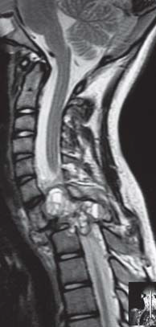
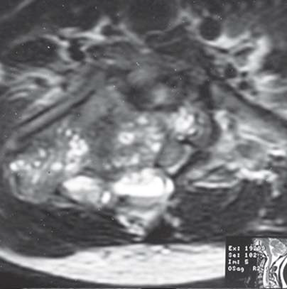
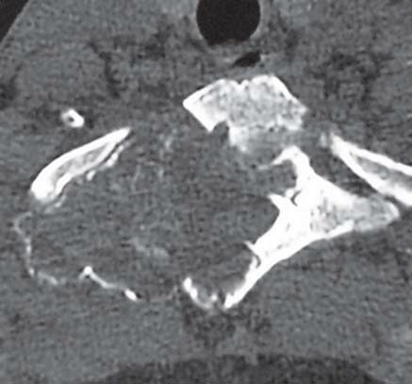

Slide 88
Giant Cell Tumor
Giant cell tumors (GCT) of the spine, representing only 3-7 percent of all GCT, are uncommon. Spinal lesions are more frequent in women and affect patients in the 2nd to 4th decades of life.
Clinical symptoms are primarily pain (often with radicular distribution), weakness and sensory deficits.
Most GCT of the spine occur in the sacrum.
Compared with chordomas, which are central lesions, sacral GCT are frequentlyeccentric and abut or extend across the sacroiliac joint.

Slide 89
When GCT occurs in the spine above the sacrum, it is usually located in the vertebral body with or without extension to the posterior elements.
Involvement of the adjacent intervertebral disks and vertebrae is not uncommon.
Pathologically, GCT is composed of abundant osteoclastic giant cells intermixed throughout a spindle cell stroma.

Slide 90
Cystic areas(similar to those seen in ABC), hemorrhage with hemosiderin and prominent areas of fibrous tissue that are high in collagen content are a frequent finding.
Despite benign pathology, they may rarely
metastasize and they recur without complete resection.
Approximately 5-10 percent of giant cell tumors are malignant

Slide 91
Radiography typically shows a lytic lesion with cortical expansion.
A purely osteolytic pattern is also possible. On CT scans, the tumor has soft-tissue attenuation with well-defined margins that may show a thin rim of sclerosis.
These very vascular neoplasms show heterogeneous signal intensity on both T1 and T2WI because of the presence of necrosis, hemorrhage, or cystic spaces.

Slide 92
Low signal intensity is frequently noted on T2WI and is related to the hemorrhagic and fibrotic content of this tumor.
There is usually no marrow edema in the absence of a pathologic fracture.
The lesion enhances after intravenous injection of contrast material.

Slide 93
At bone scintigraphy, GCT may demonstrate diffusely increased uptake of radionuclide.
However, sacral GCTs commonly demonstrate the “dougnut” sign of central photopenia and
increased peripheral activity. Angiography allows confirmation of the prominent vascularity of these tumors and is often performed along with embolization prior to attempted surgical resection.

Slide 94
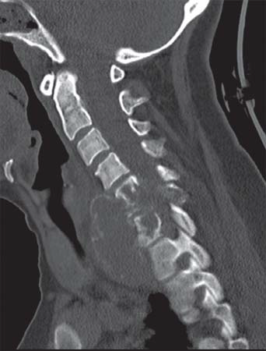
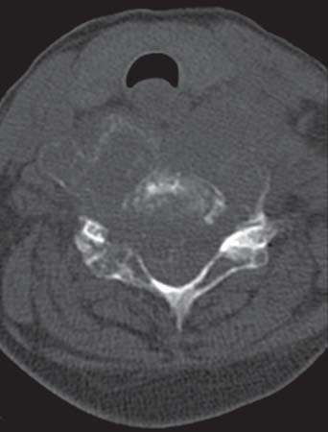

Slide 95
Osteoid Osteoma
Osteoid osteoma, relatively common benign osseous lesion, involves the axial skeleton in 10 percent of cases.
Patients are usually affected between the ages of 10 and 20 years, with a male to female distribution of 1.5:2.
Clinical symptoms include painful scoliosis, focal or radicular pain, gait disturbance and muscle atrophy. The pain is worse at night and is relieved with aspirin.
The lumbar spine is most commonly affected, followed by the cervical, thoracic and sacral segments.

Slide 96
The majority of axial osteoid osteomas (75%) are located in the posterior elements of the vertebra (pedicles, articular facets and laminae) and only 7 percent are in the vertebral body.
Pathologically, the nidus of an osteoid osteoma is a small (<1.5-2.0 cm in diameter), round mass of pink to red tissue, which reflects the vascularity of the lesion.
Frequently, the nidus is surrounded by a variable degree of reactive cortical bone.

Slide 97
Radionuclide bone scans are extremely sensitive in the detection of osteoid osteomas.
CT shows the nidus as a rounded hypodense
lesion surrounded by a hyperdense sclerotic ring.
Calcification within the nidus results in a target appearance of the lesion.
On MR imaging, nidus is generally low to intermediate signal intensity on T1WI, intermediate to high signal intensity on T2WI and enhances markedly; the surrounding osteosclerotic component results in a hypointense ring.

Slide 98
Areas of calcification have low signal intensity with all pulse sequences. The appearance of osteoid osteoma on MR images can be misleading when small lesions are located in the lamina or pedicle.
The nidus may become obscuredby signal changes due to associated surrounding sclerosis, marrow edema and soft-tissue inflammation.

Slide 99
Treatment of spinal osteoid osteoma is complete resection of the nidus.
New methods of treatment include percutaneous Ctguided removal and percutaneous ablation with a radio-frequency electrode, laser or alcohol.

Slide 100
Osteoblastoma
It is classically believed that osteoblastomas differ from osteoid osteomas only in size (>2 cm in diameter).
Osteoblastomas occur in young adults, with 90 percent of cases diagnosed in the 2nd and 3rd decades of life.
There is a male predominance (2:1).
Clinical symptoms often differ from those of osteoid osteoma, with osteoblastoma producing dull localized pain and neurologic
symptoms, including paresthesias, paraparesis and paraplegia.

Slide 101
Scoliosis occurs less frequently with osteoblastoma than with osteoid osteoma and may be convex toward the side of the tumor.
Osteoblastoma of the spine accounts for 30-40 percent of all osteoblastomas and the lesions are equally distributed in the cervical, thoracic and lumbar segments.

Slide 102
Osteoblastoma most frequently involves the posterior vertebral elements (55 percent of cases), although extension into the vertebral body is also common (42%).
Osteoblastoma confined to only the vertebral body is rare

Slide 103
Pathologically, the typical osteoblastoma is larger than 1.5-2.0 cm in diameter.
Histologic examination may reveal features very
similar to those of osteoid osteoma (interconnecting trabecular bone and fibrovascular stroma), but overall the microscopic pattern is not as well organized as that seen in osteoid osteomas.
Three radiographic patterns have been described with osteoblastoma.
The first, which consists of a central radiolucent area (with or without calcification) and surrounding osseous sclerosis, is similar to the radiographic appearance of osteoid osteoma, but the lesion is larger than 1.5 cm in diameter.

Slide 104
The second, an expansile lesion with multiple small calcifications and a peripheral sclerotic rim, is the most common appearance of spinal osteoblastomas.
The third pattern has a more aggressive appearance, consisting of osseous expansion, bone destruction, infiltration of surrounding soft tissue and intermixed matrix calcification.

Slide 105
Mineralization within an osteoblastoma may
have the radiologic appearance (rings and arcs) of chondroid matrix.
At CT, the lesion shows areas of mineralization, expansile bone remodeling and sclerosis or a thin osseous shell about its margins.
MR imaging appearance of osteoblastoma is generally nonspecific, with low to intermediate signal intensity seen on T1WI and intermediate to high signal intensity seen on T2WI.

Slide 106
MR imaging optimally depicts the effects of the tumor on the spinal canal and surrounding soft tissues and extensive peritumoral edema has been reported.
At bone scintigraphy, osteoblastoma demonstrates marked radionuclide uptake.
Treatment of spinal osteoblastoma is surgical resection and the recurrence rate for conventional lesions is 10-15 percent.

Slide 107
The diagnosis of aggressive osteoblastomas is important because they have a far greater recurrence rate (approaching 50%), which is probably related to their larger size and the resultant inability to perform complete resection.

Slide 108
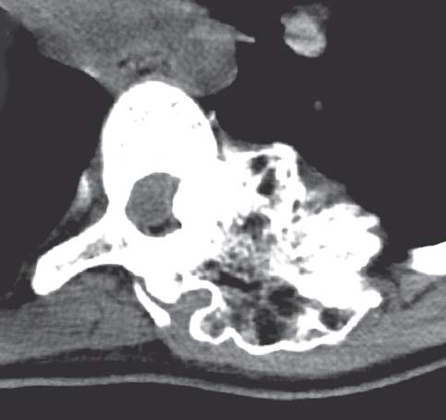

Slide 109
Osteosarcoma
Only 4 percent of all osteosarcoma involve the spine.
Peak prevalence occurs during the 4th decade of life.
Patients may present with pain, signs of neurologic compression and a palpable mass.
The thoracic and lumbar segments are equally involved, followed by the sacrum and the cervical vertebral column.
In most cases, the posterior elements are primarily involved, but secondary extension into the vertebral body is also common.

Slide 110
Pathologically, conventional osteosarcoma is a high-grade
malignant osteoblastic lesion with varying amount of osteoid production, cartilage or fibrous tissue.
Radiographs of spinal osteosarcoma usually reveal densely mineralized matrix and an ivory vertebral body may be recognized.
Purely lytic lesions have also been encountered, although infrequently and are difficult to distinguish from other solitary lesions of the spine.
Lesions with large amounts of matrix mineralization may remain low signal intensity on all MR images, regardless of pulse sequence.

Slide 111
Fluid-fluid levels have been described in association with telangiectatic osteosarcoma.
As opposed to ABCs, telangiectatic osteosarcomas with prominent fluid-filled hemorrhagic spaces are characterized by thick, solid nodular tissue surrounding the cystic spaces, matrix mineralization and a more aggressive growth pattern.
Patients with osteosarcoma of the spine should be treated with a combination of chemotherapy and at least marginal excision (assuming the tumors are surgically accessible).
Postoperative radiation therapy may be of benefit in selected patients.

Slide 112
Osteochondromas
Spinal osteochondromas are uncommon, representing only 1-4 percent of solitary exostoses and constituting 4 percent of all solitary spinal tumors.
In patients with hereditary multiple exostoses, only 7-9 percent of patients have a spinal lesion and usually there is only one spinal osteochondroma despite the multiplicity of lesions throughout the remainder of the skeleton.

Slide 113
Spinal osteochondromas are usually discovered during the 3rd and 4th decades of life when solitary and one decade earlier in patients with hereditary multiple exostoses.
There is a male predominance, which is more striking in solitary osteochondroma than in hereditary multiple exostoses.
Osteochondromas have been encountered at all levels of the spine, but they have a predilection for the cervical spine, particularly C2. Lesions most commonly arise from the posterior elements, although some originate from the vertebral body as well.

Slide 114
Osteochondromas are composed of normal bone (cortex and
marrow space) with a cartilage cap from which growth occurs.
The pathologic and radiologic hallmark of osteochondroma is continuity of the lesion with the marrow and cortex of the underlying bone.
Spinal osteochondromas may be sessile or pedunculated.
The diagnosis of spinal osteochondroma can be definitively
made from radiographic findings in only a minority of cases usually in large lesions protruding posteriorly from the spinous process where cortical and marrow continuity is easily assessed.

Slide 115
Thin-section CT is the radiologic examination of choice for detecting the osseous characteristics of the exostosis and the pathognomonic marrow and cortical continuity of the lesion to the underlying bone.
MR imaging often reveals yellow marrow centrally (which has high signal intensity on T1WI and intermediate signal intensity on T2WI) with a low-signal-intensity cortex.

Slide 116
The hyaline cartilage cap is often small and thin, with low to intermediate signal intensity on T1WI and high signal intensity on T2WI.
In adults, spinal osteochondromas with marked thickening (>1.5 cm) of the cartilage cap should be viewed with suspicion of malignant transformation to chondrosarcoma. Surgical excision of osteochondroma is usually curative.

Slide 117
Chordoma
Chordoma is the most common non lymphoproliferative primary malignant tumor of the spine and accounts for 2-4 percent of malignant osseous neoplasms.
These arise from notochordal rests and therefore, almost always occur in a midline or paramedian location in relation to the spine.
Nearly 50 percent of all chordomas originate in the sacrococcygeal region, particularly in the fourth and fifth sacral segments.

Slide 118
Another 35 percent are in the sphenooccipital region; only 15 percent of chordomas occur in the spine above the sacrum.
Men are affected twice as frequently as women; the mean age of patients is 50 years.
Chordomas are slow-growing tumors that are commonly discovered as large masses. As they enlarge, they tend to involve adjacent vertebral bodies and extend into the adjacent paraspinal tissues and epidural space; they may even grow into and expandneural foramina, potentially mimicking nerve sheath tumors.

Slide 119
Uncommonly, they can arise solely in the musculature of the perivertebral space, presumably from extraosseous notochordal nests.
Pathologically, typical chordomas contain clear cells with intracytoplasmic vacuoles (physaliphorous cells) and abundant mucin, both intracellular and extracellular.
In atypical or dedifferentiated chordomas, the mucinous matrix is replaced by chondroid or osteoid elements.

Slide 120
The most suggestive manifestation is a destructive lesion of a vertebral body associated with a soft-tissue mass with a “collar button” or “mushroom” appearance and a “dumbbell” shape, spanning several segments and sparing the disks.
Areas of amorphous calcifications are noted in 40 percent of chordomas of the mobile spine and in up to 90 percent of sacrococcygeal lesions.

Slide 121
Most chordomas are iso-or hypointense relative to muscle on T1WI.
The focal areas of hemorrhage and high protein content of the myxoid and mucinous collections may account for the high signal intensity on T1WI.
On T2WI, most chordomas have a high signal intensity due to the presence of their signature physaliphorous cells (clear cells with intracytoplasmic vacuoles and abundant mucin).

Slide 122
The fibrous septa that divide the gelatinous components of the tumor are seen as areas of low signal intensity on T2WI.
The presence of hemosiderin also accounts for the low signal intensity seen on T2WI.
This MR imaging feature has been reported in 72 percent of sacrococcygeal chordomas but is rare in spinal chordomas.

Slide 123
After the injection of gadolinium-based contrast material, most tumors demonstrate moderate heterogeneous enhancement, but ring and arc enhancement and peripheral enhancement have also been described.
Chordomas generally have a poor prognosis due to local recurrence following resection.

Slide 124
Chondrosarcoma
Chondrosarcoma is a malignant cartilage-producing neoplasm. It is the second most common nonlymphoproliferative primary malignant tumor of the spine following chordoma.
The patient may present with pain, neurological symptoms and a palpable mass.
The peak incidence is in the fifth decade, with men affected two to four times more frequently than women.

Slide 125
The spine is affected in 3 percent to 12 percent of cases.
Chondrosarcomas are seen at all levels of the spine, although the thoracic spine is the most common site.
Chondrosarcoma originates in the vertebral body (15 percent of cases), posterior element (40%), or both (45%) at presentation.

Slide 126
Chondrosarcoma of the spine is usually a relatively low-grade lesion (either grade 1 or grade 2), which likely accounts for the long-term survival of many patients.
Most lesions represent primary chondrosarcoma; however, secondary chondrosarcoma may also occur when osteochondroma (solitary or multiple with hereditary multiple exostoses) undergoes malignant transformation.

Slide 127
Chondrosarcomas of the spine usually manifest as a large, calcified mass with bone destruction.
The characteristic chondroid matrix mineralization (rings and arcs) may be evident on radiographs, but better evaluated with CT.
Calcified matrix is detected as areas of signal void at MR imaging.
The non-mineralized portion of the tumor has low attenuation on CT scans, low to intermediate signal intensity on T1WI and very high signal intensity on T2WI due to the high water content of hyaline cartilage.

Slide 128
An enhancement pattern of rings and arcs at gadolinium-enhanced MR imaging reflects the lobulated growth pattern of these cartilaginous tumors.
Extension through the intervertebral disk has been reported in 35 percent of cases.
Chondrosarcomaarising from osteochondroma is seen as thickening at the peripheral cartilaginous cap and large masses may also develop at this site.

Slide 129
Treatment of spinal chondrosarcoma is surgical resection and vertebral corpectomy with strut bone grafting may be necessary.
Radiation therapy is also used as adjunct treatment, but its effectiveness is controversial.

Slide 130
Chondroblastoma
Chondroblastoma is a benign cartilaginous neoplasm with a predilection for the growing skeleton.
Chondroblastoma of the vertebral column presents in the third decade of life, a decade later than its appendicular counterpart.
There is a male predominance(2-3:1, male-to-female ratio).
Back pain is the most common symptom. However, neurologic symptoms may occur when the spinal canal or foramina are invaded.

Slide 131
The tumor involves the vertebral body and posterior elements.68
The tumor shows aggressive features at imaging, with bone destruction and a soft-tissue mass but no surrounding bone edema.
In other cases, CT may demonstrate a geographic lesion with sclerotic borders.67 Most lesions have hypointense areas on T2WI.
Low signal intensity on T2-WI is associated with immature chondroid matrix, hypercellularity, calcifications and hemosiderin at histologic analysis.

Slide 132
EPIDURAL LESIONS
Angiolipoma
Spinal angiolipomas are rare lesions usually found in the epidural space of the thoracic spine.
Mean age of occurrence is 9 years (range 10 days-85 years) with most patients presenting with slowly progressive symptoms of spinal cord compression.
Most of these lesions are found in adults and in the thoracic region.

Slide 133
Spinal angiolipomas are typically located in the posterior and lateral aspects of the epidural space. However, infiltrating forms of tumor are generally in the anterior epidural space.
On MRI, angiolipomas are predominantly hyperintense on T1WI and inhomogeneous owing to interspersed vascular elements.

Slide 134
A high vascular content is correlated with the presence of large hypointense regions on T1WI.
These masses are hyperintense on T2WI.
The larger tumors may result in compression of the spinal cord.
Intramedullary angiolipomas have been rarely described.

Slide 135
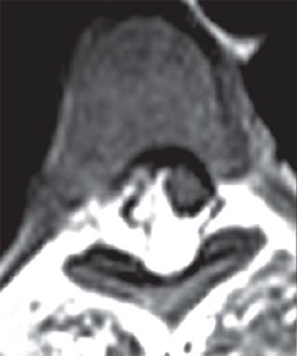
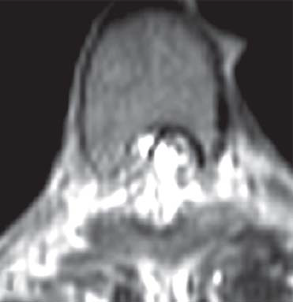
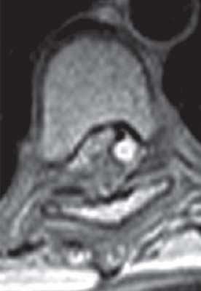
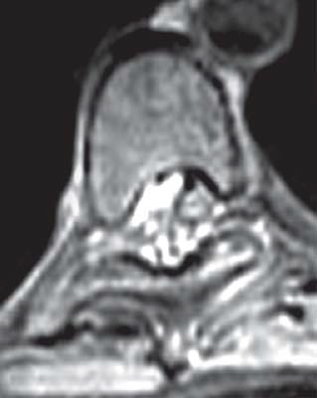

Slide 136
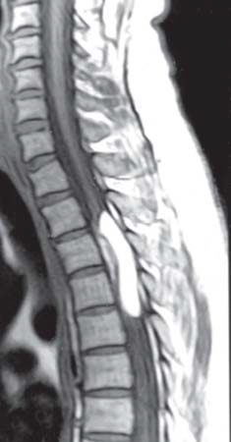
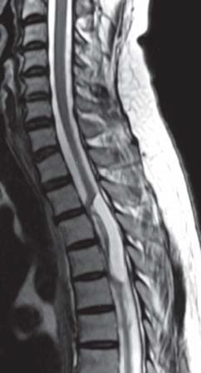
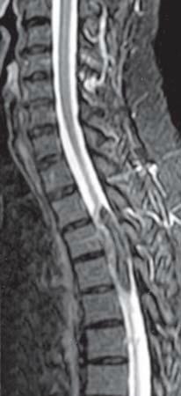

Slide 137
Epidural Lipomatosis
This entity, although not a tumor, may behave as one and result in compression of neural elements and thus is discussed here.
The most common cause of epidural lipomatosis is prolonged therapy with glucocorticoids, only a very few cases are related to endogenous Cushing’s syndrome.
Epidural lipomatosis may also be seen in morbidly obese patients. In this rare entity, there is hypertrophy of normal epidural fat, particularly in the dorsal aspects of the thoracic spine and less commonly in the lumbar region.

Slide 138
The most common symptom is back pain, but compression of the spinal cord may occur. If the fat grows at the level of neural foramina, radiculopathies also occur.
The typical MRI appearance of epidural lipomatosis is that of excessive bright Tl fat (>5 to 6 mm) in the posterior aspect of the canal on sagittal images.
The subarachnoid spaces are narrowed and the thoracic spinal cord appears thin.

Slide 139
The superior and inferior aspects of the lipomatosis taper smoothly and usually extend at least six vertebral segments in length.
On axial images, excessive fat is noted in the posterior aspect of the canal and extending laterally.
This normal fat does not enhance after contrast administration.

Slide 140
On sagittal MRI, the width of the normal posterior epidural fat is less than 3 to 5 mm.
On CT, the abnormal fat is of low density and on myelography the fat may compress the canal and result in complete blockage of the passage of contrast.
Similar findings are noted when epidural lipomatosis develops in the lumbar region.

