Slide 1
HYDROCEPHALUS
Dr Sagar M Raul
Guide : Dr S S Pawar Madam.

Slide 2
Introduction
Derived from Greek word “Hydro” meaning “Water”, and “Cephalus”, meaning “Head”.
Excessive accumulation of cerebrospinal fluid (CSF) resulting in abnormal widening of the spaces in the brain.

Slide 3
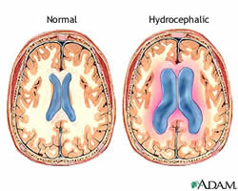

Slide 4
Ventricles of The Brain
Lateral Ventricle
Third Ventricle
Fourth Ventricle

Slide 5
Anatomy of Ventricles

Slide 6
Anatomy of Ventricles

Slide 7
Circulation of CSF
Normally, CSF flows continually from the interior cavities in the brain (ventricles) to the thin subarachnoid space that surrounds the brain and spinal cord.
CSF production rate 0.4 ml/min or
500 ml/day.
CSF Volume :
10-60 ml in neonates.
~ 150 ml in adults.

Slide 8
Circulation of CSF

Slide 9
Circulation of CSF
Normally, CSF flows through the ventricles, exits into cisterns (closed spaces that serve as reservoirs) at the base of the brain, bathes the surfaces of the brain and spinal cord, and then reabsorbs into the bloodstream.

Slide 10
Circulation of CSF

Slide 11
Cause of Hydrocephalus
The balance between production and absorption of CSF is critically important. Because CSF is made continuously, medical conditions that block its normal flow or absorption will result in an over-accumulation of CSF. The resulting pressure of the fluid against brain tissue is what causes Hydrocephalus.

Slide 12
Causes of Hydrocephalus
Notes:
Overproduction causes – CPP, CPCas. Diffuse villous hyperplasia of choroid.

Slide 13
Types of Hydrocephalus
Congenital hydrocephalus
Acquired hydrocephalus
Acute hydrocephalus
Chronic hydrocepahlus
Extraventricular (Communicating) hydrocephalus
Intraventricular hydrocephalus

Slide 14
Congenital Hydrocephalus
Congenital hydrocephalus is present at birth and may be caused by environmental influences during fetal development or by genetic factors.
Causes are:
Aqueduct Stenosis
Colloid Cyst

Slide 15
Notes:
Thinning of the choroid plexus.
Displacement of the medial and lateral walls of the lateral ventricle

Slide 16
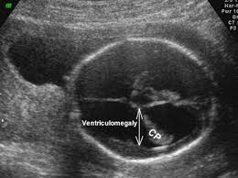
DROOPY / DANGLING CHOROIDS : - In marked hydrocephalus the choroid plexus will no longer lie in parallel fashion, tethered at foramen of Munro the free choroid will hang / dangle in CSF as it is denser than CSF. VENTRICULOMEGALY :- Mild VM – 10 to 12 mm. Mod VM – 12 to 15 mm. Severe VM - >15 mm.

Slide 17
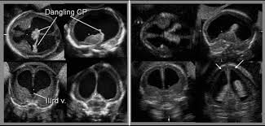

Slide 18
Acquired Hydrocephalus
Develops at the time of birth or at some point afterward. This type of hydrocephalus can affect individuals of all ages and may be caused by injury or disease.

Slide 19
Acquired Hydrocephalus
Acquired Hydrocephalus is due to:
Tumors
Hemorrhage
Ventriculitis

Slide 20
Communicating Hydrocephalus
Communicating hydrocephalus occurs when the flow of cerebrospinal fluid (CSF) is blocked after it exits the ventricles. This form is called communicating, because the CSF can still flow between the ventricles, which remain open.

Slide 22
Communicating Hydrocephalus
Causes are due to:
Post-hemorrhage
Bacterial Meningitis
Malignant Meningitis
Increased Venous Pressure

Slide 23
Non-Communicating Hydrocephalus
Non-communicating hydrocephalus, also called "obstructive" hydrocephalus, occurs when the flow of CSF is blocked along one or more of the narrow pathways connecting the ventricles.
Causes include:
Congenital
Acquired

Slide 25
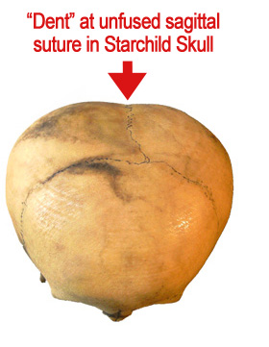
Hydrocephaly is often suggested as the cause of the unusual parietal bossing (bulging of the bones at the rear sides of the skull) in the Starchild Skull.

Slide 26
J-shaped Sella: Sella extends under anterior clinoid process and looks like “J” on side; seen in normals, Hydrocephalus or optic chiasm glioma.

Slide 27
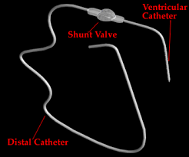

Slide 28
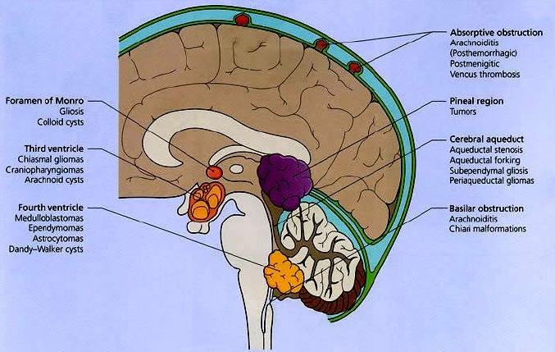
?
Colloid Cysts are usually located in the anterior (front) portion of the third ventricle, resting against the hypothalamus, where they may block the outflow pathways for the cerebrospinal fluid and cause hydrocephalus

Slide 29
Notes:
Colloid cyst with obstructive hydrocephalus. Sagittal T1-weighted MR image shows a hyperintense nodular mass at the foramen of Monro. Dilatation of both lateral ventricles is due to obstruction of CSF flow at the foramen of Monro.

Slide 30
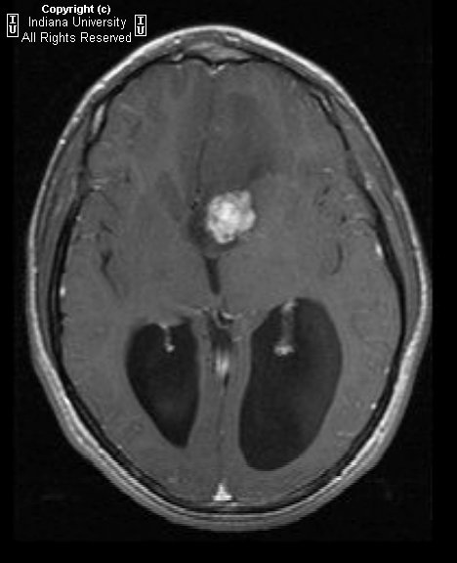
Notes:
Axial T2 weighted image demonstrates a well-marginated intraventricular mass near the foramen of Monro. The lesion is lobulated in appearance and is causing obstructive hydrocephalus. Associated vasogenic edema is noted extending into the left frontal lobe. Coronal T1 contrast-enhanced MR sequences demonstrate intense, heterogeneous enhancement of the mass.
Diagnosis: Subependymal giant cell astrocytoma

Slide 31
Notes:
A sagittal T1-weighted MRI shows a large posterior fossa cyst. The hypoplastic vermis is everted over the posterior fossa cyst (long arrow). The cerebellar hemispheres and brainstem (b) are hypoplastic. Thinned occipital squama is seen (arrowheads).
An axial T1-weighted MRI showing ventriculomegaly and a superiorly displaced posterior fossa cyst

Slide 32
Notes:
MRI sagittal view showing Aqueduct Stenosis causing Hydrocephalus

Slide 33
Notes:
Non contrast CT of the brain demonstrates marked hydrocephalus involving the lateral and third ventricles but sparing the fourth ventricle. .

Slide 34
Shunt Catheter in Situ

Slide 35
Notes:
CT postcontrast imaging showed a tumor in midline causing a bilateral obstructive hydrocephalus.
Tumor was removed in this postoperative image.

Slide 36
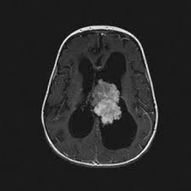
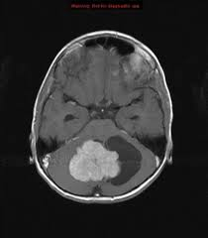

Slide 37
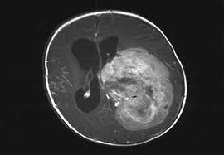
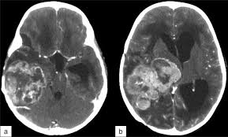

Slide 38
?
Medulloblastoma: sagittal view MRI showing an avidly enhancing solid and cystic lesion filling the fourth ventricle; obstructive hydrocephalus present

Slide 39
Notes:
Brain CT at level of Vein of Galen demonstrating thrombus.

Slide 40
Notes:
Sagittal view MR T1 post contrast showing Pineocytoma causing hydrocephalus

Slide 41
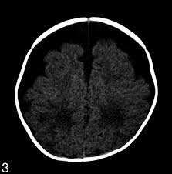
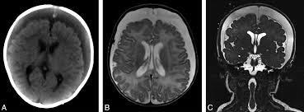

Slide 42
NORMAL PRESSURE HYDROCEPHALUS Triad: - Dementia, gait apraxia, urinary incontinence. Dilated ventricles, periventricular WM halo. Ventriculo-sulcal disproportion. Fourth ventricle may appear normal. Prominent ventricular activity at 24 hrs in In 111 DTPA cisternography is good indicator of NPH.

Slide 43
THANK YOU

