Slide 1
RADIOGRAPHIC ARTIFACTS

Slide 2
Artefact
Is defined as a feature appearing in an ultrasound image that does not correspond to or represent an actual anatomical or pathological structure.
Classification based on:
Appearance: dot, streak like, ring like,
Cause of artefact

Slide 3
MOTION BLUR
Artifacts resulting from patient :
Can be voluntary or involuntary
Best controlled by short exposure times
Use of careful instructions to the patient
Suspension of patient respiration
Immobilization devices

Slide 4
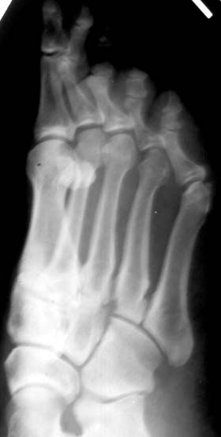
Blurring of image due to patient movement during exposure.

Slide 5
Improper positioning
Improper technique: ex., that of oblique spine X ray, If not taken properly, Complex spine posterior elements may appear abnormal,
May show many abnormal appearances.
Artefact remedy:
Technicians must be taught about proper positioning of patient for different radiographic views.

Slide 6
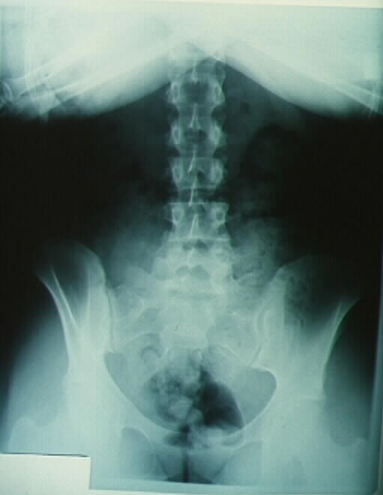
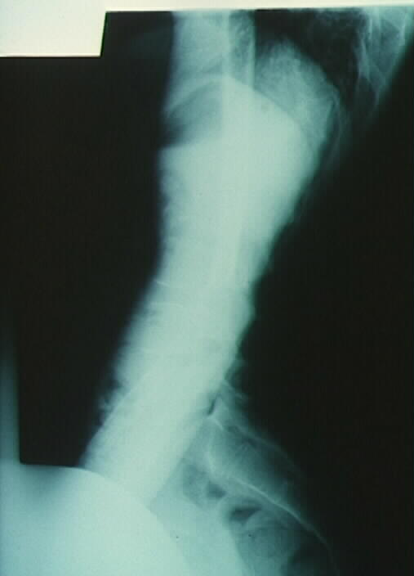
IMPROPER POSITIONING

Slide 7
IMPROPER GOWNING INSTRUCTIONS
Radio-opaque objects or foreign bodies in the path of x-ray beam produce image opacities which may obscure or confuse vital anatomical details.
Common radio-opaque artefacts are :
- Dentures - Safety pins
-Hearing aids -Hair grips
-Wrist watches -Jewellary.
Artefact remedy :
ask patient to remove all metallic objects and jewellary before radiograph is taken.

Slide 8
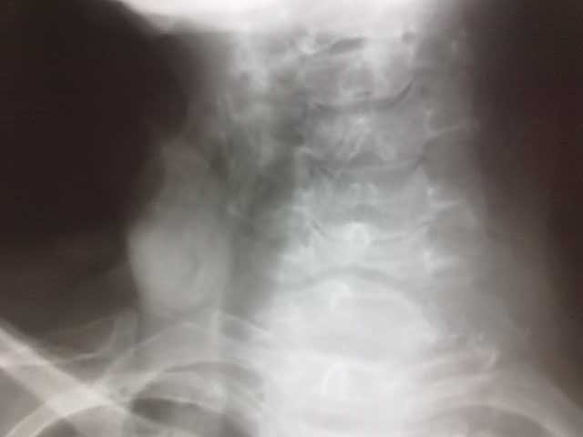
Hair Extensions

Slide 9
ARTIFACTS RESULTING FROM X-RAY MACHINE AND ANCILLARY EQUIPMENT
DOUBLE EXPOSURE
POOR FILM SCREEN CONTACT
DIRTY SCREENS
BACK-SCATTER
CASSETTE UPSIDE-DOWN
BROKEN CASSETTE
IMPROPER USE OF GRID
IMPROPER EXPOSURE FACTORS

Slide 10
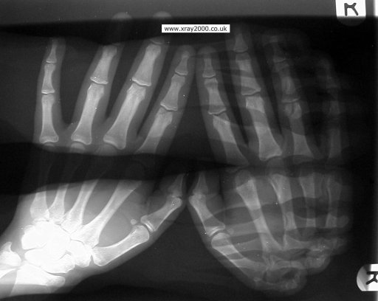
DOUBLE EXPOSURE
One film is exposed twice and so structures are not identifiable.

Slide 11
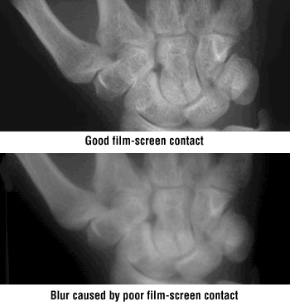
Poor film Screen Contact
Lack of contact between film and screen can cause “blurring” of the image.
Remedy : Use proper film screen holder.
Regular quality check up.

Slide 12
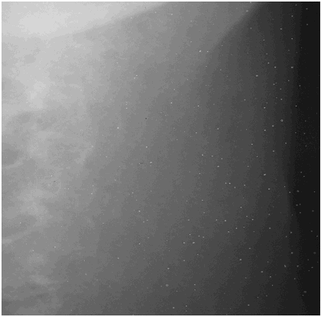
Cassette Artifacts – dirty screens
Dust, hair, fragments of paper etc or screen defects produce a corresponding white marks on the image.

Slide 13
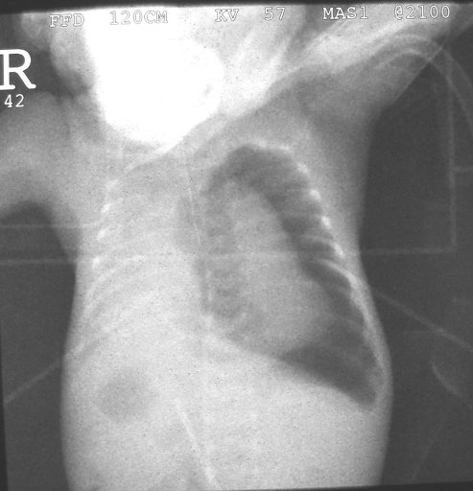
BACKSCATTER OR CASSETTE UPSIDE-DOWN
Pale image and background, with
Superimposed cassette catches seen in image.

Slide 14
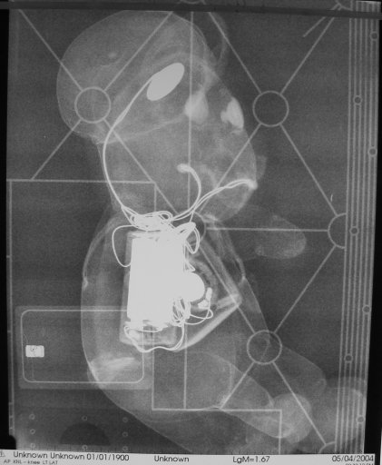
BACKSCATTER OR CASSETTE UPSIDE-DOWN
Back scatter is because of X ray are reflected from behind screen
and again fall on screen.
Newer screens have lead covering behind it.
If back-sided lead covering is damaged a line appears b/o back scatter.
Image of phantom

Slide 15
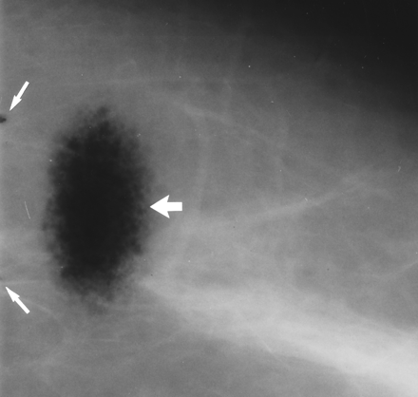
Damaged cassette CASSETTE- LIGHT LEAK
Blackening of one corner or edge of film, unrelated to image
Artefact remedy :
Check cassette is
closed properly,
Check for cassette damage

Slide 16
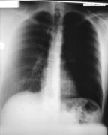
GRID CUT-OFF
Lateral displaced grid : uniform less exposure.
Off level/ tilted grid : uniform loss of exposure.
Upside down grid : Periphery is less exposed,
Grid near to focus : periphery less exposed,
Grid far from focus : periphery less exposed
Artefact remedy :
Check whether the grid is right way up, perpendicular to the X ray beam, and that the FFD is correct

Slide 17
OPERATOR ERRORS
Operator errors are especially common when
CR equipment is new to a group of users.
EX: Double exposure
Cassette placed upside down
Improper selection of grid frequency
Improper storage of cassettes

Slide 18
DOUBLE EXPOSURE
The consequence of double exposure can be either a single repeated examination, when an inanimate object is involved or two repeated examinations when two patients are involved
In DR, double exposures can also be caused by power interruptions and communications errors, as well as by inadequate erasure secondary to overexposure or erasure mechanism failure.

Slide 19
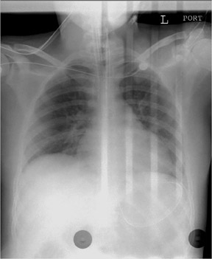
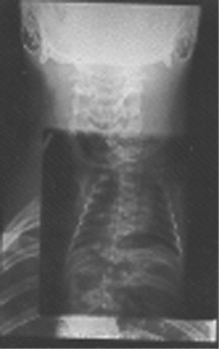

Slide 20
Moire pattern
Selection of grid frequency is an important
consideration. Low line rate grids will
cause moire' pattern to appear on images
if the grid lines are parallel to the plate
reader’s scan lines.

Slide 21
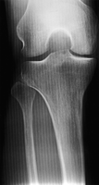
MOIRE PATTERN

Slide 22
The moire' pattern seen in this knee image was caused by using a grid with a frequency of 33 lines cm⁻¹, which was oriented with the grid lines parallel to the plate reader's scan lines.
Should use grids with more than 60 lines cm⁻¹. In addition, grid lines should run perpendicular to the plate reader's laser scan lines.

Slide 23
C) PROCESSING AND DARKROOM ARTIFACTS
Processing artifacts may be produced during developing, fixing or washing of films.
Automated film processors

Slide 24
guide shoe mark
pi-lines
roller marks
entrance roller mark
finger marks
static marks
emulsion pick-off
water stain

Slide 25
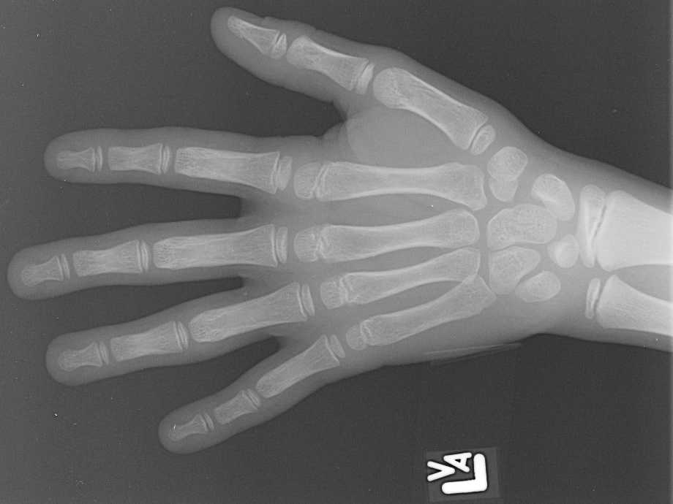
GUIDE SHOE MARK
Improper position of guide shoes in
Turn-around assembly of automated film processor.

Slide 26
PIE LINES
Due to damage to film emulsion during processing.
Badly adjusted processor film transport system may cause abrasions to emulsion surface which remain as visible marks on finished radiograph.
E.g. Pie lines

Slide 27
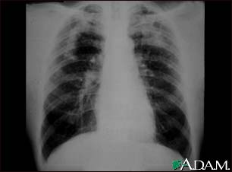
Pie lines

Slide 28
Detected by viewing a radiograph under reflected light as well as transmitted light & its surface examined gently with fingertips to locate any roughness.
Reticulation or frilling : due to partial detachment of emulsion.
Complete detachment of emulsion: expose glossy surface of the base material.

Slide 29
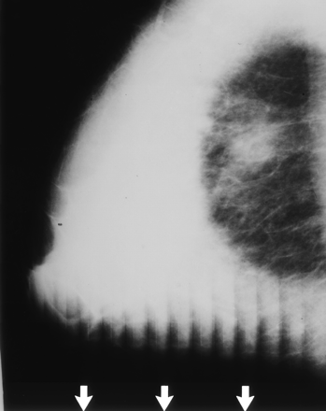
ROLLER MARKS
Parallel lines or scratches
Artefact remedy :
Check rollers are clean, not worn, and are seated correctly

Slide 30
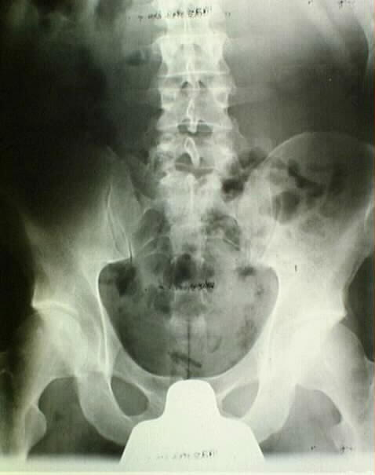
Dirty Developer Rollers
This causes the black artifacts on the middle of the film.

Slide 31
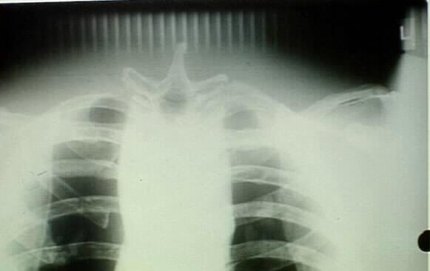
Film Handling Artifacts
The door to the darkroom was opened before the film was completely in the processor.

Slide 32
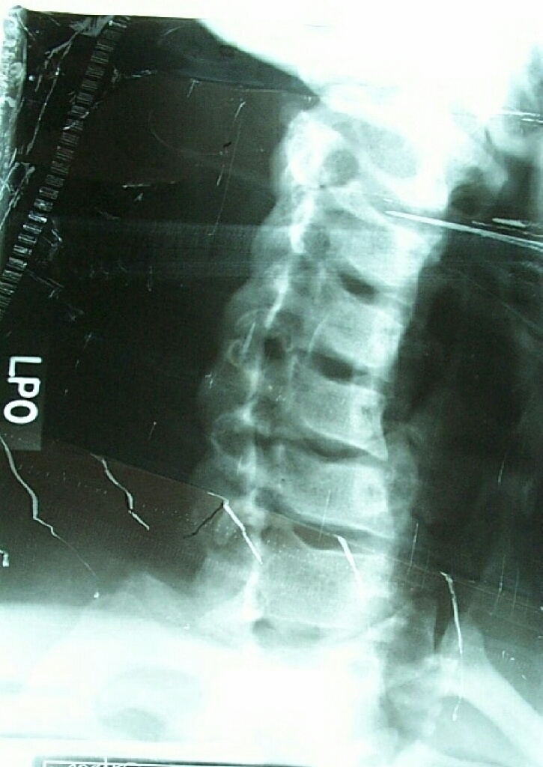
Tractor Marks from Film Jam
Result of film jamming the processor.

Slide 33
FINGER MARKS
Due to handling the surface of a film with fingers before it is
processed.
Moisture transferred to film surface from skin
Modifies action of developer during processing.
Finger print marks on radiograph.
Hands contaminated by contact with chemicals or metals are
more likely to cause such markings.

Slide 34
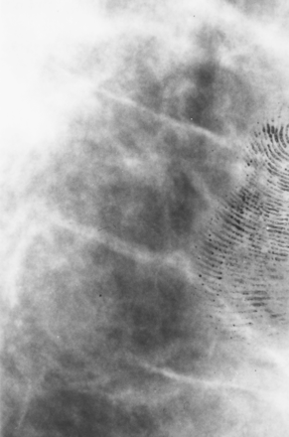
FINGER MARKS

Slide 35
STATIC MARKS
In dry atmosphere, static electrical charges
accumulate due to friction.
Handling of film (by machine or human
operator), may generate static charges which
could discharge onto or from film
Discharge triggers chemical changes in emulsion
which mimics exposure
Cause black static marks on radiographic image.

Slide 36
Static marks produced from
Film transport system of processors
Cassette loading & unloading activities.
Plastic surfaces and certain synthetic clothing material like nylon generates static charges.
Depending on appearance , static marks are described as
- Tree static
- Crown static
- Pin static
- Crow’s feet

Slide 37
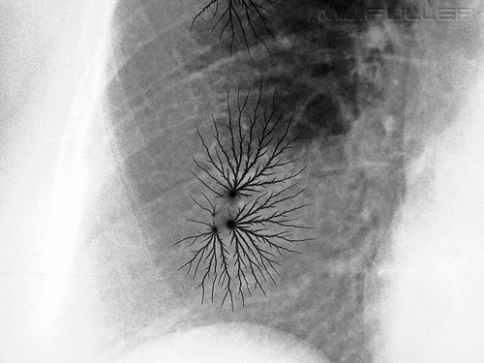
Tree static marks

Slide 38
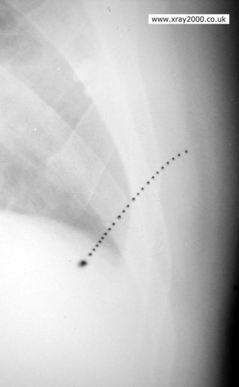
Pin static marks

Slide 39
Artefact remedy
- Keep humidity in area at proper level (> 40% )
- Avoiding nylon, plastic materials in
darkroom

Slide 40
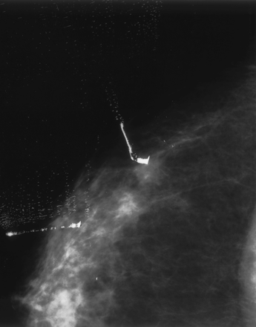
EMULSION PICK-OFF
Damage to emulsion

Slide 41
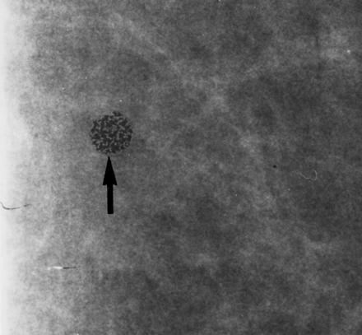
WATER STAIN
Caused by water droplets on film surface, which leave round dark spots of various sizes because of migration of silver particles

Slide 42
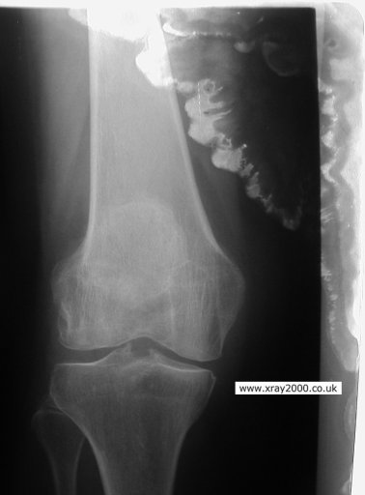
WATER STAIN

Slide 43
CHEMICAL STAINING / DICHROIC FOG
Inadequate fixing or washing during film processing leads to continuation of development in fixer.
Occurs due to presence of unstable sulphur compounds in emulsion.
Appears yellow or brown staining of film d/t deposits of very fine silver particles which diffract light
Form gradually over wks, months or even yrs of storage of radiograph.

Slide 44
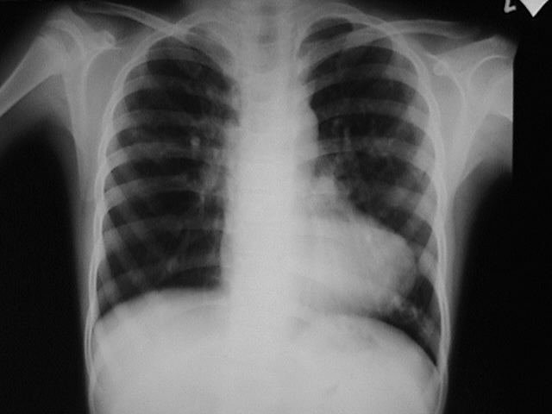
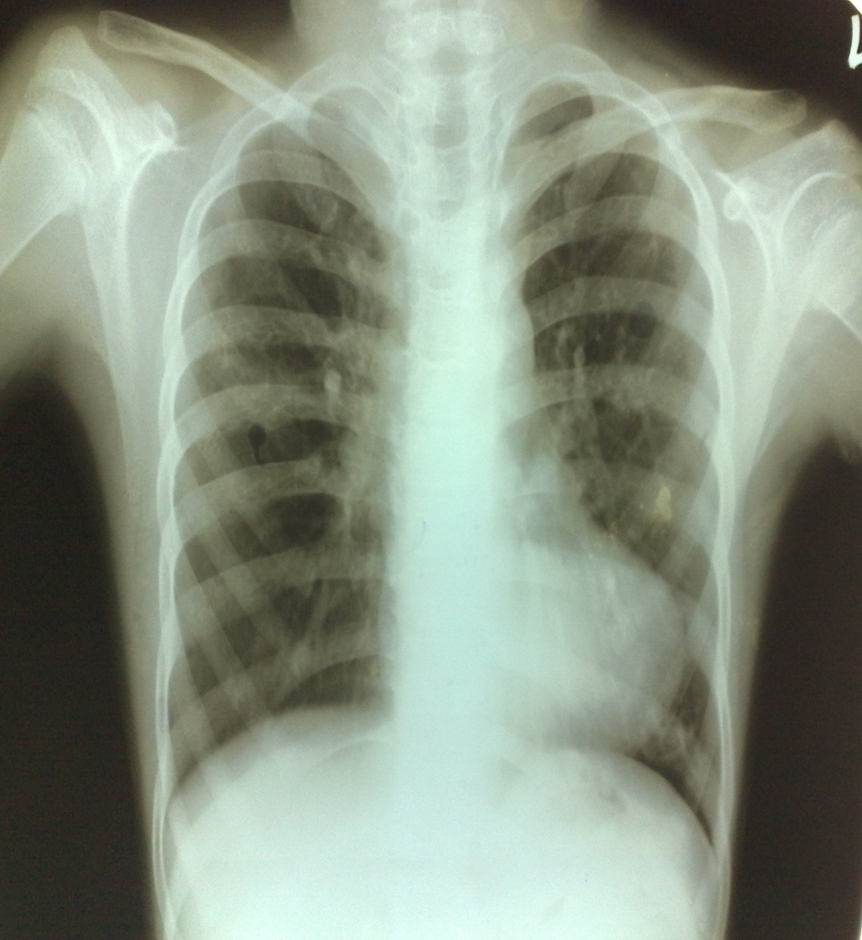
Yellowish image b/o inadequate fixing/ washing

Slide 45
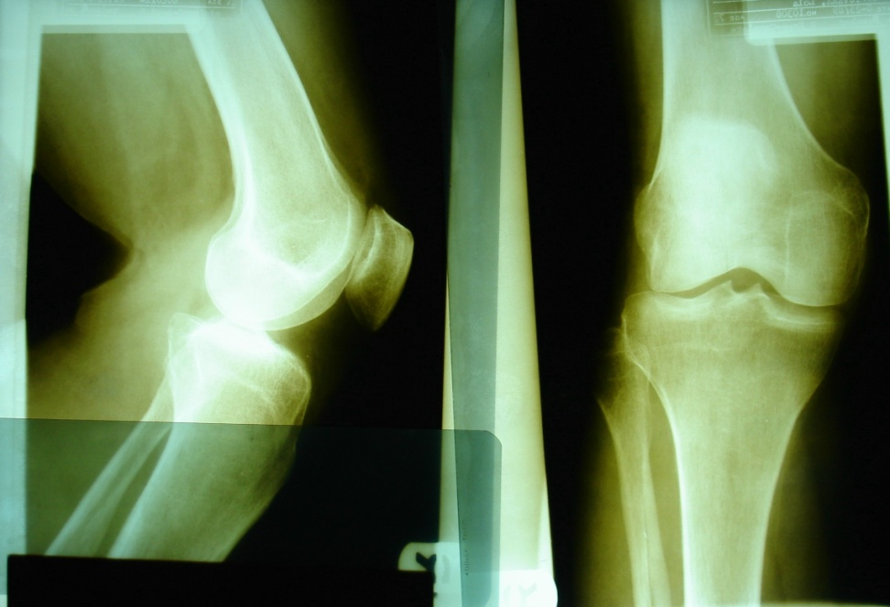
Improperly Washed Film
The retained fixer form silver sulfide and turns the image brown.
Brownish images

Slide 46
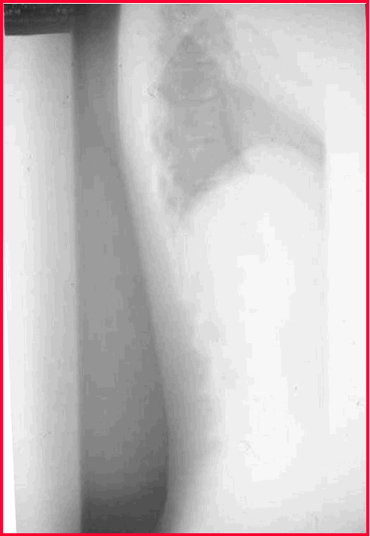
Exhausted developer
The image and the background are pale, and perhaps blotchy
Enough replenisher must be added regularly to keep developer solution from becoming rapidly exhausted.

Slide 47
Film Handling and Storage Artifacts
A number of artifacts can occur while handling the film in darkroom or in x-ray room or while the film is in storage.
Film is sensitive to heat, humidity and fog from lighting problems in the darkroom.
Improper handling can cause artifacts.

Slide 48
HANDLING & STORAGE ARTIFACTS
FILM FOG
STAINS
MARKS AND DEFECTS

Slide 49
FILM FOG
Generalised darkening of the film
Causes :
- Exposure to light
- Exposure to radiation
- Chemical fog
- Age fog

Slide 50
LIGHT FOG
When darkroom is not light proof
Safelight housing or filter is cracked
Prolonged exposure of film to safe light, especially at short distances

Slide 51
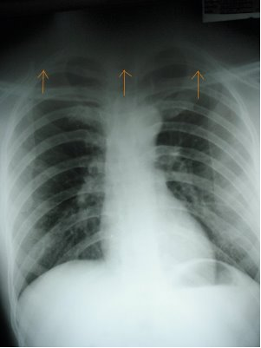
LIGHT FOG
After the exposure was done, the upper part of the film was exposed to light.

Slide 52
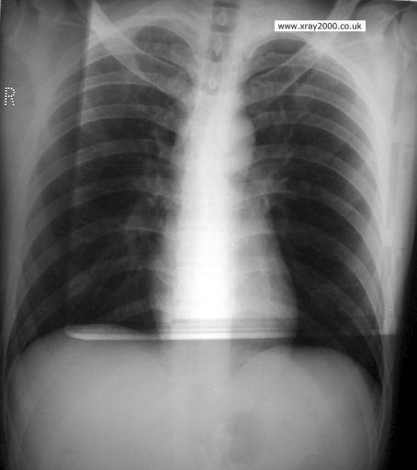
SCATTER FOG
Films should be shielded from sources of radiation by distance and sufficient thickness of lead.

Slide 53
CHEMICAL FOG
Causes :
- Overdevelopment or development at excessively high temperature
- Oxidized, deteriorated developer
- Contamination from corroded tanks

Slide 54
AGE FOG
Mottled or uniform fogging due to
- outdated films
- films stored under conditions of high
temperature and excessive humidity.

Slide 55
STAINS
Various types of discolorations appearing on films at different intervals after processing
BROWN – oxidized developer
VARIEGATED COLOR PATTERN – inadequate rinsing
GRAYISH YELLOW OR BROWN – excessive fixation or use of exhausted fixer
GRAYISH WHITE SCUM – incomplete washing

Slide 56
MARKS AND DEFECTS
1.CRINKLE MARKS-
- curved black or white lines about 1 cm in length
- result from bending of film acutely over the end of
finger
2. STATIC MARKS
3. WATER MARKS
4. AIR BELL MARKS –
- due to formation of air bubbles in the developer
- air bubble prevents developer from reaching the
underlying film, thus leaving a small clear circular spot
on radiograph.

Slide 57
5. STREAKING
Causes :
- Failure to agitate the films in the developer
- Failure to rinse the film adequately
- Failure to stir the processing solutions thoroughly after
replenishment

Slide 58
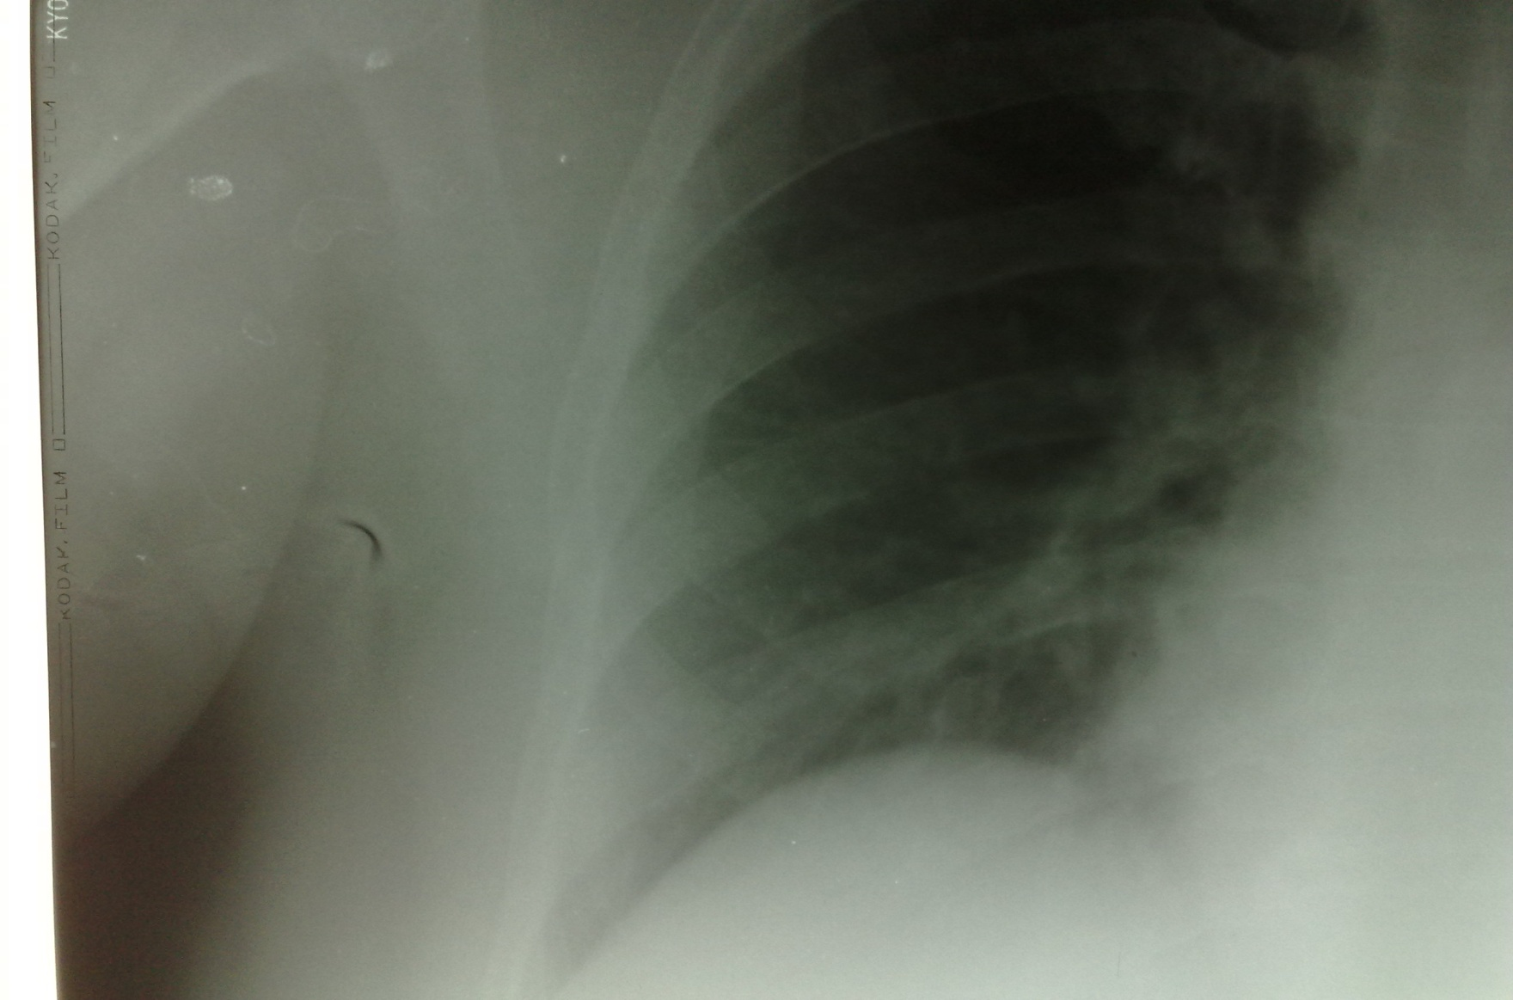
Crinkle mark

Slide 59
Thank You…….

