Slide 1
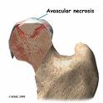
AVASCULAR NECROSIS
Dr. Rajesh Pattanaik,
PG dept of Radiodiagnosis

Slide 2
Definition
“Cellular death of bone components secondary to interruption of blood supply.”
Consequent collapse of bone components
Pain, loss of function of joints
Proximal epiphysis of femur most commonly affected

Slide 3
Presentation - History
Trauma
Corticosteroid use
Alcohol intake
Medical conditions – malignancy, thrombophilia, SLE, SCD
Pain – progressive, severity correlates with size of infarct
Deformity and stiffness – later stages

Slide 4
AGE: 3RD – 5TH DECADE
VERY RARE IN EXTREMES OF AGE
MALE : FEMALE = 4:1
BILATERAL IN 50 % OF CASES
ONSET – INSIDIOUS AND CHRONIC

Slide 5
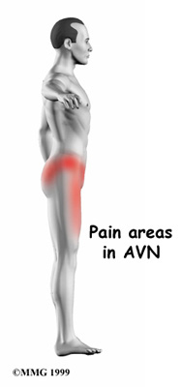
Pain.
- Dull boring .
- Progressive.
- Worse at night
-Limp while walking.
- Restricted hip
motion.
- Unable to sit cross
legged.
- Radiating to knee & Buttock

Slide 6
Pathophysiology
Affect bones with single terminal blood supply:
Talus
Carpals, tarsals
Proximal humerus
Femoral condyles
Proximal femur
Interruption of blood flow to bone cells

Slide 7
Ischaemia
Death of
haemopoietic tissue -(6-12 hrs )
Marrow Fat
(2-5 days)
Death of Bone Cells ( Osteoclast, Osteoblast & Osteocytes)
(12- 48hrs)

Slide 8
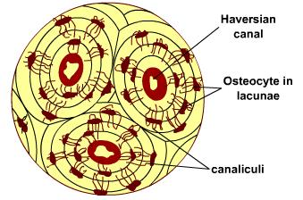
Empty Osteocyte Lacunae
But
Trabecular framework intact
Radiologically Normal Bone.

Slide 9
Revasularisation- at Live-Dead marrow interface.
Necrotic zone invaded by capillaries, fibroblasts & macophages.
Fibrous tissue replace dead marrow & may calcifay
New osteoblasts laydown fresh bone on devitalised trabeculae.
[advancing front of neo-vascularization & ossification ]
CREEPING SUBSTITUTION

Slide 10
4 ZONES IN AVN
A-ARTICULAR CARTILAGE
B-ZONE OF ISCHAMIA
C–REPARATIVE ZONE
D-NORMAL BONE

Slide 11
Vascular insufficiency to bone is of 3 types
1.Interruption to the flow of blood-
tearing of blood vessels –Trauma *
2.Emboli or sludging – by
rbc aggregates in -SCD
fat emboli in -Pancreatitis
gas bubbles in -Caisson’s disease
vasculitis in - collagen disorder
3.Intraosseous compression of vessels
Gaucher’s Diasease.

Slide 12
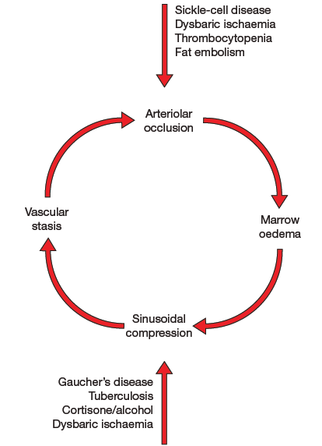

Slide 13
PATHOGENETIC CLASSIFICATION
TYPE 1: ARTERIAL INSUFFICIENCY
FRACTURES
DISLOCATIONS
SCFE
ART. EMBOLISM
VASCULITIS
TYPE 2: VENOUS OCCLUSION
VENOUS THROMBOSIS
TYPE 3: INTRAVASCULAR CAPILLARY OCCLUSION
SICKLE CELL DISEASE
DYSBARIC ISCHAEMIA
FAT EMBOLIS IN HYPERCORTISONISM AND ALCOHOLIM
SLE
TYPE 4: INTRA MEDULLARY FACTORS
BONE INFECTION
GAUCHER’S DISEASE
FATTY CHANGES
HYPERLIPIDAEMIA

Slide 14
CAUSES
Trauma
Alcohol consumption
Corticosteroid intake
Hypercortisolism
Cushing disease
Hemoglobinopathies
(SCD;Hb S/C;Polycythemia)
Caisson disease (Dysbaric osteonecrosis)
Pancreatitis
Neoplasms
CRF
Hemodialysis
Cigarette smoking
Collagen Vascular dis.
SLE
Gout and hyperuricemia
Hypercholesterolemia
Hypercoagulable states
Hyperlipidemia
Hyperparathyroidism
Intravascular coagulation
Organ transplantation
Pregnancy
Congenital dislocation Hip
Ehlers-Danlos synd
Heredity dysostosis
Legg-Calvé-Perthes dis
Fabry disease
Gaucher disease
Giant cell arteritis
Thrombophlebitis
Idiopathic

Slide 15
AVASCULAR NECROSIS
M/c affects => Femoral Head *
M/c site => Anterolateral superior aspect (Being principal Wt. bearing portion)
Incidence d/t Steroid usage & Trauma
AVN only occurs in FATTY MARROW, which contains a Sparse vascular supply. In contrast to Hematopoietic marrow which has a rich blood supply

Slide 16
lateral circumflex A.
Medial circumflex A.
BLOOD SUPPLY OF FEMORAL HEAD

Slide 17
BLOOD SUPPLY OF FEMORAL HEAD
The principal sources are the Lateral Epiphyseal Vessels (LEVs).
LEVs Posterior Superior Retinacular Vessels (PSVs)
Medial Femoral Circumflex Artery Profunda-
Femoris Artery.
LEV supplies lateral and central thirds of the femoral head
When patent, the Artery of Ligamentum Teres(ALT) supplies medial third of the femoral head.
Branches of LEVs & ALT anastomose at the junction of central & medial 1/3 of the femoral head

Slide 18
Blood Supply in Paediatric Age Gp.
Till 4-7 years of age, the vascular anatomy in a transitional stage of development.
The ALT does not penetrate the epiphysis of the femoral head until 9 or 10 years of age.
The Medial Circumflex Artery (br.of Profunda Femoris Artery), penetrates into the femoral proximal metaphysis but is prevented from passing into the femoral epiphysis by the growth plate.
The blood supply to the femoral head is especially vulnerable during this time.

Slide 19
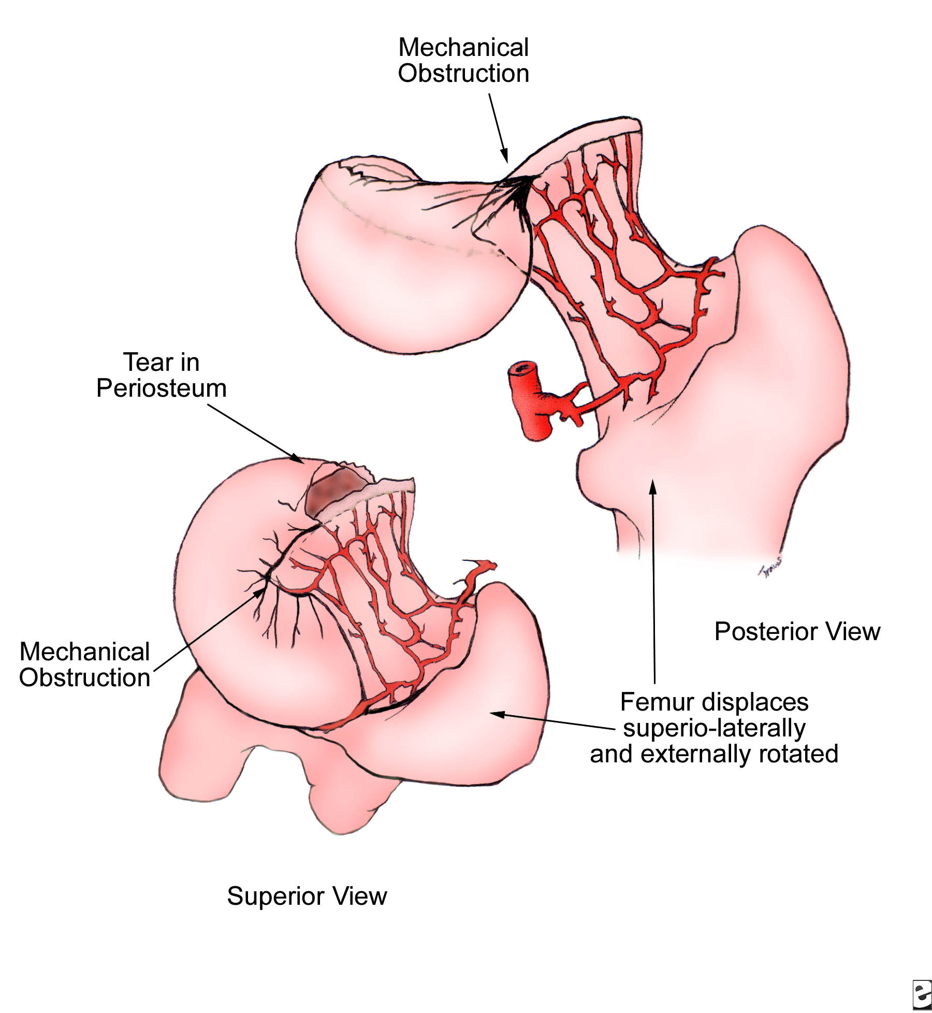
Mechanism of Development of AVN d/t Trauma

Slide 20
IMAGING

Slide 21
Radiological changes
Stage-1: No changes are visible
Stage-2: Disuse osteoporosis except avascular part.
Stage-3: Subcortical zone of demineralization (in large joints, at areas of maximal stress with cortical micro fracture followed by collapse & trabecullar compression)
Stage4: Flattened articular surface (with increased subarticular density due to compressed trabeculae )
Stage-5: Osteoarthritis with joint space narrowing.

Slide 22
Sequence of events
Fragmentation : radiolucent clefts may be seen due to necrosis of involved bone
Mottled trabecular pattern: scrutiny of trabeculae traversing the ischaemic bone demonstrates thickened irregular pattern

Slide 23
Sclerosis : with revascularisation new bone is deposited around dead bone resulting in increased bone density
Subchondral cysts : patchy well circumscribed rarefactions immediately beneath the articular cortex are frequent

Slide 24
These cysts are usually seen in region of greatest articular stress and are identical to those found in degenerative joint disease
Collapse of articular cortex this generally occurs at the region of maximal stress of involved cortex and represents a localised impaction fracture of weakened bone

Slide 25
Radiology- sequential Changes
Crescent Sign
Osteoporosis
Sclerosis
Cystic changes
Loss of spherical weight bearing dome
Partial collapse of head
Secondary Osteoarthritis

Slide 26
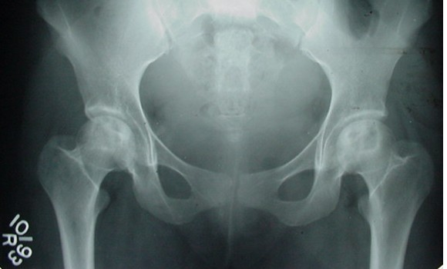
Xrays.
B/l involvement of femoral head with cystic changes/sclerosis seen
Xray changes are “stage dependent”
Early stages : normal film.
Subsequently there occurs increased “ DENSITY “ of the femoral head.
Crescent sign.
Femoral head collapse.
Osteoarthritis of the hip.

Slide 27
X RAY changes

Slide 28
MRI
MRI is most sensitive technique for early diagnosis in Osteonecrosis
Can diagnose AVN as early as 48 hours
The classical finding of AVN is decrease in the normally high intensity signal of marrow.

Slide 29
MRI Findings
Classic Findings:- look for focal lesion in the anterosuperior portion of femoral head that is well demarcated but is inhomogeneous
T1 images => serpigineous zone of low signal intensity arround avascular area.
T2 images => double line sign => classic sign of AVN, made up of 2 concentric high and low signal bands
Inner high-signal-intensity line may represent hypervascular granulation tissue nd outer low signal intensity.

Slide 30
MRI T1 image
↓ signal from ischemic marrow
Single band like area of low signal intensity.
100% sensitivity
98% specificity

Slide 31
Double Line sign – T2 image
A second high signal intensity seen within the line seen on T1 images.
Represent hyper vascular granulation tissue

Slide 33
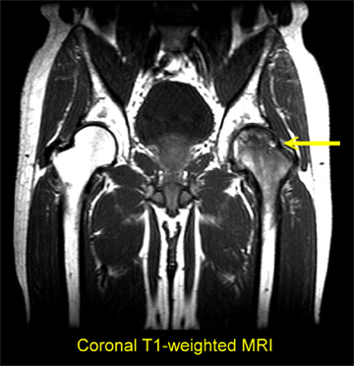
FEMORAL HEAD CHANGES

Slide 34
MRI - Findings
Bone Marrow edema
Double Line – Head in Head sign
Crescent sign
Collapse
Joint effusion
Involvement of actabulum
Status of other hip
Marrow infiltrating disease

Slide 35
T1

Slide 36
T2

Slide 37
T2 fat sat

Slide 38
CT SCAN
CT scans show sclerosis in the central part of femoral head as an alteration of asterisk sign.
ACCURATELY ASSESS THE FEMORAL HEAD COLLAPSE.
JOINT SPACE NARROWING,
SCLEROSIS
OSTEOPHYTE.
CT scanning is a good modality to assess the extent of the disease and calcification, but it is not as sensitive as MRI

Slide 39
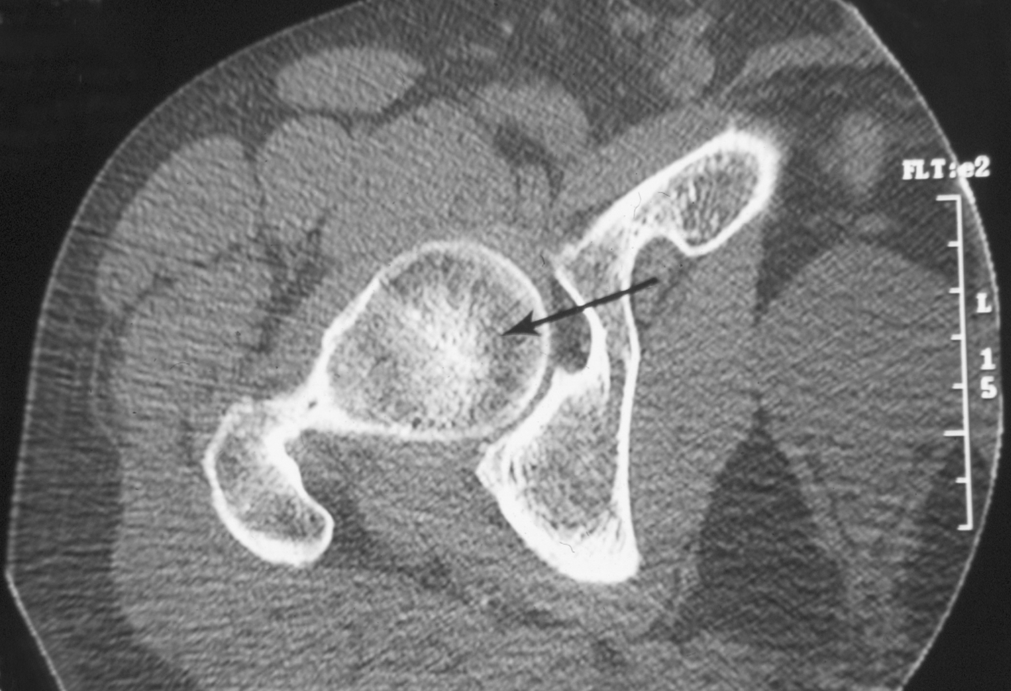
Prominent & Thickened
but Normal Trabeculae
ASTERISK SIGN
Axial CT: Patient without AVN of the Femoral Head
Notes:
delicate, sclerotic, raylike branchings
emanating in a radial fashion from the
central dense band

Slide 40
Notes:
Axial computed tomography scan in a patient with avascular necrosis. This image shows joint space narrowing, juxta-articular sclerosis, and osteophyte formation (degenerative joint disease) around the anteromedial and posterolateral aspects of the right hip.

Slide 41
Notes:
Axial CT scan of a patient with avascular necrosis of the femoral head (same patient as Images 8-12) shows clumping and distortion of the central trabeculae representing the asterisk sign (arrowhead) and an adjacent low-density region (arrow) representing the reparative zone.

Slide 42
Investigations
MRI
Bone scan
Plain X-Ray
Most Sensitive
1.5-T magnet
88% sensitivity
100% specificity
94% accuracy
Indispensable for Accurate Staging
of AVN because
images clearly depict
Size of the lesion
Gross estimates of stage
Reflects Vascular Integrity
Avascular Focus may be
demonstrated Early in
Disease (MRI Contrast)
85% sensitivity
Unable to detect disease of
stage 0 or 1
Helpful in assessing flattening
of the Femoral Head & asso.
Degen. changes
CT Scan
For Extent of Involvement
e.g. Subchondral Lucencies
& Sclerosis during Reparative stage
Enables detection of subchondral or
cancellous # & collapse

Slide 43
CLASSIFICATION & STAGING
Avascular necrosis of the hip
In the 1960s, Arlet & Ficat in France
described a 3-part staging system & in the
1970s a 4th stage was added
Paul FICAT
This form is perhaps the one most widely used now, despite the
fact that a stage 0 & a transitional stage were added later

Slide 44
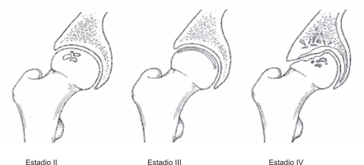

Slide 45
Stage 2

Slide 46
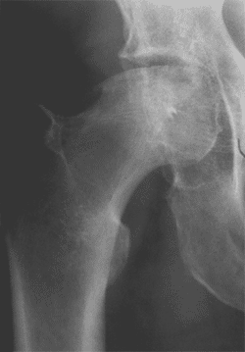
Stage 3
Moderate symptoms.
Loss of shape
Crescent sign
Subchondral collapse

Slide 47
Stage 4
Severe symptoms.
Joint space narrowing.
OA changes in acetabulum.
Notes:
Bilaterally reduced joint space with remodelled femoral heads showing areas of sclerosis. Partial collapse of the femoral heads.

Slide 48
A major disadvantage was that it didn’t include any measurement of lesion size or articular surface involvement..

Slide 49
University of Pennsylvania Classification of Osteonecrosis
0 Normal or nondiagnostic x-ray, bone scan, and MRI
I Normal x-ray;abnormal bone scan and/or MRI, subdevided based on location (medial ,central or lateral) & %
A. Mild (<15% of femoral head affected)
B. Moderate (15%–30%)
C. Severe (>30%)
II “Cystic” and sclerotic or mottled changes in femoral head without collapse or acetabular involvement.
A. Mild (15% of femoral head affected)
B. Moderate (15%–30%)
C. Severe (30%)
III Subchondral collapse (‘Crescent Sign’) without flattening
A. Mild (15% of articular surface)
B. Moderate (15%–30%)
C. Severe (30%)

Slide 50
IV Flattening of femoral head
A. Mild (15% of surface and 2 mm depression)
B. Moderate (15%–30% of surface or 2–4 mm depression)
C. Severe (30% of surface or 4 mm depression)
V Joint narrowing and/or acetabular changes
A. Mild (Average of femoral head involvement as determined in stage IV &
estimated acetabular involvement)
B. Moderate (Average of femoral head involvement as determined in stage
IV & estimated acetabular involvement)
C. Severe (Average of femoral head involvement as determined in stage IV
& estimated acetabular involvement)
VI Advanced degenerative changes

Slide 52
Mitchell’s MRI Staging
Class | T1 | T2 | Definition
A | Bright | Intermediate | Fat signal
B | Bright | Bright | Blood signal
C | Intermediate | Bright | Fluid or edema signal
D | Dark | Dark | Fibrosis signal

Slide 53
Management principles
Early stages (I & II):
Bed rest & limited weight bearing .
Bisphosphonates prevent collapse
Unloading osteotomies
Medullary decompression + bone grafting
Intermediate stage (III & IV):
Realignment osteototmies, decompression
Arthrodesis
Late stage (V & VI):
Analgesia, activity modification
Arthrodesis
Arthroplasties

Slide 54
Surgical procedures
Joint Preserving
Joint Replacing
Core
Decompression
Various
Nonvascularized &
Vascularized Bone
Grafting Procedures
Osteotomy
Procedures
Total Hip
Arthroplasty
Hip Resurfacing
Procedures

Slide 55
Thank you

