Slide 1
ANATOMY OF SMALLBOWEL & TECHNIQUE OF BARIUM MEAL FOLLOW THROUGH

Slide 2
SMALL BOWEL=>
Convoluted tube ext. from pylorus to I.C. valve.
Avg length : 6 to 7 m.
Div into Duodenum, Jejunum, Ileum.

Slide 3
DUODENUM=>
-‘C’ shaped tube measuring 25 cm long.
-Runs from pylorus to proxi. Jejunum.
-Curves around head of pancreas &
arches over aorta & I.V.C.
-First inch (2.5 cm) of duo. is
intraperitoneal, remainder is
retroperitoneal, being covered only ante.
by peritoneum.
-Duo. lacks mesentery.

Slide 4
Div. into 4 parts:-
1st part :- continuous with pylorus.
- 5 cm long, first 2 cm is duo. cap (duo. bulb)
& is conical in shape.
- lies in transpyloric plane at L₁ level.
2nd part :- 8 cm long.
- runs inferiorly over hilus of rt. kidney & to
rt. of L₂ & L₃ vert.
- Posteromedially at jn. of upper ⅔^{rd} & lower
⅓^{rd} of second part is duo. papilla or
ampulla of vater-opening of common bile
duct & pancreatic ducts into gut.

Slide 5
3rd part :- 8 cm long.
- crosses from rt. to lt. curving forward over
rt. psoas muscle, IVC & aorta following
lower margin of head of pancreas.
4th part :- 4 cm long.
- runs upward & to lt. and lies on lt. psoas
muscle.
- Ends by turning forward at duodeno-
jejunal jn. at level of L₂ vert., where it is
held in position by Ligament of Treitz.
- Lig. of Treitz is a peritoneal fold which
ascends to rt. crus of diaphragm.

Slide 6
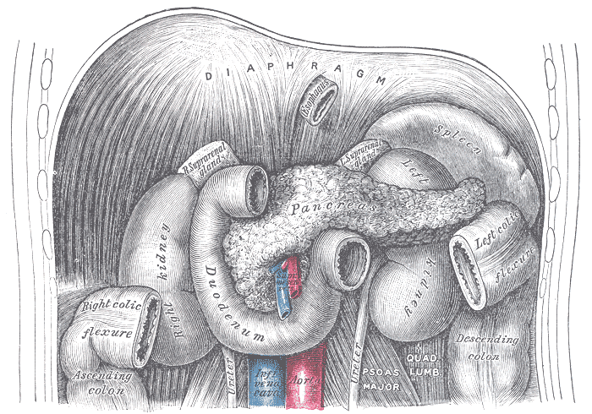

Slide 7
VASCULAR SUPPY OF DUO. =>
Duo. Cap.- small branches from hepatic & gastroduodenal arteries.
Rest of duo.- sup. & inf. panereatico-duo. arteries.
Venous bl. drains into prepyloric vn. & then into portal vn.

Slide 8
JEJUNUM & ILEUM =>
Together are appro. 6.5 m in length.
Jej. begins at Lig. of Treitz (Duo.-jej. Flexure) in lt. upper abdomen.
attached to post. abd. wall by its own fan shaped mesentery which confers considerable mobility & measures approx. 15 cm.

Slide 9
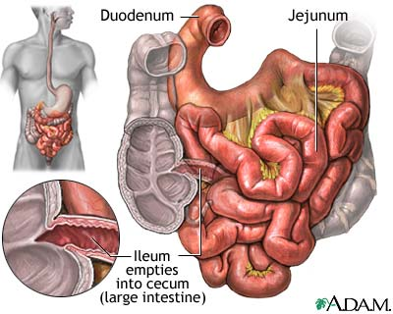

Slide 10
STRUCTURE OF SMALL INTESTINE=>
In duo. mucous membrane of 1st part is smooth, but that of rest of small bowel is broken up into plicae circularis or valvulae conniventes which are circular folds which encircle 2/3rd of inner mucosal wall.
They become less numerous & less abundant in ileum, until at termi. ileum, folds are almost entirely absent.

Slide 11
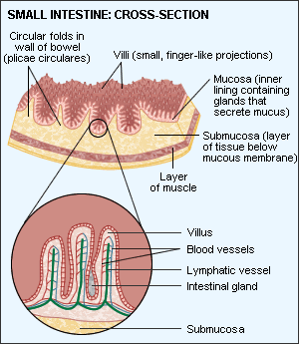

Slide 12
RAD. DIFF. BET^{N} JEJ. & ILEUM =>
JEJUNUM ILEUM
Proxi. 2/5th of sm. int. Distal 3/5th .
Position:-Upper lt. & peri-umbilical Lower rt. hypogastric
region. & pelvic region.
Max.Diameter:- 4cm. 3 cm.
Plicae circularis :- numerous & deeper set in jej. than in
ileum.
Feathery pattern
On BMFT :-Present Less feathery or
absent.

Slide 13
Vascu. Supply :-
- by branches of SMA – Jejunal, Ileal &
Ileocolic arteries.
- vns. drainage follows art. supply to drain
into sup. mes. vn.

Slide 14
Radiological investigations of Small bowel :
Plain abdominal radiography – Intestinal obstruction & intestinal perforation.
Contrast (Barium) studies.
Angiography: Inv^{n} of bleeding, detecting vascu. Malformation & inv^{n} of mesentric ischaemia.
Radionuclide studies: To detect occult bleeding , Meckel’s diverticulum with gastric mucosa & assessment of I.B.D.
C.T. & M.R.I.: Limited role.
U.S.G.: Limited application d/t bowel gas.
: To detect intra-abd. Collections &
in children, diagnosis of
Pyloric stenosis , Appendicitis ,
Intussusception.

Slide 15
The major methods used for the barium examination of the small bowel are :-
1) Small bowel follow through examination.
2) Dedicated small bowel follow through examination.
3) Enteroclysis (or) small bowel enema.
4) Peroral pneumocolon.
5) Retrograde small bowel examination.

Slide 16
BARIUM MEAL FOLLOW THROUGH -Radiographic examination of GIT – Oesophagus, Stomach, Duodenum, Small bowel & Ileo-caecal junction by oral administration of contrast media.
-So called because, is performed following a Ba meal examination of oesophagus, stomach and duodenum.
-Done to provide information about small bowel calibre, its disposition, wall thickness & distribution of volvulae conniventes.

Slide 17
INDICATIONS=>
1) Patients who have low suspicion of small bowel disease – abdominal pain and diarrhoea.
2) Patients with suspected complete (or) near complete small bowel obstruction.
3) Patients who are suspected of suffering from Crohn’s disease.
4) Elderly pts. with jejunal diverticulosis & present with malabsorption.
5) Patients who refuse placement of nasogastric tube / failed intubation.

Slide 18
CONTRA INDICATIONS=>
Colonic Obstruction
Suspected perforation.
Paralytic Ileus.
CONTRAST =>
Medium density Ba suspension (50-60% w/v) containing a suspending agent ( to maintain its stability & prevent flocculation ) is used.
When small bowel obstruction is suspected & colonic obstruction is ruled out, Ba can be used to find cause & site of lesion.

Slide 19
PREPARATION=>
Colon should be cleaned by suitable purgative.
Low fibre diet & high fluid intake – 48 hrs. prior to investigation.
NBM for 12 hrs. prior to investigation.

Slide 20
Small Bowel Follow Through =>
Initially 150ml of high density Ba and effervescent agents are used to evaluate oesophagus, stomach & duodenum by double contrast examination.
Later 200 ml of Ba (20 – 25 %) followed by 250 ml of Ba ( 40 – 45 %) is given.
Series of overhead radiographs obtained at ½ hourly intervals till terminal ileum is reached.

Slide 21
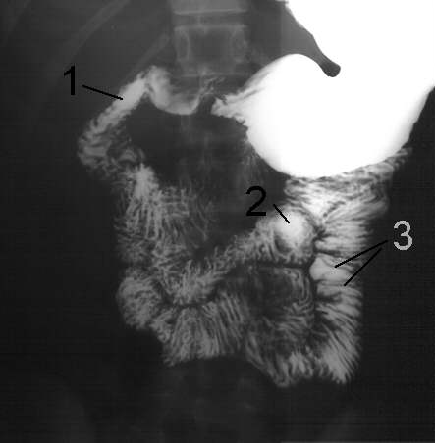

Slide 22
DEDICATED SMALL BOWEL FOLLOW THROUGH =>
Single contrast technique.
Double contrast technique.
SINGLE CONTRAST TECHNIQUE =>
Ba (600-900 ml) 50-60% is given & patient is asked to drink as rapidly as possible.
Patient put in right side dependent position to aid gastric emptying.

Slide 23
Subsequent films taken at 15-30 min. intervals till ileo-caecal junction is opacified.
To demonstrate ileocaecal junction, supine right side up is best position since ileum enters caecum in postero-medial part.

Slide 24
ORDER | POSITIONING | PURPOSE
FIRST | RIGHT SIDE DOWN DEPENDANT | TO AID GASTRIC EMPTYING
SECOND | PRONE | TO SEPARATE BOWEL LOOPS
THIRD | RIGHT SIDE UP (SUPINE) | TO VISUALIZE I.C. Jn.

Slide 25
Always empty bladder prior to these spot films.
4 spots of I.C. jn should be taken with varying degrees of compression.
Compression applied on bowel loops to avoid overlap & to efface the mucosa so that small lesions may not be missed & mobility of the loops can be well assessed.
Abnormalities must be shown in at least 2 spot films taken at different times to demonstrate persistence of lesion.

Slide 26
* Overlap of contrast filled bowel loops in pelvis is often a problem & it can be overcome by :-
- Table head down.
- 30⁰ caudal angled view of pelvis.
- Emptying U. B. prior to filming the ileal loops.
* Gastric & Bowel peristalsis may be increased by:-
DRUGS:- Metoclopramide (M/cly used)
- Neostigmine
- Glucagon
- Cholecystokinin.

Slide 27
APPEARANCE IN SOME
CONDITIONS:-
Polyposis – Films with collapsed bowel loops shows polyps.
Diverticulosis – Delayed films may show persistence of Ba in diverticulae.
Large Ulcers – Large collection of Ba seen in delayed film after bowel loops have emptied Ba.

Slide 28
DOUBLE CONTRAST TECHNIQUE=>
Similar to single contrast technique.
Gas producing agent (effervescent powder) given when head of Ba column reaches caecum.
Patient placed on left side slightly head down to allow gas to leave stomach & enter small bowel.

Slide 29
ADVANTAGES=>
Better distension.
Separation of loops.
Improved mucosal detail.
DISADVANTAGES=>
-Difficultly in interpretation by gas
bubbles.

Slide 30
ADVANTAGES OF BMFT=>
Easily performed.
No discomfort / intubation to patient unlike in enteroclysis.
It is physiological process. Hence transit time can be assessed.
DISADVANTAGES OF BMFT=>
- Overlapping of Ba filled bowel loops in pelvis.
Poor distension of bowel loops.
Operator dependant.
Time consuming.

Slide 31
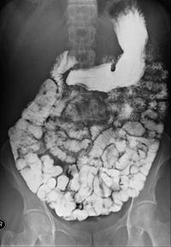

Slide 32
PER ORAL PNEUMOCOLON :-
-Used to evaluate distal ileum.
-When Ba has reached rt. & proximal
transverse colon ,air is insufflated into
rectum and refluxed into distal ileum.
-Colon preparation is imp.
-CROHN’S DISEASE & Ca CAECUM
visualized well.

Slide 33
REFLUX EXAMINATION (RETROGRADE SMALL BOWEL EXAM.:-
-Ba & Air refluxed through IC valve.
-Good view of terminal ileum.
-Now a days replaced by Enteroclysis.

Slide 34
THANK YOU!

