Slide 1
ANATOMY OF STOMACH & NORMAL BARIUM MEAL

Slide 2
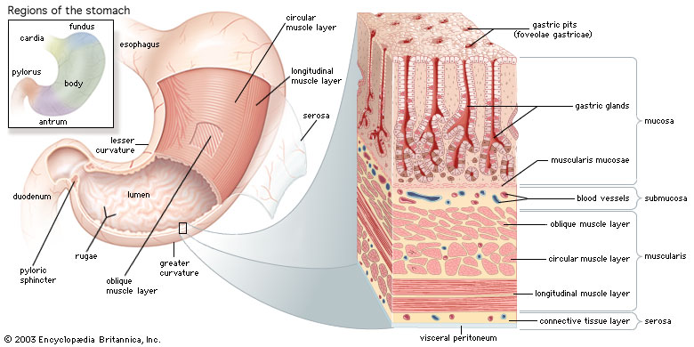
ANATOMY OF STOMACH
SURFACES: Anterosuperior & Posteroinferior.
BORDERS :lesser & greater curvatures.
DIVIDED INTO:- Fundus, Body, Antrum & pylorus.

Slide 3
Short obese people : Transverse & Steer horn shape.
Tall thin people: Longitudinal & ‘J–Shaped’
Max capacity :1500ml.
Completely covered by peritoneum.

Slide 4
HISTOLOGY OF STOMACH

Slide 5
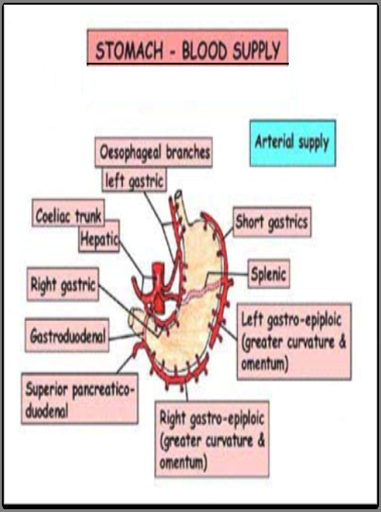

Slide 7
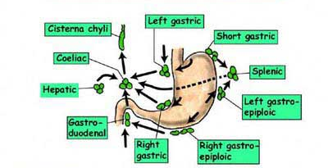
LYMPHATIC DRAINAGE

Slide 8
BARIUM MEAL
Radiological study of stomach , duodenum, and proximal jejunum by oral administration of contrast media(barium sulphate).

Slide 9
Ba fills the lumen, taking the shape of the organ and delineates any abnormal structure.
Radiolucencies are produced by mass lesions displacing Ba.
Radio-opacities by ulcer, fistula, diverticulum which extends beyond normal contours of organ.

Slide 10
INDICATIONS
Symptoms –epigastric pain,anorexia,wt loss,dyspepsia,etc.
Upper abdominal mass.
GI Hemorrhage.
Gastric or duodenal obstruction.
Ca GEO junction,stomach,duodenum.
Motility disorders.
Systemic diseases viz-TB .
CHILDREN-GE reflux, pyloric obstruction, malrotation.

Slide 11
CONTRAINDICATIONS
Gastroduodenal perforation.
H/o aspiration.
Large bowel obstruction.
Fistulous communication.
Recent biopsy.

Slide 12
PREPARATION OF PATIENT
NBM for 6hrs.
Restrain smoking.
In diabetes : early morning appt.
In Gastric outlet obstruction prolonged fasting , metaclopramide given, sometimes nasogastric intubation & aspiration needed.

Slide 13
SINGLE CONTRAST STUDY
Low density barium suspension (80-100% w/v) is used.
Conventional Radiography is done at 80-90kV.
10-15 ml of Ba given with patient supine & rotated in clockwise manner to obtain good mucosal coating.
100-250ml of Ba is given & films are taken in various views.

Slide 14
STANDARD VIEWS FOR SINGLE CONTRAST
FUNDUS
SUPINE
BODY
ERECT OR PRONE
ANTRUM & PYLORUS
PRONE RT SIDE DOWN
D1 & C LOOP
PRONE RT SIDE DOWN
D4
SUPINE

Slide 15
SINGLE CONTRAST HIGH KV TECHNIQUE
Barium Sulphate 30% w/v is used.
Radiography done at 120-130 kV.
Permits visualization through the Barium column.

Slide 16
ADVANTAGES OF SINGLE CONTRAST
Pylorospasm, fistulae & enlarged gastric rugae are better seen.
Filling defects due to large masses in pyloric & duodenal region are more easily identifiable.
Procedure of choice for suspected gastric or duodenal obstruction.

Slide 17
DISADVANTAGES
Lack of sensitivity in detecting
Small erosions/ulcers.
Early gastric Ca.
Subtle mucosal abnormalities.

Slide 18
DOUBLE CONTRAST STUDY
High density (200-250% w/v) low viscosity Ba Sulphate, to coat the wall.
Gas producing agents are used to distend the lumen, acts as negative contrast.
Smooth muscle relaxant - Buscopan

Slide 19
STANDARD VIEWS
FUNDUS
PRONE RT SIDE DOWN
BODY
SUPINE WITH HEAD END ELEVATION
ANTRUM & PYLORUS
SUPINE RT SIDE UP
D1 & C LOOP
SUPINE RT SIDE UP
D4
PRONE RT SIDE DOWN

Slide 20
ADVANTAGES
Highly accurate in detecting abnormalities following:-
Gastric surgery
Bile reflux gastritis
Marginal ulcerations
Recurrent Ca

Slide 21
DISADVANTAGES
Probably misses some polyps, ulcers, erosions, especially in non dependent walls of stomach.

Slide 22
BIPHASIC STUDY
60-100% low viscosity Ba Sulphate.
Mucosal relief film.
200-250 ml of Ba given in supine position with Eno in last few mouthfuls.

Slide 23
Prone Rt side down – Duodenal cap & C loop in SC.
Supine with Rt side up oblique – Duodenum in DC.
Erect film with compression – Duodenal Bulb.
Compression film & Fluoroscopy of stomach – For contour defects, peristalsis & emptying.

Slide 24
Erect DC films of fundus in 2 views.
Supine , 60º head up & DC film – Upper body stomach.
Supine , table horizontal & DC film – lower body & pyloric antrum.
Erect Rt Anterior Oblique – for stomach, Duo & proximal Jejunum on 1 film.

Slide 25
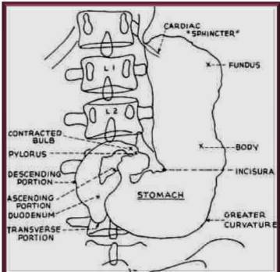
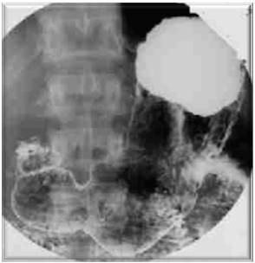

Slide 26
`

Slide 27
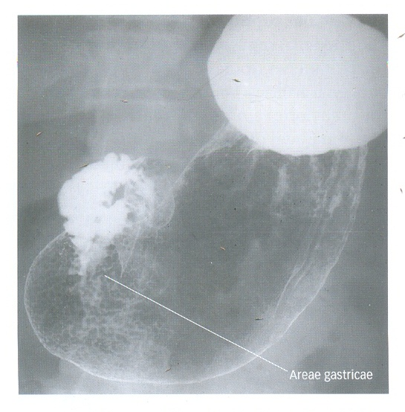
AREAE GASTRICAE
Micromucosal pattern consists of mosaic of tiny raised nodules(2-4mm) with intervening grooves.
Obvious in distal two third.

Slide 28
COMPLICATIONS
Leakage of Ba from an unsuspected perforation.
Aspiration pneumonia.
Barium impaction.
Acute gastric dilatation.
Barium embolisation if a bleeding ulcer is present.

Slide 29
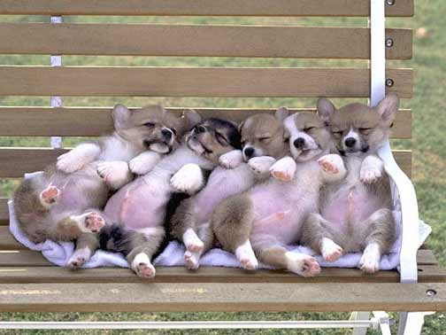
THANK YOU

