Slide 1
Barium Studies for Oesophagus

Slide 2
Anatomy of Oesophagus
25 cm in length
Extends from cervical region ( cricopharyngeus C 5 level ) to T 11.

Slide 3
Muscular layers
It has an inner circular and an outer longitudinal muscle coat.
These muscle layers comprise predominately striated muscle in the upper third of the oesophagus and predominantly smooth muscle in the lower two thirds, with the transition occurring at the level of the aortic knuckle.

Slide 4
Mucosa
The mucosa of the oesophagus is stratified squamous epithelium.
In the region of the gastro-oesophageal junction it changes to columnar epithelium along an irregular horizontal line (Z line).

Slide 5
Most of the impressions on the wall of the oesophagus are on the left side.

Slide 6
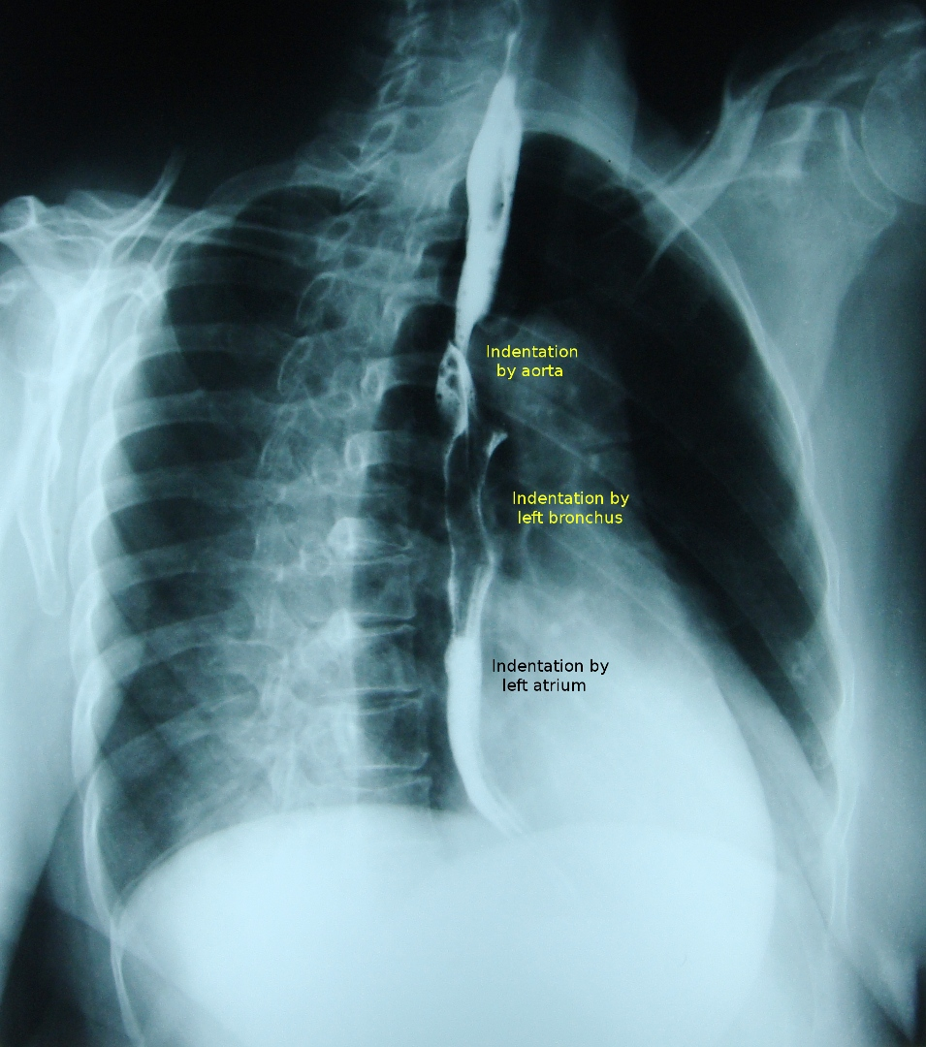

Slide 7
The aortic arch indents the left wall of the oesophagus and immediately below this point the left main bronchus produces an indentation on the left anterolateral wall.
After passing through the diaphragmatic hiatus the oesophagus extends for approximately 2 cm before joining the fundus of the stomach.

Slide 8
Lymphatic drainage
Upper oesophagus is to cervical nodes,
Midoesophagus is to preaortic nodes and
Lower oesophagus drains to coeliac and left gastric nodes.

Slide 9
Parts of the oesophagus
Oesophagus has got 4 parts.
Cervical oesophagus extends from cricoid cartilage to sterno clavicular joint.
Upper thoracic oesophagus extends from thoracic inlet to carina ( 8 cm) .
Lower thoracic oesophagus extends from carina to gastro oesophageal junction ( 8cm).
Gastro oesophageal junction.

Slide 10
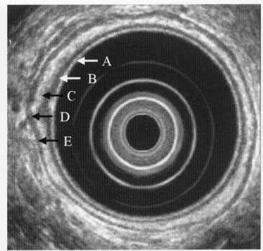
1

Slide 11
Endoscopic ultrasound of the oesophagus showing the layers of the bowel wall.
A = mucosa;
B = muscularis mucosa;
C = submucosa;
D = muscularis propria;
E = adventitia.

Slide 12
What is the difference between serosa and adventitia?

Slide 13
Serosa is the outer most covering which is lined by peritoneum.
When there is no peritoneum lining it is called adventitia.

Slide 14
What does the oesophagus have?

Slide 15
Oesophagus has serosa as well as adventitia.
In the thorax it has adventitia and in the abdomen when it crosses the diaphragm it has serosa.

Slide 16
CT
Normal wall thickness is 3 mm.
Cervical oesophagus is generally devoid of gas.
Mid and lower oesophagus may show some amount of gas.
The presence of an air-fluid level or a fluid-filled
lumen of more than I cm usually indicates the presence of functional or mechanical obstruction.
The gastro-oesophageal junction is a difficult area to evaluate with CT.

Slide 17
Barium studies
These are simple to perform, inexpensive and have high sensitivity.
Double-contrast studies may be difficult to achieve because of the transient nature of oesophageal dilatation during swallowing.
Good fluoroscopy is essential, aided by digital imaging for spot radiographs

Slide 18
Begin the examination in erect position and turned obliquely to the left, so that the body of the oesophagus is thrown clear of the spine.
A barium suspension at 100 per cent w/v is ideal, as this will allow good mucosal coating and yet not be too dense.
Observe the initial bolus fluoroscopically, to ascertain if there is any obvious structural abnormality.
Then take spot radiographs of the upper mid and lower esophagus and OG junction .

Slide 19
Then place the patient horizontally in prone oblique ( RAO) positon for assessing motility in the body of the oesophagus and to fully distend the gastro-oesophageal junction.
Full distension is required for the demonstration of both hiatal hernias and tumours.

Slide 20
The examination is concluded by further spot radiographs of the stomach, remembering that problems as far away as the pylorus can present with dysphagia.

Slide 21
Additional examinations and/or modifications to barium swallow
If a lesion is suspected in the pharynx or pharyngo-oesophageal junction,take video or rapid digital images (4–6 frames/s) of this area with the patient in the erect position.
Both anteroposterior (AP) and true lateral projections are utilized.

Slide 22
If a motility disorder of the body of the oesophagus is strongly suspected, then it is best to avoid administering a spasmolytic agent before the prone swallow.

Slide 23
Suspected oesophageal rupture or tear.
A non-ionic water-soluble contrast agent is the best option; if this fails to show any obvious leak, it may be followed by thin barium is used.
If an ionic contrast agent such as Gastrografin (meglumine diatrizoate) is aspirated, it can cause severe pulmonary problems.

Slide 24
What are the various oesophageal contractions?

Slide 25
Primary wave
Secondary wave
Tertiary wave

Slide 26
What is the primary stripping wave?

Slide 27
Stripping wave is a muscular contraction that propels the bolus downwards and collapses the lumen of the oesophagus.

Slide 28
Any residual barium will then be cleared by a secondary wave.

Slide 29
Tertiary waves are sometimes seen, particularly in elderly patients, and these usually consist of non propulsive disorganized contractions that fail to advance the barium bolus.

Slide 30
When assessing motility, only a single bolus of barium should be swallowed as repeated swallowing interferes with the assessment of normal motility.

Slide 31
(UGIE or EGD) has largely replaced the barium swallow for the assessment of peptic ulcer disease and the assessment of haematemesis.

Slide 32
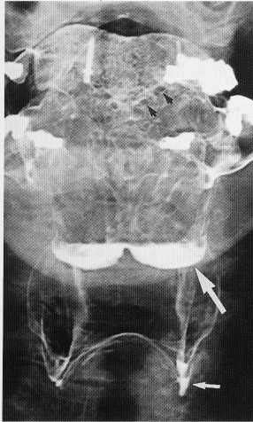
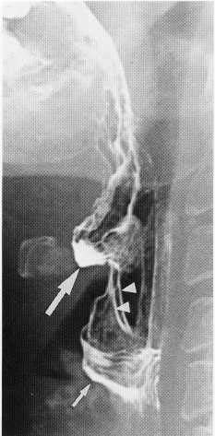

Slide 33
Normal Hypopharynx
Large White arrows show valleculae .
Small white arrow shows pyriform sinuses
Arrow heads show ary epigllotic folds.
Black arrow on AP view shows circumvallate papilla

Slide 35
Normal Swallowing Mechanism
Tongue moves backwards.
Soft palate moves backwards and down wards to close the nasopharynx.
Posterior nasopharyngeal wall moves forwards.
Peristaltic wave moves down the pharynx.
Hyoid bone elevates.
Epiglottis inverts

Slide 36
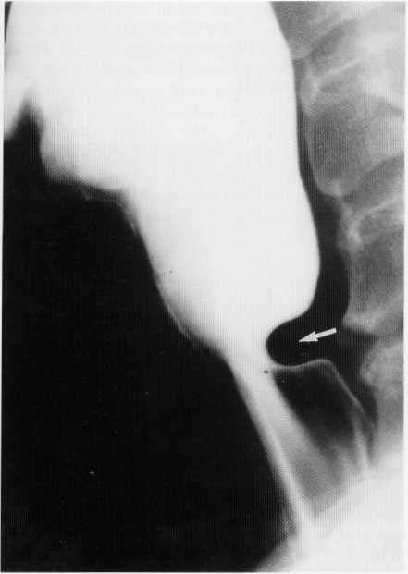

Slide 37
Cricopharyngeal muscle spasm
The posterior impression (arrow) is produced by failure of the cricopharyngeus muscle to relax.

Slide 38
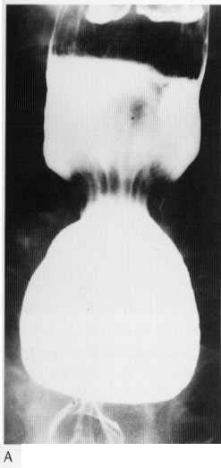
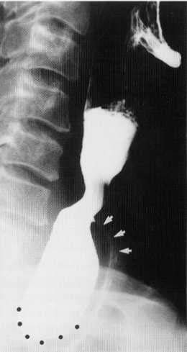

Slide 39
Posterior pharyngeal diverticulum
Barium fills the diverticulum and then spills over into the anteriorly displaced oesophagus (arrows).

Slide 40
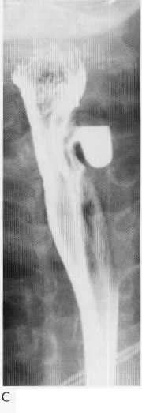

Slide 41
Lateral cervical oesophageal diverticulum (Kill ian-lamieson diverticulum).

Slide 42
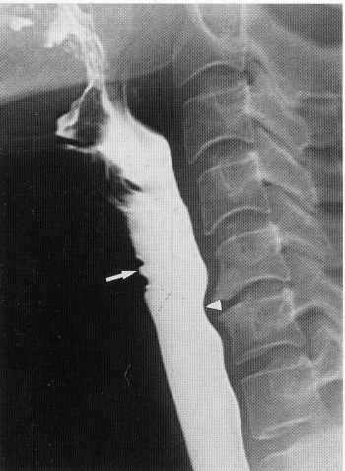

Slide 43
Arrows show the indentation due to anterior venous plexus.
Arrow heads point to the impression due to the osteophytes.

Slide 44
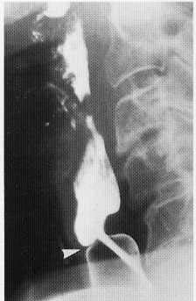

Slide 45
Arrow shows the web anteriorly
Posterior impression is due to the contracted cricopharyngeus.

Slide 46
Why do you get the jet phenomenon?

Slide 47
Jet phenomenon is seen due to reduction in luminal space by the web anteriorly and the cricopharyngeal spasm posteriorly.

Slide 48
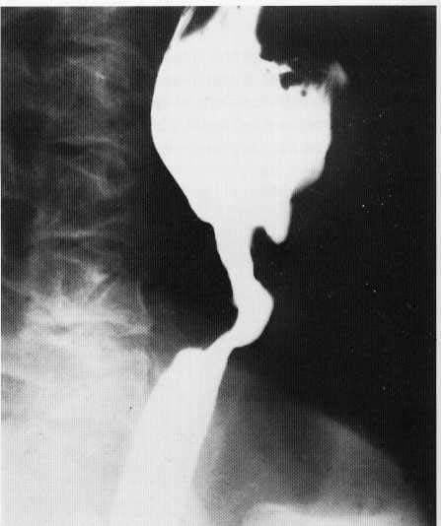
9

Slide 49
Post cricoid malignancy seen as narrowing , irregularity and increased post cricoid space.

Slide 50
Motility Disorders
May be primary or secondary.
Diffuse Esophageal Spasm.
Nut cracker Oesophagus.
Hypertrophic Oesophageal Sphincter
Pres byoesophagus

Slide 51
Secondary to a wide variety of diseases, including oesophagitis, diabetes, alcoholism, and collagen, endocrine and neuromuscular diseases.
Calcium channel blockers can be useful for treating primary motility disorders.

Slide 52
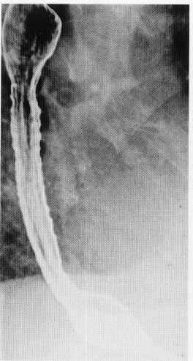

Slide 53
Tertiary contractions seen as rippling of oesophageal wall.

Slide 54
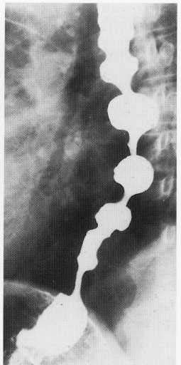

Slide 55
A series of indentations resembling a corkscrew (hence the description 'corkscrew oesophagus').

Slide 56
Which part of the oesophagus is affected in Myaesthenia Gravis ? And which in Slceroderma ? Why?

Slide 57
Disorders involving striated muscle, such as motor neuron disease and myasthenia gravis, will only affect the pharynx and upper third of the oesophagus, whereas disorders of smooth muscle, such as scleroderma, affect the lower two-thirds .

Slide 58
Striated muscle coats the pharynx and upper 4 cm of the oesophagus, while the lower half of the oesophagus has a smooth muscle coat; between the two, striated and smooth muscle intermingle.
The transition from smooth to striated muscle is at the level of the aortic knuckle.

Slide 59
Name the components of Plummer Winson Syndrome .

Slide 60
Plummer-Vinson syndrome
Iron-deficiency anaemia,
dysphagia,
stomatitis,
glossitis and
Koilonychia .
There may be an increased risk of developing pharyngeal and cervical oesophageal carcinomas.

Slide 61
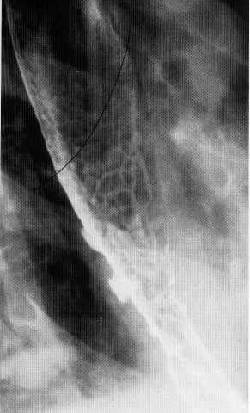

Slide 62
Scleroderma
Incompetence of the gastro-oesophageal sphincter resulting in severe reflux oesophagitis with ulceration.

Slide 63
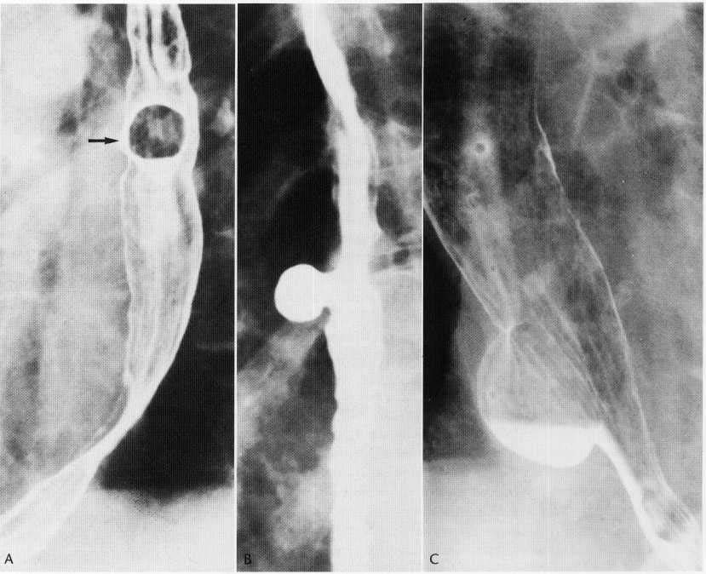

Slide 64
Pulsion diverticulam
Seen enface and in profile
Traction diverticulam are also seen in the thoracic region .
The neck of the diverticulam is a key feature in identifying both.
Wide neck is a feature of pulsion diverticulam.

Slide 66
Epiphreinc Diverticulam

Slide 68
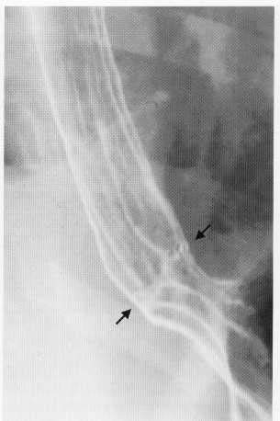

Slide 69
Z-line (between the arrows) marks the junction of squamous (oesophageal) and columnar (gastric) epithelium.
Gastric rugae are seen extending up to the line.

Slide 70
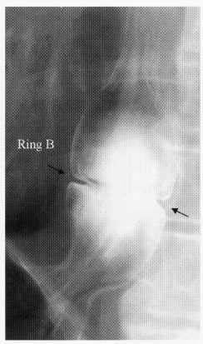

Slide 71
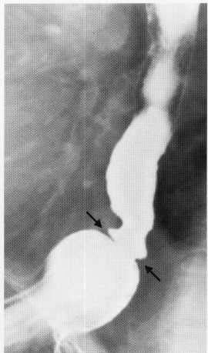
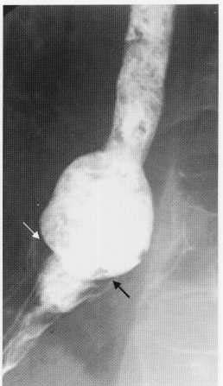

Slide 72
Schatski's ring
(A) Schatski's ring (between arrows) demonstrated by barium swallow.
(B) Bread soaked in barium has been swallowed and is lodged above the ring.

Slide 73
Schatzki ‘ Ring
It is defined as a pathological annular narrowing at the oesophago gastric junction causing dysphagia.
A Schatski or B ring is pathognomonic of a hiatal hernia because it marks the junction between squamous and columnar epithelium and represents the Z line.
These rings are very thin ( 2–3 mm ) in thickness and, despite being mucosal, can be surprisingly symptomatic and may require dilatation .

Slide 74
If the B ring is incomplete, part of it can sometimes be demonstrated as the incisural notch, which is inevitably on the greater curve aspect of the stomach.

Slide 75
Before dysphagia occurs , the lumen of the oesophagus has generally narrowed to less than 13 mm diameter.
May be congenital, or inflammatory .

Slide 76
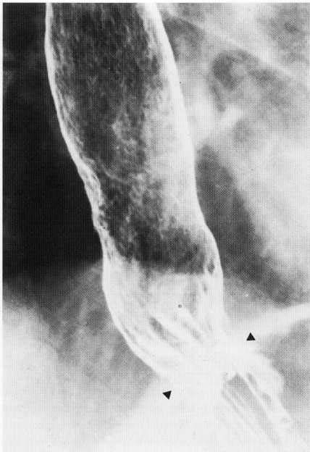

Slide 77
Hiatus hernia with granular appearance of the oesophagus due to peptic oesophagitis.

Slide 78
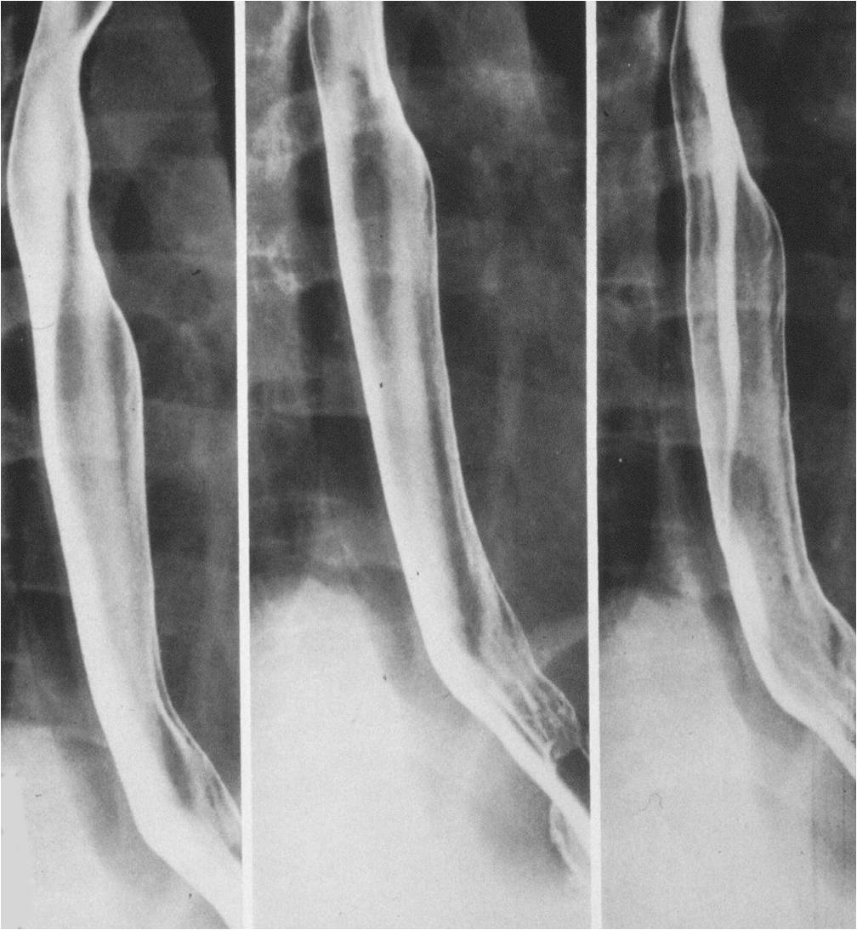

Slide 79
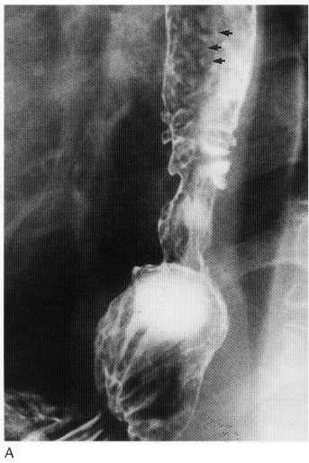

Slide 80
Assymetric stricture in the oesophagus with hiatus hernia.

Slide 81
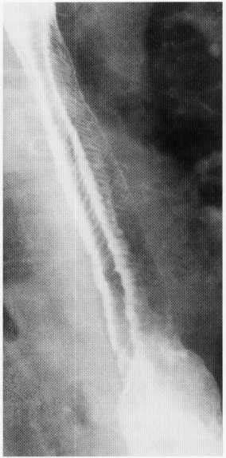

Slide 82
Feline Oesophagus
Fine mucosal folds due to contraction of muscularis mucosae .
Generally a transient finding.
Will disappear in most cases after adequate distension.
Occasionally may be seen in oesophagiits.
Name given as a similar appearance is found in cats.

Slide 83
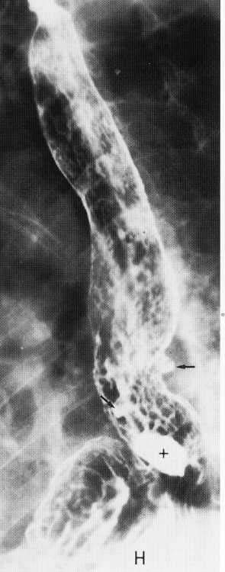

Slide 84
Barret’s Oesophagus
Hiatus hernia is seen.
Ulceration is seen .
Note the reticular pattern of gastric mucosa seen in the oesophago gastric junction.

Slide 85
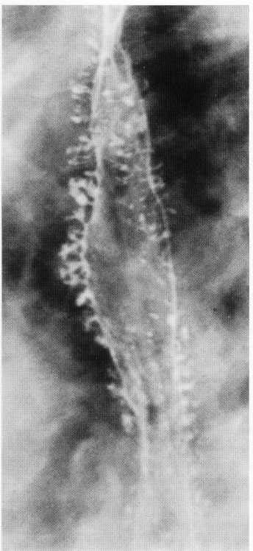

Slide 86
Intramural pseudodiverticulosis
Multiple flask-shaped projections produced by barium entering dilated oesophageal glands.

Slide 87
Intramural pseudodiverticulosis
About 300 oesophageal glands may be seen to fill with Barium.
These glands show caudal angulation.
This condition is easily diagnosed on Barium studies rather than on endoscopy as the glands are very small and may not be seen on endoscopy.
Candida may be isolated from the glands but may be due to secondary infection.

Slide 88
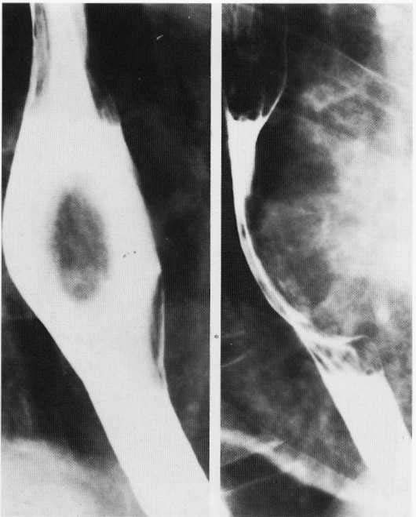

Slide 89
Leiomyoma
View showing features typical of an intramural or extrinsic lesion.
There is a broad-based filling defect bulging into, and widening the lumen of the oesophagus.
The lesion makes a wide angle with the wall of the oesophagus.

Slide 90
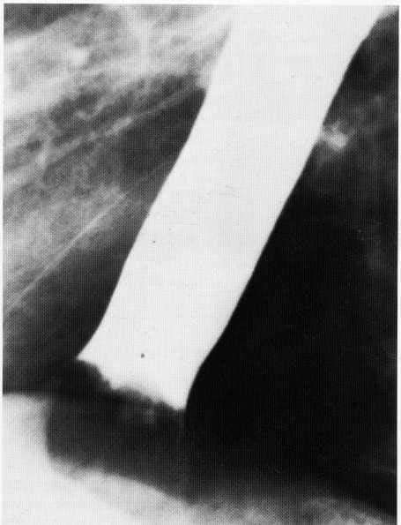

Slide 91
Lower oesophageal obstruction produced by impaction of a large meat bolus

Slide 92
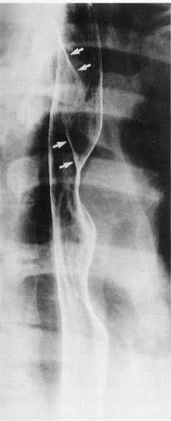

Slide 94
aberrant right subclavian artery
Aberrant right subclavian artery arises from the aortic arch distal to the origin of the left subclavian artery, and passes upwards and to the right behind the oesophagus.
This gives rise to a characteristic smooth, oblique indentation on the posterior wall of the barium-filled oesophagus on the oblique view.

Slide 96
Characteristic radiological features of hiatus hernia and stricture in proximal oesophagus.

Slide 98
Barret’s Ulcer
Barret’s ulcer causing penetration of the posterior wall of the oesophagus.

Slide 99
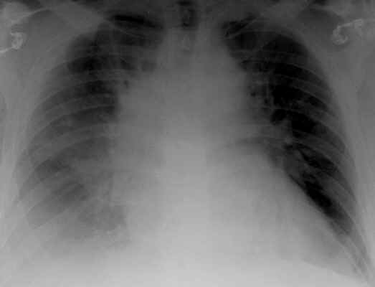
Patient with sudden onset chest pain

Slide 100
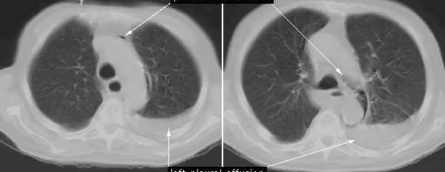
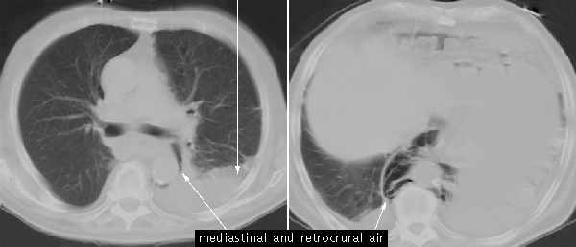

Slide 101
Pneumomediastinum and pleural effusion

Slide 102
Boerhaave’s syndrome
Esophageal rupture is due to a sudden rise in intraluminal esophageal pressure produced during vomiting.
Neuromuscular in coordination causes failure of the cricopharyngeus muscle to relax.
The syndrome commonly is associated with overindulgence in food and/or alcohol.

Slide 103
Location of tear in Boerhaave syndrome
Left postero lateral wall of the lower third of the esophagus, 2-3 cm proximal to the gastro esophageal junction.

Slide 104
GI Bleeding Definitions
Upper GI Bleeding = proximal to ligament of Treitz
Hematemesis = vomiting blood
This is diagnostic of upper GI bleeding
Melena = passage of tarry or maroon stool
Can be upper or lower (more commonly upper)
Hematochezia = Bright red blood per rectum
Usually characteristic of colonic hemorrhage

Slide 106
combined-type hiatus hernia.
Contrast study demonstrating a combined-type hiatus hernia.
Note the rolling component with a large portion of stomach above the diaphragm, but in addition the gastro-oesophageal junction has also migrated cranially.

Slide 108
Fixed sliding hiatal hernia together with several B or Schatski rings.

Slide 109
Types of Hiatus hernia
Sliding
Para oesophageal
Mixed
Intrathoracic stomach

Slide 110
Para oesophageal hernia is better diagnosed on Barium studies .
Hiatus hernia is better diagnosed on enodoscopy as the Z line of squamo columnar junction is better seen.
Z line is around 40 cm from incisor teeth .

Slide 111
Why is hiatus hernia difficult to diagnose on Barium studies?

Slide 112
It is difficult to diagnose Hiatus hernia on Barium studies because they do not normally define the mucosal junction and we have to utilize secondary features that indicate the position of the mucosal junction.
These include a Schatski or B ring, incisural notch and estimation of hiatal width.

Slide 113
Ennumerate the techniques used for evaluating hiatus hernia.
What is the gold standard ?

Slide 114
Barium studies,
Endoscopy with biopsy,
pH measurement and
Radionuclide techniques.

Slide 115
Barium studies and endoscopy assess the damage caused by gastro-oesophageal reflux disease.
Radionuclide studies and 24 hour pH assess gastro-oesophageal reflux.
24-hour pH measurement is the ‘gold standard’ .

Slide 117
Large sliding hiatal hernia that demonstrates gross spontaneous gastro-oesophageal reflux when the patient lifts the left side whilst in the supine position.
Note also the marked oesophageal inco-ordination produced by the reflux

Slide 119
A scintigraphic study demonstrating gross gastro-oesophageal reflux

Slide 121
Esophageal duplication cyst (arrowheads). Note thin smooth wall and near-water-density contents.
D/D esophageal retention cysts .( They are smaller in size and may be multiple. They are rarer than duplication cysts.)

Slide 123
Achalasia
The esophagus is dilated and contains food and fluid and a coiled nasogastric tube (arrow) that could not be passed across the lower esophageal sphincter.
The wall thickening in achalasia is limited to the lower-esophageal sphincter and is generally less than 10 mm in thickness .
The remainder of the esophagus is dilated and often fluid-filled.

Slide 125
Diffuse esophageal spasm
There is symmetric mural thickening (arrows) of the entire thoracic esophagus.
The thickening is smooth, and there is no luminal dilatation.

Slide 126
What are uphill varices ?
What are down varices?

Slide 127
Uphill varices
Result from reversal of venous flow in the coronary vein into the distal esophageal venous plexus.
These periesophageal veins drain into the systemic circulation via the azygous vein.
Most commonly seen in cirrhosis and portal hypertension.
Uphill varices can bleed or rupture, leading to massive GI hemorrhage

Slide 128
Downhill varices
Occur due to obstruction of the SVC .
This results in collateral drainage from the head, neck, and upper-extremity venous systems into the veins surrounding the mid- and upper-thoracic esophagus and into the azygous vein.

Slide 130
Fundoplication
The fundus (arrows) is wrapped around the distal esophagus.
NG tube courses through the esophagus.
Note that there is a sliding hiatal hernia, and the wrap lies above the esophageal hiatus (curved arrows).

Slide 131
A Nissen fundoplication is a complete 360Â° wrap, and a Toupet fundoplication is partial 270Â° wrap.
On CT, a fundoplication has the appearance of a soft-tissue mass at the gastroesophageal junction .
CT does not provide functional information, it is ideal for assessing postoperative complications of leak and abscess .

Slide 132
Fundoplication failure can be diagnosed on CT performed in the prone position after administering an effervescent agent.
Fundoplication dehiscence is diagnosed when there is lack of circumferential thickening around the distal esophagus and when there is gaseous distension of the lower esophageal sphincter

Slide 133
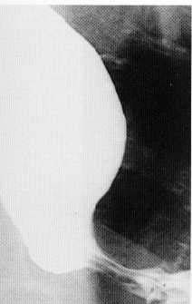
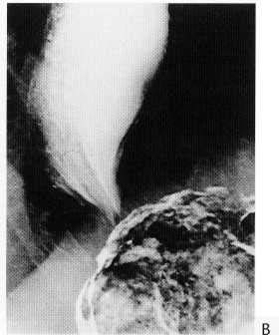

Slide 134
Achalasia
The oesophagus is distended.
Intact oesophageal folds pass through the tapered narrowing, which corresponds to the site of the lower oesophageal sphincter.
Fluoroscopy shows impaired motility.
Sufficient barium has entered the stomach to coat the fundus . This excludes an infiltrating gastric carcinoma .

Slide 135
What is secondary achalasia ?
What is vigorous achalasia ?

Slide 136
Achalasia developing rapidly, or after the age of 50 should arouse the suspicion of underlying neoplasm .
This is secondary or pseudo achalasia.
In early cases of primary achalasia the fluoroscopic examination might show tertiary contractions in the lower oesophagus. This is called vigorous achalasia.

Slide 137
a

Slide 139
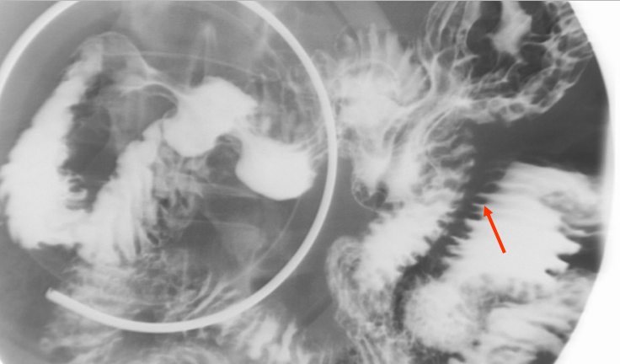
b

Slide 140
c

Slide 141
Arthralgia, myopathy, acro-osteolysis, osteopenia.
Subcutaneous calcinosis.

