Slide 1
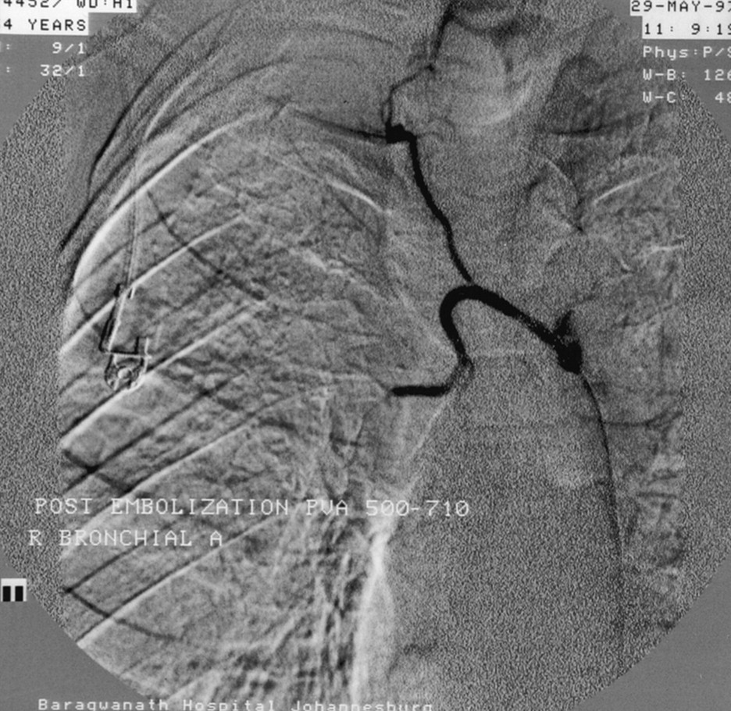
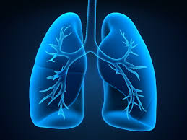
BRONCHIAL ARTERY EMBOLIZATION
DR TINKU JOSEPH
DM Resident
Department of Pulmonary Medicine
AIMS, Kochin
Email-: tinkujoseph2010@gmail.com

Slide 2
contents
Bronchial circulation
Bronchial Artery Embolization (BAE)
Indications
Procedure
Complications

Slide 3
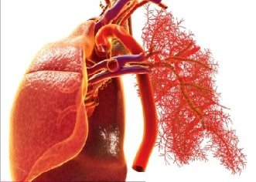
Two Circulations in the Lung
Bronchial Circulation
Arises from the aorta.
Part of systemic circulation.
Receives about 2% of left ventricular output.
Pulmonary Circulation
Arises from Right Ventricle.
Receives 100% of blood flow.

Slide 4
ANATOMICAL CONSIDERATION- Bronchial Artery
Variable anatomy in terms of origin, branching pattern, and course.
Bronchial arteries usually arise as a pair or as a common trunk, from the descending thoracic aorta below the origin of left subclavian artery.
The standard or orthotopic origin is from the aorta between the levels of T5 and T6 (80%).
ANOMALOUS – Outside the levels of T5 and T6 .
ANOMALOUS - Aortic arch, Internal mammary artery, Thyrocervical trunk, Subclavian, Costocervical trunk, Pericardicophrenic artery, Inferior phrenic artery.

Slide 5
BRONCHIAL CIRCULATION
Sometimes part of blood supply of anterior spinal artery come from bronchial vessels.
When bronchial artery embolization is performed, consideration must be given to the arterial supply to the spinal cord.
Most important is Anterior Spinal Artery.
Anterior spinal artery receives contributions from the anterior radiculo medullary branches of the intercostals and lumbar arteries.

Slide 6
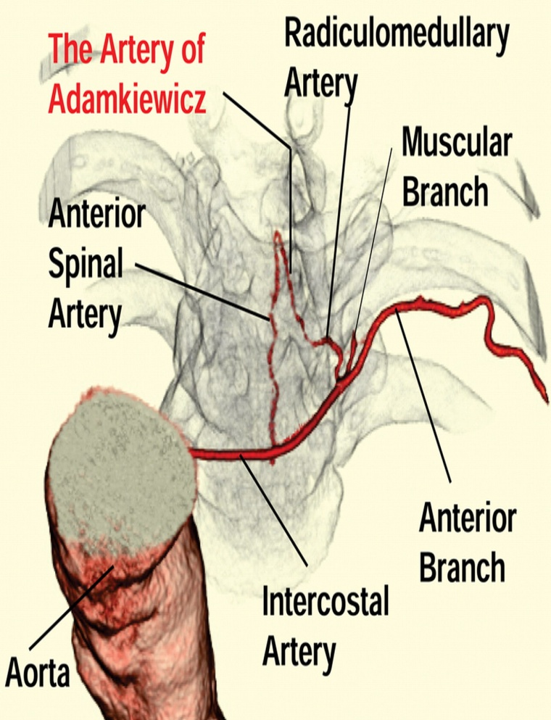
ARTERY OF ADAMKIEWICZ
The largest anterior medullary branch.
Has variable origin from T5 –L5 level, but most commonly from T8 – L1 level.
In 5 % of population Rt. IBT contributes to artery of Adamkiewicz.
The left bronchial arteries very rarely contribute the anterior spinal artery.

Slide 7
Topographical Facts: Normal Anatomy and Variations

Slide 8
Bronchial artery branching pattern
Cauldwell et al - four patterns:
Type I
Type II
Type III
Type IV
Cauldwell EW, Siekert RG, Lininger RE, Anson BJ.The bronchial arteries: an anatomic study of 105 human cadavers. Surg Gynecol Obstet 1948; 86:395–412.

Slide 9
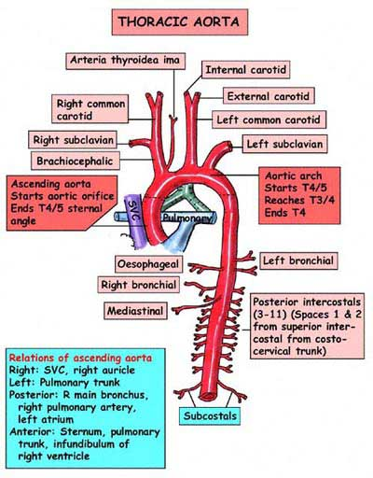
Bronchial Artery- Course
Leave the aorta at an upward angle, against the direction of blood flow.
Send braches to oesophagus, mediastinum, lymph nodes and nerves.
On reaching the main bronchi divide into visceral pleural branches to the mediastinal pleura and true bronchial arteries to the bronchial tree.

Slide 10
Bronchial Artery Embolization
Minimally invasive alternative to surgery.
selective bronchial artery catheterization and angiography, followed by embolization of any identified abnormal vessels to stop the bleeding.
Considered to be the most effective nonsurgical treatment in the management of massive and recurrent hemoptysis.

Slide 11
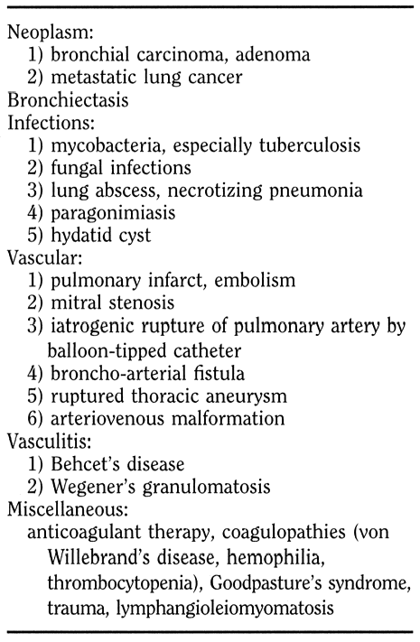
Indications
Haemoptysis-:Failure of conservative or bronchoscopic treatment to control bleeding.
ISRN Vascular Medicine
Volume 2013, Article ID 263259, 7 pages

Slide 12
Indications
Managing ruptured pulmonary artery venous malformation.
To Stabilize patients before surgical resection or medical treatment.
As a definitive therapeutic approach in patients:
-Who refuse surgery
-Who are not candidates for surgery
-Where surgery is contraindicated
Bronchial artery embolization: Managing ruptured pulmonary artery venous malformation e A case report Dharitri Goswami a,*, Shantanu Das b,1, Ashok Parida c,2, Joy Sanyal c,3. Respiratory Medicine CME 4 (2011) 160e163
poor lung function, bilateral pulmonary disease, co morbidities.

Slide 13
WHY BAE ??
1)Bronchial circulation (90% of cases)
- Pulmonary circulation (5%) .
- Aorta (5%)(eg, aorto bronchial fistula, ruptured aortic aneurysm).
2) Surgery
- Mortality 18% when performed electively, rising to 40% when performed emergently.
- conservative approach , mortality risk of at least 50%.
3) Minimally invasive
- clinical success - 85% to 100%,
- recurrence of hemorrhage – 10%.

Slide 14
BAE- TECHNIQUE
Prior to the procedure, a brief neurological exam is performed to establish a baseline.
Femoral route/Trans-Axillary route
Monitor vitals/spo2
Sedation optional
Clean groin with antiseptics.
Adequate LA
A preliminary descending thoracic aortogram (Ionic/non ionic contrast) can be performed as a roadmap to the bronchial arteries.

Slide 15
BAE - TECHNIQUE
Both bronchial arteries and nonbronchial systemic arteries are opacified.
The diagnostic angiographic injections are always selective into the bronchial, intercostals, subclavian, internal mammary, intercostobronchial, and inferior phrenic arteries.
Under X-Ray machine guidance (Digital cardiac imaging with digital subtraction facility)
Reverse curve catheter – mikaelsson, simmons 1, shepherd’s hook.
Low arotic arch – forward looking catheters ( cobra or RC ) used.

Slide 16
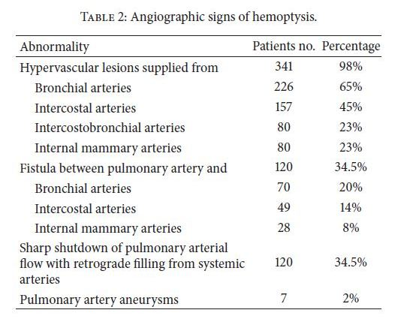
Angiographic signs of haemoptysis
ISRN Vascular Medicine Volume 2013, Article ID 263259, 7 pages

Slide 17
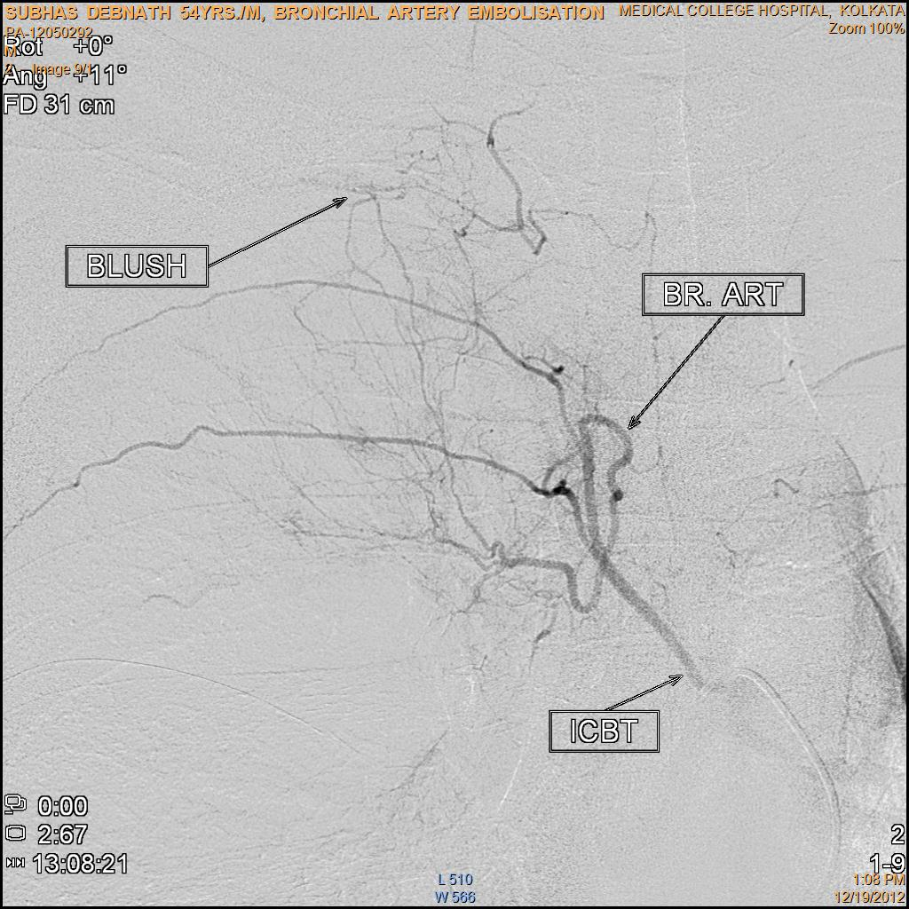
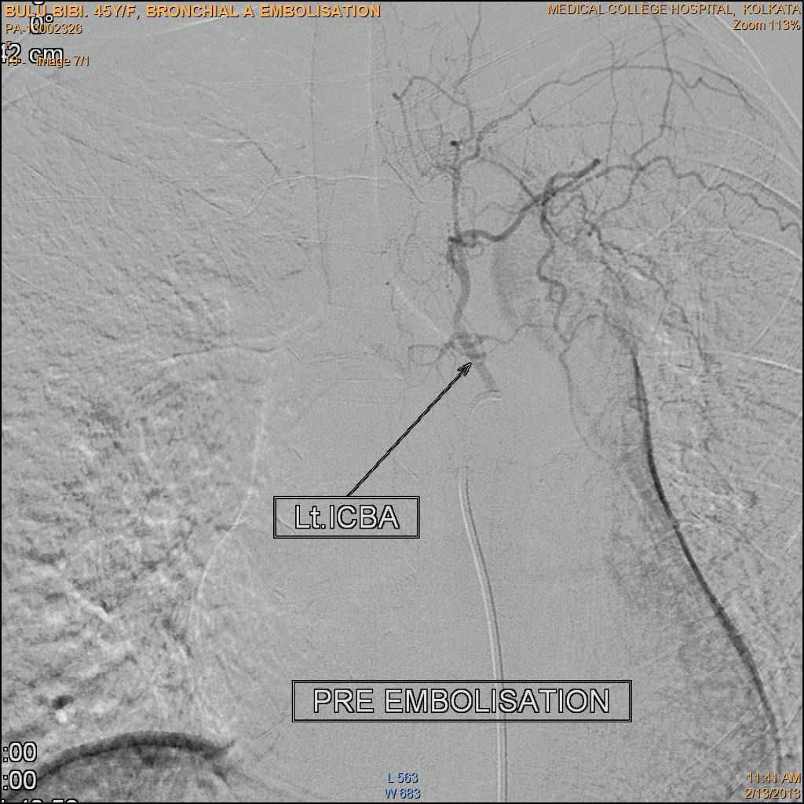
BAE - TECHNIQUE
The left main stem bronchus serves as a convenient fluoroscopic landmark for the general location of the bronchial arteries
The catheter is directed lateral or anterolateral for the right bronchial and more anterior for the left.
Bronchial arteries – course of main stem bronchi towards hila.
Intercostal arteries – initial cephalic course , then laterally along undersurface of rib

Slide 18
BAE - TECHNIQUE
The embolization materials commonly used are non-absorbable particles of polyvinyl alcohol (PVA) (Ivalon; Nycomed SA; Paris, France), 355–500 𝜇m in size (some larger vessels required particles as large as 2 mm), and fibred platinum coils of 2 and 3mm in size (MicroNester Embolization Coils; Cook, Bjaeverskov, Denmark).

Slide 19
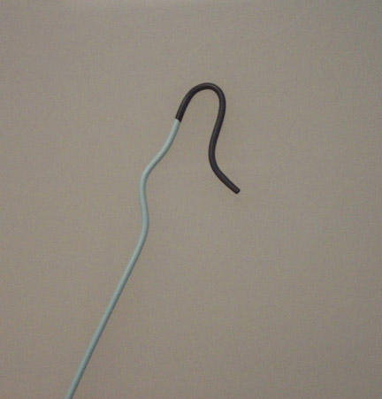
Catheters:
Reverse-curved catheters (Mikaelson, Simmons I, SOS Omni)
Forward-looking catheters (Cobra, HIH,RC)
Sizes: 4, 5, or 5.5 Fr are routinely used.
Mikaelson catheter

Slide 20
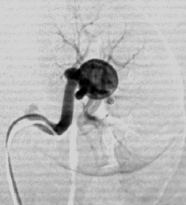
Cobra type: curved catheter
Most commonly used
Microcatheter
Superselective catherization
Less complications

Slide 21
Embolizing materials:
PVA particles (350-500 mic)
Most common & Safe
Liquid embolic agents
-ischemic necrosis
Stainless steel platinum coils
-occlude more proximal vessels.

Slide 22
Embolization coils: Platinum Microcoils

Slide 23
Embolizing materials:
Particles > 200 to 250 micr.m should be used
No ischaemia and no neurologic damage
Isobutyl-2 cyanoacrolate, Absolute alcohol
Used in pulmonary artery aneurysms
to avoid tissue ischemia and neurologic damage

Slide 24
Embolizing materials:
Distal embolization : ideal
Proximal occlusion: temporary relief
particles < 200 micr.m :avoided
-Tissue infarction
Liquid embolic agents should always be avoided because these cause tissue infarction

Slide 25
Bronchial Artery Embolization
Success rates : 64% to 100%.
Recurrent non-massive bleeding :16–46%
Recurrence of haemoptysis may be due to:
Incomplete embolization of the bronchial vessels
Recannalization of the embolized arteries.
Presence of non-bronchial systemic arteries.
Development of collateral circulation in response to continuing pulmonary inflammation.

Slide 26
Bronchial Artery Embolization
Technical failure: 13%
Technical failure is caused by non-bronchial artery collaterals from systemic vessels such as the phrenic, intercostal, mammary,(PLEURA) or subclavian Arteries.

Slide 27
Complications of BAE
Transversemyelitis
The most feared complication due to non target occlusion of branches.
When the anterior spinal artery is identified as originating from the bronchial artery, embolisation is often deferred owing to the risk of infaction and paraparesis.

Slide 28
Complications of BAE
The anterior spinal artery is the blood vessel that supplies the anterior portion of the spinal cord.
It arises from branches of the vertebral arteries and is supplied by the anterior segmental medullary arteries, including the artery of Adamkiewicz, and courses along the anterior aspect of the spinal cord.
Disruption of the anterior spinal cord leads to bilateral disruption of the corticospinal tract, causing motor deficits, and bilateral disruption of the spinothalamic tract, causing sensory deficits in the form of pain/temperature sense loss

Slide 29
Complications of BAE
Chest pain is the most common complication.
Dysphagia due to embolization of esophageal branches may also be encountered.
Rare complications
Aortic and bronchial necrosis
Bronchoesophageal fistula
Non–target organ embolization (eg, ischemic colitis)
Pulmonary infarction.

Slide 30
CONCLUSION
The development of bronchial artery embolization techniques has revolutionized the approach to hemoptysis patients.
Bronchial artery embolization possesses high rates of immediate clinical success coupled with low complication rates.
When bronchial artery angiography and embolization is performed, consideration must be given to the arterial supply to the spine.

Slide 31
CONCLUSION
4) Surgery should be considered only in case where embolisation is not possible due technical difficulty and in case of embolisation failure. Otherwise bronchial artery embolisation is considered as the mainstay treatment for hemoptysis.

