Slide 1
CARBON DIOXIDE ANGIOGRAPHY

Slide 2
Intro:
We inject CO2 in vessel, it causes small decrease in density of lumen of blood in vessel, Demonstrated by using digital subtraction.
Main purpose:
Patients with raised creatinine.

Slide 3
Carbon dioxide was first reported as a contrast agent in 1982.
It has been used for performing angiography for as long as 30 years in various institutes across the world.
In India, it was first used at a hospital in Bangalore in the year 2001.
Why Carbon Dioxide???
Non allergic
Non nephrotoxic/ hepatotoxic
Inexpensive
Unlimited amounts of CO₂ may be used for vascular imaging because the gas is effectively eliminated by means of respiration.
CO₂ is particularly useful for patients with compromised cardiac and renal function who are undergoing complex vascular interventions.

Slide 4
PHYSICAL PROPERTIES of CO2
Colorless and odorless
More soluble than oxygen
Completely dissolves in 2-3 min
Displaces blood allowing vascular imaging

Slide 5
We inject CO2 in vessel, it causes small decrease in density of lumen of blood in vessel b/o it’s physical presence,
This image is then subtracted form mask image and we now see vessel as bright or radioluscent structure.
THUS, Vessel is Demonstrated by using digital subtraction.
We may see vessel black (as in usual angio) if we use inverted images in Co2 angio.

Slide 6
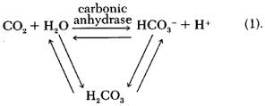
EXCRETION
When CO₂ is injected into the blood, it combines with water to produce carbonic acid. It becomes bicarbonate (HCO₃⁻) in the blood stream; bicarbonate reverts to CO₂ before being expelled out of capillaries into the lung. Carbonic anhydrase catalyzes the conversion of CO₂ to bicarbonate and protons.

Slide 7
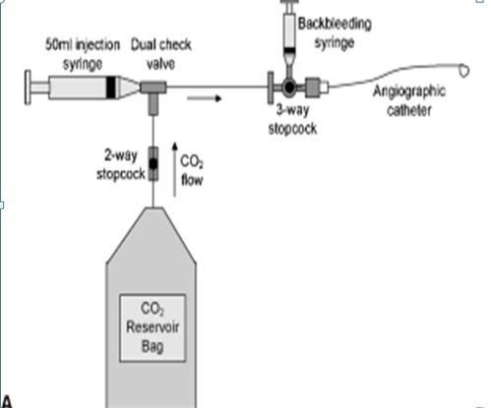

Slide 8
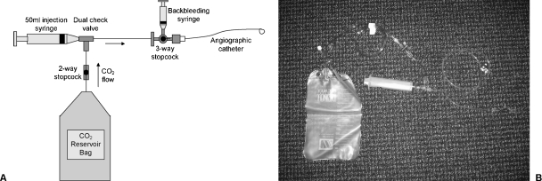
EQUIPMENT FOR CO2 ANGIOGRAPHY
The filled bag is connected to the remaining manifold and the two-way stopcock is opened. The 50-mL syringe is filled with CO₂ via a dual check valve and expelled to purge air out of the tubing, which is then connected to the angiographic catheter.
The three-way stopcock can be turned off to CO₂ to allow back bleeding into a small syringe to eliminate all air from the system.
The stopcock is then closed to the back bleeding syringe, and the blood is gently purged from the catheter by slowly injecting CO₂ via the syringe.

Slide 9
Approach:
Usually femoral.
Use:
Seldinger’s technique.
Rate of injection:
20 ml/sec
Superselective angio:
Use special smaller catheters,
Injection of CO₂ as close to the target vessel as possible should be performed to optimize CO₂ imaging.

Slide 10
TECHNIQUE:
Patients should be supine, and injections must be made below the level of the diaphragm. (So that CO2 will be removed by pulmonary circulation and do not reach brain.)
Typically. 30 to 50 mL of CO₂ are injected into the aorta (below diaphragm) or inferior vena cava via a pigtail catheter
Injections are performed 2 to 3 minutes apart; occasionally slightly longer delays are used when performing mesenteric angiography. Time to allow wash out of CO2.
Angiographic runs are then performed at two to six frames per second using digital subtraction software.
For evaluation of the calves and feet, the legs can be elevated slightly on pillows to allow the gas to “rise” to fill the arteries in this region.

Slide 11
Monitor:
ECG,
Pulse oximetry,
Capnogram in intubated patients.

Slide 12
TECHNIQUE
Heavy sedation should be avoided as respiratory depression and hypotension caused by air contamination may be mistaken for adverse effects of the sedatives and/or analgesics.
All patients undergoing CO₂ angiography should be monitored with ECG and pulse oximetry.
Capnograms should be obtained if the patient is intubated.
Digital subtraction angiography (1024 X 1024 DSA system and magnification technique) should be used for CO₂ imaging. Stacking software for integrating a series of images has solved problems associated with the breakup of CO₂ bubbles after injection.
Rapid exposures (4 to 6 frames per second) should be obtained, and superselective injection of CO₂ as close to the target vessel as possible should be performed to optimize CO₂ imaging.
Elevation of target vessels 15-20° above the level of the angiographic table, as well as the intra-arterial administration of 100-150 µg of nitroglycerin, may improve filling of the peripheral arteries in the lower extremities.

Slide 15
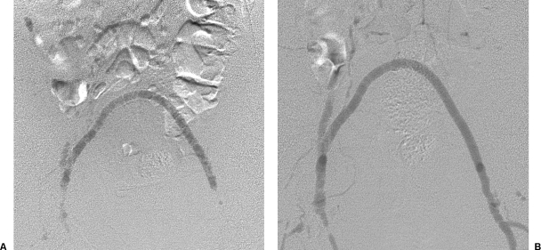
It is important to recognize that CO2 “floats” on the top of blood; therefore abnormalities in the dependent portions of blood vessels (e.g., posterior plaques in iliac arteries) may not be demonstrated to full advantage.
In practical terms, this is only a problem in larger (i.e., > 1 cm diameter) vessels because CO2 fills smaller caliber arteries more completely.
Arteries that assume a posterior course, such as dependent coursing renal arteries, may be difficult to fill, particularly from a nonselective injection.

Slide 16
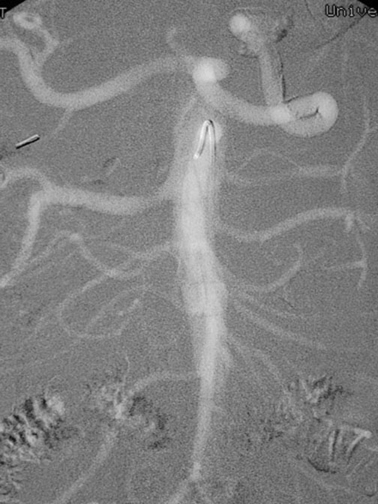
USES OF CO2 ANGIOGRAPHY
This frontal carbon dioxide digital subtraction aortogram shows a single right renal artery with a mild stenosis at the origin and 2 left renal arteries. The celiac and superior mesenteric arteries fill nicely because of their anterior origin.

Slide 17
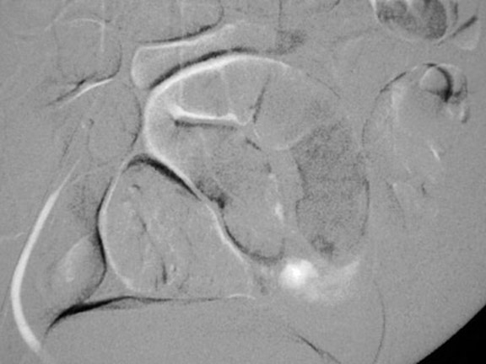
This mesenteric carbon dioxide digital subtraction angiogram in a patient with small-bowel bleeding shows extravasation of carbon dioxide gas bubbles. Embolization with coils stopped the bleeding.

Slide 18
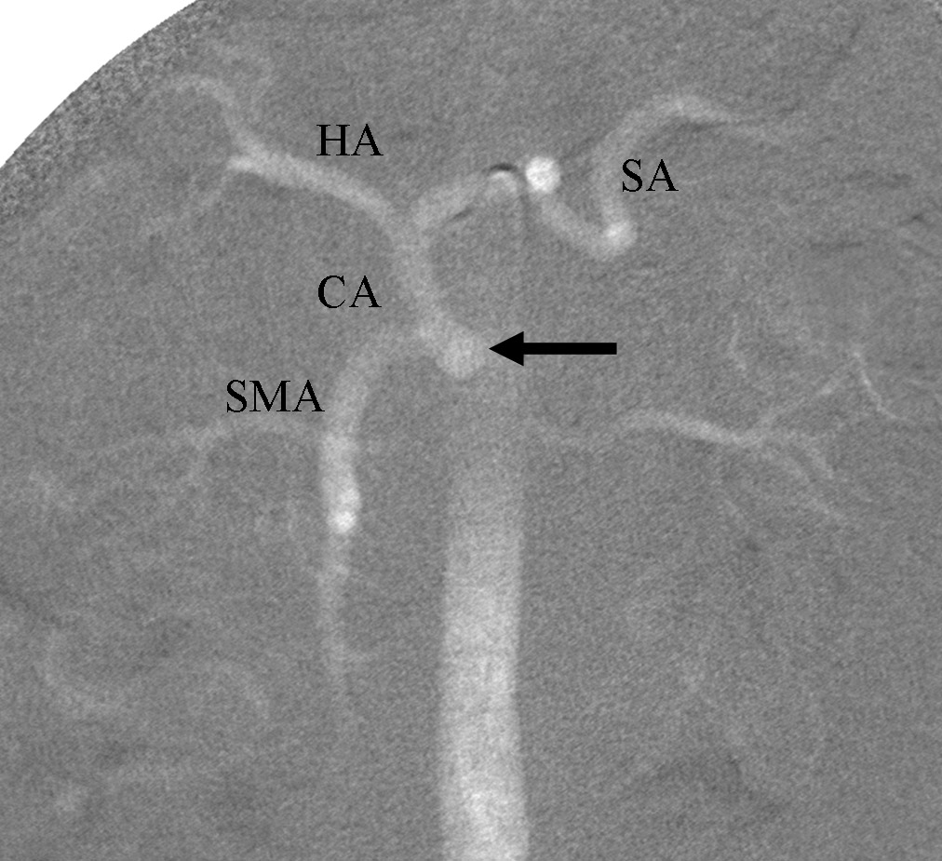
CO2 aortogram demonstrates celicomesenteric trunk, common origin of the celiac axis (CA) and superior mesenteric arteries. Common hepatic (HA) and splenic (SA) arteries are visualized.

Slide 19
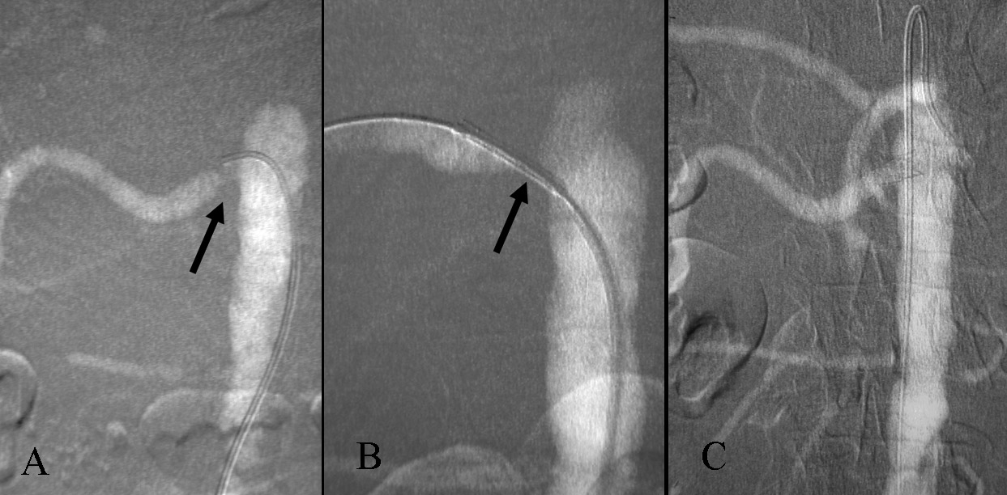
Carbon dioxide guided stent placement of right renal artery stenosis. A. CO2 DSA demonstrates orificeal stenosis of right renal artery (arrow).
B. DSA with the injection of CO2 through the sheath demonstrates the stent in good position (arrow).
C. After stent deployment, the renal artery is widely patent.

Slide 20
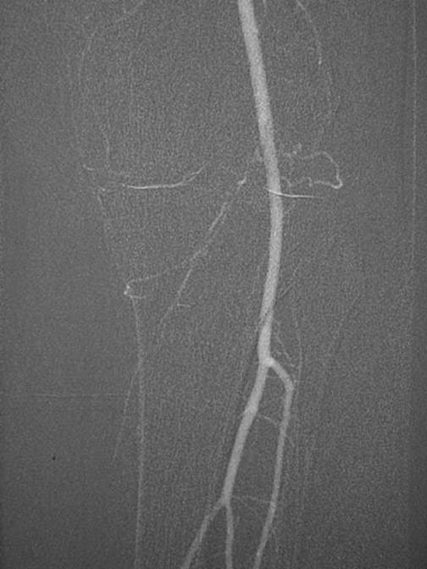
This carbon dioxide digital subtraction angiogram (stacked image) of the left lower extremity shows the popliteal, anterior tibial, peroneal, and posterior tibial arteries.

Slide 21
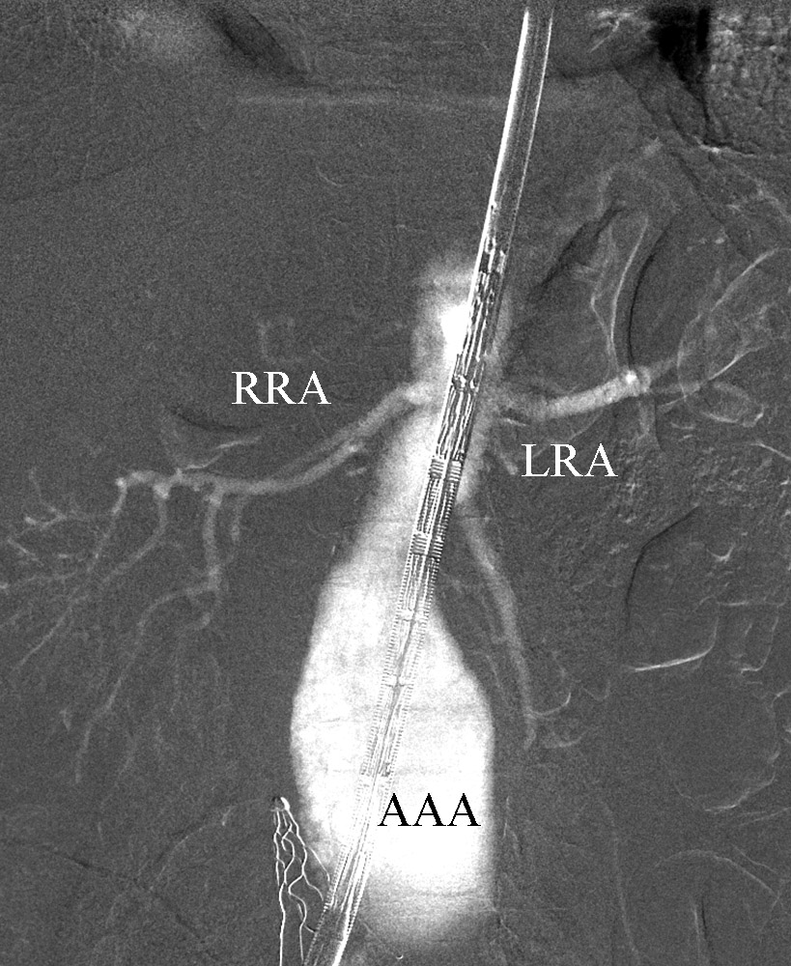
This carbon dioxide aortogram obtained with the injection of CO2 through the sheath during endovascular aortic repair demonstrates the right and left renal arteries and an aortic aneurysm.

Slide 22
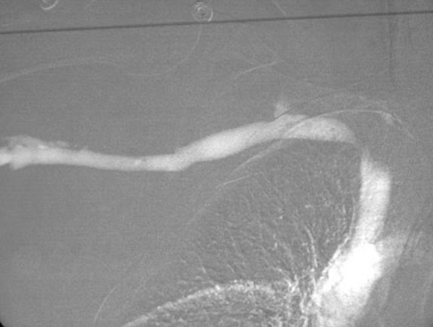
This carbon dioxide digital subtraction venogram shows stenosis of the right subclavian vein. (CAN BE used for veins above diaphragm because pulm circulation comes before brain in these cases.)

Slide 23
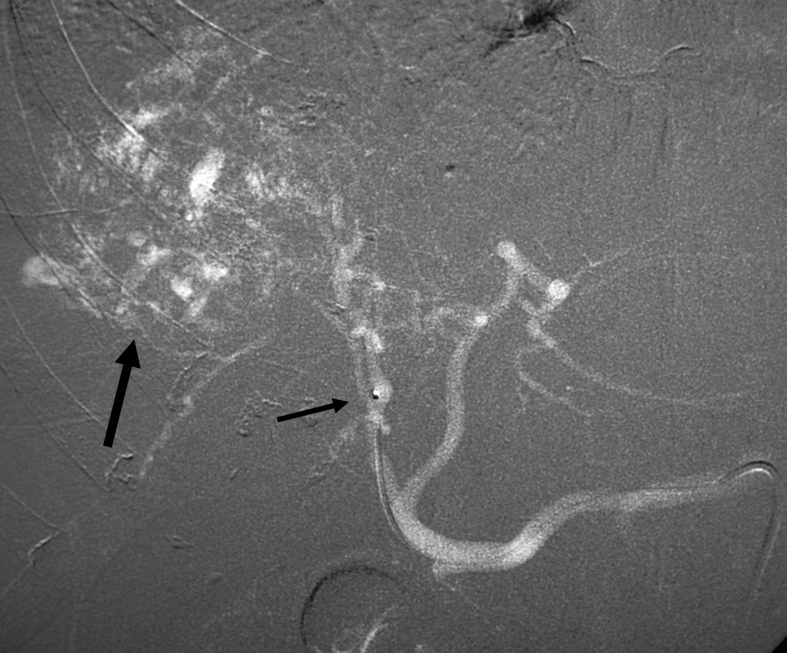
Right hepatic DSA with CO2 demonstrates a vascular tumor in the right hepatic lobe (arrow). The shorter arrow points at the tip of the micro catheter positioned in the celiac axis. CO2 refluxed, filling the left hepatic and common hepatic arteries.

Slide 24
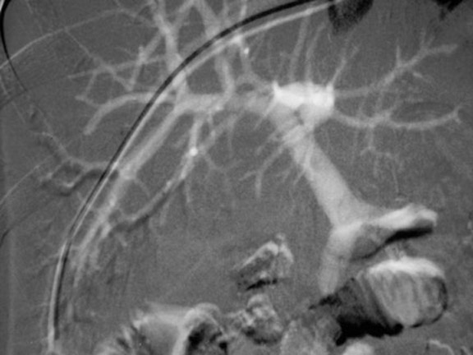
This carbon dioxide digital subtraction angiogram was obtained with an injection of carbon dioxide into the wedged hepatic venous catheter. Both the intrahepatic and extrahepatic portal veins fill nicely.

Slide 25
COMPLICATIONS:
Abdominal pain- is due to CO₂ in the mesenteric vessels and is best handled by rotating the patient from side to side and gently massaging the abdomen to allow the CO₂ to diffuse into the blood. It may be caused by vapor lock in mesenteric arteries and is reported to be more likely in patients with CO₂ collecting in abdominal aortic aneurysms.
Nausea- when high flow rates are used.
Vapor lock in the heart is a feared complication that occurs when CO₂ is trapped there, increasing pulmonary artery pressure and preventing normal blood flow and venous return. If this occurs, the patient should be rotated into a left lateral decubitus position.
CO₂ is contraindicated in the cerebral vessels and should not be injected in arteries above the level of the diaphragm or used in patients with left-to-right shunts.

Slide 26
DISADVANTAGES
Image quality poorer,
More radiation exposure,
Cannot be used for cerebral angiography,
Cautious use in pulmonary insufficiency / hypertension.
Cautious use in left to right shunts.

Slide 27
Risks:
Nondiagnostic study,
Contamination of CO2 and air so effect of air embolism and may be fatal,
CO₂ is contraindicated in the cerebral vessels and should not be injected in arteries above the level of the diaphragm or used in patients with left-to-right shunts.
Trapping of CO2 in aortic aneurysm,

Slide 28
Non diagnostic image: Remedies:
Make patient lateral decubitus position so that side to observe is nondependent,
Inject more quantity of CO2,
Inject at faster rate,
Do selective catheterization of artery,
Elevation of target vessels 15-20° above the level of the angiographic table,
as well as the intra-arterial administration of 100-150 µg of nitroglycerin, may improve filling of the peripheral arteries in the lower extremities.

Slide 29
Hybrid angio:
Supplemental nonionic iodinated contrast material,
Ranging from 2-10 ml
Nonionic contrast material was diluted in a 1:1 mixture with normal saline to provide more volume;
It was used for selective injections when the significance of the pre- or postangioplasty stenosis (or both) was questionable with carbon dioxide.

Slide 30
OPTIONS TO CO2 angio:
Doppler,
CT angio,
MRA: Use Gado only if GFR > 30 ml/m2.min

Slide 31
THANK YOU

